Slide 1
Enhanced Software Defect Classification with NLP
Ying Shi, PhD, NASA GSFC
Leila Meshkat, PhD, NASA JPL
Daniel Chang, Yale University

Slide 2
Overview and Outline
Background
Status of the collection and analysis of Software Anomaly/Discrepancy Data
Classification of Software Defects Data
NLP for classification
Initial Results and Future Research

Slide 3
Background
Spacecraft systems at NASA and elsewhere are becoming increasingly reliant on software for command-and-control purposes.
The growth of software code for human and robotic missions, as described by Dvorak (JPL), is shown here:

Slide 4
Software defects study
Questions addressed include:
  How can we use discrepancies/anomalies that are discovered to improve software reliability across the board?
  What are those discrepancies/anomalies telling us about design philosophy, coding methods, programmer biases, common parameters, cross-module dependencies, other dependencies, and recurring issues
  How can we discover them?
  How do we apply them?
  How do we address them?
To address these questions, we first consider a classification scheme for existing anomaly/discrepancy information that helps to discriminate between different types of issues.

Slide 5
Data Collections
Development Phase - Software Discrepancy Reports:
  Problem (or Failure) Reporting and Corrective Action (PRACA) systems have been used at NASA historically to capture errors introduced into the system throughout the design and development.
  Project software team usually keeps a separate software discrepancy report using various systems like Excel, Jira, Confluence, and Github.
On-orbit Operations Phase – Software Anomaly Reports:
  Goddard Spacecraft On-orbit Anomaly Reports (SOARs)
  JPL Incident Surprise and Anomaly (ISA) Reports
Each center/project uses different systems to document and track software discrepancy/anomaly data
  These systems were initially developed for hardware-based systems and do not adequately address software failure behaviors and software defect characteristics

Slide 6
First Level Classification
Development Phase - Software Discrepancy Reports:
  Defect (need further classification)
  Enhancement/Feature
  Questions
  Documentation
On-orbit Operations Phase – Software Anomaly Reports:
  Defect (need further classification)
  Idiosyncrasies

Slide 7
Suggested Defect Classification
Algorithm: An incorrect implementation of the set of instructions or rules that can be followed to solve a problem.
Incorrect Parameter: A specific value within the code that is incorrect (constant, limit, definition, etc.).
Command Script: An error in the procedure or command sent to the spacecraft, causing unexpected behavior
Interfaces: The interaction between hardware and software is causing unexpected behavior.
  Sub-classes: Hardware/Software, Software Modules, User Interface, Ground Software (GSW) and Flight Software (FSW)
Timing (Sequence, Other): The specific time in which an interrupt/module/command occurs and causes unexpected behavior.
Hardware Limitation: The root cause of the anomaly is hardware-related, but the corrective action is a change to the flight software.
Omission, which is a subset of most of the classes, itself can include multiple attributes:
  Missing scenarios
  Missing condition/boundary check (e.g., software does not know how to deal with out-of-range timestamps)
  Missing requirements
  Missing states in the state diagram
  Missing parameters

Slide 8
Existing and Future Anomaly Data Reporting
Various systems (Excel, Jira, Confluence, etc.) have been used to capture software anomaly data
Historical anomaly data are not categorized
Several JPL projects adopted the proposed defect categorization scheme. Many centers prefer to continue their existing systems rather than adopt a universal system for the agency
Proposed approach: use NLP to help with categorizing all the defects (historical and new but not using the proposed categorization)

Slide 9
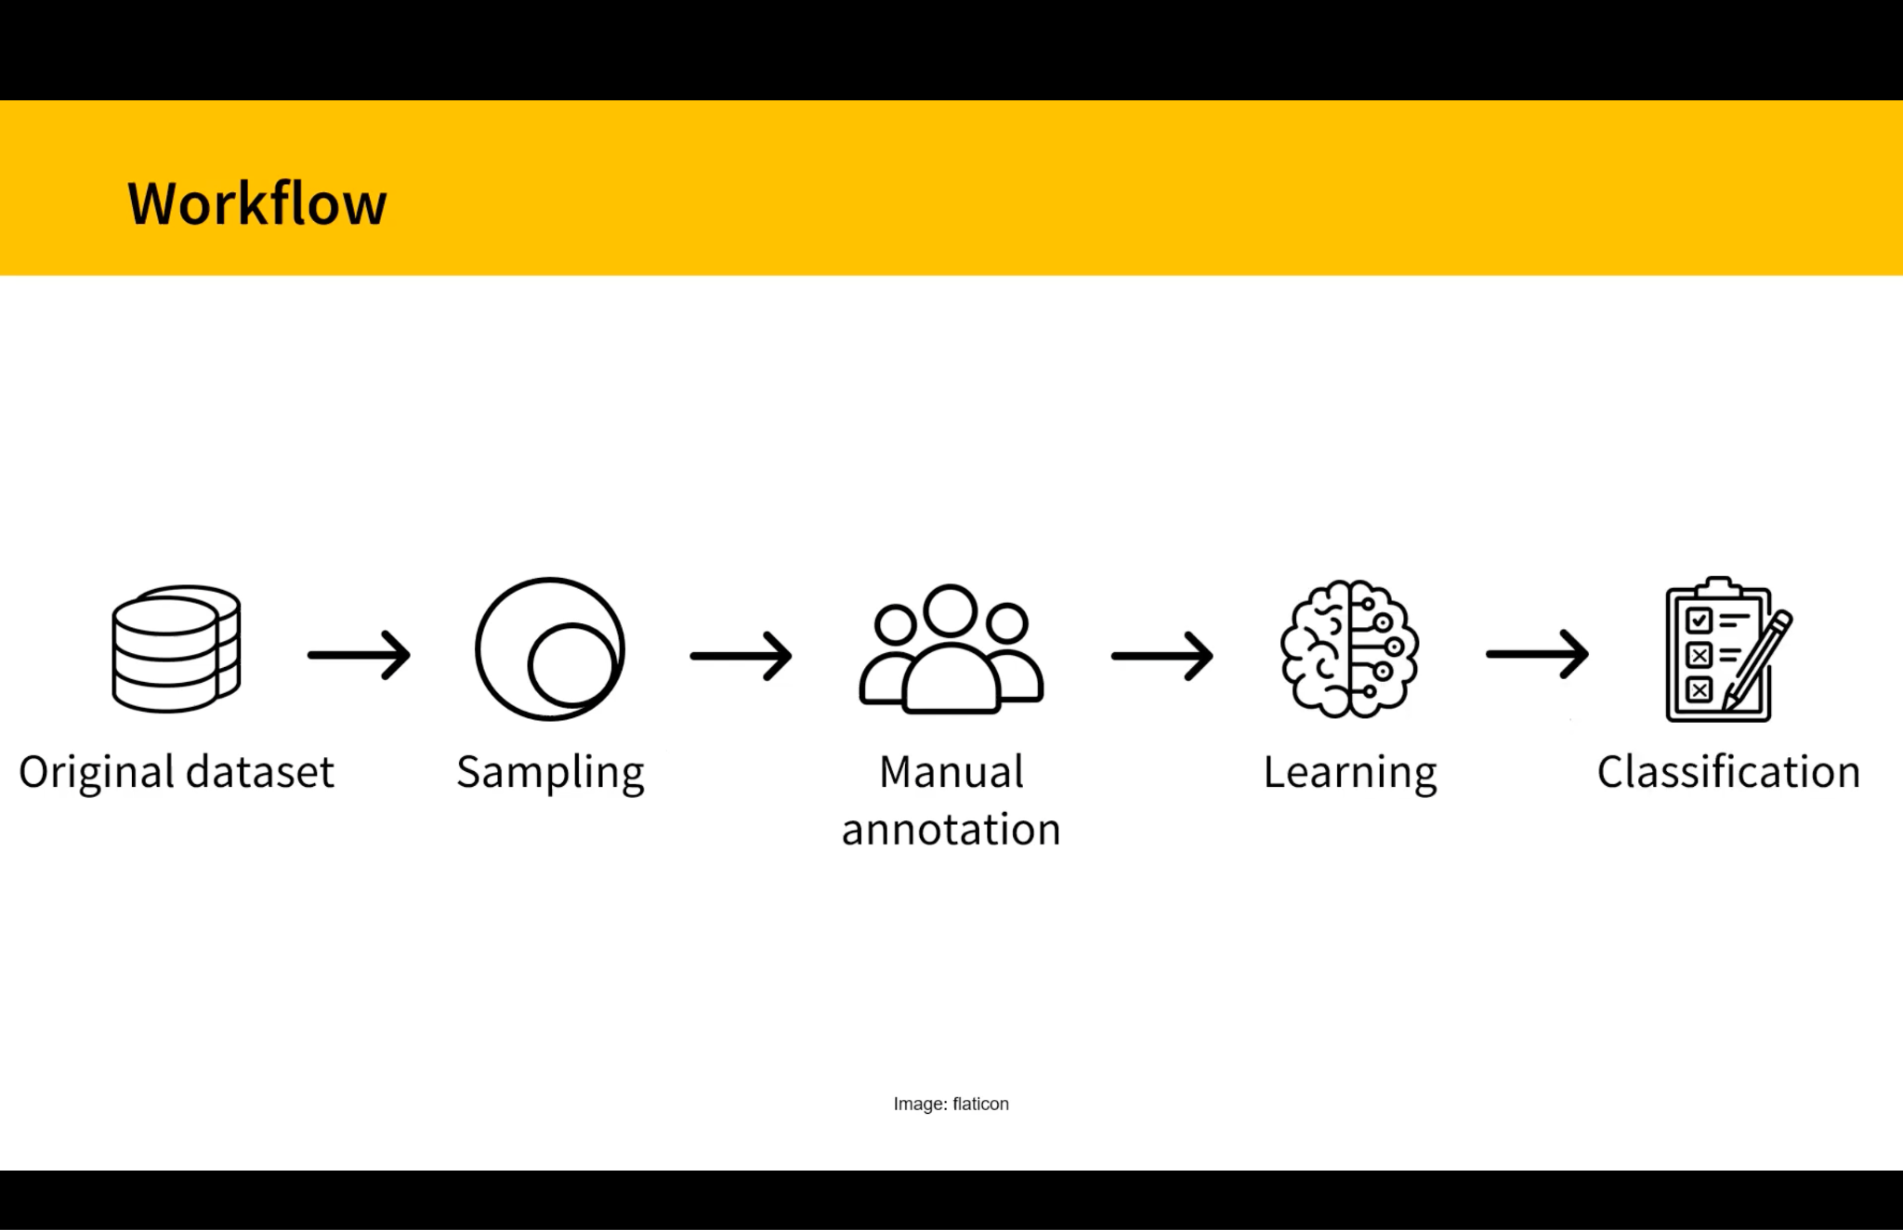
NLP for Text Classification
BERT based few-shot learning for issue reports classification
Colavito, G., Lanubile, F., Novielli, N. (2023, May 20). Few-Shot Learning for Issue Report Classifcation [PowerPoint presentation], Slide 2. The 2nd Intl. Workshop on NL-based Software Engineering, Melbourne, Australia.
https://www.nlbse2023.github.io

Slide 10
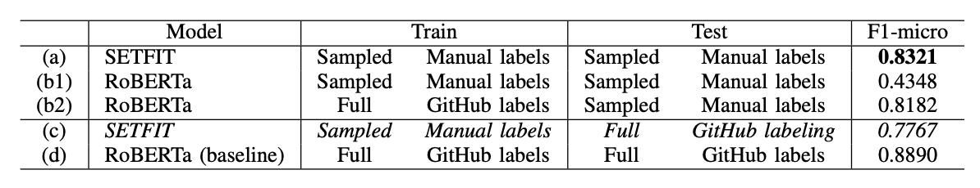
Few Shot Learners
Fine tuning sentence transformers
Only require a few dozen samples from each category
Comparable results to large language models from very low sample sizes
Colavito, G., Lanubile, F., Novielli, N. (2023, May 20). Few-Shot Learning for Issue Report Classification [PowerPoint presentation], Slide 2. The 2nd Intl. Workshop on NL-based Software Engineering, Melbourne, Australia.

Slide 11
cFS application
 | Precision | Recall | F1 Score | Support
Bug | 0.7959 | 0.7800 | 0.7879 | 50
Documentation | 0.9149 | 0.8600 | 0.8866 | 50
Feature | 0.8077 | 0.8400 | 0.8235 | 50
Question | 0.7097 | 0.7586 | 0.7333 | 29
Accuracy |  |  | 0.8156 | 179
Macro Average | 0.8070 | 0.8097 | 0.8078 | 179
Weighted Average | 0.8185 | 0.8156 | 0.8166 | 179
Various performance metrics of the model. 100 issues from each category were randomly sampled, and half were set aside for the training set and the other half for the test set. There were only 79 issues with the label question, so 50 were randomly sampled and set aside for the training set, while the other 29 were set aside for the test set. The performance metrics are slightly higher than reported, as some issues had multiple labels, but were only labeled as one for the purposes of training and testing.

Slide 12
Future Research
Collaborate with U. of Bari to fine-tune the few-shot model and to further improve the F1 score
  Increase the number of training data by manually classifying defect data
  Use NASA-specific corpus for preprocessing text
Extend cFS’ current issue labels with the proposed defect classification schema into the learning models.

Slide 13
References
D. Dvorak, et. al. “NASA Study on Flight Software Complexity”, 2009
Colavito, G., Lanubile, F., Novielli, N. (2023, May 20). Few-Shot Learning for Issue Report Classification. The 2nd Intl. Workshop on NL-based Software Engineering, Melbourne, Australia. https://www.nlbse2023.github.io
Leila Meshkat, Daniel Chang, Ying Shi, Software Error Classification and Dependency Assessment for NASA Missions, 70th Annual Reliability and Maintainability Symposium, Albuquerque, NM, Jan 2024

