Slide 1
Variation in Predicated Orbital Lifetime due to Launch Year
Caley Burke
NASA’s Launch Services Program
Kennedy Space Center, Florida
August 6, 2024

Slide 2




Booth 17

Slide 3
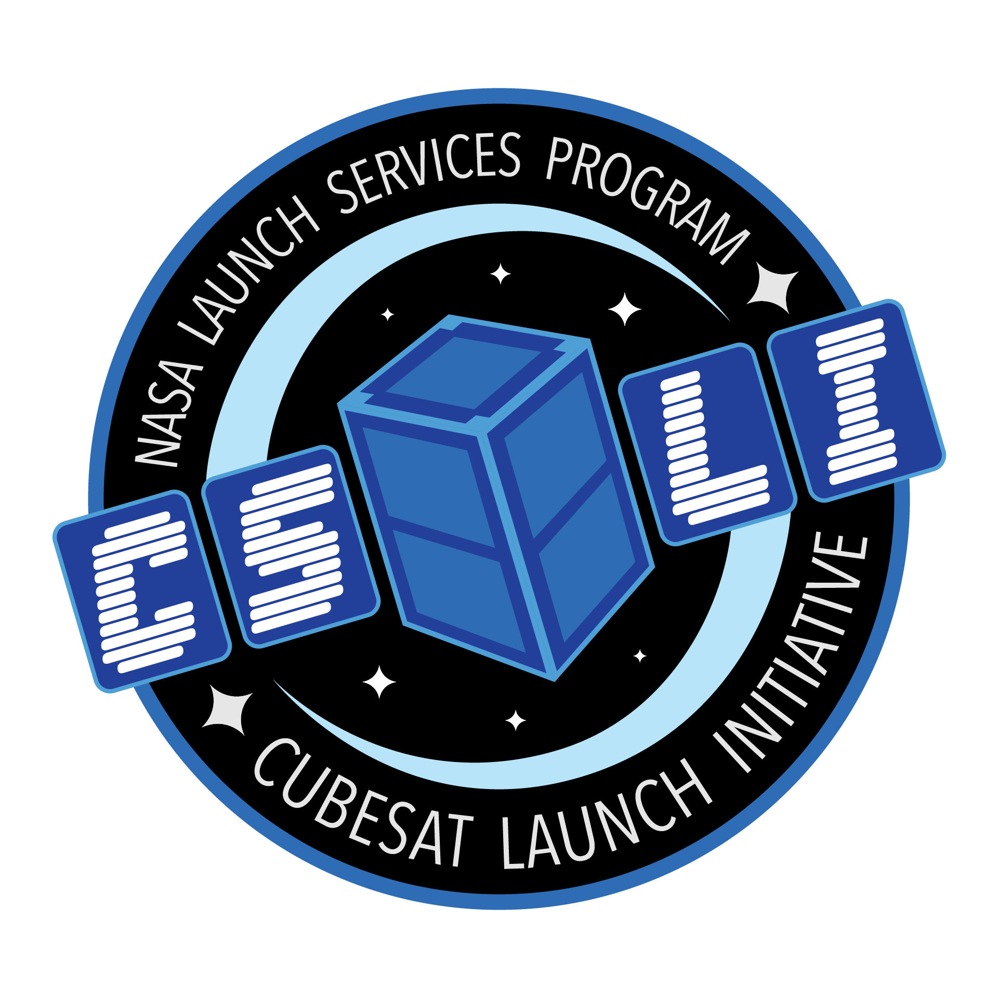
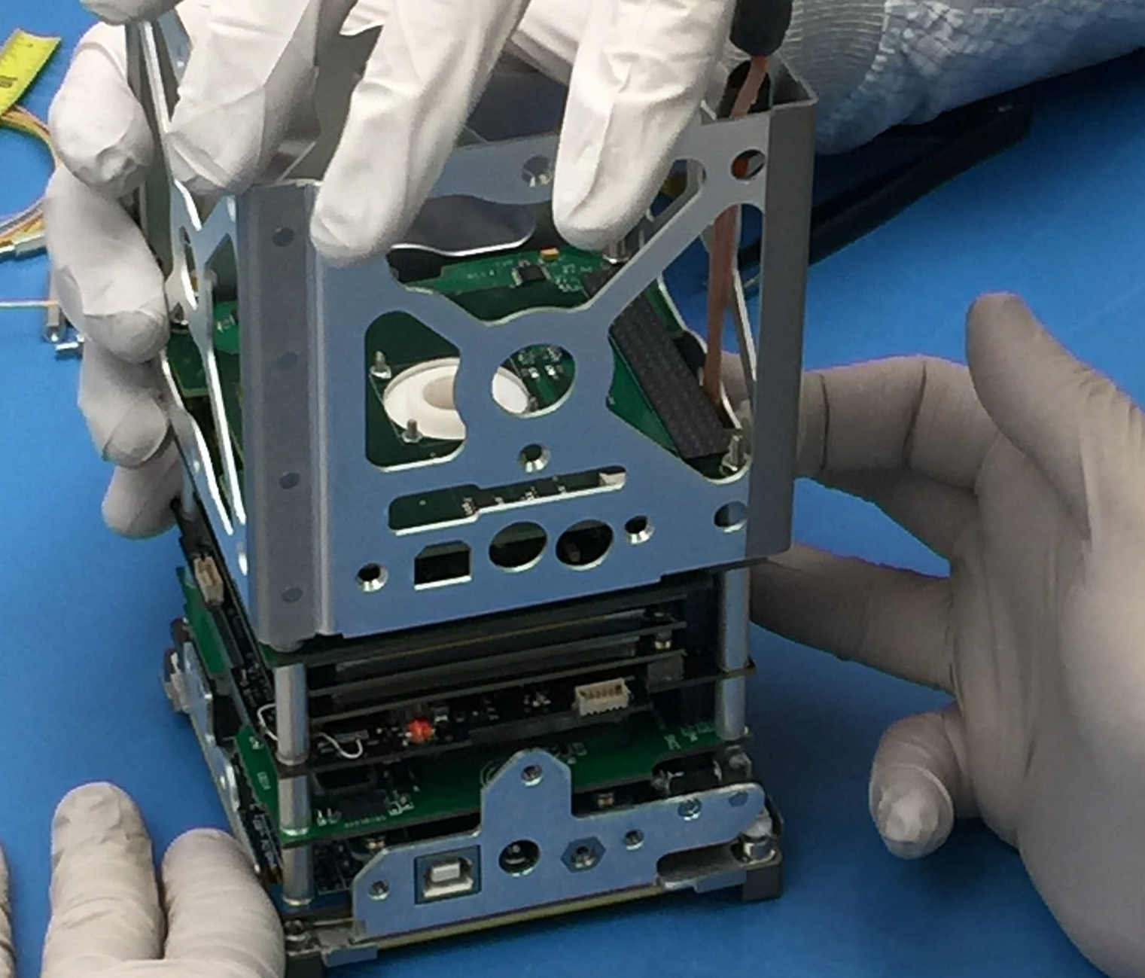
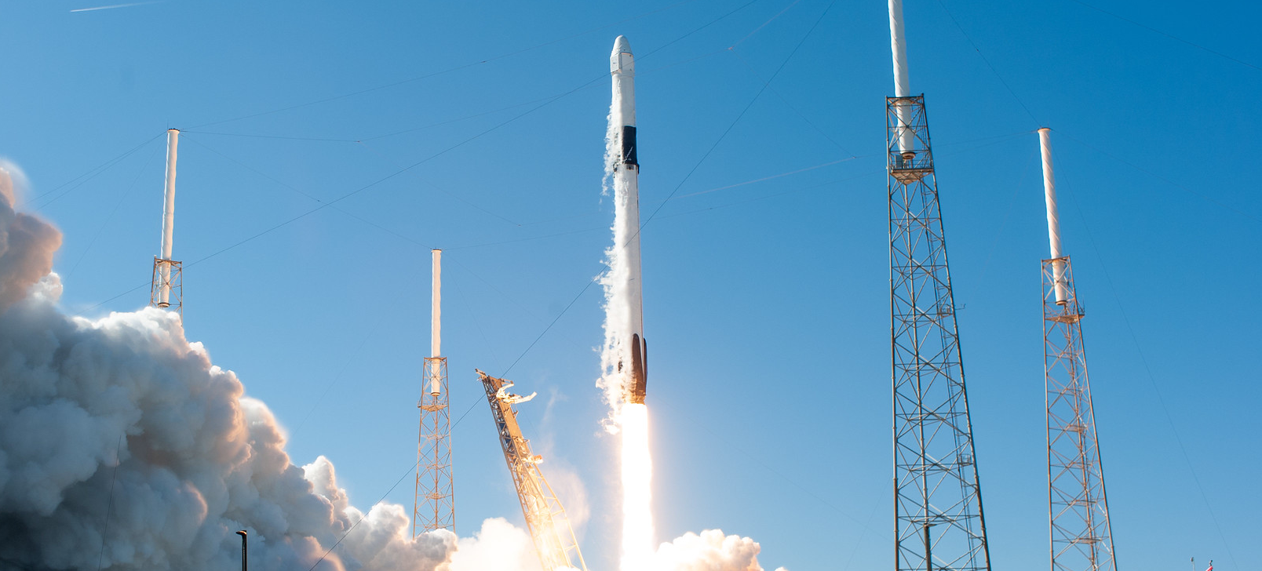
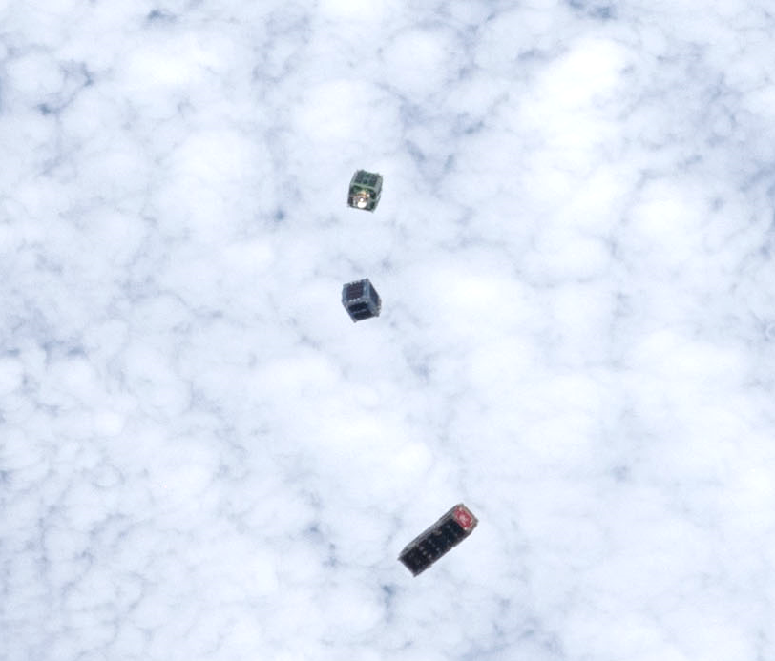
How CubeSat Launch Initiative (CSLI) works…
SpX-16 (ELaNa21) Launch
Credit: NASA/Tony Gray, Tim Terry & Kevin O’Connell
BisonSat (ELaNa-12)
Credit: Salish Kootenai College
SC Team Designs/Builds/Tests their Spacecraft
NASA CSLI Procures and Funds the Launch Service
SC Team Operates their Spacecraft

Slide 4
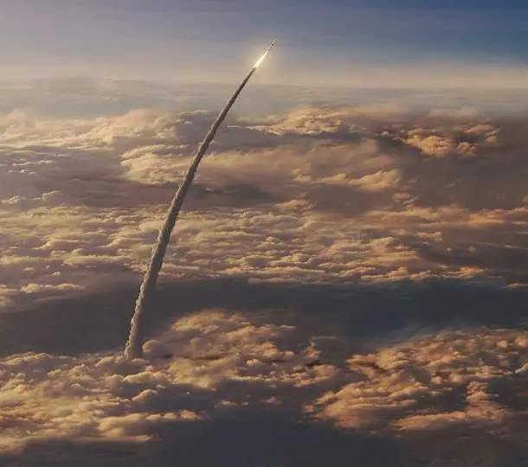
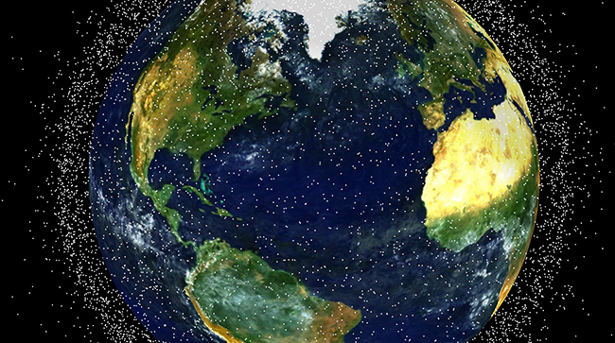
LSP Flight Design Analysis & CubeSats
Flight Design (i.e. Trajectory) Analysis
Orbital Debris Analysis Reports (ODARs)
Launch vehicles
CubeSats for CSLI
Notes:
Rocket picture
https://blogs.nasa.gov/Rocketology/category/space-launch-system/page/3/
https://blogs.nasa.gov/Rocketology/wp-content/uploads/sites/251/2015/09/NASA-Space-Launch-System-SLS-ascends-through-clouds.jpg
Orbital Debris picture
https://www.orbitaldebris.jsc.nasa.gov/_pictures/_slideshow/reentry-risk.jpg
Alternatives:
https://technology.nasa.gov/t2media/tops/img/MSC-TOPS-90/Orbital_Debris_V2.jpg
https://sma.nasa.gov/images/default-source/news/posters/hero---nasa-updates-the-nasa-technical-standard-for-limiting-orbital-debris.png?sfvrsn=b7aec3f8_0
https://sma.nasa.gov/images/default-source/news/posters/od-hero.jpg?sfvrsn=ed60f0f8_0
https://vienna.usmission.gov/2022-copuos-stsc-space-debris/

Slide 5
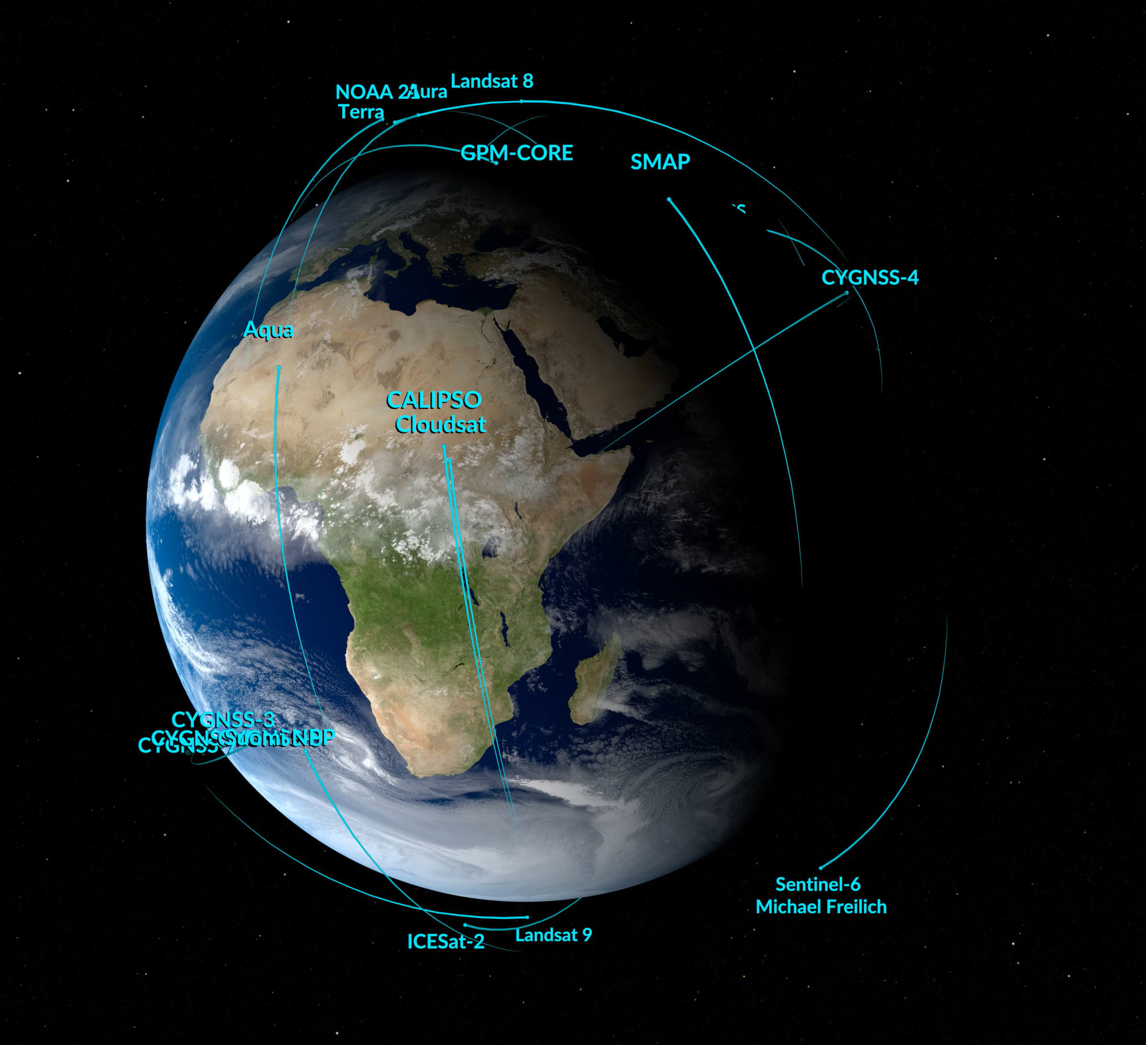

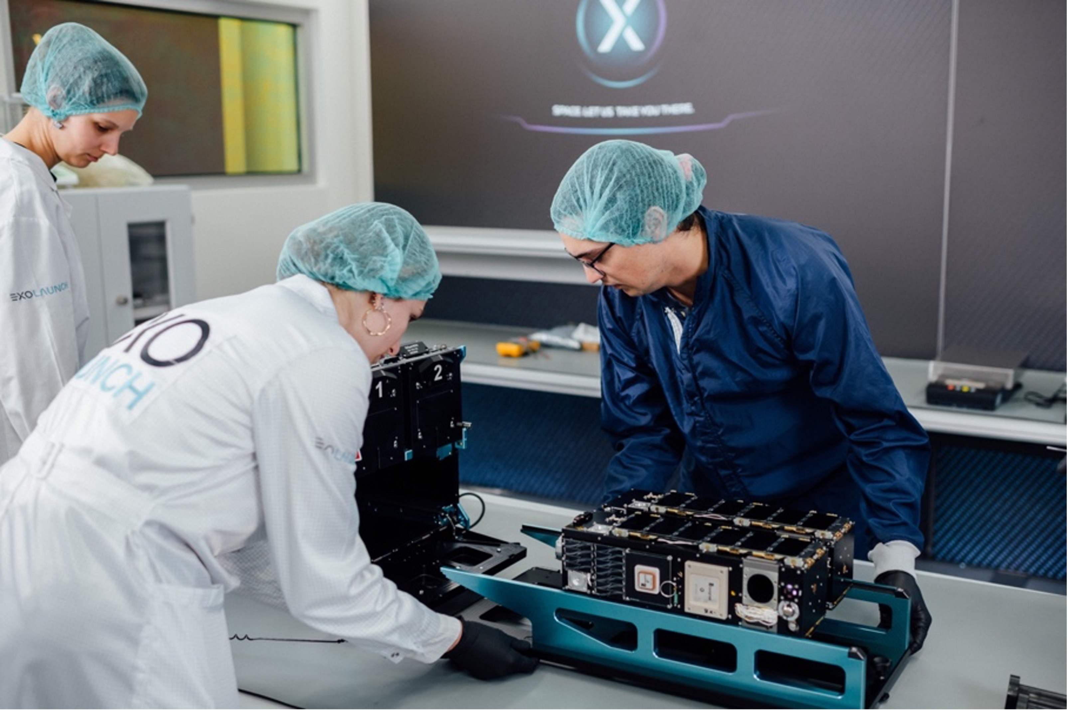
Typical CSLI CubeSat Missions
Post-mission disposal via passive reentry
CURIE (ELaNa 48)
Credit: ExoLaunch
Higher Altitudes → Longer Orbital Lifetimes
Denser Spacecraft → Longer Orbital Lifetimes
Notes:
Orbit Image: still from Earth Observing Fleet (January 2023)
https://svs.gsfc.nasa.gov/5061/
1U image: Still from the NASA animation, https://www.youtube.com/watch?v=HZMiJ_Q47qk
6U image: https://science.nasa.gov/science-research/heliophysics/nasa-mission-to-study-mysteries-in-the-origin-of-solar-radio-waves/

Slide 6
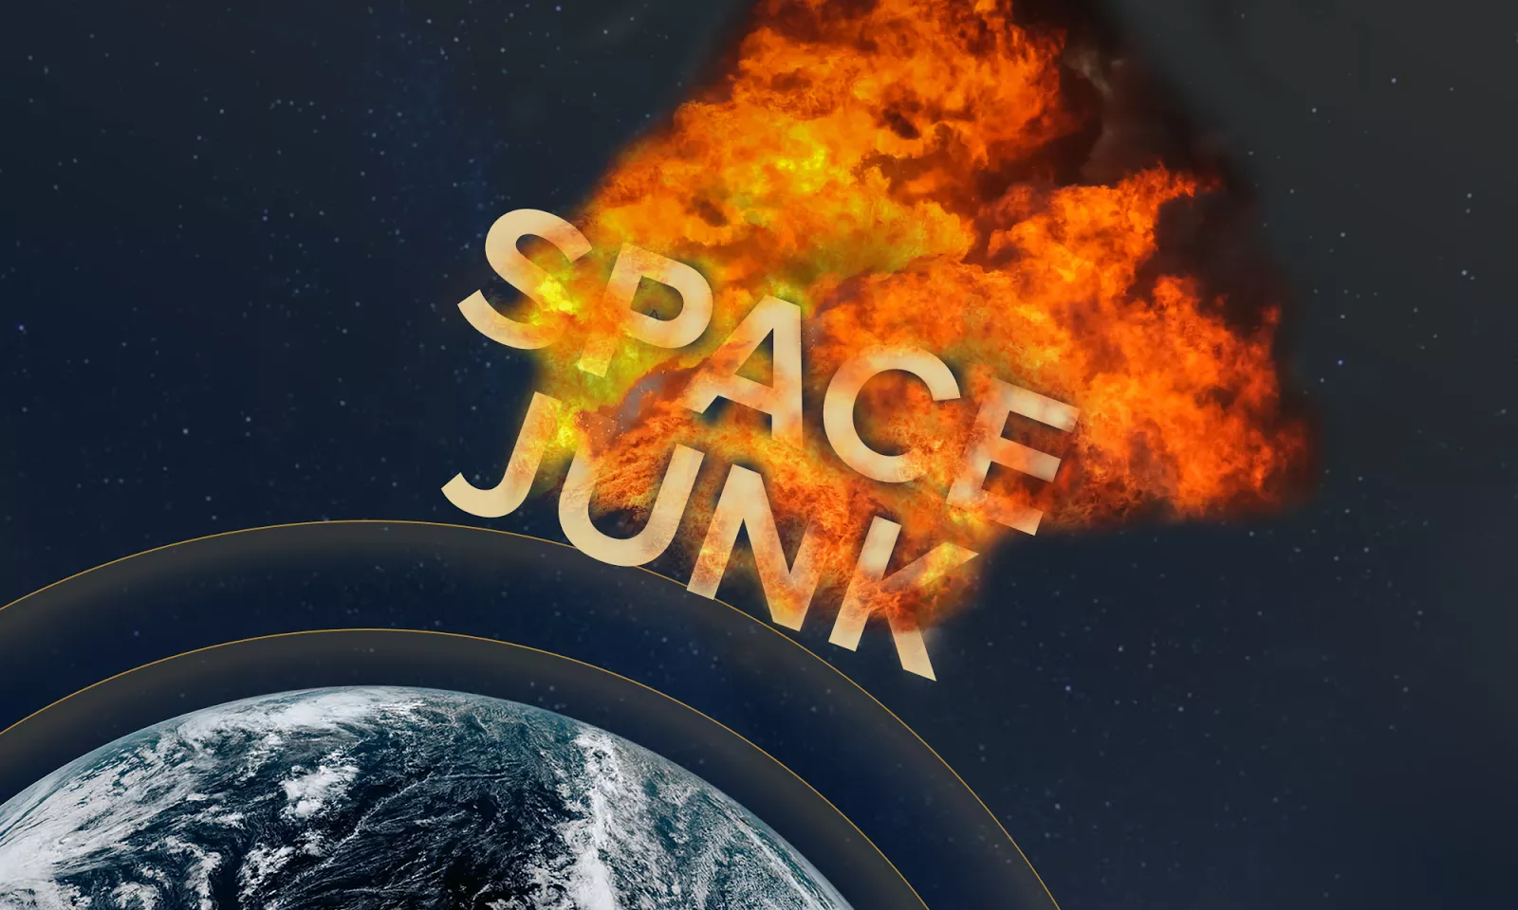
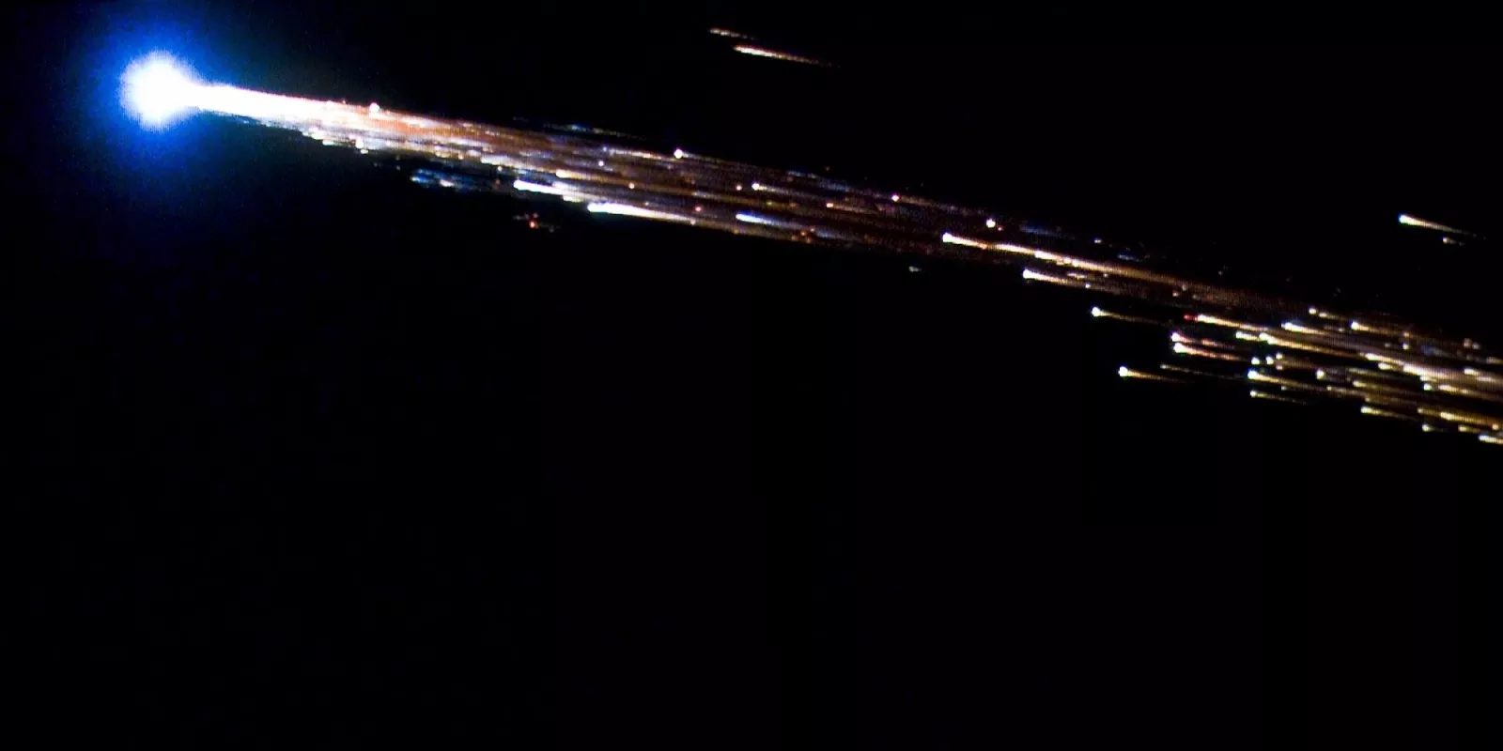
Post-Mission Disposal Rules
Orbital Debris Analysis Reports (ODARs) address post-mission disposal rules
NASA requirement: 25-year post-mission orbital lifetime
FCC rule: 5-year post-mission orbital lifetime
For other licensing agencies, check their rules / regulations
ESA's Jules Verne ATV (2008)
Credit: NASA/ESA/Bill Moede and Jesse Carpenter
Credit: NOAA
Notes:
Both images: https://www.nesdis.noaa.gov/news/does-space-junk-fall-the-sky NASA
Requirement 4.6-1.a “Natural reentry: …no more than 25 years after the completion of mission.”
Process for Limiting Orbital Debris, NASA-STD-8719.14C, 5 November 2021
FCC
“successful disposal…no later than five years following completion of the mission”
All satellites launched from September 30, 2024 on must meet this rule or else seek a waiver
In the Matter of Space Innovation Mitigation of Orbital Debris in the New Space Age, Federal Communications Commission FCC 22-74, 30 September 2022

Slide 7
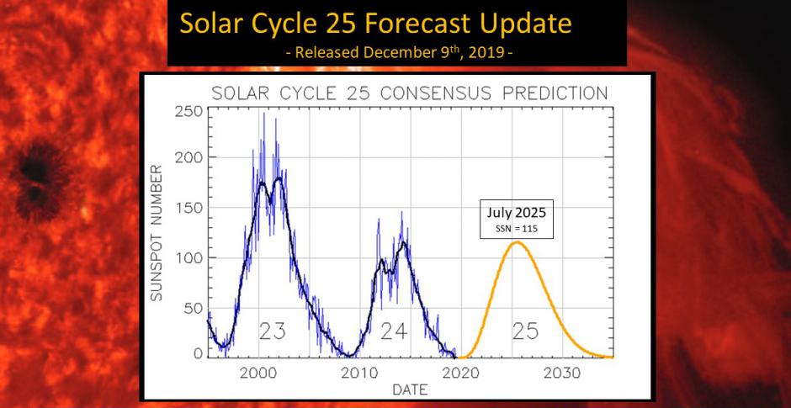
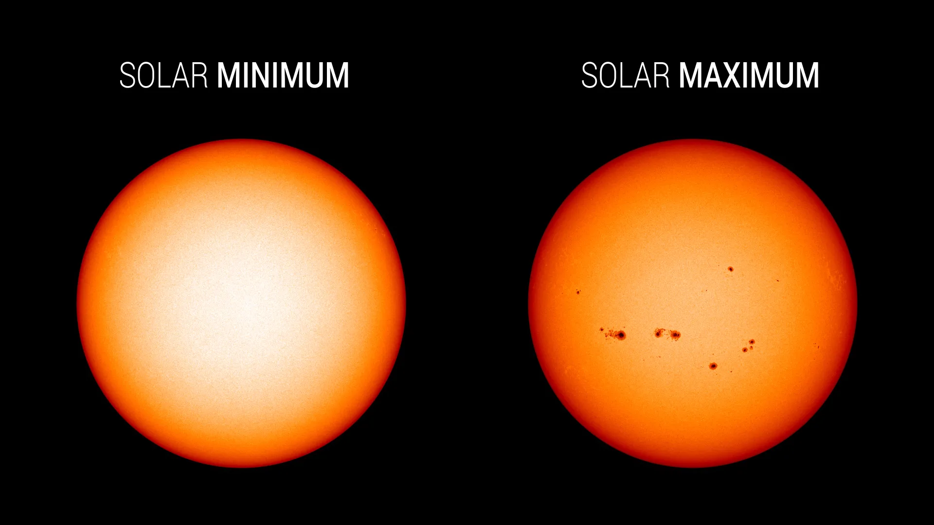
Solar Cycle: 11 years
Notes:
Max/ min: https://www.nasa.gov/missions/sdo/what-will-solar-cycle-25-look-like/
Solar cycle: https://svs.gsfc.nasa.gov/13776

Slide 8
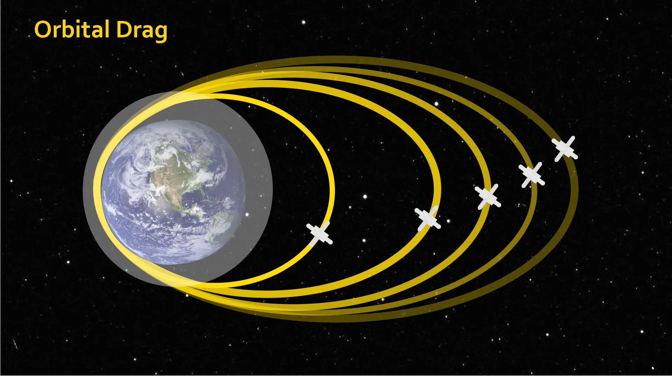
Sun → Atmospheric Drag → Orbital Lifetime
Notes:
Image: https://www.nasa.gov/solar-system/revolutions-in-understanding-the-ionosphere-earths-interface-to-space/

Slide 9
Predicted Orbital Lifetime at 430 km: Launched over 2 Solar Cycles (2021-2044)
Notes:
Predicted Orbit Lifetime vs Launch Year for Perigee Altitude = 430 km
DAS = 3.2.3 version, Solar Flux Data (F10) = 20230927 release date
Inclination = 51.6 deg, R.A. of Ascending Node = 0 deg
Argument of Perigee = 0 deg

Slide 10
Predicted Orbital Lifetime at 550 km: Launched over 2 Solar Cycles (2021-2044)
Notes:
Predicted Orbit Lifetime vs Launch Year for Perigee Altitude = 550 km
DAS = 3.2.3 version, Solar Flux Data (F10) = 20230927 release date
Inclination = 51.6 deg, R.A. of Ascending Node = 0 deg
Argument of Perigee = 0 deg

Slide 11
Solar Cycle Impact on Orbital Lifetime
Predicted orbital lifetime can change up to
A factor of 2.5 in just two years
A factor of 5 over the solar cycle
Maximum orbital lifetime occurs at different launch years for different mission designs
Notes:
Mission A: Calculated Orbit Lifetime vs Launch Year for Perigee Altitude = 430 km
DAS = 3.2.3 version, Solar Flux Data (F10) = 20230927 release date
Inclination = 51.6 deg, R.A. of Ascending Node = 0 deg
Argument of Perigee = 0 deg
Area-to-Mass 0.005 (m^2/kg)
2026: 2 years
2028: 5 years
Mission B: Calculated Orbit Lifetime vs Launch Year for Perigee Altitude = 550 km
DAS = 3.2.3 version, Solar Flux Data (F10) = 20230927 release date
Inclination = 51.6 deg, R.A. of Ascending Node = 0 deg
Argument of Perigee = 0 deg
Area-to-Mass 0.02 (m^2/kg)
2035: 1.6 years
2038: 7.4 years

Slide 12
Summary - Orbital Lifetime Risk Planning
Plan for CubeSat’s licensing and estimate spacecraft mission parameters
Plan for launch slips - calculate orbital lifetime over multiple launch years
Consider mission design changes early in development process
Notes:
Calculated Orbit Lifetime vs Launch Year for Perigee Altitude = 550 km
DAS = 3.2.6 version, Solar Flux Data (F10) = 20230927 release date
Inclination = 98.8 deg, R.A. of Ascending Node = 0 deg
Argument of Perigee = 0 deg
Area-to-Mass 0.010 (m^2/kg)

Slide 13
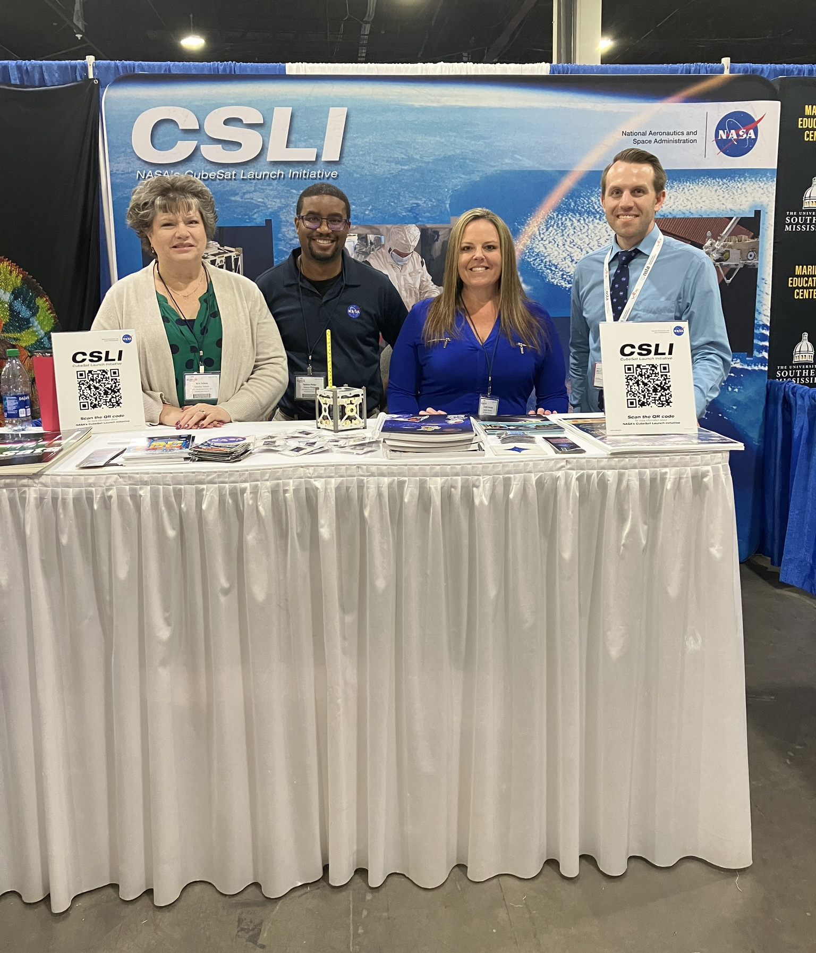
Variation in Predicated Orbital Lifetime due to Launch Year
Thank you for your attention
Visit NASA LSP & learn about CSLI: Booth 17
Paper to come
Will post on NASA Technical Reports Server (NTRS)
Caley.A.Burke@nasa.gov
Booth 17
Notes:
NASA LSP Facebook page (March 2023): https://www.facebook.com/photo/?fbid=607126108129316&set=a.229501599225104
NASA LSP Twitter page (April 2023): https://twitter.com/NASA_LSP/status/1651964755135930371/photo/1
NASA LSP Twitter page (May 2023): https://twitter.com/NASA_LSP/status/1771978019181097341/photo/1
NASA LSP Twitter page (August 2023): https://twitter.com/NASA_LSP/status/1688973430811463693/photo/1

Slide 14
backup

Slide 15
Debris Assessment Software (DAS)
Data presented on slides 9-12 were created using NASA’s DAS
Slides 19-20 show the inputs used for the figures on Slides 9-10
The notes on all slides include the inputs used to generate the results
Debris Assessment Software (DAS) v. 3.2.6 is currently available
Request at https://software.nasa.gov/software/MSC-26690-1
Release Type: General Public Release
DAS is released by NASA Orbital Debris Program Office (ODPO) at Johnson Space Center
https://www.orbitaldebris.jsc.nasa.gov/

Slide 16
Typical CSLI CubeSat Missions
Low Earth Orbit (LEO) missions
Deploy from ISS
~430 km at 51.6 deg inclination
≤ 650 km sun-synchronous orbit (SSO)
≤ 650 km at other inclinations
Mission length: 6 months to 2 years
Post-mission disposal via passive reentry
i.e. atmospheric drag gradually lowers orbit
Higher Altitudes → Longer Orbital Lifetimes
Notes:
Image: still from Earth Observing Fleet (January 2023)
https://svs.gsfc.nasa.gov/5061/
Credit: NASA's Scientific Visualization Studio

Slide 17
Typical CSLI CubeSats
Size: 1U to 6U
Mass: 1-13 kg
Median Area-To-Mass Ratios
1U: 0.014 m²/kg
3U: 0.010 m²/kg
6U: 0.007 m²/kg
Lower Area-To-Mass Ratios
~ Denser Spacecraft
CURIE (ELaNa 48)
Credit: ExoLaunch
Denser Spacecraft → Longer Orbital Lifetimes
Notes:
1U image: Still from the NASA animation, https://www.youtube.com/watch?v=HZMiJ_Q47qk
6U image: https://science.nasa.gov/science-research/heliophysics/nasa-mission-to-study-mysteries-in-the-origin-of-solar-radio-waves/

Slide 18
Post-mission Disposal Rules
ODARs address post-mission disposal rules
Time length depends on satellite’s licensing body
NASA: 25-year post-mission orbital lifetime
Requirement 4.6-1.a “Natural reentry: …no more than 25 years after the completion of mission.”
Process for Limiting Orbital Debris, NASA-STD-8719.14C, 5 November 2021
FCC: 5-year post-mission orbital lifetime
“successful disposal…no later than five years following completion of the mission”
All satellites launched from September 30, 2024 on must meet this rule or else seek a waiver
In the Matter of Space Innovation Mitigation of Orbital Debris in the New Space Age, Federal Communications Commission FCC 22-74, 30 September 2022
For other licensing agencies, check their rules / regulations

Slide 19
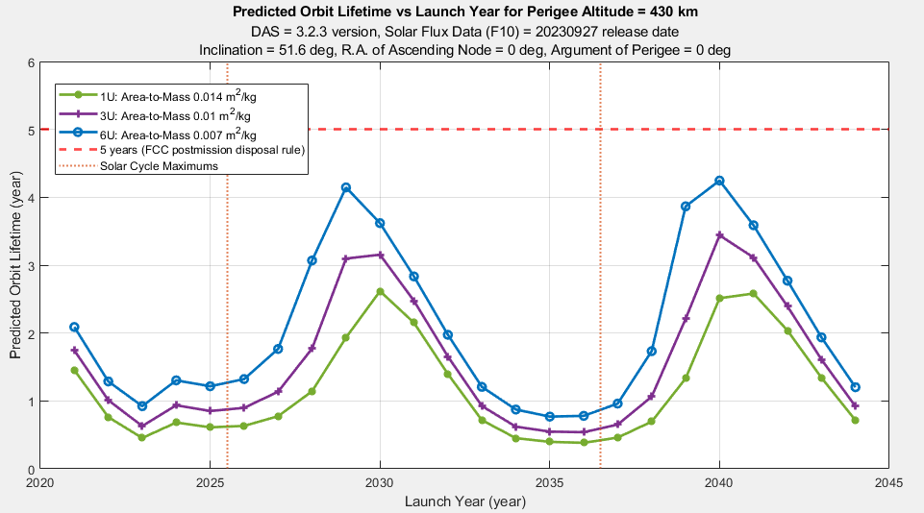
Predicted Orbital Lifetime at 430 km: Deployed over 2 Solar Cycles (2021-2044)

Slide 20
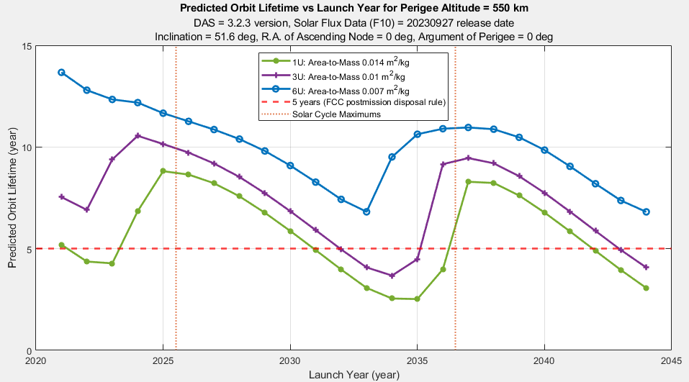
Predicted Orbital Lifetime at 550 km: Deployed over 2 Solar Cycles (2021-2044)

Slide 21
Solar Cycle Impact on Orbital Lifetime
Predicted orbital lifetime changes up to a factor of 2.5 in just two years
2026: 2 years
2028: 5 years
Predicted orbital lifetime changes up to a factor of 5 over the solar cycle
2035: 1.6 years
2038: 7.4 years
Maximum orbital lifetime occurs at different launch years for different mission designs
Maximum predicted orbital lifetime don’t occur consistently across the solar cycle
Different altitude and area-to-mass ratio combinations have different launch years that result in the maximum predicted orbital lifetime
Notes:
Mission A: Calculated Orbit Lifetime vs Launch Year for Perigee Altitude = 430 km
DAS = 3.2.3 version, Solar Flux Data (F10) = 20230927 release date
Inclination = 51.6 deg, R.A. of Ascending Node = 0 deg
Argument of Perigee = 0 deg
Area-to-Mass 0.005 (m^2/kg)
Mission B: Calculated Orbit Lifetime vs Launch Year for Perigee Altitude = 550 km
DAS = 3.2.3 version, Solar Flux Data (F10) = 20230927 release date
Inclination = 51.6 deg, R.A. of Ascending Node = 0 deg
Argument of Perigee = 0 deg
Area-to-Mass 0.02 (m^2/kg)

Slide 22
Summary - Orbital Lifetime Risk Planning
Plan for CubeSat’s licensing and estimate spacecraft mission parameters
Learn the rules for the licensing body
Estimate mission length, Area-to-Mass ratio, orbit
Plan for launch slips - calculate orbital lifetime over multiple launch years
Expect the launch date to slip due to spacecraft or launch vehicle readiness
Orbital debris waivers are sometimes possible, but not guaranteed
Consider mission design changes early in development process to:
Improve likelihood of compliance with orbital debris requirements
Meet minimum mission length
E.g. add propulsion, change cross-sectional area (deployables), change mass, etc

Slide 23
Traditional LSP Roles and Responsibilities
Acquire Launch Services
Verify and validate mission engineering analysis
Manage launch vehicle to spacecraft integration
Certify launch systems for NASA use
Provide insight and approval of production, integration, testing and processing

Slide 24

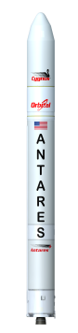
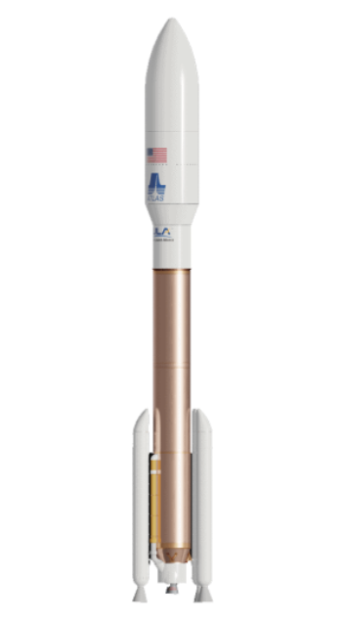
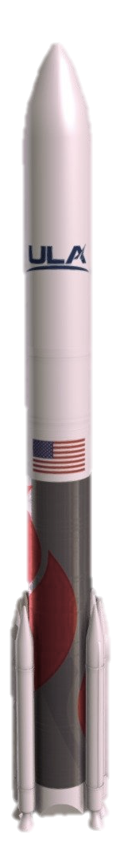
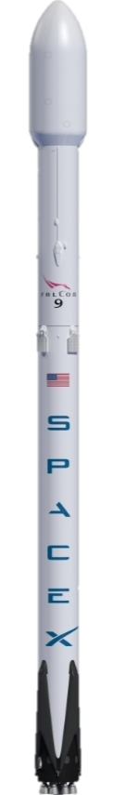
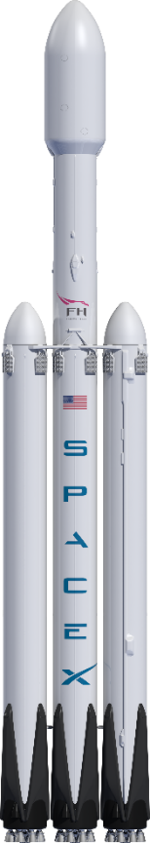
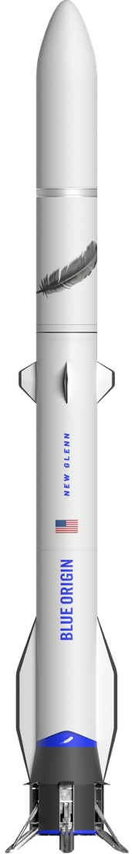

Launch Services Program – Current Vehicle Fleet – NLS II -
NGIS Pegasus XL | NGIS Antares | ULA Atlas V | SpaceX Falcon 9 | SpaceX Falcon Heavy | ULA Vulcan | Blue Origin New Glenn
*Not shown to scale
Notes:
CURRENT FLEET
NGIS, Pegasus XL (Certified NLS-II)
NGIS, Antares (NLS-II)
ULA, Atlas V (Certified NLS-II)
SpaceX, Falcon 9 (Certified NLS-II)
SpaceX, Falcon Heavy (Certified NLS-II)
ULA, Vulcan (NLS-II)
Blue Origin, New Glenn (NLS-II)

Slide 25



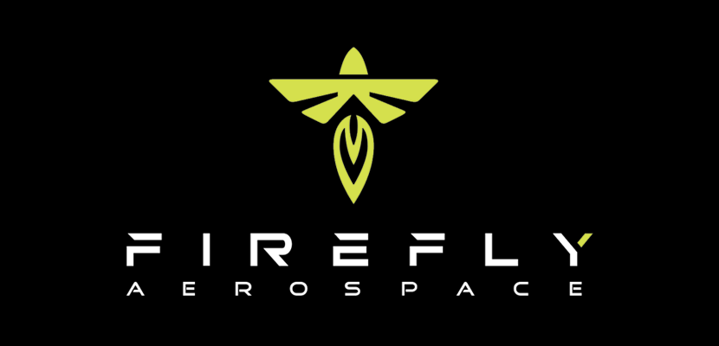
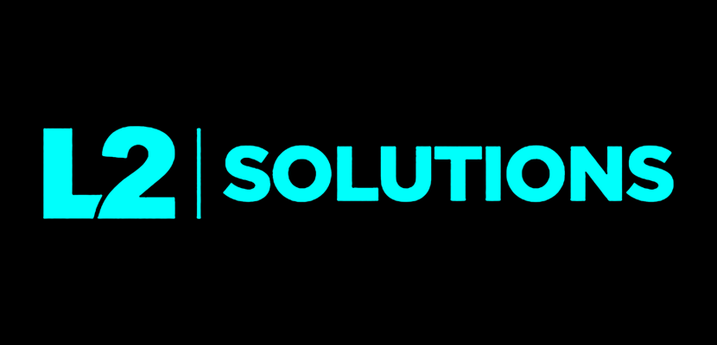

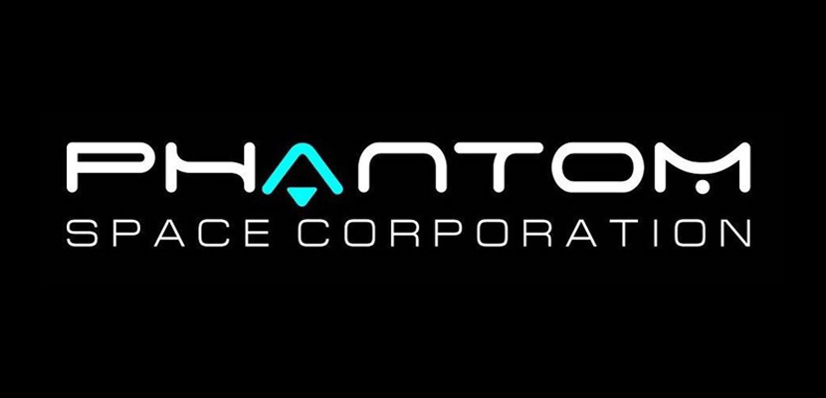


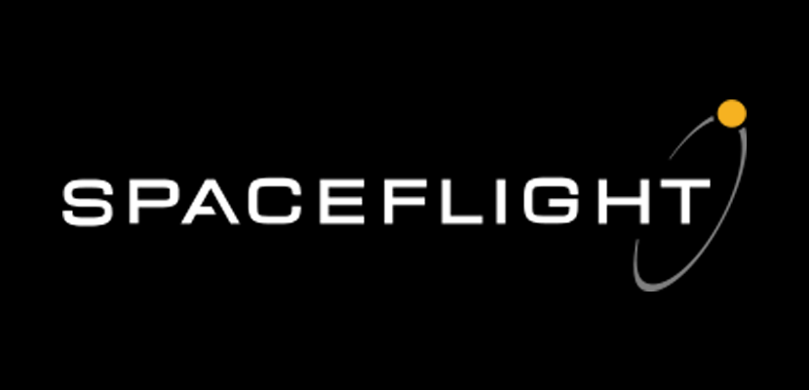
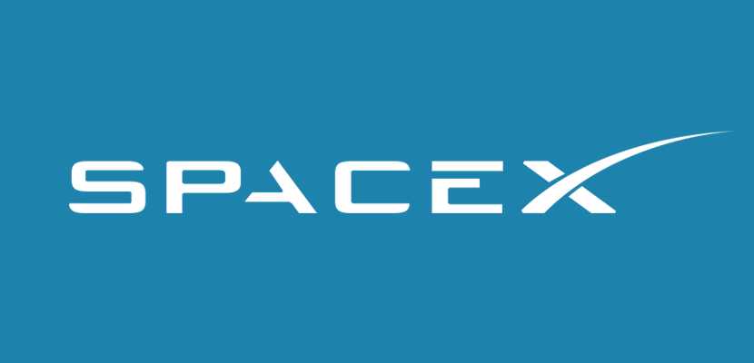

Launch Services Program – VADR Launch Service Providers -

Slide 26
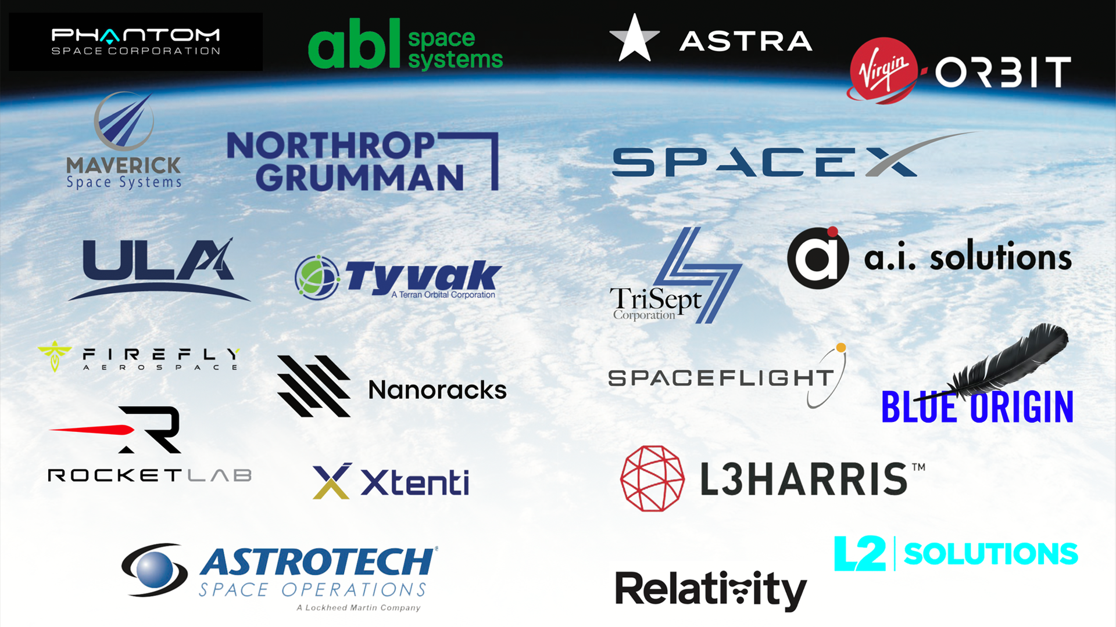
Notes:
LSP Partnerships and Collaborations

Slide 27
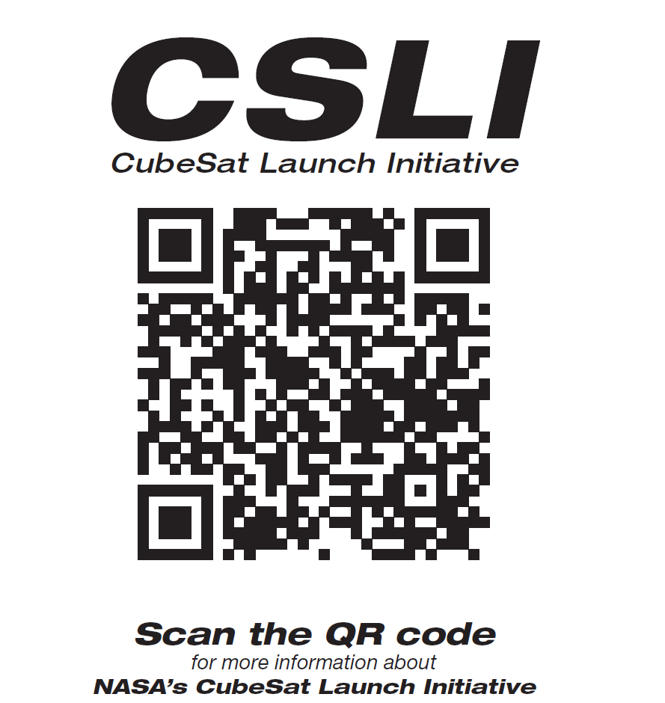
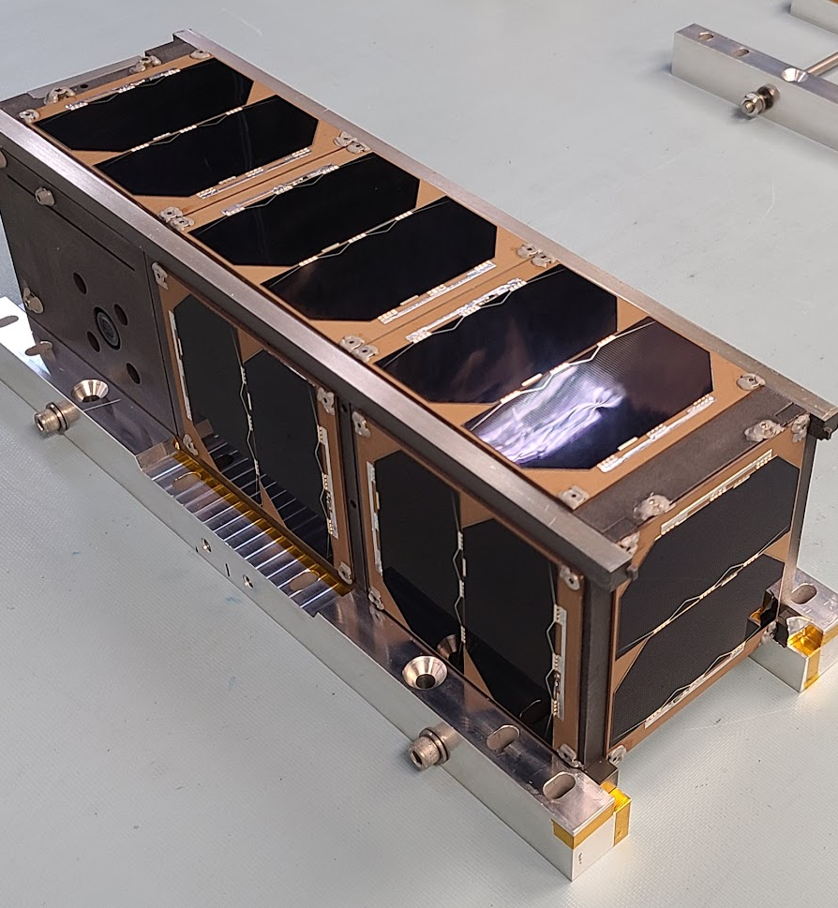
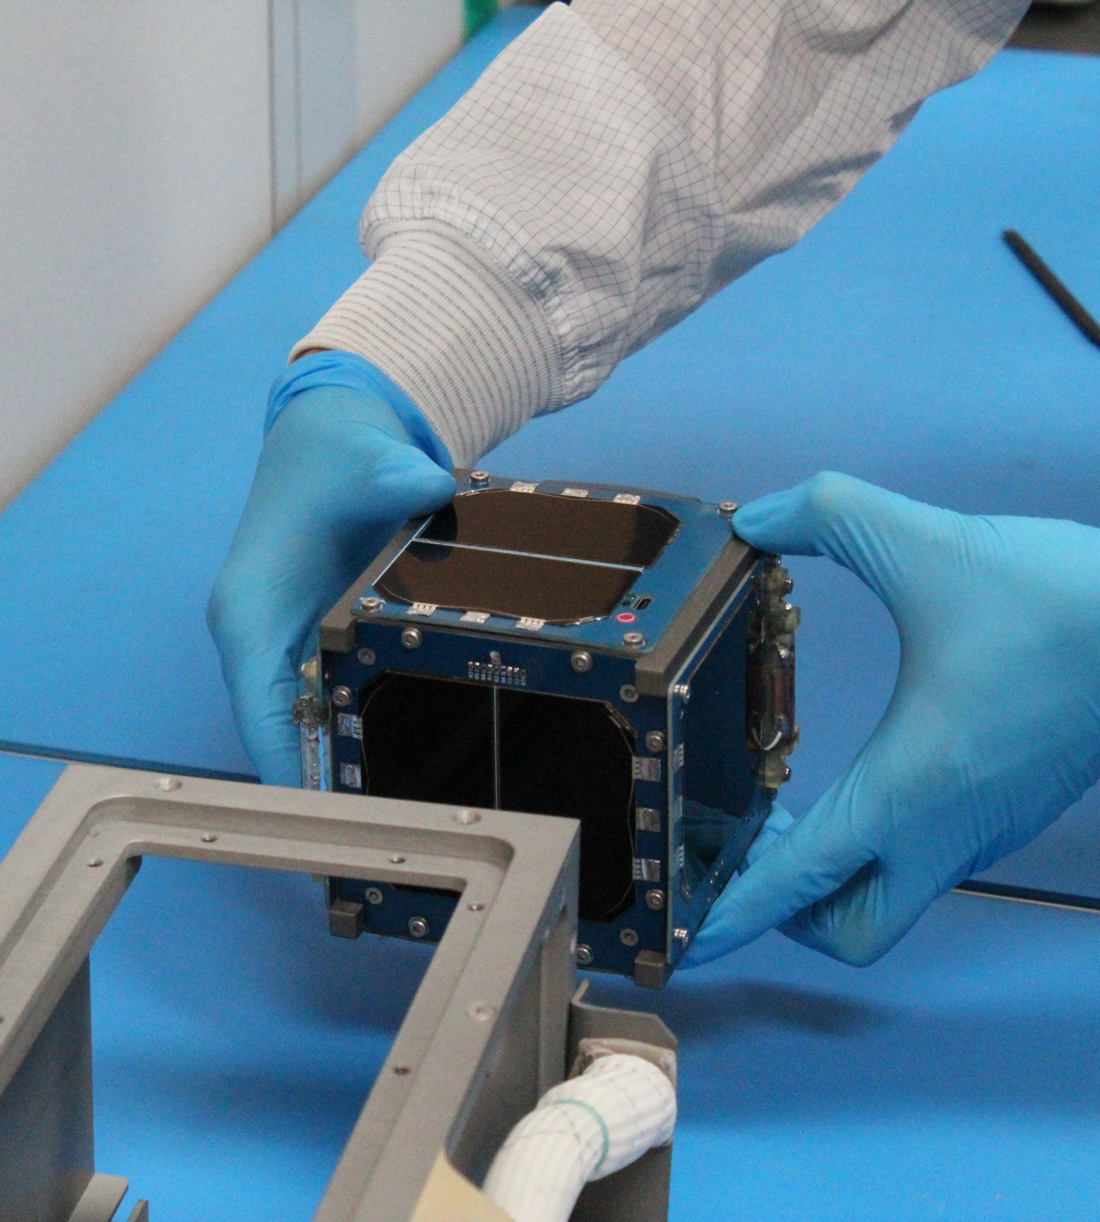
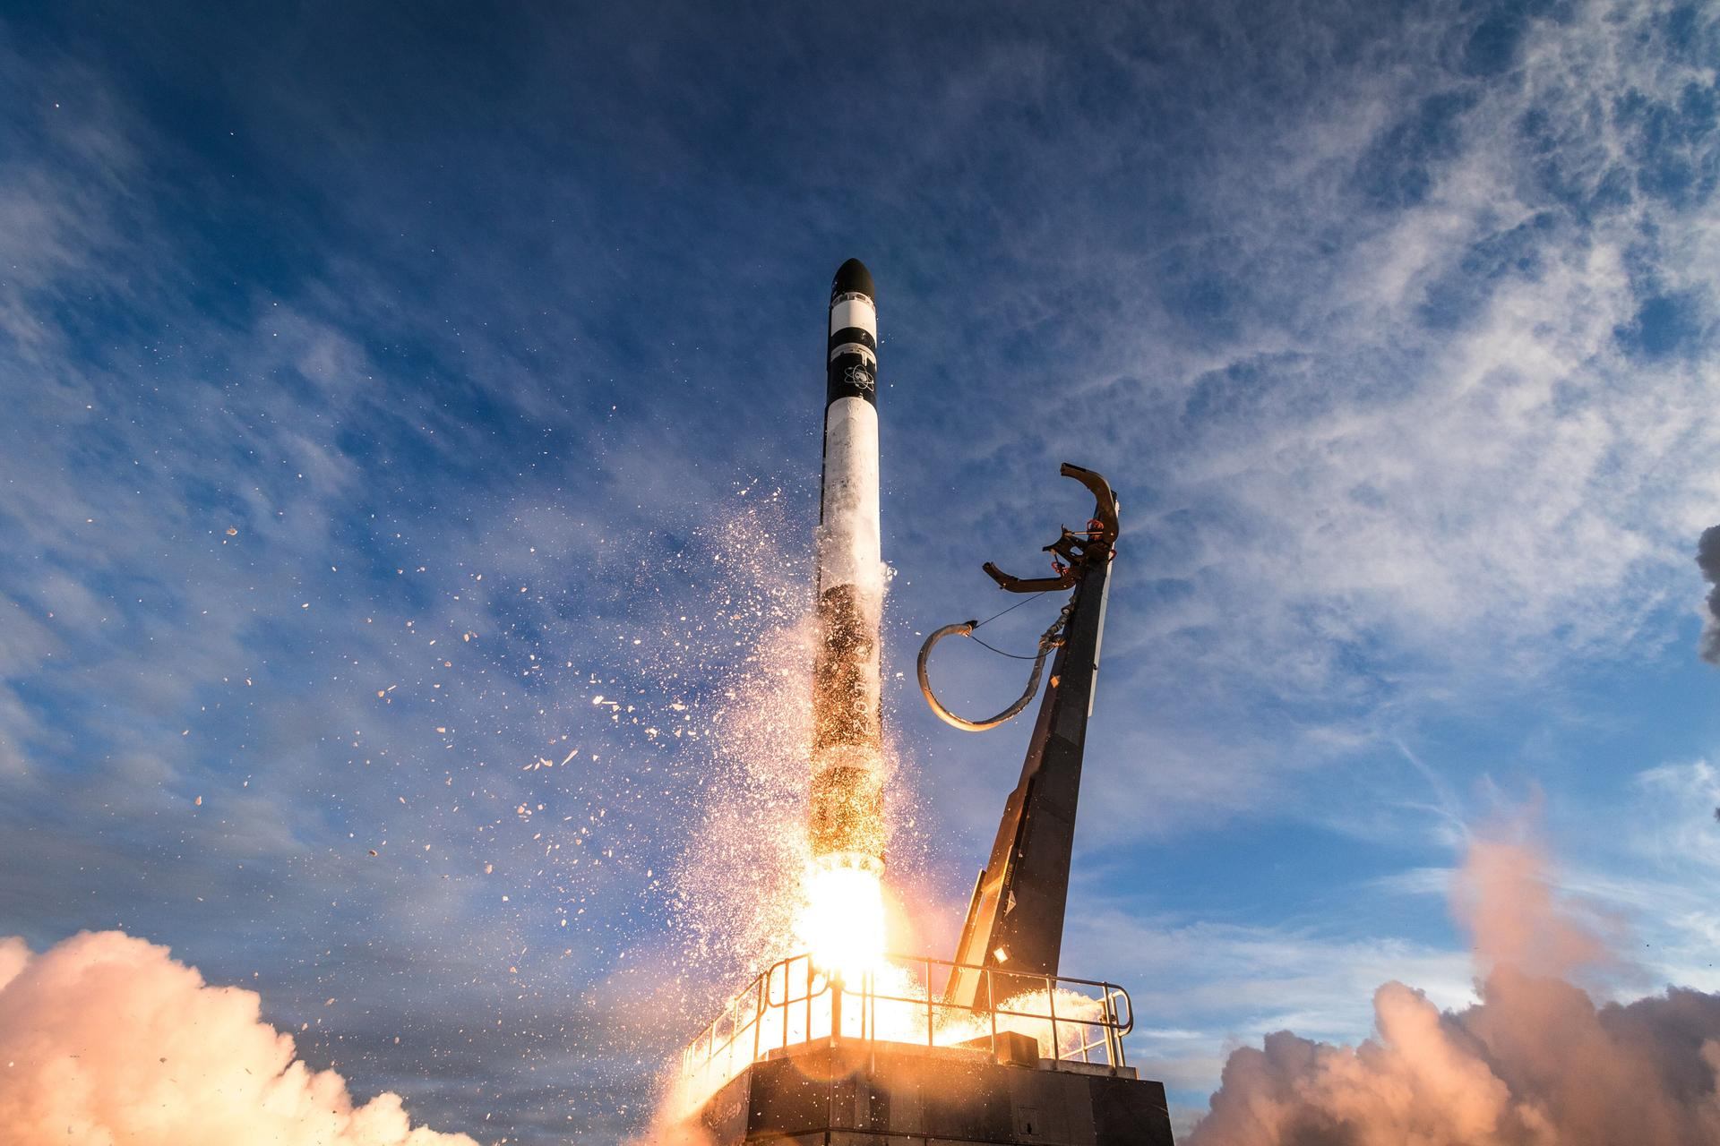
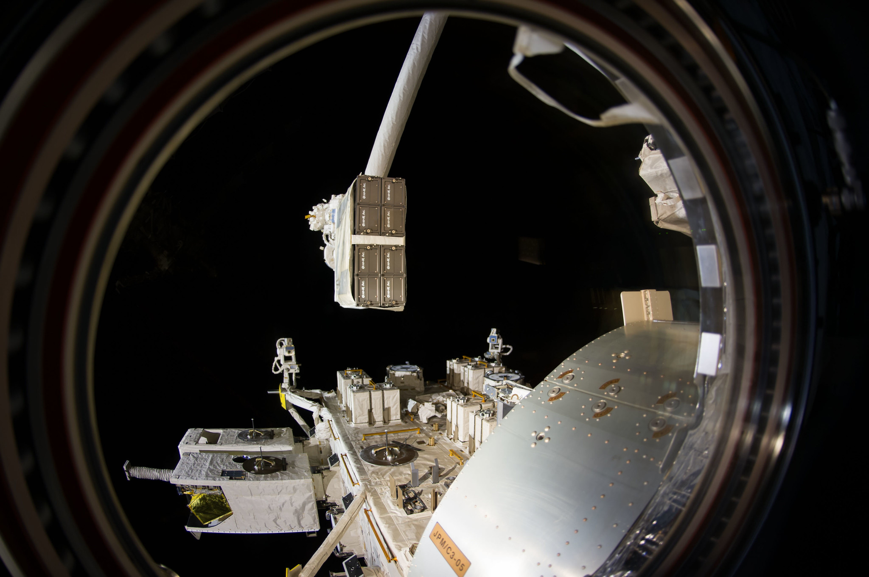
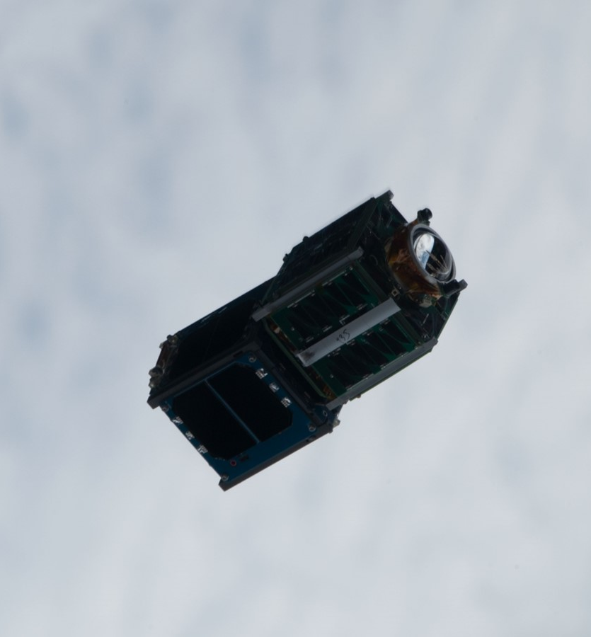
CubeSat Launch Initiative (CSLI)
CSLI provides launch opportunities to U.S. CubeSat developers, thereby giving them a pathway to conduct research in the areas of science, exploration, technology development and education.
Opportunity for NASA to fund CubeSat launches
Announcement of Partnership Opportunity (AoPO) posted in early August, applications due around Thanksgiving
https://www.nasa.gov/kennedy/launch-services-program/cubesat-launch-initiative/
LightCube integration
Credit: Nanoracks
CubeSat Deployers on ISS
GPX2, Credit: NASA
Image: ELaNa 19 Launch Credit: Rocket Lab/Trevor Mahlmann

Slide 28
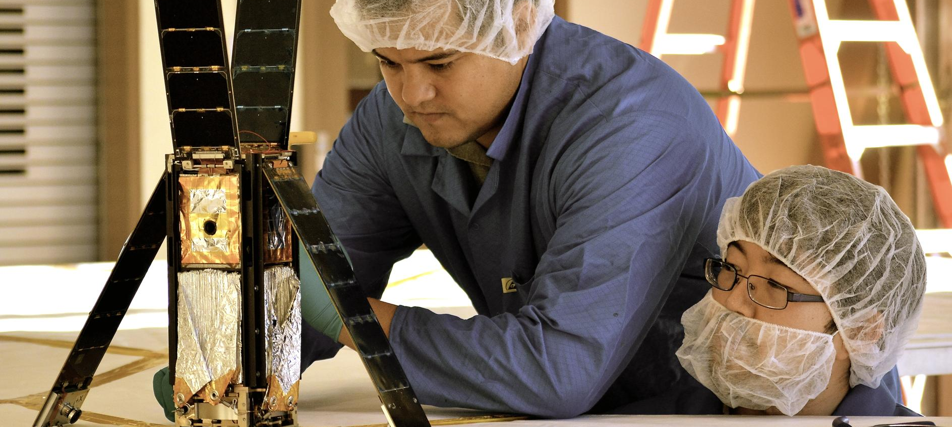
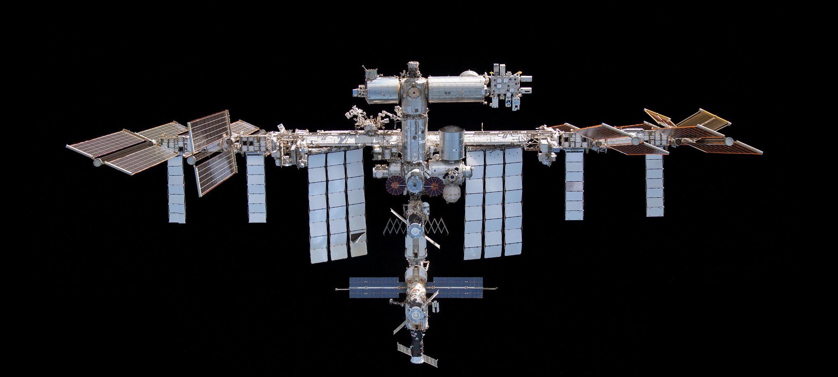
CubeSat Launch Initiative
Mission
Provide launch opportunities to U.S. CubeSat developers, thereby giving them a pathway to conduct research in the areas of science, exploration, technology development and education.
LightSail, Credit: The Planetary Society
CubeSat Deployers on ISS
Image: ELaNa 19 Launch, Credit: Rocket Lab/Trevor Mahlmann
International Space Station
https://www.nasa.gov/kennedy/launch-services-program/cubesat-launch-initiative/

Slide 29
How CubeSat Launch Initiative (CSLI) works…
SpX-16 (ELaNa21) Launch
Credit: NASA/Tony Gray, Tim Terry & Kevin O’Connell
BisonSat (ELaNa-12)
Credit: Salish Kootenai College
SC Team Designs/Builds/Tests their Spacecraft
NASA CSLI Procures and Funds* the Launch Service
SC Team Operates their Spacecraft
* Projects that are NASA funded and/or sponsored may be asked to provide matching funding if requirements exceed the baselined budget for integration and launch.

Slide 30
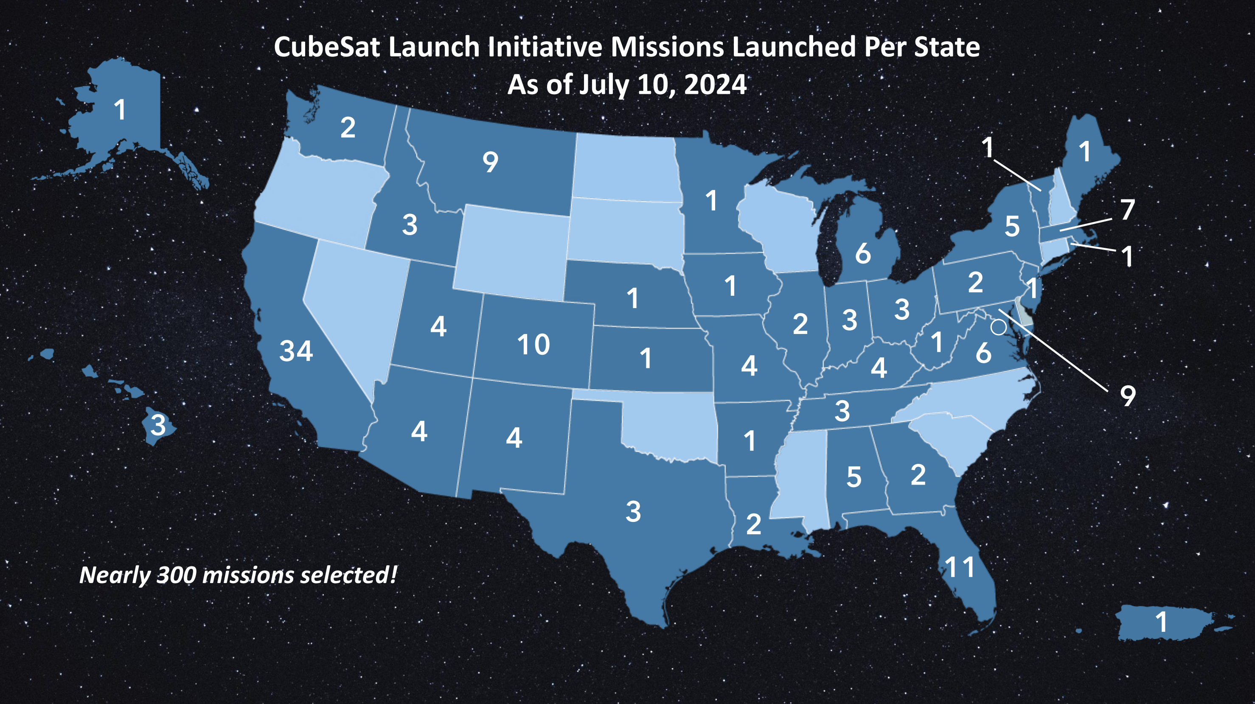
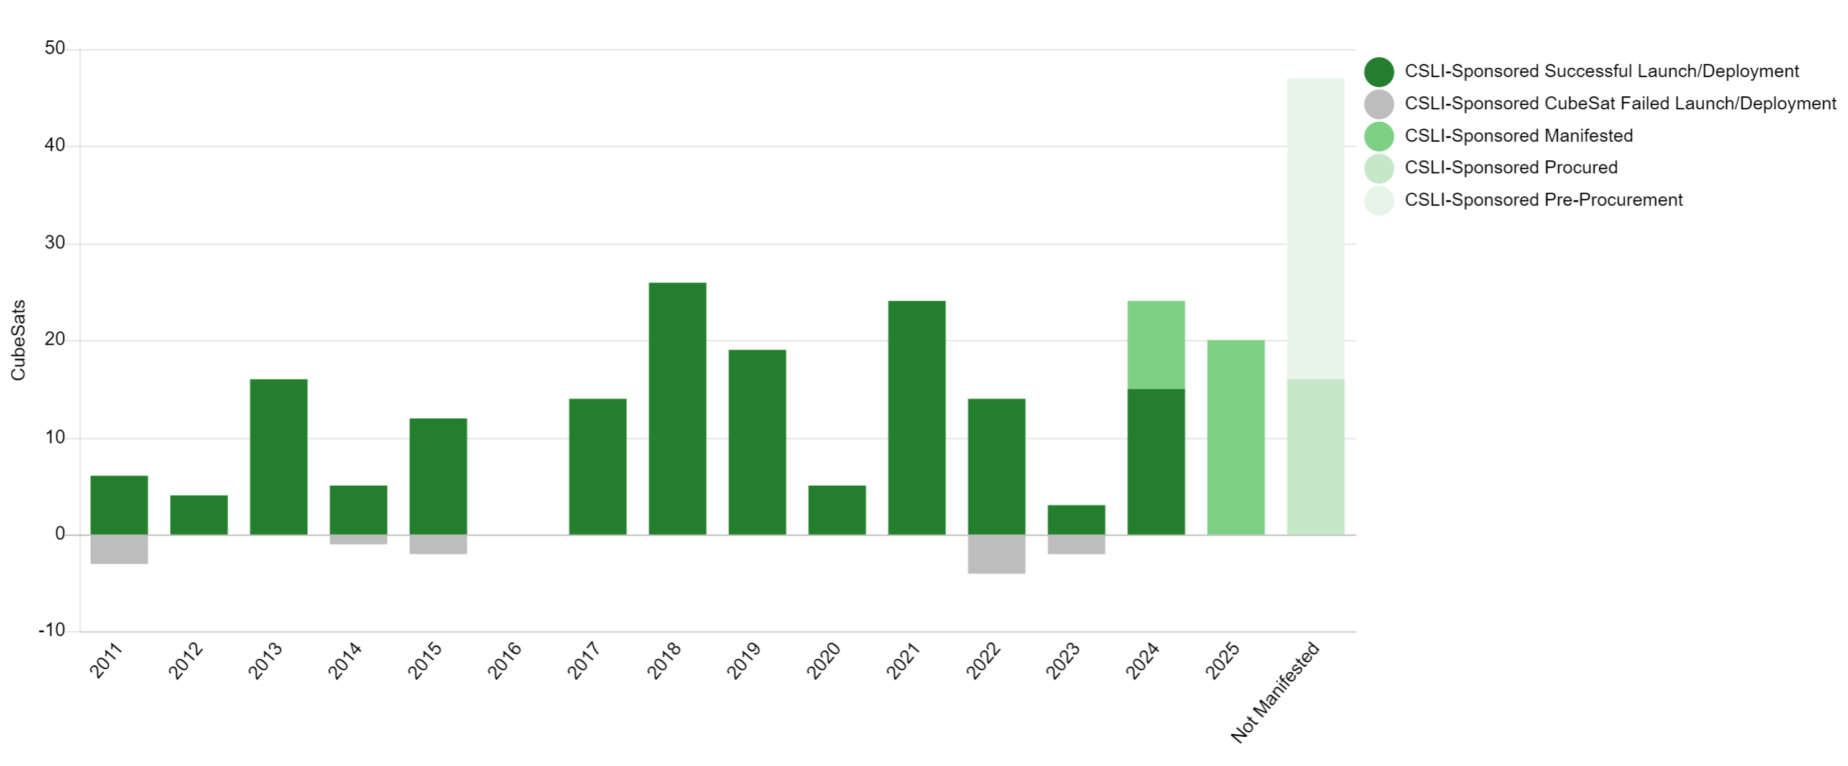
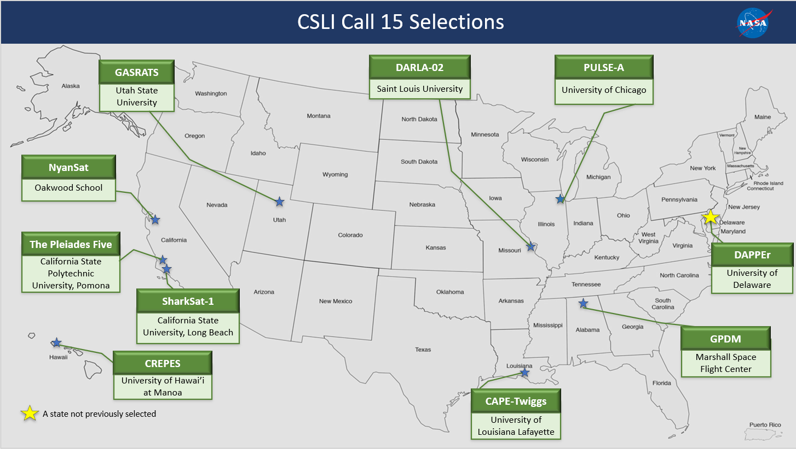
CSLI Progress
Nearly 300 CubeSat Projects from 100+ organizations selected from 42 states, Washington DC, and Puerto Rico
Successfully launched 162 CubeSats to date!
Data current as of 07/19/2024

Slide 31
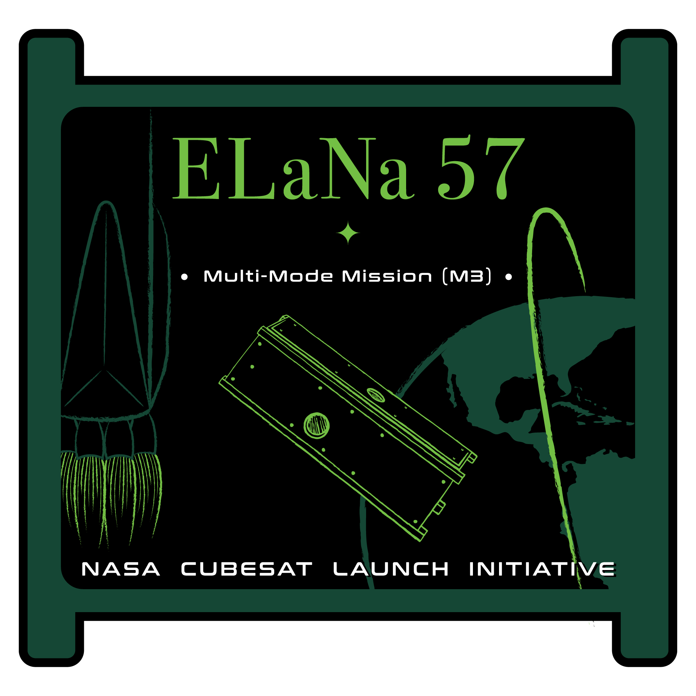
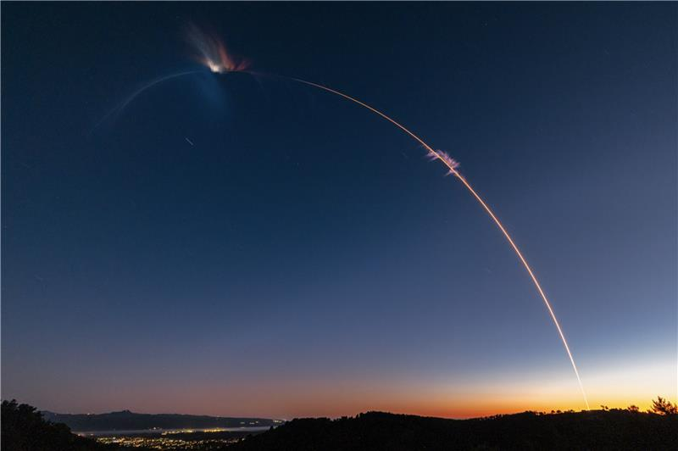
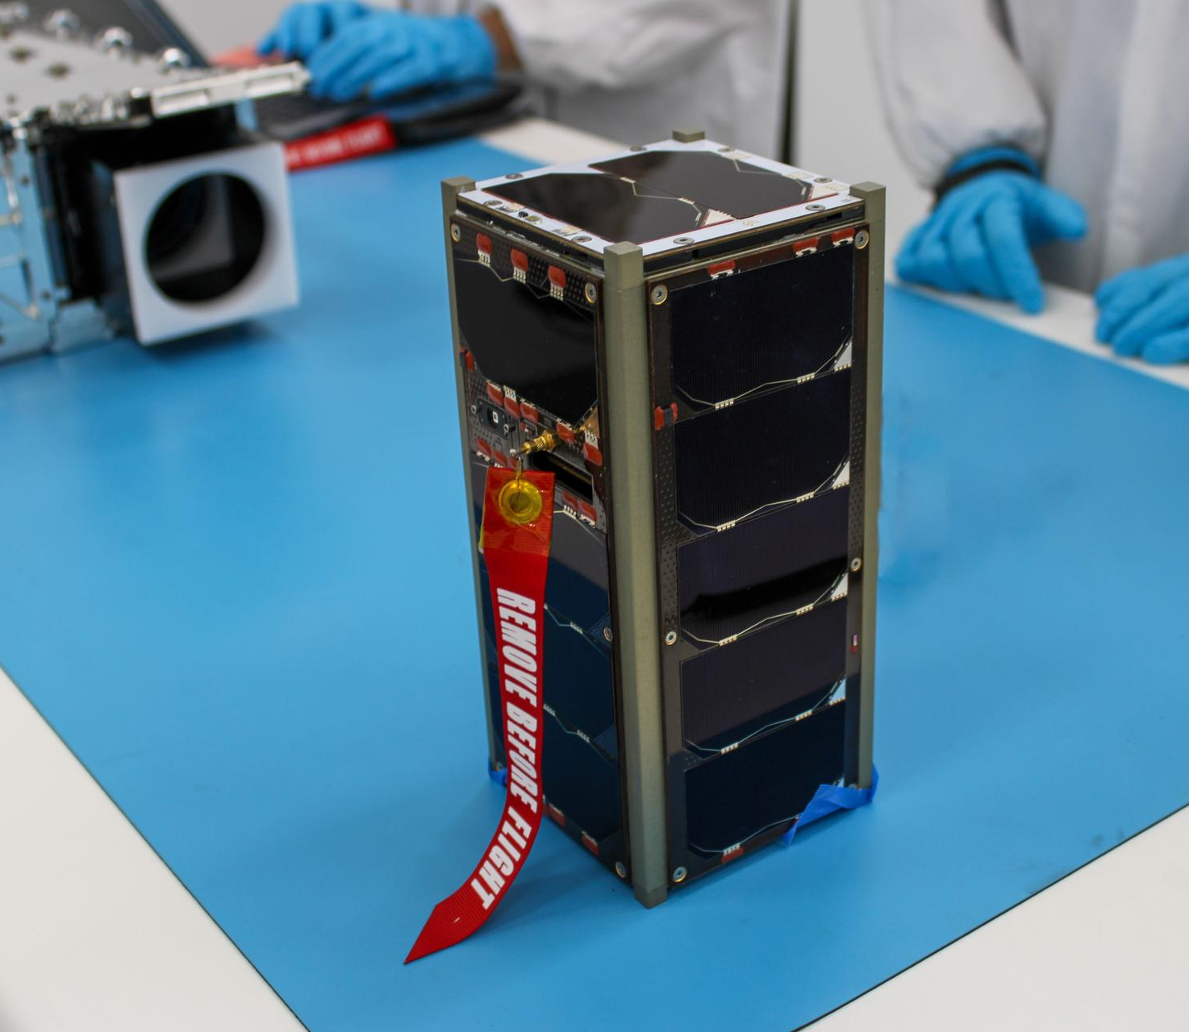
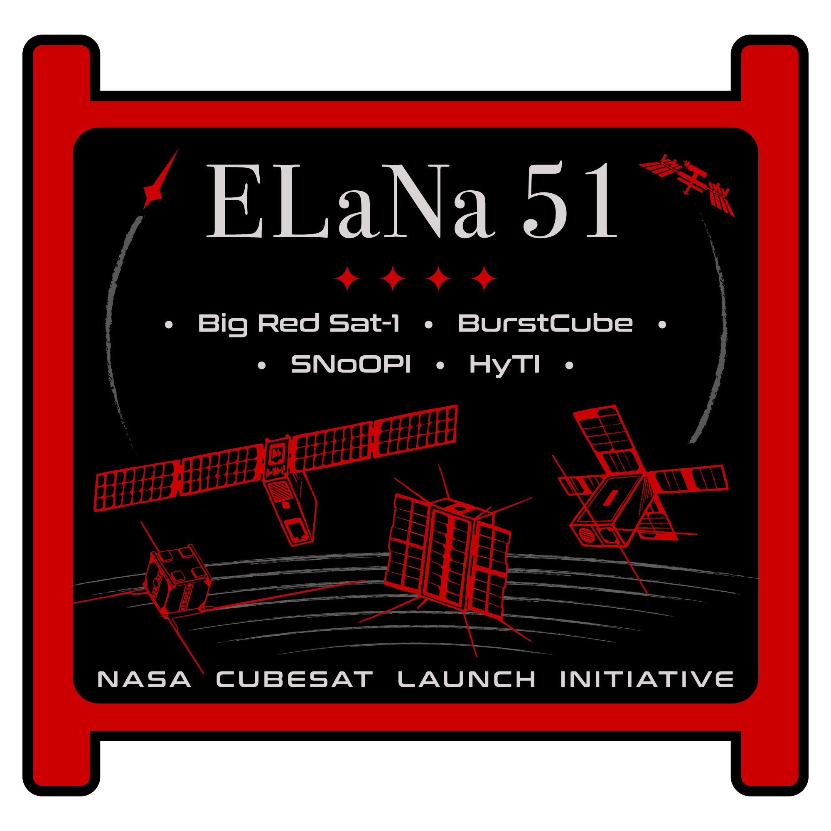
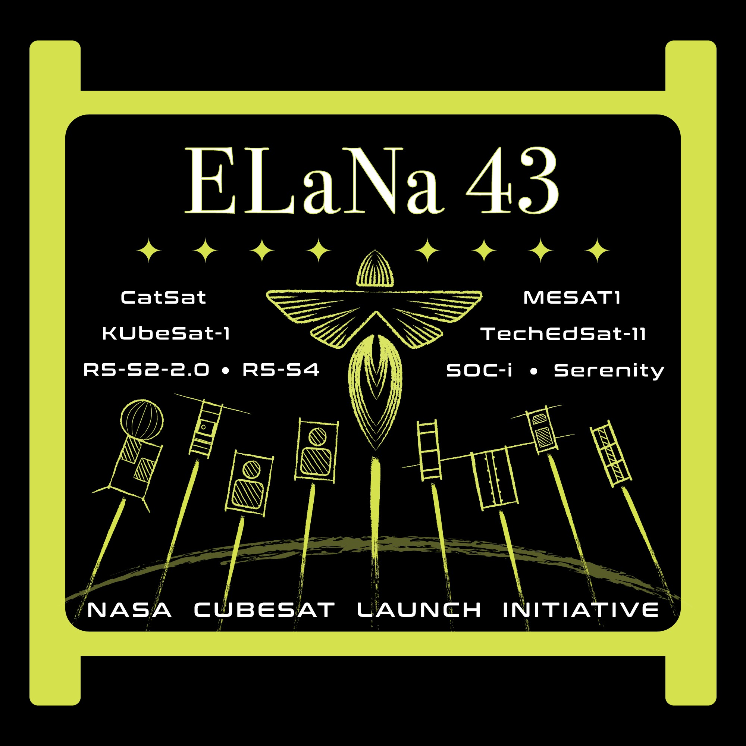
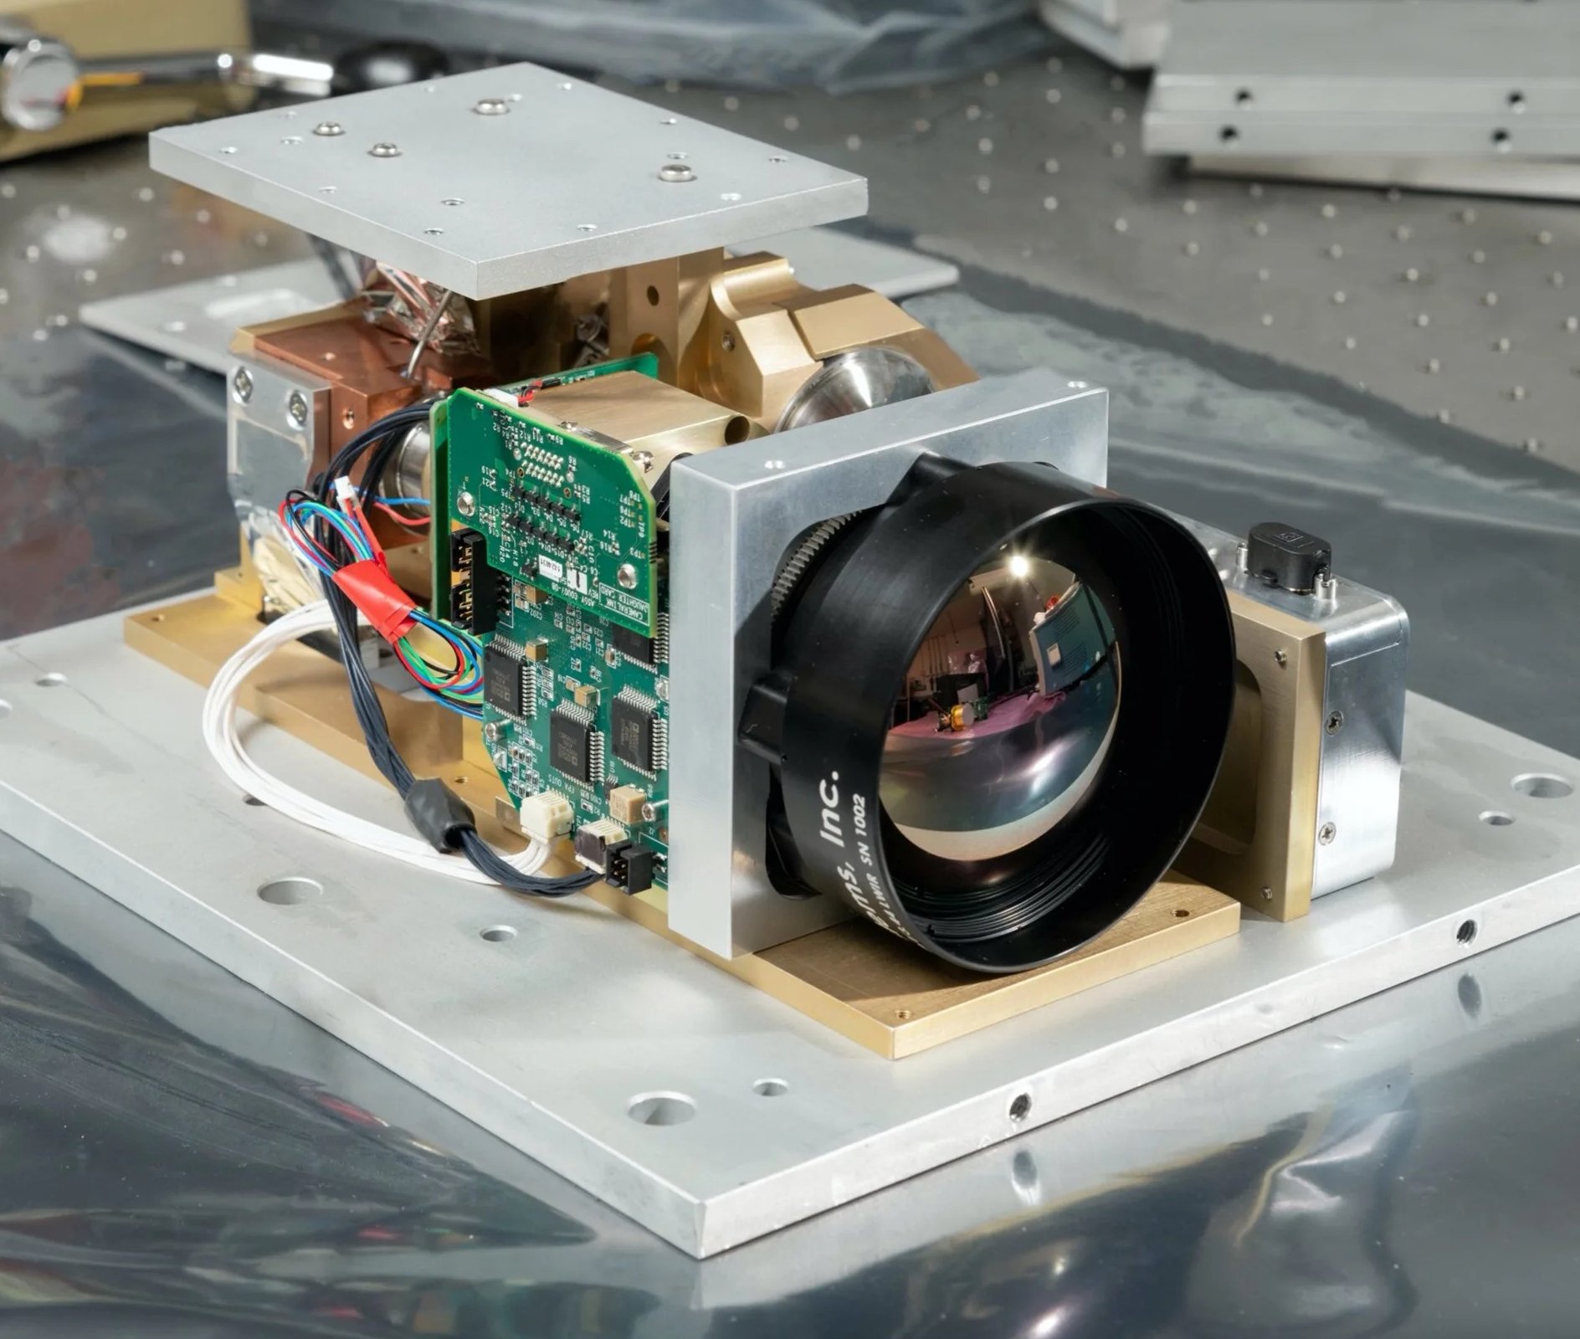
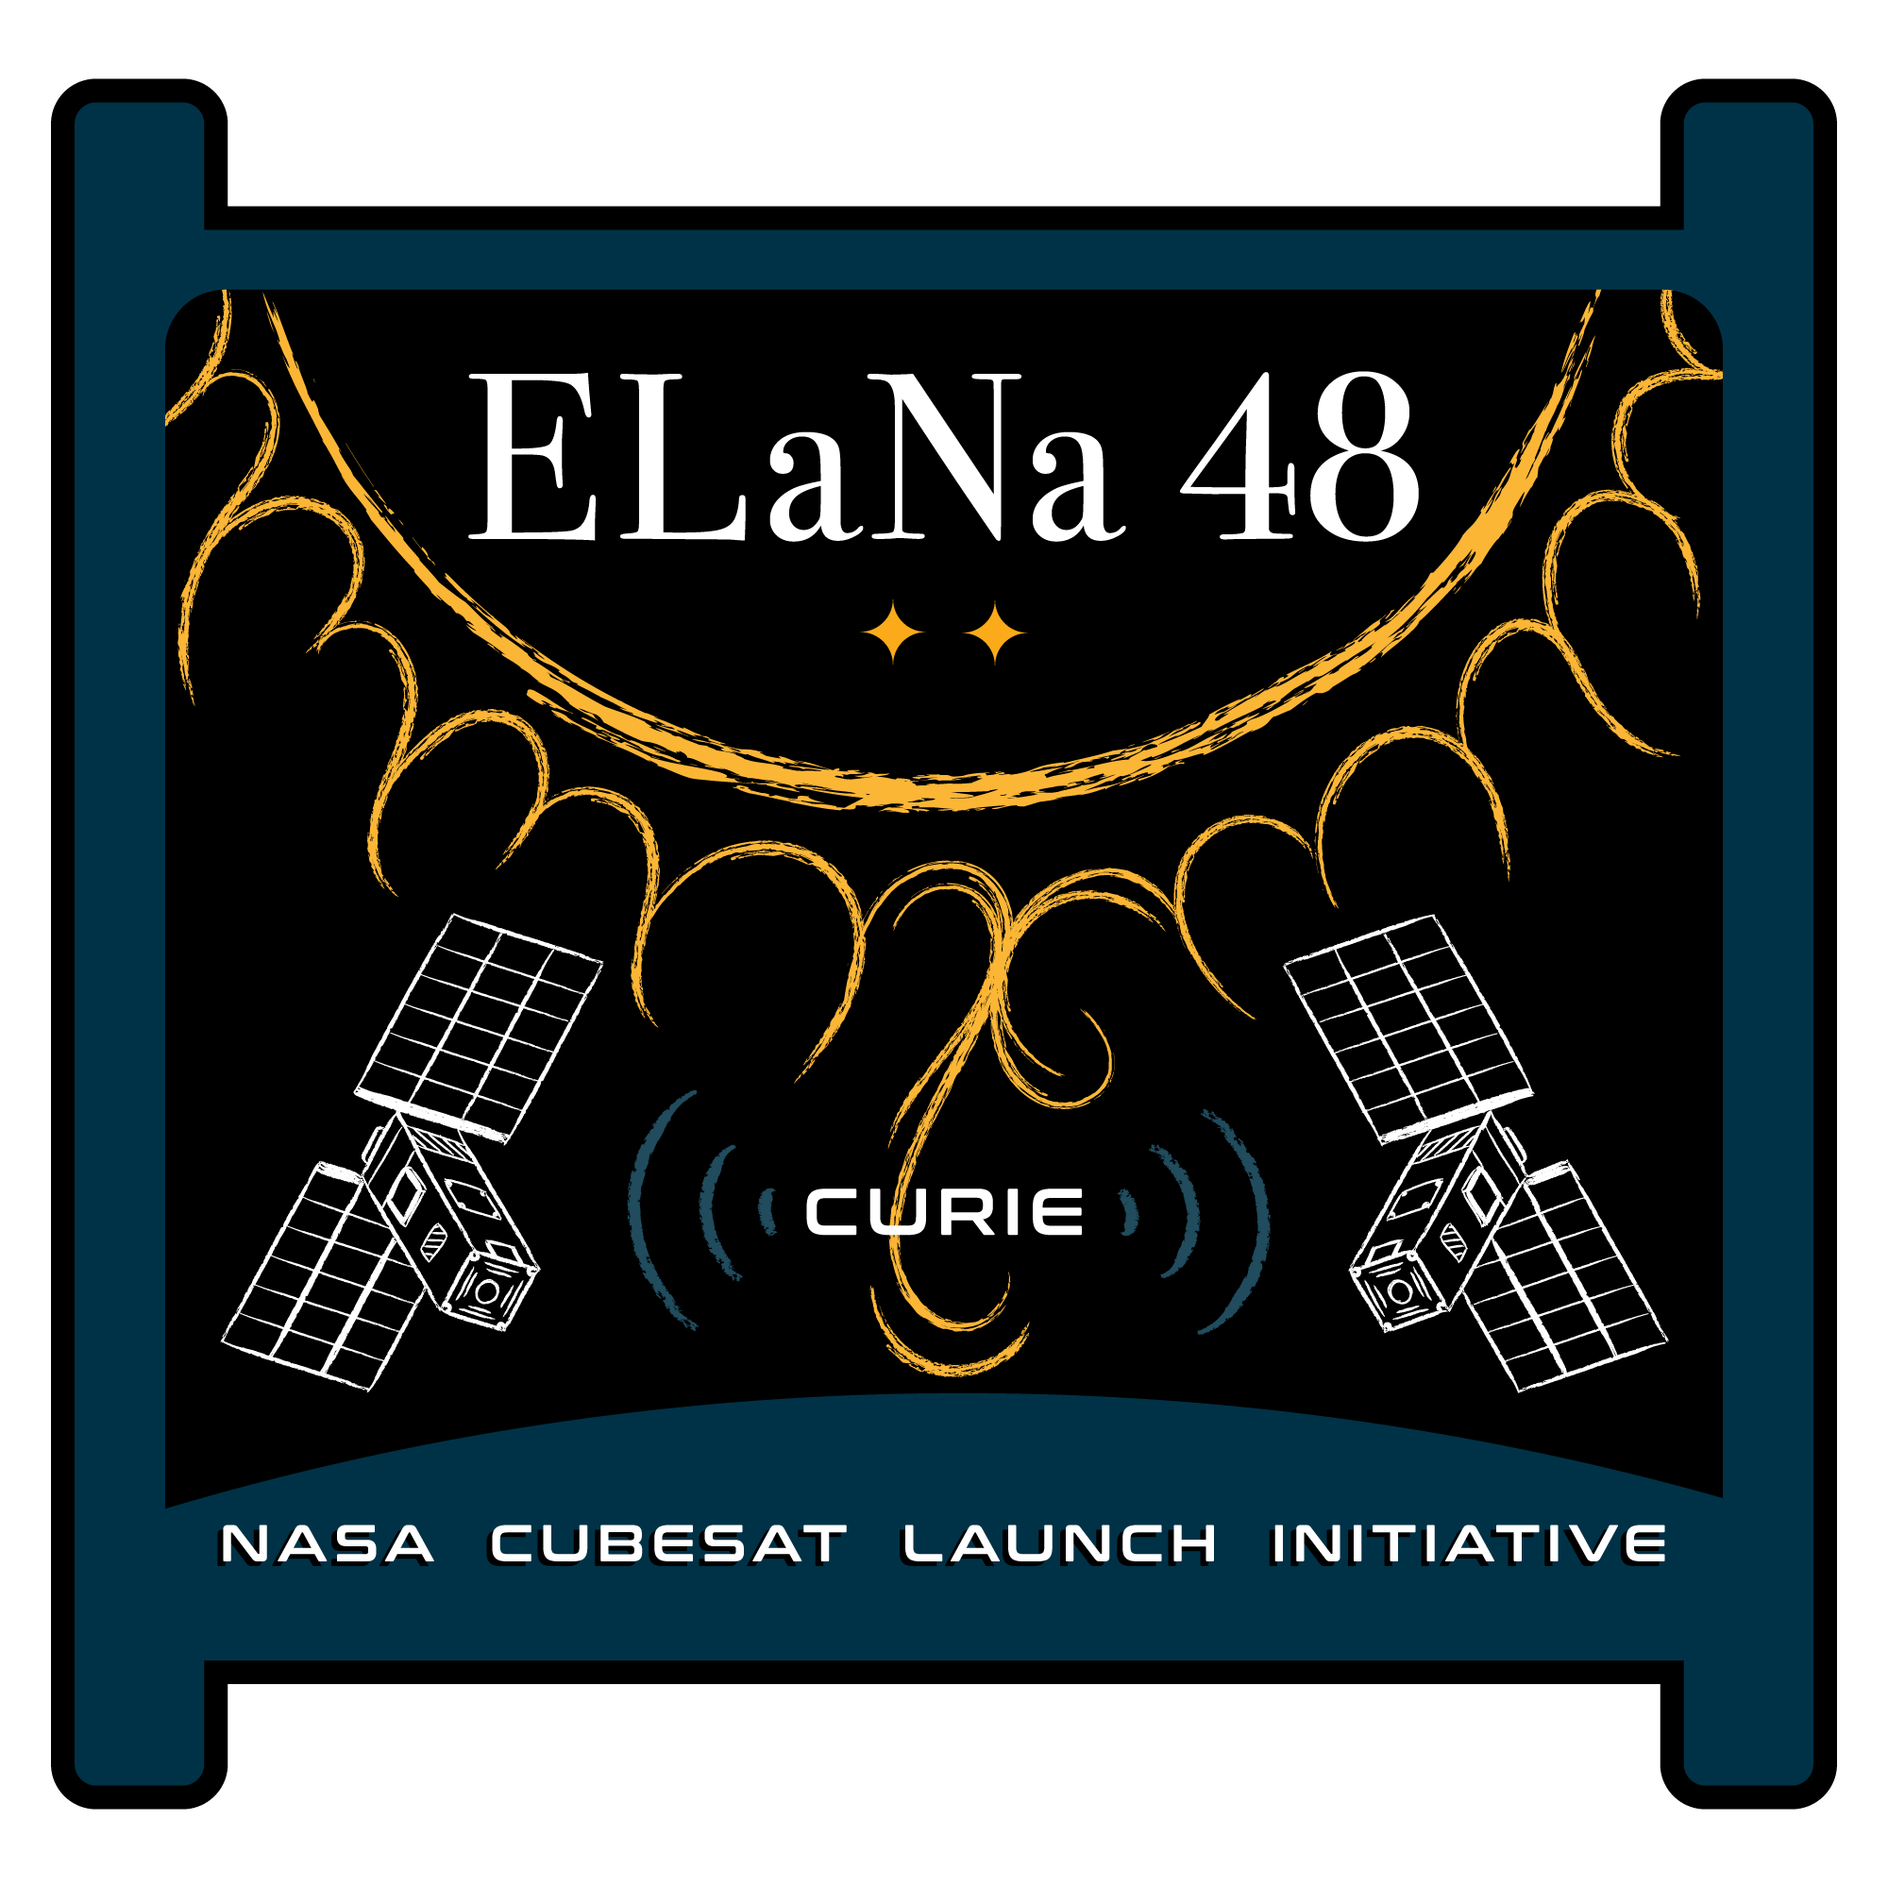
Recent CSLI Launches (2024)
ELaNa 57, Transporter 10, Falcon 9, 3/4/2024
M3, Missouri University of Science and Technology
ELaNa 51, Transporter 10, Falcon 9, 3/21/2024
Big Red Sat-1 University of Nebraska at Lincoln
BurstCube, NASA Goddard Space Flight Center
HyTI, University of Hawaii at Manoa
SNoOPI, Purdue University
ELaNa 43, VCLS Demo 2, Firefly Alpha ,7/3/2024
CatSat, University of Arizona
KUbeSat-1, University of Kansas - First from Kansas
MESAT-1, University of Maine - First From Maine
R5-S2-2.0, NASA Johnson Space Center
R5-S4, NASA Johnson Space Center
Serenity, Teachers in Space
SOC-i, University of Washington
TechEdSat-11, NASA Ames Research Center
ELaNa 48, Ariane VI First Flight, 7/9/2024
CURIE (Qty. 2), University of California at Berkely
SOC-i (ELaNa 43)
ELaNa 43 Launch
Credit: Firefly Aerospace/Trevor Mahlmann
HyTI Instrument (ELaNa 51)
CURIE (ELaNa 48)
Credit: ExoLaunch
https://www.nasa.gov/kennedy/launch-services-program/cubesat-launch-initiative/
Notes:
3 missions 14 CubeSats

Slide 32
How to join CSLI through the AoPO…
Develop your Idea/Experiment
With the assistance of a faculty advisor, professor and/or mentor, develop a scientific experiment/demonstration that is in line with NASA’s strategic goals and objectives
1
Build Your Team
If you are an educational institution, your team must be composed of students and be student run and student led. Professional and Faculty mentors are not only encouraged but required. Clearly define all roles and responsibilities and maintain redundancy for all roles
2
Secure Funding
Secure all funding required for your mission. CSLI submittals must show evidence that all funding is secured prior to submittal
3
Merit/Feasibility Reviews
Conduct a structured (if possible competitive) merit and feasibility review, with independent reviewers not affiliated with your project. List the names and qualifications of all your reviewers, record action items and how you addressed each one.
4
Apply!
Announcement of Partnership Opportunity (AOPO) is released around the first week of August every Year. Applications are due around Thanksgiving.
Follow all Directions in the Application!
5
https://www.nasa.gov/kennedy/launch-services-program/cubesat-launch-initiative/

Slide 33
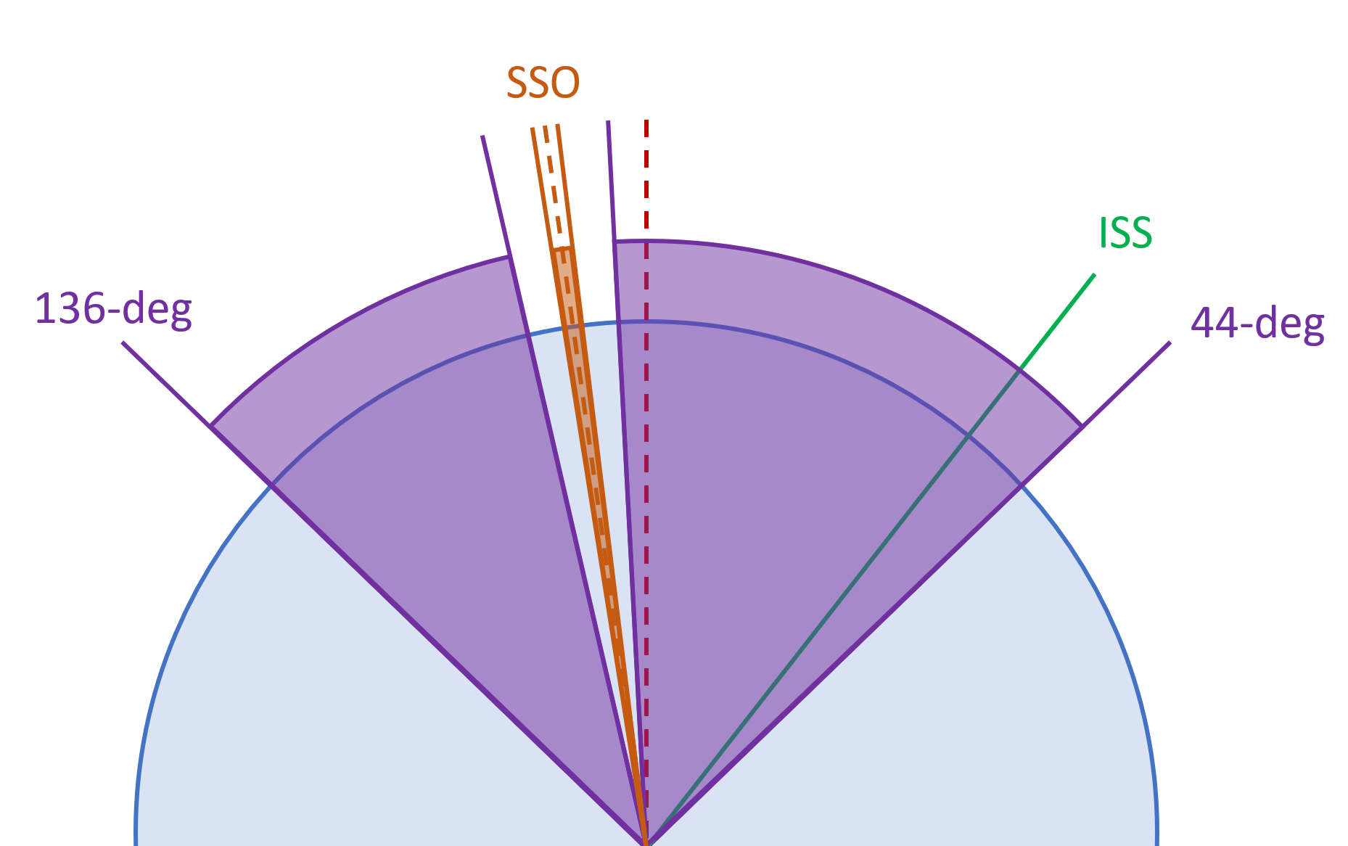
2024 AoPO Orbital Parameter Options Summary
Must be compatible with any deployment orbit within at least one of the following options.
 | 1 | 2 | 3
 | Deployment from ISS | Sun-Synchronous Orbit (SSO) | Non-SSO Orbit
Altitude* | Approximately 400 km | ≤ 650km May define a 50 km span of acceptability | ≤ 650km May define a 50 km span of acceptability
Inclination | 51.6 degrees | SSO ± 1 degree | 44 to 136 degrees, and not within 5 degrees of SSO
Mean Local Time of the Ascending Node (MLTAN) | N/A | At least 8-hour span of acceptability | N/A
* Relevant orbital debris mitigation requirements must be met (Ex., FCC’s “5-year rule” if applicable) which may reduce the acceptable altitude depending on spacecraft design.
You may request a waiver with necessity and significant value and benefit to NASA, but waiver acceptance is not guaranteed.
https://www.nasa.gov/kennedy/launch-services-program/cubesat-launch-initiative/

Slide 34
CubeSat Launch Initiative (CSLI) Contact Information
Liam Cheney
Liam.J.Cheney@nasa.gov
Mission Manager
NASA Launch Services Program
Creg Raffington
Creg.O.Raffington@nasa.gov
Mission Manager
NASA Launch Services Program
News about how to apply through the AoPO will be posted here
https://www.nasa.gov/kennedy/launch-services-program/cubesat-launch-initiative/

