Slide 1
6/4/2024
Application of Norton-Thevenin Receptance Coupling (NTRC) to Space Launch System (SLS) Payload Coupled Loads Analysis (CLA)
Austin Decker
Mike Craft
MSFC SLS Liftoff and Ascent Loads Teams

Slide 2
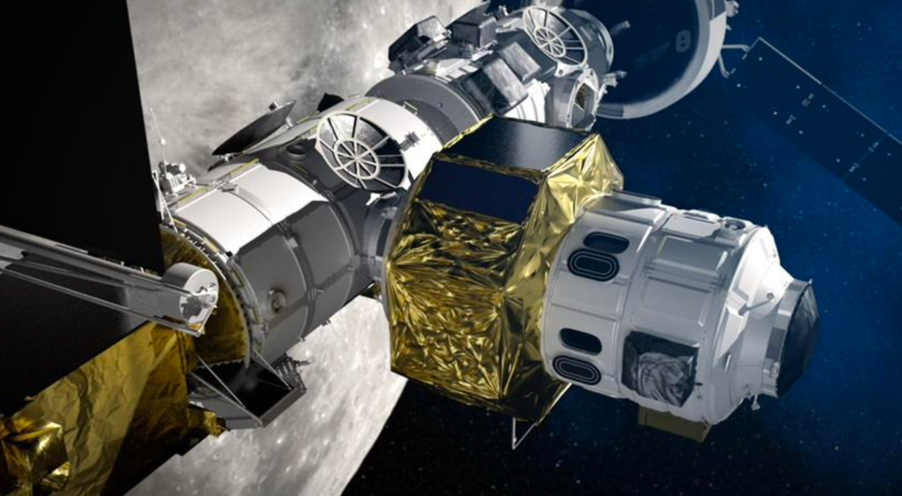
Introduction
NASA’s Space Launch System (SLS) is currently slated to deliver critical components to the lunar-orbiting Gateway space station
  International Habitation Module (I-HAB) – Habitat/logistics module with four docking ports, launched on Artemis IV
  ESPRIT Refueling Module (ERM) – Fuel storage and observation, launched on Artemis V
To date, SLS Block 1B Integrated Vehicle Coupled Loads Analysis (CLA) efforts have incorporated I-HAB as a representative co-manifested payload
  I-HAB program is more mature than ERM
Prior to the assessment described in this presentation, the SLS Mission Planner’s Guide was the only source of launch environment design loads for the ERM program
An alternate payload CLA method has been used to develop representative CLA loading environments for the ERM based on a recent SLS B1B analysis cycle
  D. Kaufman, et al, Norton-Thevenin Receptance Coupling (NTRC) Coupled Loads Analysis (CLA) Method, NASA Engineering Safety Center Technical Assessment Report, Version 1.0, June 2018.
  Goals:
    Provide PDR fidelity loads to supplement the initial sizing loads in
    the Mission Planner’s Guide
    To complete the ERM assessment using a small fraction
    of the effort and resources typically used in a CLA
This presentation describes implementation of
NTRC for assessment of the ERM
  Overview of the NTRC methodology
  Verification methods
  Comparison of I-HAB and ERM responses
  Significant findings
Image of ERM attached to Lunar Gateway
https://www.esa.int/Science_Exploration/Human_and_Robotic_Exploration/Gateway_ESPRIT

Slide 3
Why NTRC?
Currently, SLS provides initial sizing environments in the SLS Mission Planner’s Guide (MPG), ESD 30000, which is publicly available
  Suitable for SRR phase development of payloads
SLS Loads, Dynamics, and Integrated Design (LDI) has supported I-HAB by incorporating it into planned integrated vehicle CLA cycles
  This delivers a high maturity product with more detailed deliveries, sufficient to support all reviews
However, demand from additional SLS payloads has required a different approach
  Timing of payload requests does not match planned SLS CLA cycles
  An intermediate approach to provide PDR-fidelity or higher results without requiring additional integrated vehicle CLAs is required to support payloads within current LDI resource constraints
NTRC allows a reference set of forcing functions to be developed from a baseline SLS CLA and applied to any co-manifested payload needing results
Results from NTRC with IHAB indicate that the method produces a good match to traditional integrated vehicle CLA results
ERM results completed with the recommended coverage factors
  Results delivered to ESA

Slide 4
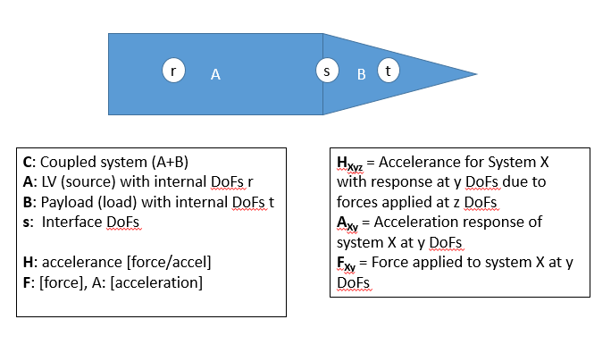


A Synopsis of the NTRC Method*
NTRC Nomenclature
Coupled system partitioned into LV free dof (r), payload free dof (t), and interface dof (s):
Eq [1]
Frequency domain representation of a ‘classical’ base drive:
Eq [3]
Norton-Thevenin approximation of relationship between coupled system acceleration at i/f and LV-only acceleration at i/f:
Eq [4]
A frequency domain representation of Newton’s 2nd Law of Motion:
Substituting [4] into [3] yields effective coupled system response of payload free dof:
Eq [5]
$$A(ω)=H\left(ω\right)F\left(ω\right)$$
where:
Eqs [4] and [5] generate total acceleration response of payload
$$H(ω)=\left[\frac{{−ω}^{2}}{−Mω^{2}+ Ciω+K}\right]$$
Accelerance
NTRC in Practice
Requires a full CLA assessment using a ‘no payload’ version of the launch vehicle
Necessary to diagonalize state matrices using assumed modes
NTRC damping term will result in slightly different results compared with CLA
*From TI-15-01093 Norton Thevenin Receptance Coupling
(NTRC) Coupled Loads Analysis Method,
pages 16 and 17

Slide 5
SLS Coupled Loads Analysis
The SLS CLA process involves the development of loads that represent the required enclosure level for potential loading environments in each analysis cycle
For early payload analyses, the liftoff and ascent regimes are most important
  Liftoff Event
    Buildup and Ignition 5000 case Monte Carlo assessment
    Encompasses Buildup, Ignition, and Shutdown
      Shutdown not used in this study
  Ascent Event
    Vehicle mission is decomposed into specified Mach ranges, or bins
    Loading events (buffet, gust, maneuvering, etc.) that occur during a bin are evaluated independently and uncertainty factors are applied to results
    Most significant loads occur during ‘boost phase’ (first stage) flight
    Ascent event loads combined into a single response via a Load Combination Equation
Only the Liftoff and Ascent Boost events were evaluated for the ERM NTRC analysis
Quasi-Static
NTRC

Slide 6
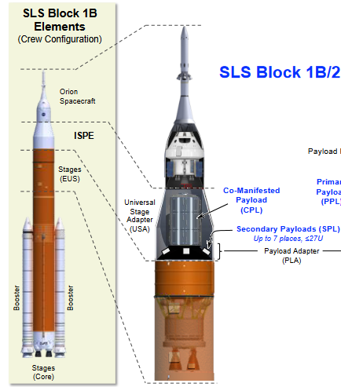
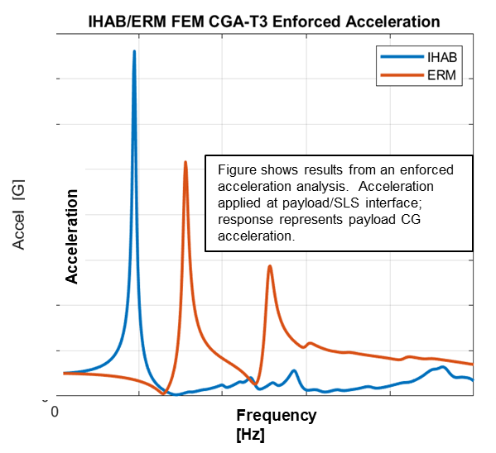
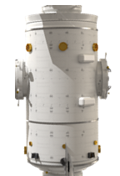
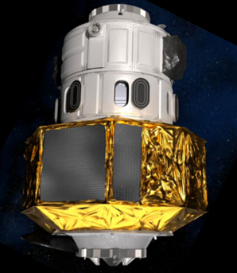
SLS B1B, IHAB, and ERM Finite Element Models
A series of SLS FEMs are provided for each loads analysis cycle
  Represent vehicle at different mission times
  Baseline SLS B1B CLA delivery consisted of 20+ models
    Generally 10000+ DOF
    Coupled damping
    Included IHAB as co-manifested payload
  NTRC required 13 additional SLS B1B models (no payload, interface grids in boundary)
    Liftoff and Ascent Boost models only
Payload models
  I-HAB model
    100+ boundary grids representing IHAB geometry and interfaces
    24 boundary grids at SLS PLA attach ring
  ERM model
    Pre-PDR maturity
    Composed of two major substructures: Windows & Tunnel (WIT) and Unpressurized Module and Xenon Transfer (UMAXT)
    1 boundary grid, thousands of modal DOF
  While the IHAB and ERM have similar size and mass, their dynamic characteristics differ
SLS Block 1B with Payload
From SLS Mission Planner’s Guide, Figure 6-4
I-HAB
ERM
WIT
UMAXT
https://www.esa.int/ESA_Multimedia/Images/2021/01/Gateway_zoom_on_I-Hab
https://www.esa.int/Science_Exploration/Human_and_Robotic_Exploration/Gateway_ESPRIT

Slide 7
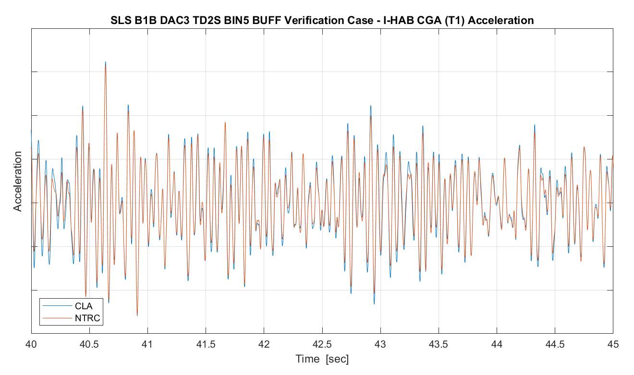
Verification of NTRC with I-HAB
An example of the SLS implementation of the NTRC method is a comparison to the I-HAB B1B CLA buffet assessment
  Mach Bin 5 FFN as test case, T05 – T55 sec
  ‘Truth’ is B1B full CLA results for I-HAB
  Base drive state made with B1B SLS NTRC model (no payload)
  Assessment is NTRC using I-HAB payload, damping schedule same as coupled vehicle, 500 Hz resolution of time domain results
  No adjustments to applied buffet load
Three simulations were made for assessment purposes
  Run 1 – time domain solution of coupled SLS/I-HAB system
  Run 2 – time domain solution of SLS, no payload
  Run 3 – NTRC base drive of I-HAB using results from [2]
  Figure shows comparison of Run 1 results to Run 3 results
Results comparison used IHAB LTMs
  CG Acceleration (CGA) shown
Results are generally as expected
  Trends from NTRC are a good match with SLS integrated vehicle CLA
  Coverage factor developed to envelope CLA results
Example Max
I-HAB Buffet Example CGA ABS MAX Comparison
Note - table displays results normalized to largest parameter.

Slide 8
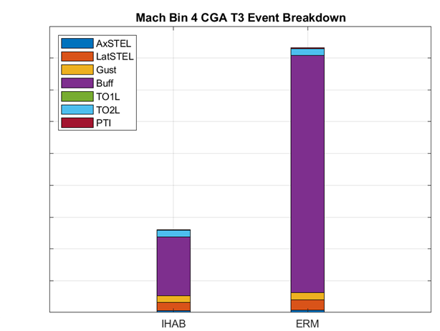
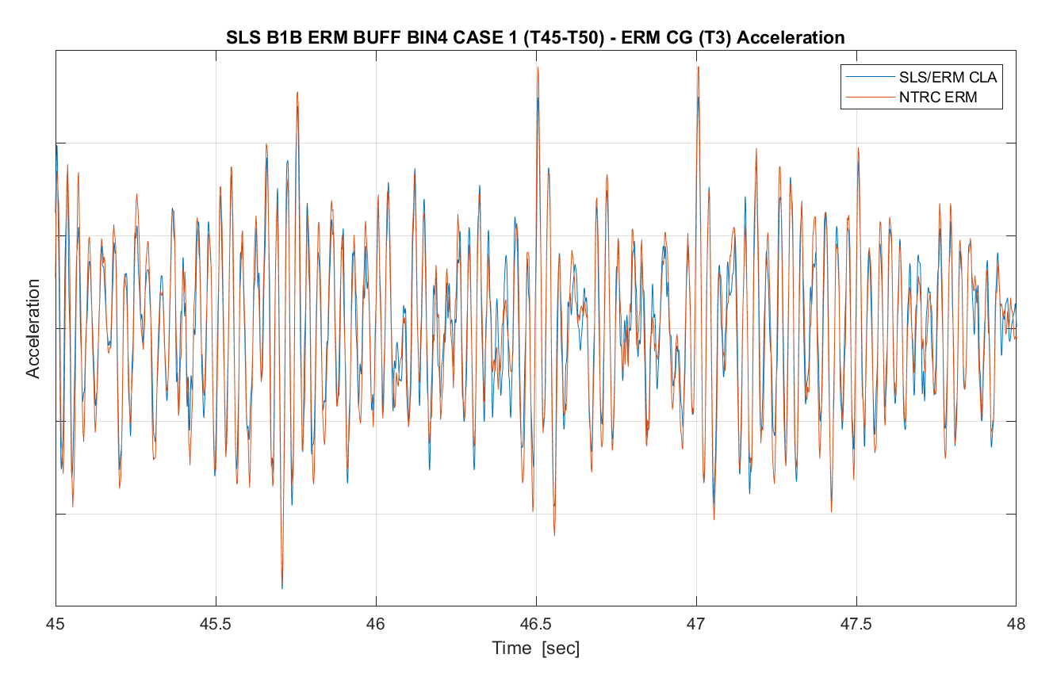
SLS B1B/ERM NTRC CLA Initial Analysis Results Synopsis
NTRC SLS/ERM assessment completed in May 2023
  Max/min responses for ACC, CGA, DSP, FRC, and IFF output transformation matrices (OTMs) provided to ESA/TAS-F
Prior to analysis, expectations were that ERM launch loads would be generally similar to I-HAB launch loads
Analysis results showed the ERM experiencing unexpectedly high lateral loads during the first transonic Mach bin
Peak lateral ERM CG acceleration occurred during ascent in early transonic flight
  Upper left bar graph shows a comparison of I-HAB and ERM early transonic CGA responses and their relative contributing events
  Primary contributing event is buffet
NTRC buffet verified with traditional CLA
  Coupled SLS/ERM CLA FEMs were used for spot checks of buffet results
  NTRC correctly predicted CLA responses

Slide 9
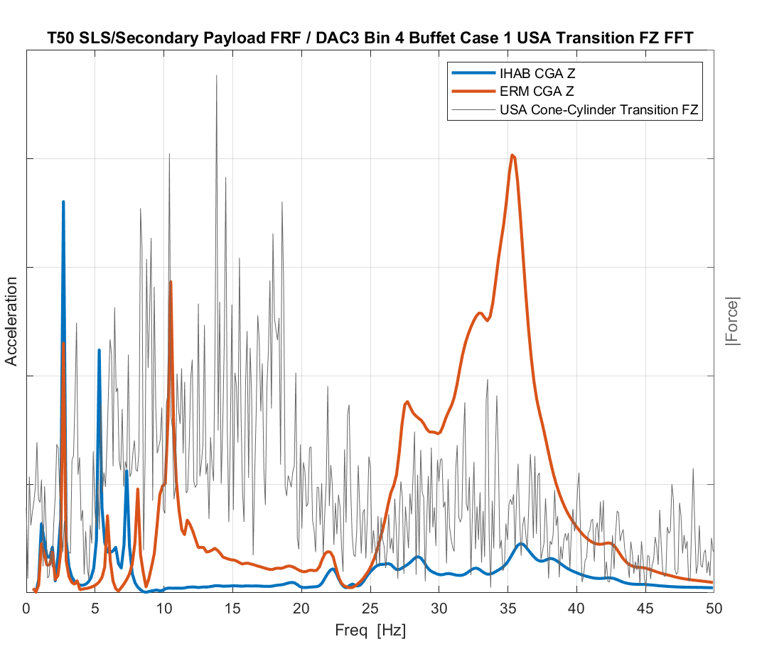
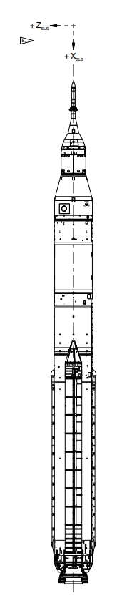
SLS B1B/ERM NTRC CLA Initial Results Assessment
A comparison of the co-manifested payload dynamics to an applied buffet force in the frequency domain provides an explanation for the ERM’s higher responses
  Blue, red curves show frequency response function (FRF) results of the SLS B1B T50 / I-HAB and ERM structures, respectively
    FRF input is a distributed FZ load at the SLS centerline aero grids
    FRF output is the secondary payload (I-HAB, ERM) CG acceleration
  Gray curve represents the FFT magnitude of the FZ buffet force applied to the USA Cone/Cylinder transition from the Mach 0.7/alpha=0/beta=0 buffet case
The SLS/ERM model is more reactive to forces with higher frequency content
  Particularly sensitive to loads at USA Cone/Cylinder Transition
Response change found to be due to differences between the I-HAB and ERM, not the NTRC vs. standard CLA
Payload
USA Cone/Cylinder Transition

Slide 10
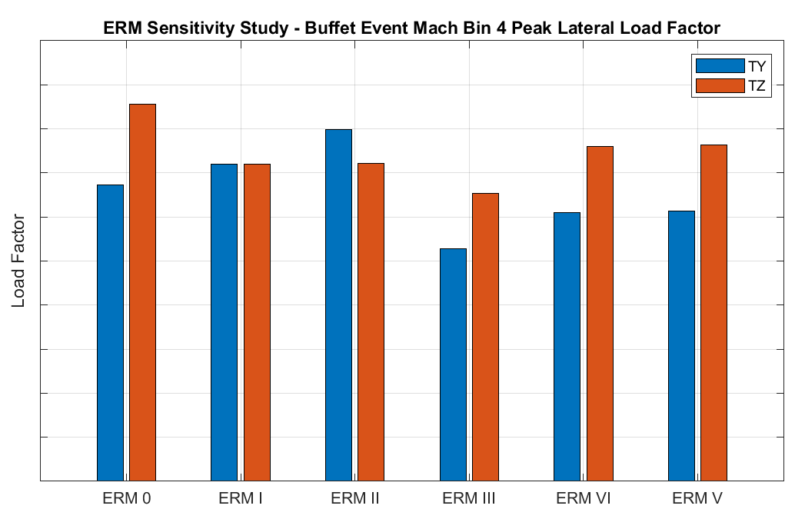

SLS B1B/ERM NTRC Sensitivity Study
ERM is currently in a design refinement process. As part of that process, ESA/TAS-F provided MSFC with five (5) simplified ERM finite element models (FEMs) to perform a launch load sensitivity study
Due to time and resource constraints, only a buffet assessment was conducted for each of the five ERM variant models
Without the NTRC process, the sensitivity study would have been infeasible given SLS resource limitations
Equivalent lateral load factors were developed using buffet event results
  Assuming the ERM is constrained at the payload attach ring, the load factor
  represents the equivalent lateral static load applied to the ERM CG required to
  represent the peak base bending moment
The plot shows a comparison of the maximum equivalent quasi-static
load factors for Mach Bin 4
  Each ERM SS model variant (I-V) yields similar or lower load factors compared to
  the original ERM model (ERM 0)
  Variant with lowest response buffet is ERM III
$$LF=\frac{M_{base}}{mass∗L_{base}^{cg}∗G}$$

Slide 11
Summary
The SLS coupled loads team needed a payload CLA tool to enable support of multiple co-manifested payloads for the B1B SLS vehicle
Using the Kaufman et. al paper methodology, the SLS team developed an NTRC-based tool to meet this need
Benchmarking with the I-HAB results from a standard SLS CLA indicated that the NTRC implementation provided loads comparable to a full CLA
The NTRC process was successfully used to provide a set of refined early design loads for ERM spacecraft payloads for the SLS B1B liftoff and boost phase ascent environments
  Once baseline forcing functions and accelerance matrices were developed, evaluation took far less time than a typical SLS CLA
  Analyses for future payloads can be performed quickly using the baseline NTRC model and forcing function database
Initial SLS/ERM results yielded higher-than-expected responses
  Expected ERM launch loads to be similar to I-HAB loads
  Primary loads contributor was transonic buffet
  NTRC ERM response verified using traditional CLA simulation
  Difference in results due to I-HAB and ERM model differences, not NTRC vs. traditional CLA
Based on the initial analysis results, a sensitivity study was conducted using NTRC to develop SLS/ERM coupled loads for buffet events
  Evaluated the responses of five candidate ERM models to buffet loads

