Slide 1
Fostering Open Science in Earth Data Science Research: Insights from Earthdata Forum by ASDC
Hazem Mahmoud, Ph.D.
ASDC DAAC Scientist
Notes:
STILL

Slide 2
EOSDIS Overview
ASDC Overview
ESD Vision
TOPS
Earth Data Forum
Questions

Slide 3
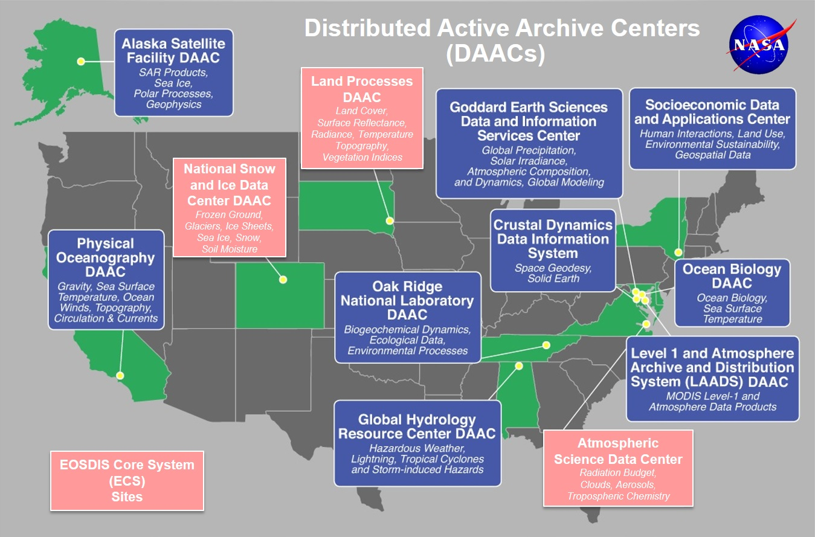
Earth Observation System Data and Information System EOSDIS
EOSDIS data centers process, archive, and distribute thousands of data products to the global user community. The primary services provided by EOSDIS are data archive & management, distribution, information management, product generation, and user support. It is comprised of multiple components including:
Distributed Active Archive Centers (DAACs)
Science Data Processing Segment (SDPS)
Science Investigator-led Processing Systems (SIPS)
Common Metadata Repository (CMR)
Earthdata
Global Imagery Browse Services (GIBS)
more
Notes:
We support TEMPO because we are part of EOSDIS Earth Observation System Data and Information System and it is the NASA’s infrastructure for all data archiving and distribution. We process, we archive and we distribute thousands of data products to the global user community and we provide use support services. We offer benefits to the science teams such as support to the metadata development, metrics and tracking. Add the data to distribution applications. In the core of ESDIS system is the (DAACS) or Distributed Active archive centers. There are 12 DAACs distributed across the country, each is focusing in a science domain and you can see where they are here on the map. Other elements are science data processing segments. CMR is high performance metadata database that carries data from DAACs for search and discovery for any NASA archived datasets. It can be accessed by public api or EDS. Also, NASA Worldview and GIBS

Slide 4

ASDC Vision
"To be a leading provider of atmospheric science data products and services to the science community through agility, innovation, and technical excellence“

Slide 5
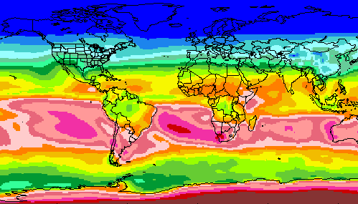
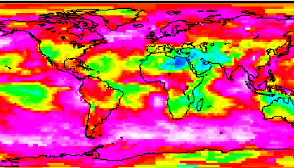
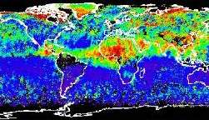
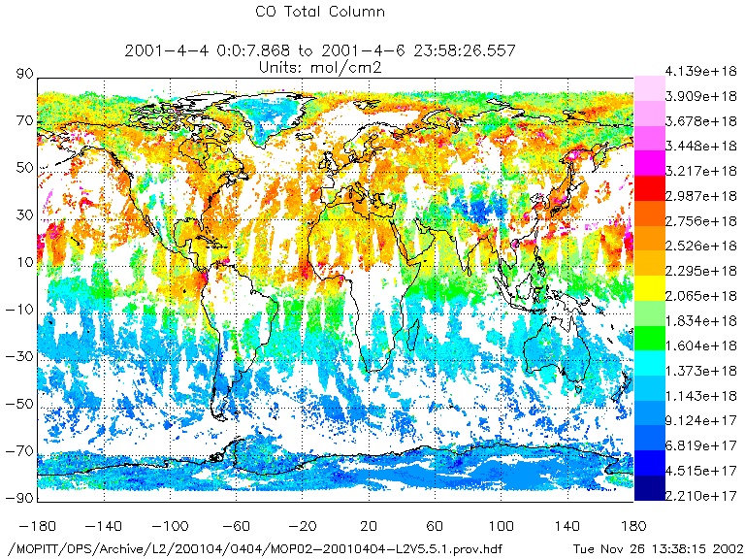
RADIATION BUDGET
CLOUDS
ASDC at a glance
100+ Science projects
  ⚬ TEMPO ⚬ MISR ⚬ MOPITT ⚬ MAIA ⚬ CERES
  ⚬ CALIPSO → RSIG (EPA)
  ⚬ Airborne field campaigns
  (KORUS AQ, DISCOVER AQ, FIREX AQ)
1300+ unique science products
Data usage
  ⚬ 4,600+ Terabytes ⚬ 160,000+ users
  ⚬ 158 countries
Data archive
  ⚬ 5.8 Petabytes ⚬ 141 million files (4,400 TB) on high-speed disks
Data in cloud (ongoing)
  ⚬ Data and services in the cloud
  ⚬ Scalable infrastructure
AEROSOLS
TROPOSPHERIC COMPOSITION
Primary Functions of ASDC
Ingest receive data from data provider
Archive preservation & provenance
Distribute tools and services
Process create higher level products
Outreach & Support research community

Slide 6
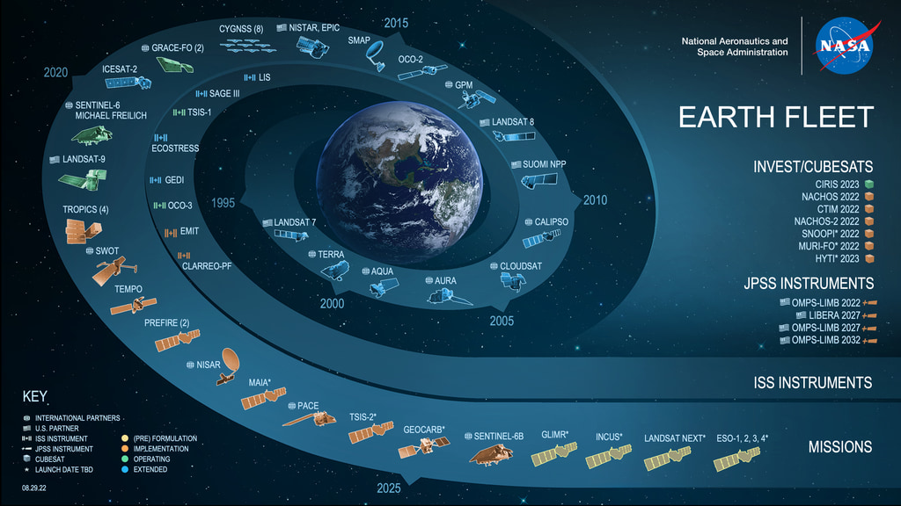
Notes:
Earth Science Satellite constellation which is the bread and butter of what we are working here so currently they offered 20 satellite and sensor in NASA’s earth science constellation continuedly monitoring weather climate and environment for research and application purposes. This constellation include several sensors onboard the continuously crude international space station. When you are looking at this chart, All the satellites in the cooler colors. The greens and the blues are the satellites that we are currently have operating on orbit. The ons that are in the warmer colors, the oranges and the yellows are the one we are planning to launch from now till the end of the decade because currently this is the largest civilian Earth Observing Satellite constellation that the world has ever known.
An investment by year of the US government 2 Billion US Dollars with a B. So we want to make sure that we make the maximum use of this huge investment back to our home.
This huge constellation won’t be possible with working alone. We must work as a team to success as a team. NASA is working with international partners. Other US government agencies and National Universities and Research Centers.

Slide 7



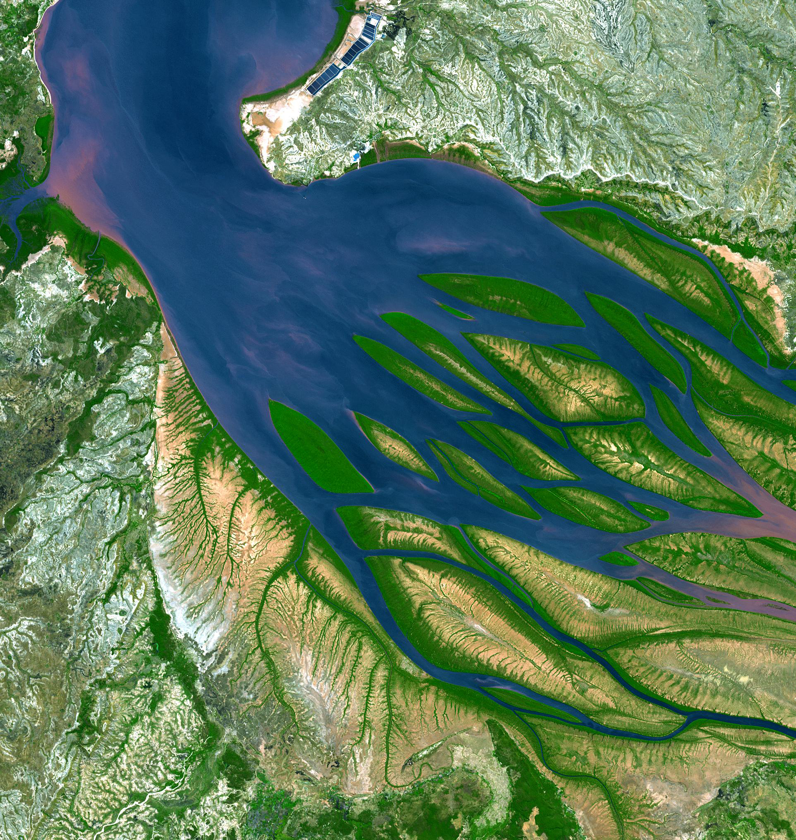
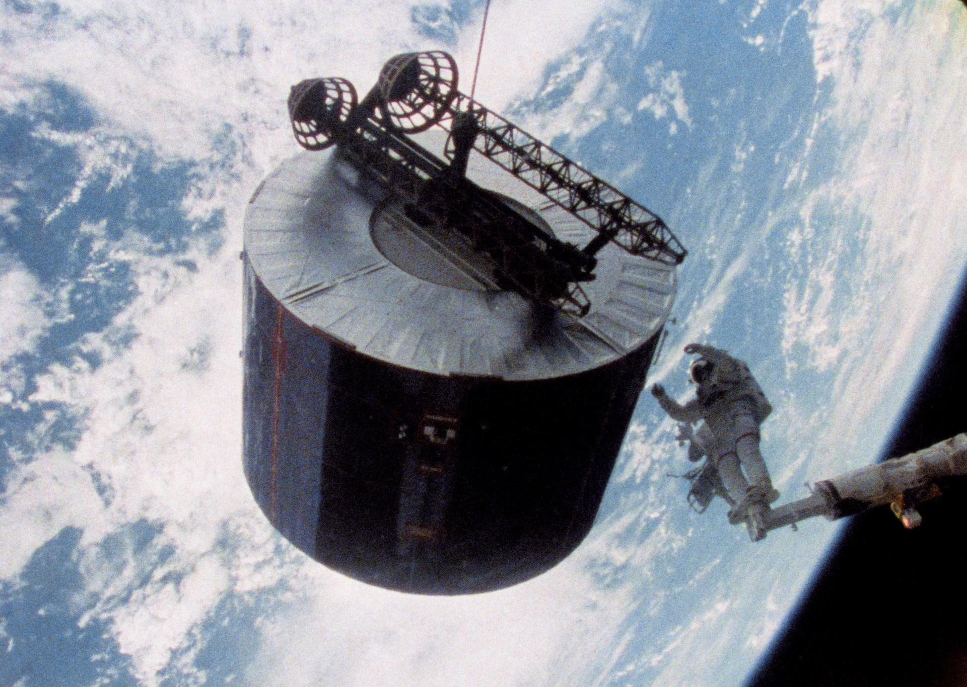
Earth Science to Action Strategy
Public Understanding & Exchange
Solutions & Societal Value
Earth System Science & Applied Research
Foundational Knowledge, Technology,
Missions, & Data
06.27.23
Notes:
Base layer: foundational knowledge, technology, missions & data. Includes building models. (Knowing)
2nd layer: Earth system science and applied research. Includes improving models (Learning)
3rd layer: Solutions & Societal Value Includes using models (Doing)
Top layer: Public understanding & exchange (Teaching)
One of the Changes that has Happened in the last few years is the vision of the Director of NASA Earth Science Division Dr. Karen St German. She has sled an effort in the past few years to Pivot NASA’s Earth Science strategy to be more focused on earth action, solutions and Outcomes. In fact in this strategy which is called Earth Science to Action.
This strategy starts at the bottom of this pyramid . With foundation knowledge, technology, Mission and Data.
The next part is Earth system science and applied research from Airborne Ground and Satellite to grow scientific understanding of Earth;s system and use predictive models and applications and tools for use in mitigating adapting and response to climate change
The following piece of the puzzle here is solutions and societal value by offer info through open science , support operational climate services and provide applications and tools to inform decisions like NRT
The spere on the top is the capstone of the pyramid is getting this information to the public by engaging broader audiences and data users to put this understanding the public sphere. Deliver applied science to users. Participate in multi-way info exchange. Use input to inform subsequent work and we need to bring this information back to the foundation to enhance our earth science/data for future planning of the next decade and to meet user needs and meet the challenges that we are facing globally including the climate crises.
We want to make an example of Earth Action

Slide 8
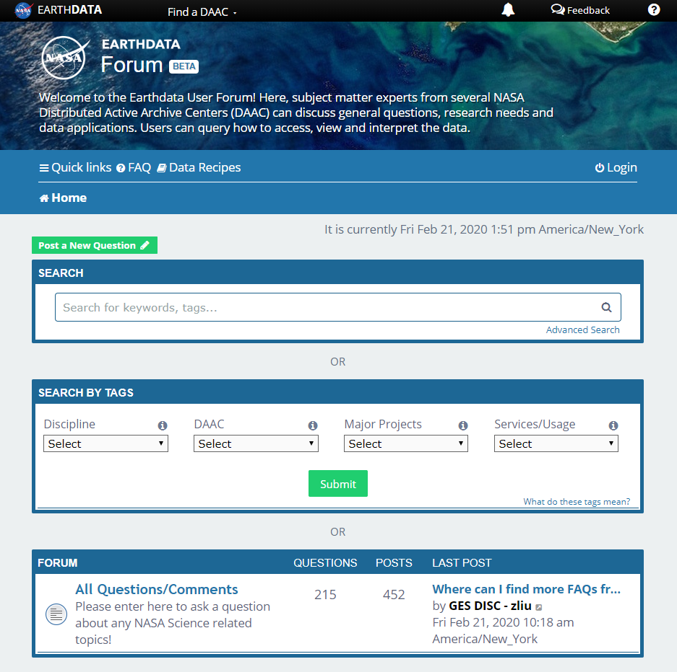
Earthdata Forum
Science Data Users can seamlessly search for information even if they do not know which DAAC the data belongs to.
Scientists & Data Providers can effectively assist their user community in more accurately using their products.
DAACs & Subject Matter Experts (SMEs) can quickly link users to existing resources.
DAAC User Services can swiftly provide inquirers with an authoritative source related to DAAC data products & services.
https://forum.earthdata.nasa.gov/
Notes:
The Earthdata Forum is our new online resource for staff members and subject matter experts from several NASA Distributed Active Archive Centers (DAACs) assist inquirers with questions about their NASA Earth science data. General questions, research needs, and data applications can all be subjects here. Members of the NASA scientific user community are encouraged also provide insights and collaborative assistance.​
The
Forum serves as a cross-DAAC platform from which user communities can obtain
authoritative information relating to NASA Earth Science.

Slide 9
Earthdata FORUM Users by Country
Notes:
The Earthdata Forum saw a total of 46,922 users this reporting period, an increase
of 21,455 users, which accounts for both new and registered users. The total
distribution of Earthdata Forum users are shown in Fig. 1 and list the top 10
countries. The vast majority of Earthdata Forum users are from within the United
States and account for 21,737 users. India had 3,018 users closely followed by
10
China with 3,005 users. In the European continent, the United Kingdom accounts
for 1,072 registered users, followed by Germany with 1,053 users. The top five
countries account for over 63% of Earthdata Forum users.

Slide 10
Usability and Future Goals
Add Private messages
Expand usability to interdisciplinary research
Expand usability to the public
Migration to the Cloud

Slide 11
Atmospheric Science Data Center
NASA Langley Research Center
Hampton, Virginia (USA)
https://asdc.larc.nasa.gov/
support-asdc@earthdata.nasa.gov

