Slide 1
Subset of slides from the
X-57 Subproject Closeout Programmatic Summary briefing 3/4/2024

Slide 2
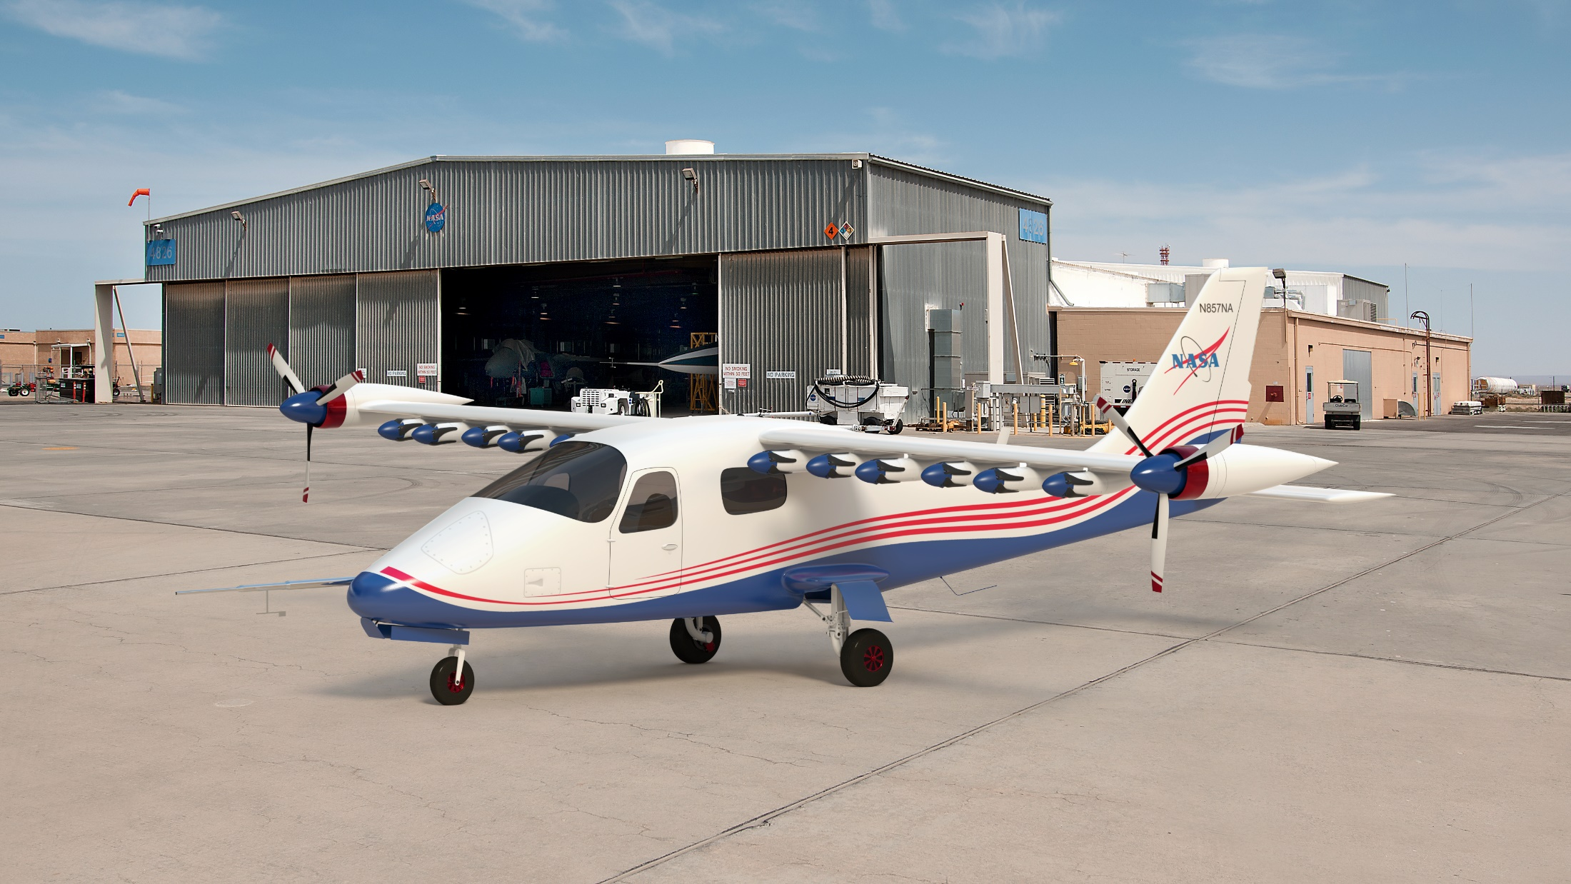
X-57 Contributions
Whirl flutter research for distributed propulsion configurations [University of Alabama]
New material for wing spar [Hexel]
Extensive CFD database for blown-wing configurations [Electra.aero]
Airworthiness rule for use of propellers as high-lift device [14 CFR §23.2110(b)]
High-lift laminar flow airfoil and flap [Mod III Wing]
Airworthiness standards for electric motors [ASTM F3338]
Cruise motor controller design [NASA EPFD, NASA SUSAN]
First auto-coded safety-critical flight software for NASA Aeronautics [High-lift motor controllers]
Commercialized battery system capable on several flying electric aircraft [Bye, Ampaire, Archer, Regent, Diamond, Harbour Air, Aurora, others]
New material for EMI chokes [NASA GRC]
U.S. electrified aviation small business growth [ESAero, Joby Aviation, Electric Power Systems]

Slide 3
Overall Impact to Electrified Aviation
X-57 contributions have been substantial, especially compared to level of investment
  Elevated electric propulsion TRL of components leading to integration with flight performance specs
  X-57 publishing approach has been 'early and often', includes sharing of design tools, component and subsystem test data, and operational lessons learned with academia and industry
Contractor/Subcontractors grew, in part, because of X-57
  Joby Aviation – working through certification full scale flight demonstrations now
  EPSystems – commercialized X-57-series battery systems and continues to advance product line
  ESAero grew substantially during execution and has integrated QA practices (AS9100 certification)
Wider impact across the electrified aviation space (industry, regulators, academia)
  Published architecture is a principal reference for academia and standards development
  Design and test standards and lessons learned are being adopted​
  Impact on regulations and standards ongoing as operational constraints drive further learning​
X-57 HAS advanced the Nation's ability to design, test, and determine airworthiness of electrified aircraft technologies

Slide 4
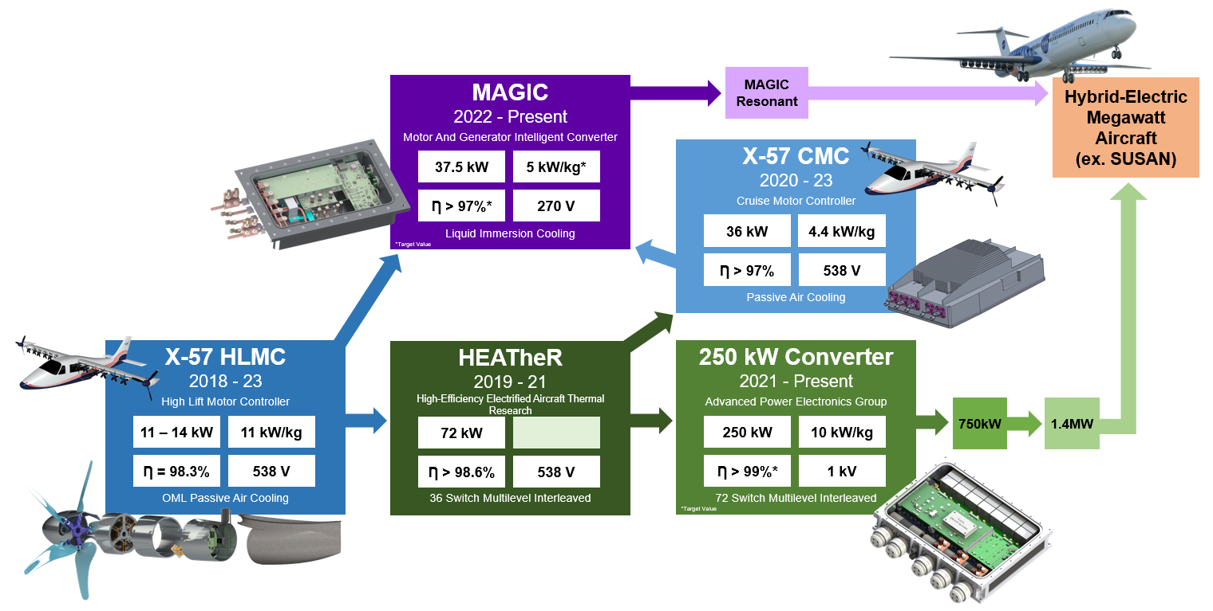
X-57 Motor Controllers - Building the Future
X-57’s High Lift Motor Controller efforts laid the groundwork for many new GRC converters
NASA’s Motor Controller Team is also benefiting EPFD
Notes:
HLMC paved the way for numerous new motor converter designs at GRC.
In green is our higher power converter work, beginning with the HEATheR project in which incorporated all the lessons learned from HLMC regarding its driver and power stage design. This project pushed the design up to 72 kW, an ~5x increase in power from HLMC, and stepped from 6 MOSFETs on HLMC up to 36 MOSFETs in a multilevel, interleaved configuration.
Following this subproject we again increased power, up to 250 kW on our next converter. This converter boasts 72 MOSFETs also in a multilevel, interleaved configuration. It also increased DC bus voltage up to 1 kV, pushed efficiency goals up to over 99%, and is an altitude rated design. This 250 kW converter is currently being tested at GRC and has so far verified the 1 kV design and is working on stepping up in power.
HEATheR and HLMC influenced the CMC XM3 redesign effort, where the driver and power stages were redesigned based on knowledge from these previous converters. With this knowledge and upgrade, CMC was able to pass its environmental and power tests.
The purple box is our newest converter, with its biggest innovation focused on thermal management, as it is an immersion cooled converter. It’s taken HLMC’s controller design, CMCs driver and power stage, and combined and upgraded them to create MAGIC. These electronics are immersion cooled, meaning completely immersed in a dielectric fluid, which allows for closer packaging of electronics as there is no need for bulky, heavy heatsinks. This converter is actively being tested in the lab at GRC. Future designs for this converter will look to increase DC bus voltage levels and potentially incorporate a resonant switching topology.
Future plans for this converter work are to continue to push to higher power levels and continue researching ways to improve power density and efficiency. As individual technologies continue to be proven on a smaller scale, they will begin to be combined with the end goal to create converters which can work with megawatt class motors and electric drive systems in future electric and hybrid electric aircraft.

Slide 5
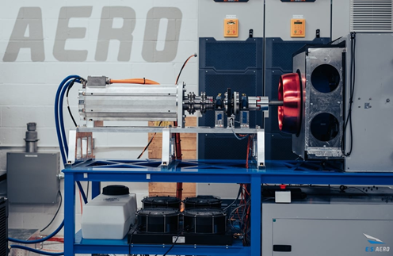
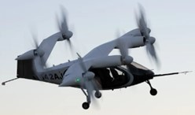
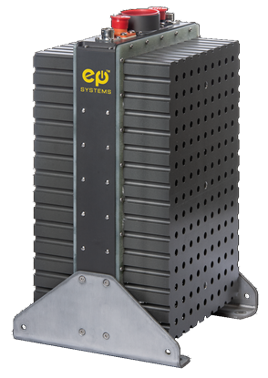
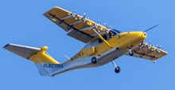
Direct Knowledge Transfer to Industry
Empirical Systems Aerospace | Joby Aviation | Electric Power Systems | Electra.Aero
X-57 Prime Contractor Grew substantially over life of project Mentorship and knowledge transfer for electrification and integration AS9100 certification | X-57 Subcontractor Early lessons learned for electrical integration, motor, controller design Went public, S4 in certification, current market cap of $4B | X-57 Subcontractor Design of thermal runaway-tolerant battery system Developed commercial product in use on over a dozen aircraft types | STTR Partner with NASA Leveraged X-57 CFD aero database to develop blown lift tools and design Over 2,000 orders booked for $8B in potential value

Slide 6
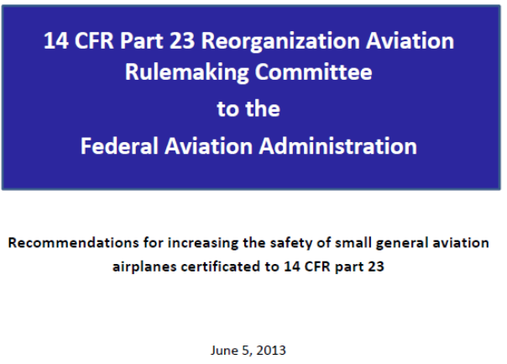
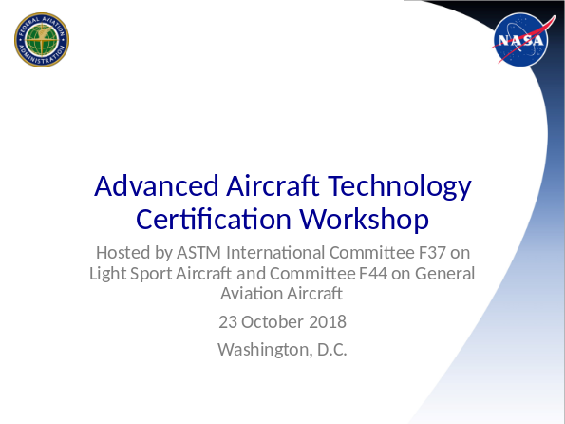
Rules and Standards Development
14 CFR Part 23 (Civil Airworthiness Standards for Normal Category Airplanes) in 2017 created new opportunity for faster adoption of new technologies
  Move from prescriptive to performance-based requirements
  Use of consensus standards as means of compliance
X-57 (then CEPT in formulation) used as one of three examples in FY15 FAA “stress test” to determine if new performance-based rules categories were adequate
  14 CFR 23.2110(b) associated with use of propellers for lift augmentation directly resulted from early FAA engagement
X-57 SMEs helped develop consensus standards for DEP
  ASTM Committee F39 on Aircraft Systems
  ASTM Committee F44 on General Aviation

Slide 7


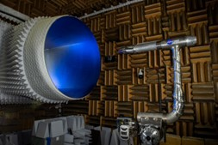
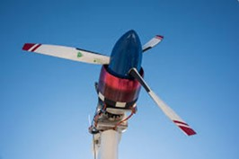
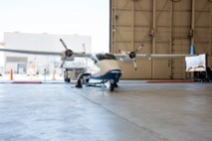

Direct Knowledge Transfer within NASA
Electrified Powertrain Flight Demonstrator | Motor Controller Development | RVLT Project | Convergent Aeronautics Solutions | Electrified Aircraft Operations
X-57 engagement with standards orgs served as the model for EPFD engagement and objectives Knowledge transfer to industry partners on EPFD | Motor controller hardware/software development for HLMCs and CMCs used for HEATheR, SUSAN, MAGIC, and other ongoing development and design at GRC | High-lift propellers tested as part of commissioning of Propeller Test Stand and reference for acoustic data Motor and controller data / development | Leveraging X-57 hardware to develop electrified test capability at AFRC that will integrate with GRC, NREL as part of CAS ÆNode activity | NASA procedures for electrified aircraft operations High-voltage system interaction, energy system maintenance Hangar power-on testing
Long-term collaboration among NASA centers fostered relationships and distributed team practices

