Slide 1
Rideshare on NASA Missions
Government Small Satellite Forum
April 16-17, 2024
Aly Mendoza-Hill – SMD Rideshare Lead
Katie Nelson – Rideshare Process Analyst

Slide 2
Agenda
Benefits of Rideshare
SMD Rideshare Introduction
  SMD Org Chart
  NASA SMD Rideshare Policy
Maturing Rideshare on NASA Missions
Launch Options for SmallSats
NASA SMD Rideshare Examples

Slide 3
Benefits of Rideshare
Rideshare is the method of getting additional payloads to orbit by connecting them with a primary payload, a pre-established launch, that has excess performance capabilities.
Rideshare is akin to using city bus system to get to the office. The bus has specific rules for the passengers, the routes/timelines are planned years in advance, and you may still have an extended walk to your actual destination.
The purpose of rideshare is to decrease the cost of reaching orbit through these joint launches, thus increasing opportunities for space exploration and scientific studies.
If you aren’t flexible enough to match up with a Primary’s launch parameters, then Rideshare is not for you!

Slide 4
SMD Rideshare Office (SRO) Intro
Goal:
Provide a single POC for SMD Rideshare-related inquiries for both NASA Center and external partners;
Maintain overall knowledge and tracking of Rideshare activities for SMD missions, and ensure best utilization of excess LV performance to obtain maximum science on SMD missions
Scope of work:
Supports ALL SMD Divisions
Works closely with NASA’s Launch Service Program (LSP)
Works with NASA Center Rideshare POCs to create unified NASA/SMD Rideshare message; delegates tasks to appropriate Center POCs as required; does not replace Center-level Rideshare Payload development work
What We Do: Develop a robust rideshare program to utilize excess mass to orbit and enable additional launch opportunities for the science community
Standardizing Announcement of Opportunity (AO) language and reviewing each AO for consistency
Developing key documents: SMD RS101, SMD RUG & DNH requirements, & the internal SMD RS Implementation Plan
Performing top-level payload compatibility analyses of rideshare missions to identify potential impacts to the primary payload or the success of the secondaries
Maintaining a list of SMD launch opportunities and tracking potential external launch opportunities

Slide 5
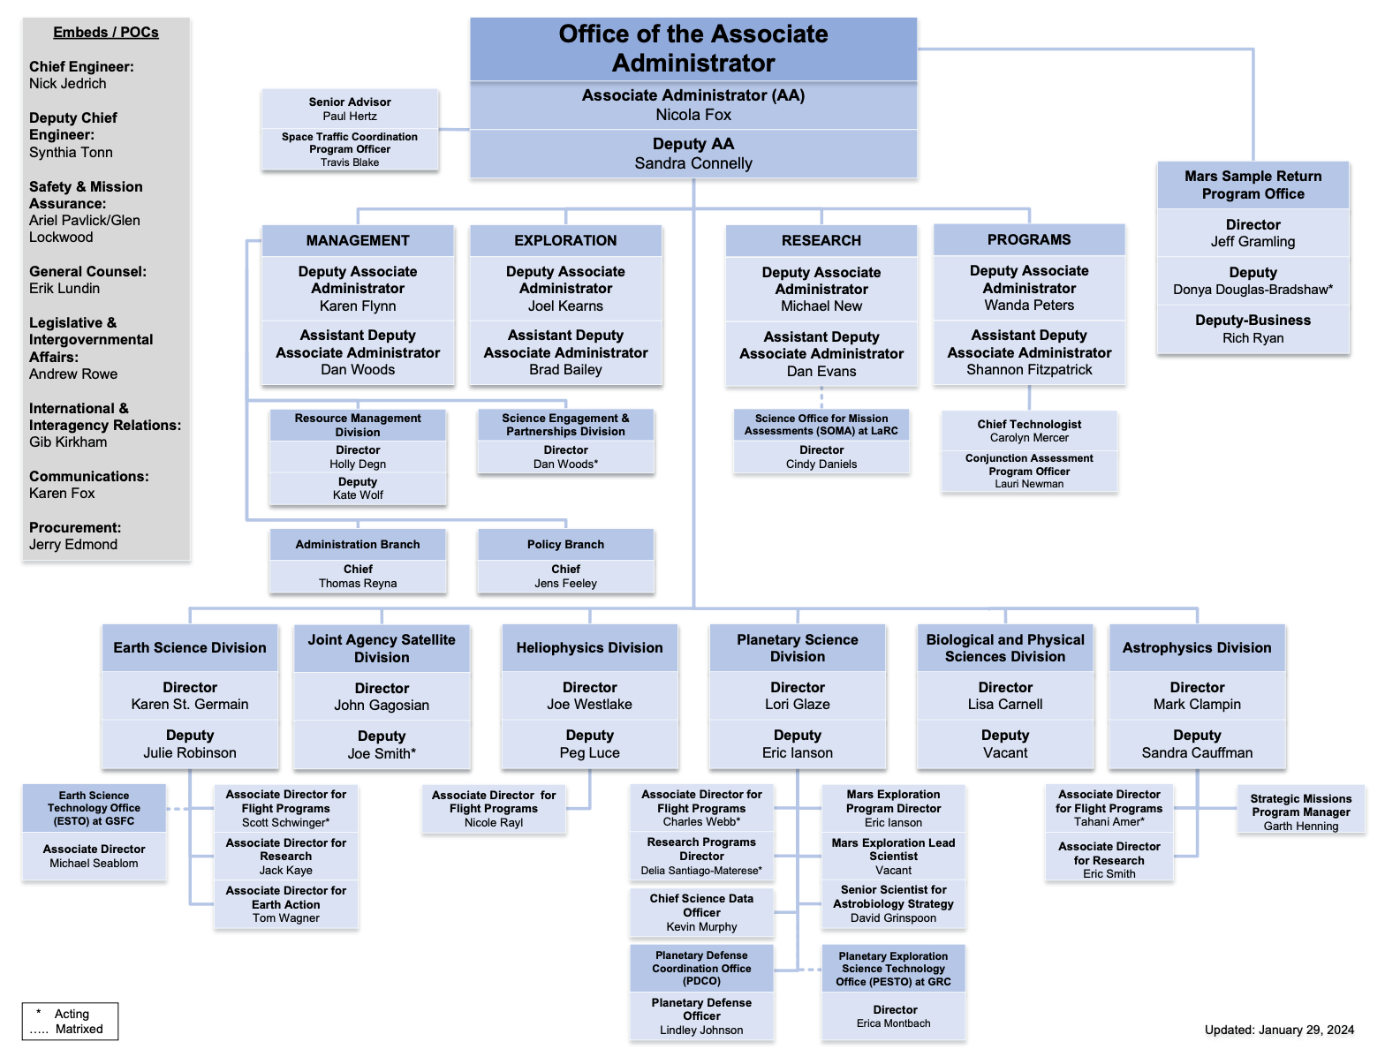
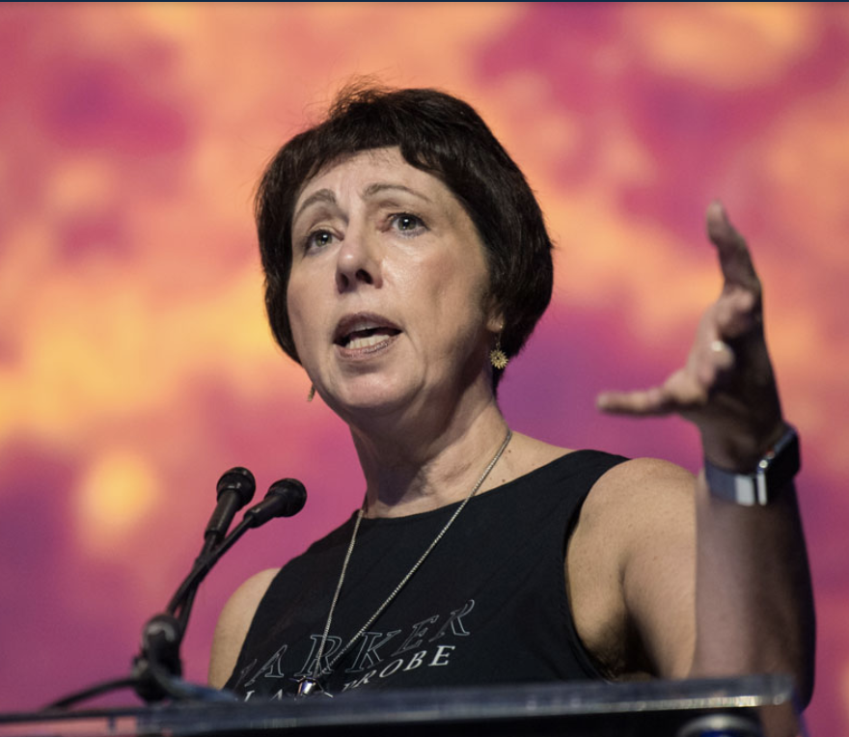
SMD Rideshare Office (SRO) Organization
NEW SMD AA, Nicola Fox,
Reports to
DAAP
SMD Rideshare Office
Lead: Aly-Mendoza-Hill
Joe Westlake
Peg Luce & Nicole Rayl
Alan Zide (PT)
David Cheney (PT)
Katie Nelson
Supports all SMD
Divisions and
Missions
SSCG
NASA Centers
ARC, GSFC, LaRC, MSFC, KSC, JPL etc.
Florence Tan
Deputy Chief Technologist,
SSCG Chair
Launch Services Program
Space Operations Mission Directorate

Slide 6
NASA SMD Rideshare Policy
SMD produced a rideshare policy and established the SRO to develop standard rideshare processes.
SPD-32 Evolved Expendable Launch Vehicle (EELV) Secondary Payload Adapter (ESPA) Secondary Payloads Rideshare
  Baseline policy signed Oct. 2018; Policy updated January 2021 (Rev 2); Enables rideshare or launch accommodation opportunities using an ESPA-type ring integrated on the launch service procured for an SMD primary payload with identified excess performance.
    Enables SMD to offer any excess capacity not utilized for SMD investigations to other NASA Mission Directorates (MD), other U.S. Government Agencies, or NASA’s International partners
    Establishes that secondary manifests will be decided NLT 24 months prior to the launch date to minimize impacts to NASA primary missions
  Rev 3 expected 2024
** This policy currently only applies to ESPA-class and independent Cubesat missions on ESPA ports (not Cubesats which are managed through the CubeSat Launch Initiative-CSLI).

Slide 7
Maturing Rideshare on NASA Missions
NASA SMD Rideshare Office Established
VADR Option
Initial SMD Rideshare Policy signed
& MOU USAF/NASA Sept ’20
Cooperative Area #7 - Rideshare
General Raymond, USSF
Mr. Bridenstein, NASA Administrator
Launch options expanded with implementation of VADR
2018
2019
2020
2021
2022
2023
Rideshare SIS for IMAP
LSP Strategic Inititiave
Update to Rideshare Policy & RUG
Initial approach for Rideshare
developed
Mature Rideshare Process for Customers
Based on Lessons Learned and industry maturation

Slide 8
SMD Rideshare Office Compatibility Assessments
Initial
AO Development Support
(MO’s, EVM’s, SIMPLEX’s, Pioneers, etc)
SmallSat Selection
Detailed
~PDR/CDR
(need LSIRD)
SMD Primary
Compatibility Assessment
USSF Opportunity
Assessment
Class D Risk
Assessment
Launch Options:
Utilize excess performance on NASA SMD Primary launches => RS Policy
For NASA Science-unique orbits => VADR
Partnering with government and commercial providers for increased opportunities
RS on NASA SMD Primary NLS-II Mission
VADR
RS on OGA Launches
Class A-D
Low risk tolerant full spacecraft missions
Full LSP technical oversight
Dedicated launches can add rideshare if excess performance
Class D and higher risk tolerant full spacecraft missions including CubeSats
Limited LSP technical insight
Dedicated launches or rideshare opportunities on commercial FAA licensed launches
Rideshare opportunities for free flying spacecraft on DoD procured launches coordinated through the SMD Rideshare Office

Slide 9
Access to Space Options
Free flyers
Instruments
Dedicated Vehicles
Rideshare
Co-manifest
Hosted Payloads
Suborbital
NLS II
NLS II
RS on OGAs or Intl Partners
NLS-II
CLPS
Sounding Rockets
VADR
VADR
PI Procured Launch
VADR
ISS
High Altitude Balloons
PI Procured Launch
Artemis Cubesats
CSLI
Hosted Services
Other Cubesats
Notes:
NLS II – class A-D, low risk tolerant missions, full LSP technical oversight, dedicated launches can add rideshare if excess performance
VADR – class D and higher risk tolerant missions, limited LSP technical insight, dedicated launches or rideshare opportunities on commercial non-NASA procured launches
CLPS – full service contracts to the moon for instruments and hosted payloads
OGAs – rideshare opps on DoD procured launches

Slide 10

Rideshare OGA Launch Opportunity Primary POC’s
MOU USAF/NASA –Sept 2020
Cooperative Area #7 - Rideshare
General Raymond, USSF
Mr. Bridenstein, NASA Administrator
SMD
Small Spacecraft Coordination Group
(SSCG)
Florence Tan / Aly
Shad Combs*/Andres
Chris Baker/Justin
SSCA
ESDMD
SOLAR
SMD Rideshare Office (SRO)
Lead: Aly-Mendoza-Hill, Prog Exec
David Cheney, Prog Exec
SOMD
SLDG
STMD
MMDS
SmallSat Database
SERB
MMO/STP
Submit PLs to SSCG
data calls to be
included in dB
Launch Services Program
@ KSC (reports to SOMD/LSO)
Shaun Daly (Rideshare)
Norman Phelps & Liam Cheney (CSLI)
NASA Center Reps
Ames, GRC, GSFC,
JPL, JSC, KSC,
LaRC, MSFC, WFF, etc.
Launch Opportunity Calls sent to:
Florence Tan (SSCG rep)
Aly Mendoza-Hill. (SRO Rep)
Norman Phelps (LSP Rep)
Chris Baker (STMD Rep)
Shad Combs (SOMD Rep)
LSO - Flight Planning Board
When OGA rideshare launch opportunities are identified to NASA, the
SSCG and the SRO will work together to provide a coordinated NASA response consisting of a list of prioritized mission candidates.

Slide 11
SMD Rideshare Examples
Landsat-9
JPSS-2
IMAP
SPHEREx

Slide 12
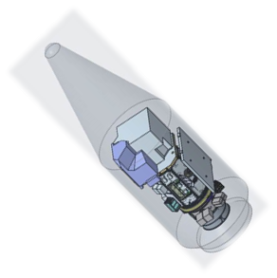
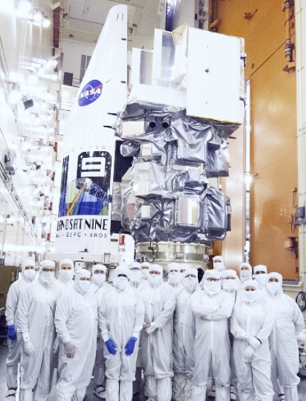
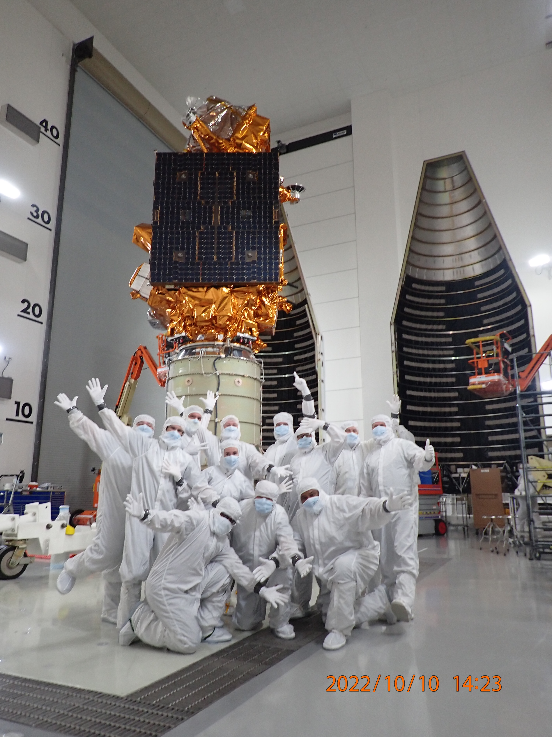
SMD Primary NLS-II Rideshare Examples
Landsat-9
-Earth Science Division
-LV: AtlasV-401
-ESPA Standard
-Rideshare Payloads: 4 CubeSats
JPSS-2
-Joint Agency Satellite Division
-LV: AtlasV-401
-ULA C-Adapters
-Rideshare Payload: LOFTID
Launched
November
10, 2022
Launched
September
27, 2021
Majority of excess performance utilized

Slide 13
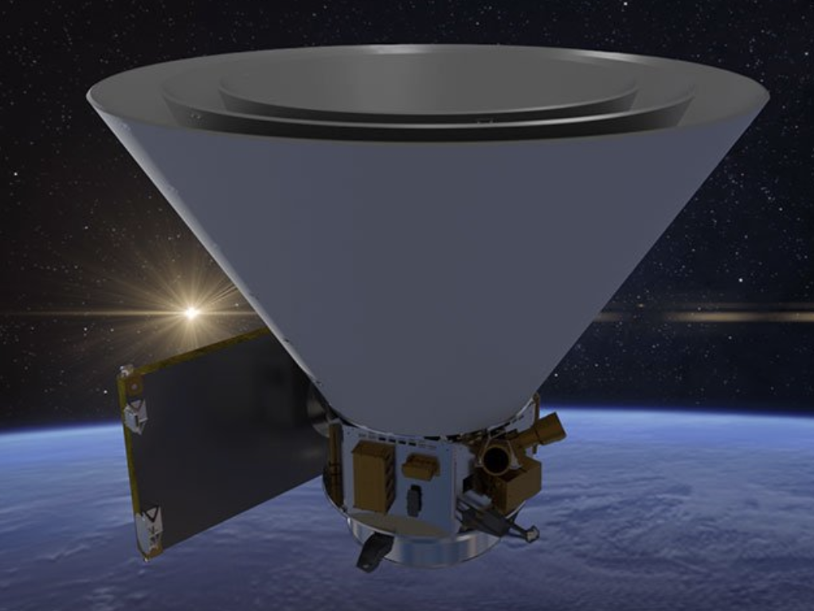
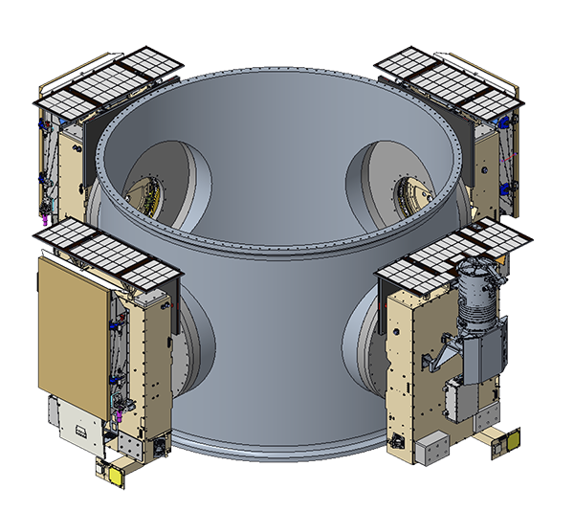
SMD Primary NLS-II Rideshare Examples - continued
Images not to scale
SPHEREx
-Astrophysics Division
-LV: Falcon 9
-ESPA Grande
-Rideshare Payload:
-PUNCH
-Heliophysics Division
-4 Spacecraft
Launching
NET April 2025

Slide 14
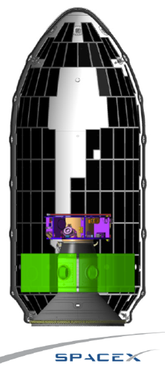
SMD Primary NLS-II Rideshare Examples
IMAP
-Heliophysics Division
-LV: Falcon
-ESPA Grande
-Rideshare Payloads:
-SWFO L1
-HPD Carruthers Geocorona Observatory
Launching
NET April 29, 2025
Majority of excess performance utilized
Images not to exact scale

Slide 15




Back Up Charts
NASA HQ Science Mission Directorate
Rideshare Office
Q & A’s?
Aly
Mendoza-Hill
Alan
Zide
David
Cheney
Katie
Nelson
The Rideshare ”Balance"
SC flexibility to meet Primary Launch Parameters
Minimized Launch Costs
15

