Slide 1

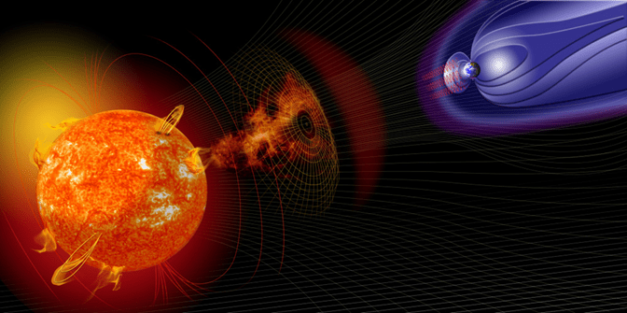
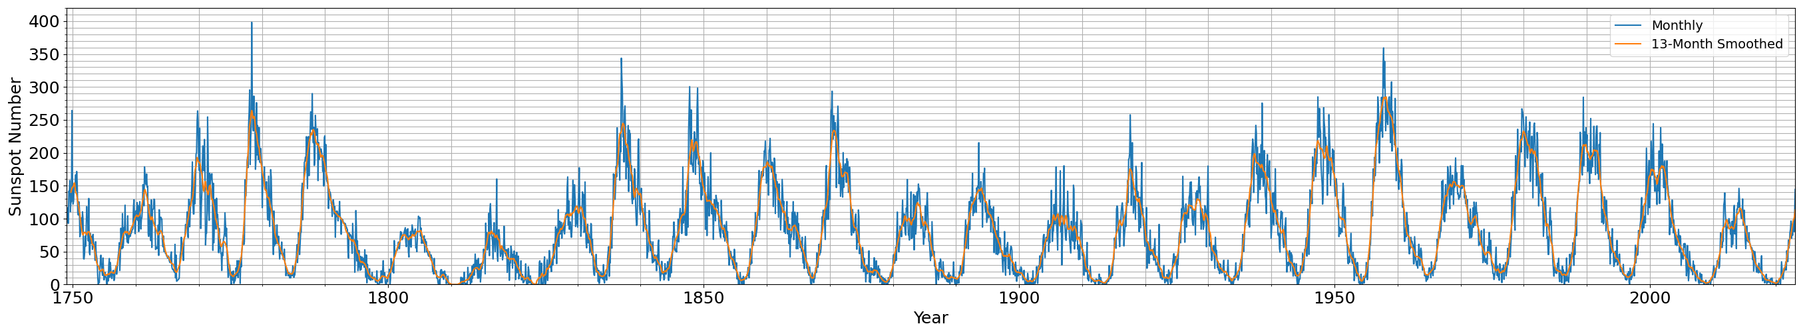
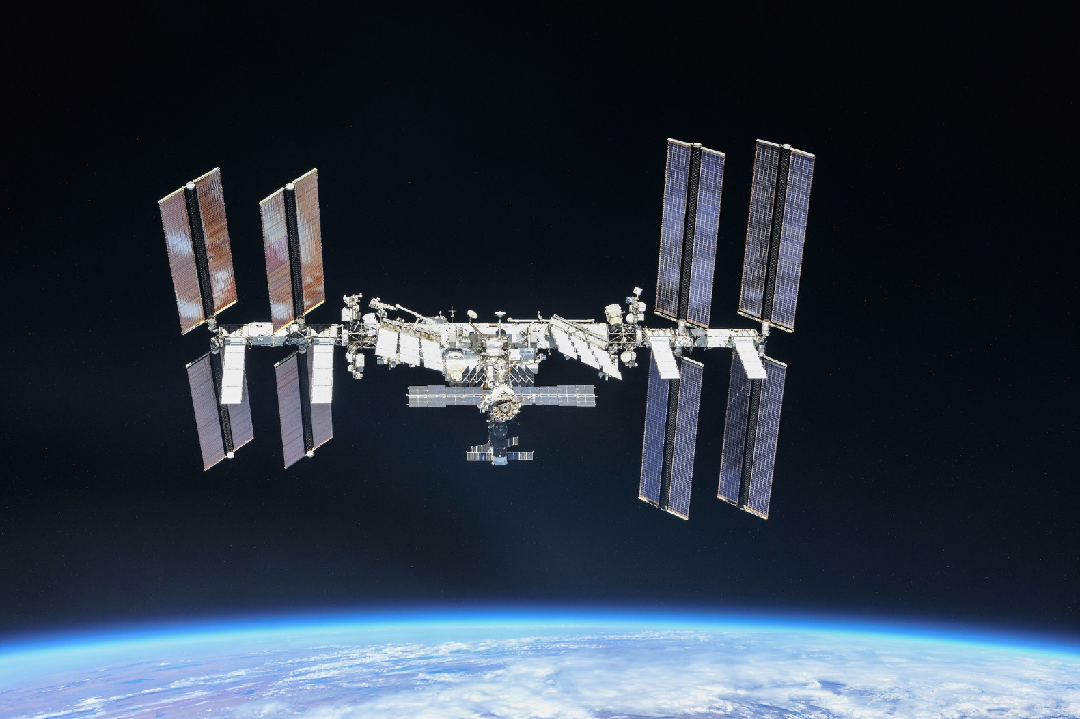
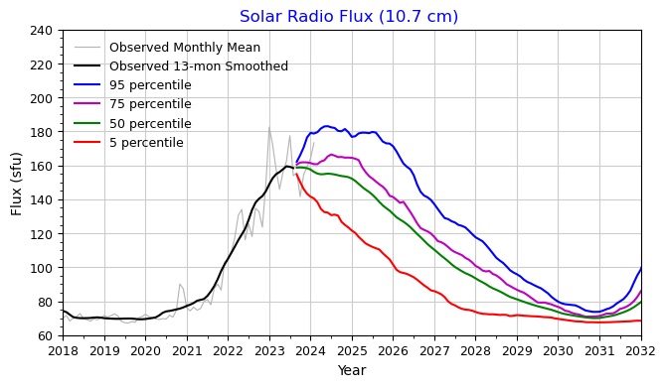
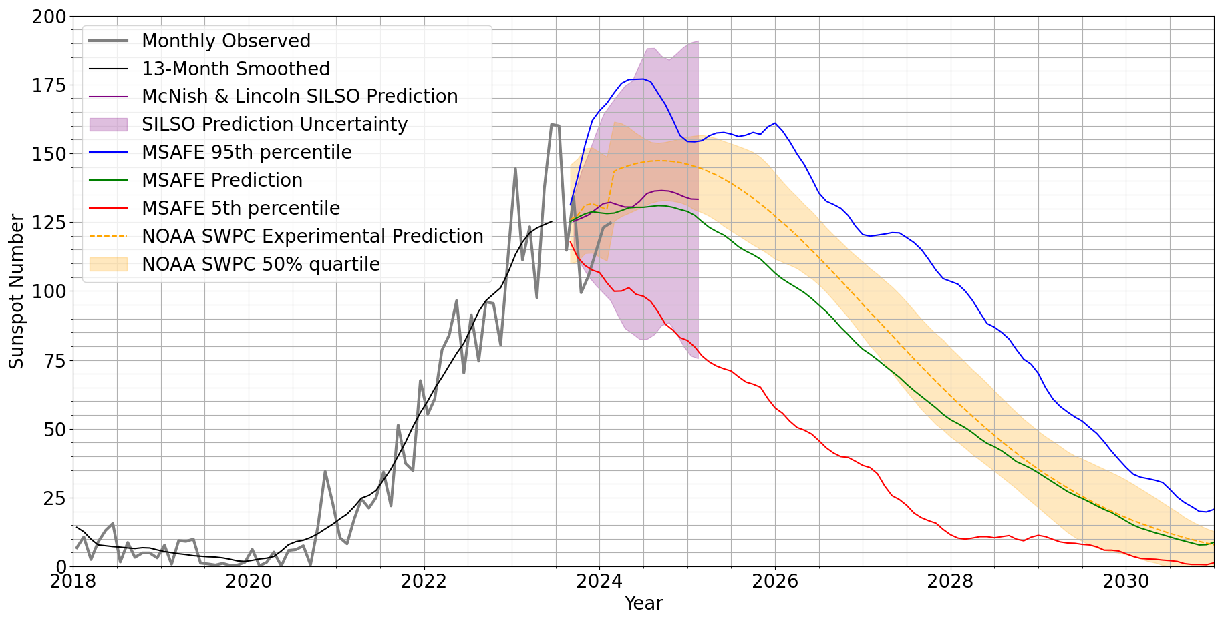
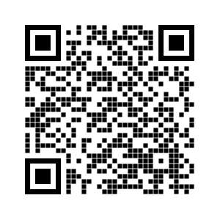
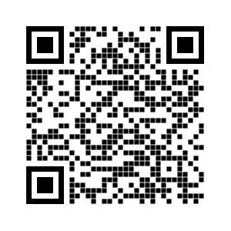
Solar Cycle 25 Model Prediction Comparisons: An Engineering Perspective DeStefano, Anthony (anthony.m.destefano@nasa.gov); Suggs, Ronnie NASA/Marshall Space Flight Center, Huntsville, AL
Motivation:
Carrington Event (1859)
Space Age
The solar cycle prediction is important to in-space laboratories such as the International Space Station (ISS), Figure 1. Understanding when the solar maximum occurs and for how long is vital for planning how often the ISS requires orbit raising maneuvers (ORM) being in a low-Earth orbit (LEO).
Dalton Minimum
Figure 2: Recalibrated historic sunspot number and 13-month smoothed sunspot number (www.sidc.be/SILSO/datafiles) [1]
Cycle 25
Solar Cycle Prediction Comparisons:
Cycle 25
Several solar cycle predictions are available to the public. In Figure 5, three such predictions are shown for sunspot number, provided by:
Royal Observatory of Belgium, Sunspot Index and Long-Term Solar Observations (SILSO)
NASA Marshall Space Flight Center, MSFC Solar Activity Future Estimation (MSAFE)
NOAA Space Weather Prediction Center (SWPC)
Figure 1: The ISS as of 10/4/18 (NASA)
Solar Cycle Prediction:
Figure 3: The March 2024 MSAFE [3] prediction of the F10 solar radio flux (www.nasa.gov/solar-cycle-progression-and-forecast/)
Knowledge of the thermosphere density and ISS’s drag coefficient aid in the prediction of how fast the ISS’s orbit decays. Modeling the thermosphere involves information about future states of the solar radio flux (F10). The F10 prediction is provided monthly to the ISS Program by MSFC Engineering for such ORM planning, e.g., Figure 3.
Times before the historic F10 database can be populated by using correlation functions between times when the sunspot number and F10 overlap.
Difficulties arise in the solar cycle prediction when the observed data has two peaks (see Figure 4), attributed to lag of activity between the northern and southern hemispheres of the Sun.
Cycle 24
Figure 5: Comparison of various sunspot number predictions for solar cycle 25 showing McNish & Lincoln SILSO [2], MSAFE [3], and NOAA SWPC [4]
Acknowledgements
Forward Work:
Support for the monthly MSAFE solar forecasts is provided by the ISS Program Office. Additional support for MSFC space weather SBIR and related activities is provided by the NASA Space Weather Program.
Understanding how various solar cycle prediction models perform at different points in the cycle can be insightful to satellite owners and flying laboratories such as ISS. Due to the increase of assets in LEO and plans for a commercial space station, it is even more imperative to have improved solar inputs to thermosphere models for drag estimation.
References
[1] Clette, F., Svalgaard, L., Vaquero, J.M., Cliver, E. W., 2014: Revisiting the Sunspot Number. A 400-Year Perspective on the Solar Cycle, Space Science Reviews, Volume 186, Issue 1-4, pp. 35-103. DOI: 10.1007/s11214-014-0074-2
[2] McNish A.G. & Lincoln J.V. 1949, Trans. Am. Geophys. Union 30, 673-685
[3] Niehuss, K.O., Euler Jr, H.C. and Vaughan, W.W., 1996. Statistical technique for intermediate and long-range estimation of 13-month smoothed solar flux and geomagnetic index (No. NASA-TM-4759)
[4] https://testbed.swpc.noaa.gov/products/solar-cycle-progression-updated-prediction-experimental
Figure 4: The June 2012 MSAFE [3] prediction of the F10 solar radio flux, overlaid with the future observations (https://www.nasa.gov/solar-cycle-progression-and-forecast/archived-forecast/)

