Slide 1
Centralized Data Management Platform (Patent US 11,556,398) NASA Ames Newly Patented Technologies Industry Webinar
Mohana M. Gurram
NASA Ames Research Center
04/17/2024

Slide 2
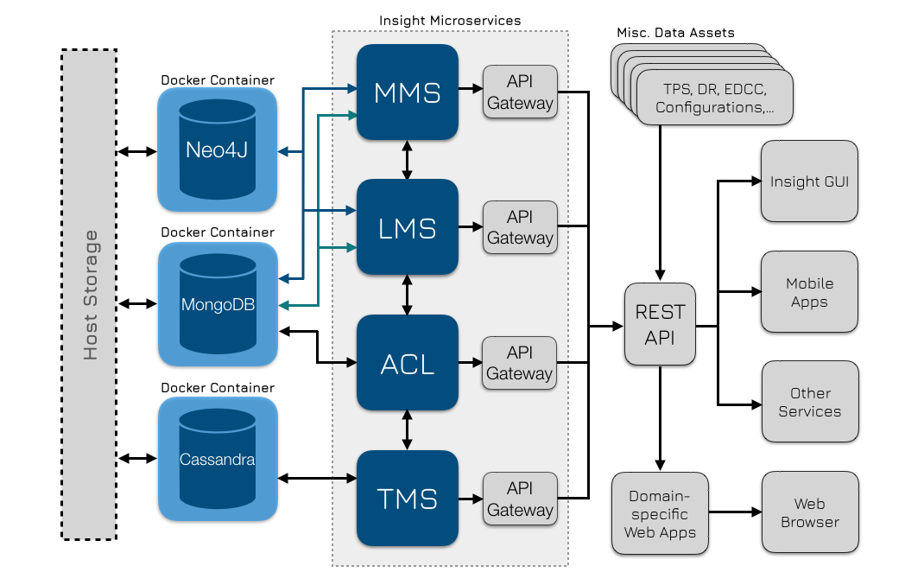
Centralized Data Management Platform
Technology Overview
The technology is an adaptive data management and integration platform designed for disparate data sources. It is built to support multitenancy, manage data governance, handle heterogeneous data formats and advance data democratization using a suite of connected, independent microservices. Each service can be used within an integrated environment, or as a standalone product, with a dedicated set of functionalities, such as metadata management, data versioning, access control, data tagging, link management, and analytics, among others.
Applications
Data management and Analysis
Manage Product Data Lifecycle
Internet of Management Things (IMT)
Data Lineage and Provenance
Knowledge Graphs
Benefits
Data tagging services for efficient organization of disparate data from multiple heterogenous data systems
Data relationships services for data assets association based on content.
Data lifecycle services to facilitate data lifecycle management including data collection, data maintenance, and data synthesis
Data lineage and provenance tracking service to facilitate error detection and origin and promote interoperability

