Slide 1

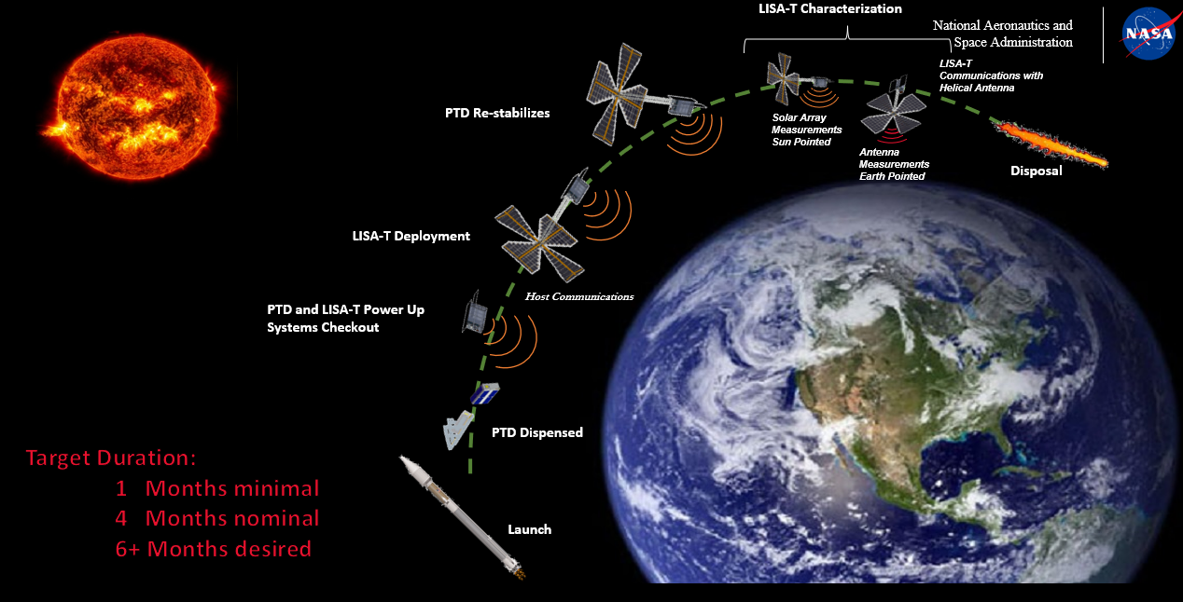
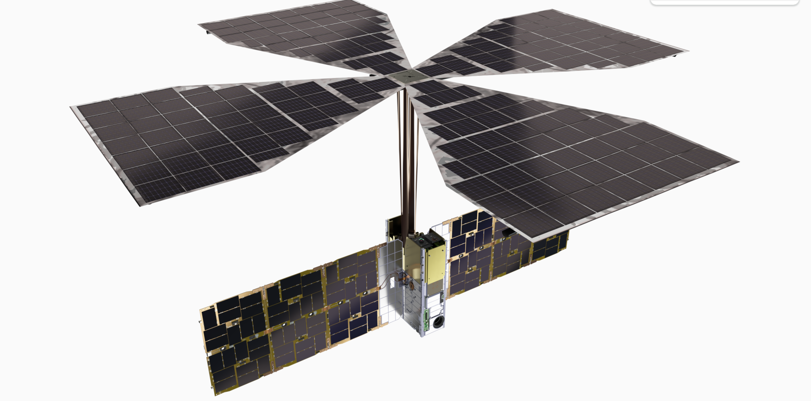
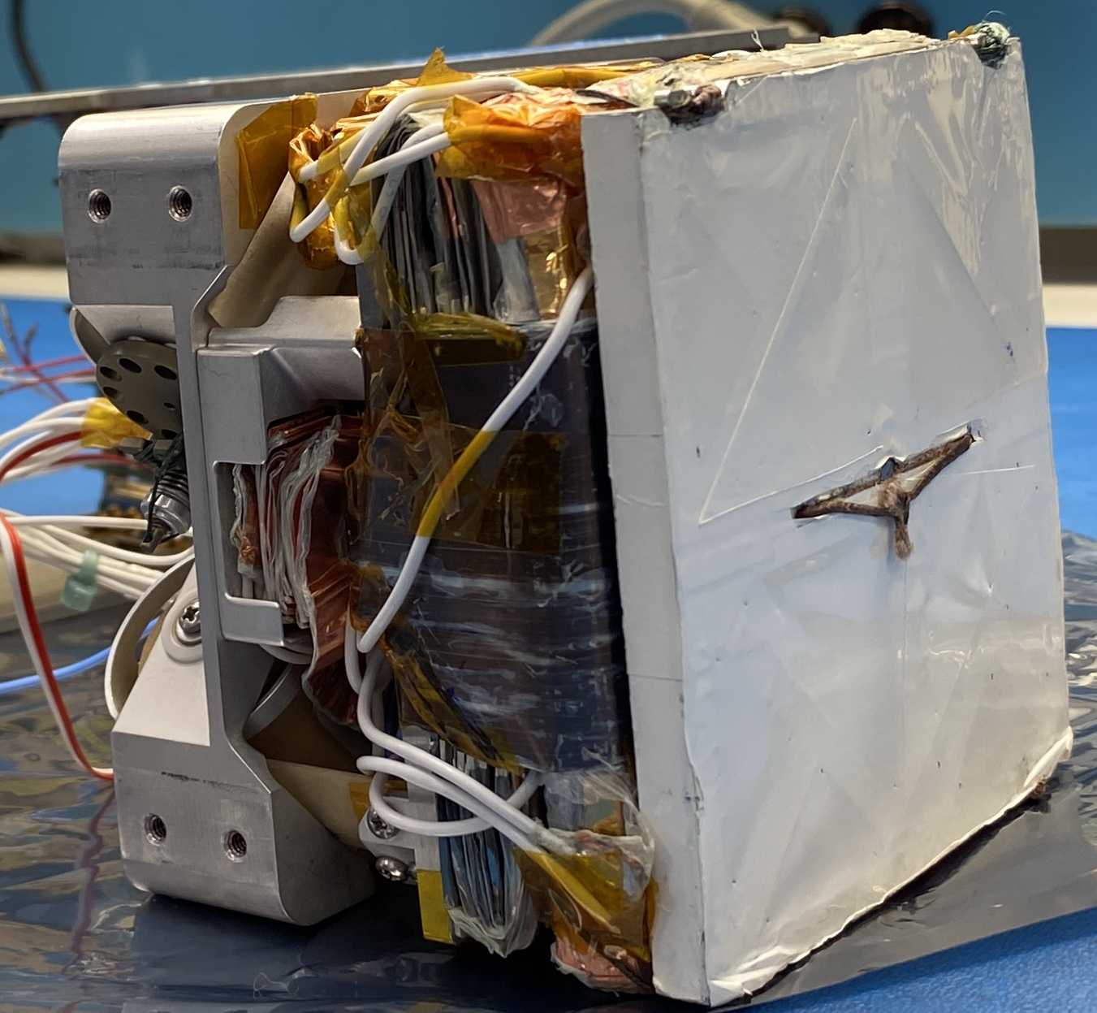
Lightweight Integrated Solar Array and anTenna (LISA-T)
Darren Boyd (MSFC), Quinn Jackson (MSFC), Samantha Shine Harris (MSFC), John Carr (MSFC), Les Johnson (MSFC), NeXolve Holding, LLC, and Terran Orbital
INTRODUCTION
Approach
Flight Demonstration
LISA-T provides a compact, lightweight, efficient, and affordable power generation system with an integrated antenna for small spacecraft missions. LISA-T generates > 300% more power per mass and volume than state of the art options, vastly improving electrical power availability on small spacecraft. This will enable both highly capable near-earth small spacecraft as well as the capability for small spacecraft to venture deeper into space.
The use of thin film based solar arrays for spacecraft applications has long been recognized as an advantageous power generation option, however, the materials, cells, and deployment systems have not been available to make them a reality. Thinner materials yield both mass and volume savings, enabling more power to be generated from the same mass and volume application. Perhaps just as important for small spacecraft, the mechanical flexibility of thin films lends itself well to stowage and deployment schemes. LISA-T is utilizing advanced solar cells being developed in industry (both inverted metamorphic multijunction as well as coper indium gallium (di)selenide cells) coupled with advanced, space rated polyimide materials manufactured by our partner, NeXolve Holding, LLC., to form the basis of LISA-T. These cells and core materials are backed by a novel multifunction mechanical system, which provides both the structural backing as well as deployment (unfolding) forces for the array.
Project Description
LISA-T Con-Ops
NASA currently classifies small spacecraft to be spacecraft with a mass less than 180 kg. The large body of research and development within government, academia, and industry has greatly advanced small spacecraft technologies and, as a result mission capabilities. However, electrical power systems have not commensurately increased in capability, creating a bottleneck in bus design and, ultimately, payload capability. This is driving the need for advanced power generation, storage, and distribution designs. LISA-T is being developed, in partnership with NeXolve Holding, LLC to fill the power generation portion of this technology gap.
The array has been combined with avionics and other critical elements to form a demonstration payload, known as the LISA-T Cartridge. This payload has been integrated with the fourth bus in the Terran Orbital Pathfinder Technology Demonstrator (PTD) platform – PTD-4. This 6U CubeSat will fly to Low Earth Orbit for a ~2-to-6-month demonstration mission via SpaceX Transporter 11. This flight will demonstrate the array capabilities, raise the TRL of the technology to 7, and reduce risk for future technology infusion. LISA-T was integrated to the PTD-4 spacecraft in February-March 2024. Spacecraft environmental tests have since been successfully completed with only detailed flight software checkouts remaining. Launch is expected in July 2024.
Development
Bistable fiberglass layup ‘tape springs’ are utilized for the central booms of the design. The bistable booms rolls tightly for stowage and passively deploy via stored strain energy. A Dyneema tie down restrains the booms for launch and a thermal knife releases the tape booms on orbit. The solar array petal stack sits atop the central deployment mechanism and is a tightly packed fold-up of the solar cells, substrate, coatings, and multicomponent panel deployment and structural systems. There are four solar cell petals per stack.
CONCLUSION
The LISA-T array will enable both highly capable, near-earth small spacecraft as well as the capability for small spacecraft to operate deeper into space through both improved power generation and communication capabilities on the same deployable array. The LISA-T PTD mission will demonstrate this array, proving it for future mission use. The deployment, operation, and environmental survivability of LISA-T will be tested. This mission, combined with ground-based testing, parabolic flight testing, and international space station material exposure testing will enable LISA-T to provide >300% improved power generation to small spacecraft and usher in a new class of low cost, fast paced, risk tolerant missions.
LISA-T fully deployed flight configuration
Credit: Terran Orbital
Much the same as power generation, communication suffers from the limited resource availability on small spacecraft. The LISA-T deployment structure can be advantageously used to simultaneously improve communications capability by embedding thin-film antennas within the array. The combined power generation and communication array can be stored in the body of a 6U spacecraft and deployed on-orbit. A rendering of the flight demonstration vehicle is shown above with the stowed LISA-T flight hardware below.
LISA-T Bus Integration
Credit: Terran Orbital
The entire array occupies approximately 2.4U of the 6U Terran Orbital PTD CubeSAT.
REFERENCES
Integrated Comm
J.A. Carr, L. Johnson, D. Boyd, B. Phillips, M. Finckenor, B. Farmer, J. Smith, LISA-T part three: The design and space environments testing of a thin-film power generation and communication array, Acta Astronaut. 205 (2023) 267-280.
The Lightweight Integrated Solar Array and anTenna (LISA-T) Pathfinder Technology Demonstrator (PTD) quarterly report 9-14-23, STMD-Small Spacecraft Technology Program Office.
A novel integrated Lightweight Deployable Integrable Antenna (LiDIA) is embedded in the center of the solar array. This new LiDIA technology enables scaling to deployable high gain antenna arrays with extraordinarily low mass and stowage volume. Combining LISA-T and LiDIA allows future options for antenna only arrays or combinations of antenna and photovoltaic arrays.
By providing high data rate communication over long distances with lower antenna mass and stowage volume, the LiDIA array technology aims to fill a critical communications technology gap recognized by NASA, NOAA, and commercial spacecraft entities. This gap is especially important for small satellites, solar sail spacecraft, and/or missions beyond low earth orbit.
LISA-T Final Design

