Slide 1
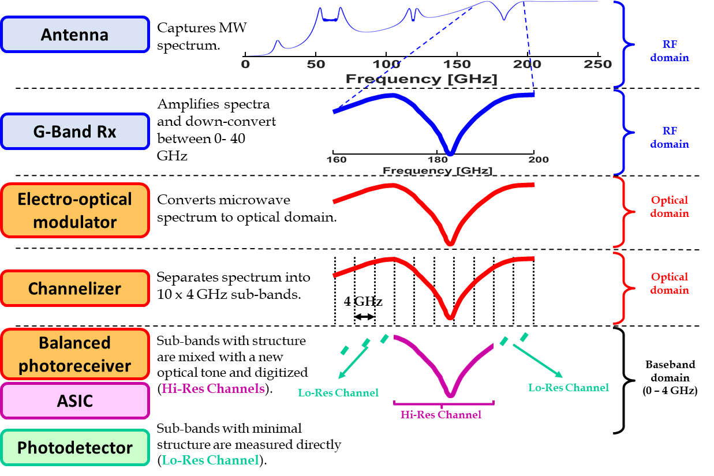
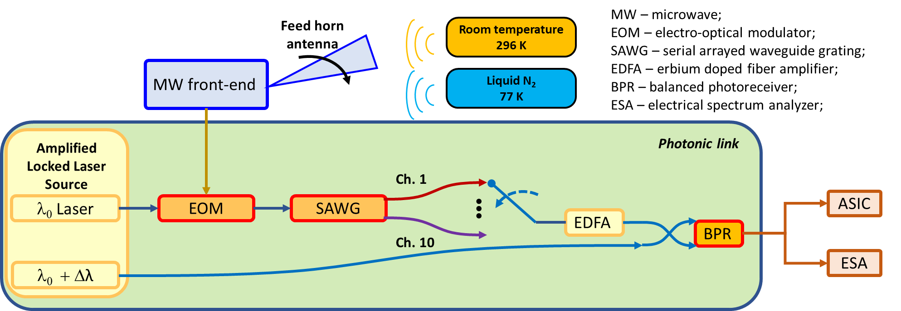
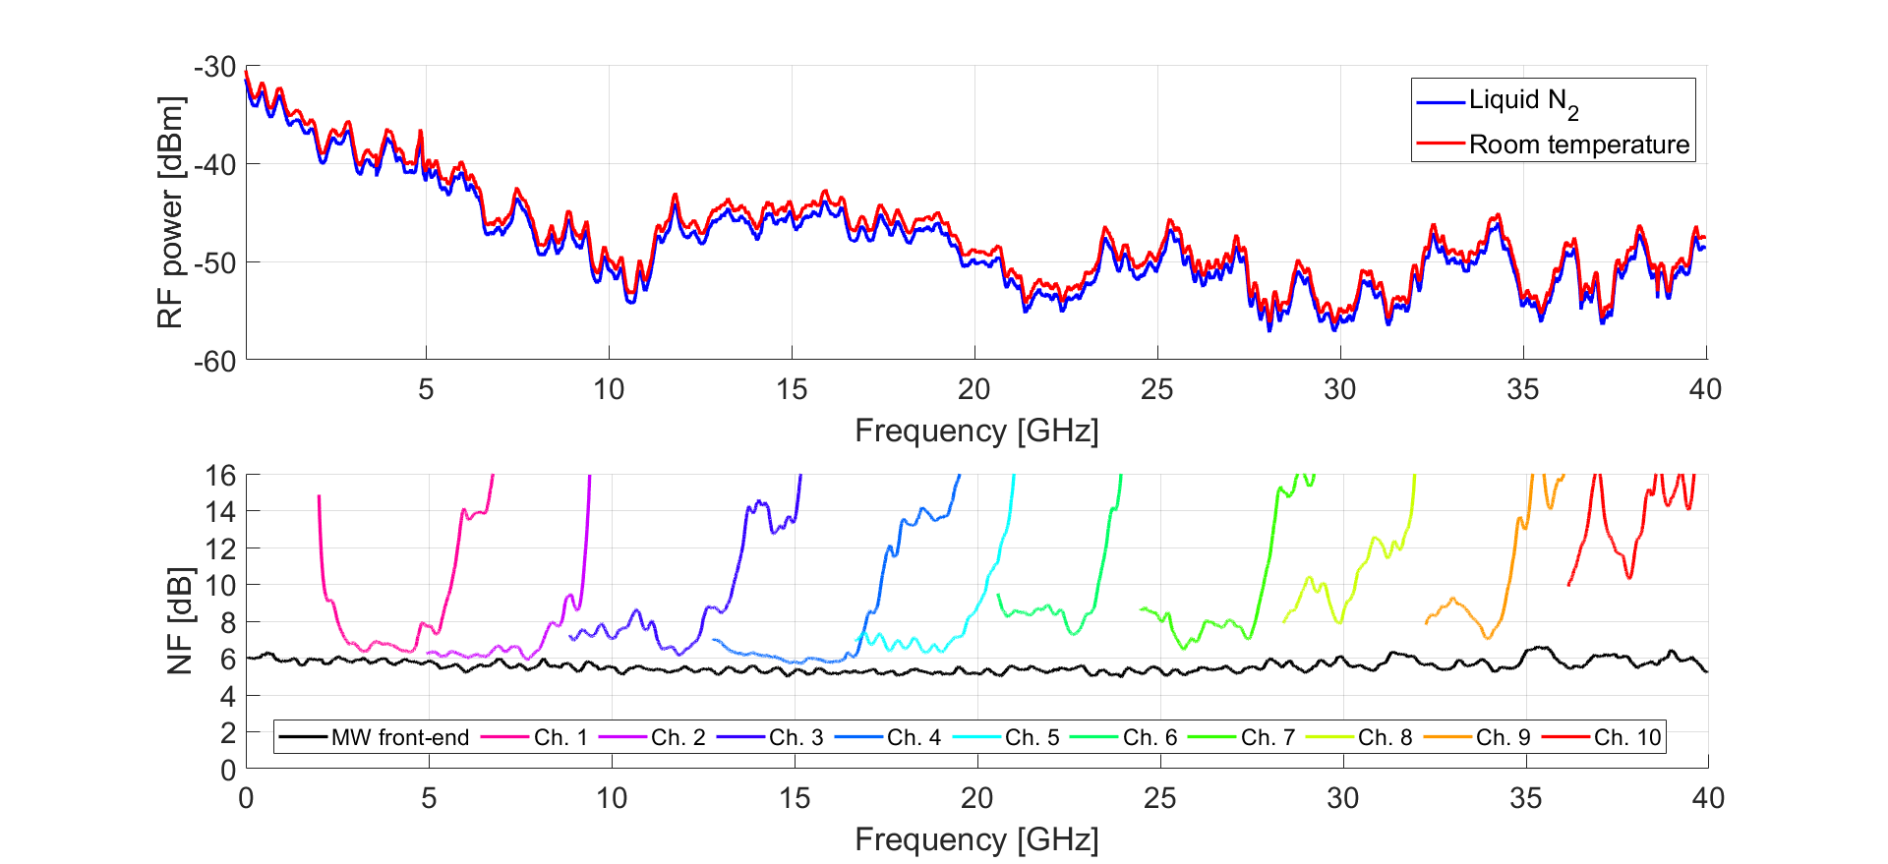
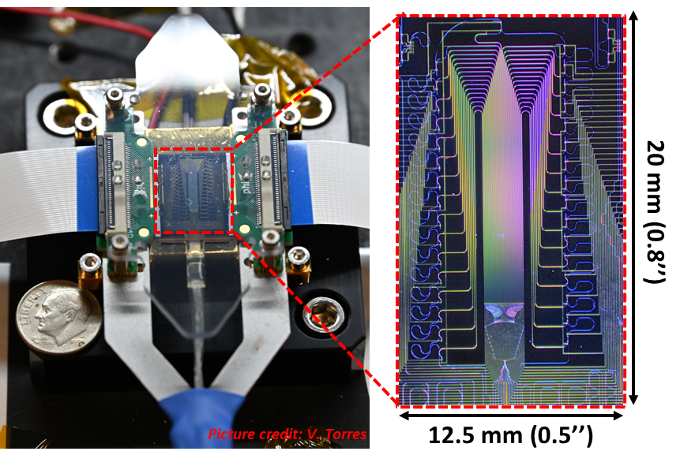
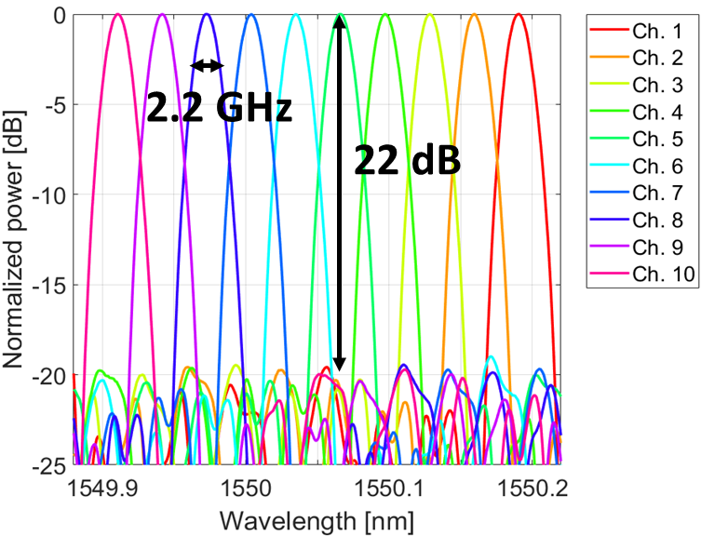
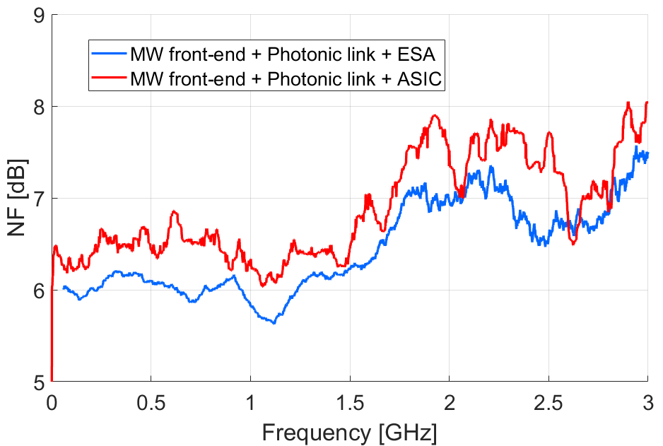
The Hyperspectral Microwave Photonic Instrument (HyMPI)
Starting TRL: 2
Ending TRL: 5
F. Gambini^{1,2,3}, V. Torres¹, D. Robles³, E. Leong³, P. Mohammed^{3,4}, M. Coon³, R. Banting³, J. Piepmeier³, M. Stephen³, A. Gambacorta³ (¹Univ. of Maryland Baltimore County, ²CRESST II, ³NASA Goddard Space Flight Center, ⁴Morgan State Univ.)
Motivation:
Microwave (MW) sounders like AMSU and ATMS represent the primary source of information for Numerical Weather Prediction for their capability to sound atmospheric temperature and water vapor under all-sky conditions. These systems provide few non-contiguous channels, and they are missing critical information related to the microwave spectrum.
Current MW technology limits the performance and scalability of the systems. The significant size, weight, power and associated cost (SWaP-C) greatly reduces its selectability for future missions
Our goal is to develop a revolutionary spectrometer based on photonics integrated circuits (PIC) and Application Specific Integrated Circuit (ASIC), that offer ultra-small SWaP with non-moving parts, lower cost and hyperspectral capabilities for the sounding of the planetary boundary layer (PBL) spectrum.
Project objectives:
Demonstrate the performance, functionalities and feasibility of the HyMPI spectrometer
  Minimize SWaP-C for small-sat
  Provide hyperspectral resolution (few MHz or lower)
Provide a modular back-end that can be used with different MW front-end to achieve contiguous spectral coverage of the PBL MW spectrum (200 GHz)
The experimental setup:
Noise figure experimental evaluation:
ESA (8 MHz resolution):
Channelizer: the Serial Arrayed Waveguide Grating (SAWG)
ASIC (8 MHz resolution):
US Patent 11852864 - Serial Arrayed Waveguide Grating​
IEEE JLT, 2024, doi: 10.1109/JLT.2024.3349932 ​
0.5 dB
SAWG channel cut-off
Conclusions:
HyMPI enables wide-band, hyperspectral resolution and continuous spectral coverage without significantly increasing the noise level of the system.
PICs can be used to overcome the limitation of the MW technology: they can enhance the performance of the system and minimize the SWaP-C of the instrument at the same time.

