Slide 1
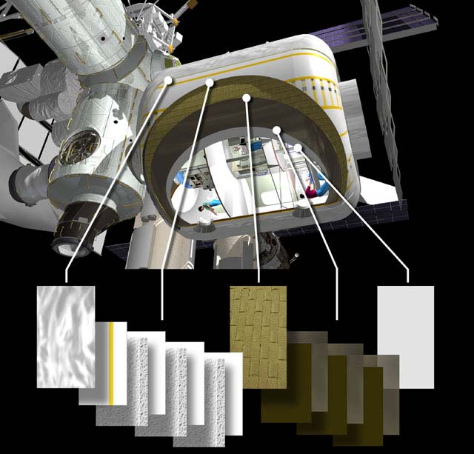
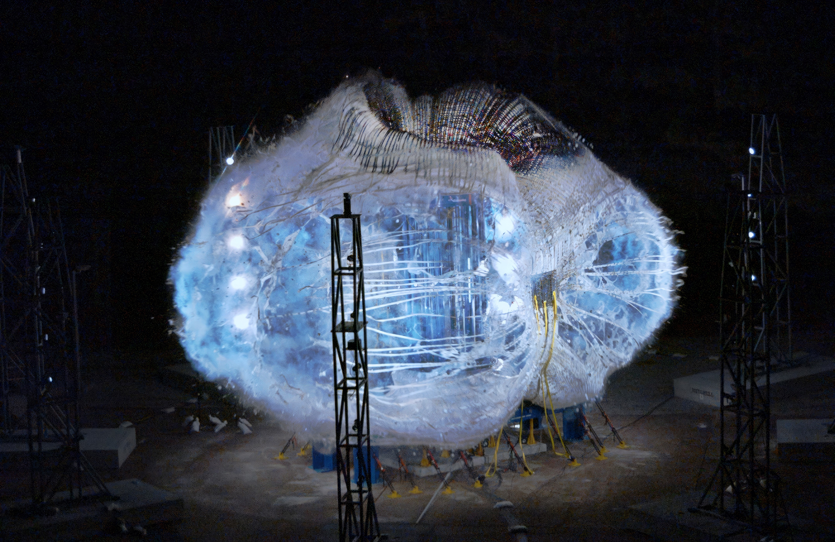
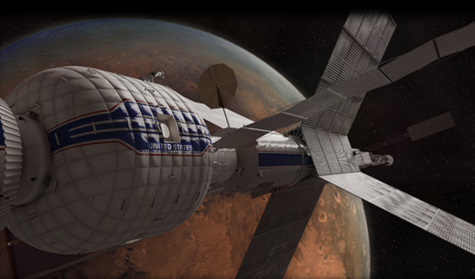
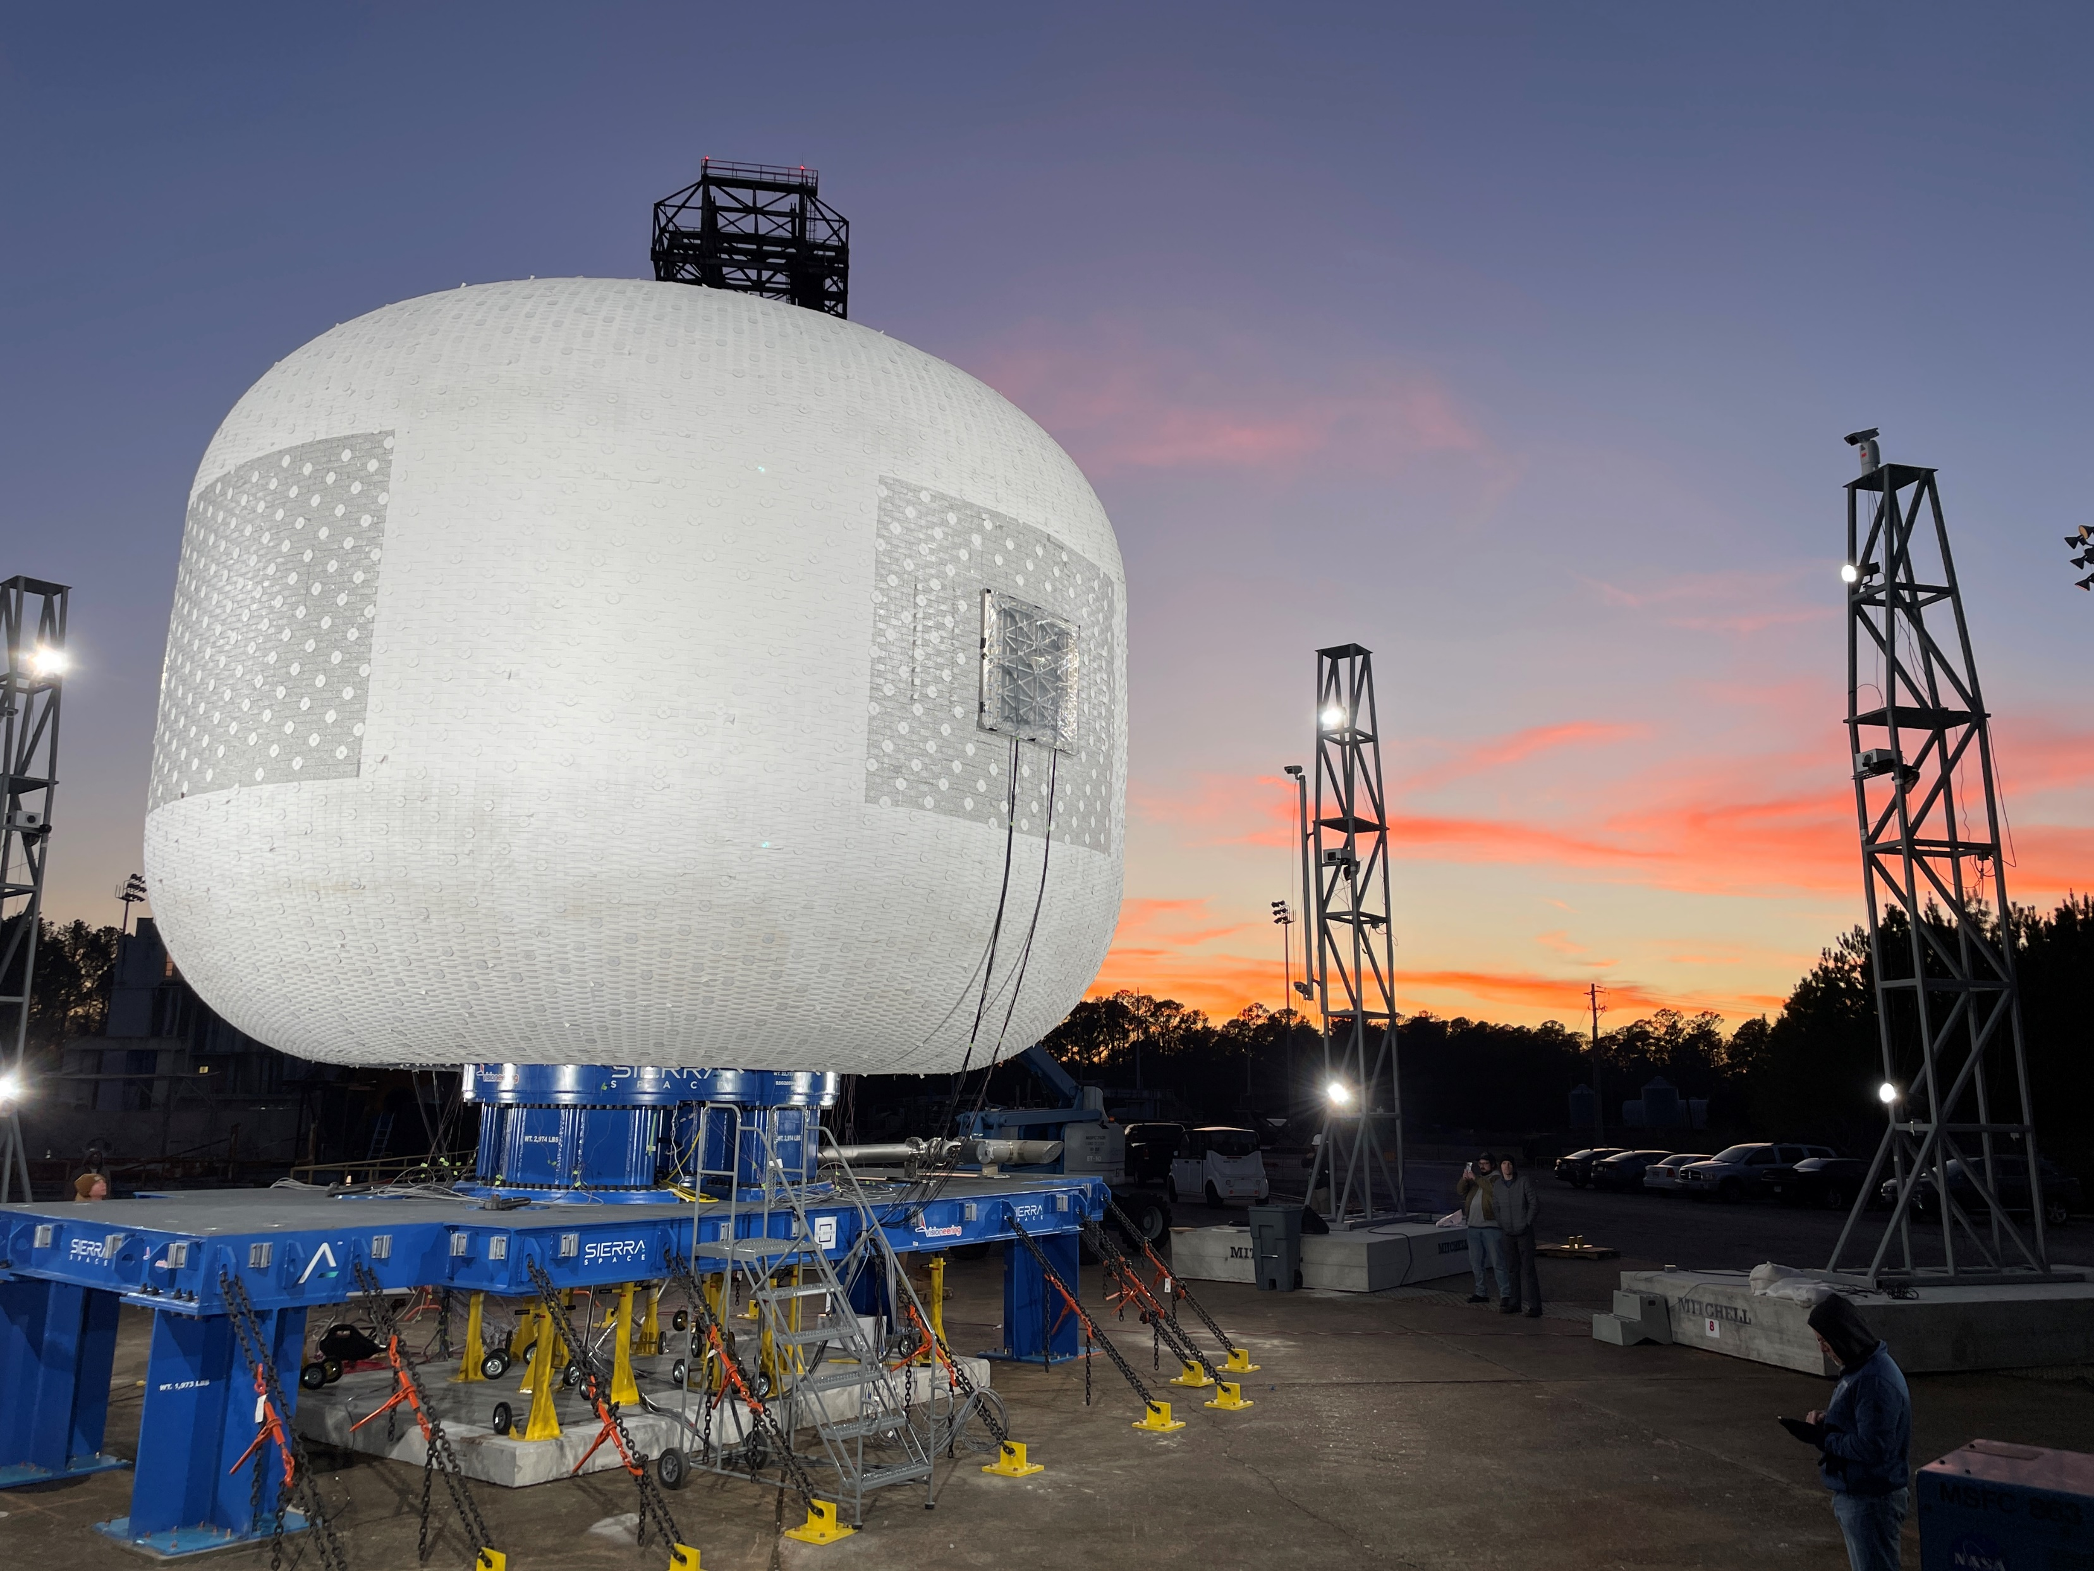
Full-Scale Burst Testing for Inflatable Softgoods
Tracie Prater (HP40), Jonah Burgin (ET10), Tom Jones (HP40), Deanna Whitehead (HP40)
1. Internal Scuff Layer: Protects against punctures and fires
What are inflatable softgoods?
2. Bladder: Keeps air inside the habitat from escaping
Complex, multi-material system in which each layer performs a specific function.
Development of inflatable softgoods for habitation began at NASA in the 1960s.
Softgoods were further matured through NASA’s Transhab project in the 1990s, which focused on development of a Mars transit habitat.
Today NASA is supporting the private sector in development and testing of inflatable softgoods architectures through public-private partnerships.
Inflatable softgoods represent one structural material option for future habitation platforms.
3. Restraint Layer: Structural layer, usually Kevlar or Vectran
4. Micro-meteoroid/ Orbital Debris Shield: Multiple layers protect the structure from impacts
5. Thermal Blanket: Protects the crew from extreme temperatures
6. External Shield: Protects the habitat from erosion by atomic Oxygen or regolith
The use of inflatable softgoods as a primary structural material for habitation elements can enable more mass efficient structures (greater volume per unit mass).
Inflatable softgoods allow mission planners to subvert the “tyranny of the payload fairing,” as softgoods structures can be compactly stowed for launch and deployed at the point of use.
One challenge to implementation of inflatable softgoods is certification, as these materials have not previously been used in long duration habitation scenarios as a primary structure.
NASA has published certification guidance (JSC-67721) which outlines a series of tests to characterize material behavior, understand failure modes, verify factors of safety in the design, and predict the structure’s operational life.
Concept rendering of government reference design for Mars transit habitat. This represents one concept under trade.
What is burst testing?
JSC-67721 (softgoods certification guidance) advises that burst testing for a softgoods architecture should be performed at both the subscale and full-scale.
Ultimate burst testing can:
validate predictive models
verify the material system’s design factor of safety (per NASA-STD-5001)
determine pressure levels for creep testing, where the article is held at some percentage of ultimate burst pressure (UBP) for longer duration
Burst tests of multiple articles can demonstrate repeatability in results.
The full-scale burst test in December 2023 for Sierra Space was the first ever pneumatic burst test of a full-scale softgoods article.
Sierra Space full-scale test article. Test was performed near T-Tower at MSFC in December 2023.
In 2024, MSFC will further enhance burst test capabilities with the Rapid Pressurization Test Area (RPTA).
The Rapid Pressurization Test Area (RPTA) at NASA Marshall Space Flight Center is being developed to support burst testing. It is a state of the art facility in a remote, restricted access location with:
40’ W x 40’ L x 12” T concrete test pad
Modular camera stands on concrete bases which can be re-configured to support customer needs
Variable position fluid valves (accurate control of pressure ramps to burst)
Cross-country gas supply
Permanent power, instrumentation, and control systems to support robust operations
Burst event

