Slide 1
Parahydrogen Properties Version 05 Database Release for NTP Applications
Corey Smith
Senior Nuclear Engineer, AMA
Supported by: Adam Boylston (AMA) and Jonathan McDonald (KBR, Inc.)

Slide 2
Acknowledgements
This work was supported by NASA’s Space Technology Mission Directorate (STMD) through the Space Nuclear Propulsion (SNP) Project
Contract No. 80LARC23DA003

Slide 3
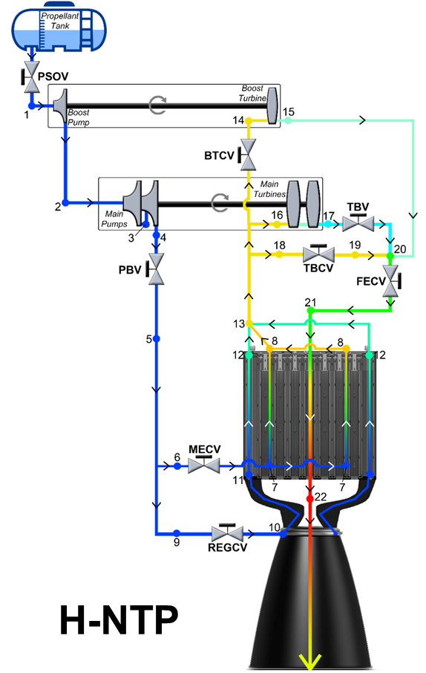
Applicability to Nuclear Thermal Propulsion
Real-gas properties are needed for the full engine cycle (propellant tank to nozzle exit).
NTP engines often utilize parahydrogen as the primary coolant and propellant option to reach the high specific impulse and thrust to enable crewed Mars missions
  Requires high-fidelity fluid property libraries ranging from cryogenic temperatures to thousands of Kelvin
  Pressures ranging from ~0 Pa to 20 MPa
NIST’s REFPROP database only reaches 1000 K and does not account for dissociation, requiring different approaches for high temperatures
  Previous database created by Jon McDonald (Version 03b) utilized statistical mechanics property calculations above 1000 K
  Modern efforts required the generation of a new dataset to account for dissociation effects at high temperature
Maintaining a consistent fluid property database across all NTP modeling efforts creates a baseline when comparing model results.
Notes:
Q: Why not just append CEA results to REFPROP 10 in a manner similar to how you append the SNP calculations?
A: At 20 Mpa and 1000 K, CEA overpredicts the density by 4% and underpredicts sound speed by 3.5%.

Slide 4
Motivations and Objectives
Generation of a new database required extensive software development.
Property Calculation Translation
Usage of a modern, open-source software (Python) for the property database calculations
Removal of localized discrepancies between the version 03b data and Python results along with documentation of findings
Database Creation, Verification, and Advanced Functionality
Correct an error in the fugacity relation and rearrange the equilibrium mole fraction to improve its results
Improve the methodology of melding REFPROP and the a-priori dissociating calculation results since REFPROP does not account for dissociation
Perform extensive verification activities against available high-temperature databases
Creation of a software suite with database creation, plotting, and interpolation options

Slide 5
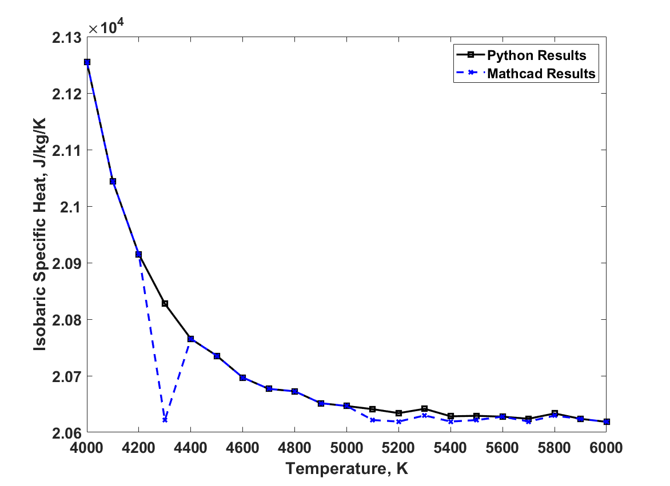
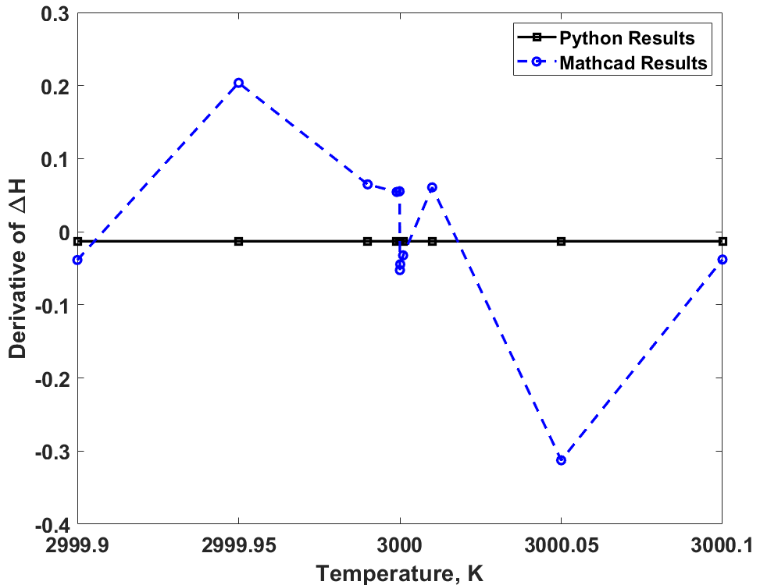
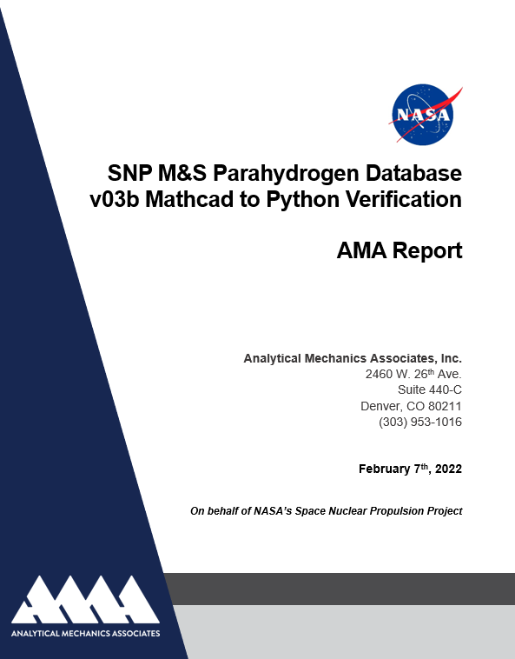
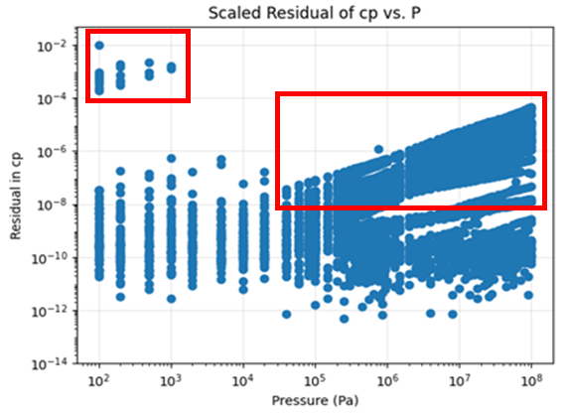

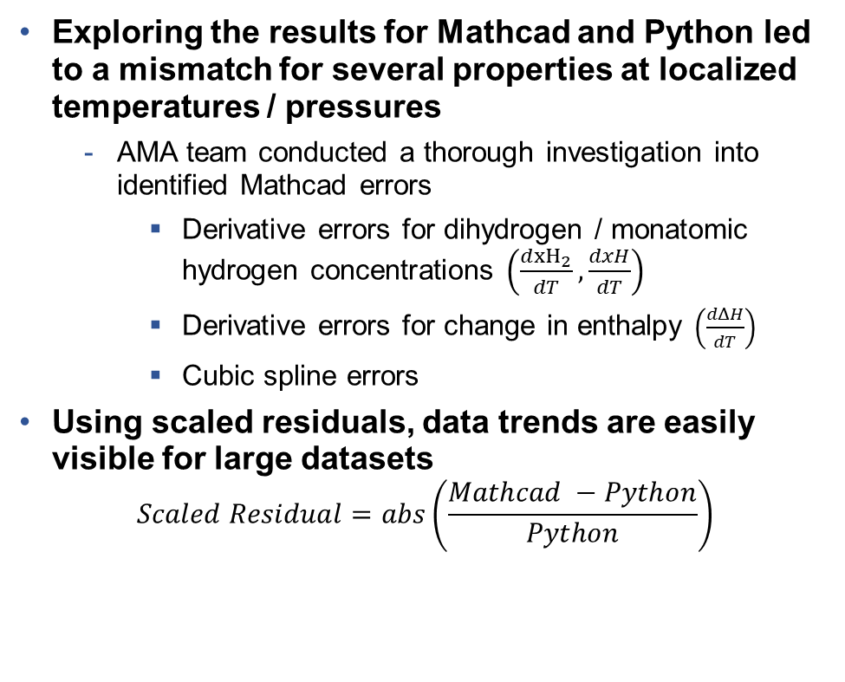

Version 03b Translation to Python
Maximum error of ~5% between python and Mathcad with equivalent methodologies.
Exploring the results for Mathcad and Python led to a mismatch for several properties at localized temperatures / pressures
  AMA team conducted a thorough investigation into identified Mathcad errors
    Derivative errors for dihydrogen / monatomic hydrogen concentrations $\left(\frac{d{xH}_{2}}{dT},\frac{dxH}{dT}\right)$
    Derivative errors for change in enthalpy $\left(\frac{dΔH}{dT}\right)$
    Cubic spline errors
Using scaled residuals, data trends are easily visible for large datasets
$$Scaled Residual=abs\left(\frac{Mathcad −Python}{Python}\right)$$
$$\frac{d{xH}_{2}}{dT}$$
$$\frac{dΔH}{dT}$$

Slide 6
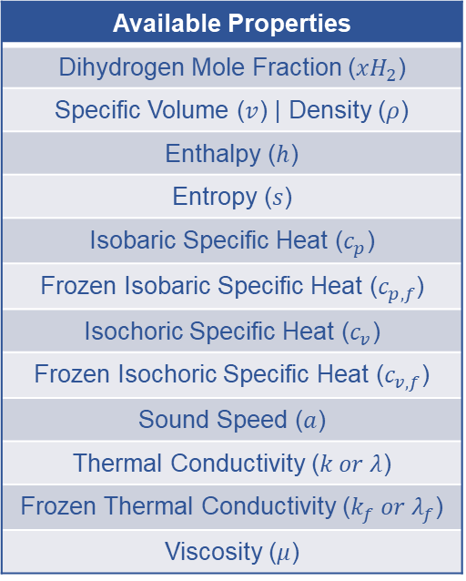
Version 05 Database Creation Capabilities
Calculation routine enhancements removed underlying assumptions and increased fidelity.
Version 05 Improvements:
  Incorporates property data from REFPROP 10 below the parahydrogen dissociation temperature (pressure-dependent)
  Mathcad errors were vetted and removed, including several small typos in the computational routines
  Updated zero-pressure backbone calculations for enthalpy and entropy
  Separation of frozen and equilibrium properties for isobaric specific heat, isochoric specific heat, and thermal conductivity
Validated Temperature and Pressure Ranges:
  13.8 K to 6000 K
  1 Pa to 100 MPa
Available Properties
Dihydrogen Mole Fraction ($xH_{2}$)
Specific Volume ($v$) | Density ($ρ$)
Enthalpy ($h$)
Entropy ($s$)
Isobaric Specific Heat ($c_{p}$)
Frozen Isobaric Specific Heat ($c_{p,f}$)
Isochoric Specific Heat ($c_{v}$)
Frozen Isochoric Specific Heat ($c_{v,f}$)
Sound Speed ($a$)
Thermal Conductivity ($k or λ$)
Frozen Thermal Conductivity ($k_{f} or λ_{f}$)
Viscosity ($μ$)
The validated temperature and pressure range cover any possibly observed conditions in an NTP engine cycle.

Slide 7
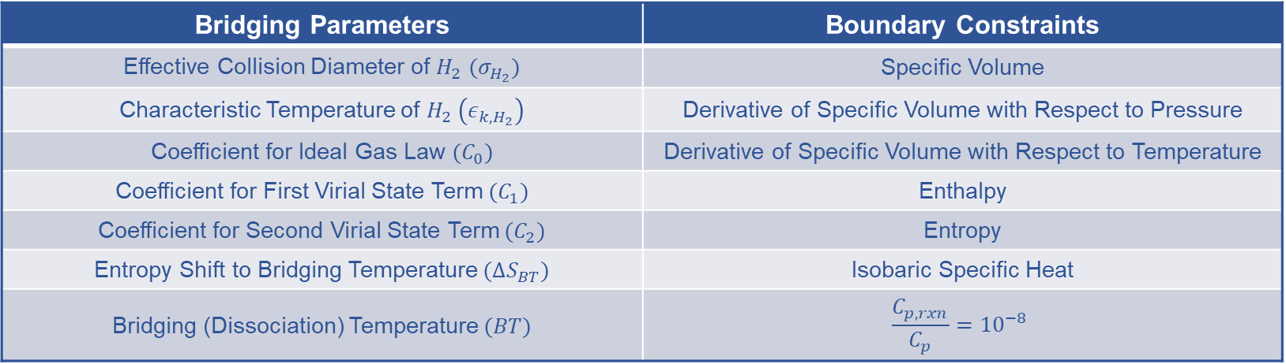
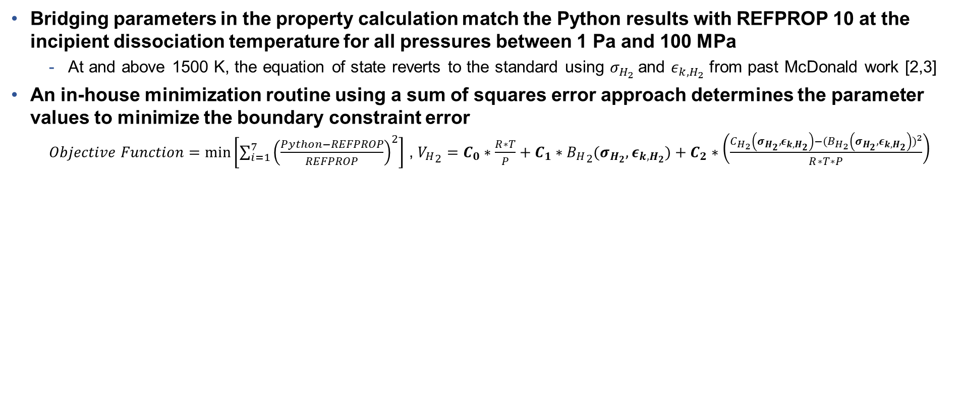
Bridging Parameters Methodology
A set of seven pressure-dependent values connect REFPROP to the high-temperature properties.
Bridging parameters in the property calculation match the Python results with REFPROP 10 at the incipient dissociation temperature for all pressures between 1 Pa and 100 MPa
  At and above 1500 K, the equation of state reverts to the standard using $σ_{H_{2}}$and $ε_{k,H_{2}}$ from past McDonald work [2,3]
An in-house minimization routine using a sum of squares error approach determines the parameter values to minimize the boundary constraint error
  $Objective Function=\min\left[\sum_{i=1}^{7}{{\left(\frac{Python−REFPROP}{REFPROP}\right)}^{2}}\right]$ , ${V_{H}}_{2}=C_{0}∗\frac{R∗T}{P}+C_{1}∗{B_{H}}_{2}(σ_{H_{2}},ε_{k,H_{2}})+C_{2}∗\left(\frac{C_{H_{2}}\left(σ_{H_{2}},ε_{k,H_{2}}\right)−{(B}_{H_{2}}{\left(σ_{H_{2}},ε_{k,H_{2}}\right))}^{2}}{R∗T∗P}\right)$
Bridging Parameters | Boundary Constraints
Effective Collision Diameter of $H_{2}$ $(σ_{H_{2}})$ | Specific Volume
Characteristic Temperature of $H_{2} \left(ε_{k,H_{2}}\right)$ | Derivative of Specific Volume with Respect to Pressure
Coefficient for Ideal Gas Law $(C_{0})$ | Derivative of Specific Volume with Respect to Temperature
Coefficient for First Virial State Term $(C_{1})$ | Enthalpy
Coefficient for Second Virial State Term $(C_{2})$ | Entropy
Entropy Shift to Bridging Temperature $(ΔS_{BT})$ | Isobaric Specific Heat
Bridging (Dissociation) Temperature $(BT)$ | $$\frac{C_{p,rxn}}{C_{p}}={10}^{−8}$$
Parahydrogen Properties v05 Database Release

Slide 8
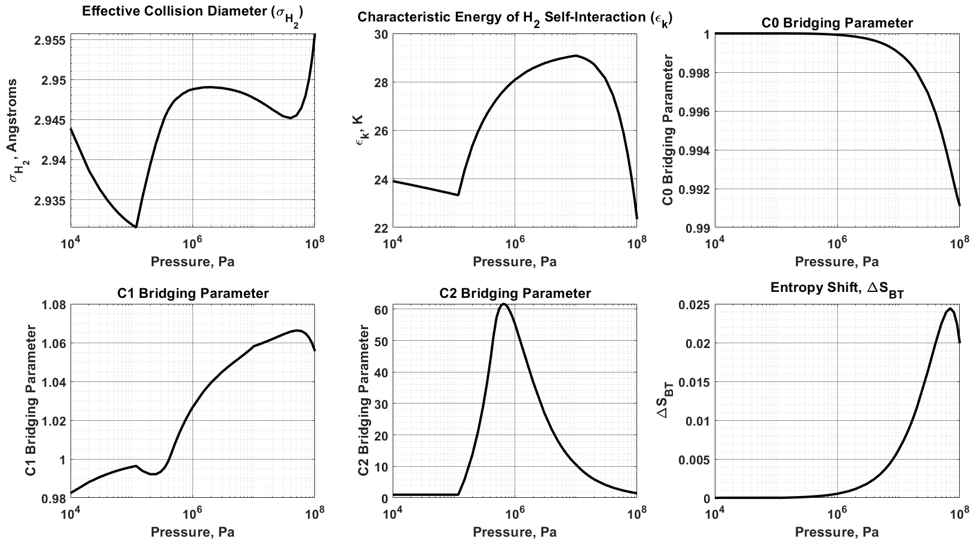
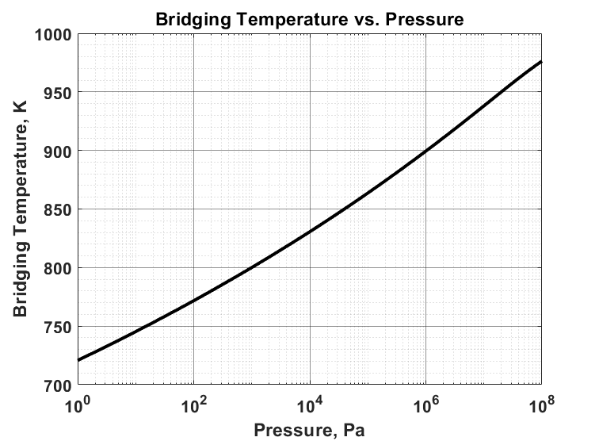
Final v05 Database Bridging Parameters
These curves enable a smooth ‘bridging’ of REFPROP and the dissociating properties.
Trends in the bridging parameters exhibit good behavior between 10 kPa and 100 MPa. Properties below 10 kPa use the parameters at 10 kPa due to ideal gas law assumptions.

Slide 9
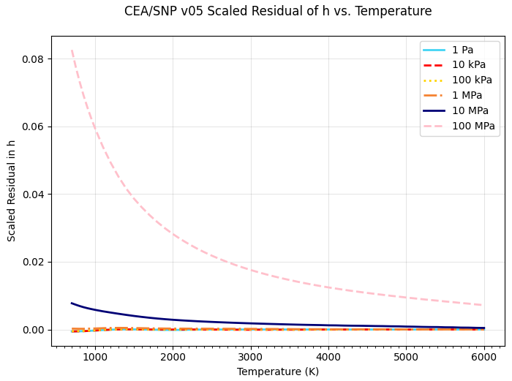
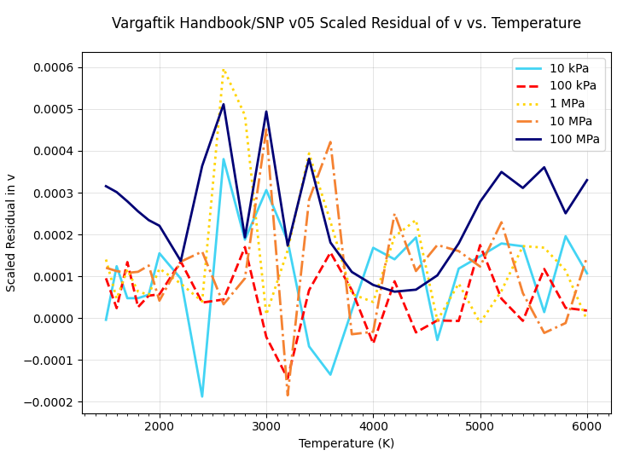
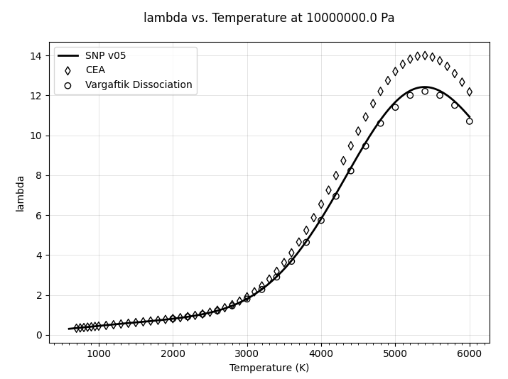
Results Verification Activities
SNP v05 database compared with several heritage sources to identify any inaccuracies.
Investigation focused on three primary databases for comparison
  National Bureau of Standards (NBS) – Monograph 168, NASA’s Chemical Equilibrium with Applications (CEA) [6], and the Vargaftik (1996) tabulations of the late 1960’s work of Gorykin [5,8]
  Internal analysis showed that NBS 168 contained substantial error in entropy, leading to its removal from our V&V

Slide 10
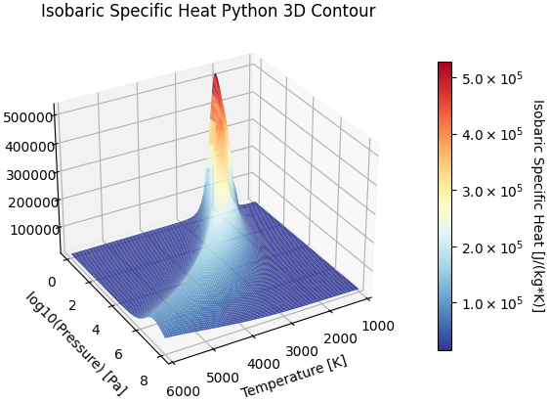
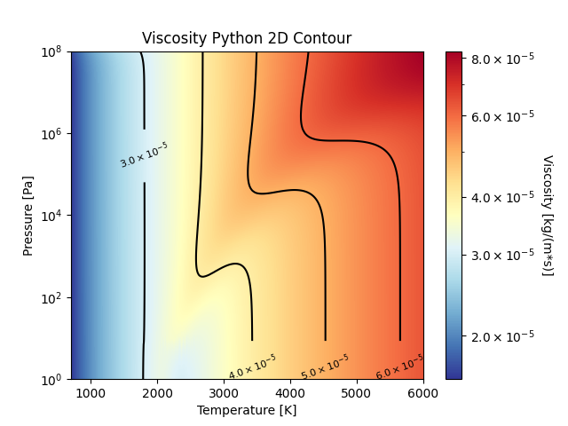
Advanced Database Features
Increasing the number of applicable use cases improves the user’s modeling capabilities.
Multidimensional Plotting:
  2D contour and 3D surface plots are available for each property
  Comparison plots to the verification datasets are also available
Interpolation:
  User can choose between generating databases and interpolating
    Interpolation is faster for large datasets but loses some accuracy away from spline inputs
    Advanced regression techniques improves interpolation accuracy
  Ability to use inputs other than temperature/pressure to solve for resulting properties
High-Fidelity Software Integration:
  Ongoing collaboration with Idaho National Laboratory and its subcontractors to introduce the version 05 database into MOOSE

Slide 11
Conclusions and Potential Forward Work
Version 05 will likely be the final high-temperature database for some time.
Following technical peer review, the database will be released to SNP M&S personnel for integration into pre-existing models
  Version 05 will become the primary SNP property database given the errors found with version 03b
  In-house capabilities to create finer or coarser mesh databases for niche use cases
  Database release will include final report with code appendices
Code efficiency reduces runtime while maintaining high accuracy
  Incorporation of parallel processing since each run is independent
  Reduction on per property calculation time with high-fidelity interpolation and regression
Future database development ideas include:
  Higher-fidelity analysis of properties in the low temperature regime (less than 100 K)
  Improvements to the python API to fit user needs
  Further enhancements to the computation time requirement to generate large databases

Slide 12
Additional Acknowledgements and References
REFERENCES
[1] R. M. Bliesner, "Parahydrogen-Orthohydrogen Conversion for Boil-Off Reduction from Space Stage Fuel Systems," Washington State University (2013).
[2] J. P. McDonald, "Re-creation of the Calculations Behind the Dissociating Dihydrogen Thermodynamic Property Tables of Vargaftik et al.," Jacobs ESSSA Group, Huntsville, AL (2017).
[3] J. P. McDonald, "Reconciling the Dihydrogen Property Calculations of McDonald (2017) to the REFPROP 9.1 Dataset," Jacobs Space Exploration Group, Huntsville, AL (2018).
[4] I. H. Bell, J. Wronski, S. Quoilin and V. Pourpoint, "Pure and Pseudo-Pure Fluid Thermophysical Property Evaluation and the Open-Source Property Library CoolProp," Industrial and Engineering Chemistry Research, vol. 53, no. 6, pp. 2498-2508 (2014).
[5] N. B. Vargaftik, Y. K. Vinogradov, V. S. Yargin, "Handbook of Physical Properties of Liquids and Gases – Pure Substances and Mixtures," 3rd Augmented and Revised Edition, Begell House, New York (1996).
[6] B. J. McBride, M. J. Zehe, and S. Gordon, "NASA Glenn Coefficients for Calculating Thermodynamic Properties of Individual Species," NASA Report TP-2002-211556 (2002).
[7] C. D. Smith, A. D. Boylston, J. P. McDonald, "SNP M&S Parahydrogen Database v03b Mathcad to Python Verification," Analytical Mechanics Associates / NASA Report (2022).
[8] P. M. Kessel’man, A. S. Bestuzhev, Y. I. Blank, A. S. Litvinov, "Transport Coefficients of Water Vapor and Air at T = 1000 - 6000 K with Account of Their Thermal Dissociation," Heat and Mass Transfer, Vol. 7, Energiya Press, Moscow-Leningrad (1968).

Slide 13
Questions?
Corey Smith
corey.d.smith@ama-inc.com
corey.d.smith@nasa.gov

