Slide 1
Space Launch System (SLS) Human Factors Engineering Modeling & Analysis
Human Systems Integration & Engineering
Department of Defense Human Factors Engineering
Technical Advisory Group (DoD HFE TAG) 2024
Brooke Allen
NASA Marshall Space Flight Center
Becky MacLaren
Jacobs/Jacobs ESSCA Group
April 2024

Slide 2
Space Launch System (SLS) Human Factors Engineering
Modeling & Analysis
The Human Systems Integration & Engineering (HSI&E) team at NASA’s Marshall Space Flight Center (MSFC) strives to advocate for the humans in the loop of Space Launch System’s (SLS) ground operations.
Using assessment methods like human simulation, virtual reality, and physical mockups, both flight hardware and ground support equipment (GSE) are evaluated for human integration.
Those ranging from 5th percentile female (approximately 5’2” tall) to 95th percentile male (approximately 6’2” tall) should be able to perform all SLS stacking operations.
Operations include element physical mates, element electrical mates, and testing activities.

Slide 3
Space Launch System (SLS) Human Factors Engineering
Modeling & Analysis
SLS PAYLOAD ADAPTER (PLA)
The PLA has been designed and constructed in-house at MSFC.
It serves as an adapter between the Exploration Upper Stage (EUS) and the Co-Manifested Payload (CPL).

Slide 4
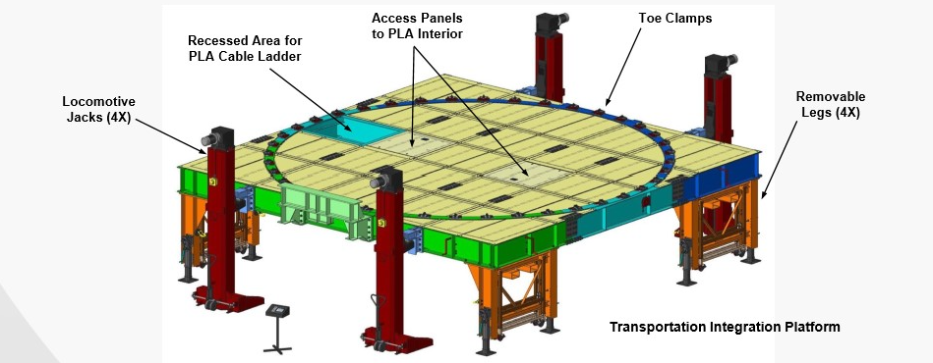
Space Launch System (SLS) Human Factors Engineering
Modeling & Analysis
TRANSPORTATION & INTEGRATION PLATFORM (TIP)
The TIP has been designed and constructed in-house at MSFC and serves as ground support equipment (GSE).
Used to transport PLA to Kennedy Space Center (KSC) for stacking in the Vertical Assembly Building (VAB).

Slide 5
Space Launch System (SLS) Human Factors Engineering
Modeling & Analysis
ACCESS TO PLA CABLES FOR TESTING
Analysis Objectives:
Determine if personnel can access and retrieve PLA cables for testing activities.
Verify all applicable requirements
Methodology:
Using Siemen’s Process Simulate Human modeling software, analyze if both a 5th percentile female and 95th percentile male can complete the task.
Procedure:
Task is designed to be completed by reaching through an opening in the side of the TIP. From there, personnel should be able to reach cable bundles from the cable ladder and pull the cables through the TIP opening for testing activities.
Assumption: Cable bundles will be attached to the bracket (2-3” below the cable ladder)

Slide 6
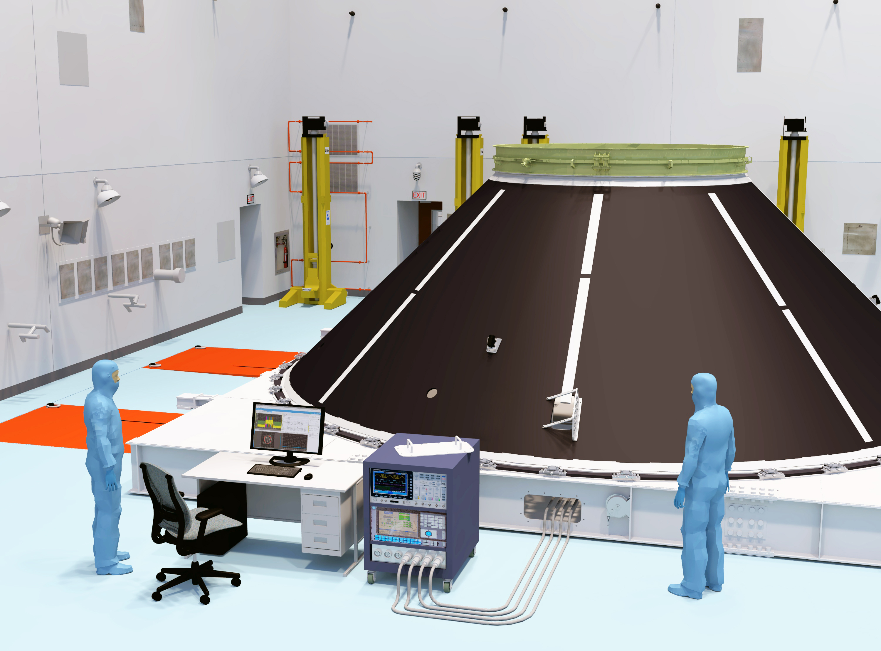
Space Launch System (SLS) Human Factors Engineering
Modeling & Analysis
ACCESS TO PLA CABLES FOR TESTING

Slide 7
Space Launch System (SLS) Human Factors Engineering
Modeling & Analysis
APPLICABLE REQUIREMENTS
Analysis was performed to validate applicable system level SLS-RQMT-161 and Level 4 SLS-SPIE-RQMT-028 HSI Requirements
Requirement Number​ | Text​ | Verification Method​
SLS-HSIR-001​ | Worksites for ground processing tasks shall be sized for the 5th female to 95th male percentiles ground crew population.​ | Analysis​
SLS-HSIR-005​ | SLS hardware and translation paths shall be designed to protect ground crews against injury from sharp edges.​ | Analysis​
SLS-HSIR-018​ | The system shall be designed to provide work envelope volumes needed to perform ground processing tasks.​ | Analysis​
SLS-HSIR-019​ | The system shall provide reach envelope volumes needed to perform ground processing tasks.​ | Analysis​
SLS-HSIR-020​ | The system shall be designed to provide the ground crew visual access needed to perform ground processing tasks.​ | Analysis​
SLS-HSIR-033​ | Components that require inspection shall be accessible during ground processing.​ | Analysis​
SLS-HSIR-034​ | The system shall provide access to components that are part of ground processing tasks.​ | Analysis​
SLS-HSIR-035​ | The system should provide direct line-of-sight visual access to all equipment, except blind-mate connectors.​ | Analysis​

Slide 8
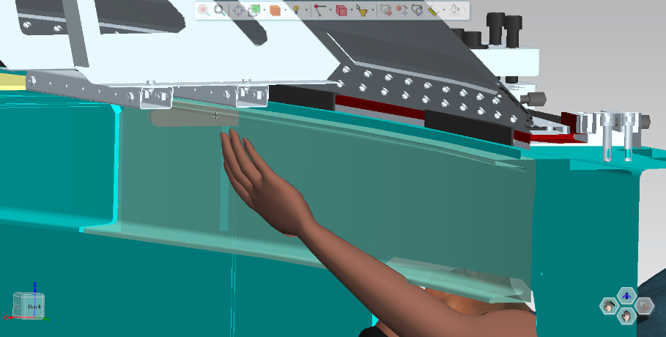
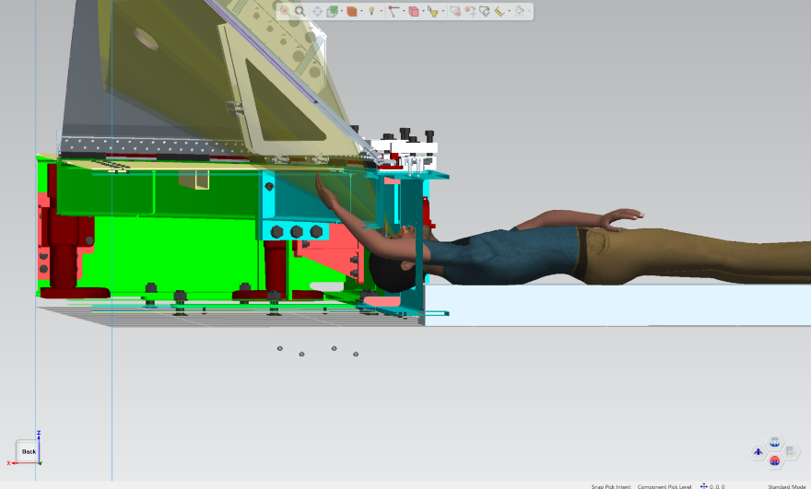
Space Launch System (SLS) Human Factors Engineering
Modeling & Analysis
95th percentile male
Limited reach access
No visual access (due to C-beam)

Slide 9
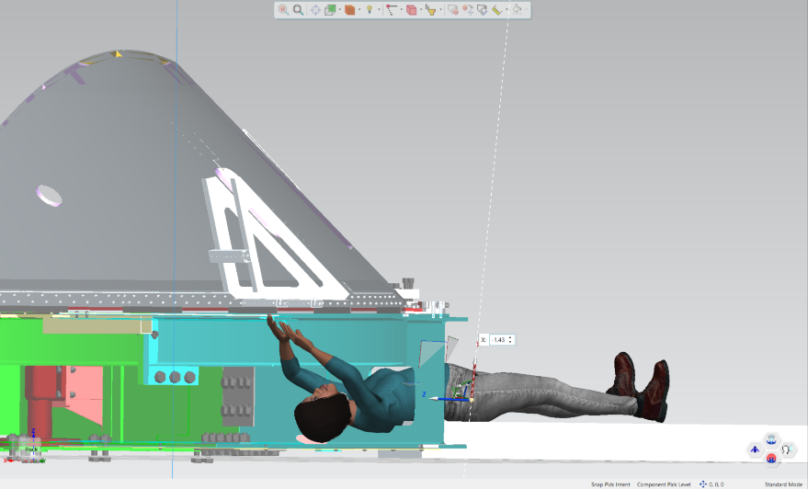
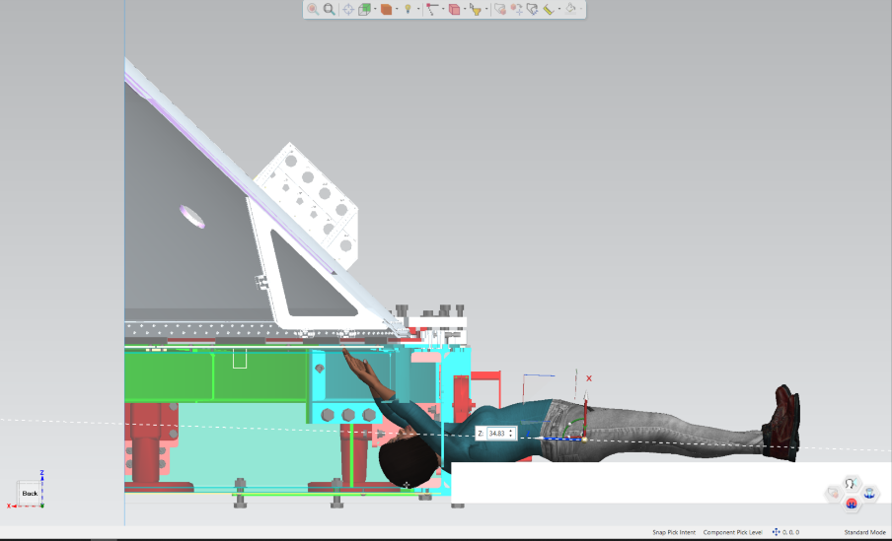
Space Launch System (SLS) Human Factors Engineering
Modeling & Analysis
5th percentile female
Position 1: Torso through opening
No access due to interference with TIP opening
Position 2: Head and arms through opening
No visual access or reach access due to C-beam

Slide 10
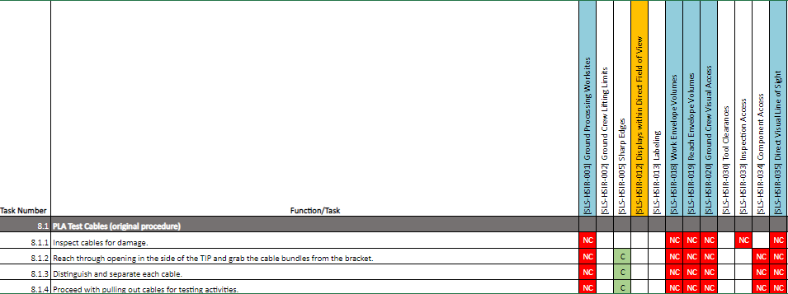
Space Launch System (SLS) Human Factors Engineering
Modeling & Analysis
COMPLIANCE MATRIX

Slide 11
Space Launch System (SLS) Human Factors Engineering
Modeling & Analysis
RECOMMENDED PROCEDURE
Because personnel can’t reach the PLA cables through the opening in the side of the TIP as proposed, HSI&E analyzed another method for access.
It is recommended that a panel of the TIP be removed, and the cables be accessed through the bottom of the TIP.
Personnel would need stepladders to reach the cable bundles.

Slide 12
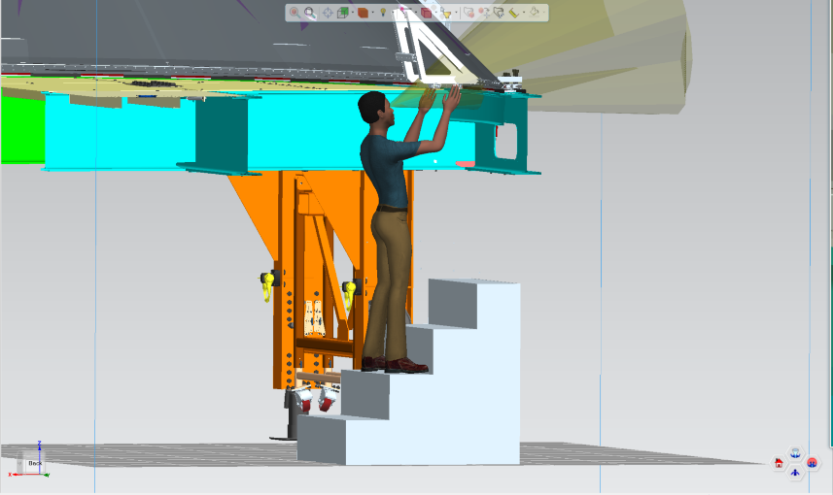
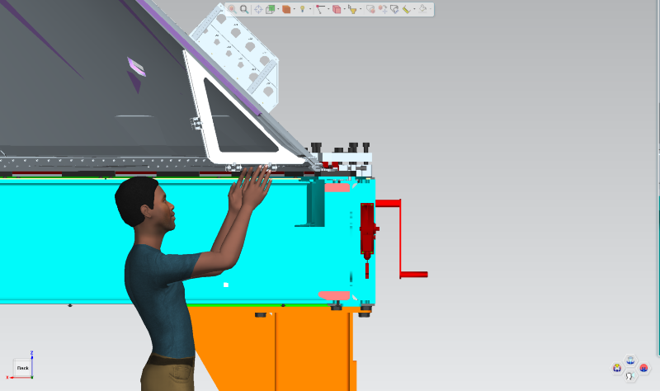
Space Launch System (SLS) Human Factors Engineering
Modeling & Analysis
95th percentile male
Reach access
Visual access
24''

Slide 13
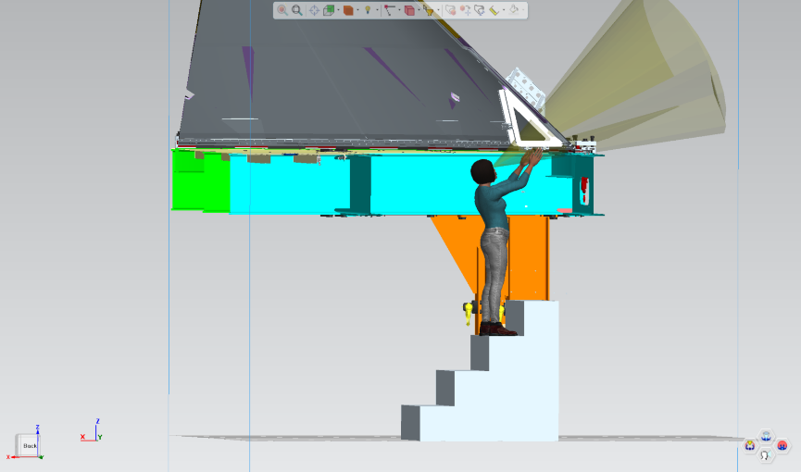
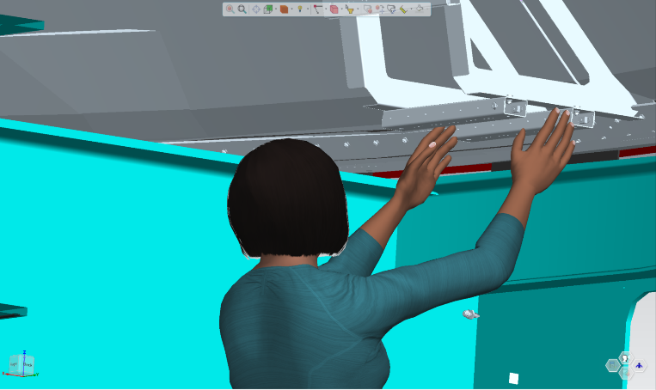
Space Launch System (SLS) Human Factors Engineering
Modeling & Analysis
5th percentile female
Reach access
Visual access
36''

Slide 14
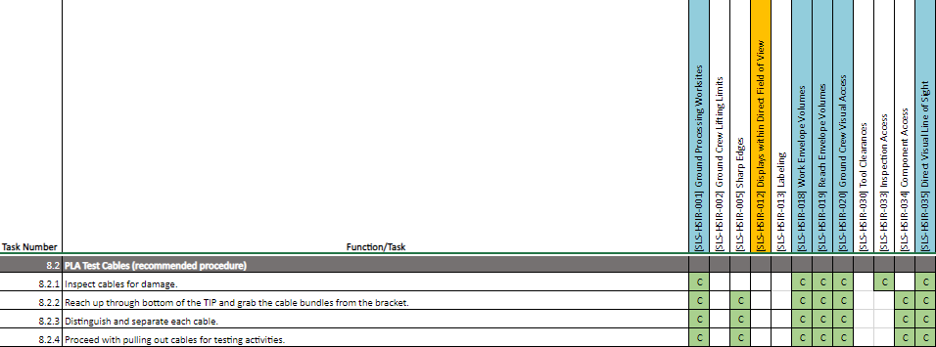
Space Launch System (SLS) Human Factors Engineering
Modeling & Analysis
COMPLIANCE MATRIX

Slide 15
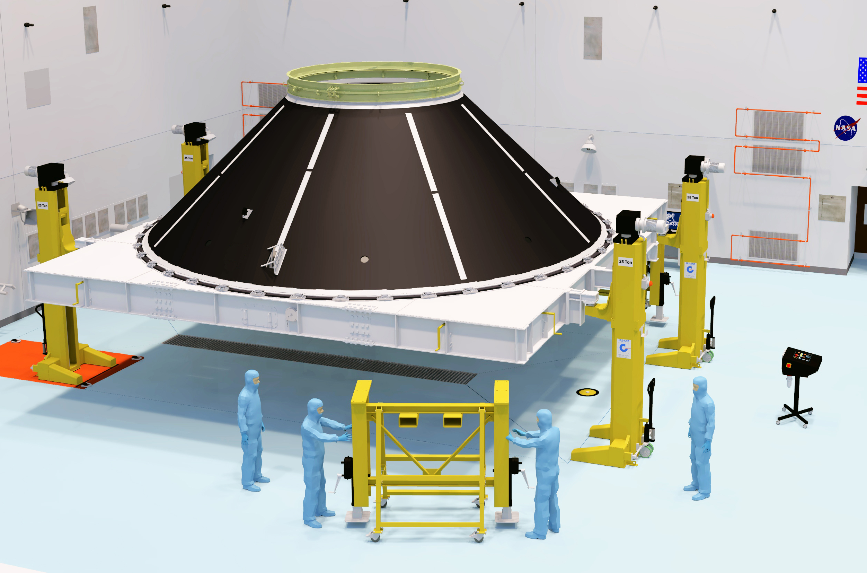
Space Launch System (SLS) Human Factors Engineering
Modeling & Analysis
CONCLUSION
When the PLA cables are accessed through the bottom of the TIP, both the 5th percentile female and 95th percentile male have reach and visual access. This recommended procedure satisfies all applicable HSIR’s.
RISKS
Change of procedure (hardware configuration)
Original procedure: TIP legs are removed and TIP is resting on the internal jacks.
Recommended procedure: TIP legs are installed and panel is removed.
Affects schedule
Affects cost

Slide 16
Space Launch System (SLS) Human Factors Engineering
Modeling & Analysis
PERFORMANCE
In this case, the original design does not work for the task. However, designers confirmed that the proposed plan is an option.
Trade-offs between machines and their human counterparts are common in human factors engineering; however, this project is an exception.
The new proposed plan to access the PLA through the bottom of the TIP was welcomed by designers – advocating for the human.
Although typically there is a trade-off between system performance and human performance, the design of the TIP allows for procedural change with minor risks involved (schedule, time, cost).

Slide 17
Thank You
Brooke Allen
brooke.allen@nasa.gov
Becky MacLaren
rebecca.maclaren@nasa.gov

