Slide 1
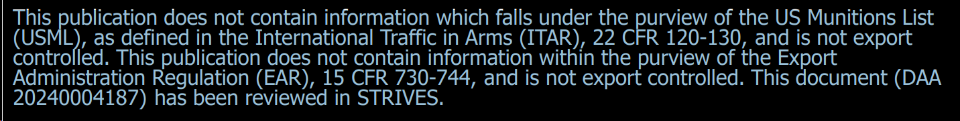
Discrete Event Simulation-based Timeline Validation Using R2U2
James B. Dabney, University of Houston – Clear Lake
Michael Whitzer, NASA JSC
Julia M. Badger, NASA JSC
May 2024

Slide 2
Overview
  Background
    Gateway VSM Autonomy
    Timeline generation
    Timeline verification
  Timeline modeling
  R2U2 overview
  Generating R2U2 input
  Verification
  Conclusions and Future Work

Slide 3
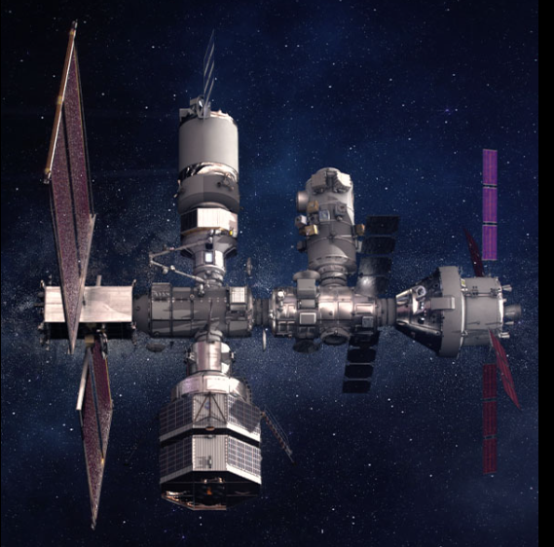
Lunar Gateway
Artemis space station in cislunar (NRHO) orbit
Gradual buildup of modules
Initial Co-Manifested Vehicle
  Habitation and Logistics Outpost (HALO)
  Power and Propulsion Element (PPE)
Sustaining
  International Habitation Module (IHAB)
  Airlock
  Visiting vehicles – Orion spacecraft

Slide 4
Vehicle System Manager
Four management functions
Integrates modules; interfaces with humans and visiting vehicles
Fully autonomous when uncrewed and no active ground control
Can dial down autonomy to collaborate with flight crews and ground in operating vehicle

Slide 5
Timeline Generation
Sequence of tasks to accomplish mission objectives
Can run for extended time periods
Simple task single action at specified time and specified duration
Compound tasks (TrEX) that contain branching, event triggers, handle uncertainty
A timeline can be a complex state machine with many branches

Slide 6
Gateway VSM Timelines
Created on the ground
Validated
Uplinked to Gateway
Executed autonomously or semi-autonomously (when crewed)

Slide 7
Timeline Validation Tool Requirements
Requires high-fidelity simulation
  Detailed, final validation checks before uplinking timeline to Gateway
  Simulation of each individual command within task procedures
    Telemetry returned from simulation for each command and states updated at each
    Requires detailed model of Gateway systems that will produce accurate and representative telemetry feedback in response to commands
    Validation checks performed at each command of each procedure associated with each task on timeline
TrEX Procedures
  Possible conflicts among commands in parallel tasks with uncertain sequences

Slide 8
Timeline Validation Alternatives
Model checking (such as TLA+/PlusCal)
  Complete coverage of state-space
  Requires tool to convert timeline into state machine model
  Susceptible to state-space explosion due to complexity of timelines
Direct simulation
  Monte Carlo simulation using flight software test facility
  Excellent fidelity
  Test system runs at real time or small multiple of real time
Discrete event timeline simulation
  Potential for rapid execution as each step is an event
  Requires models of tasks and TrEX procedures
Selected approach
  Discrete event timeline simulation
  Augmented with small number of direct simulation cases

Slide 9
Behaviors
Timeline Validation Behavior | Approach
Detailed final validation checks | Use R2U2 validation rule base of assume-guarantee contracts
Simulation of each command | Data structure representing each possible outcome and probability of occurrence
Telemetry returned from each command and state update | Tool produces event sequence input to R2U2 which produces verdict sequence – each Monte Carlo trial
Detailed model of Gateway systems | Treat each system as stochastic black box with set of possible outcomes, each with probability of occurrence. Variable execution times represented as continuous random variables with specified probability density function
Branching logic | Represented with probability model
Variable timing | Treat end time as continuous random variable
Conflicts among parallel tasks | Detected in R2U2 check of event sequence

Slide 10
Key Features
Check that timeline is feasible
  Nominal scenarios with dispersed timing
  Off-nominal, faults
Model MSM behavior as black box with uncertain response
Perform many trials rapidly
Check the generated event sequence using assume-guarantee contracts implemented in R2U2

Slide 11
Assume-Guarantee Contracts
AGCs define expected behavior of systems, subsystems, components
Assumptions or pre-conditions on the subsystem’s inputs bound the conditions in which the contract applies
Guarantees or post-conditions of a subsystem’s contract declare conditions that the subsystem’s outputs must satisfy and can serve as verification goals
Contracts can be used to define safety properties or hazard controls:
  E.g., a car should not start unless the transmission is in park mode
  Can be converted to a mathematical specification and model checked to ensure that specified system has the desired behavior and safety properties
Notes:
See if you can convert this into a graphic

Slide 12
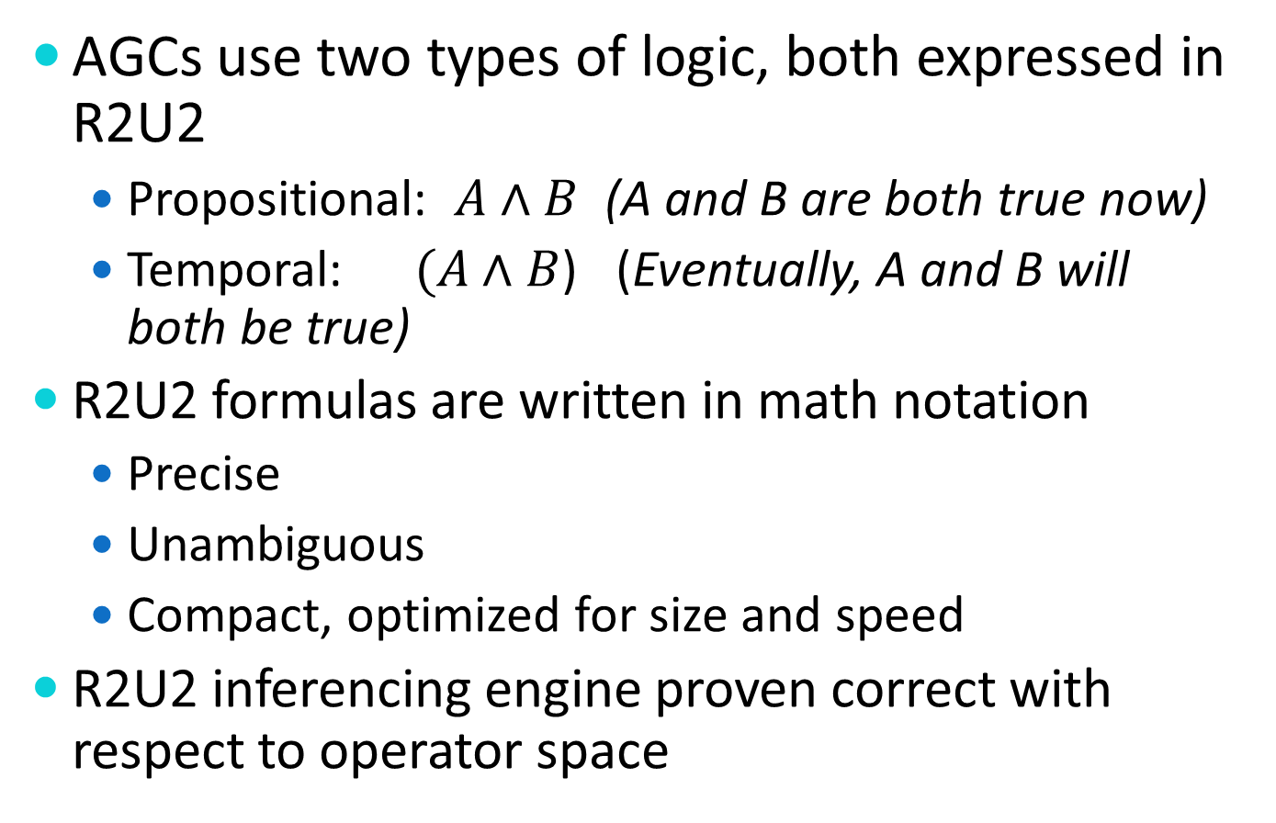
Specifying Contracts
AGCs use two types of logic, both expressed in R2U2
  Propositional: $A∧B$ (A and B are both true now)
  Temporal:$(A∧B$) (Eventually, A and B will both be true)
R2U2 formulas are written in math notation
  Precise
  Unambiguous
  Compact, optimized for size and speed
R2U2 inferencing engine proven correct with respect to operator space

Slide 13
Inputs & Outputs
Inputs
  Nominal timeline
  Set of possible outcomes for each task ID number
    Probability of occurrence of each
    Probability density functions for times and other continuous variables
  R2U2 input file
    Filter commands
    MLTL formulas
Outputs
  Set of event sequences
  Set of verdict sequences

Slide 14
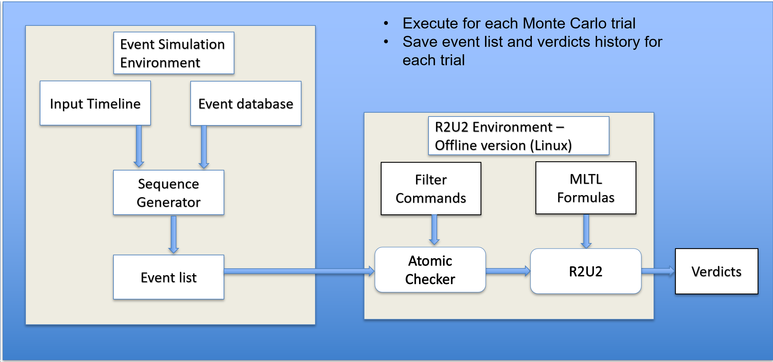
Logical View of Architecture

Slide 15
Tool Development Status
Preliminary tool implemented and tested using small scale timelines
Working with Iowa State R2U2 team to adapt runtime environment for rapid offline execution verdict stream capture

Slide 16
Lessons Learned & Future Work
Discrete event approach is promising
  Permits coverage of large state space in reasonable time
  Exploits experience with R2U2 in VSM flight software
Future work
  Extend to real timelines
  Implement TrEX models
  Integrate with R2U2

