Slide 1
iROSA Computational Model Development and Integration for the International Space Station
Steven Korn
NASA Glenn Research Center
Space Power Workshop 2024

Slide 2
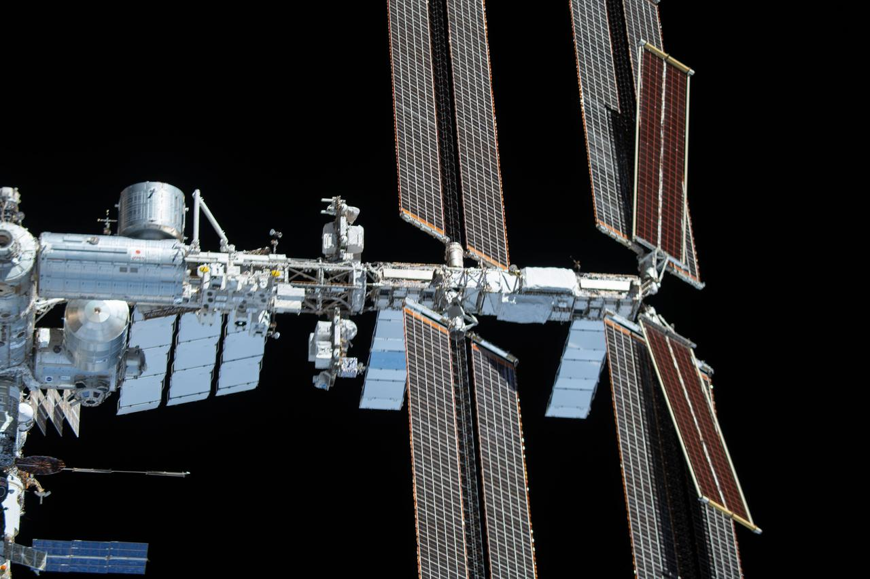
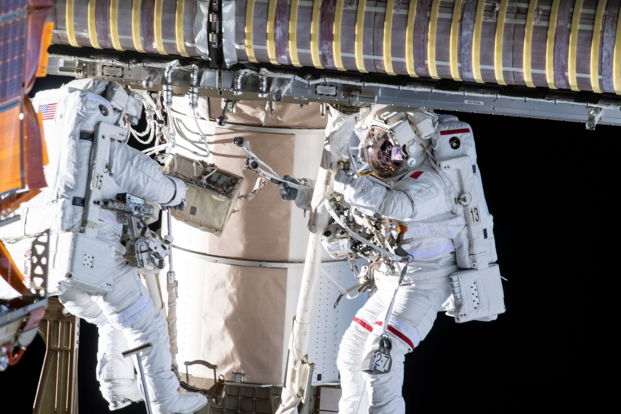
iROSA Installation

Slide 3
Task for SPACE-ISS Team
Our team models the EPS of the ISS using SPACE.
Therefore, we needed to develop and integrate the iROSA into our model.
  Building up iROSA power calculations
  Developing new shadowing methodologies
  Integrating the changes into our model
  Evaluate the completed model ahead of flight

Slide 4
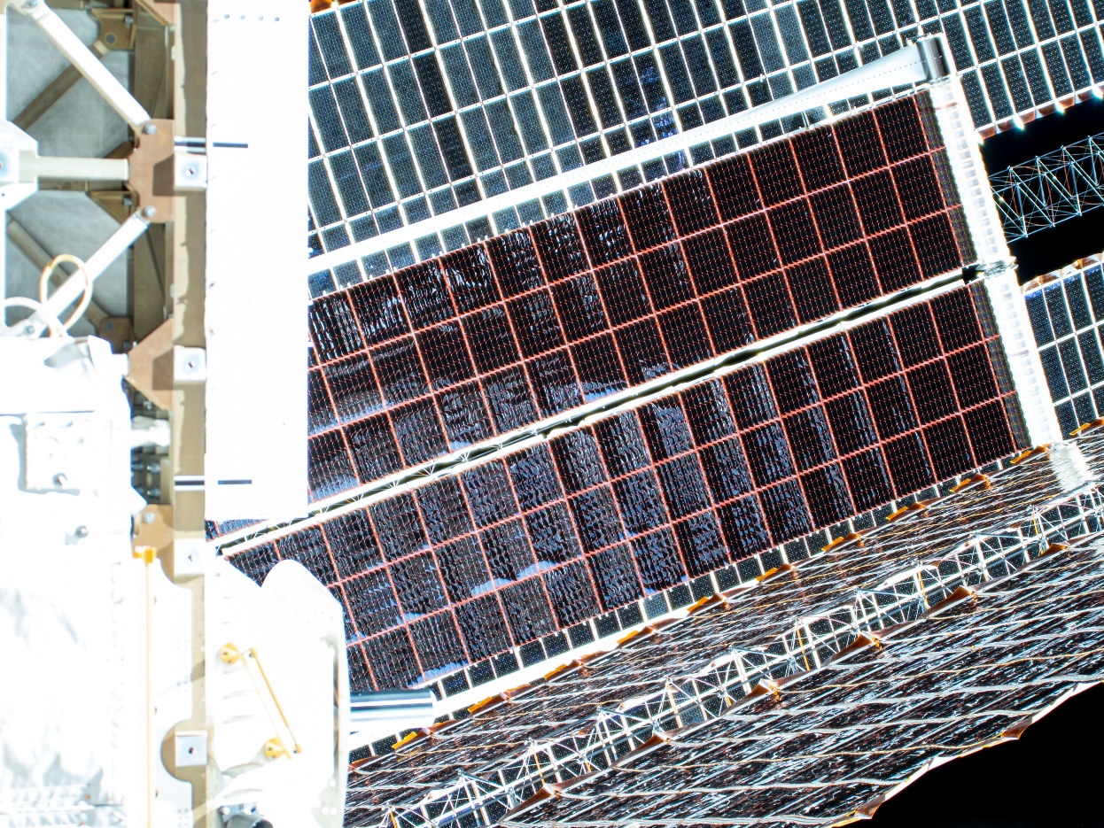
New Cells and Layout
Different Solar Cell IV Curve
Different Solar Cell Size
Different Degradation Rates
Different Temperature Coefficients
Different Harnessing Resistances
Different Solar Absorptance and Emittance
Different Number of Cells per String

Slide 5
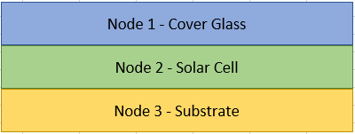
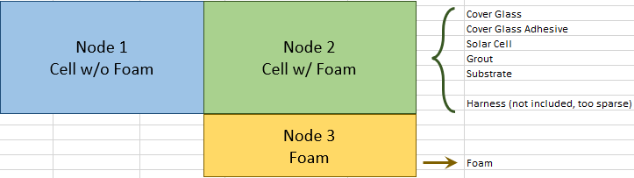
Different Thermal Model
Traditional Node Design
iROSA Node Design

Slide 6
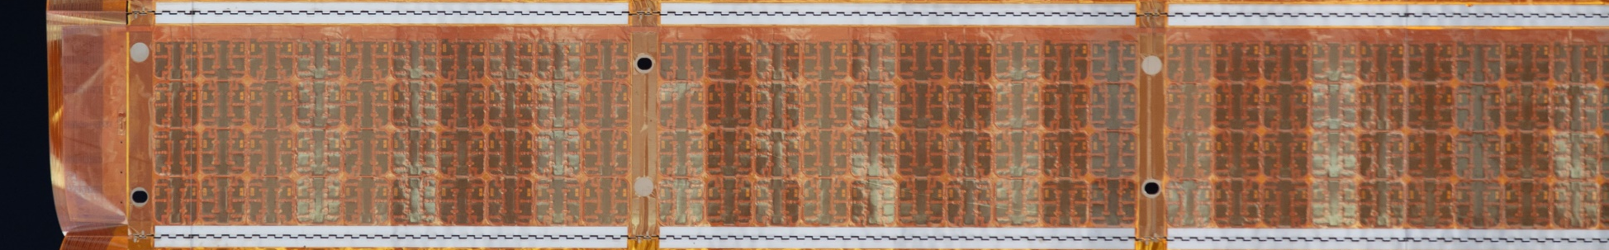
New Shadowing Algorithms
82 panels per blanket
Legacy
25 bypass diodes along panel
iROSA
32 panels along blanket
Legacy Blanket:
25 bypass diodes per panel
82 panels per blanket
iROSA Blanket:
18 x 256 bypass diodes per blanket
18 cells along width
256 cells along length

Slide 7
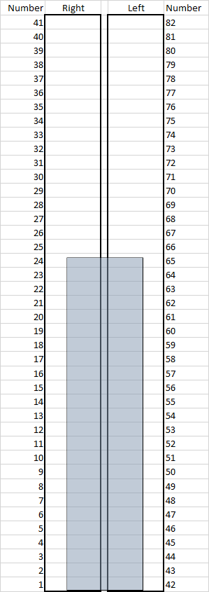
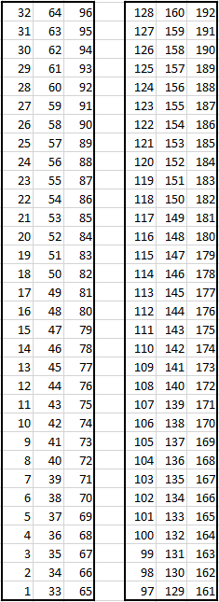
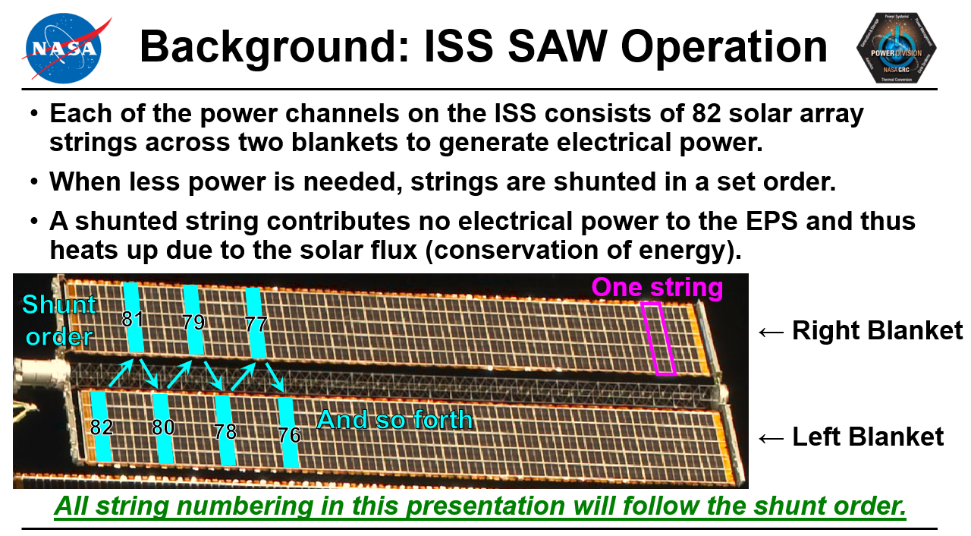
String Mapping
iROSA strings replace Legacy strings nearest the base of the array
Need to map via the shunt order
See 2019 SPW presentation

Slide 8
Calculating Power Correctly
Is string Legacy or iROSA?
Is the string failed?
IV Curve Magic
Full Sun
Shunt Order
No Sun
Partial sun

Slide 9
Calculating Power Correctly
iROSA
iROSA
Power Requested
Legacy
Legacy
iROSA
iROSA
Shunt Order
Legacy
Legacy
iROSA
iROSA
Legacy
Legacy
Everything left is shunted

Slide 10
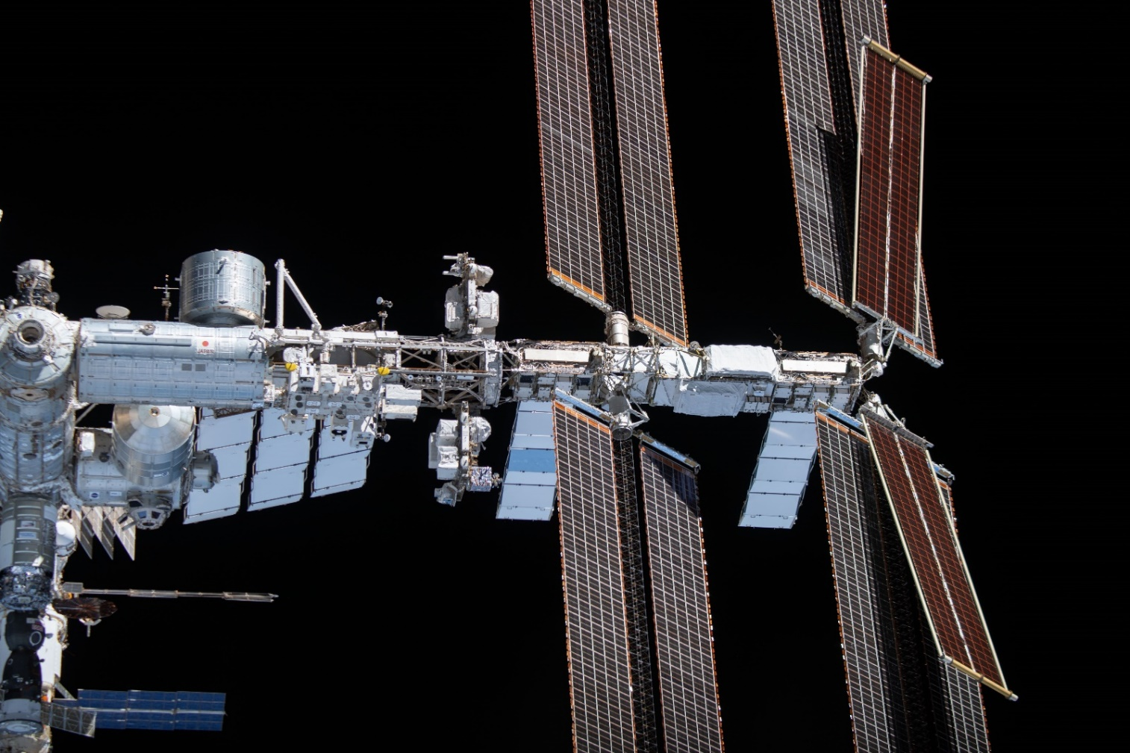
Model Checkout - Fun Bugs
0K is not OK
I don’t feel like it today
Stick it where the Sun don’t shine?
iROSA Temperatures below Absolute Zero
Negative power while in the Sun
Cant in the wrong direction (some of them)

Slide 11
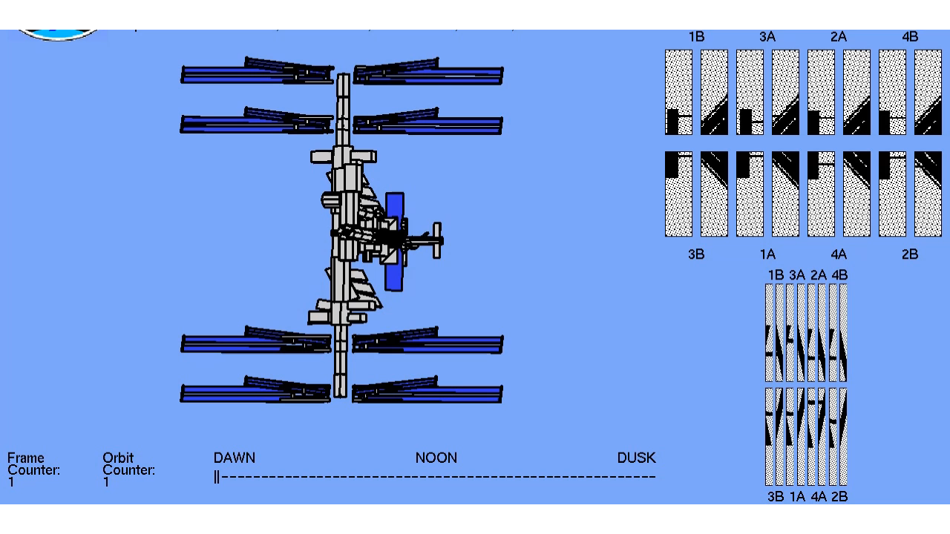
Model Checkout - Most Fun Bug
View of ISS as if you were looking from the Sun
Shadow patterns on Legacy Solar Arrays
Timeline through insolation
iROSA shadow patterns
Watch here

Slide 12
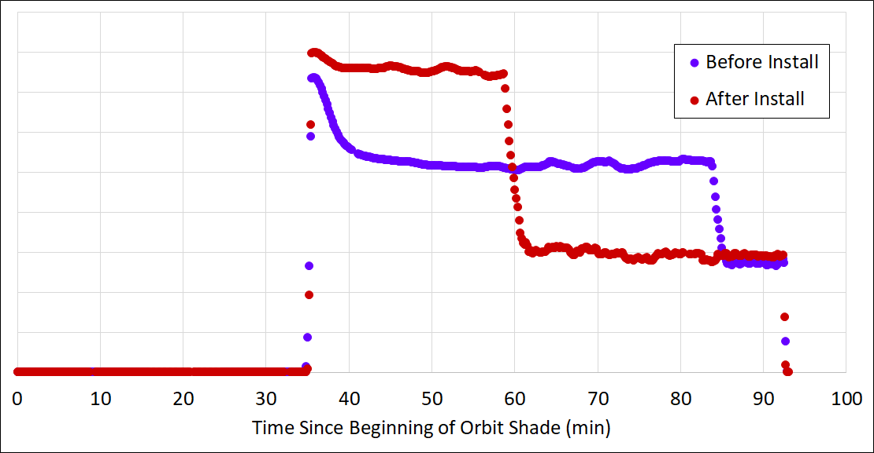
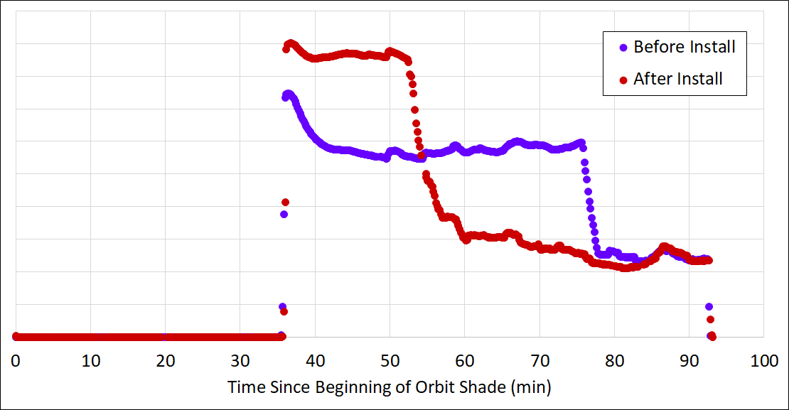
Gains in Power Generation
First iROSA (Jun 2021)
Second iROSA (Jun 2021)
Shunting Begins
Shunting Begins
Power Gain
Power Gain
Shunting Begins
Shunting Begins
Power Gain from Initial iROSA: Nominally 5-7 kW Best case 7-9 kW

Slide 13
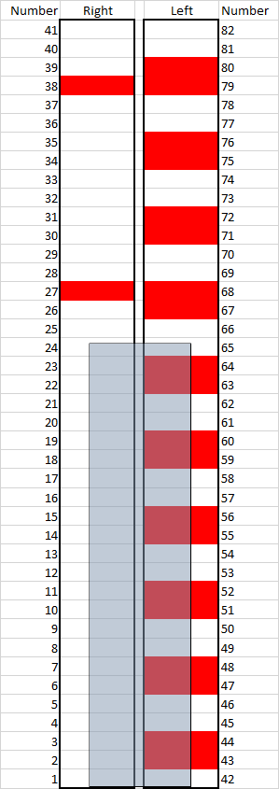
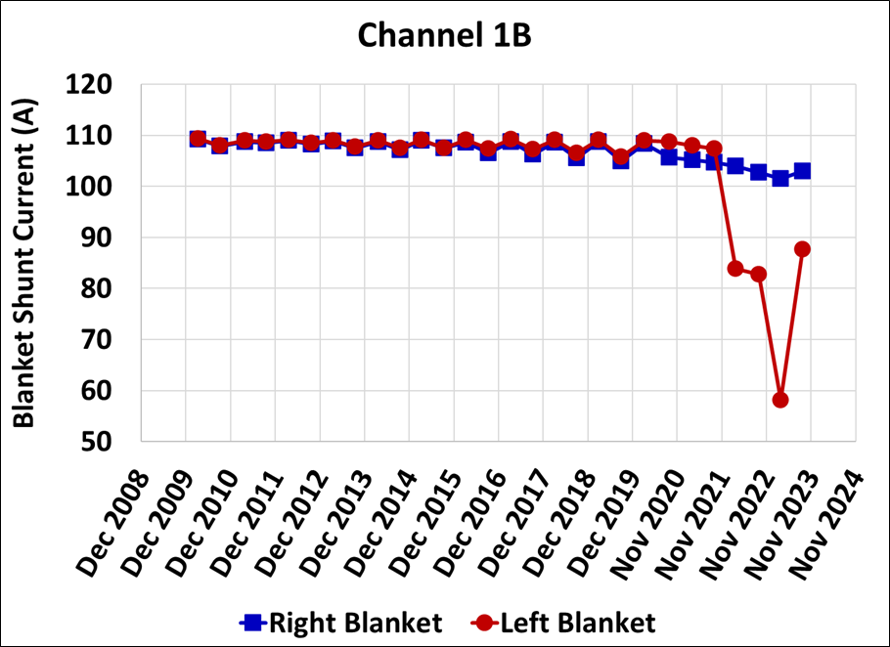
Restoring Lost Circuitry (kinda)
Some of the legacy string failures went away
Tip
10 Failed strings remain after the iROSA install
12 Failed strings are now unplugged due to iROSA install
iROSA silhouette
See 2019 SPW presentation
Base

Slide 14
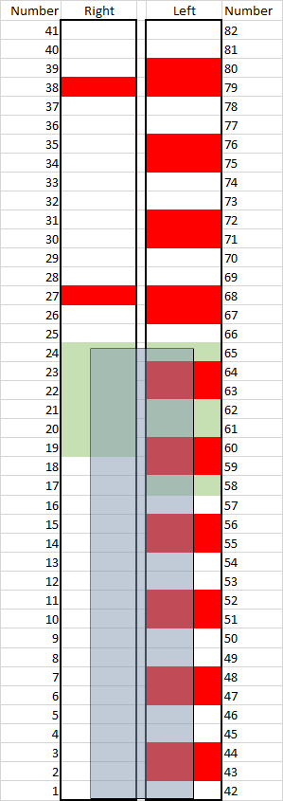
Opportunity for Even More Power
An off-pointed array lets some light around the side of iROSA onto legacy strings.
Could we unplug the 10 failed strings near the tip and wire in different legacy strings to get some additional power?
Yes. It requires more rewiring on EVA, but
could give a bit more power.
Tip
10 Failed strings remain after the iROSA install
Wire in these 10 strings
12 Failed strings are now unplugged due to iROSA install
iROSA silhouette
Base

Slide 15
Thank You
Ann Delleur / NASA GRC
Sarah Tipler / NASA GRC
Brandon Klefman / NASA GRC
Jeff Hojnicki / NASA GRC
Stuart Wodzro / NASA GRC (former)
Caroline Austin / NASA GRC (former)
David Mckissock / NASA GRC (ret.)
David Hoffman / NASA GRC (ret.)
Tom Kerslake / NASA GRC (ret.)
Conference Organizers

