Slide 1
Flexible Data and Frame Synchronization Structure for the LunaNet PNT Signal
Phil Dafesh, Gourav Khadge,
Nathan Wong and Goran Djuknic
The Aerospace Corporation

Slide 2
Outline
Acknowledgements
Introduction
Draft LunaNet Signal Description
I Channel Signal Structure
  Spreading Code
  Sync Word
  Data Structure and Coding
Q Channel Signal Structure
  Primary Code and Overlay Alternatives
  Cross-Correlation Results
Summary of Design Changes for Revision 5 of LunaNet AFS Specifications
Summary and Conclusions

Slide 3
Acknowledgements
We would like to acknowledge the support of the National Aeronautics and Space Administration (NASA) under contract 80GSFC19D0011. This analysis was performed for NASA’s Lunar Communications Relay and Navigation Systems (LCRNS) project to inform the LunaNet Interoperability Specifications.
We especially acknowledge the feedback from NASA team leads Ms. Cheryl Gramling and Mr. Juan Crenshaw throughout the course of this work
We also acknowledge ongoing feedback from the European Space Agency (ESA) and Japanese Space Exploration Agency (JAXA) representatives, which enabled us to research a solution that potentially addresses the needs of stakeholders
Finally, we acknowledge ESA for the suggestion to incorporate a 2-bit frame ID (FID) together with a 7-bit TOI in the BCH(52,9) code of subframe 1

Slide 4
Introduction
The future cislunar regime will rely on the delivery of PNT services by satellite and terrestrial providers through a framework of mutually agreed-upon standards
  Provides precise navigation capabilities for programs such as the NASA Artemis mission
The LunaNet Interoperability Specification (LNIS) defines requirements for PNT signals that will provide an interoperable signal standard to be employed by participating service providers and user equipment manufacturers
The current draft version 5 of the LNIS, Applicable Document-1 version 1 describes the Augmented Forward Signal (AFS) with a data signal on “I” designed for low complexity user applications and a high performance dataless signal on “Q”
  Analogous to the GPS C/A code and Galileo E5 or the GPS L5 signals, respectively
This presentation highlights results of a detailed trade study to inform key aspects of the draft AFS structure including spreading codes, data encoding, and frame synchronization word
It also describes new capabilities available to all future space-based Nav. systems
  Application of 5 G forward error control FEC coding
  Application of a tertiary overlay code to satellite navigation systems for precise time
“I” = In-phase signal
“Q” = quadrature signal

Slide 5
LunaNet AFS Receiver Use Cases
Overall
  Flexibility to operate under wide range of carrier power to noise-power-spectral-density ratio (C/No ) conditions and receiver operating modes
    e.g., User antenna under radome, signal blockage, co-channel interference
Low SWAP receivers using data channel only (C/A-like but with modern FEC)
  Use I Channel only (Data) with 1.023 MCPS Ranging Code
  Requires sync word on data channel to decode LDPC encoded data blocks
  Sensitivity limited by maximum coherent integration ≤ 2 ms in the presence of data
    Current Draft specifies 1023-chip (1 ms) primary
High performance user receivers will employ both data and pilot channels (baseline)
  Obtain more robust and higher accuracy performance with increased SWAP
  PLL tracking of pilot enables higher reliability carrier aided code tracking at reduced code loop bandwidths
  Longer coherent integration time (>> 2 ms) for improved acquisition and tracking sensitivity
  Robust, immediate frame sync desired with overlay code that encodes time within 12 sec
  Improved accuracy and multi-path immunity with 5.115 MCPS code
  Improved data demodulation with higher sensitivity PLL tracking
PLL = Phase locked loop, FEC = Forward Error Control Coding, SWAP = Size Weight And Power

Slide 6
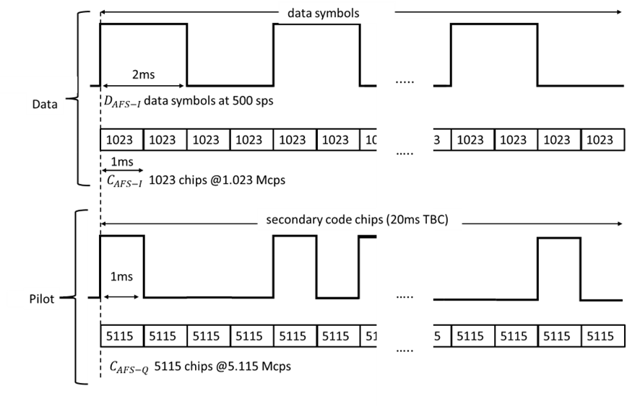
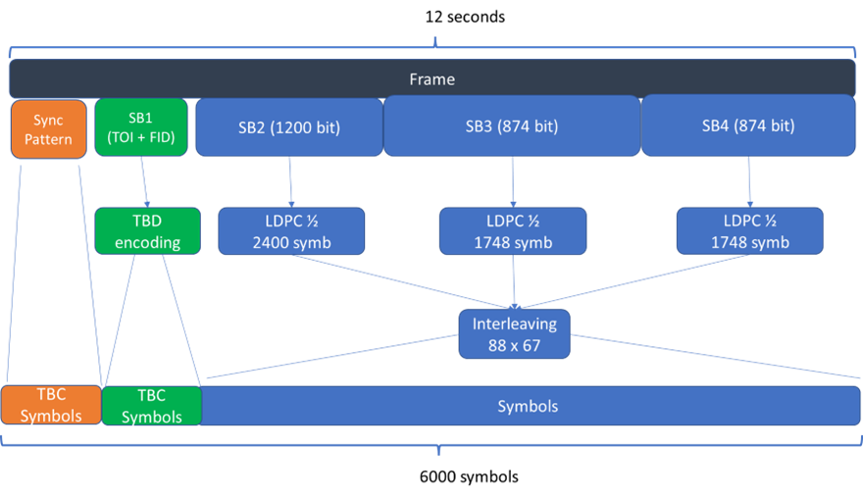
Current Draft LunaNet Signal Structure*
12 sec
I Data:
LDPC Encoding: To be
Confirmed (TBC)
Primary Code Description
-To Be written (TBW)
- Code period is TBC
Q Pilot
Overlay Code (TBC)
Primary Code (TBC)
Sync Pattern
TBC
TOI and FID
Encoding TBC
SB2 = Subframe 2
Clock and Ephemeris
Data (CED)
104 Symbols
5896 Symbols
*Described in LunaNet Signal-In-Space Recommended Standard (Applicable Document #1)
- Augmented Forward Signal (LSIS), Draft Version, August 31, 2023.

Slide 7
AFS Design Considerations Requiring Confirmation
Frame ID size, encoding and location requires specification
  e.g., In SB1 (BCH encoded) or SB2 (LDPC Encoded)
Specific LDPC Code
  Block size to be specified based on sync word size
Primary code period on I – Data Channel
  Doesn’t provide bit sync upon acquisition of code
  Coherent integration during acquisition is limited to 1 ms to prevent loss across a symbol transition
Sync Word On I Channel
  Needed to perform frame sync for low complexity receivers
  Desire that sync word operates down to the C/No limit of the TOI (e.g. BCH code)
    Trade performance with number of data bits used
Interleaver
  To be designed based on sync word and size of data blocks
  Impacted by factorization for a given option
Primary and Overlay Codes on Q Channel (Pilot)
  Current draft structure doesn’t provide frame sync or absolute time
    Only slightly improves correlation properties by extending 1 ms to 20 ms (with overlay)
  5115-bit pilot code does not align with data symbols

Slide 8
I: Data Channel Design

Slide 9
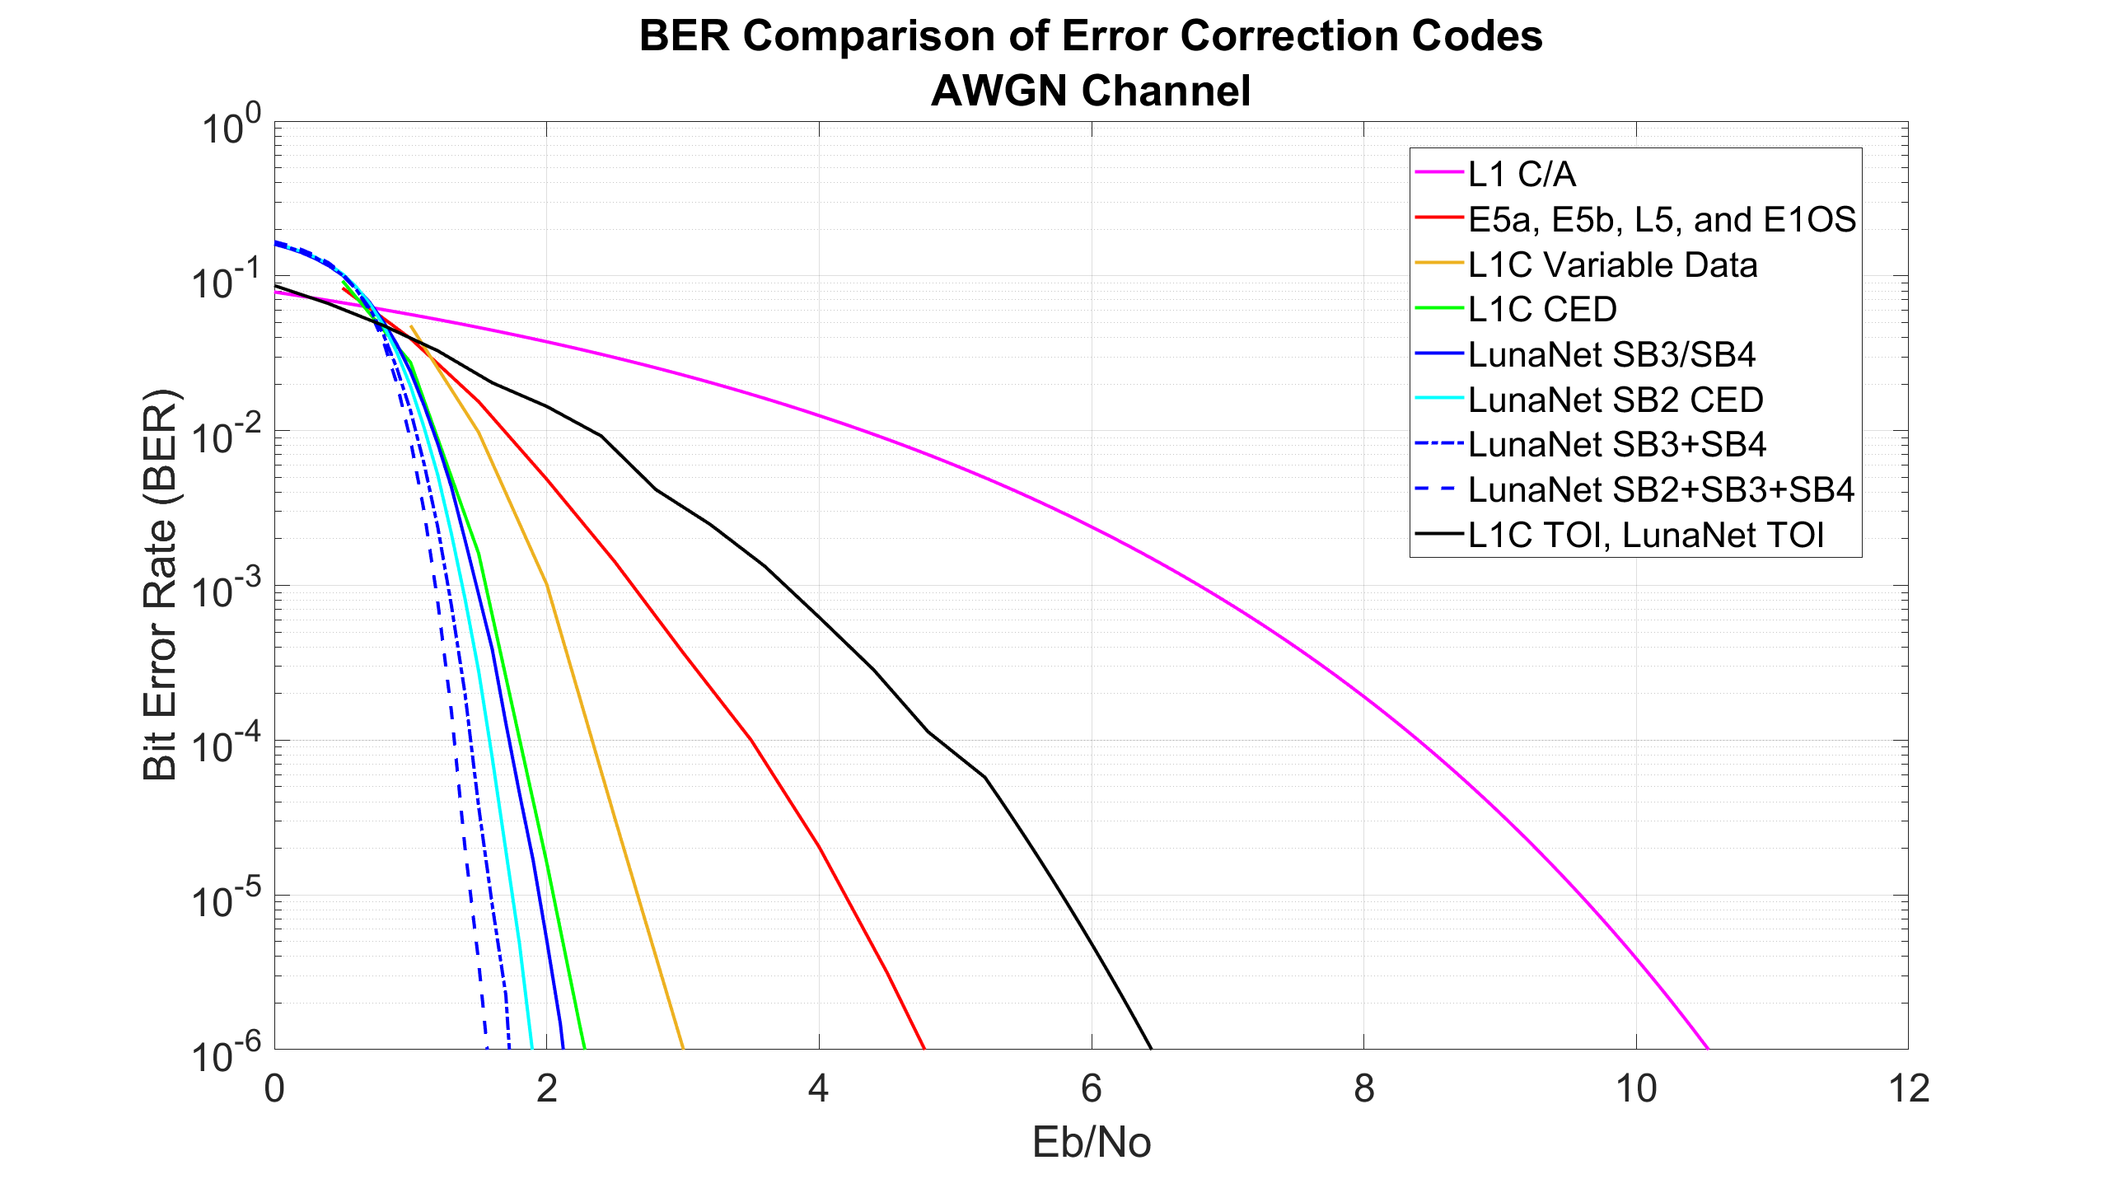
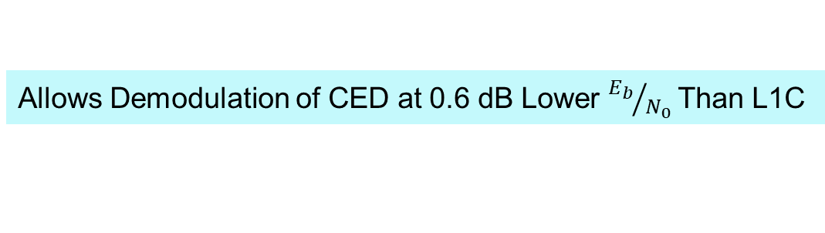
5 G New Radio Code
Proposal would be first Use of 5GNR in a Satellite Navigation System
  Provides abundant IP¹ to enable rapid development of future receivers
Proposed LUNANET 5G NR LDPC Codes
Outperform Codes Used in All Other Satnav Signals
CED= Clock and Ephemeris data
Allows Demodulation of CED at 0.6 dB Lower ${E_{b}}/{N_{0}}$ Than L1C
Hoydis, Jakob; et al. “Sionna: An Open-Source Library for Next-Generation Physical Layer Research.” March 2023. Available: https://arxiv.org/abs/2203.11854

Slide 10
1.023 MCPS - I Channel Primary Code
Designed 2046 Chip Weil and Gold primary codes for comparison
  2053 Chip Weil Sequence short cycled to 2046 chips
  2047 chip Gold Code short cycled to 2046 Chips
  Created 50 initial codes with good auto and cross-correlation properties for comparison to 37 2046 Chip BeiDou B1b codes and to C/A code for acquisition and tracking
Proposed NEW 2046 Chip Gold code Provides Best Balance of Performance
- Exceeds cross-correlation performance of C/A Code by 3 dB
- Exceeds cross-correlation of BeiDou B1 by 1 dB
- Exceeds performance of new Weil codes by 0.5 dB

Slide 11
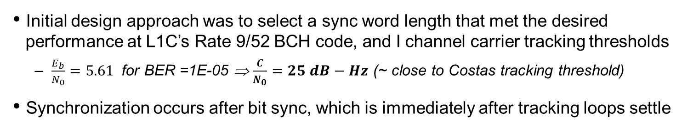
Sync Word Design and FID
Initial design approach was to select a sync word length that met the desired performance at L1C’s Rate 9/52 BCH code, and I channel carrier tracking thresholds
  $\frac{E_{b}}{N_{0}}=5.61$ for BER =1E-05 ⇒ $\frac{C}{N_{0}}=25 dB−Hz$ (~ close to Costas tracking threshold)
Synchronization occurs after bit sync, which is immediately after tracking loops settle
*
68 Symbol sync word provides the best balance between number
of symbols, frame sync performance and interleaver factorization
Two FID bits can be assigned to two out of 9 BCH Code bits
permitting the flexibility to change the data frame structure in the future
*Assumed sync word detection and false alarm probabilities: $P_{d}$ = 0.99 and $P_{fa}={10}^{−6}$

Slide 12
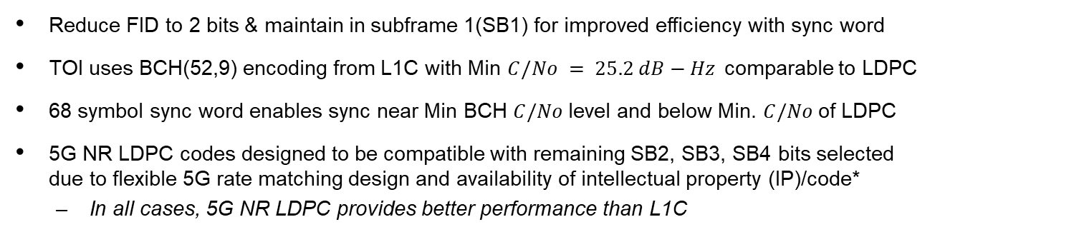
Summary of Recommended
LunaNet AFS Data Frame Specification
Reduce FID to 2 bits & maintain in subframe 1(SB1) for improved efficiency with sync word
TOI uses BCH(52,9) encoding from L1C with Min $C/No = 25.2 dB−Hz$comparable to LDPC
68 symbol sync word enables sync near Min BCH $C/No$level and below Min. $C/No$of LDPC
5G NR LDPC codes designed to be compatible with remaining SB2, SB3, SB4 bits selected
due to flexible 5G rate matching design and availability of intellectual property (IP)/code*
  In all cases, 5G NR LDPC provides better performance than L1C
Frame sync
Data Frame
SB1
7 bit TOI and 2 bit FID
SB2 (1200 bits)
for CED
SB3 (870 bits)
SB4 (870 bits)
BCH 9/52
Encoding
52 Sym
5G NR LDPC ½
2400 Symbols
5G NR LDPC ½
1740 Symbols
5G NR LDPC ½
1740 Symbols
Interleaving (98x60)
68
Sync Symbols
52 TOI+ FID Symbols
5880 Data Symbols
*e.g.,https://github.com/NVlabs/sionna
6000 Symbols (12 sec frame at 500 sps)

Slide 13
Q: Pilot Channel Design

Slide 14




Multi-Tiered Satellite Navigation Pilot Overlays
- Example Showing Repeating Primary + Repeating Secondary + Tertiary Outer Code
12 seconds
I: Data Chanel
2046 chip code
Data Frame
12 seconds (time aligned to data channel frame)
$$C_{T}$$
Tertiary Overlay Code (1500 symbols, 8ms each)
8 ms, 1 tertiary code symbol
Q: Pilot Chanel
$$C_{S}$$
Secondary Overlay Code (4 symbols, 2ms each)
2 ms, 1 secondary code symbol
$$C_{p}$$
Primary Code (10230 Chips, 5.115 Mchips/s)
Repeating Primary + Repeating Secondary + Tertiary (Outer)
$C_{Tiered}=C_{p}$ $⊕$ $C_{S}⊕C_{T}$
(1500 Symb)
The above multi-tiered overlay approach was the third of five options considered.
Provides flexible acquisition on 2 ms or 8 ms repeating code + tertiary overlay for absolute time

Slide 15


Pilot Ranging Code Options Under Consideration
Option 5
Options 1-4
Repeating Primary + Secondary (Outer)
Repeating Primary + Repeating Secondary + Tertiary (Outer)
$C_{Tiered}=C_{p}⊕$ $C_{S}$
$C_{Tiered}=C_{p}$ $⊕$ $C_{S}⊕C_{T}$
Prior Example
50 Gold codes were designed for assessing the performance of options 1 and 2
50 Weil codes were designed for assessing options 3-5
All codes were selected to have good autocorrelation and cross-correlation properties
First use for tertiary overlay codes in satellite navigation
Enables flexible acquisition alternatives and absolute time via outer code
- Applies to high reliability frame sync and time of week for network assisted CED

Slide 16
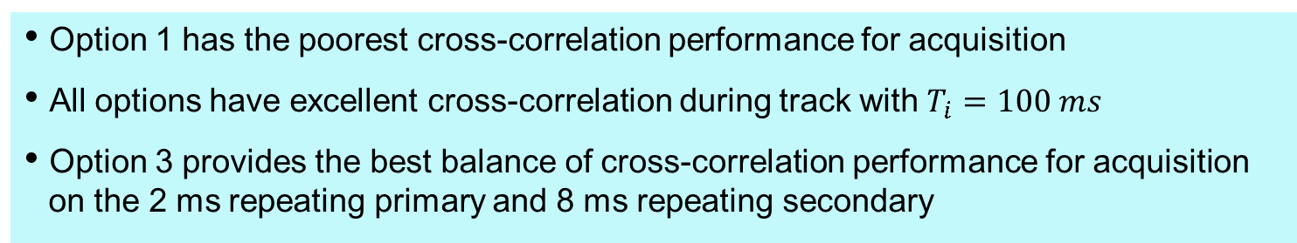
99 % Confidence and RMS Cross-Correlation
Option 1 has the poorest cross-correlation performance for acquisition
All options have excellent cross-correlation during track with $T_{i}=100 ms$
Option 3 provides the best balance of cross-correlation performance for acquisition on the 2 ms repeating primary and 8 ms repeating secondary

Slide 17
Pilot Options Trade
Option 3 provides the best balance of capabilities
- Large spreading code families with good properties
- Two repeating acquisition codes
- The best processing gain for feasible repeating signal acquisition
- Short time to sync with outer code

Slide 18













Summary of Recommended Design Changes for the LunaNet AFS Specifications
Sync Word
SB1, SB2, SB3 Data
68 Symb
5932 Symb
Data
“I”
2 ms
$$⋯$$
$$⋯$$
$$C_{d}$$
2046
2046
$$⋯$$
2046
2046
2046
2046
2046
2046
$$⋯$$
2046
2046
2046
2046
2046
2046
2046
2046
12 sec
Tertiary code (12 sec) 1500 symbols
$$C_{T}$$
$$⋯$$
Pilot
“Q”
Secondary code
1
1
1
$$⋯$$
$$C_{s}$$
2 ms
0
$$C_{p}$$
10230
10230
10230
10230
10230
10230
10230
10230
10230
$$⋯$$
10230
10230
1023
10230
10230
10230
10230
10230
8 ms
4 symbols
40,920 chips
5.115 MCPS
$C_{\begin{aligned}Intermediate \\ Code\end{aligned}}=C_{p}$ $⊕$ $C_{S}$
$C_{\begin{aligned}Tiered \\ Code\end{aligned}}=C_{p}$ $⊕$ $C_{S}⊕C_{T}$
Provides robust acquisition
Provides absolute time and weak
signal frame sync
SB1 – (2-bit FID_/ 7-bit TOI) – L1C BCH Coded
SB2/SB3 – 5G NR LDPC Coded
(98x60 Data Interleaving)

Slide 19
Summary and Conclusions
We have conducted a trade study for the design of the first generation
LunaNet Augmented Forward Signal (AFS) with exceptional performance and flexibility
If implemented, the AFS design would be the first I/Q signal that services two classes of users, providing capabilities comparable or better than C/A code and L5 in one signal
The design demonstrates the best cross-correlation performance of any 2046-chip SatNav code
The design provides more flexible acquisition alternatives compared to any GNSS signal
  2046-chip (2 ms),1.023 MCPS code with 2X complexity of C/A
  10230-chip (2 ms), 5.115 MCPS I channel primary code that requires ½ the complexity L5
  Tiered 40920-chip (8 ms), 5.115 MCPS pilot spreading code with 2X the complexity of L5
The work describes the first use of commercial 5G standard in any satellite navigation signal
  Permits rapid encoder development and exploitation of commercial intellectual property
  Demonstrates the best performing FEC of any satellite navigation signal
    Exceeds L1C’s LDPC code Eb/No threshold by 0.6 dB
The design represents the first use of a tertiary overlay code to enable flexible acquisition at higher processing gain
The design provides the first standalone data signal with a high integrity sync word
  Enables very low SWAP receivers to enjoy the benefits of high performance LDPC codes

Slide 20
Backup

Slide 21
Cross Correlation Results – Maximum Cross-Correlation
Results Imply that there is no benefit to100 ms Coherent
Integration during track and that option 3 has the worst performance
The likelihood of having the Max cross-correlation is extremely low!!
Max cross-correlation results should not be used to compare the cross-correlation performance of navigation signals as the outcome can be misleading
  Only useful for initial code design and selection

