Slide 1
PLANNING A SUSTAINABLE WORLD
APRIL 30, 2024
MATT KENNEY

Slide 2

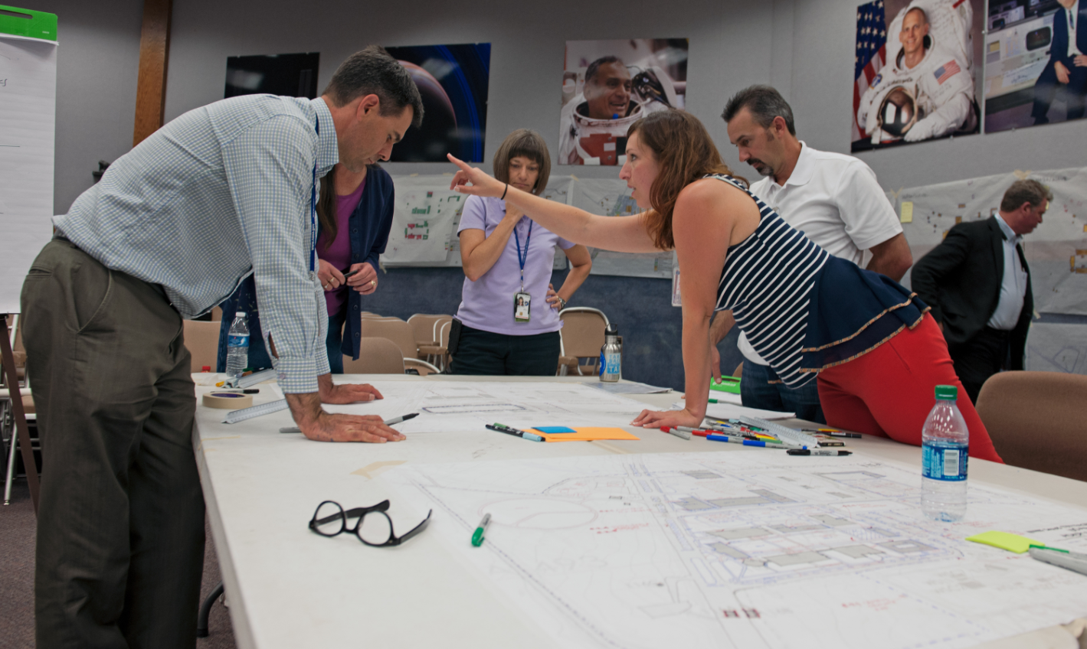
PUBLIC PLANNING (CURRENT CAREER)
SOURCE: NASA

Slide 3
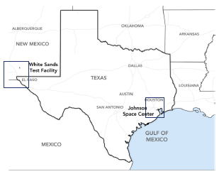
PUBLIC PLANNING (CURRENT CAREER)
WHITE SANDS TEST FACILITY
FOUNDED JULY 6, 1963
FIRED ITS FIRST ROCKET IN 1964
PART OF THE JOHNSON SPACE SENTER
SPECIALIZES IN HAZARDOUS MATERIAL TESTING
  ROCKET PROPULSION TESTING AND EVALUATION
  OXYGEN SYSTEMS TESTING AND ANALYSIS
  COMPOSITE PRESSURE SYSTEMS TESTING AND ANALYSIS
  HYPERVELOCITY IMPACT TESTING
  PROPELLANTS AND AEROSPACE FLUIDS TESTING AND ANALYSIS
  SPACEFLIGHT COMPONENT SERVICES
  FLIGHT ACCEPTANCE STANDARD TEST
SOURCE: NASA

Slide 4
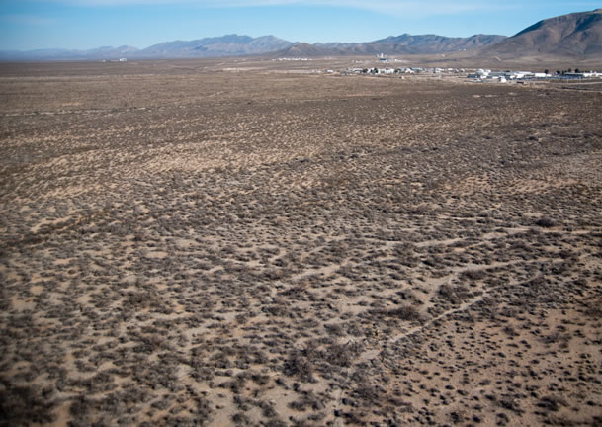
PUBLIC PLANNING (CURRENT CAREER)
SOURCE: NASA

Slide 5
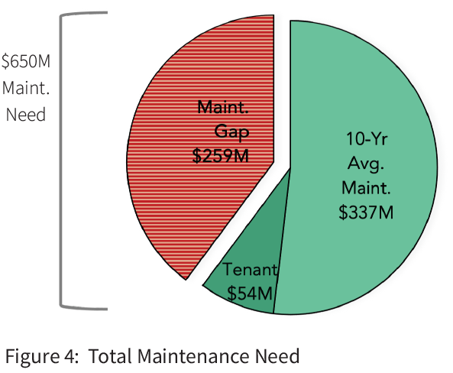
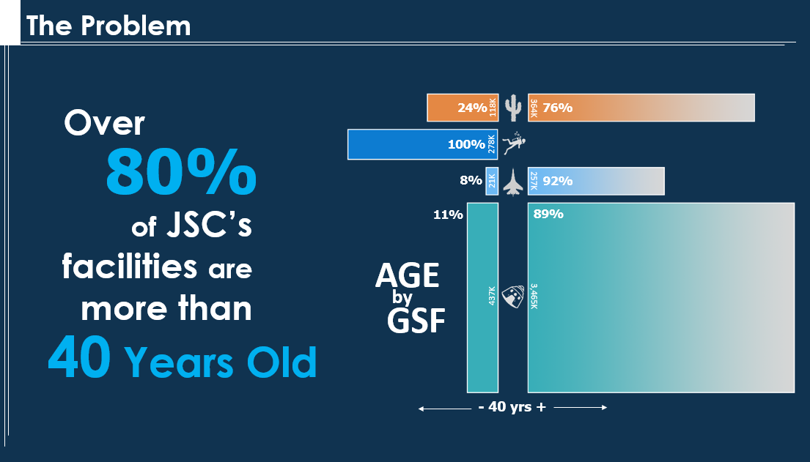
PUBLIC PLANNING (CURRENT CAREER)
NASA FACILITY FUNDING GAP
$391M/YR SPENT ON MAINTENANCE
SOURCE: NASA

Slide 6
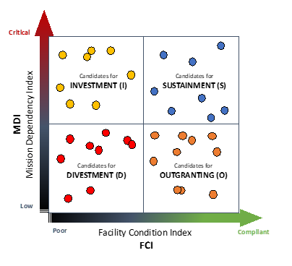
PUBLIC PLANNING (CURRENT CAREER)
AGENCY MASTER PLAN
ASSET INVENTORY ASSESSMENT (AIA)
INVEST
DIVEST
SUSTAIN
OUTGRANT
SOURCE: NASA

Slide 7
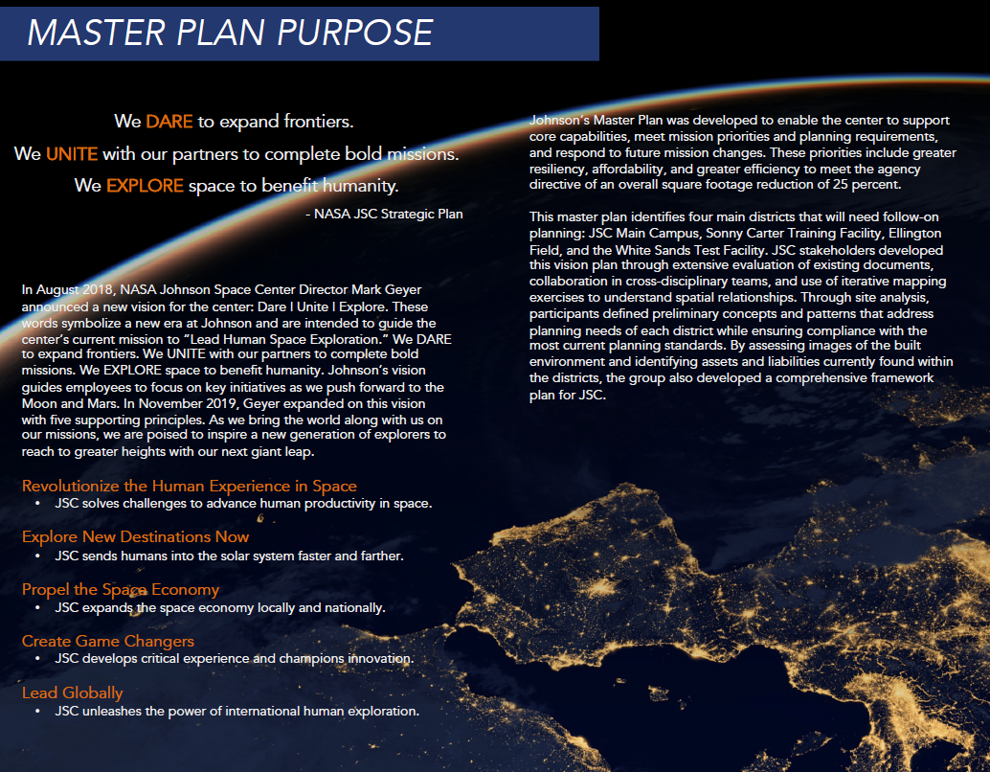

PUBLIC PLANNING (CURRENT CAREER)
SOURCE: NASA

Slide 8
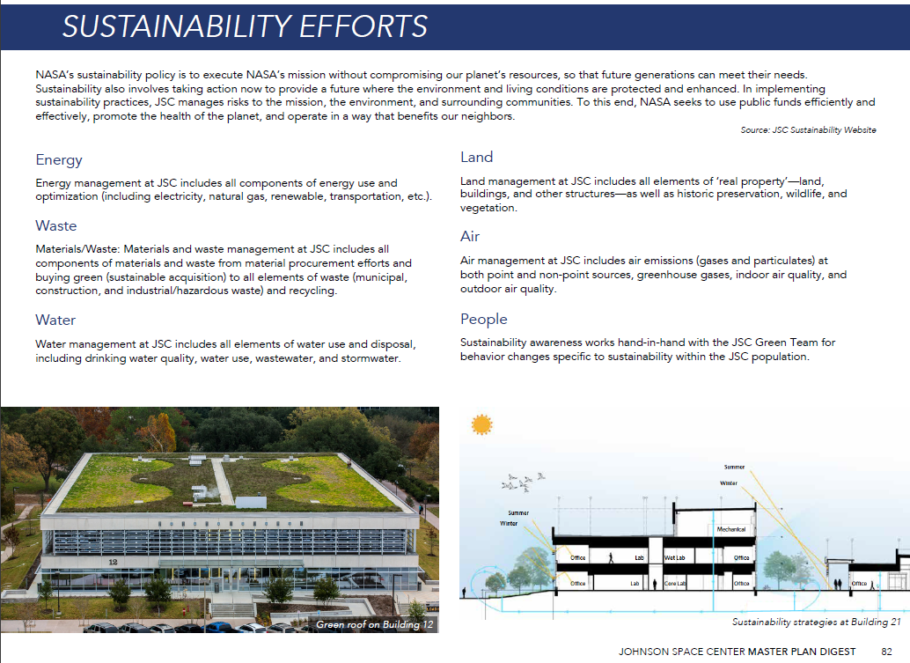
PUBLIC PLANNING (CURRENT CAREER)
SUSTAINABILITY CONCEPTS
SOURCE: NASA

Slide 9
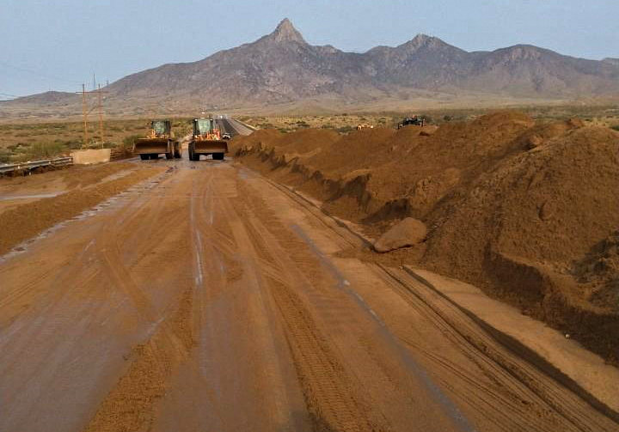
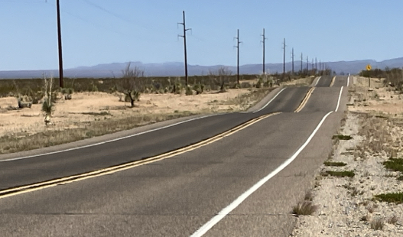
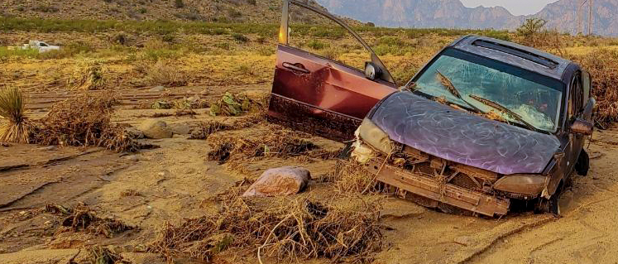
PUBLIC PLANNING (CURRENT CAREER)
RESILIENT INFRASTRUCTURE
EXISTING NASA ROAD
HIGHWAY 70 – 2021 FLOOD
SOURCE: NASA

Slide 10
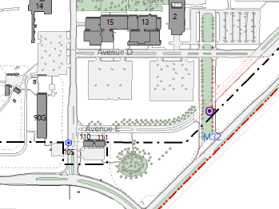
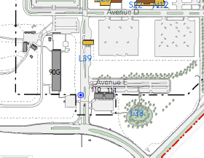
PUBLIC PLANNING (CURRENT CAREER)
SAFE & SECURE ACCESS
EXISTING GATE
PROPOSED GATE
SOURCE: NASA

Slide 11
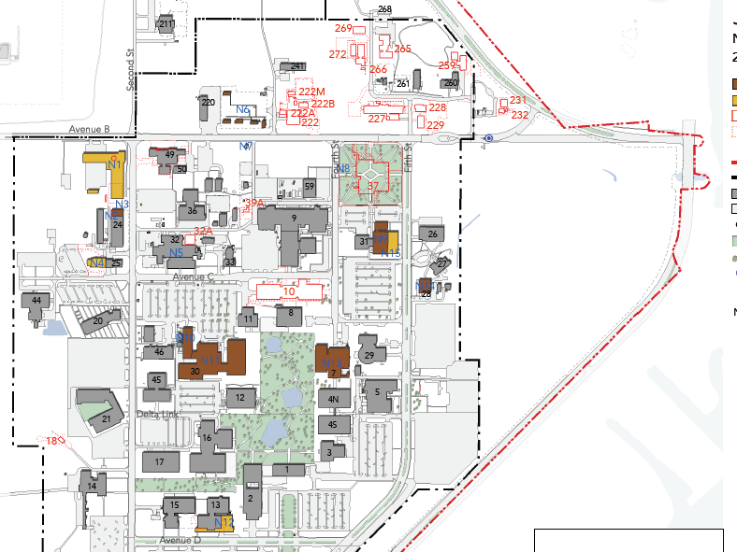
PUBLIC PLANNING (CURRENT CAREER)
LIVEABLE CAMPUS
SOURCE: GOOGLE MAPS

Slide 12
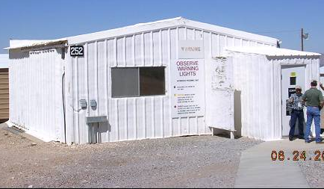
PUBLIC PLANNING (CURRENT CAREER)
250 AREA CONTROL ROOM
OXYGEN COMPATABILITY AND PARTICLE IMPACT TESTING
687 SF (BUILT AS A WELD SHOP)
NO BATHROOMS
TOO SMALL FOR OCCUPANCY DURING TEST
NOT SAFE FOR SHELTER IN PLACE
SOURCE: NASA

Slide 13
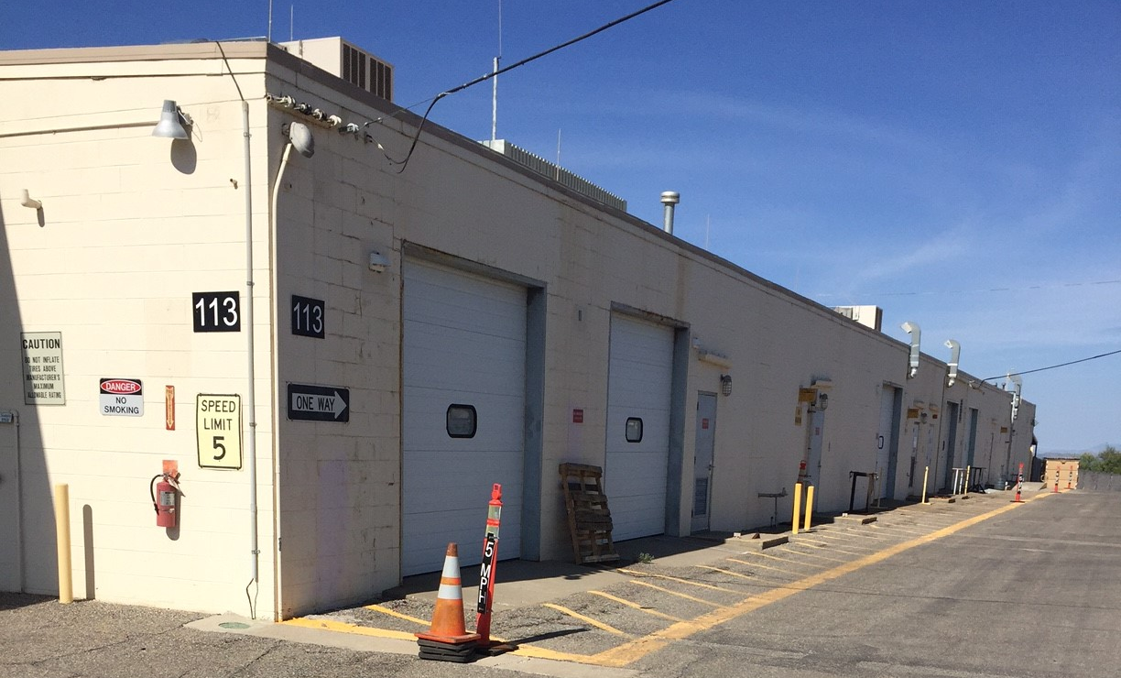
PUBLIC PLANNING (CURRENT CAREER)
WSTF FABRICATION SHOP
BUILT IN 1964
19,763 SF
SOURCE: NASA

Slide 14
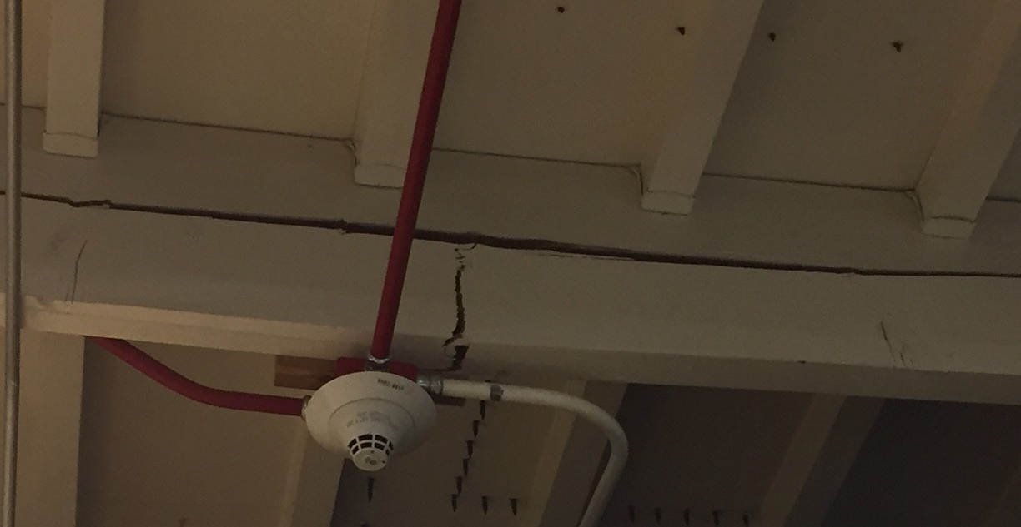
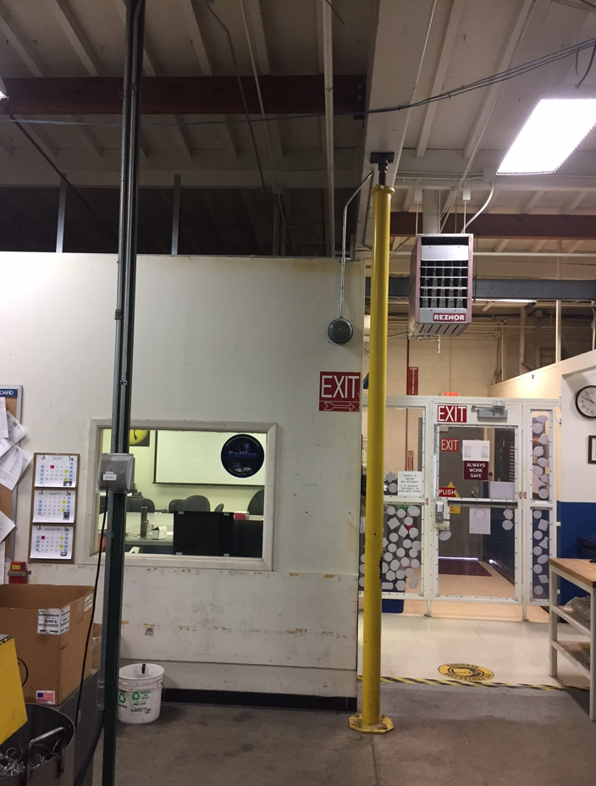
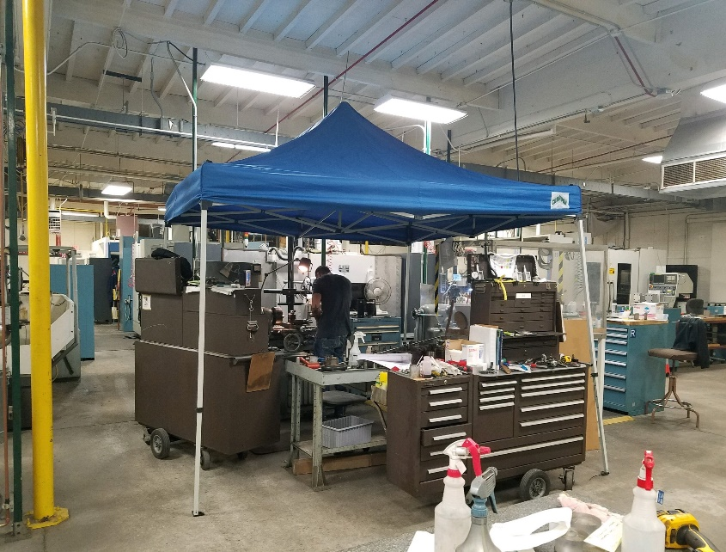
PUBLIC PLANNING (CURRENT CAREER)
WSTF FABRICATION SHOP
FAILING ROOF BEAMS
LEAKING ROOF
SOURCE: NASA

Slide 15
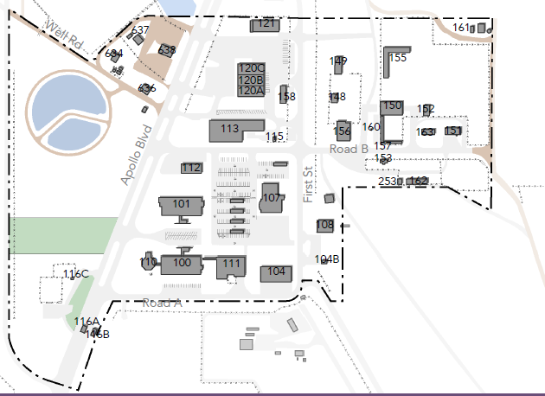
PUBLIC PLANNING (CURRENT CAREER)
WSTF 100 AREA
EXISTING CONDITION
SOURCE: NASA

Slide 16
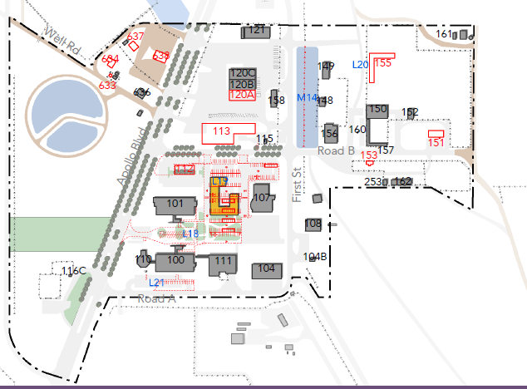
PUBLIC PLANNING (CURRENT CAREER)
WSTF 100 AREA
FUTURE CONDITION
SOURCE: NASA

Slide 17
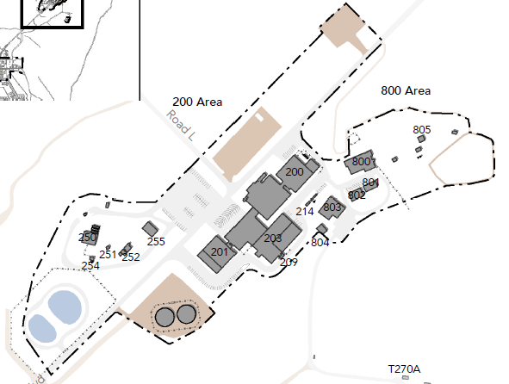
PUBLIC PLANNING (CURRENT CAREER)
WSTF 200 AREA
EXISTING CONDITION
SOURCE: NASA

Slide 18
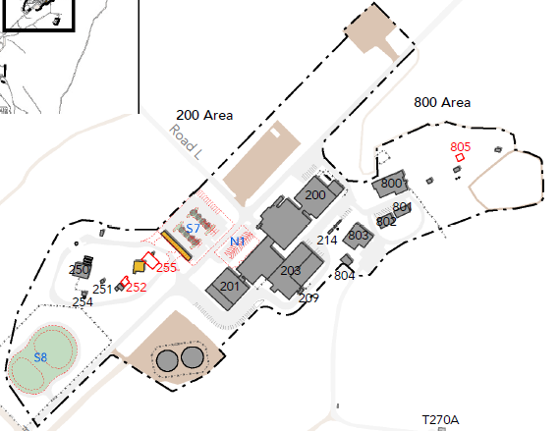
PUBLIC PLANNING (CURRENT CAREER)
WSTF 200 AREA
FUTURE CONDITION
SOURCE: NASA

