Slide 1


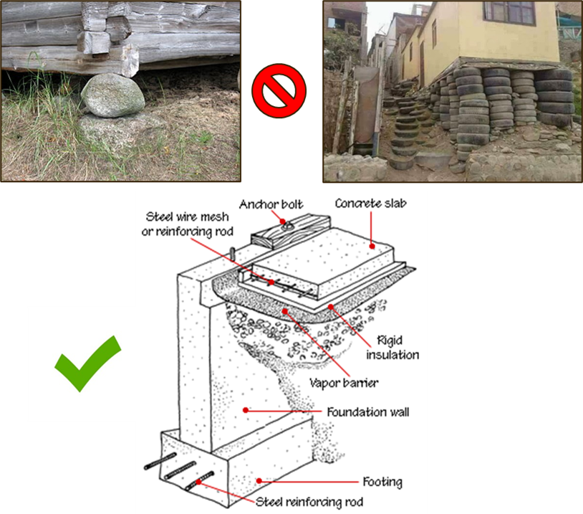
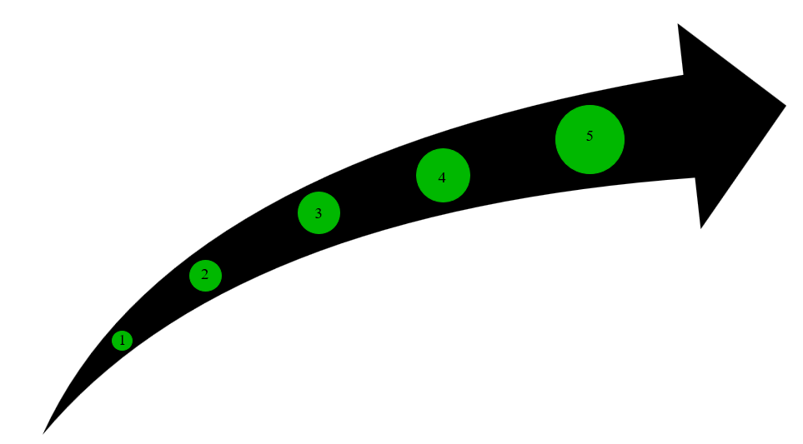


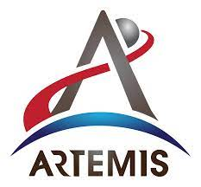
How to effectively generate an Additive Manufacturing Control Plan (AMCP) documenting compliance, method of implementation and tailoring rationale to NASA Technical Standard NASA-STD-6030.
Tim Poe, MSFC EM42
Andrew Glendening, GSFC-3730
What is an Additive Manufacturing Control Plan (AMCP)
How do you write an AMCP
What is an AMCP?​
The AMCP is the backbone of NASA-STD-6030 compliance​
It documents and communicates “how you do additive” ​
Responses to 115 unique requirements address degree of compliance, method of implementation, proposed tailoring (and rationale thereof)​
Types of Responses:
Implementation only: meets the Additive Manufacturing Requirement (AMR) as written
Tailoring: rewrites the requirement, but meets the intent and/or is baseline risk
Elevated Risk Tailoring: rewrites the requirement and doesn't meet intent
The Generation of an AMCP​
Developing an effective AMCP starts with looking at the overall process and not with specific parts in mind.​
For pre-existing AM Programs, first begin by just writing down what you currently do and compare it to each AMR​
Mature AM programs that have been evaluated by NASA to date have been largely compliant right out of the gate.​
NASA-STD-6030 was explicitly designed to be adaptable to the widest possible (reasonable) range of (known) manufacturing practices
Method of Implementation
How you apply the tailored AMR to your current process
Develop rationale for tailoring
Answer these question:
Why do you need to tailor?
What do you need to tailor?
How does tailoring affect the way you do AM?
AMCP is Submitted to NASA Program for approval
Reproduce the AMR as-written
Proposed Tailoring
Proposed “shall statement” that meets the intent of the NASA-STD-6030 AMR
Describe the Degree of Compliance
Complies (i.e., we accept the requirement as written) – Skip to step 5
Tailored (i.e., we request a change to the requirement)
Does Not Apply (we don’t need a change to the requirement, we just don’t have a method of implementation to describe, because it doesn’t apply to us
Does Not Comply (i.e., no intent to comply)
AMCP's are the Roadmap for successfully running an AM program.
An AMCP is required when NASA-STD-6030 is levied on a program
Introduction to Tailoring an Additive Manufacturing Requirement
Please Note:​
An AMCP is NASA Program Specific.​
*Once approved by a NASA program, the AMCP becomes the governing document by which your additive program, and the parts you produce, are measured (i.e., it replaces NASA-STD-6030)
An approved AMCP does not grant “qualification” applicable to other NASA Programs​
It is certainly the hope of the NASA AM SMEs that the vast majority of AM processes and practices that are acceptable to one NASA program will be acceptable to most NASA Programs​
A formal NASA AM Certification Body is a dream, but not yet a reality​
PLEASE reach out to us if you are struggling, ​we do not want people to struggle in silence.
What is Tailoring an AMR?
Tailoring Definition: The process of creating revised shall statements to a NASA-STD-6030 AMR.
How to Start the Tailoring Process?
Understand the current approach to AM at your organization or within your project
When does tailoring occur?
Program Tailoring: prior to NASA-STD-6030 being levied
Prior to program kick off
Cognizant Engineering Organization (CEO) Tailoring: Prior to Implementation
CEO tailors the as-levied requirements for custom approach to implementation
When do AMR’s require tailoring?
NASA AM Certification SMEs have found that mature aerospace AM programs can meet the intent of most NASA-STD-6030 AMRs as written without the need for tailoring when evaluating the AMRs individually
The AMCP documents the as-tailored requirement with rationale and implementation methods for each AMR listed in NASA-STD-6030.
Tailoring NASA-STD-6030 Example: Section 5.4.1 Feedstock/ QMS System
NASA-STD-6030 AMR
[AMR-38] Feedstock to be used for a Candidate QMP shall be controlled by industry standard specifications or configuration-controlled material specifications that levy requirements, including tolerances when applicable, to ensure consistent performance in the process and govern, at a minimum, the aspects of virgin feedstock production and procurement defined … Tables 9-12: Require powder producers and distributors to operate under a QMS conforming to SAE AS9100, SAE AS9120, Quality Management Systems
Tailored
Requirement
Rationale for Tailoring
[Company] uses an ISO9001 Powder feedstock supplier and compliance to this AMR would require a change to an AS9100 approved feedstock supplier. For an ISO9001 certified supplier, evidence and rationale will be provided that establish a rigid quality management system (QMS) and robust feedstock controls that meets the intent of NASA-STD-6030. The ISO9001 supplier has been audited and continues to be audited on a three (3) year cycle. [Company]’s feedstock supplier has provided no issues with the quality of material being produced.
All feedstock shall be procured and controlled per approved [Company] feedstock specs.
Implementation
[Company] feedstock spec [INTDOC-1235] complies with NASA-STD-6030 AMR-38 with the exception of the AS9100 QMS feedstock supplier. [INTDOC-1235] allow for ISO9001 QMS for suppliers that have been audited and approved by the [Company].
Tailored
NASA-STD-6030
AMR*
NASA-STD-6030 AMR
Current Process
Rationale for tailoring
Implementation
Method
NASA Program Consultation
*Still subject to NASA Program approval
1
1
Document the Tailored AMR, rationale and Implementation in the AMCP to be presented to NASA Program for approval.

