Slide 1
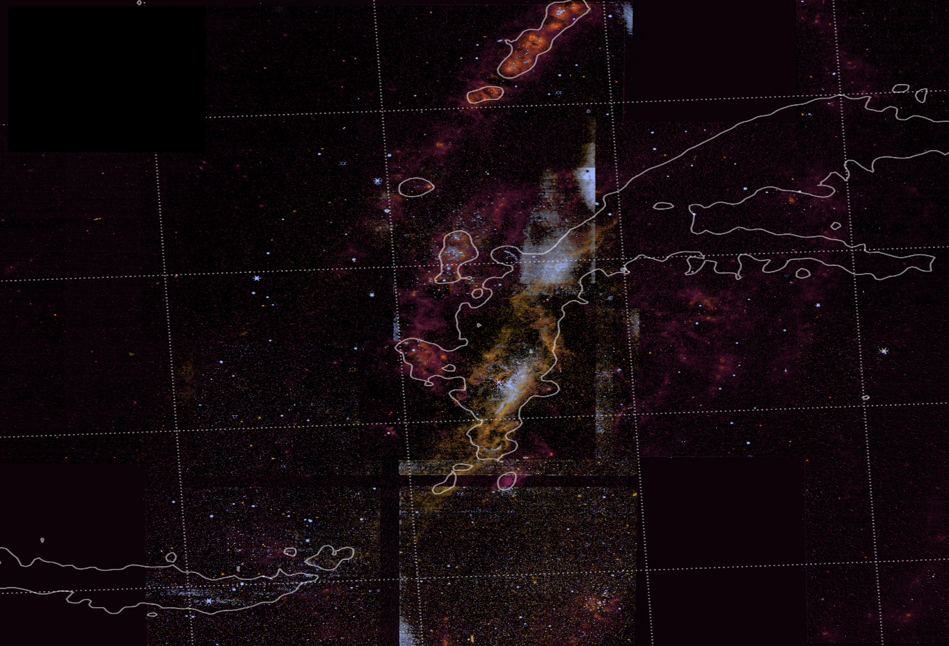
Resolving Stellar Populations in the Nuclear Region of NGC 4258
Isha Nayak
NASA Goddard Space Flight Center
isha.nayak@nasa.gov
Nicholas Cothard (NASA GSFC), Travis Fischer (STScI), Jason Glenn (NASA GSFC), Henrique Schmitt (Naval Observatory), Erin Smith (NASA GSFC)
PI: Jason Glenn
PID: 2080
Slide 1
Notes:
Hi everyone. My name is Isha Nayak. I feel excited to be at this symposium and partake in sharing exciting Webb results. Thank you to the conference organizers for allowing me to share these NIRCam results on NGC 4258. Today I will be talking about resolving stellar populations in the nuclear region of NGC 4258.

Slide 2
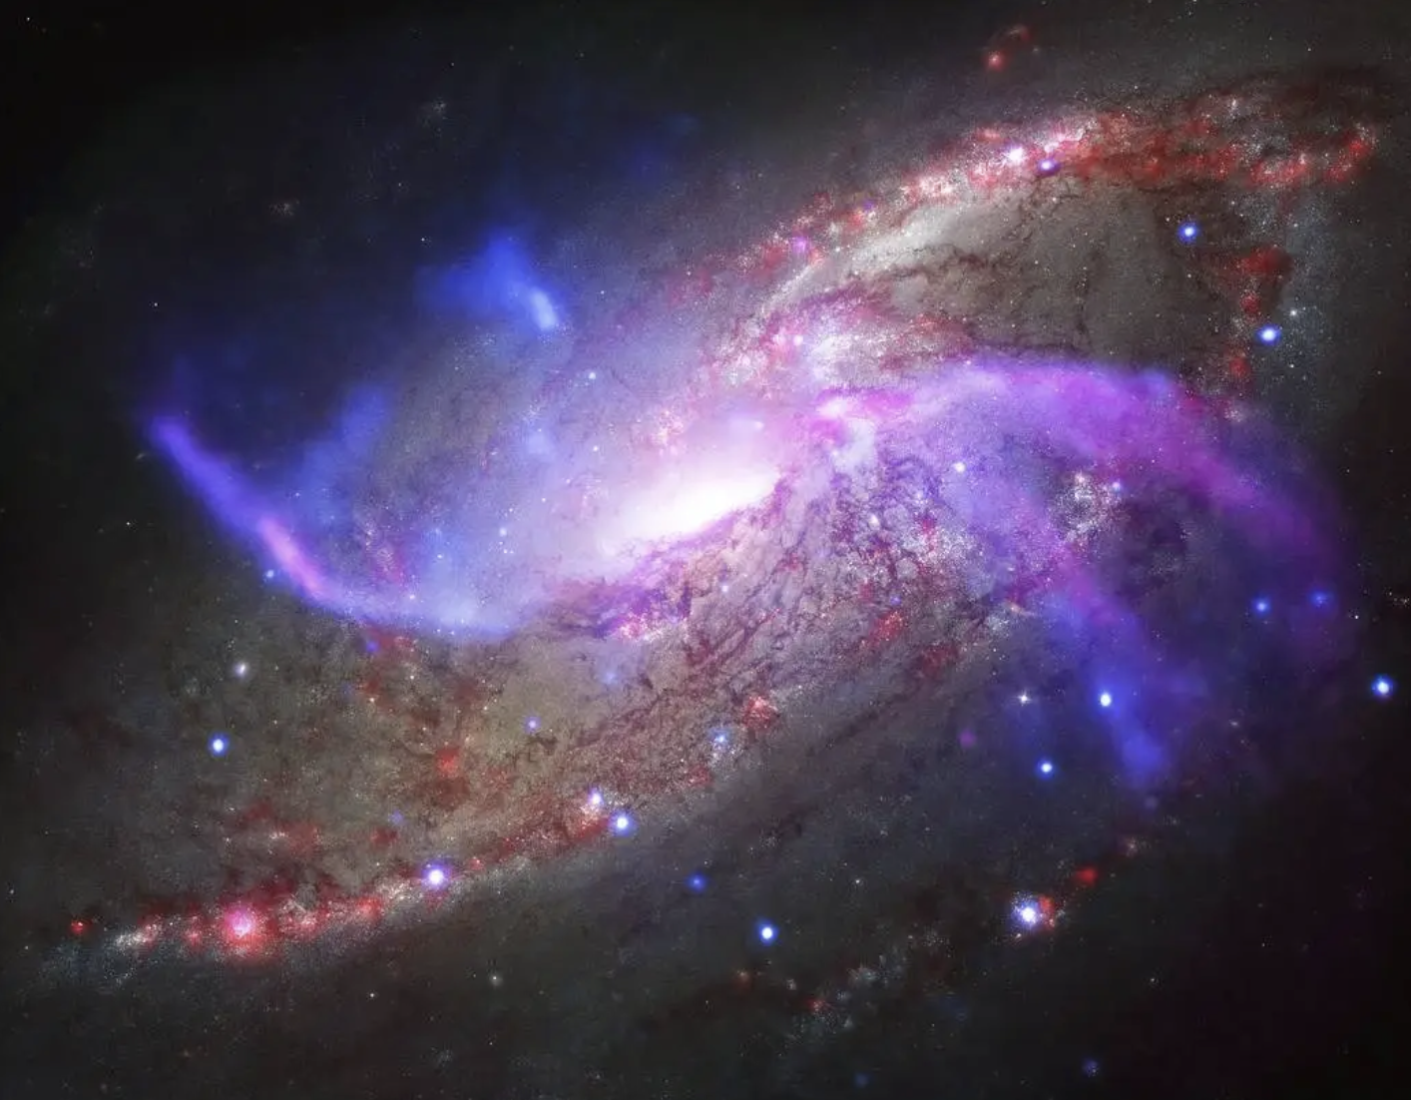
Chandra
VLA
HST
Spitzer
Chandra: NASA/CXC/Univ. of Maryland/A.S. Wilson et al.
HST: Pal.Obs. DSS
Spitzer: NASA/JPL-Caltech
VLA: NRAO/AUI/NSF
Slide 2
Notes:
Here is a non-JWST image of NGC 4258, which has previously been imaged with X-ray wavelengths with Chandra, radio wavelengths with the VLA, optical wavelengths with Hubble, and infrared wavelengths with Spitzer. The dusty sources can be seen in red with the Spitzer observations. The yellow point-like sources likely trace stars visible in optical wavelengths. The red and yellow seen in this image trace the spiral arms of the galaxy. The purple and blue seen with Chandra and VLA, which are the x-ray and radio wavelengths, are offset from the spiral arm which I will refer to as the anomalous arc in this talk. Today I will present JWST NIRCam observations of….

Slide 3
Chandra
VLA
HST
Spitzer
Chandra: NASA/CXC/Univ. of Maryland/A.S. Wilson et al.
HST: Pal.Obs. DSS
Spitzer: NASA/JPL-Caltech
VLA: NRAO/AUI/NSF
Slide 3
Notes:
….this region highlighted with the white box. I do want to point out there is a lot more Spitzer and Hubble emission towards the right-side of this box, than the left side, which will be relevant later in the talk. With NIRCam we have multiple different narrow and medium band emission lines to quantify the effects of possible shocks on the interstellar medium. Shocks heat up and compress molecular gas, possibly leading to gravitational collapse and star formation on small scales, while also depositing energy into the interstellar medium and causing feedback on galaxy-wide scales. We want to study the impact of the shocks within the spiral arms of the galaxy seen with Spitzer in red, as well as the jet-like structures seen with X-ray and radio emission seen in blue and purple.

Slide 4
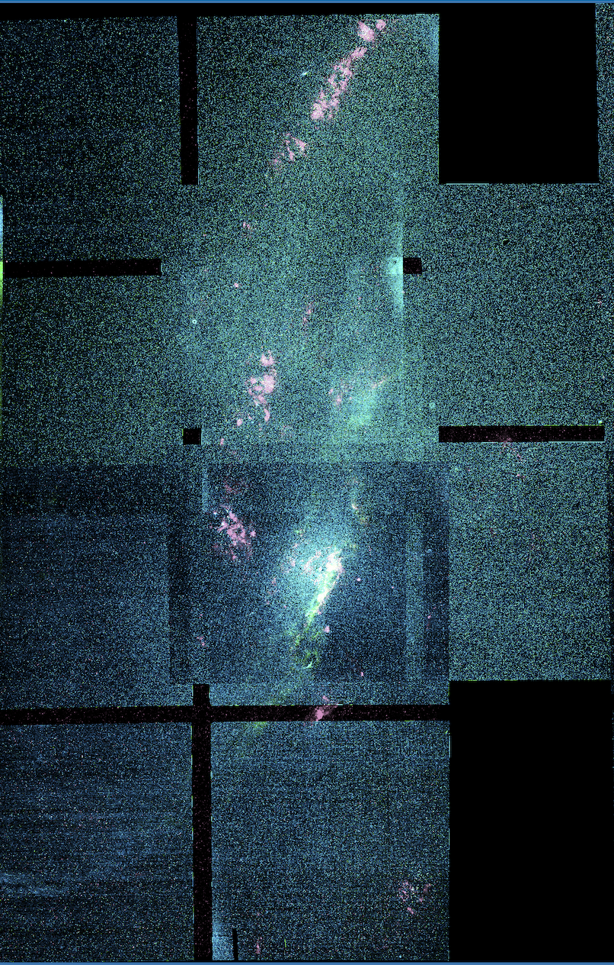
Why do we want to study NGC 4258?
[FeII]
H₂
PAH
Distance: 7.2 +/- 0.3 Mpc (Ho et al. 1997)
SMBH Mass Derived from Water Maser Emission: 3.8 x 10⁷ M☉ (Miyoshi et al. 1995; Greenhill et al. 1995)
Nucleus 1-20 µm Luminosity: 2 x 10⁸ L☉ (Saglia et al. 2016)
Broad H₂ and Brγ emission lines suggest molecular disk around SMBH with diameter of 15.7 pc (Menezes et. al. 2017)
Nucleus Accretion Rate: 10⁻³ M☉ yr⁻¹
This galaxy is close enough that we are able to spatially resolve emission lines which cannot be done for further away galaxies
N
E
1 arcmin
2 kpc
Slide 4
Notes:
So why do we want to study NGC 4258? At a distance of 7.2 Mpc, it presents a rare opportunity to study the effects of shocks through the disk of the galaxy at parsec-scale resolution. The super massive black hole mass is 3.8 x 10^7 solar masses and the nucleus luminosity summed over 1-20 microns is 2x10^8 solar luminosities. Previous observations of molecular hydrogen and Brackett gamma indicate the presence of a molecular disk around the central super massive black hole with a diameter of 15.7 pc. The nucleus accretion rate is 10^-3 solar masses per year. With its proximity, NGC 4258 is closer enough that we can spatially resolve emission lines with Webb which cannot be done for further away galaxies. And because we can resolve structure on a parsec-level, we can study not just the ISM but the stellar populations within this galaxy. The analysis of JWST data that can be done not just NGC 4258, but for galaxies around 7 Mpc away, are similar to what Spitzer could do for the Magellanic clouds which are 50-60 kpc away.
We chose this particularly galaxy because it has extended radio structure interacting with host medium. And it is nearby enough that we can take advantage of NIRCam resolution and spatially resolve AN feedback effects. A lot of AGNs are further away and emission gets redshifted away from the narrow band filters. We can get large-scale faint-emission at 7.2 Mpc. We are hoping to see stratification of emission lines in our data. This image here is a three-color image with [FeII] in blue, molecular hydrogen in green, and PAH emission in purple. We chose this lines to study the different components on the AGN.

Slide 5
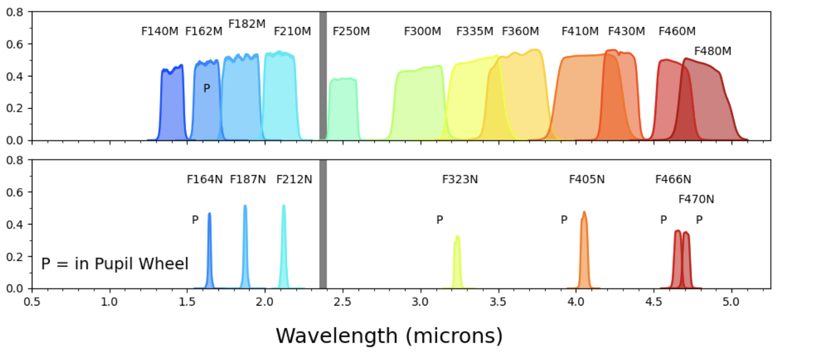
JWST NIRCam Filter Selection and Strategy
Total Time: 28 hours
Total Area Coverage: 6 arcmin x 7 arcmin
Slide 5
Notes:
To determine the impact of the anomalous arc seen in x-ray and radio emission, we map NGC 4258 with six tracers and six medium band filters for continuum subtraction purposes…

Slide 6
JWST NIRCam Filter Selection and Strategy
Total Time: 28 hours
Total Area Coverage: 6 arcmin x 7 arcmin
Slide 6
Notes:
… and circled are the 12 NIRCam bands for which we have observations. The total observation time for our data was 28 hours and the total are covered is about 6 arcminutes times 7 arcminutes.

Slide 7
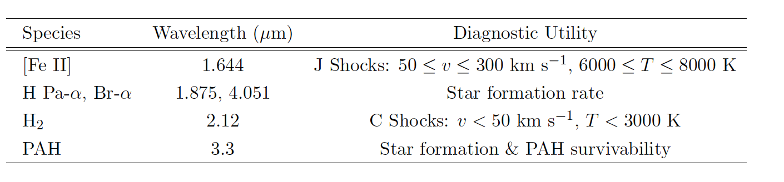
JWST NIRCam Filter Selection and Strategy
[FeII]: 1.64 µm
Paschen ⍺: 1.87 µm
H₂: 2.12 µm
PAH: 3.35 µm
Brackett ⍺: 4.05 µm
CO: 4.66 µm
Slide 7
Notes:
I have listed the emissions we observe and their respective wavelengths. [FeII] typically traces shocks associated with velocities over 100 km/s likely driven by the central black hole. Paschen alpha and Brackett alpha are common tracers of recent star formation activity. We also map the galaxy in molecular hydrogen, which typically traces shocks from star formation. Polyaromatic hydrocarbons (or PAHs) are common tracers of dust embedded sources: either very young stellar clusters of more evolved asymptotic giant brant stars. Additionally, we map NGC 4258 in CO absorption. So to summarize Iron will identify regions of strong shocks likely AGN driven. Molecular hydrogen will trace lower-velocity shocks due to star formation. Paschen alpha and Brackett alpha will provide additional information on recent star formation activity. And Polyaromatic hydrocarbons will trace dusty sources, either young stellar clusters or asymptotic giant brant stars.

Slide 8
Anomalous Arm
Pa⍺
PAH
H₂
[FeII]
VLA 4.8 GHz
[FeII] Emission in Radio Arc
Slide 8
Notes:
Here is a four-color JWST image we make with our NIRCam observations. The dark orange in Paschen alpha, the purple is polyaromatic hydrocarbon, the lighter orange is molecular hydrogen, and iron is indicated by the light blue. The white contours are of the radio data taken with the VLA. [FeII] is seen in the southern anomalous jet-like structure.

Slide 9
Anomalous Arm
H₂ and [FeII] Shock Fronts
Pa⍺
PAH
H₂
[FeII]
VLA 4.8 GHz
[FeII] Emission in Radio Arc
Slide 9
Notes:
Molecular hydrogen and iron shock fronts are seen surrounding the nucleus. As for this image, it is interesting to note the [FeII] is closer to the nucleus region than molecular hydrogen, indicating gas closer to the super massive black hole is associated with stronger shocks than gas further away from it. The current leading theory, which our NIRCam observations agree with, is that the anomalous jet-like structure is due to AGN activity disrupting nearby material and then blowing out the same material in an angle that is not aligned with the disk of the galaxy. The northern anomalous jet-like structure is stronger in radio emission because this jet-like arc is located more towards us, and the southern anomalous jet-like structure is more faint because this it is located behind the disk of the galaxy, leading to more extinction along our line of sight.

Slide 10
Anomalous Arm
Extended PAH Emission
H₂ and [FeII] Shock Fronts
Pa⍺
PAH
H₂
[FeII]
VLA 4.8 GHz
[FeII] Emission in Radio Arc
Slide 10
Notes:
And some iron emission is seen along the southern anomalous arc as well. Our stitched observations seem a bit patchy and we have better signal to noise in some regions in comparison to other regions. However, I do want to note that we got new data three weeks ago covering a similar footprint: We have much better signal to noise over the entire footprint. Additionally, are data extends further down which has another star forming arm, as well as extends more to the left and covers the entirely of this southern anomalous arc. I want to thank the NIRCam observers and the NIRCam pipeline team for getting this data for us.
As for this image, it is interesting to note the [FeII] is closer to the nucleus region than molecular hydrogen, indicating gas closer to the super massive black hole is associated with stronger shocks than gas further away from it. The southern anomalous arc also has [FeII] emission. The current leading theory, which our NIRCam observations agree with, is that the anomalous arc is due to AGN activity disrupting nearby material and then blowing out the same material in an angle that is not aligned with the disk of the galaxy. The northern anomalous radio arc is more stronger in radio emission because this jet-like arc is more towards us, and the southern anomalous radio arc is more faint because this jet-like arc is shooting out behind the disk of the galaxy, leading to more extinction along our line of sight.
[FeII] and H2 and fast and slow shocks. And it traces the radio structure. And here is where the SF is going on. AGN stuff first.
Extended PAH emission on the right traces spiral arm seen in Spitzer…

Slide 11
Chandra
VLA
HST
Spitzer
Chandra: NASA/CXC/Univ. of Maryland/A.S. Wilson et al.
HST: Pal.Obs. DSS
Spitzer: NASA/JPL-Caltech
VLA: NRAO/AUI/NSF
Slide11
Notes:
Here is a non-JWST image of NGC 4258, which has previously been imaged with X-ray wavelengths with Chandra, radio wavelengths with the VLA, optical wavelengths with Hubble, and infrared wavelengths with Spitzer. The dusty sources can be seen in red with the Spitzer observations. The yellow point-like sources likely trace stars visible in optical wavelengths. The red and yellow seen in this image trace the spiral arms of the galaxy. The purple and blue seen with Chandra and VLA, which are the x-ray and radio wavelengths, are offset from the spiral arm which I will refer to as the anomalous arc in this talk. Today I will present JWST NIRCam observations of….

Slide 12
Anomalous Arm
Star Forming Arm
Extended PAH Emission
H₂ and [FeII] Shock Fronts
Pa⍺
PAH
H₂
[FeII]
VLA 4.8 GHz
[FeII] Emission in Radio Arc
Slide 12
Notes:
There is some 4.8 Ghz radio emission along the star forming arm, which also is strongly emitting Paschen alpha and polyaromatic hydrocarbon. Our stitched observations seem a bit patchy, and we have better signal to noise in some regions in comparison to other regions. However, I do want to note that we got new data three weeks ago. We have much better signal to noise over the entire footprint. Additionally, the data extends further down which has another star forming arm, as well as extends more to the left and covers the entirely of this southern anomalous jet-like structure. I want to thank the NIRCam observers and the NIRCam pipeline team for getting this data for us.

Slide 13
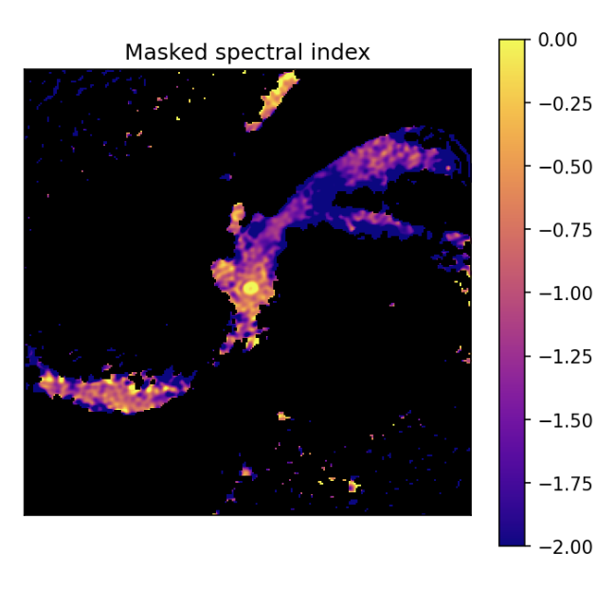
Feedback Within the AGN
Slide 13
Notes:
Feedback from the AGN can be measured by the spectral index calculated using VLA observations at 4.8 GHz and xxx GHz. Here we show a map of the masked spectral idex.

Slide 14
Feedback Within the AGN
More Likely to be Bremsstrahlung Radiation
Slide 14
Notes:
A less steep slope, where it is more yellow, it is likely that Bremsstrahlung emission is dominating.

Slide 15
Feedback Within the AGN
More Likely to be Bremsstrahlung Radiation
More Likely to be Synchrotron Radiation
Slide 15
Notes:
A more steep slope, where is is more purple, it is likely synchrotron radiation is dominating. Nucleus looks like Bremsstrahlung; however it is multiple synchrotron radiation stacking together to make the spectral index appear to be less steep.

Slide 16
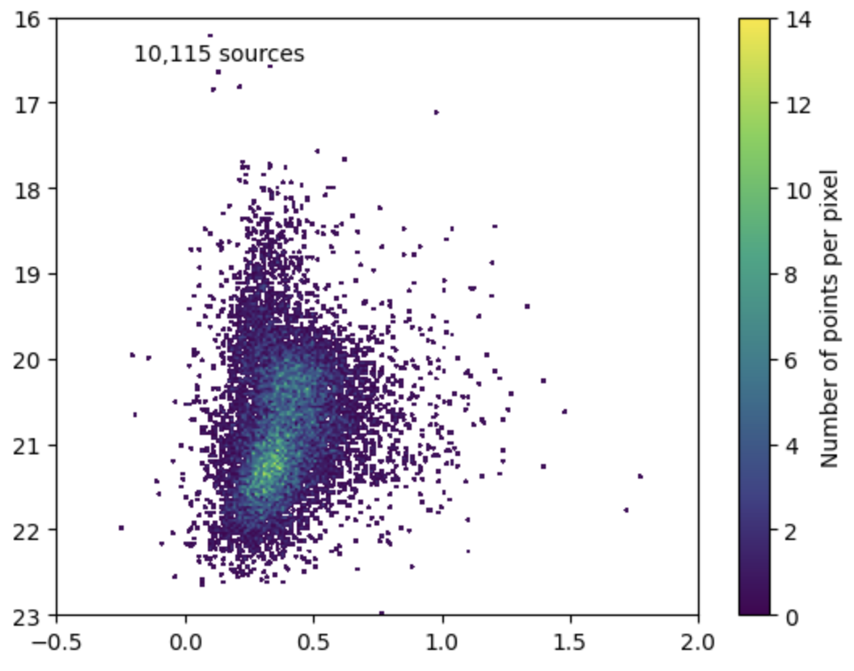
Stellar Populations Within NIRCam Footprint
F212N
F164N – F212N
Slide 16
Notes:
We want inventory of all the stellar populations in order to better understand what is going on in the AGN. One way to analyze stellar populations is with color magnitude diagrams where you plot point sources identified in one of the bands on the y-axis and then the difference between the observed magnitudes in two bands on the x-axis.

Slide 17
Stellar Populations Within NIRCam Footprint
F212N
F164N – F212N
[FeII]
H₂
Slide 17
Notes:
We plot F164N (which is [FeII]) minus F212N (which is molecular hydrogen) versus F212N. There are a total of 10,115 sources in this plot known as a hess diagram where color indicates denseness of the points.

Slide 18
Stellar Populations Within NIRCam Footprint
F212N
Red Clump
F164N – F212N
Slide 18
Notes:
The denser region around magnitude of 21.5 is made up of sources known as the red clump. As old or intermediate-aged stars undergo a helium flash, they tend to collect in a certain spot in the color magnitude diagram, named the red clump.

Slide 19
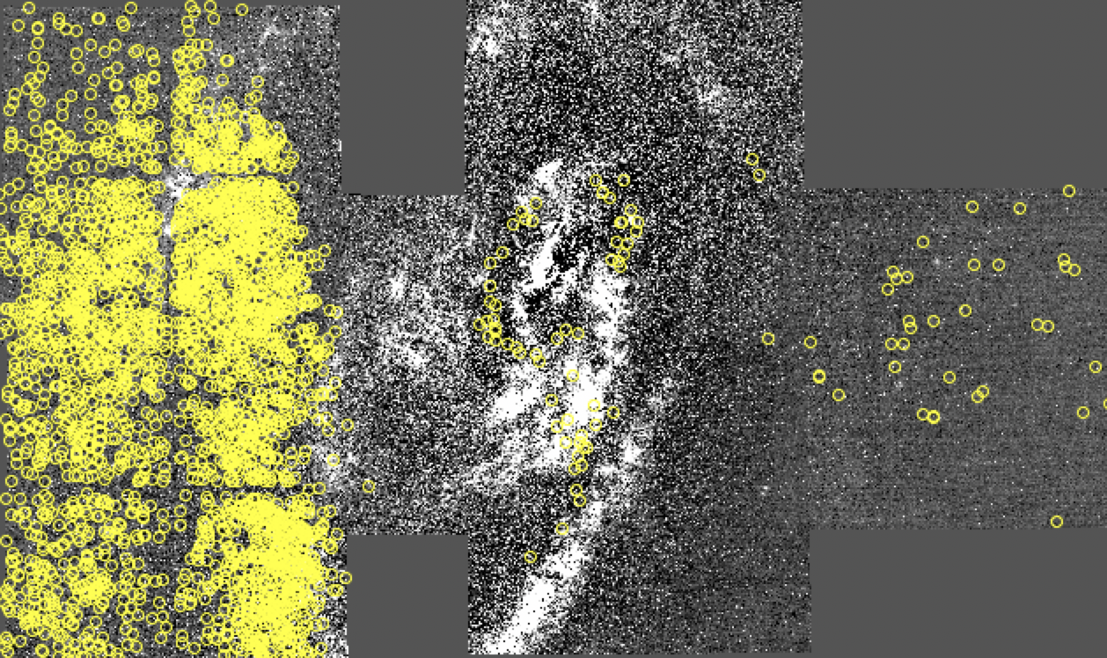
Stellar Populations Within NIRCam Footprint
F335 Emission
2504 Red Clump Sources
F212N
Red Clump
F164N – F212N
Slide 19
Notes:
We plot the point sources detected in both bands of which there are a bit over 10000 sources in a density plot known as a hess diagram. There are two regions which are more dense in number of points. The more dense region around a magnitude of around 21.5 is the red clump. As old or intermediate-aged stars undergo a helium flash, they tend to collect in a certain spot in the color magnitude diagram, named the red clump.

Slide 20
Stellar Populations Within NIRCam Footprint
F212N
AGB bump
F164N – F212N
Slide 20
Notes:
The second dense region is the asymptotic giant branch bump. The AGBb is a population of stars that can be seen in the color magnitude diagrams and are indicative of the population of stars where their hydrogen-burning shells are extinguished by the expansion of their convective layer. This stellar population momentarily stalls in its evolution as He-burning of the shell ignites, leading to the dense region seen in the CMD.

Slide 21
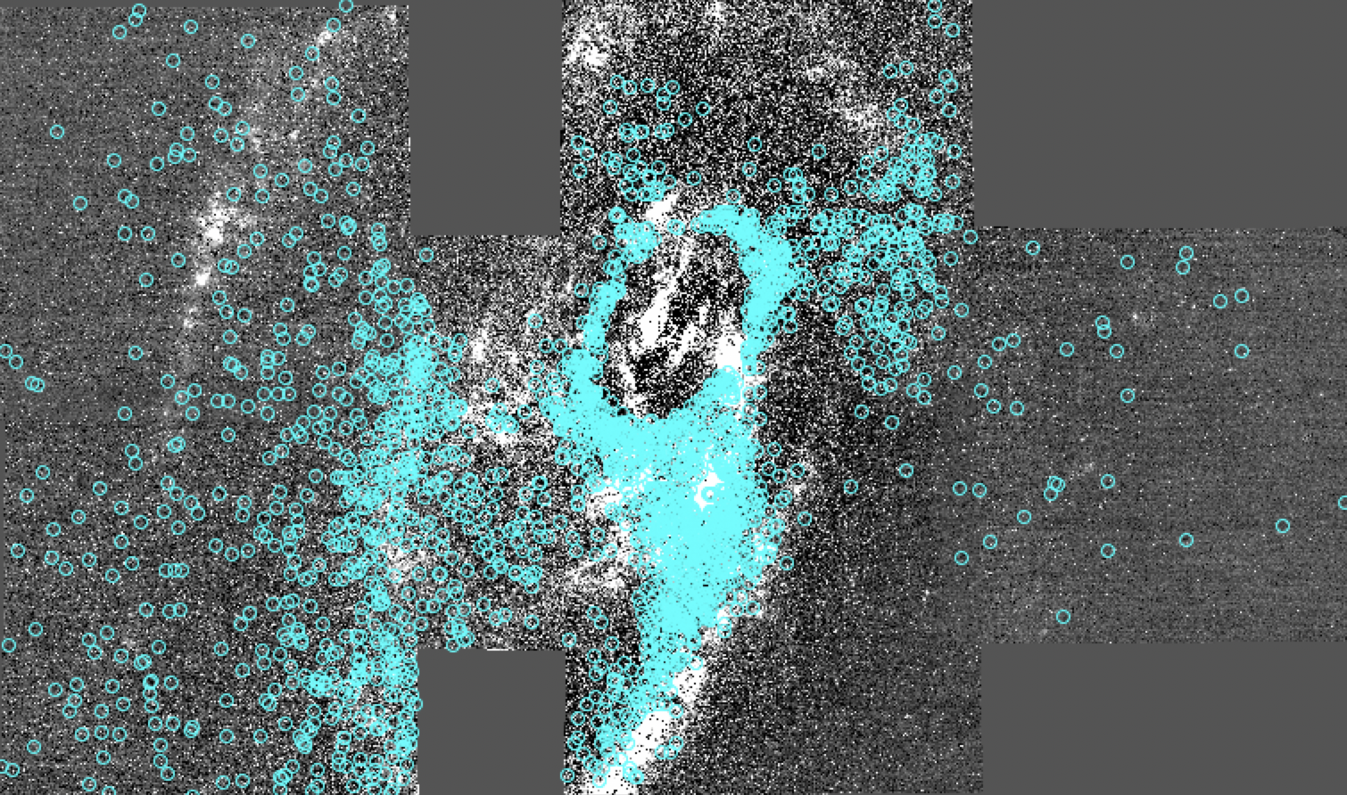
Stellar Populations Within NIRCam Footprint
F335 Emission
2387 Red AGB bump Sources
F212N
AGB bump
F164N – F212N
Slide 21
Notes:
The second dense region is the asymptotic giant branch bump. The AGBb is a population of stars that can be seen in the color magnitude diagrams and are indicative of the population of stars where their hydrogen-burning shells are extinguished by the expansion of their convective layer. This stellar population momentarily stalls in its evolution as He-burning of the shell ignites, leading to the dense region seen in the CMD.

Slide 22
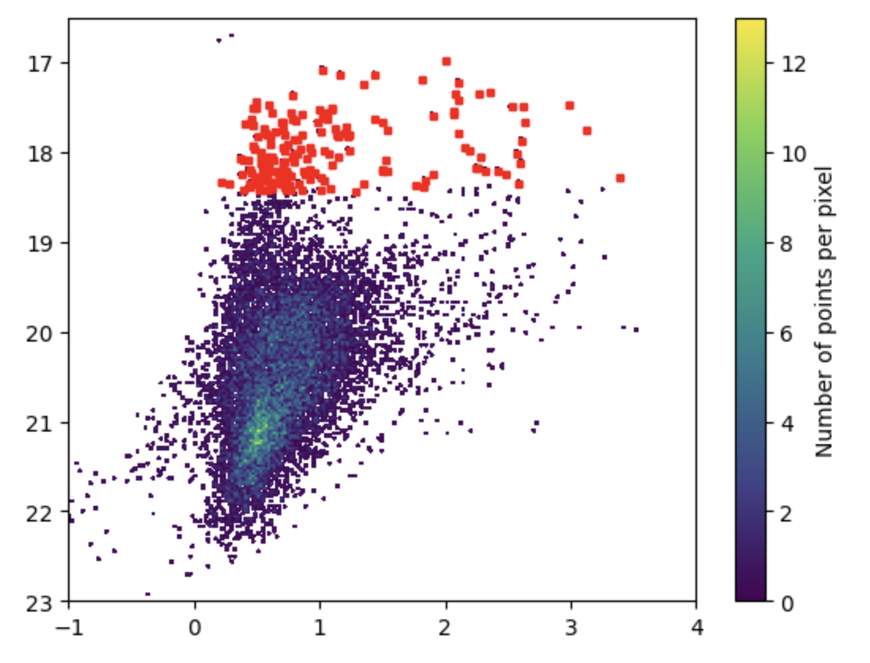
Stellar Populations Within NIRCam Footprint
AGB Stars
F335M
F164N – F335M
[FeII]
PAH
Slide 22
Notes:
In this figure I show a different combination of filters: I shows F164N – F335M on the x-axis which are the [FeII] and PAH emissions, respectively. We also see asymptotic giant brance stars in our CMDs, likely both carbon-rich and oxygen-rich asymptotic giant branch stars are in this region highlighted with red points. Whether a source is carbon-rich or oxygen-rich is dependent on initial conditions on if there is either on overabundance of carbon or oxygen molecules in the stellar photospheres of these sources.

Slide 23
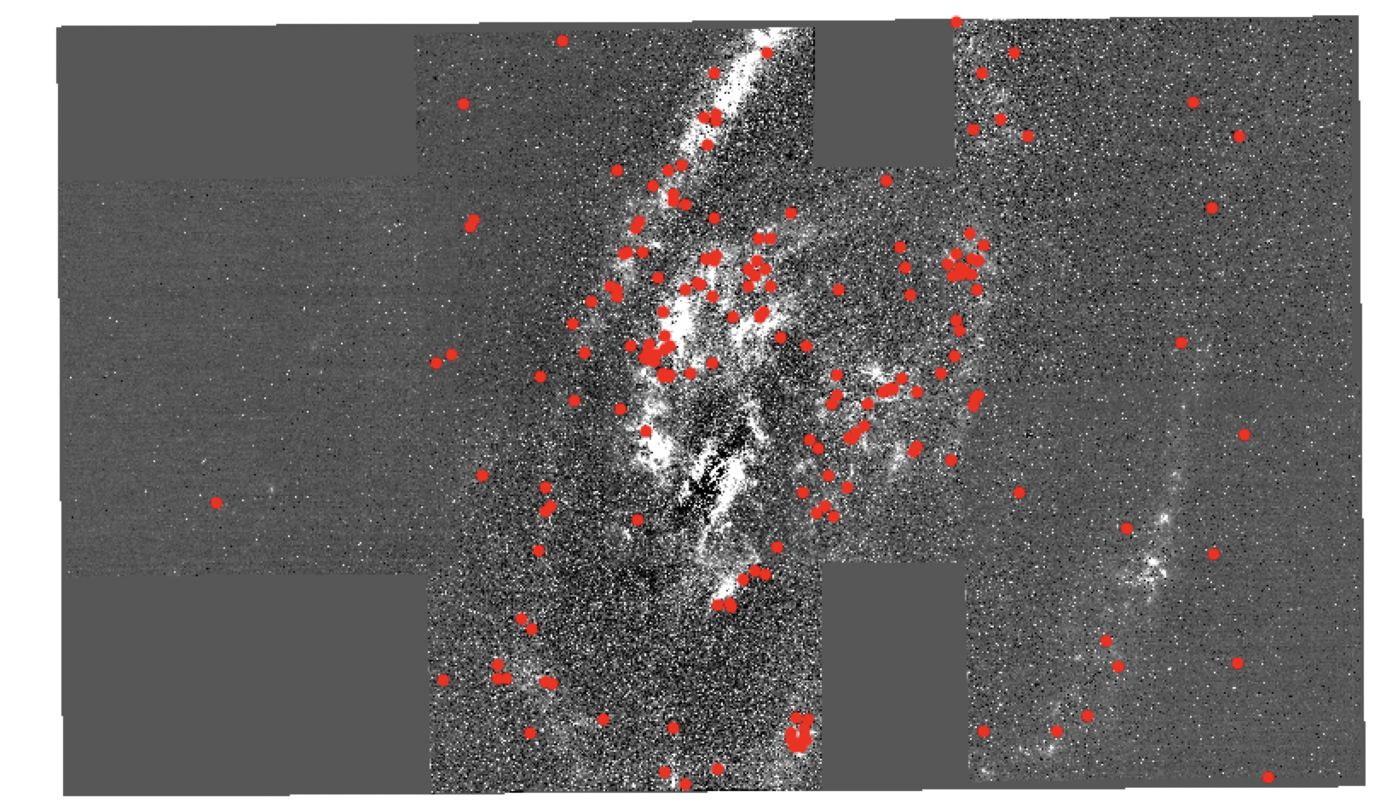
Stellar Populations Within NIRCam Footprint
AGB Stars
F335M Emission
183 AGB Stars
F335M
F164N – F335M
Slide 23

Slide 24
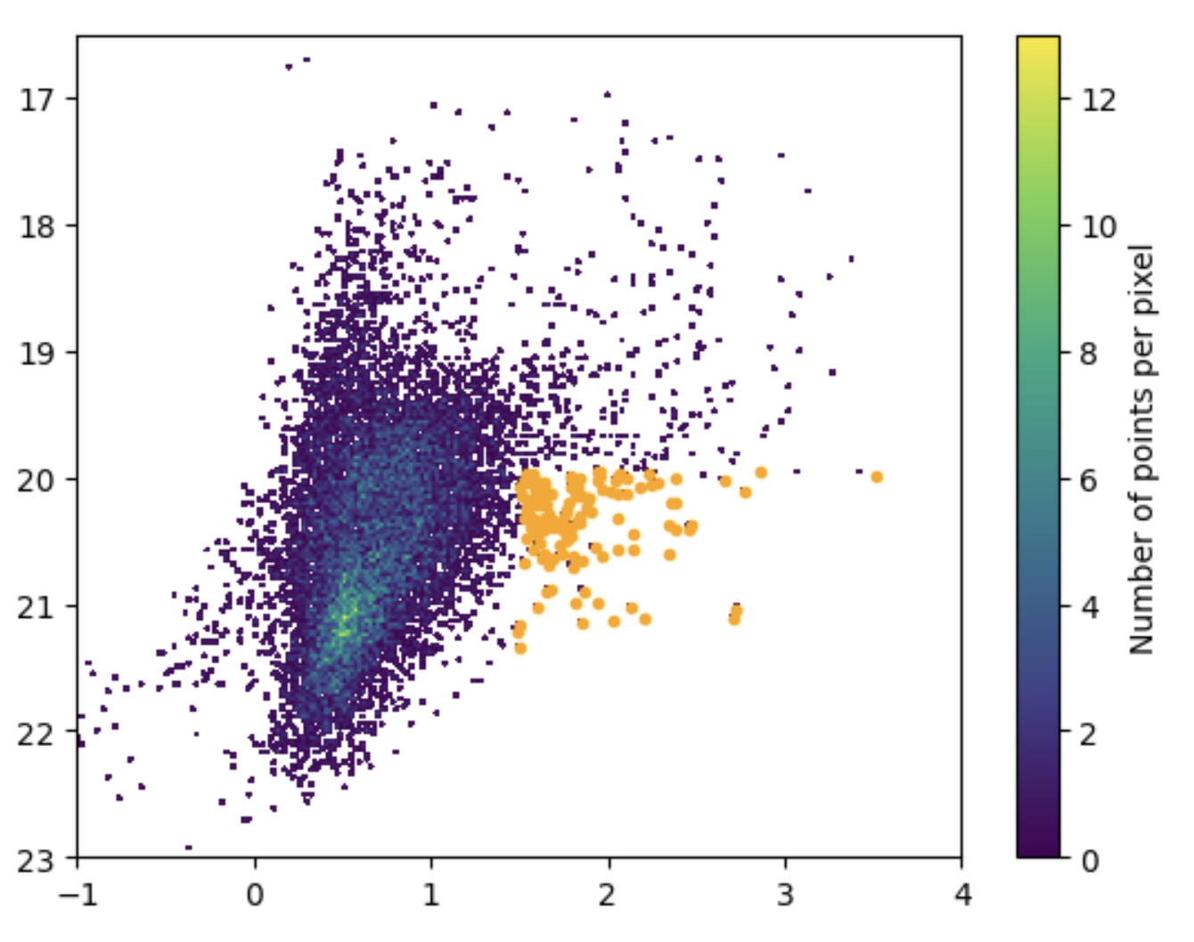
Stellar Populations Within NIRCam Footprint
YSOs
F335M
F164N – F335M
Slide 24
Notes:
These sources shown in orange here are likely young stellar objects which are enshrouded in dust, therefore have excess emission at 3.35 microns. Young stellar objects are often associated with polyaromatic hydrocarbons. The more red, or more infrared excess, a source has, the younger the protostar.

Slide 25
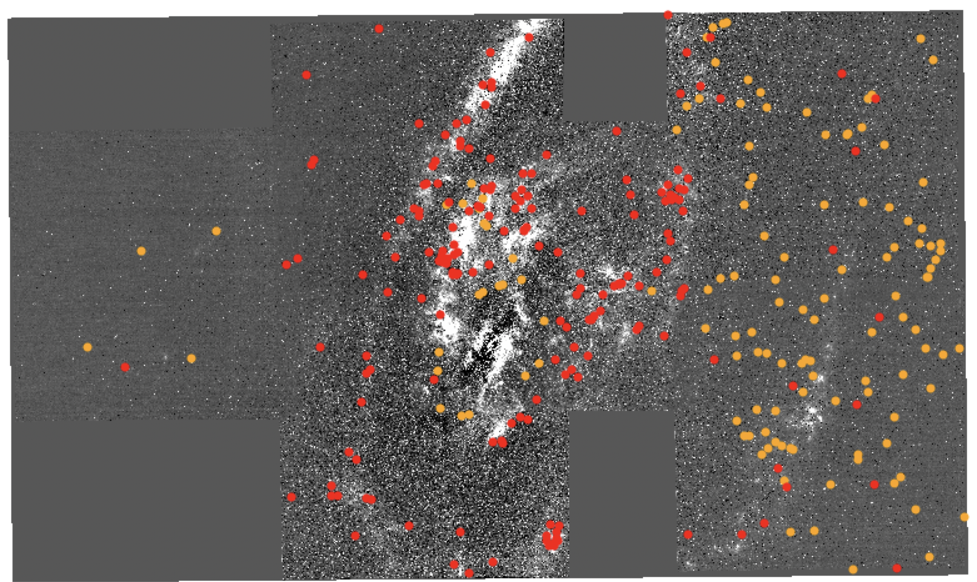
Stellar Populations Within NIRCam Footprint
YSOs
F335M Emission
183 AGB Stars
129 YSOs
F335M
F164N – F335M
Slide 25
Notes:
The 129 young stellar clusters which we identify are located throughout the galaxy. With more sources on the right like, likely tracing sources seen in the Spitzer image.

Slide 26
CMD of All Sources Within NIRCam Footprint
O-AGB
C-AGB
F212N
AGB bump
YSOs
Red Clump
F164N – F212N
Slide 26

Slide 27
Anomalous Arm
Star Forming Arm
Pa⍺
PAH
H₂
[FeII]
VLA 4.8 GHz
Slide 27
Notes:
Let’s take a look at only sources that are within the northern star forming arm, that is all sources located within this white box.

Slide 28
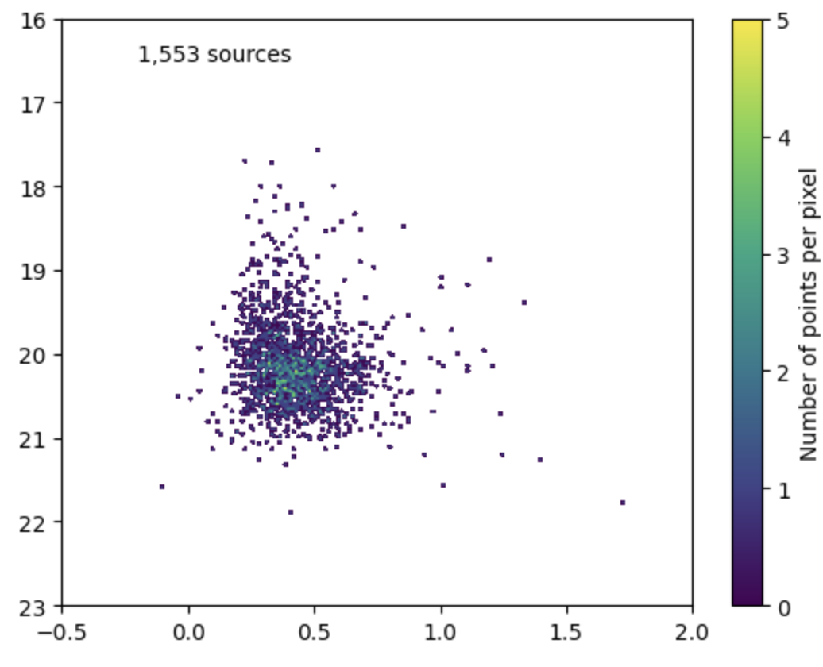
Stellar Populations in the Star Forming Arm
O-AGB
C-AGB
F212N
AGB bump
YSOs
Red Clump
F164N – F212N
Slide 28
Notes:
There are about 1500 or so sources and the majority of them seem to be located in the region of the CMD where there is a dense region signifying the AGB bump, and the brigher population are AGB stars.

Slide 29
Upper Anomalous Arc
Pa⍺
PAH
H₂
[FeII]
VLA 4.8 GHz
Slide 29
Notes:
Now let’s look at the sources within the upper anomalous arc.

Slide 30
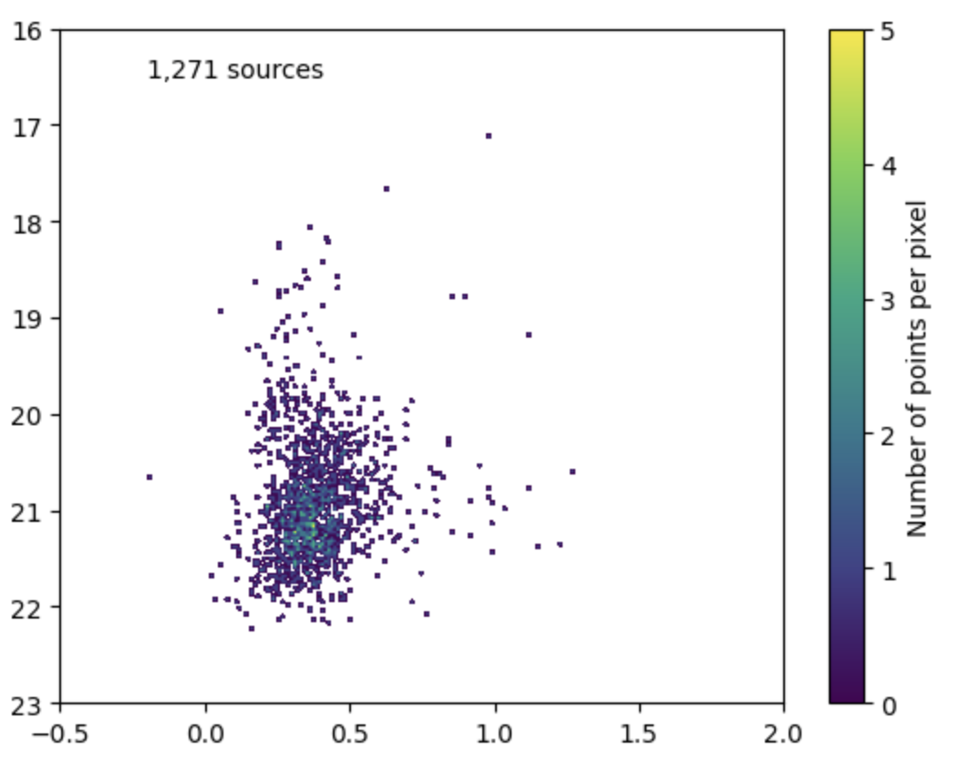
Stellar Populations in the Upper Anomalous Arc
O-AGB
C-AGB
F212N
AGB bump
YSOs
Red Clump
F164N – F212N
Slide 30
Notes:
The circles signifying the red clump and the AGB bump, as well as all the arrows are all at the same location as before. Many of the 1271 sources within the upper arc are sources which are part of the red clump, with a few scatters young stellar objects as well as some AGB stars.

Slide 31
Lower Anomalous Arc
Pa⍺
PAH
H₂
[FeII]
VLA 4.8 GHz
Slide 31
Notes:
Now what about the sources in the lower anomalous arc.

Slide 32
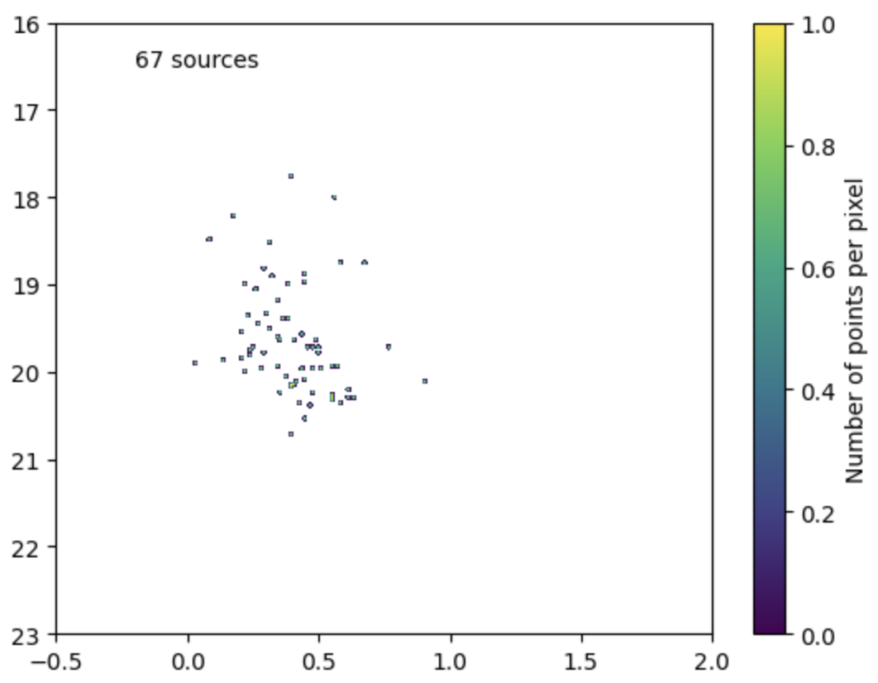
Stellar Populations in the Upper Anomalous Arc
O-AGB
C-AGB
F212N
AGB bump
YSOs
Red Clump
F164N – F212N
Slide 32
Notes:
Sources in lower arc seem to be AGB stars. Not as many sources are within lower arc in comparison to the upper arc which has 1271 sources. However, they all seem to be older sources possibly 100 million years old or more since main sequence stars sit in the red clump phase (or He-burning phase) for a long time and then go up along the AGB branch. Lower anomalous arc has older stellar population in comparison to the upper anomalous arc. Or there is more extinction along the line of sight towards it, and that explains why we aren’t seeing as many sources.

Slide 33
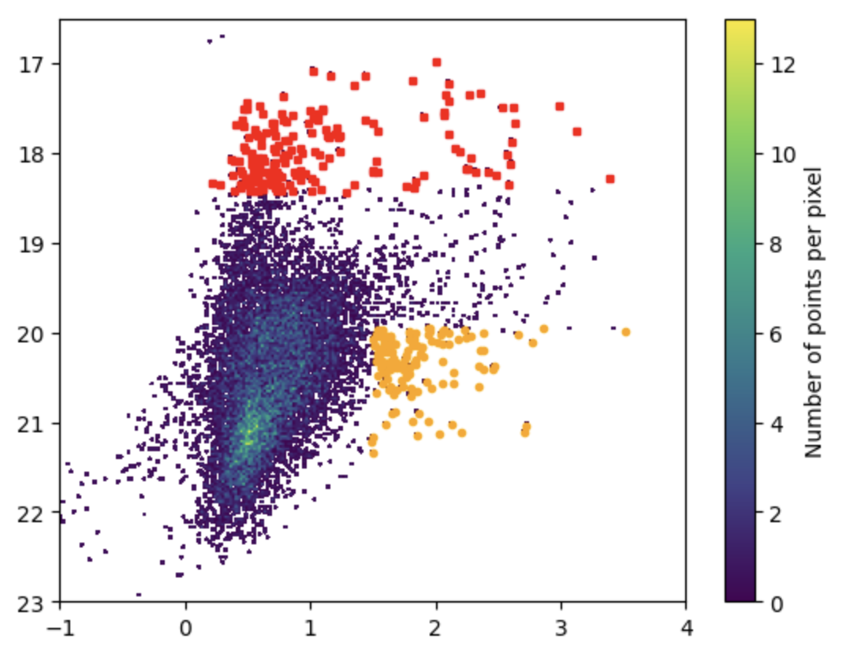
Older Asymptotic Giant Branch Stars and Young Stellar Objects in the CMD
129 YSOs
183 AGB stars
F335M
AGB bump
PRELIMINARY
Red Clump
F164N – F335M
Slide 33
Notes:
This is preliminary! We have new data we got three weeks ago and recently completed reducing and aligning all 12 bands. We plan to implement multiple color cuts to identify young and old stellar populations.

Slide 34
Conclusions
We have observations made with12 JWST NIRCam filters to detect line emission as well as continuum emission
We want to characterize the AGN, the spiral arms, and anomalous arms seen in various wavelengths
Simple color cut reveals there to be 129 massive young clusters and 189 AGB stars
Northern spiral arm seems to have more Bremsstrahlung radiation
Northern anomalous arm seems to have more Synchrotron radiation while there is a mix between Bremsstrahlung and Synchrotron in the Southern anomalous arm
We just got more data three weeks ago!
Slide 34
Notes:
We have observations made with12 JWST NIRCam filters to detect line emission as well as continuum emission. We want to characterize the AGN, the spiral arms, and anomalous arms seen in various wavelengths. Simple color cut reveals there to be 129 massive young clusters and 189 AGB stars. Northern spiral arm seems to have more Bremsstrahlung radiation consistent with there being some young stellar clusters and AGB stars. Northern anomalous jet-like structure seems to have more synchrotron radiation while there is a mix between Bremsstrahlung and Synchrotron in the Southern anomalous jet-like structure. We just got more data three weeks ago which we are still in the process of analyzing.

Slide 35
Slide 35
Notes:
And I will leave this three-color image we made with the new data up while I answer any questions.

