Slide 1

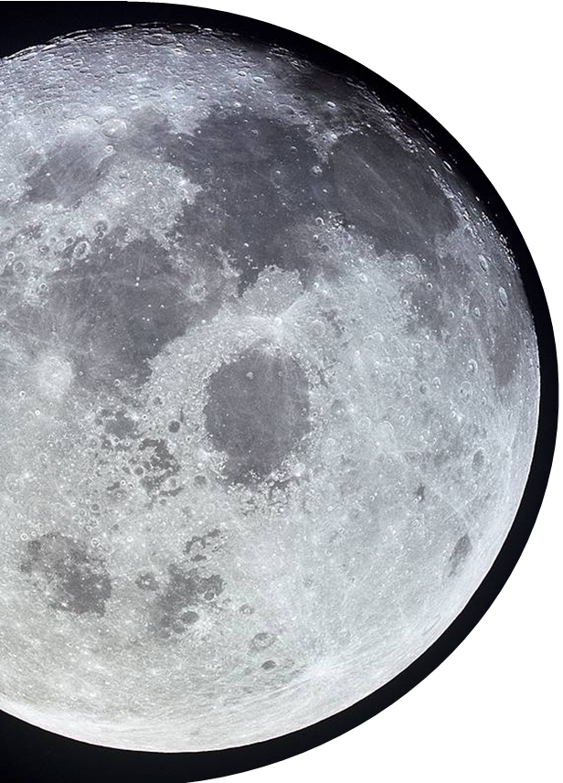
UNCLASSIFIED
NASA Space Technology Research Grants (STRG) Program
Matt Deans, Ph.D. – STRG Program Executive
Website: https://www.nasa.gov/space-technology-research-grants/
Email: nasa-strg@mail.nasa.gov
Solicitations: https://nspires.nasaprs.com/external/
  Refer to the Space Technology Research, Development, Demonstration, and Infusion (SpaceTech REDDI) umbrella solicitation
All STRG vehicles have NASA Research Collaborators as well as other engagement opportunities
NSTGRO addresses all NASA space technology Envisioned Future areas; other solicitations are topic based
NASA Space Technology Graduate Research Opportunities (NSTGRO)
Early Career Faculty (ECF)
Early Stage Innovations (ESI)
Lunar Surface Technology Research (LuSTR) Opportunities
Space Technology Research Institutes (STRI)
Graduate student research in space technology; research conducted on campuses and at NASA Centers and not-for-profit R&D labs
Annual – Target Late August release, April Award
$84k total award value each year, up to 4 years
Focused on supporting outstanding faculty researches early in their careers as they conduct space technology research of high priority to NASA’s Mission Directorates
Typically Annual
Has been up to $200k a year, up to 3 years
University-led efforts on early-stage space technology research of high priority to NASA’s Mission Directorates. Paid teaming with other universities, industry, and non-profits permitted
Typically Annual
Active Solicitation
$250k a year, up to 3 years
University-led efforts addressing high priority lunar surface challenges. Short duration, high value grants with emphasis on potential infusion. Paid teaming with other universities, industry, and non-profits encouraged
Has been up to $2M total, up to 2 years
University-led, integrated, multidisciplinary teams focused on high-priority early-stage space technology research for several years
Typically Biennial
Has been up to $3M a year, planned for 5 years
UNCLASSIFIED

