Slide 1



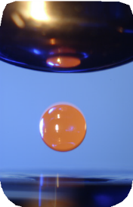
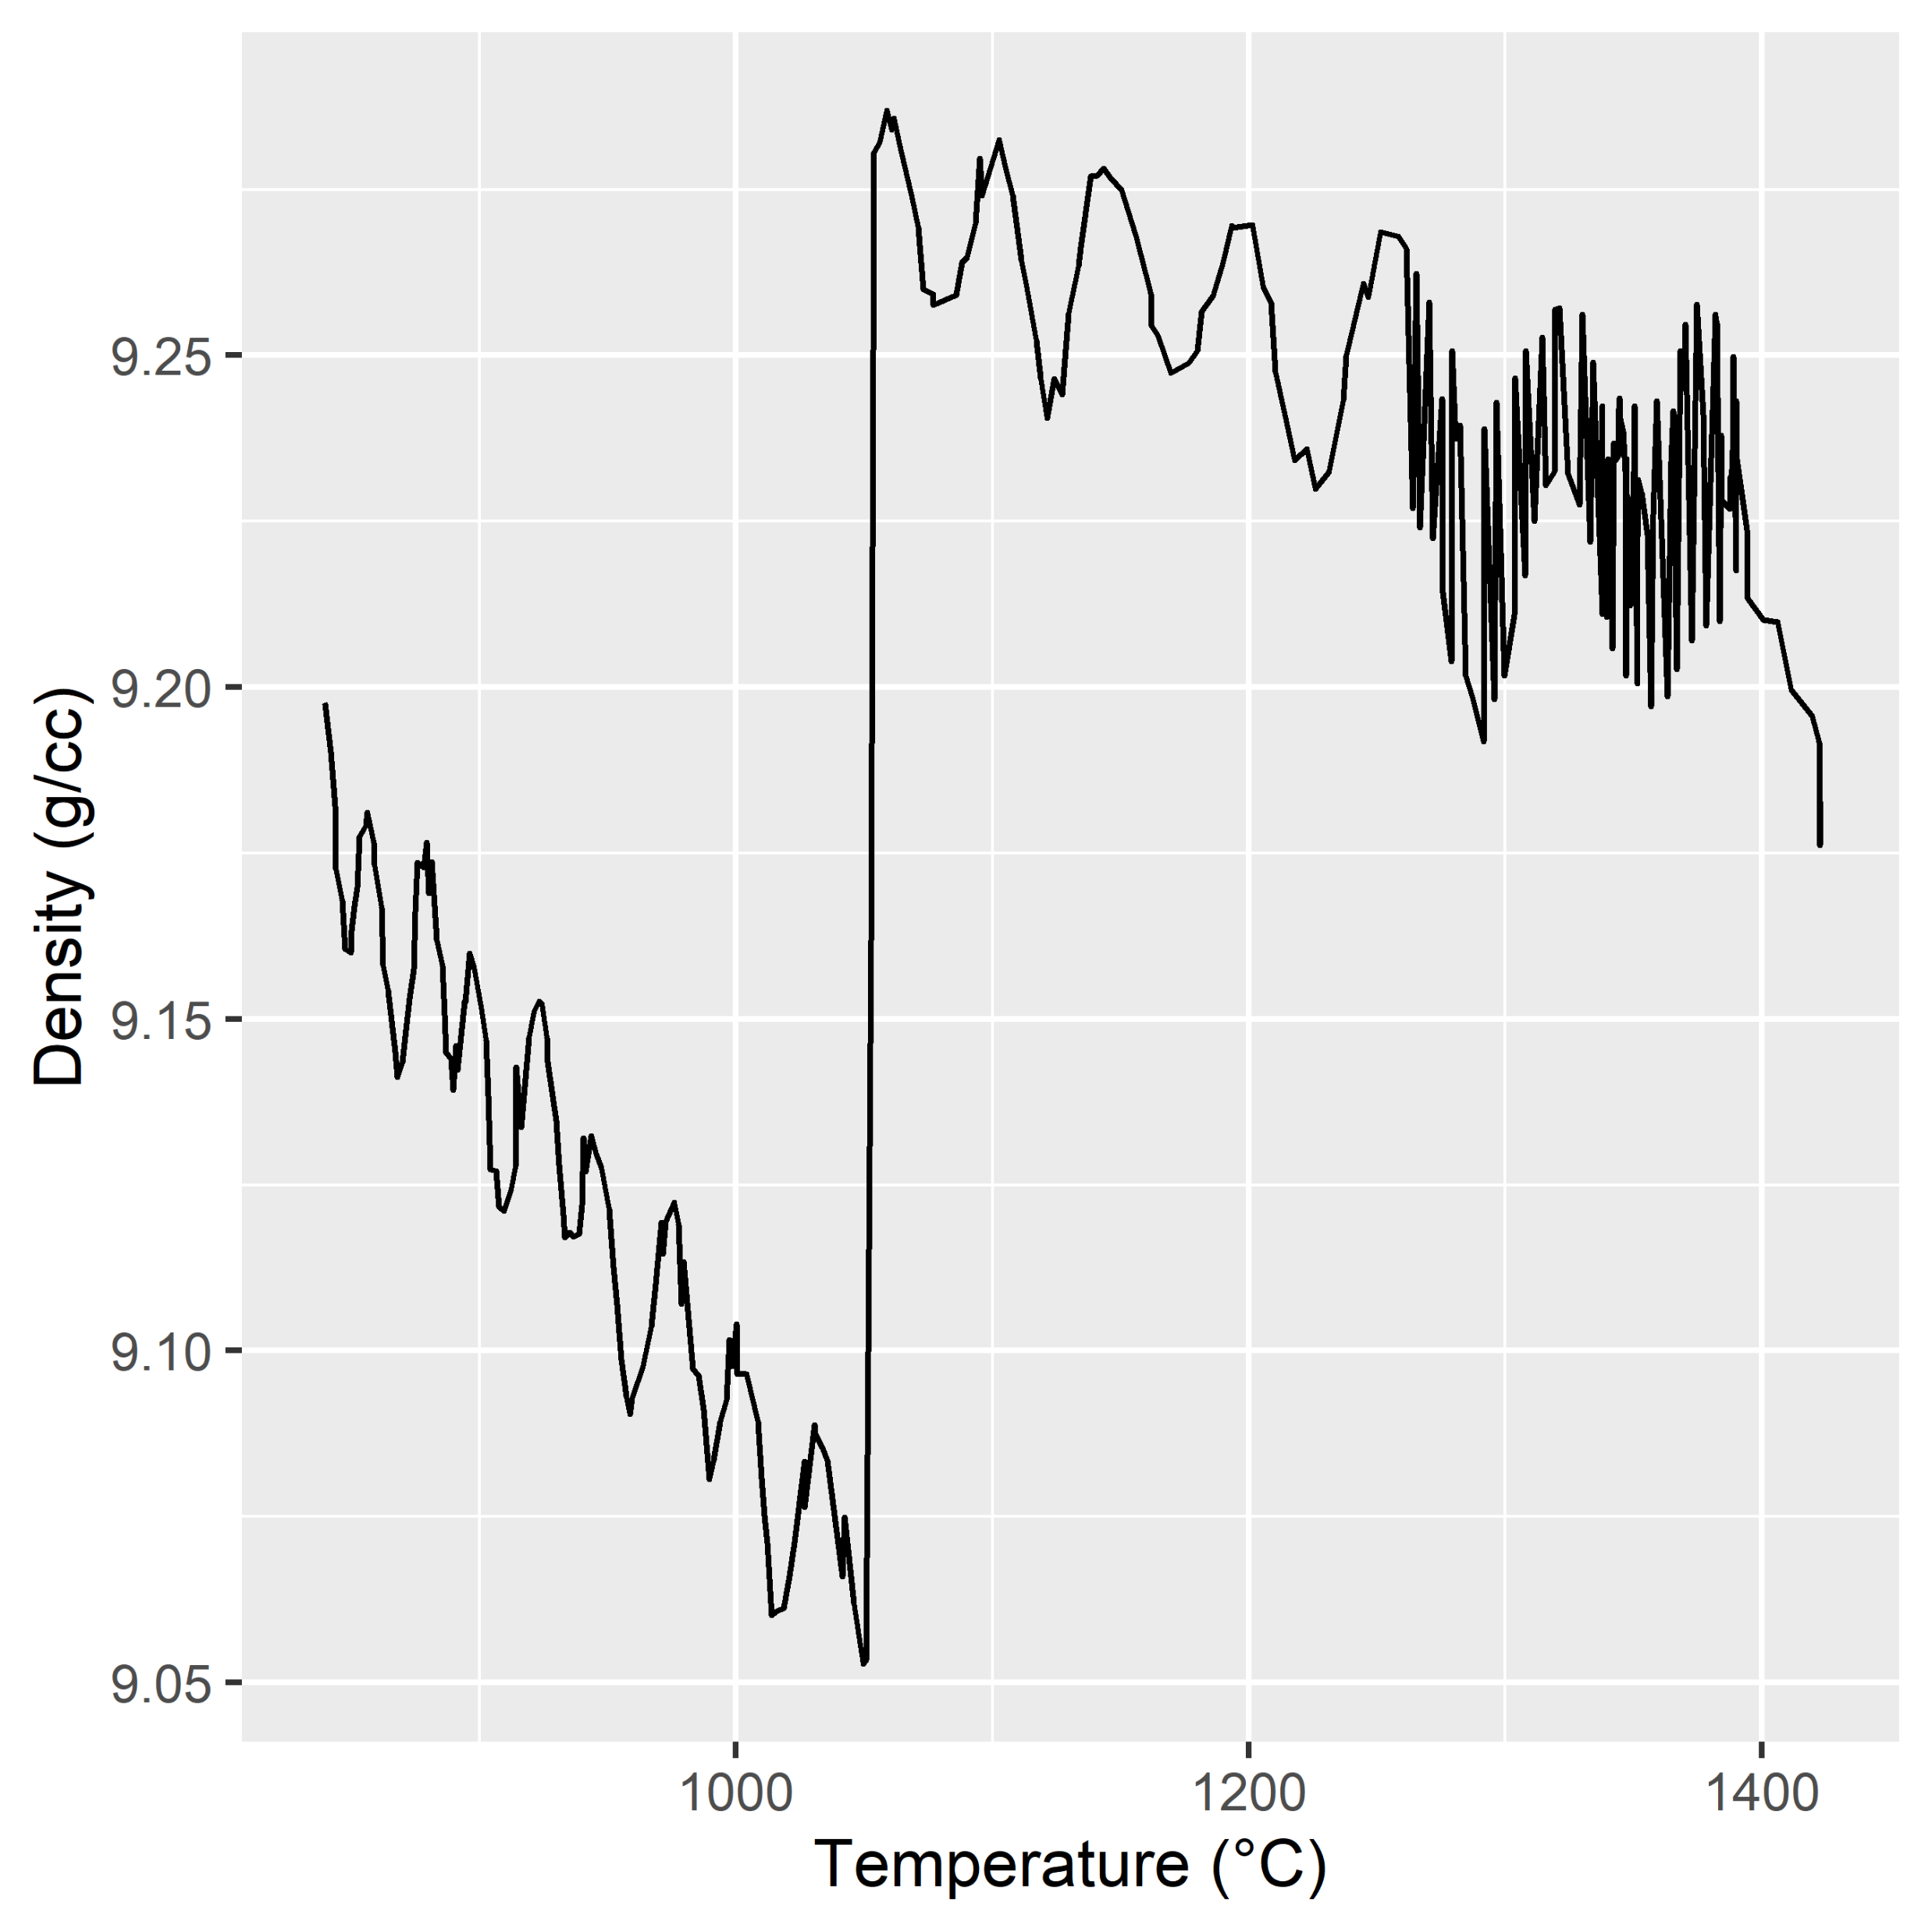

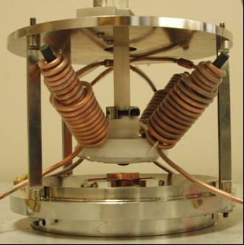

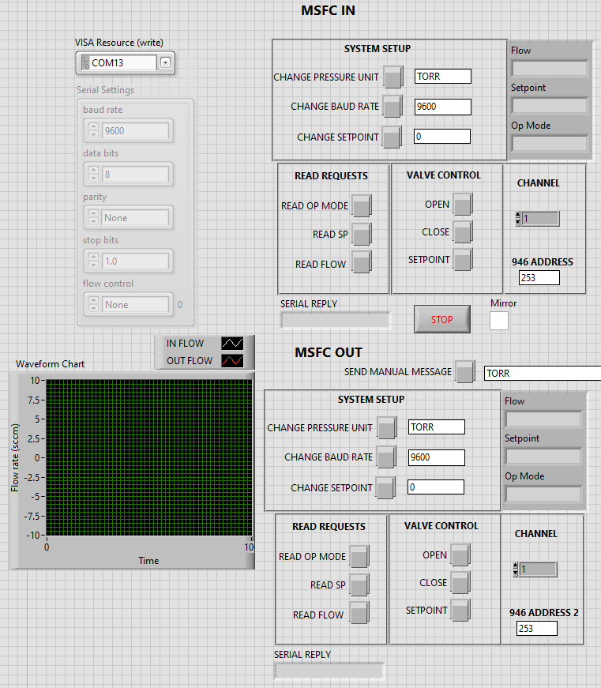
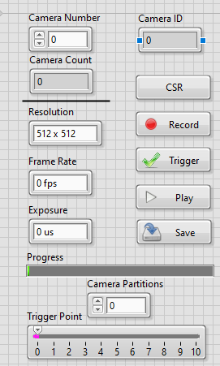
Marshall Space Flight Center
National Aeronautics and
Space Administration
Materials Levitation Laboratory
Electrostatic Levitator Capabilities
Irene Prado (METTS III), Kane Bergeron (ESSCA), Matthew Brown (ESSCA), Glenn Fountain (ESSCA)
MSFC EM31
Data Processing
The system generates large amounts of raw data. Current efforts are creating a data processing pipeline to better analyze that data and reduce the workload of those who receive it.
Levitated Samples
Ambient Heated
Background
MSFC’s electrostatic levitator enables high impact materials science and thermophysical property measurement. This container-less measurement technique allows in-situ observations of materials deemed too reactive or with too high of melting points to be measured by traditional techniques.
This system is the ground-analog to JAXA’s ELF on ISS. As a user facility, it must be state-of-the-art to keep current to the needs of industry and OGA customers.
Density measurement liquid GRX-810
Density as a function of temperature
Raw data from high- speed camera
Application
This apparatus provides a way to rapidly determine the liquid state thermophysical properties of materials, increasing the pace of materials development for space and defense applications.
Creep Assembly
Deformed Sample
High-speed Camera Integrated GUI
Creep Capabilities
Creep measures the mechanical distortion of a material over time. To simulate this in the levitator metallic alloys are heated to a point below melting then subjected to a magnetic field to spin the material. The speed of the spin can be controlled by the strength of the field. Analysis of the deformed sample can determine the strain.
Hybrid Gas Control Interface
For Main ESL
Control System Modifications & Hybrid Levitation
New updates to the control code and physical system allow for a combination of electrostatic levitation and aero levitation to accommodate instances of phase shifts in materials that cause a sample to drop out.
LabVIEW integration of the high-speed camera reduces the need for multiple users running the system.

