Slide 1

NASA's Moon to Mars
Architecture Updates
NASA Advisory Council
Nujoud Merancy
Deputy Associate Administrator
Strategy and Architecture
NASA Headquarters – April 26, 2024

Slide 2
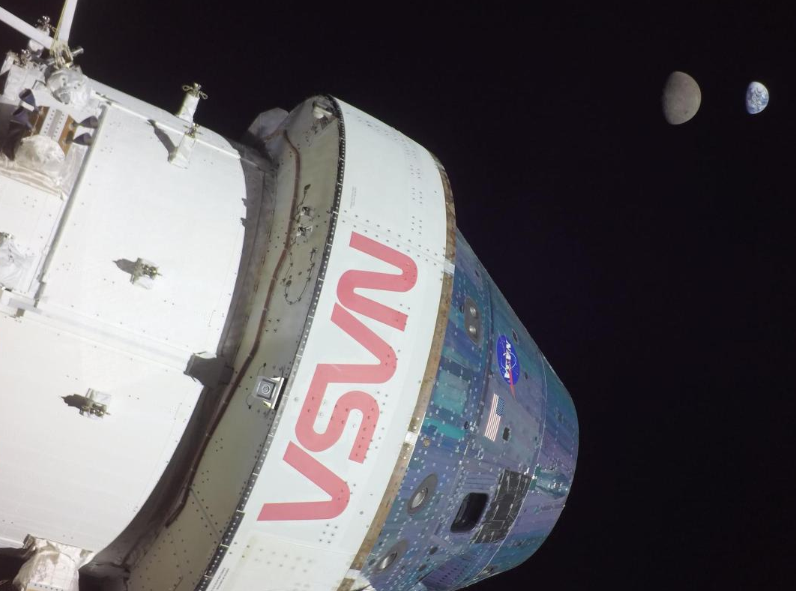
Agenda
2024 Architecture Workshops
Pre-Formulation Process
Mars Priority Decisions
2024 SAO Priorities
Credit: NASA

Slide 3

Credit: NASA/Keegan Barber
2024
Architecture
Workshops

Slide 4

2024 Architecture Workshops
Credit: NASA/Greg Mercer
February 20–22 – Washington, DC
The workshops remain a great forum for receiving feedback from stakeholders and answering questions.
Key discussion areas included next steps in the process for technology and systems definitions.
NASA continues to engage partners of all types: emerging and established space agencies, small and large companies, and academia and the science community.
National Academy of Sciences
Fred Kavli Auditorium
Washington, D.C.

Slide 5
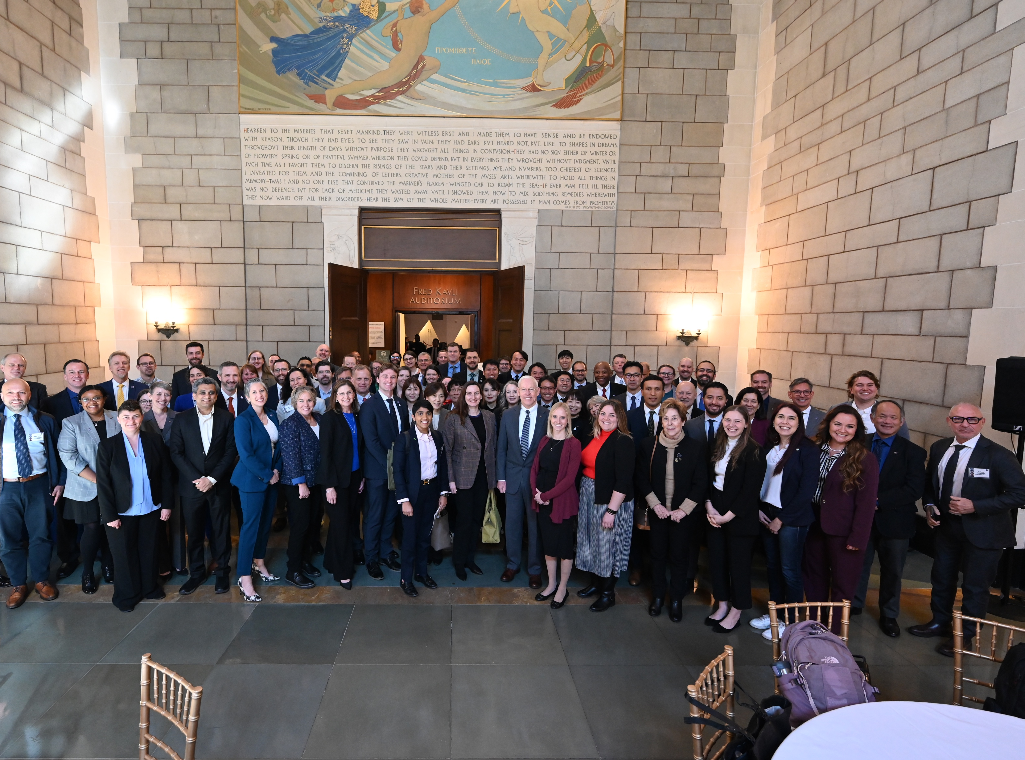
International Partner
Credit: NASA/Greg Mercer
50
18
from
attendees
countries
Key Themes:
The community aspect of the day was integral.
Partners want to engage domestic stakeholders and build support for space.
Some emerging space agencies are struggling to identify where they can engage in the ADD process.
There is confusion between the Artemis Accords, Artemis campaign, and the Moon to Mars Architecture.
National Academy of Sciences
February 20, 2024

Slide 6
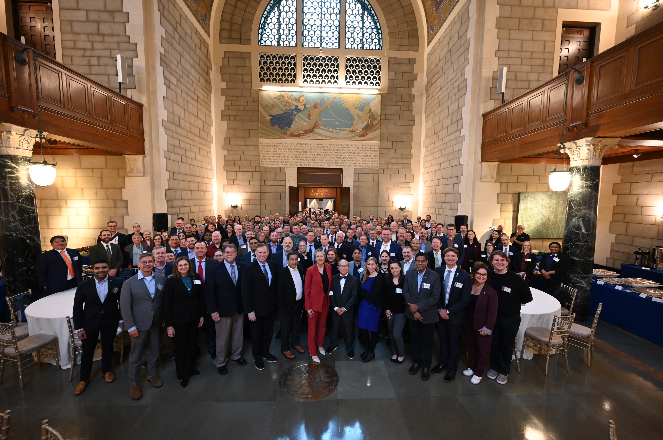
Industry and Academia
Credit: NASA/Greg Mercer
140
110
from
attendees
organizations
85 companies, 25 academic institutions
Key Themes:
Communication has improved.
Stakeholders appreciate transparency regarding decisions and decision-making.
Industry desires more clarity on investment priorities.
Industry and academia would appreciate opportunities to engage in the architecture process earlier.
National Academy of Sciences
February 22, 2024

Slide 7


Subscribe to Updates
Credit: NASA
Subscribe to the Moon to Mars Architecture email list at the link below:
https://socialforms.nasa.gov/Architecture-Updates

Slide 8

Credit: NASA
Pre-
Formulation
Process

Slide 9
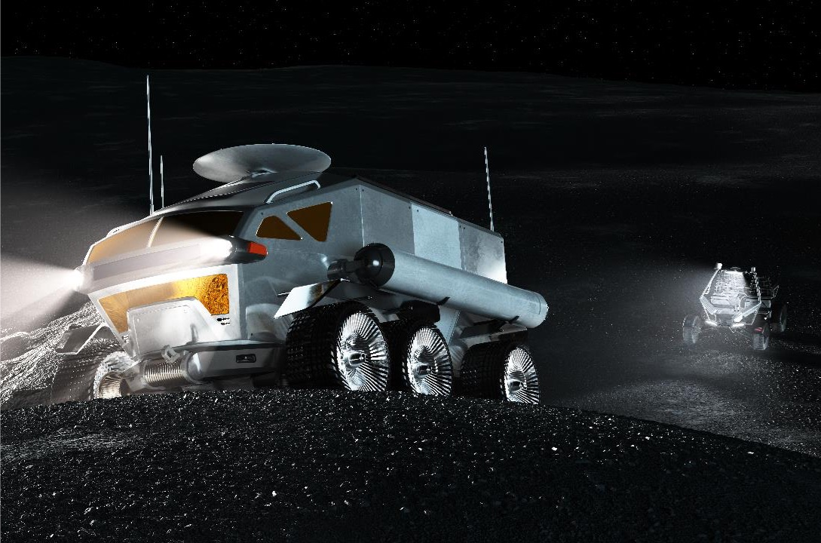
Element Initiation Purpose
Overt integration point based for an identified gap in the Moon to Mars Architecture coordinated with partner mission directorates.
Indicates a commitment to formulate element with approval at a Directorate Program Management Council (DPMC).
Affirms strategic alignment and coordination of architecture need and implies intent to apply necessary resources for element formulation.
Applied to large elements or systems that need to integrate across programs and projects and not intended for small payloads, utilization, etc.
Element initiation may include:
  Architecture Use Cases & Functions
  A Preliminary Concept
  Potential International Partner Contributions
  Schedule, Planning, and Pre-project Team
Credit: NASA

Slide 10
ESDMD Pre-Formulation for Industry
Element Initiation:
overt decision to proceed with maturation of concept assessed for Arch. priority, budget, and strategy
Mission Concept Review: To evaluate the feasibility of the proposed mission concept(s) and its fulfillment of the Architecture needs and objectives.
Acquisition Strategy Meeting: Transition to Moon to Mars Program for implementation, completion of project roles & responsibilities leading to contracting process (e.g. RFP)
M2M Obj.
ACR
EI
MCR
ASM
Arch. Studies
Gap Analysis/Concept
Mission /Concept Trades
Acquisition Plan
M2M Program Int.
ADD
EI
RFP
Studies
Industry BAA, RFI, etc.
MCR
Element Definition
Contracted Solution
Feasibility studies and collaboration identify potential concept
Mission refinement to optimize for strategic value and functional achievement, use of study mechanisms to better inform planning
Feedback incorporated into Architecture products as milestones occur
Document(s)
NASA Milestone
ESDMD Strategy & Architecture Office
ESDMD Moon to Mars Program
Collaboration Partner

Slide 11
ESDMD Pre-Formulation for International Partners
Element Initiation:
overt decision to proceed with maturation of concept assessed for Arch. priority, budget, and strategy
Mission Concept Review: To evaluate the feasibility of the proposed mission concept(s) and its fulfillment of the Architecture needs and objectives.
Acquisition Strategy Meeting: Transition to Moon to Mars Program for implementation, completion of project roles & responsibilities leading to Implementing Arrangement
M2M Obj.
ACR
EI
MCR
ASM
Arch. Studies
Gap Analysis/Concept
Mission /Concept Trades
Acquisition Plan
M2M Program Int.
ADD
EI
IA
Studies
Partner Pre-Phase A/B
MCR
Partner Integration
Element Definition
Collaboration Partner
Feasibility studies and collaboration identify potential concept
Mission refinement to optimize for strategic value and functional achievement
Feedback incorporated into Architecture products as milestones occur
Document(s)
NASA Milestone
ESDMD Strategy & Architecture Office
ESDMD Moon to Mars Program
Collaboration Partner

Slide 12
Upcoming Pre-Formulation Milestones
Pre-Phase A Tailored 7120 Approach |  |  |  |  | Forecast elements for FY24-25 are assessed to inform PPBE26 planning. Element Initiations will only occur if assessed as supportable with budget and programmatic planning. Elements must be approved through MCR to be formally included in the Architecture Concept Review (ACR) and Architecture Definition Document (ADD) update.
Element Initiation | Decision Framing Meeting | Mission Concept Review | Acquisition Strategy Meeting | Key Decision Point A
EI | DFM | MCR | ASM | KDP-A
 | FY24 |  |  |  | FY25
Element | QTR1 | QTR2 | QTR3 | QTR4
Initial Surface Habitation | EI (1/10) | DFM (1/18) MCR Phase 1 (1/31) | MCR Phase 1 Closeout (04/29) | MDR (ASI) (July) MCR Phase 2 (Sept) | ASM
Small Cargo Lander | EI (11/27) | DFM (4/4) | MCR Board (Jun/Jul) | ASM (TBD) | Payload EI Payload MCR
Utility Rover |  |  | EI (Jun) | DFM (TBD) | MCR ASM

Slide 13

Credit: NASA/JPL-Caltech/ASU/MSSS
Mars
Priority
Decisions

Slide 14
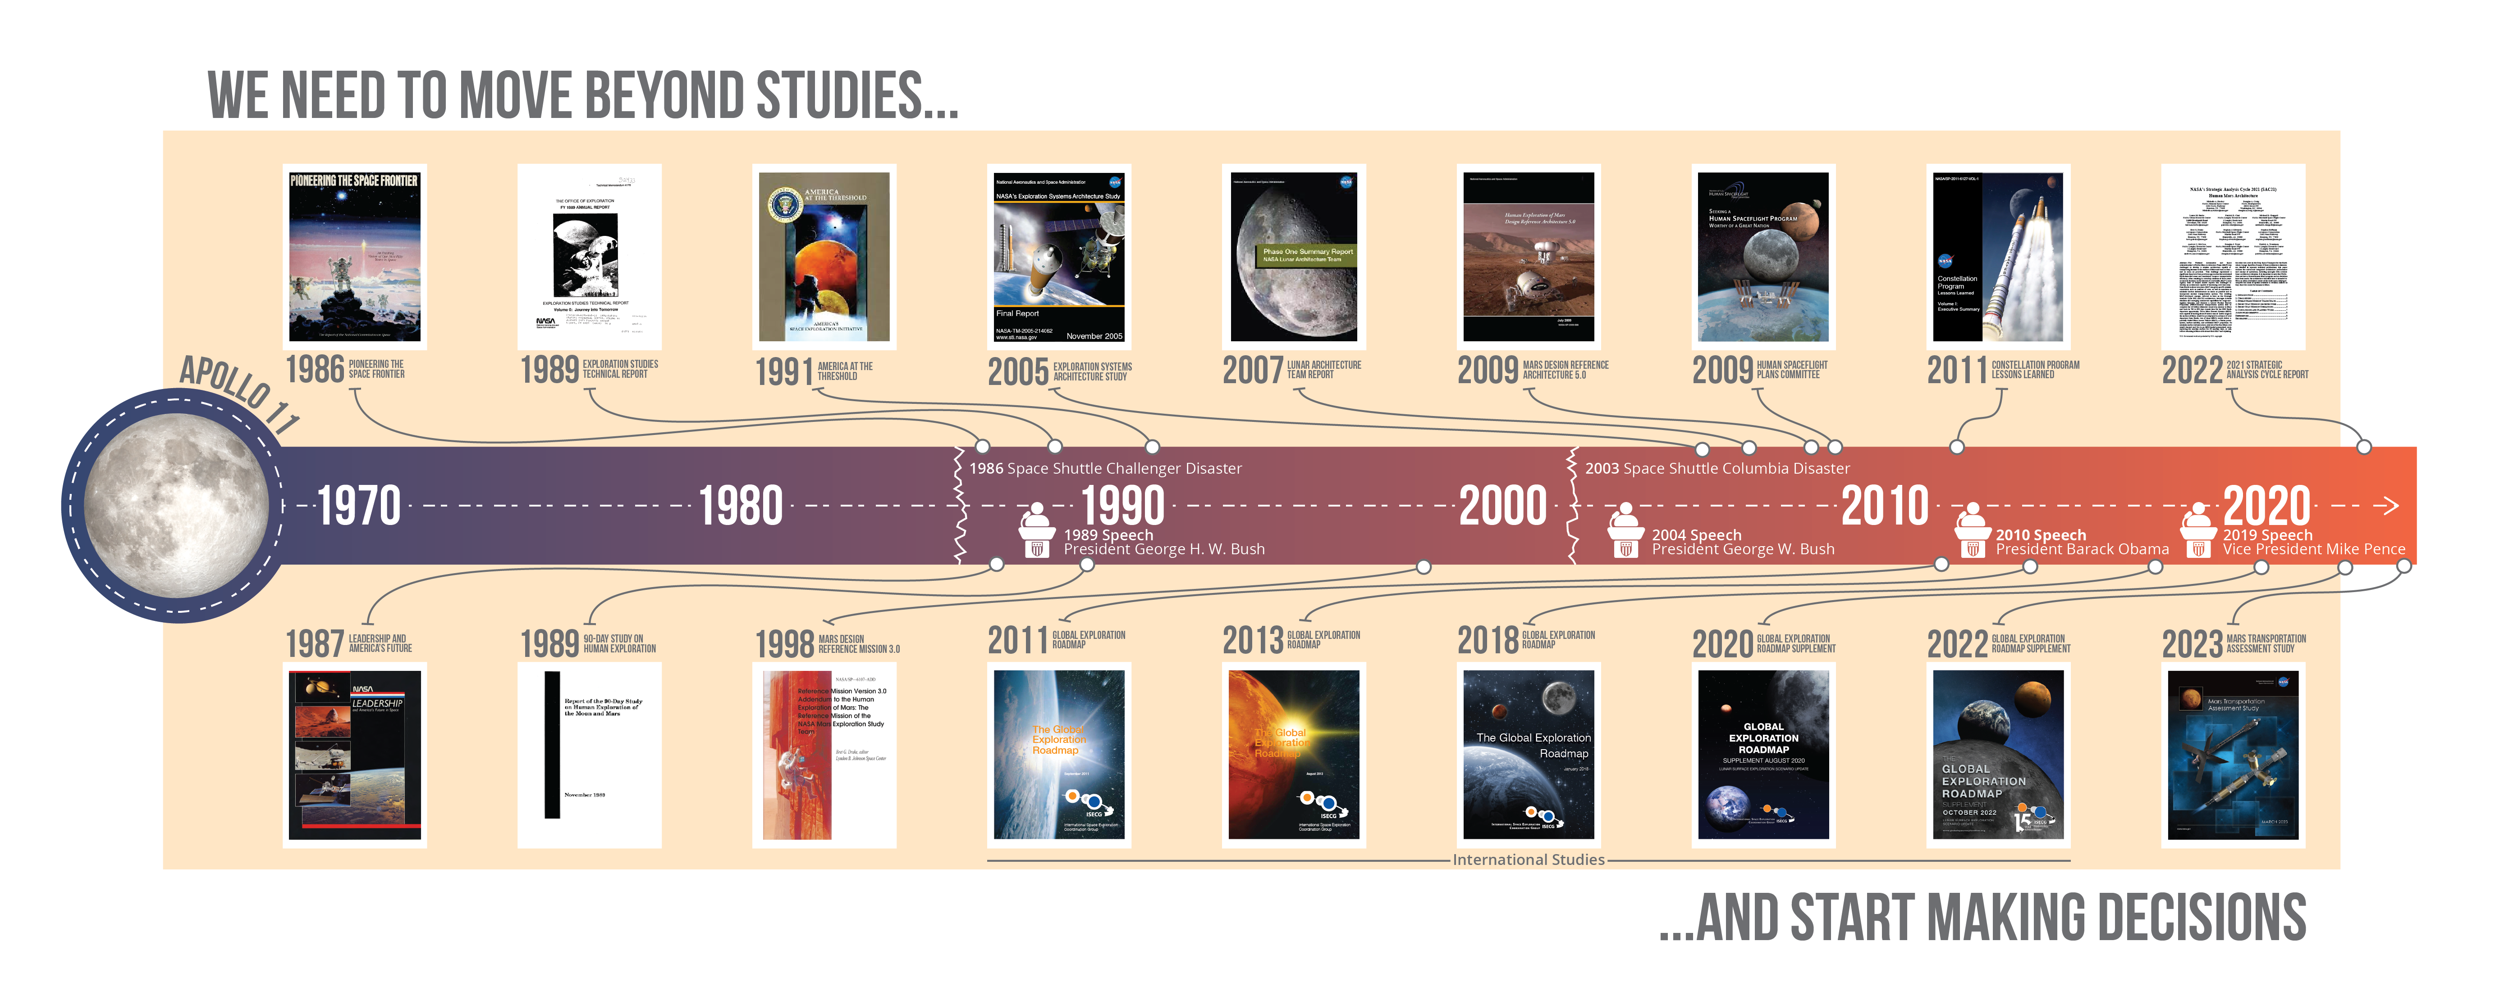
To Send Humans to Mars…

Slide 15
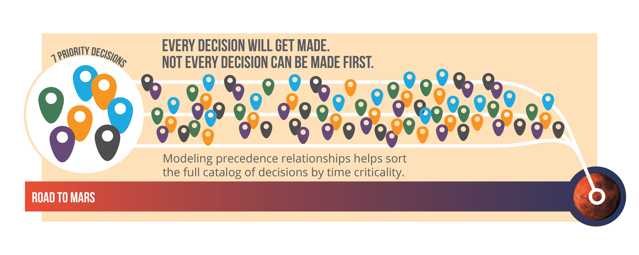
Decision Time Criticality

Slide 16
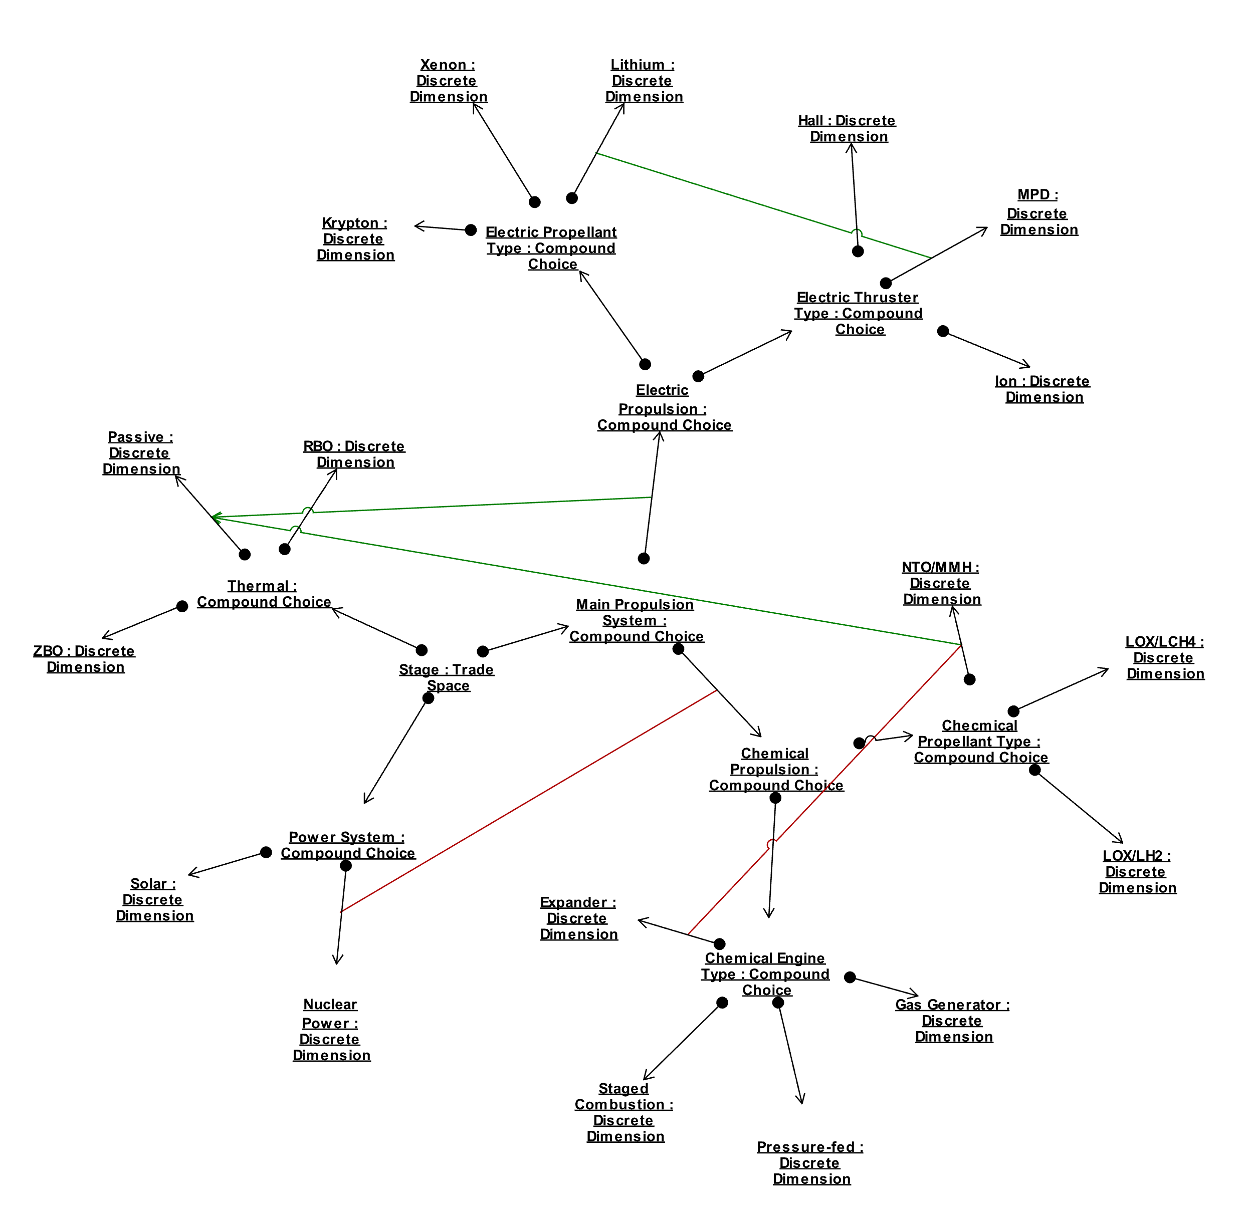
Mars Decision Modeling
NASA is developing a decision modeling process and tools.
  Preliminary analysis identified nearly 100 key architecture decisions.
  NASA is currently refining the catalog of needed decisions and modeling in a decision trade space that maps linkages between decisions.
Seven key decisions recommended for priority analysis in the 2024 analysis cycle.

Slide 17


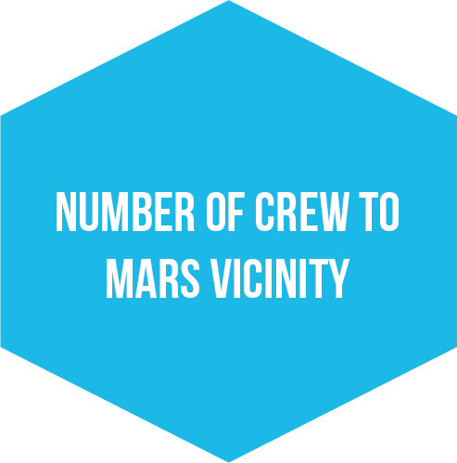


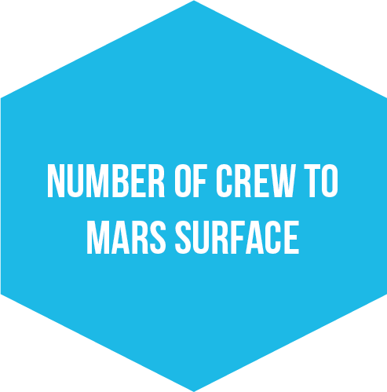


Priority Mars Decisions
In 2024, NASA has begun analyses needed to allow for informed decision-making by agency leadership, beginning with the seven priority decisions identified.
Decisions for Mars will inform lunar planning, development, and needs to demonstrate and ready systems and operations for eventual Humans to Mars segment missions.

Slide 18
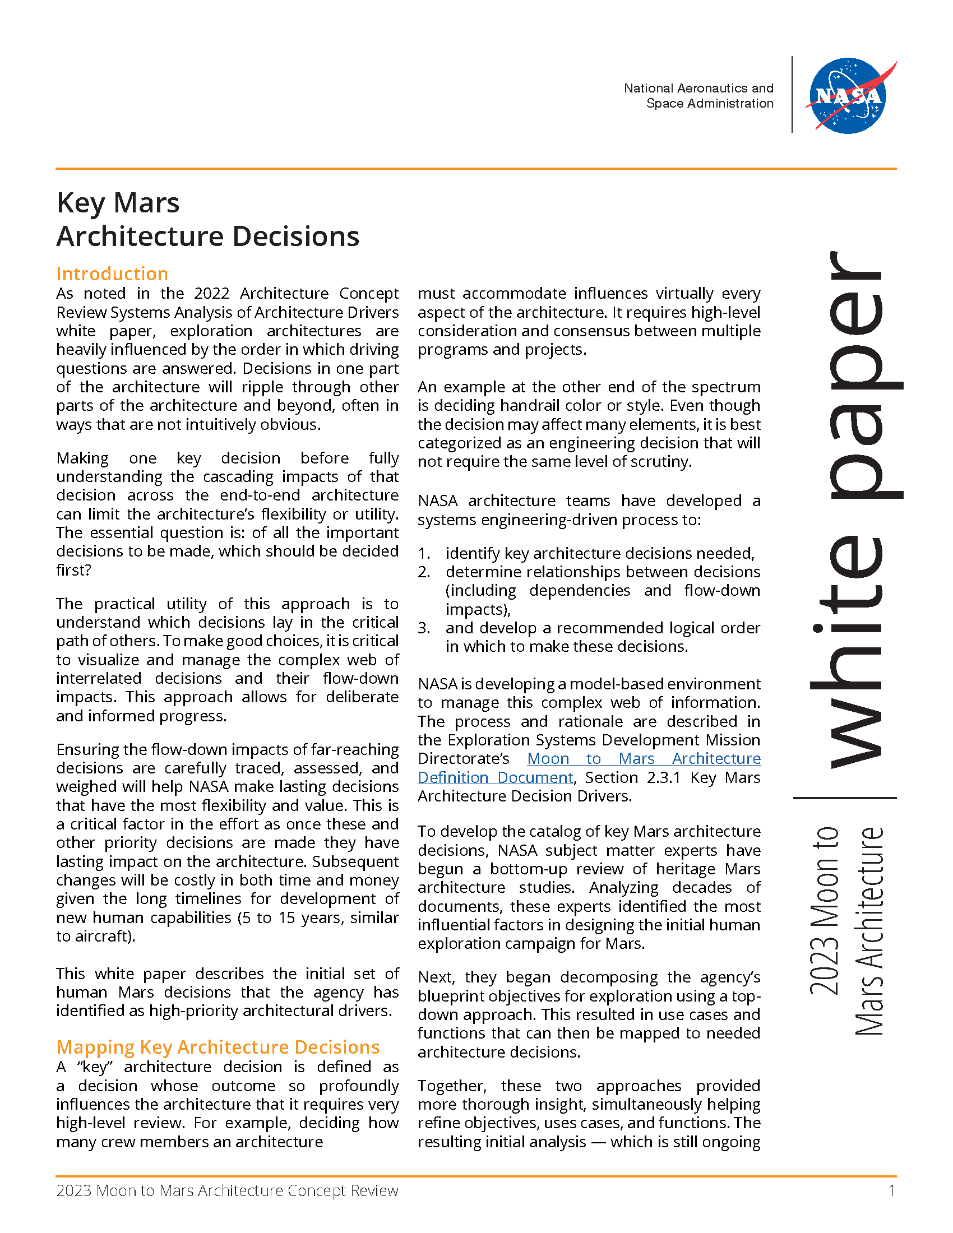
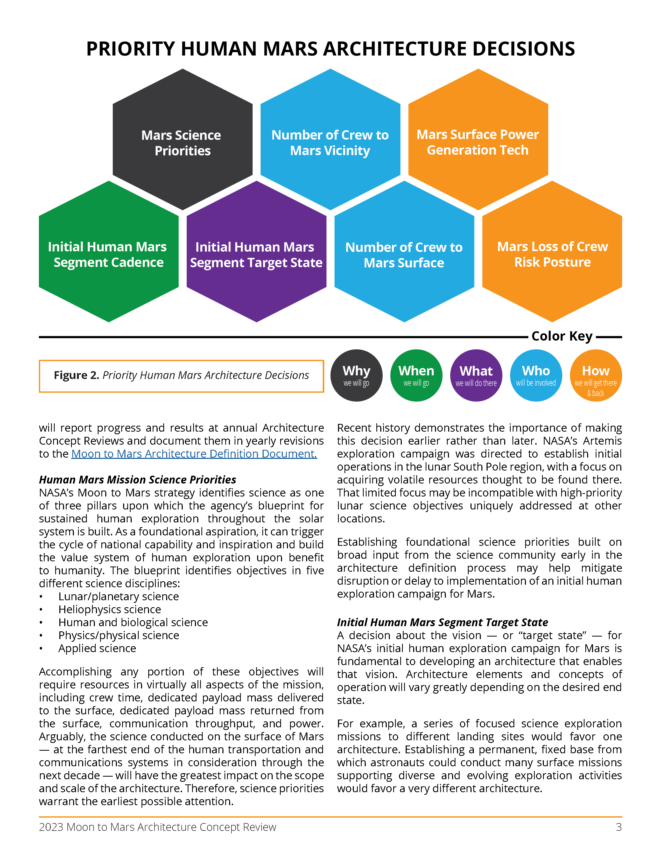
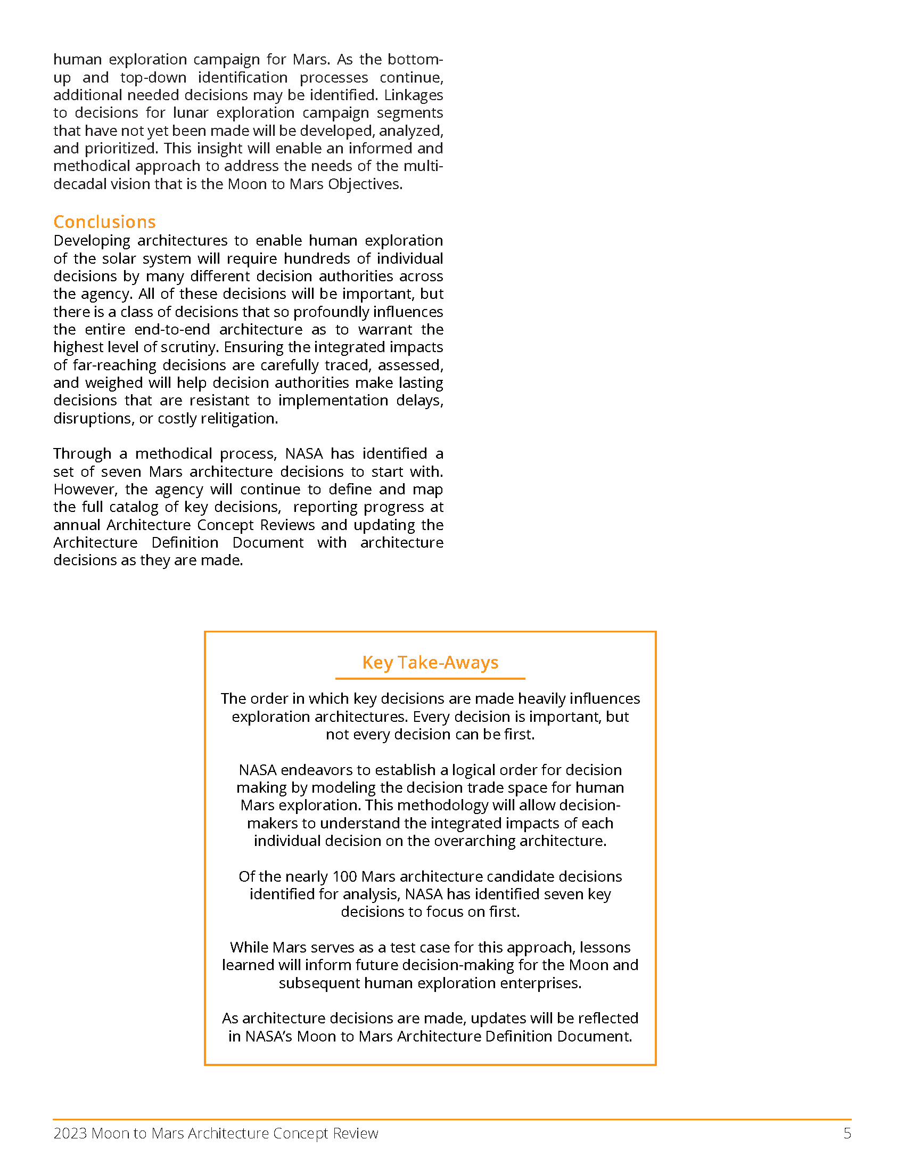
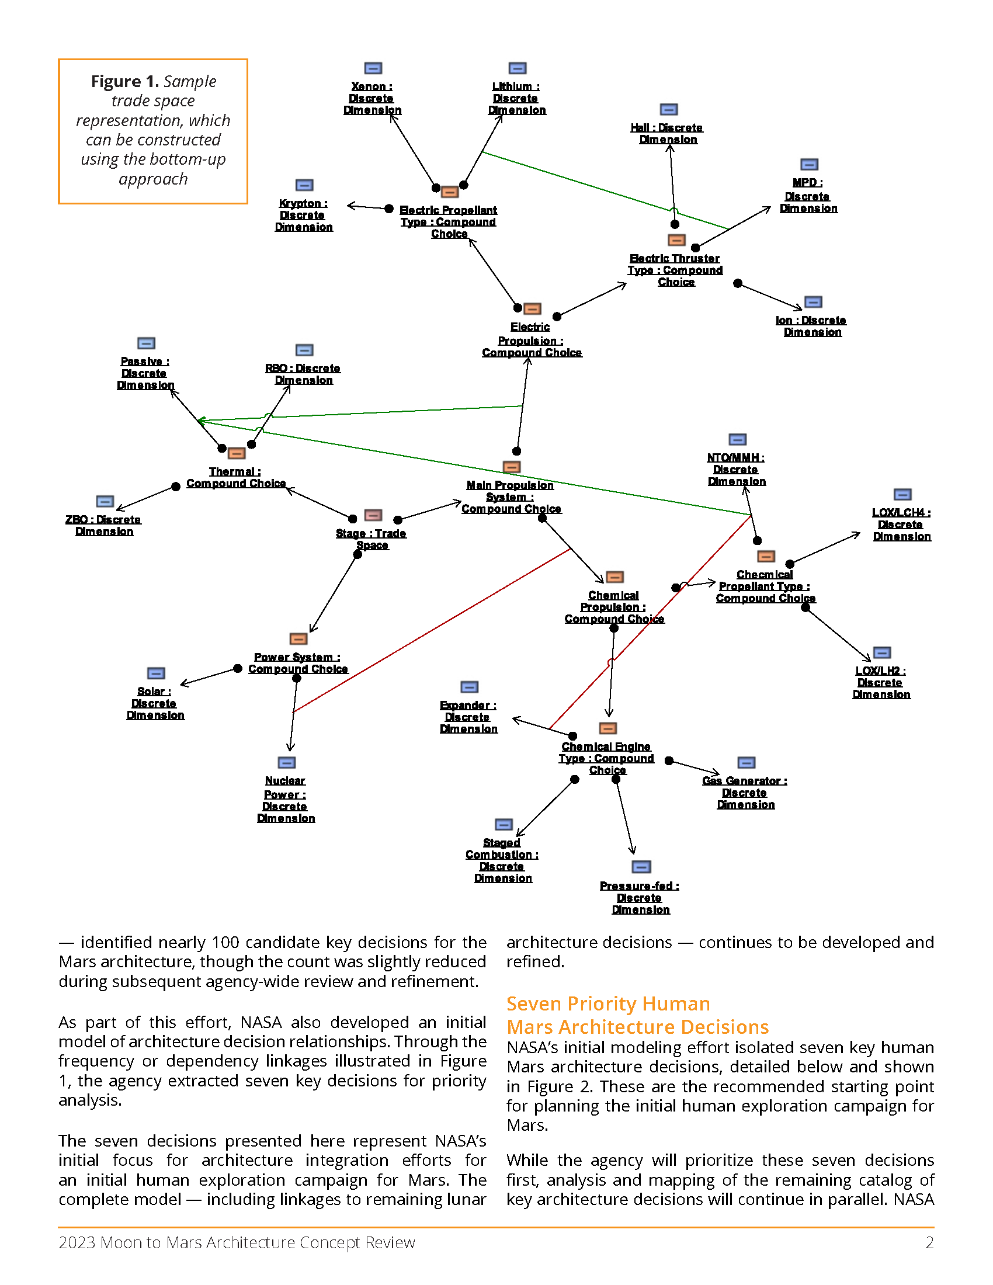
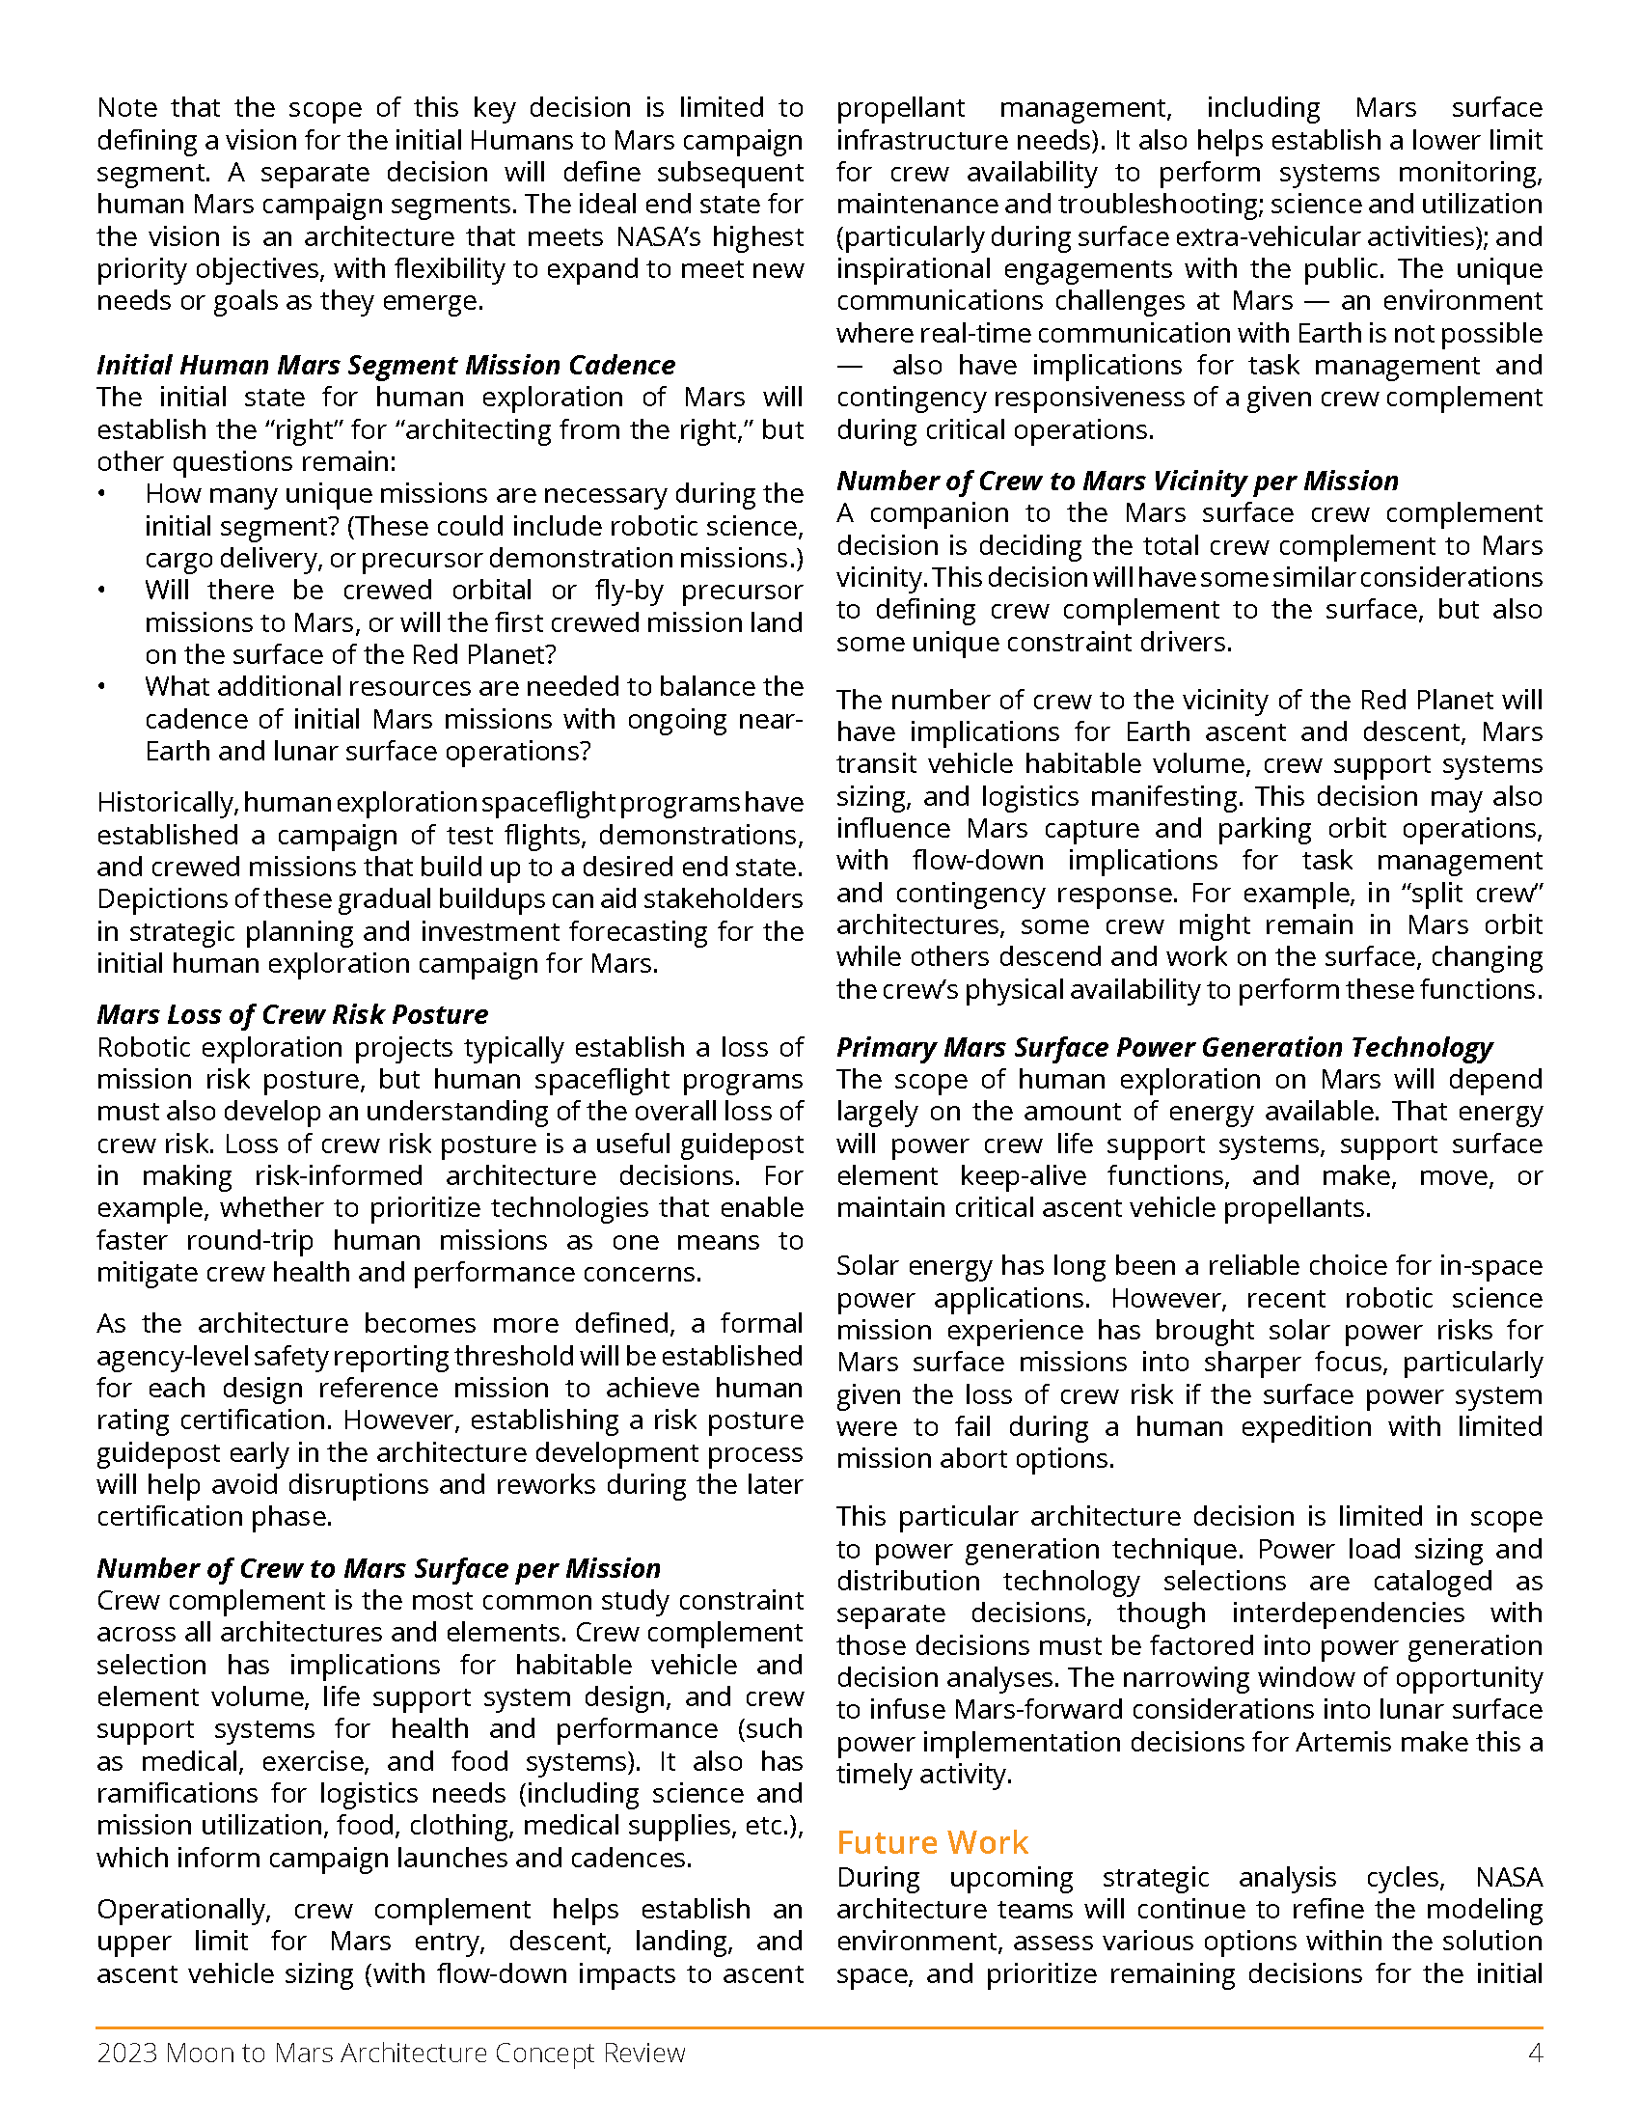

White Paper

Slide 19





Progress Under ACR Approach
image credit: Toyota/JAXA
image credit: NASA
image credit: NASA
TRACEABILITY
Decomposition of Blueprint Objectives to executing Architecture elements
Credit: JAXA/Toyota
ARCHITECTURE FRAMEWORK
Organizational construct to ensure system/element relationships are understood and gaps can be identified
PROCESS & PRODUCTS
Clear communication and
review integration paths for stakeholders
Assigned functions to all Human Lunar Return segment and initial Foundational Exploration segment elements
Implemented full digital traceability to Moon to Mars program requirements, identifying areas for further integration
Demonstrated process through incorporation of the United Arab Emirates Gateway Airlock and JAXA Pressurized Rover
Identified architecture gaps for large cargo return, logistics demand, and surface docking
Aligning international partner strategic planning efforts to articulated gaps
Enabling industry studies and logistics investments to meet needs, including for mobility and surface cargo capabilities
Informing the work of industry partners, as shown by the alignment of portfolios to architecture needs and gaps
Tracing architecture gaps to science and technology portfolio for greater coordination
Prioritized CubeSat selections for the Artemis II mission using identified gaps in the architecture
Leveraged segment use cases to inform Artemis III mission objectives

Slide 20

2024 SAO Priorities
Integrate architectural decomposition process within other NASA mission directorates.
Develop NASA’s lunar surface exploration strategy.
Deliver one Mars priority decision package for consideration by decisionmakers.
Demonstrate element handoff from SAO to the Moon to Mars Program Office (M2MPO)
Consolidate and document an architecture-derived list of prioritized technology gaps.
Establish and integrate Model-Based Systems Engineering (MBSE) tools throughout the architecture process.

Slide 21

nasa.gov/architecture
Moon to Mars Architecture, Objectives, White Papers and More

