Slide 1

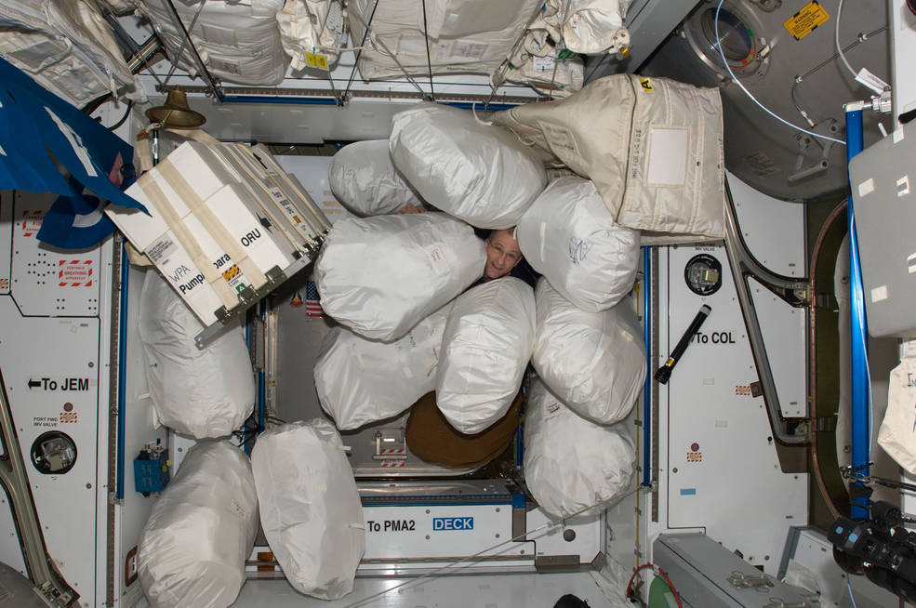
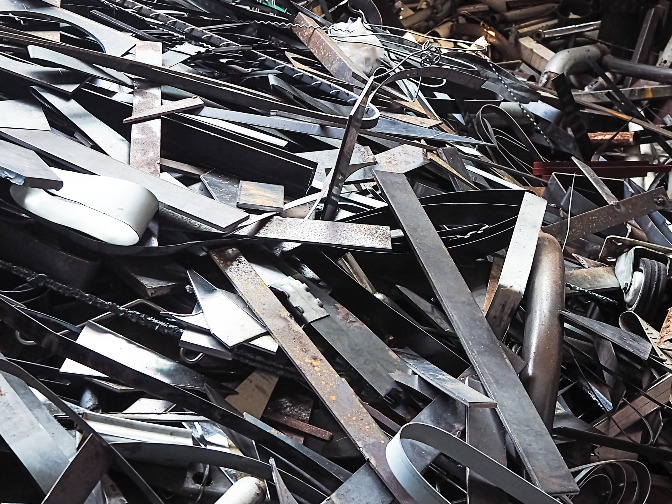
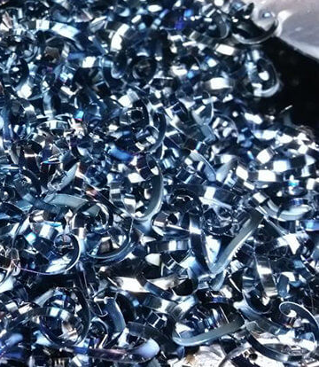
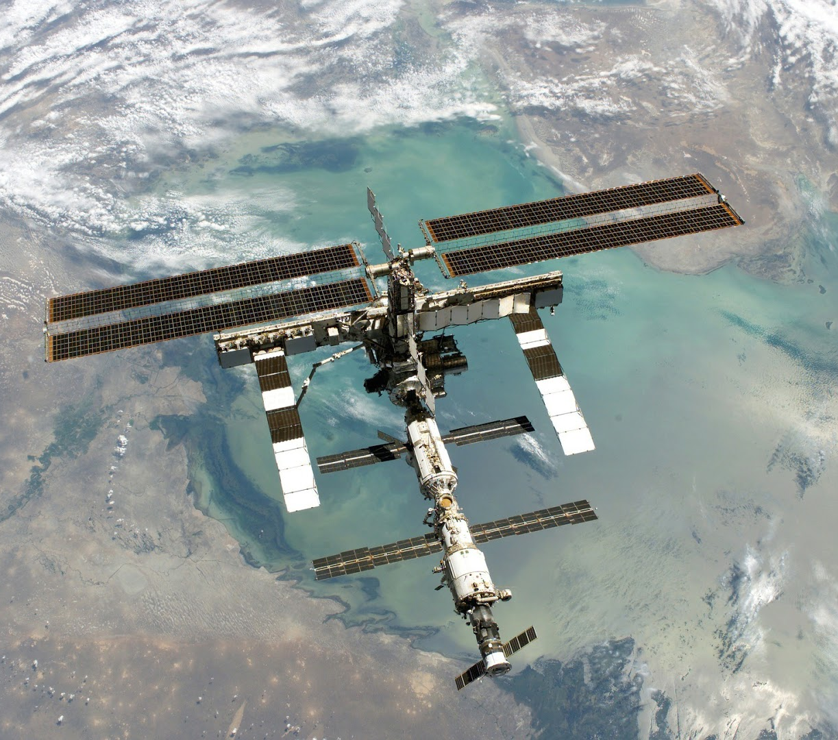
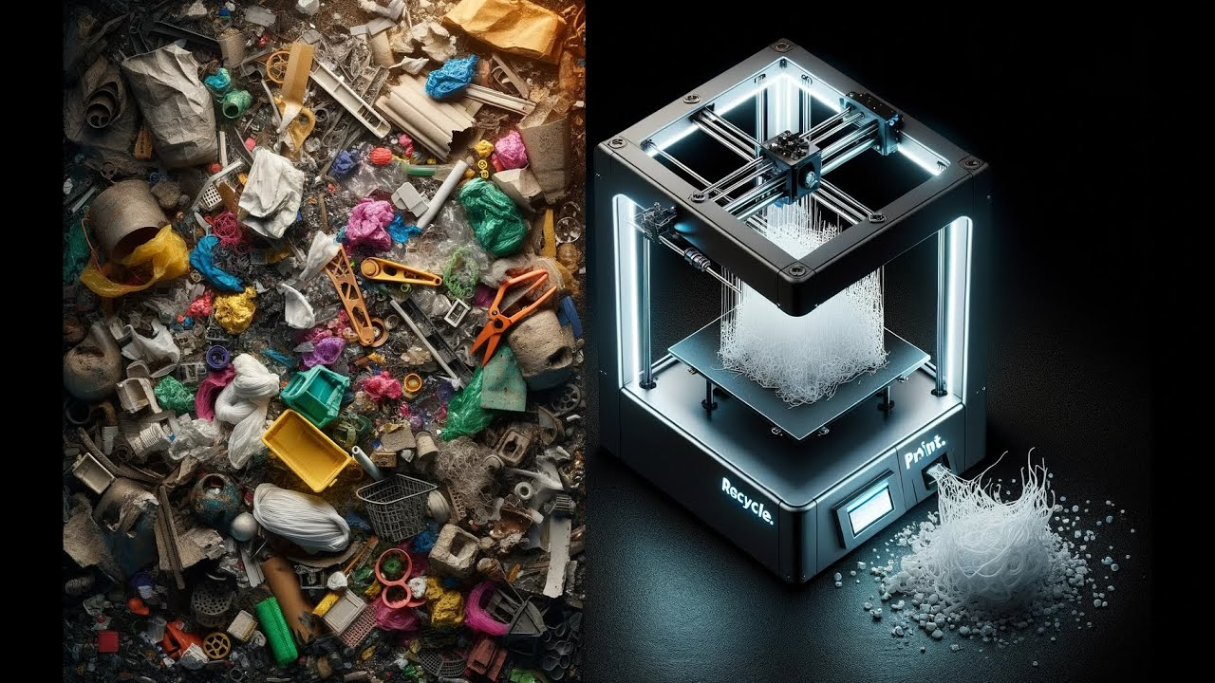
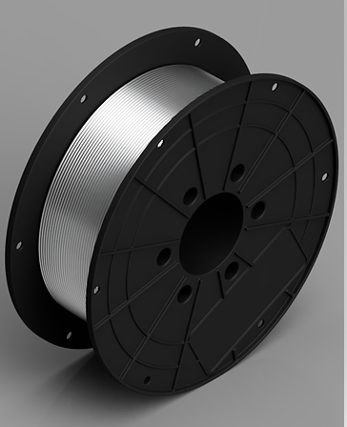
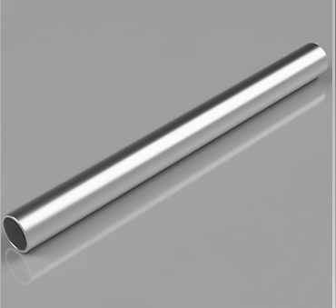
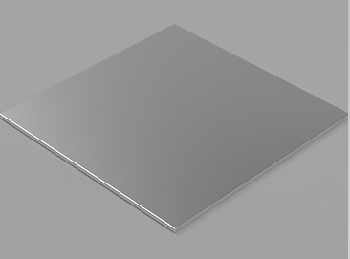


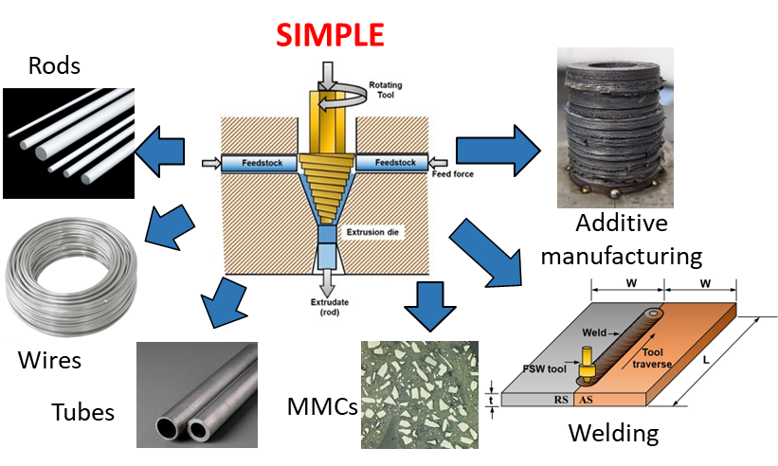
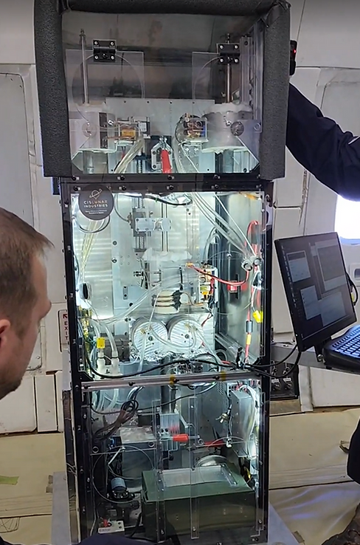
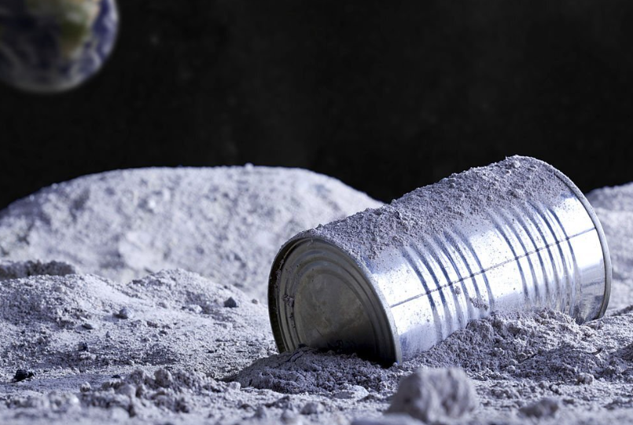
Waste materials recycling for in space manufacturing
Brady Kimbrel, EM42 Team Lead
brady.a.kimbrel@nasa.gov
Why is this Important?
Logistics and resupply payloads for Lunar and Martian missions are significantly more cost and schedule prohibitive compared to LEO destinations. Recycling of waste and trash materials generated throughout the duration of a mission, as well as previous missions, will be critical for enabling sustained human presence beyond Earth
Currently, no solution exists for recycling waste materials back into feedstock form beyond entry-level hobbyist equipment, which is not suitable nor practical for space applications. There is already over 500,000 lbs of trash on the moon from previous missions, which will grow exponentially over the coming decade throughout the Artemis Campaign. Waste and trash materials are precious resources that, if recovered and properly processed, can be transformed back into usable feedstock form for on-demand manufacturing capabilities. Hence, it is prudent that a recycling solution be developed and infused into future missions.
Polymers
Metallics
Component end of life
Manufacture Component
Material Decomposition
Reprocessed, repurposed into AM feedstock, tubes, sheets, or other shapes
Feedstock Verification
Clean and Purify Material
The objective is to develop and demonstrate a hazard-free end-to-end recycling system utilizing polymer trash/waste as input. This will be a fully integrated system capable of performing each step of the recycling process beginning with shredding/grinding input materials and ending with feedstock production and quality verification. Development is currently in the discovery and planning phase
There has been work to investigate materials for recycling and specific processes (i.e. recycling of 3D printed parts and post-process considerations), but nothing comprehensive involving multiple processes or an end-to-end process development activity scoped specifically to the needs of future exploration
Extrude into Feedstock
General Approach
This larger effort will be satisfied with (2) discrete tasks:
  Task 1: Develop and demonstrate a hazard-free end-to-end recycling system utilizing polymer trash/waste as input for crew use during space and surface missions
  Task 2: Develop processes for recycling metallic materials into usable product forms to enable habitation at the point-of-need using locally sourced and waste/scrap materials
Executing these tasks will partially close 6 StarPort gaps and will address 6 M2M objectives via technology maturation of recycling processes for space applications and infusion into NASA missions.
Alignment to MSFC and Agency
Gap ID: This task addresses 6 Starport Technology Gaps:
642: On-demand manufacturing of metals, recycling and reuse
952: Inability to fabricate spare parts, replacement units (on-demand manufacturing)
974: Approaches to sparing for habitation
1341: Recycling and reuse of thermoplastics and metals
1342: Recycling of Orbital and Surface Debris
1343: Recycling: On-surface Resource Utilization of Hardware, Trash
Previous/Current Work:
SBIR (2015) – Common use materials development (recyclable materials for ISS packaging)
SBIR (2018) – Payload to recycle 3D printed parts into feedstock for 3D printing (ReFabricator)
ISM (2019) – Faculty fellow study on in-space recycling challenges and opportunities (Sarker)
ISM (2020-2023) – Analysis of material recyclability from CMC (Blanchard, Kimbrel)
CAN (2022) – Sterilization/Verification of recycled AM components (University of Nebraska Omaha)
Crowdsourcing Contenders (2024) – Soliciting innovative concepts and approaches for potential recycling solutions for trash materials generated over the life of a mission
IRAD (2024) – In-house development of a polymer recycling system and process development

