Slide 1



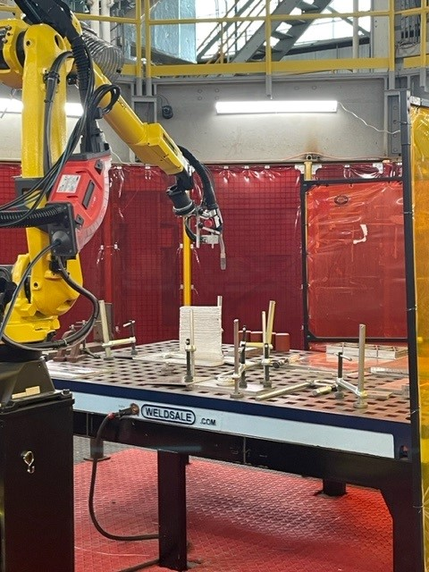
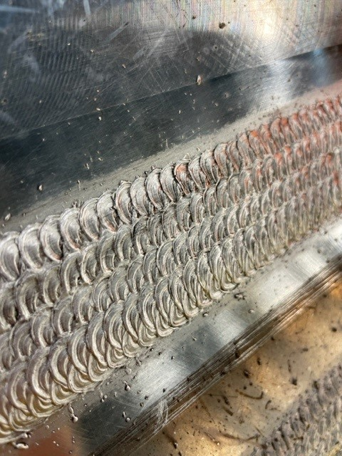
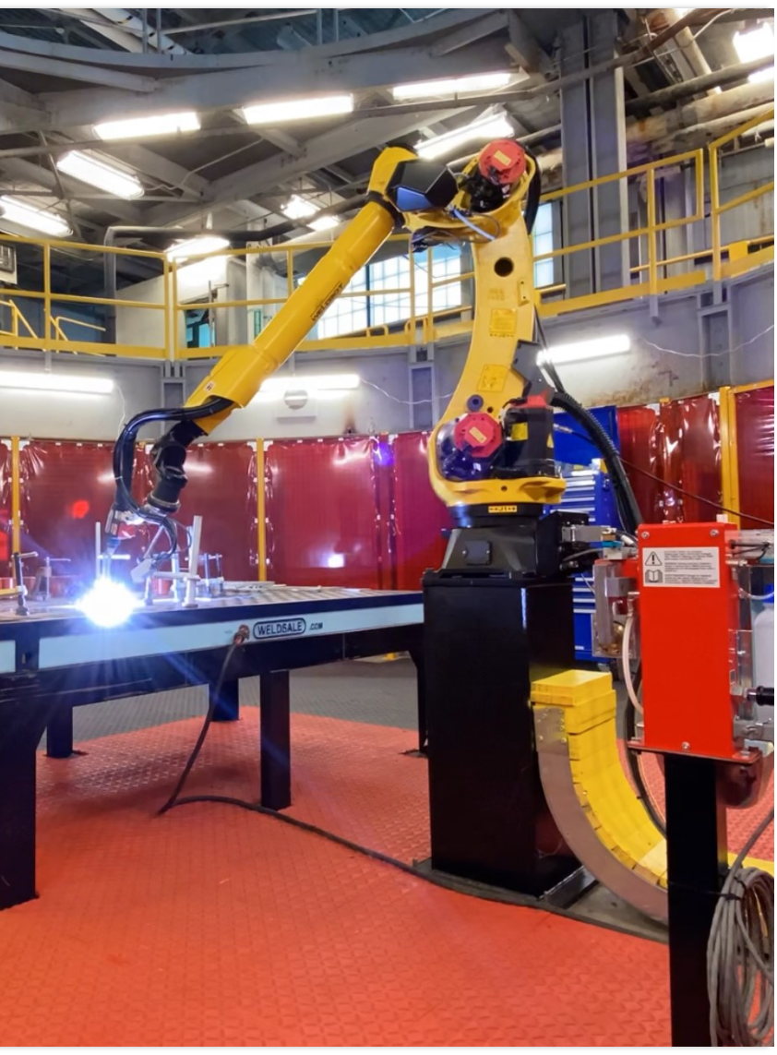
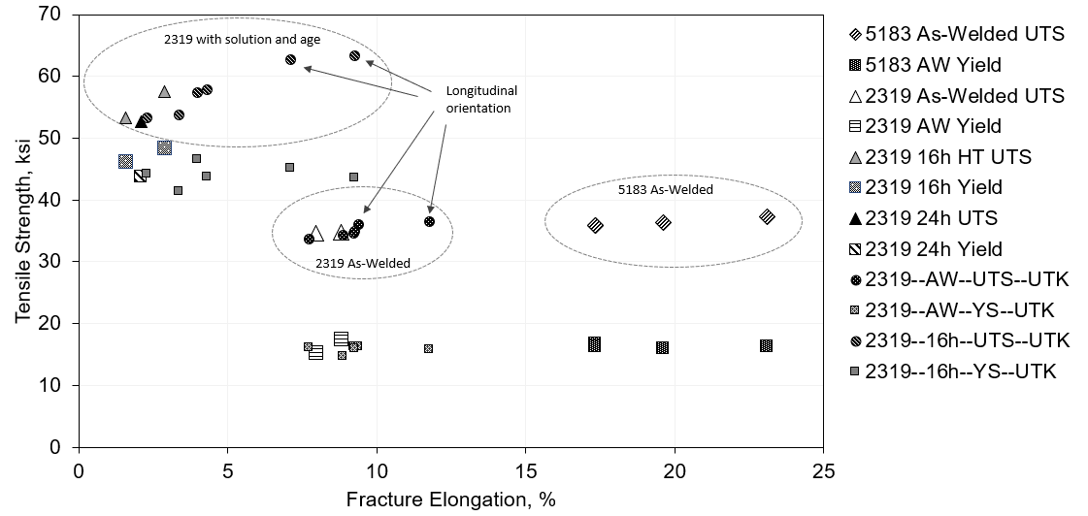
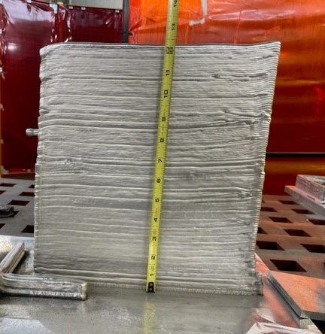
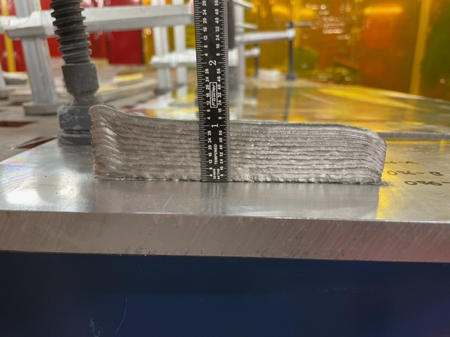
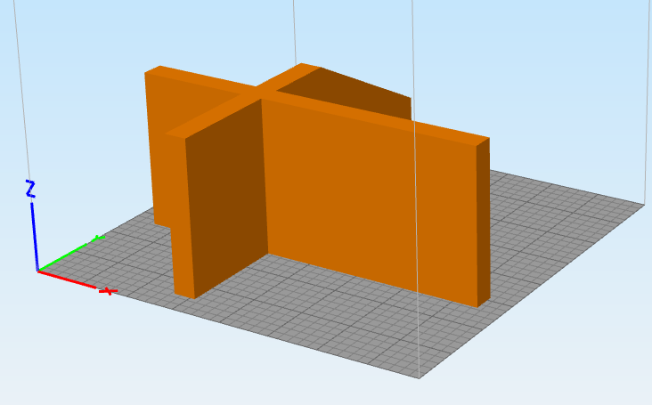
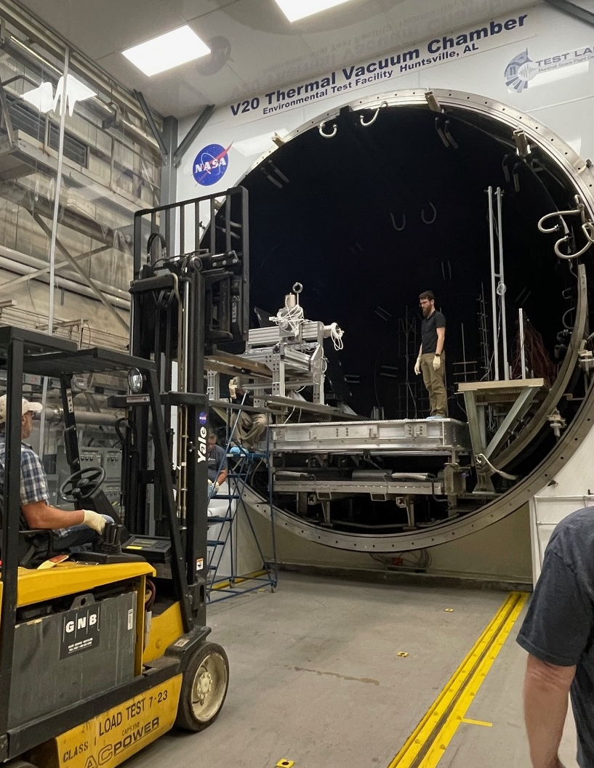
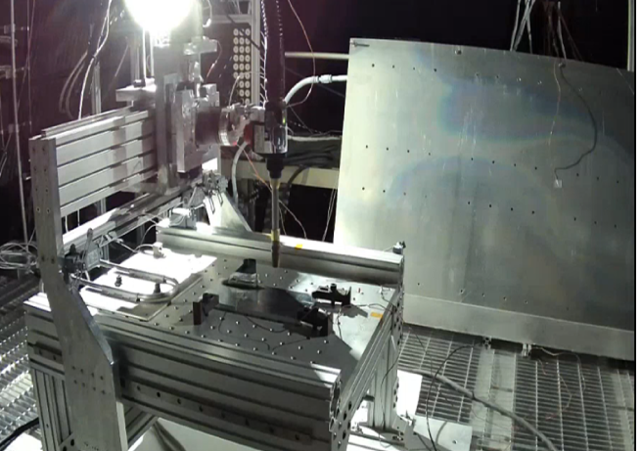
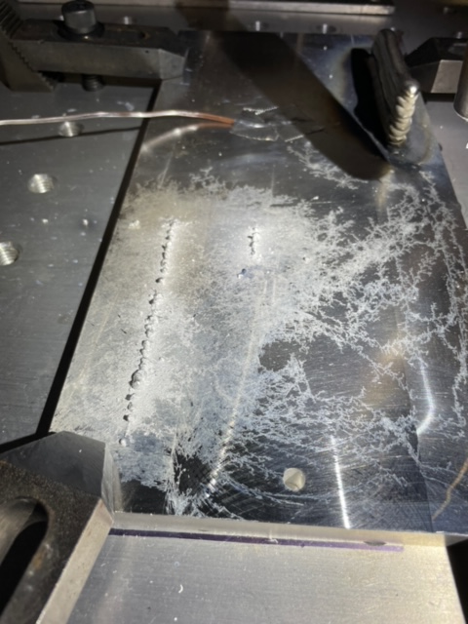
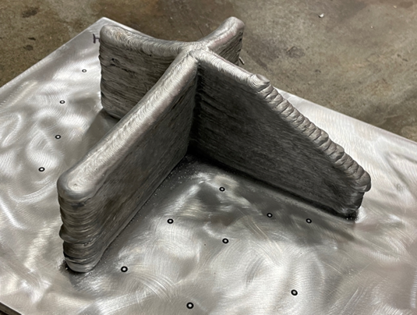
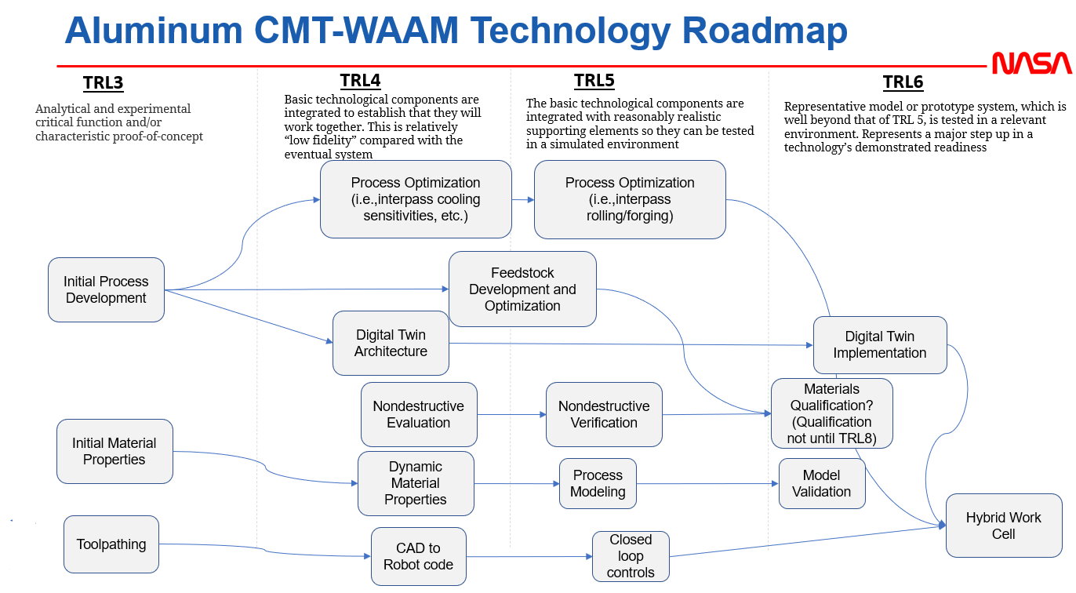
Cold Metal Transfer (CMT) Wire-Arc Additive Manufacturing (WAAM)
Ilana Lu | EM42 Additive Manufacturing Team
ilana.k.lu@nasa.gov
Background and Objective
Aluminum has been identified as a compound within regolith and is likely to become a core component of our infrastructure on the lunar surface as in-situ resource utilization (ISRU) capabilities are advanced
Large-scale components, outfitting, and repairs of aluminum materials can be fabricated with robotic wire arc additive manufacturing (WAAM) in order to inhabit the moon’s surface long term
WAAM is a high value process for lunar advanced manufacturing as it does not require special containment to reduce explosion hazards such as powder-based additive processes and feedstock
The welding process of cold metal transfer (CMT) is a relatively new variation of gas metal arc welding (GMAW, also known as MIG) that relies on the detection of a short circuit in the welding process to control the deposition droplet action, resulting in lower heat input and splatter compared to conventional MIG welding
Results
Aluminum alloys 2219 and 5183 have so far been tested through tensile—both as-printed and heat treated where applicable. Their results are listed below. AA5183 has an average ultimate tensile stress of 36 ksi which is 87% of 5083 base material strength. AA2319 averages at ultimate tensile stress of 55 ksi which is 83% of that of the 2219-T8 parent material
Materials 2050, 4043, 6061, B218, and other aluminum alloys are planned for development and testing where applicable for this fiscal year’s work
The past year was spent developing the CMT-WAAM process for aluminum materials, tested specialty feedstock, tested within the high vacuum environment, and advanced the MSFC capability to perform complex toolpathing from solid models
Upcoming and future work includes large depositions working towards material certification for multiple feedstocks, in-situ monitoring, work to use recycled materials for the AM feedstock, and the design and fabrication of a parabolic flight experiment payload.
Major Achievements Fiscal Year 2023-Present
Printing from a CAD model
Recycled aluminum-lithium (AA2050) feedstock produced and directly printed into walls
1-ft height single-wide wall with AA2319
Design, fabrication, integration, and testing of CMT-WAAM in V20 thermal vacuum (TVAC) chamber
General Approach
Shorter term development includes but not limited to:
Process Development and Optimization with 2319 aluminum alloy feedstock and other chemistries
  → Completed in FY23, but ongoing with more alloys and materials
Explore Process in Vacuum Environment
  → Completed in FY23
Evaluate Process in Microgravity Environments
  Current work (FY24)
Build large prints towards material certification
  → Current work (FY24)
In situ monitoring and closed loop control
  → Future work
Alignment to MSFC and Agency
Gap | Description | CMT WAAM Solution
STMD-AMSM-030 (MANU-650, HEOMD 3084) | Very large-scale additive manufacturing | The goal is to design and additively manufacture a “bracket” demonstrator, from CAD-to-part no less than 3” in height. Several cylinders of 3.25” height have been consistently printed with this system to date
STMD-AMSM-022 (MANU-651, HEOMD 3088) | High-fidelity physics-based simulations for design, certification, production, and operations | TE for FY23 was awarded to begin instrumenting the robot and cell with sensors for a future thermal digital twin.
STMD-OSAM-022 (MANU-651, HEOMD 3088) | Materials Process Modeling | Thermal data for a 5-layer wall has been acquired and will be used to populate temperature profiles and thermal history of a rudimentary model
STMD-OSAM-009 (MANU-642, HEOMD 3061) | Fabrication and repair of on-orbit and lunar surface hardware, components and structures using advanced manufacturing processes | The large-scale AM and vacuum/gravity evaluations of this technology within the next year will provide key knowledge and methods for the fabrication of large-scale lunar surface infrastructure
STMD-AMSM-028 (MANU-644, HEOMD 3061) | Lunar surface manufacturing, recycling, reuse, repurposing, and repair capabilities | Aluminum feedstock is chosen for this process due to availability in regolith (an ISRU identified potential capability). Solid state wire extrusion from billet is also being evaluated with this process as a potential feedstock that can be derived from scrap material in situ and repurposed for new parts, repairs, or outfitting
Awarded and Related Work
FY22 Center Innovation Fund (CIF)
FY22 Cooperative Agreement Notice (CAN) with The University of Tennessee Knoxville (UTK)
FY23 Technical Excellence Awards
FY23 Cooperative Agreement Notice (CAN) with Fronius USA
FY24 Technical Excellence Awards

