Slide 1


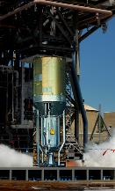
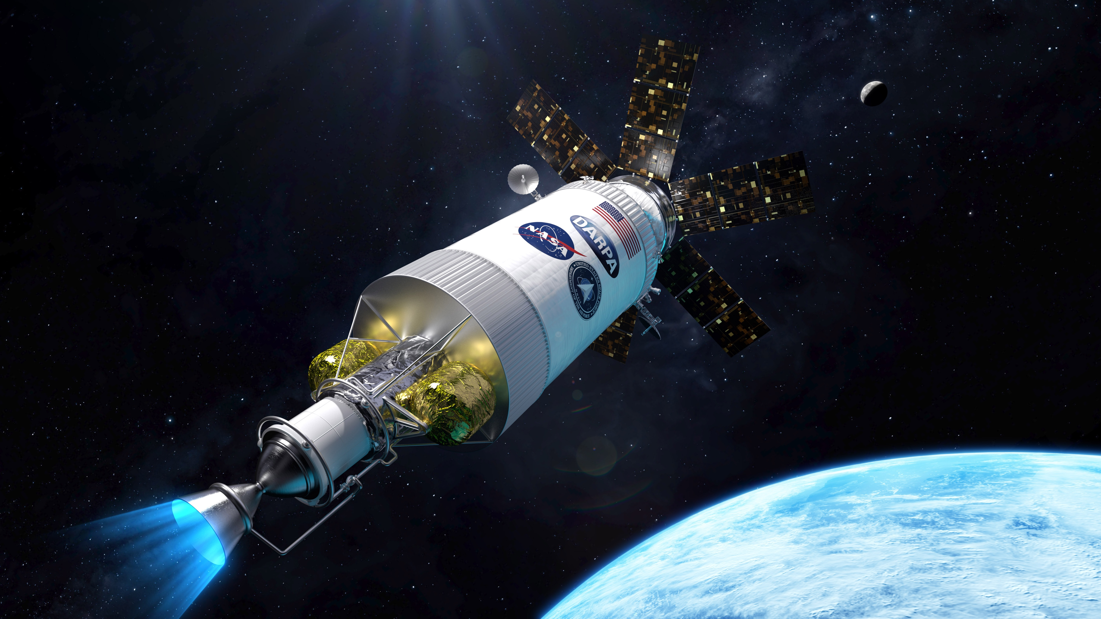
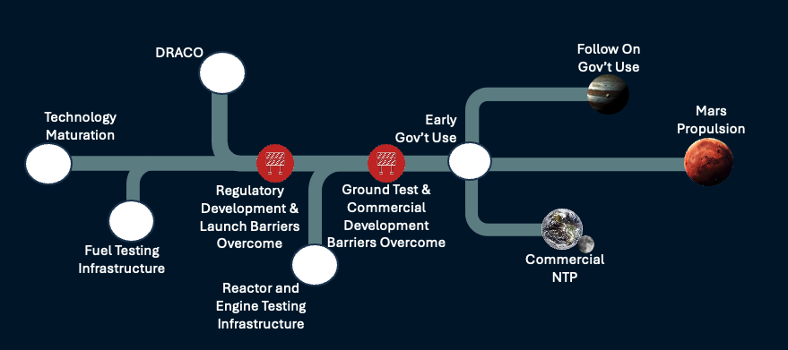
Nuclear Thermal Propulsion (NTP) – Propelling into the Future
Sara Sumner, James Maddox, Adam Butt – Marshall Space Flight Center
INTRODUCTION
PICTU
PICTU
THE GENESIS
Nuclear Thermal Propulsion (NTP) is the exciting advancement of engine system technology that will enable NASA to perform deep space missions previously beyond reach. Since the 1940s, the United States has attempted to mature this technology to fulfill the mission that JFK famously declared in his special address to Congress in 1961 stating our need to “Accelerate development of the Rover nuclear rocket. This gives promise of someday providing a means for even more exciting and ambitious exploration of space… to the very end of the solar system itself.” Today, we are dedicated to realize this mission, embarking on the journey with other government agencies and industry giants to boldly go where no one has gone before…
DRACO
HISTORY
THE REALIZATION
On January 24, 2023, Bill Nelson announced a collaboration between NASA and DAPRA to design, build, launch, and demonstrate the first Nuclear Thermal Rocket Engine (NTRE) on-orbit. In this partnership, NASA and DARPA jointly manage the DRACO project. This project, is managed under the Space Nuclear Propulsion (SNP) program at Marshall Space Flight Center (MSFC) and will pave the way for future operational NTP systems currently being planned, in the SNP Program.
First proposed in the 1940s, NTP saw extensive development during the Rover/NERVA program (1955-1973) and the Space Nuclear Thermal Propulsion (SNTP) program (1987-1993). Unlike chemical systems, the power for NTP systems is derived from fission reactions, which have energy densities over 10 million times that of the most energetic chemical reactions. This decoupling of the power source from the propellant choice used enables a much wider range of propellant choices, including ammonia, methane, or other volatiles. Highest specific impulse (I_{sp}) is achieved using low molecular weight propellants (typically hydrogen), with near-term solid fuel NTP systems designed for 900 sec I_{sp} and more exotic liquid fuel concepts capable of significantly higher values.
Previous NTP efforts have used reactor designs fueled by highly enriched uranium (HEU), which poses significant proliferation risks and costs that can be difficult for a program to overcome. Recent advances in materials technologies have provided a more affordable, lower proliferation risk pathway to develop a nuclear rocket engine using high-assay low enriched uranium (HALEU), where the uranium has an enrichment of ²³⁵U fuel less than 20%.
DEVELOPMENT
THE PATH
Demonstration Rocket for Agile Cislunar Operations (DRACO), and other “Early Government Use” programs, move technology across commercial and political barriers that are required to gain support for future test infrastructure and development investments. DRACO specifically provides a pathfinder for developing regulatory basis for launching and operating a fission-based reactor system, with the long-term goal of a Mars application.
DRACO OBJECTIVES
Design, fabricate, and assemble a fully integrated NTP system capable of successfully execution a flight demonstration
Exercise the nuclear launch approval process
Safe launch of an NTP system
On-orbit operation of a nuclear reactor
Gather reactor and engine characterization data to use in the development of an extensible NTP system
Safe end of mission disposal

