Slide 1

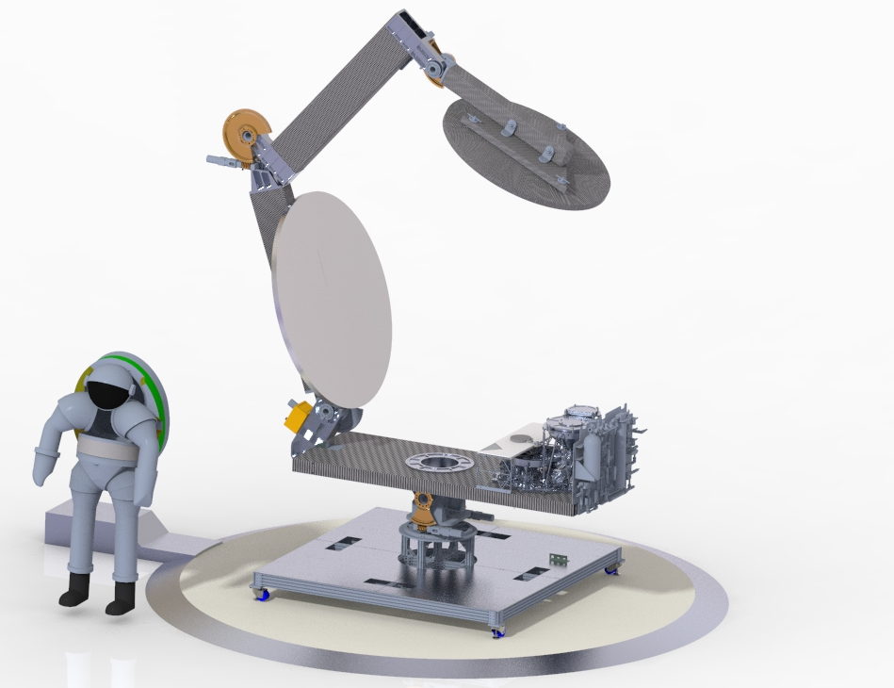
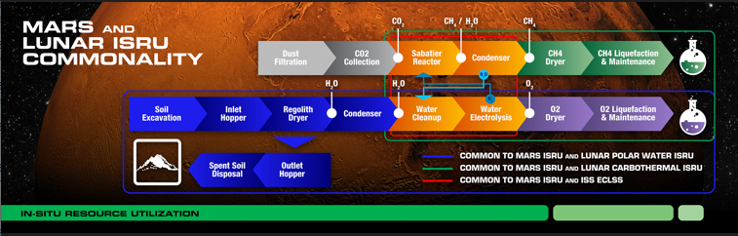
Carbothermal Reduction
Demonstration (CaRD)
Project Management Aaron Paz / 281-244-0163 / aaron.paz-1@nasa.gov
Leads Nilab Azim, Chris Bond, Tony Colozza, Jim Kania, Jeff Michel, Desmond O’Connor, Brant White
TX 7.1.3 Resource Processing for Production of Mission Consumables TRL: start 4 / current 5
overview
This project will integrate the key components of the solar-carbothermal process (solar concentrator, carbothermal reactor, gas analysis, avionics, software) and demonstrate operations in a relevant environment. In the solar-carbothermal reduction process, concentrated solar energy is delivered into a pressurized reactor. The thermal energy delivered to the reactor is used to melt lunar regolith simulant contained within the reactor. The molten regolith reacts with a source of carbon and oxygen is removed from silicate minerals in the form of carbon monoxide. The reaction products are quantified using a mass spectrometer to determine the performance of the process.
Deployable Structure
Glenn Research Center
Not Shown:
Gas Analysis
Kennedy Space Center
Heliostat
Johnson Space Center
Secondary Mirror
Composite Mirror Applications
Primary Mirror
Composite Mirror Applications
Optical Shutter
Johnson Space Center
Avionics/Software
Kennedy Space Center
Carbothermal Reactor
Sierra Space
Fluid System
Sierra Space
Azimuth/Altitude Mount
Glen Research Center
Lander Deck Mockup
Johnson Space Center
CaRD Integrated Solar-Carbothermal Prototype System
CaRD will generate CO, which can be combined with hydrogen to make methane and water like Mars ISRU

