Slide 1
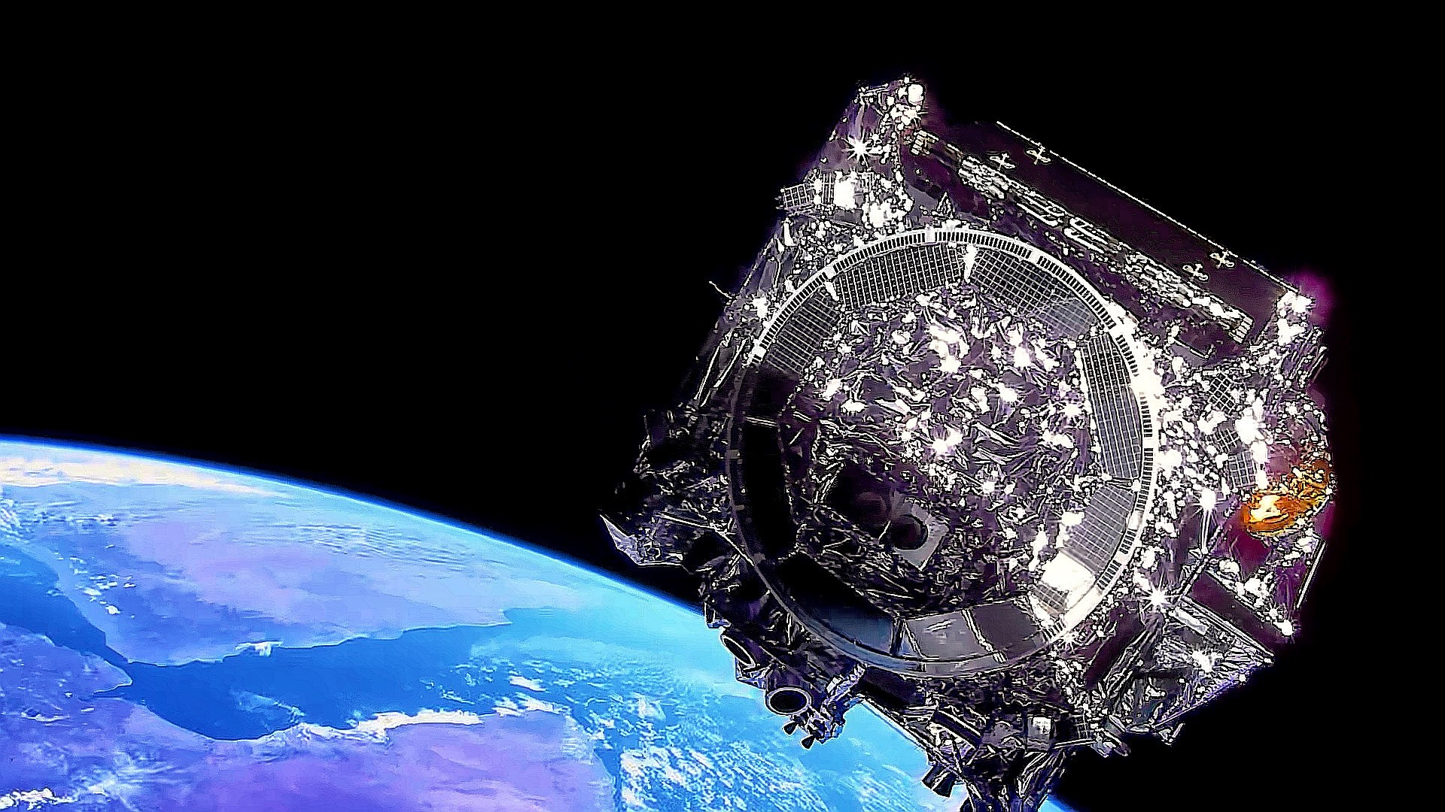

Arlin P.S. Crotts Radical Hypothesis Lecture:
A space-based path to the high definition universe
Lee Feinberg, NASA Goddard Space Flight Center
JWST Telescope Manager, Optics Lead
Habitable Worlds Observatory TAG Co-Chair

Slide 2
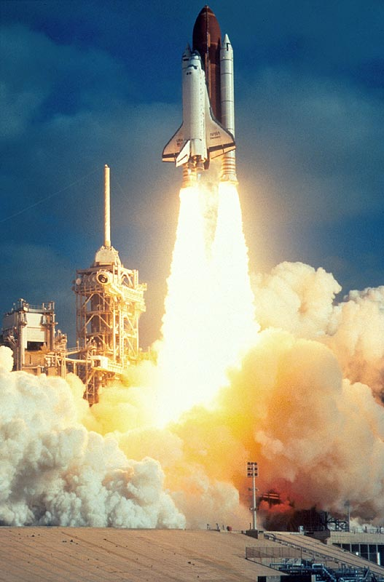
Hubble Space Telescope Launched in Spring, of 1990

Slide 3
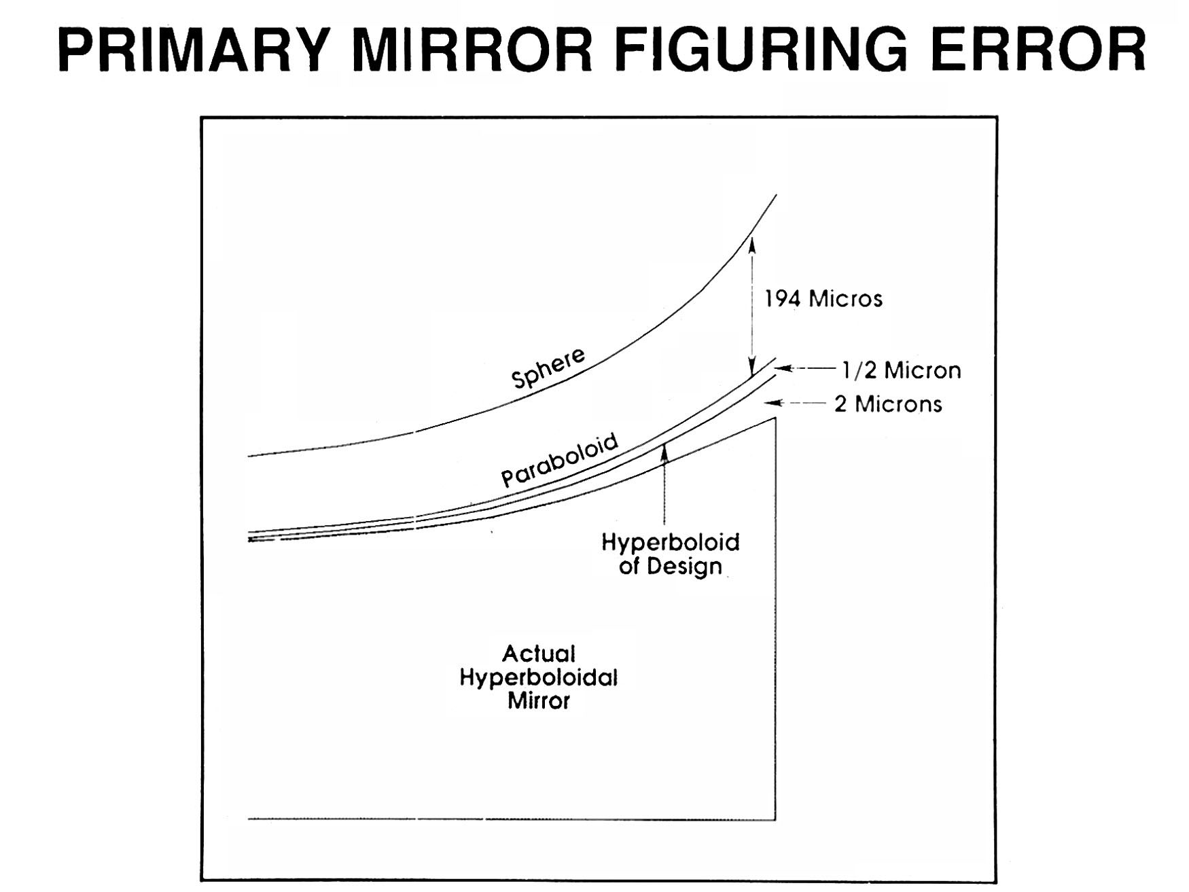
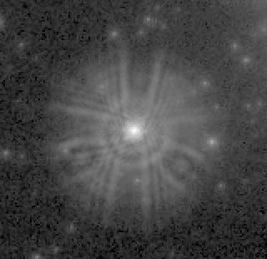
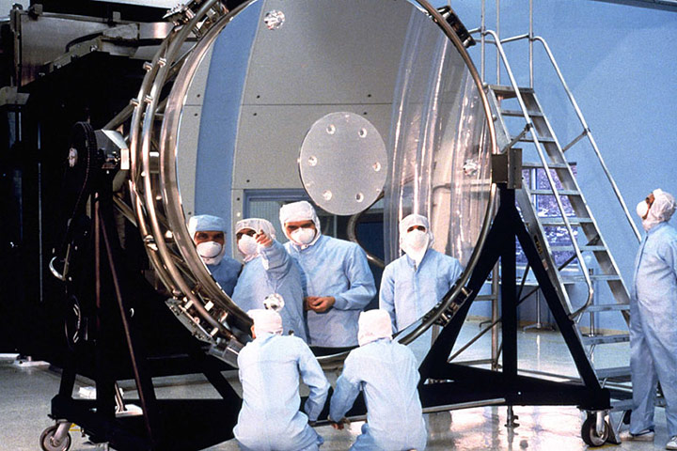
Primary Mirror Made “Precisely” Wrong

Slide 4
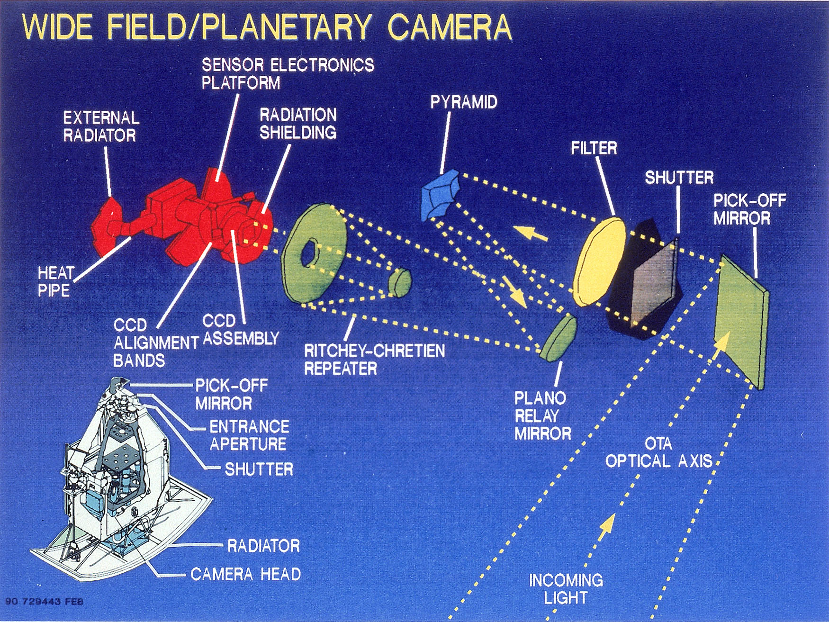
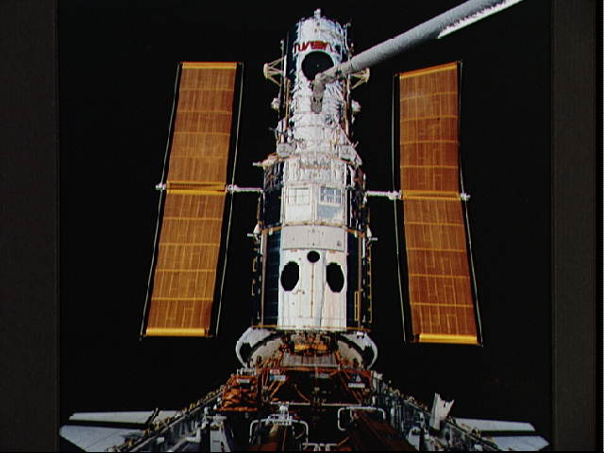
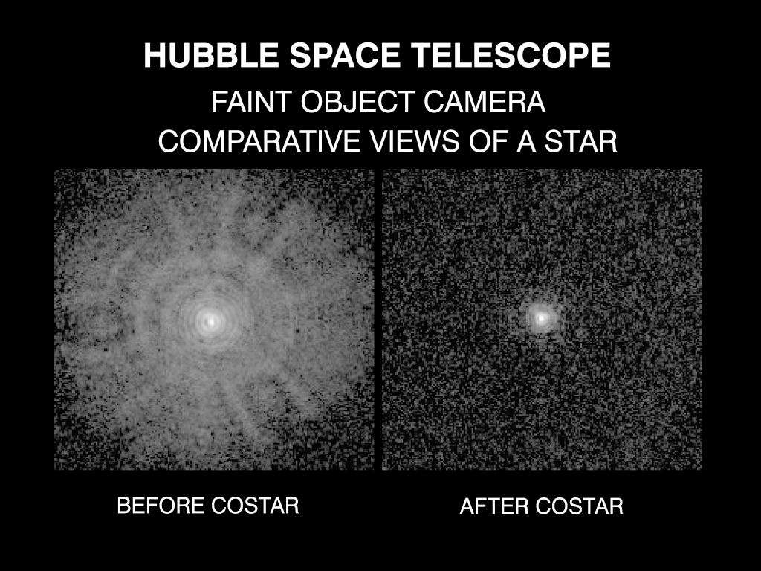
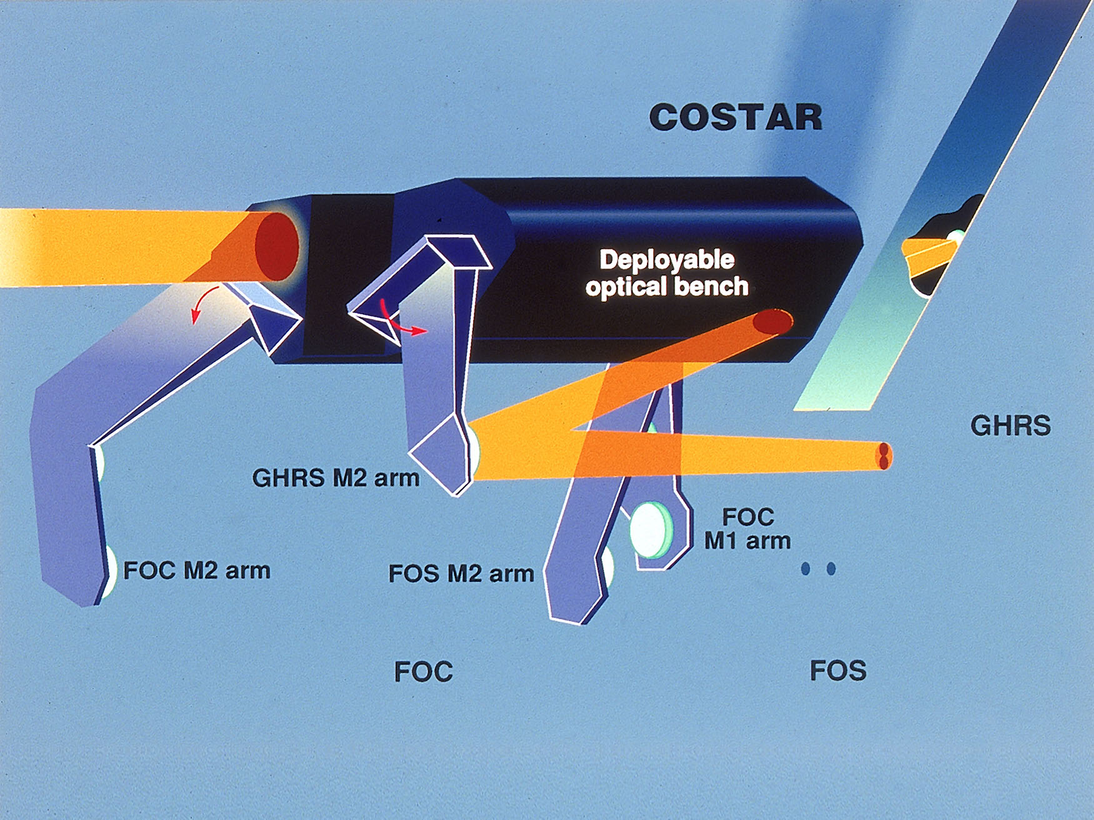
In Dec 1993, instruments with corrective optics were installed in Hubble by Astronauts using the Space Shuttle

Slide 5
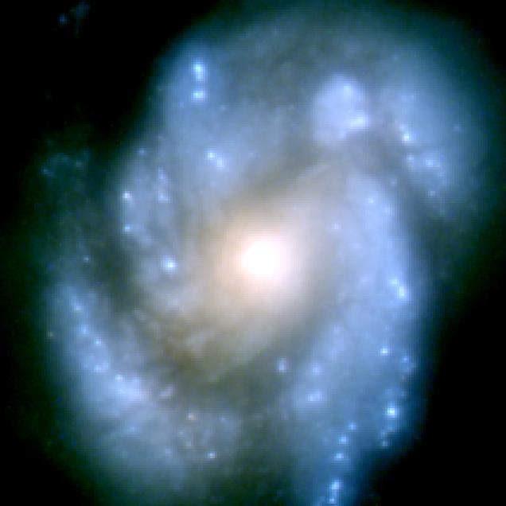
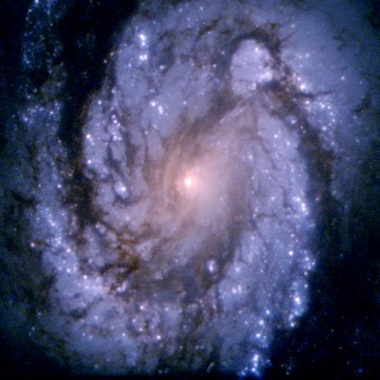
Hubble Space Telescope Before and After Repair

Slide 6
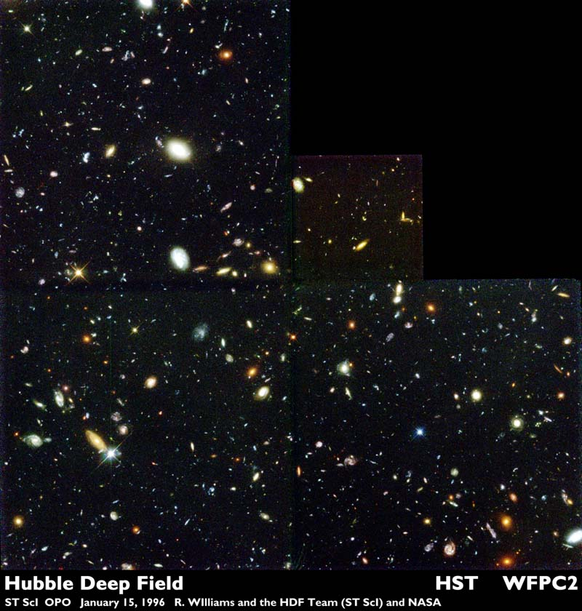

Slide 7
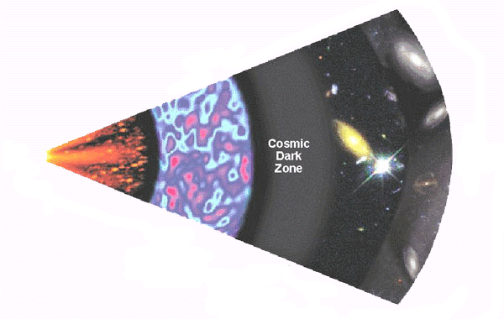
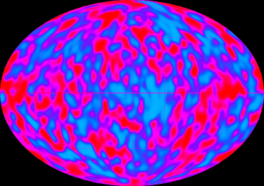
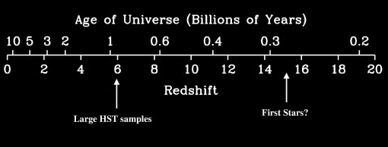
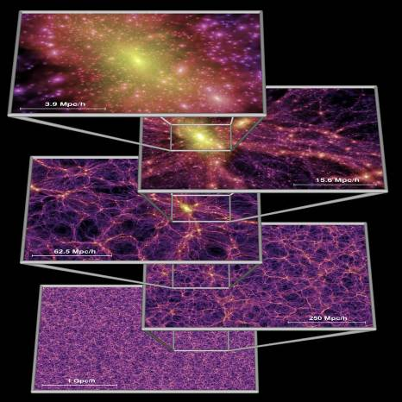
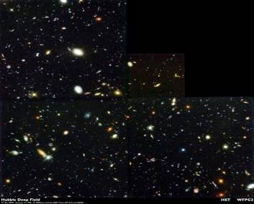
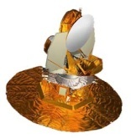
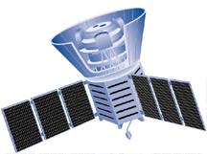
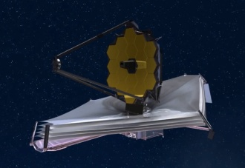
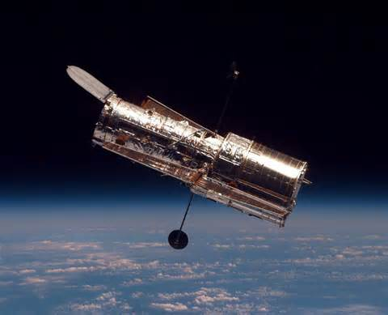
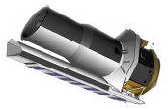
A Brief History of Time
JWST was designed to look back in time to see the first galaxies
First Light (After the Big Bang)
First luminous objects, proto-galaxies, supernovae of first stars
COBE: The oldest light
Credit: Rychard Bouwens
3
minutes
HST: Most distant objects yet seen
300,000 years
100 million years
1 billion years
Millennium Simulation
13.7 billion years
WMAP
COBE
JWST
HST
Spitzer

Slide 8
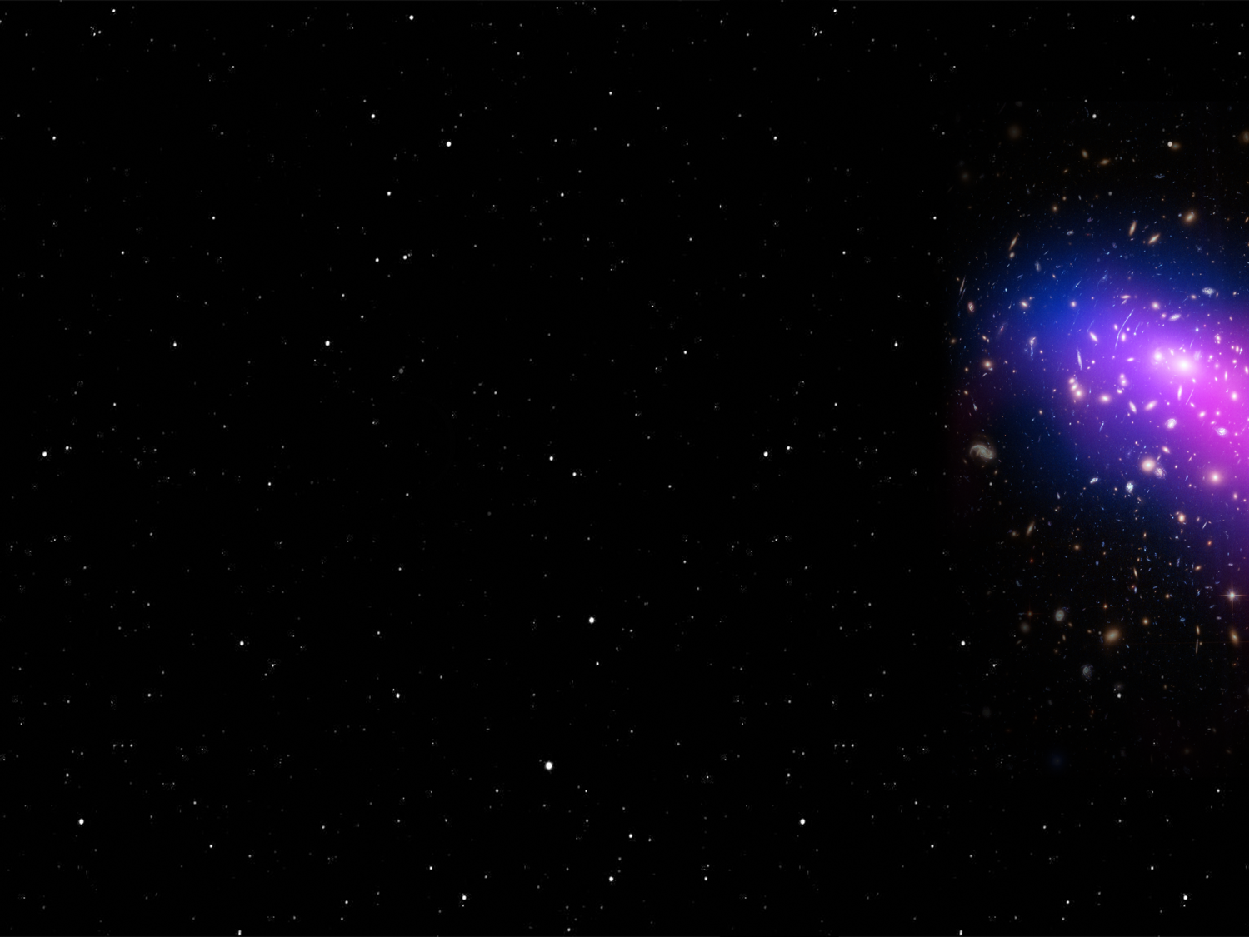
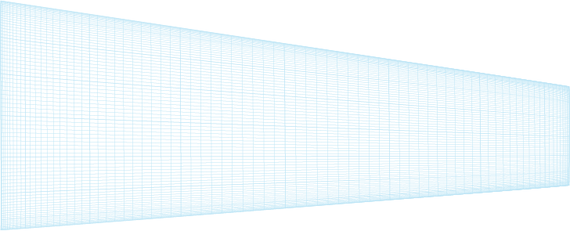
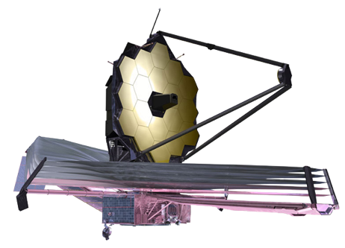

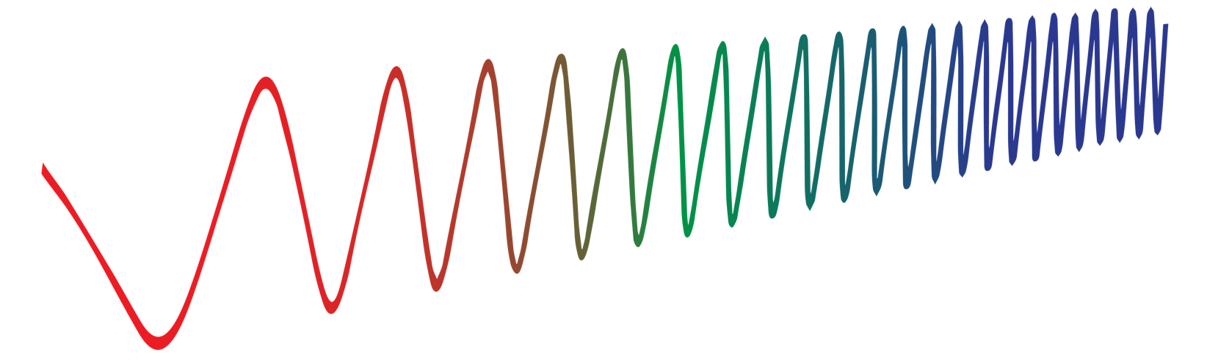
Fabric of Space Time Has Stretched..
Dim early visible light shifts to the infrared

Slide 9
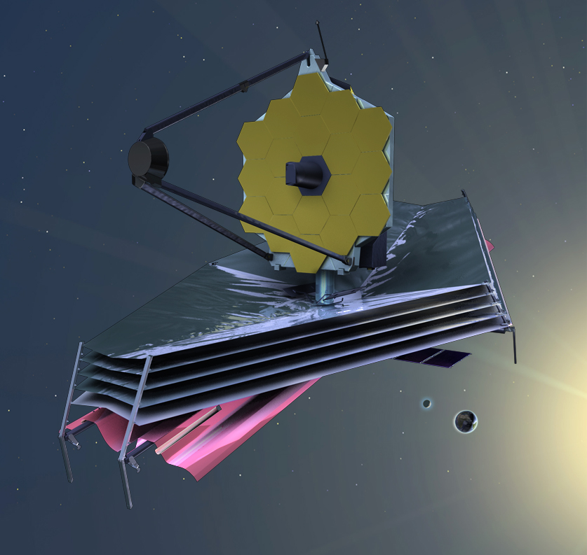
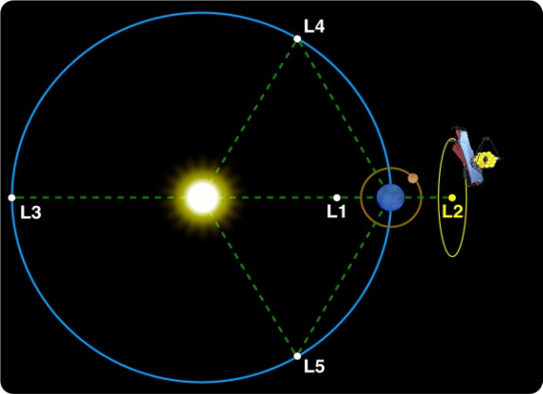
James Webb Space Telescope (JWST)
Mission Objective
  Study the origin and evolution of galaxies, stars and planetary systems
    Optimized for infrared observations (0.6 – 28 μm)
  Study Exoplanets – Transiits
Organization
  Mission Lead: Goddard Space Flight Center
  International collaboration with ESA & CSA
  Prime Contractor: Northrop Grumman Aerospace Systems
    Telescope Subs: Ball Aersopace, Harris Corp, Orbital ATK
  Instruments:
    Near Infrared Camera (NIRCam) – Univ. of Arizona
    Near Infrared Spectrograph (NIRSpec) – ESA
    Mid-Infrared Instrument (MIRI) – JPL/ESA
    Fine Guidance Sensor (FGS) – CSA
  Operations: Space Telescope Science Institute (STScI)
Optical Telescope Element (OTE)
Integrated
Science
Instrument
Module (ISIM)
Cold, space-facing side
Sunshield
Warm, Sun-facing side
Spacecraft Bus
Description
  Deployable telescope w/ 6.5m diameter segmented adjustable primary mirror
  Cryogenic temperature telescope and instruments for infrared performance
    50K, -370F
  5-year science mission (10-year goal) – current estimates are 25 plus years of fuel!

Slide 10
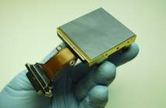
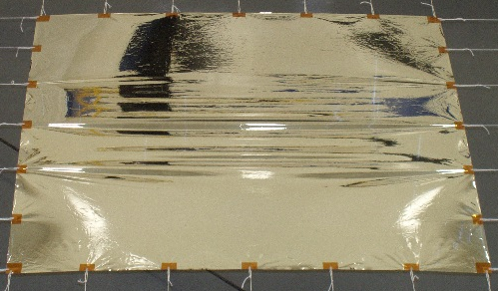
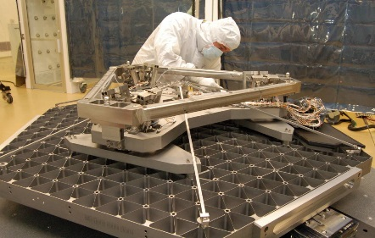
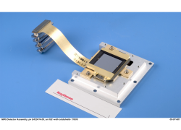
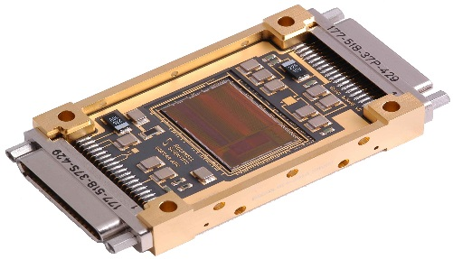
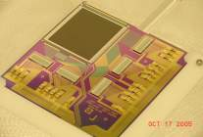
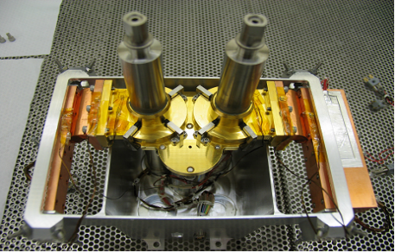
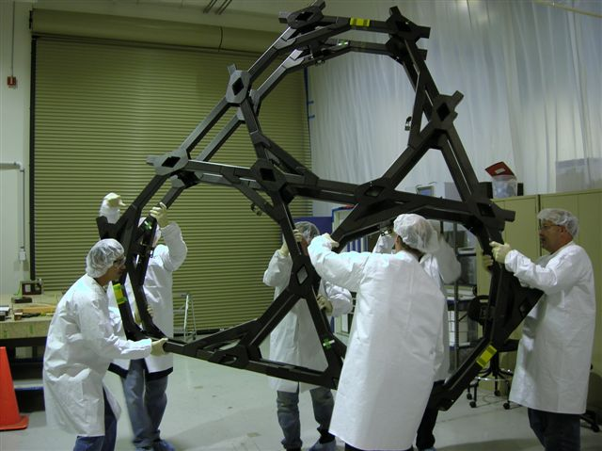
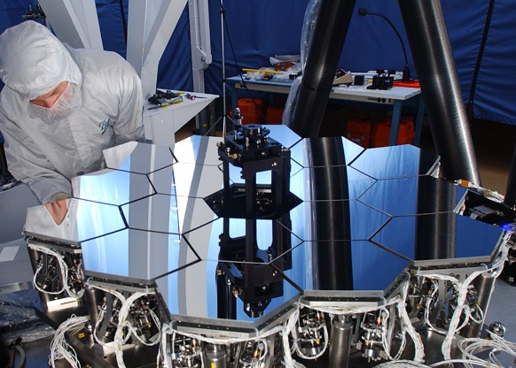
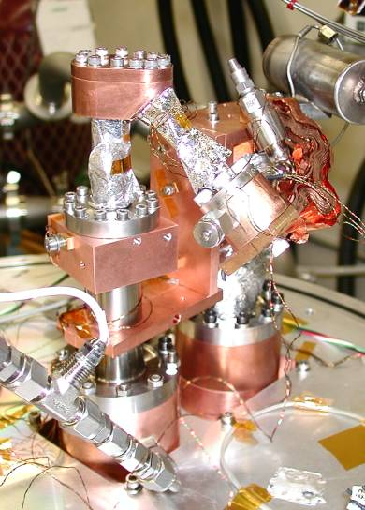
10 Technologies Demonstrated in 2006
Near Infrared Detectors
April 2006
Sunshield Material
April 2006
Primary Mirror Segment Assembly
June 2006
Mid Infrared Detectors
July 2006
Cryo ASICs
August 2006
Microshutter Arrays
August 2006
Heat Switches
September 2006
Large Precision Cryogenic Structure
November 2006
Wavefront Sensing & Control
November 2006
Cryocooler
December 2006

Slide 11
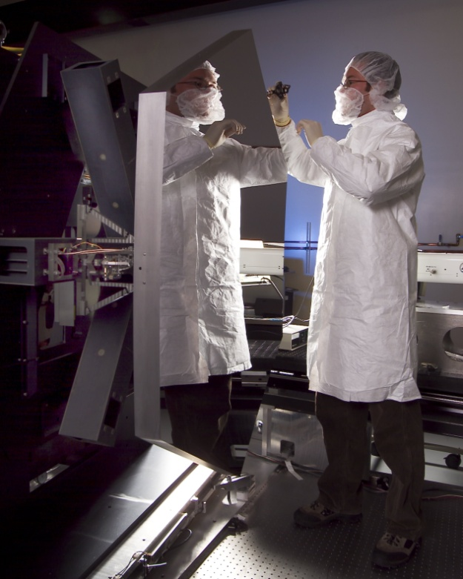
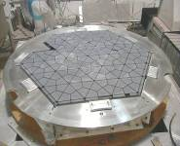
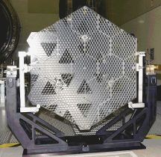
Mirror Technology
NASA and DoD partnership funded 3 lightweight mirror technologies
Ball beryllium mirror technology completed and baselined for JWST in 2003
Mirror manufacturing of flight mirrors started in September 2003
Ball Aerospace
Beryllium
Mirror
Goodrich
High Authority
Mirror
Kodak (now L3 Harris)
w/ULE® CorningGlass Mirror

Slide 12
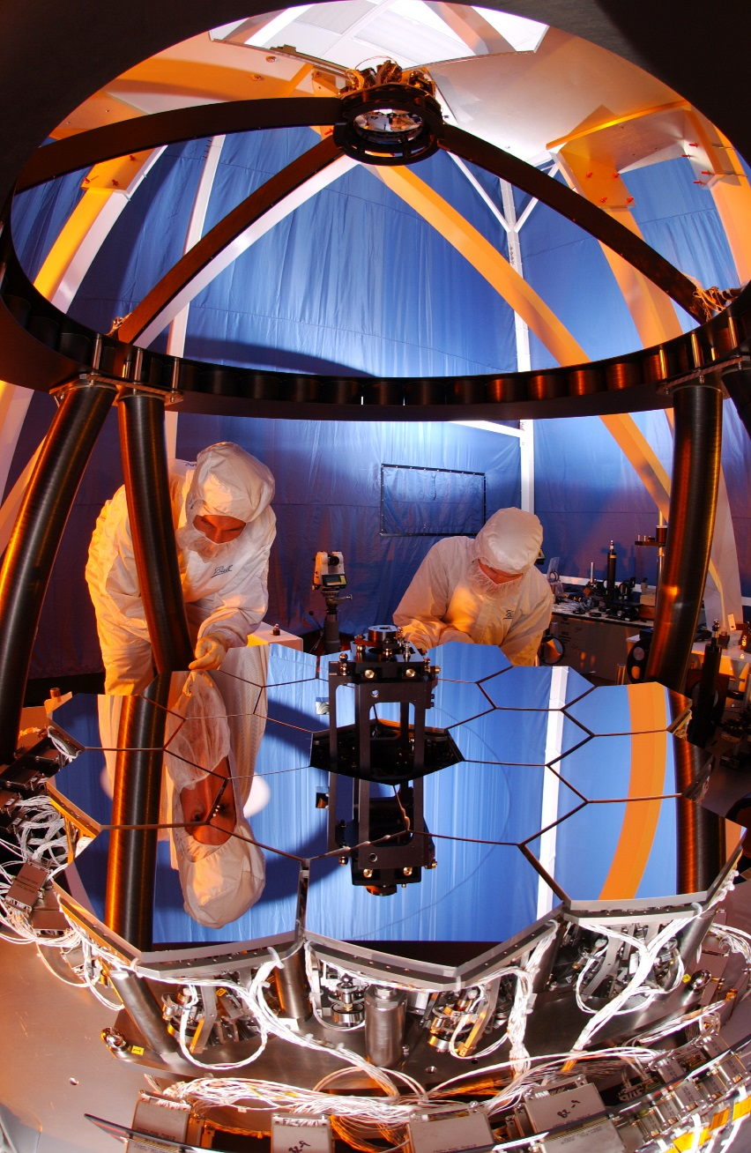









Alignment Algorithms were demonstrated on a 1/6th scale testbed
OTE Deployment
SM Focus Sweep
Segment ID
Segment Search
(if needed)
Segment-Image Array
Global Alignment
Image Stacking
Coarse Phasing
Fine Phasing
Multi-Field Alignment
Ball Aerospace, Boulder Colorado
Wavefront Maintenance

Slide 13
December 25th, 2021: French Guiana

Slide 14
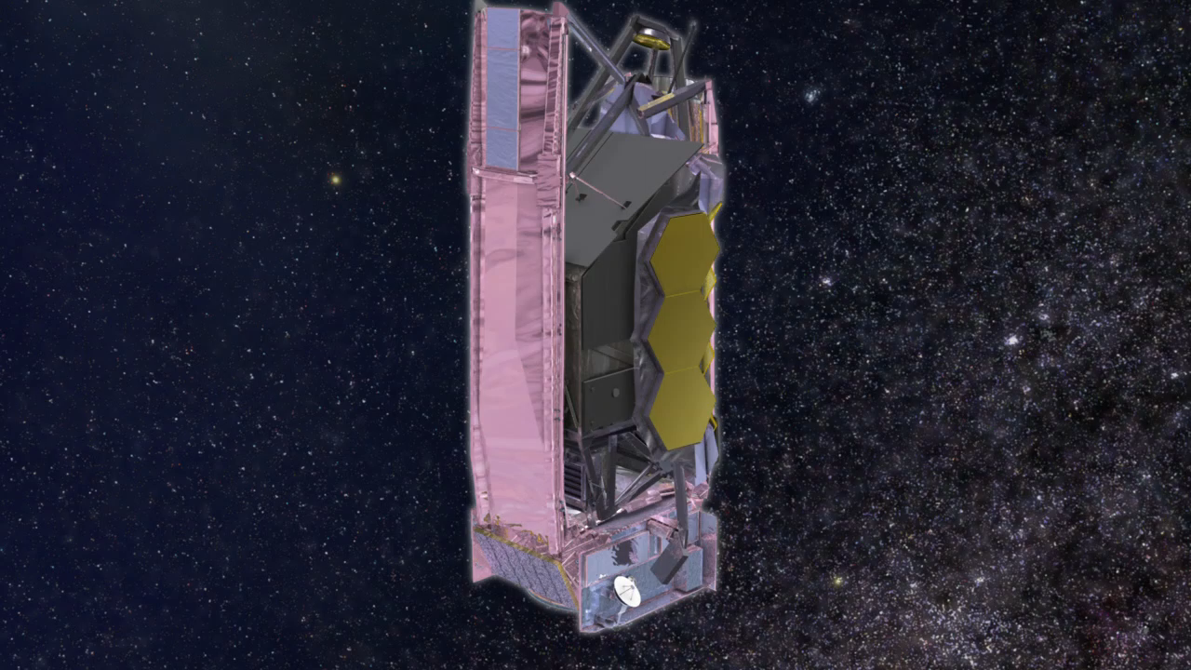
JWST Deployment
Notes:
Deployment video. Triumph of mech engineering. No other way. Fit rocket. Unfold in space. Get cold. 10 inventions. No other way. Redundancy. Ran out of money several times. But we did good work, Congress believed in us, and gave the needed $. Thank you. Light from distant U bounces off big mirror. Gold for IR. Be for light weight and stability.

Slide 15

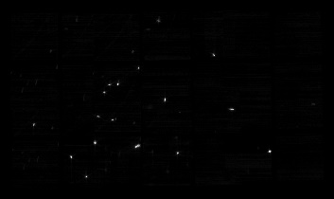
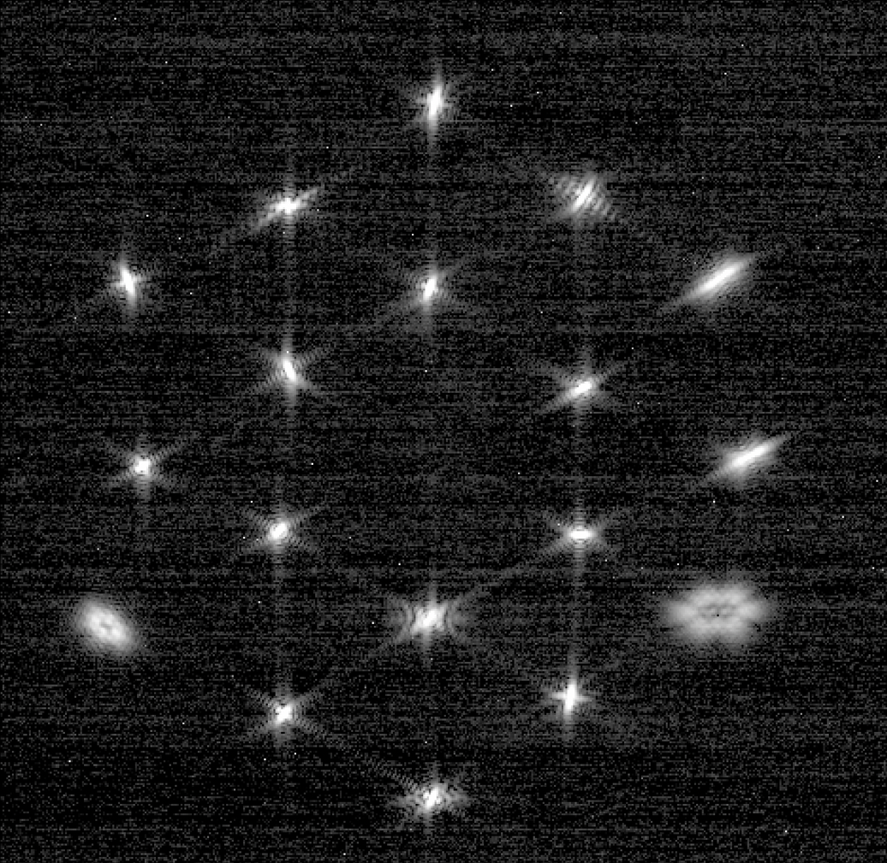

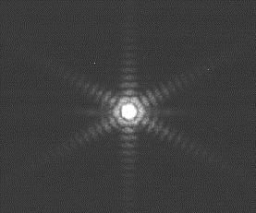
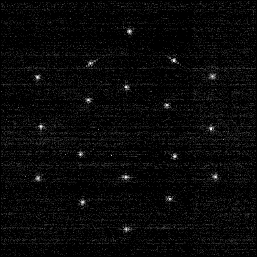
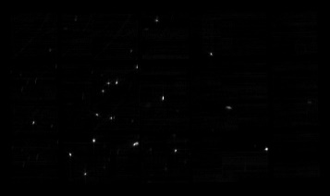
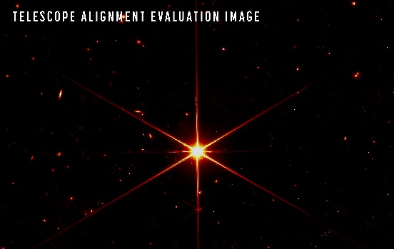
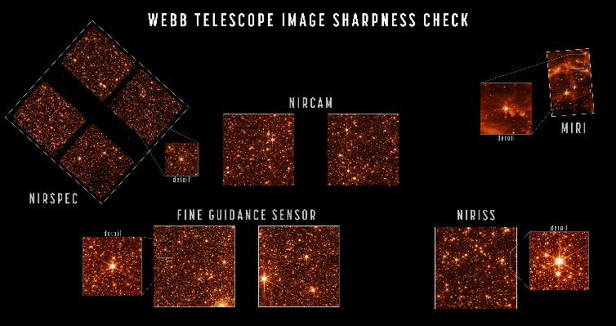


Telescope Alignment
Telescope Alignment In a Slide
18 Segment Image Mosaic
9. Science Performance & Readiness: NIRCam 3
[Feb 02 2022/9am]
Focus Sweep
Segment Image Array
Image Stacking
Segment Global Alignment
Coarse Phasing

Slide 16

First Image Release: July 11, 2022

Slide 17




Planets with JWST
Jupiter
Neptune
Uranus

Slide 18



Exoplanets
Uranus
Jupiter
Webb can primarily detect atmospheres of gas giants…around stars that are full of radiation
  First exoplanet detection of carbon dioxide
  First exoplanet evidence of photochemistry (sulfur dioxide)
To search for Earth-like planets around Sun-like stars requires a new observatory designed especially for that…..

Slide 19



Habitable Worlds Observatory (HWO)
NASA’s next flagship mission concept
recommended by Astro2020 Decadal Survey
First telescope designed specifically to search for signs of life on planets
outside our solar system
Large IR/Opt/UV
observatory performing
transformative astrophysics like JWST
Slide by Megan Ansdell (GOMAP PS)

Slide 20
Habitable Worlds Observatory (HWO)
NASA’s next flagship mission concept
recommended by Astro2020 Decadal Survey
First telescope designed specifically to search for signs of life on planets
outside our solar system
Large IR/Opt/UV
observatory performing
transformative astrophysics like JWST
Slide by Megan Ansdell (GOMAP PS)

Slide 21



Nancy Grace Roman Space Telescope:
Major Goals are to Study Dark Energy and Demonstrate Coronagaph Technology

Slide 22




Technology Evolution
James Webb Space Telescope: on-orbit stability
Roman Coronagraphic Imager (CGI) - In thermal vacuum: digging a high contrast dark hole (Courtesy JPL)

Slide 23

What is Habitable Worlds Observatory?
Large UV / optical / infrared space telescope
to search for life on exoplanets and enable transformative astrophysics
“If planets like Earth are rare, our own world becomes even more precious.
If we do discover the signature of life in another planetary system, it will
change our place in the universe in a way not seen since the days of Copernicus.”
– 2021 Astro2020 Decadal Survey Report, page 1-5
Notes:
Aki

Slide 24



How will it search for life?
Modern Earth
1.5
H₂O
Simulation
O₃
H₂O
1
H₂O
H₂O
Planet-star flux ratio x 10⁻¹⁰
0.5
CH₄
O₂
Simulated high-contrast
coronagraphic image
0
0.5
1.0
1.5
Wavelength [μm]
Analyze light directly reflected by the planet, with little or no starlight mixed in
Notes:
Aki

Slide 25

Surveying Exo-earths at various states of evolution
Notes:
Astro2020 Primary Recommendation

Slide 26

Detecting Reflected Exo-earths
with a large space telescope
Starlight
(10 billion times
brighter!)
Reflected
Exo-earth light
Telescope needs to be large and stable (but can be warm)

Slide 27


Blocking the starlight with a coronagraph
Light from telescope
Image of Exoearth
Detector
Blocked!
Pupil
Mask
Prism
Spectrum
Coronagraph
Roman Coronagraph Instrument/Technology Demonstrator

Slide 28
Habitable Worlds Observatory Science And Engineering Working Groups
Technical Assessment Group (TAG) Working Groups (TWG)
Science Working Groups
(SWG)
Joint Working Groups
(JWG)
Technology Working Groups (TWG)
Integrated Modeling (IM)
Servicing
Systems
Technology
Model Standards &
Uncertainty Quantification
Starlight Suppression
Error Budget
Sensing & Control
Science Working Groups (SWG)
Model Validation
High-Contrast Post-Processing & ConOps
Mirrors
New Methods &
Collaborative Environment
Starshade Compatibility
Coronagraphs
Living Worlds (LW)
Solar Systems in Context (SSiC)
Evolution of the Elements (EE)
Galaxy Growth (GG)
Computational Architecture
Detectors
UV Technology
Cross-Cutting
Technologies
Biosignature Possibilities
Characterizing Exoplanets
Stars & Stellar Populations
IGM & CGM
Joint Working Groups (JWG)
Biosignature Interpretation
Solar System Observations
Star Formation
AGN
Science Case Simulation (SCS)
Science Data Simulation (SDS)
Science-Engineering Interface (SEI)
Artificial Intelligence & Machine Learning (AIML)
Past Studies Comparison (Past)
Target Stars & Systems
Demographics & Architectures
Transients
Ionizing Photons
Birth & Evolution
Dark Sector
Astrometry
Wide-Field Imaging
Exoplanet Yields
High-Contrast
UV Galaxy Evolution
UV

Slide 29









Exploring the HWO Trade Space:
Three Initial Exploratory Analytic Cases
  Off-axis 6m ID/7.2m OD
  Off-axis, 6m
  On-axis, 8m (round)
  First round cases fit in fairings currently in development:
  New Glenn (case on left) and Starship Standard Volumes (all)

Slide 30






Example Technologies Needed for HWO
Utrastable Mirrors (L3- Harris)
First Mode in Hz
Active Sensing and Control (BAE)
Roman Space Telescope Coronagraph with
Deformable Mirrors (JPL)
Post processing algorithms (from C.Stark/GSFC)
15 kg/m²
Target
Reference
Post Processed
Ultrastable
Picometer
Stability
(GSFC/SAO)
Disturbance Free CubeSat Isolation
(Lockheed Martin)
<10 pm RMS

Slide 31




HWO Planned Servicing: Mountaintop Observatory at L2
Enables Future Upgrades for Instrument/Coronagraphs/Starshades
Robotic Servicing at L2
Hubble
Servicing
Hubble/Shuttle Model
Mountaintop
Observatory

Slide 32




Launcher Mass and Volume Capabilities
Red circles are the ones currently being built.
NASA
Space Launch System
Space-X
Starship
Blue Origin
New Glenn
Roman Space Telescope started being compatible with 3 rockets. Only 1 was ready when Falcon 9H chosen
Fitting in both the New Glenn and Starship fairings in development mitigates risk.
Key issue is that rocket is need in 20+ years
Launcher | Mass to L2 (kg) | Notes
Space-X Starship | 100,000 | Starship will require re-fueling in low earth orbit (and a fuel depot).
NASA Space Launch Systems (SLS) | 44,300 | Not currently building a large fairing.
Blue Origin New Glenn | 15,000 | First launch planned for 2024. More mass capability TBD.

Slide 33

Mirror Stiffness Scales Non-Linearly with Diameter
First Mode in Hz
A stiffer mirror is highly desirable to prevent mirror bending from dynamic inputs or from strain from back or during polishing.
Thick Borosilicate (like GMT) is high CTE
Low CTE Mirror need to be <3m to be stiff, 1.5m class can be very stiff
Desirable range
Typical range for space
Floppy
Source is SAO Mirror Modeling Team

Slide 34

Sensitivity20 + Meter telescopes, Robotic Assembly + AI/ML
Modular assembled space telescope, Feinberg et al
Opt. Eng. 52(9), 091802 (Apr 25, 2013). doi:10.1117/1.OE.52.9.091802

Slide 35


New Era of Space Robotics
DARPA NRL RSGS Space Robotics Now Teamed
with Northrop Grumman
Gateway arm (model)

Slide 36



Interferometry and VLBI
Event Horizon Telescope 2017
Heterodyne Optical/IR
Direct Detection.
Can do either Michelson or Fizeau Interferometry
Each combination is 2 apertures at a time, slow
Need to maintain phase
Good place to start is Sub-mm
Multiple groups have considered nulling interferometry at 10um
Uses local atomic clocks
Correlation of signals
Undersamples UV plane
230 Ghz (narrow band), 1.2mm radio
Heterodyne Fiber Optic
Interferometry
Low level sources infeasible

Slide 37
Quantum Telescopes
There are at least 3 approaches to quantum telescopes:
Quantum inspired telescopes – Quantum Fisher Information shows higher resolution possible, one possibility being explored is using mode transformations which is actually a classical method
  It’s not impossible these methods could be used on HWO for latter generation instruments, Issues are can they work in crowded fields and broadband
Quantum Telescopes – Use quantum to achieve supersensitivity (no shot noise), possibility of measuring the electric field directly (not intensity), can capture quantum states
Quantum Optical VLBI – Connecting apertures using a quantum network, combining multiple baselines simultaneously using a quantum Fourier transform, no propagation losses, likely requires quantum memory to make efficient

Slide 38



Optical VLBI/Quantum
Assisted Telescopes
Quantum Telescope Example
Several Groups are looking at Quantum Assisted Optical VLBI and Telescopes
Key to this is distributing entanglement (Bell State Measurements) with the methods being proposed for quantum networking. We can teleport quantum information to combine with a Quantum Fourier Transform.
However, it’s hard to get high efficiency. Quantum memory has promise to solve that.
Yes quantum memory current requires Cryo memory arrays, but work is progressing for many reason in this field.

Slide 39
Where might this all be going?
For the coming decades, it depends on the science and missions as recommended by national academy. Some private telescopes likely, but not true flagship science and limited capability.
Following up on HWO might demand a very large segmented telescope that is assembled and broadband, might even be cryo for NIR spectroscopy (Webb+HWO?)
  Webb has demonstrated the power of NIR spectroscopy, but need Lamda/D
One can imagine large assembled filled apertures or interferometers tailored to the science need from UV to FIR
Use quantum technology to improve sensitivity and resolution of ground and space telescopes
Quantum networking can combine ground telescopes across the globe or hybrid space ground systems
Finally, one can imagine that one can combine many, many telescopes separated over large distances using entanglement distribution/quantum networking to help phase and combined via quantum Fourier transforms, arrayed like a Radio Telescope

Slide 40


For more information:
www.webbtelescope.org
www.jwst.nasa.gov
@nasawebb
https://habitableworldsobservatory.org/home
https://science.nasa.gov/astrophysics/programs/habitable-worlds-observatory/

