Slide 1
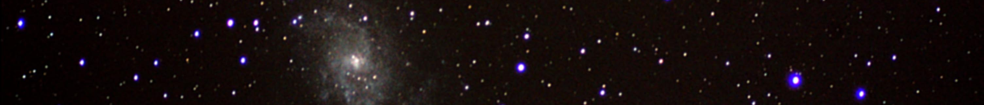


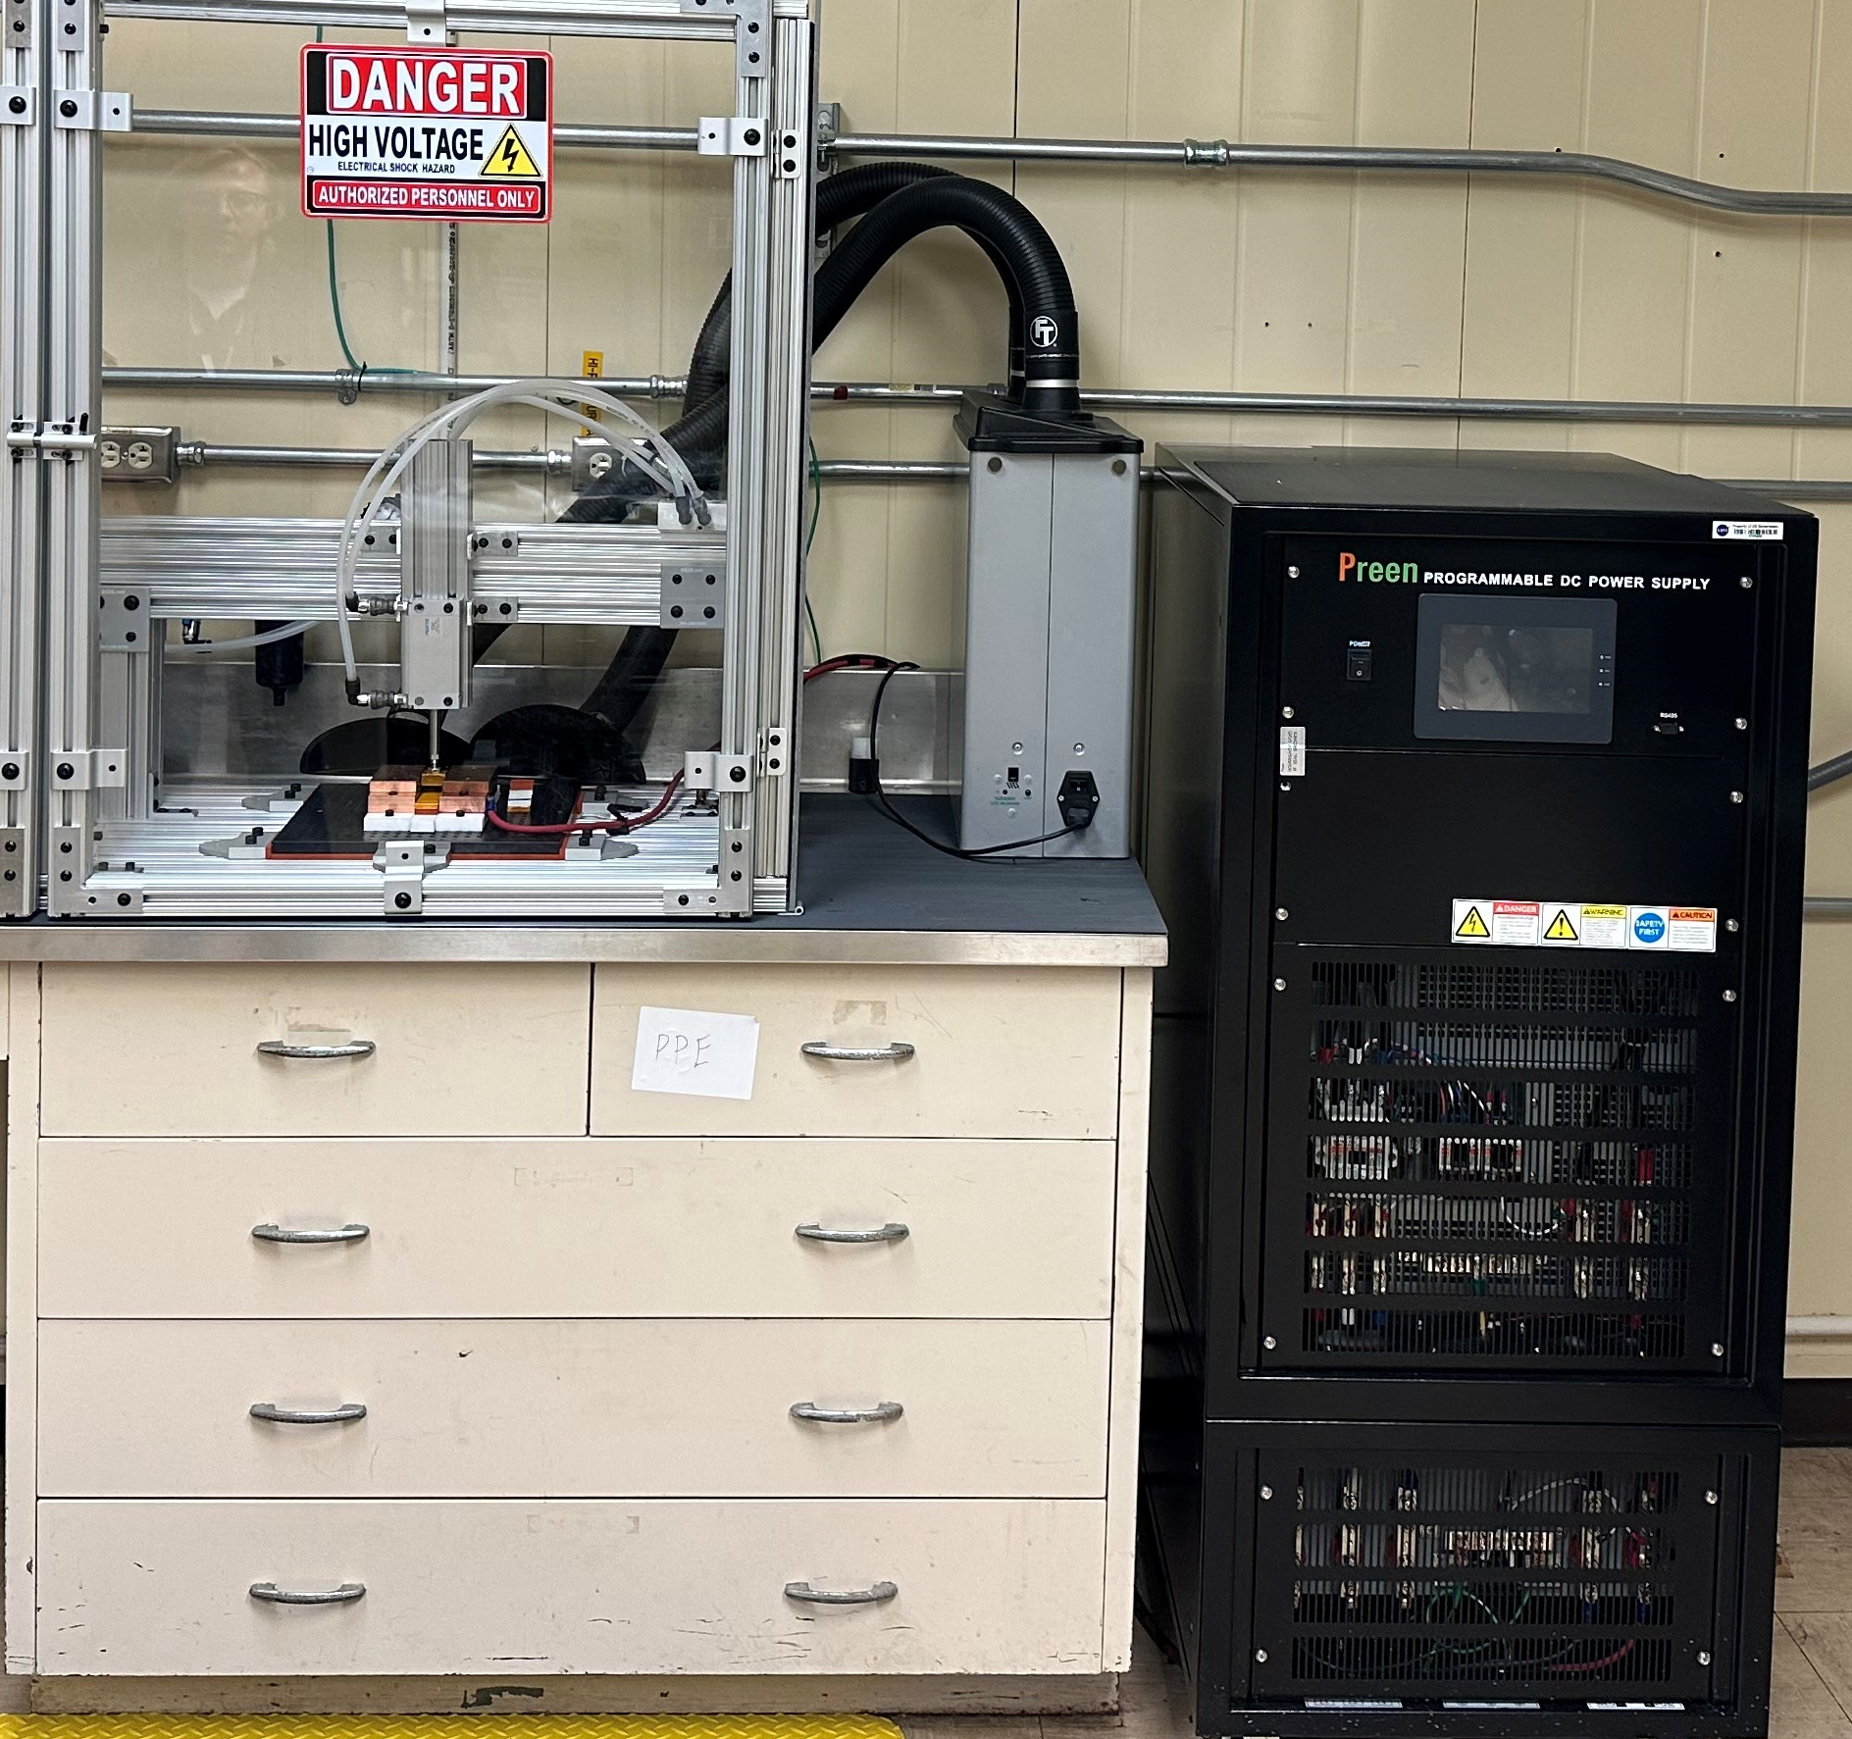
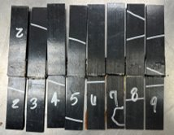

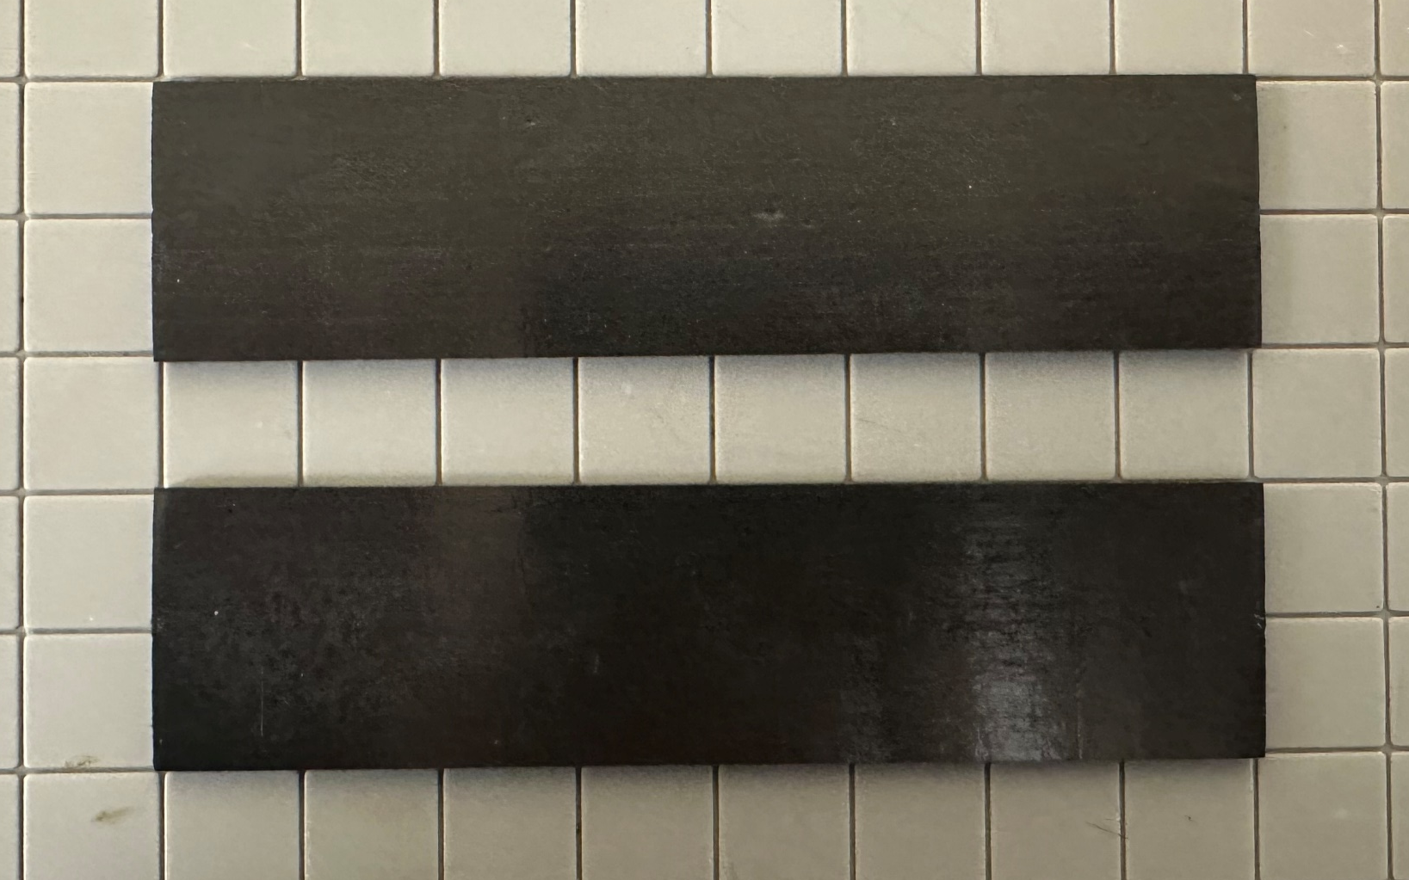
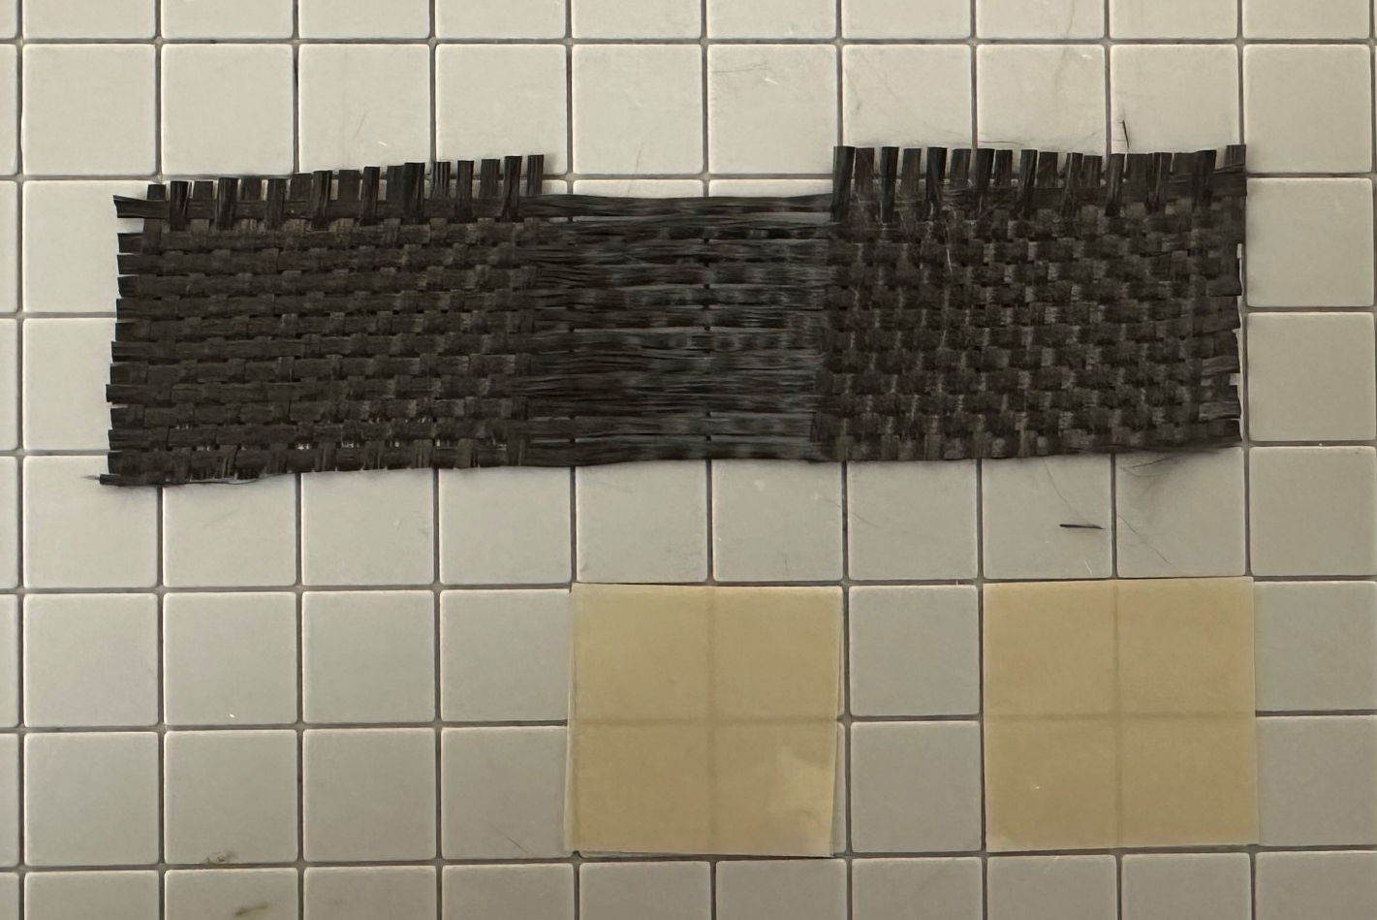
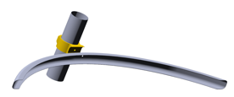
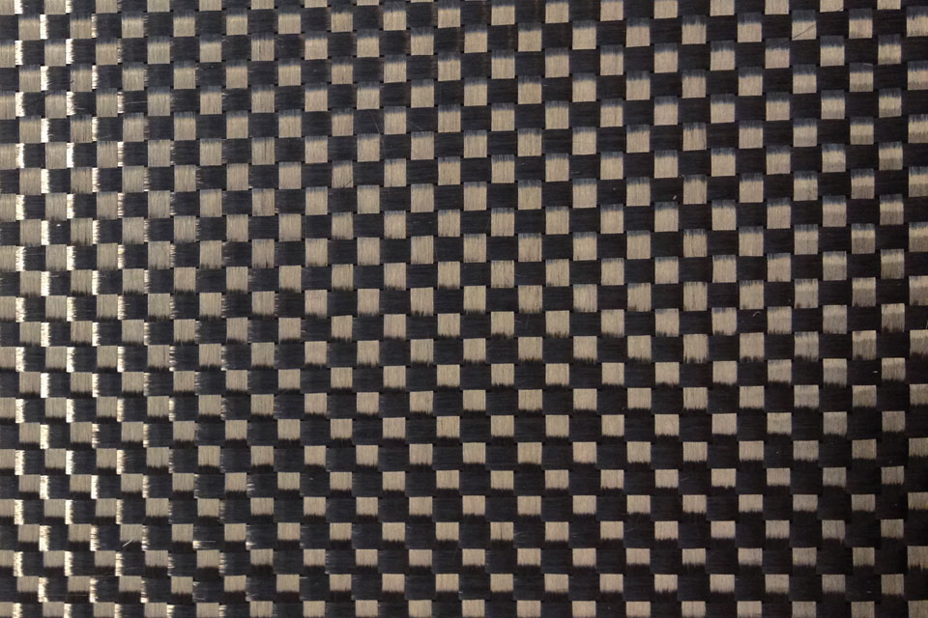
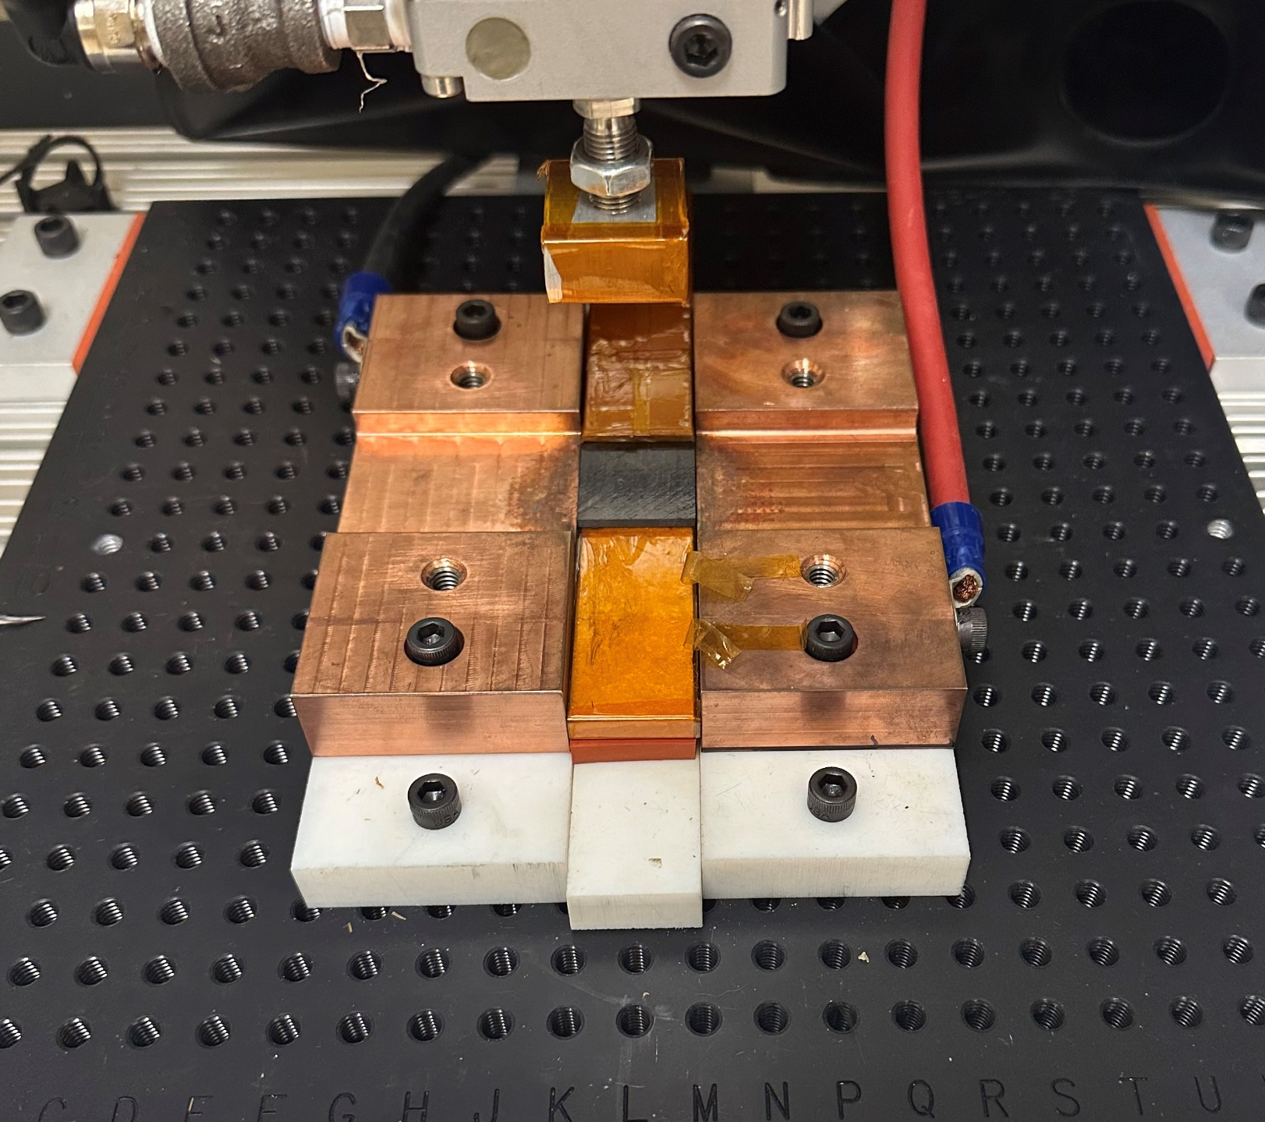
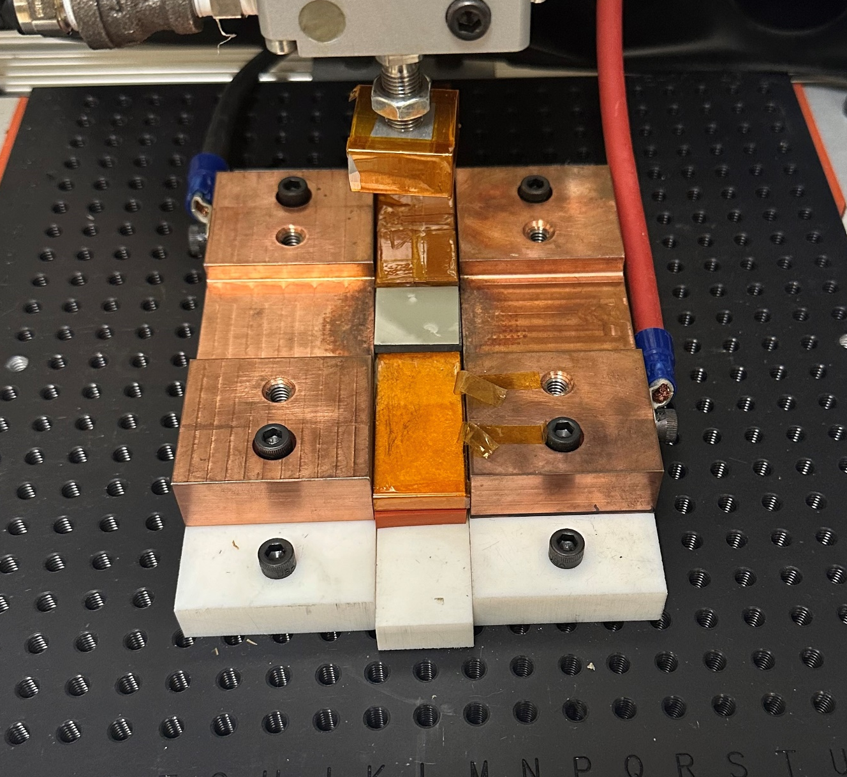
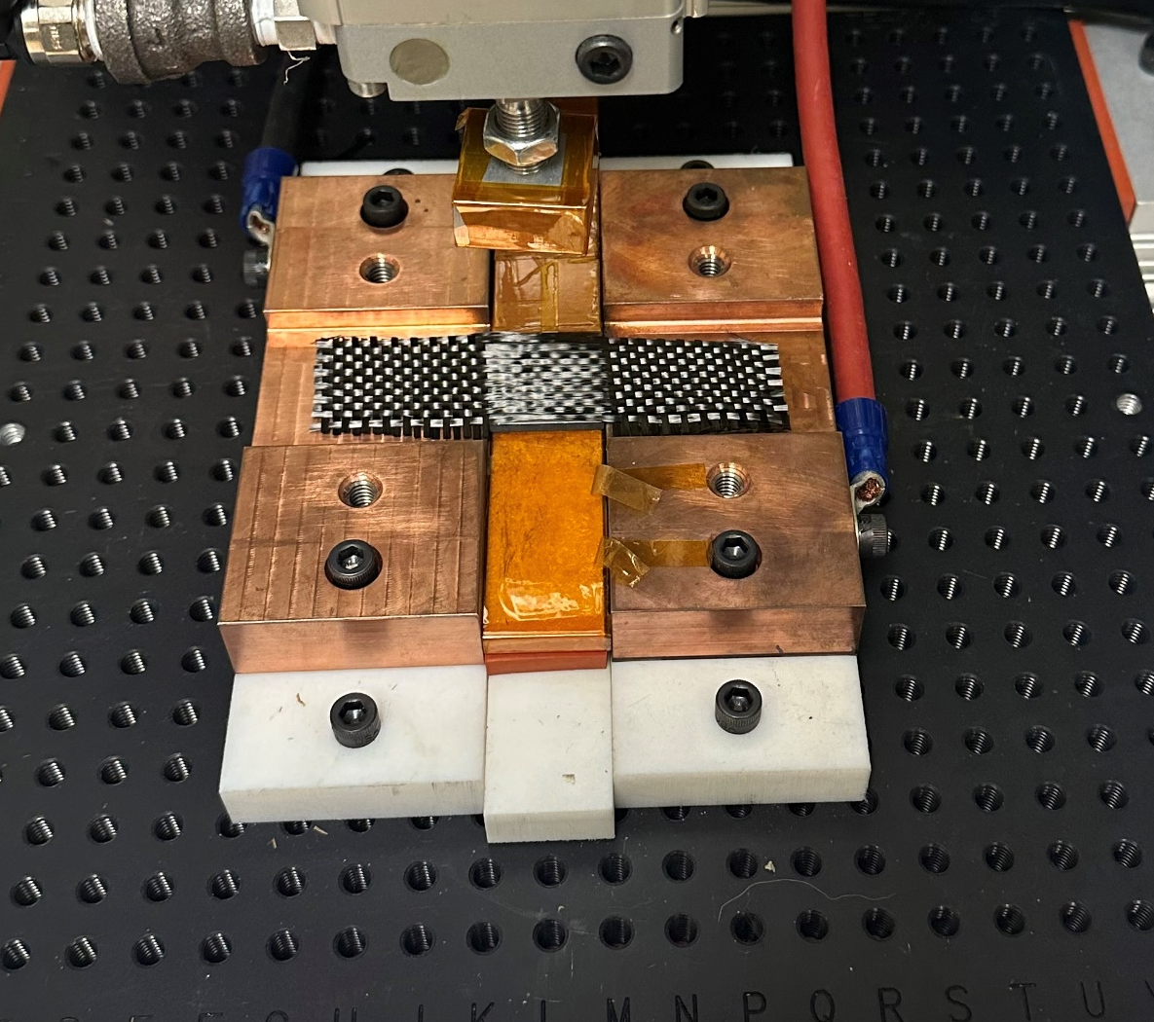
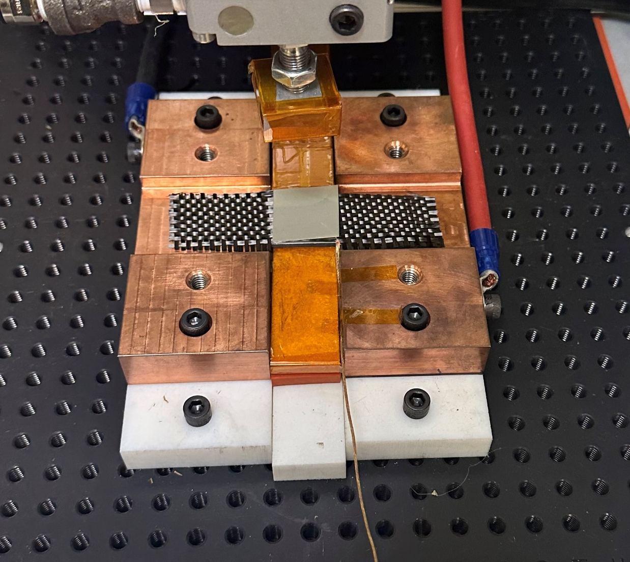
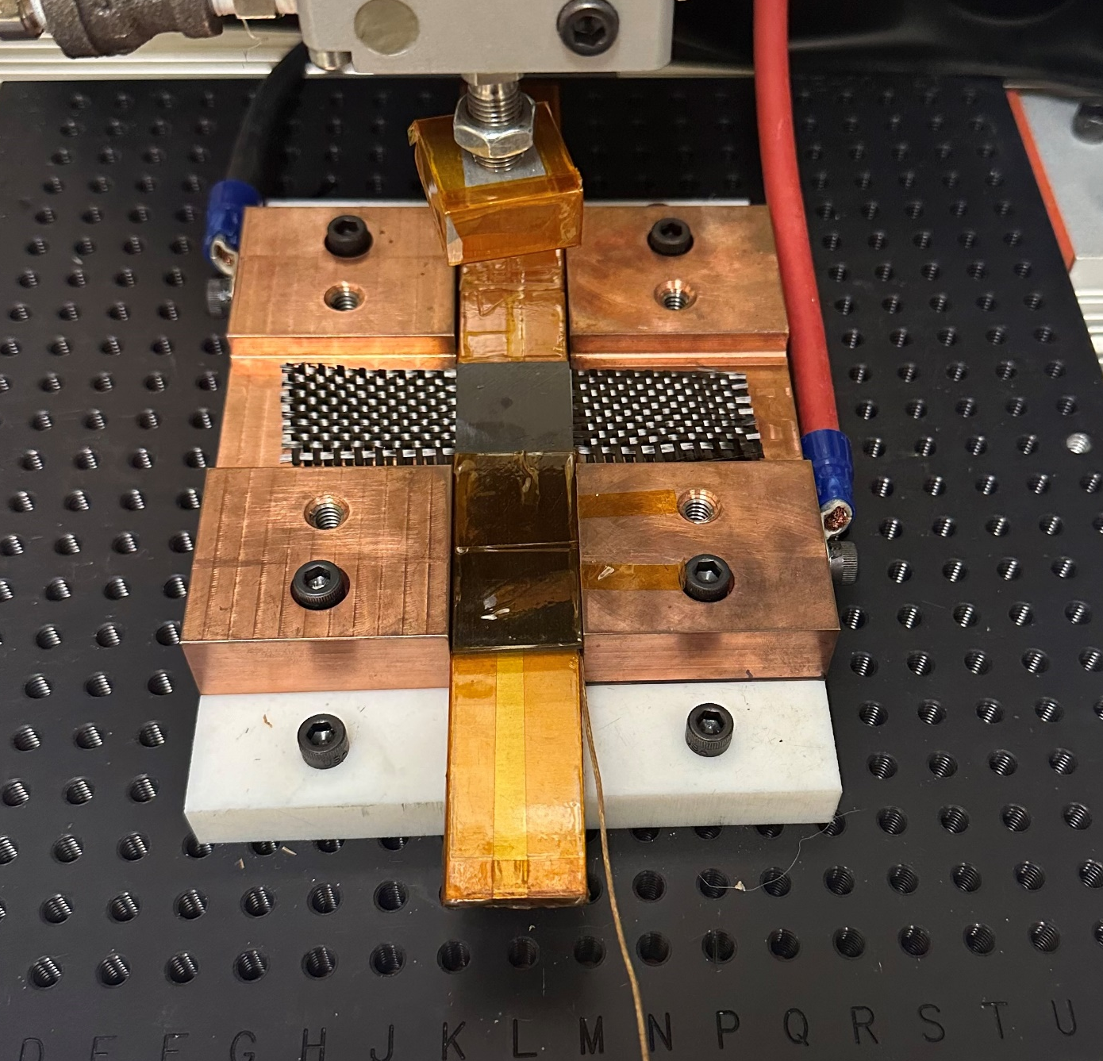
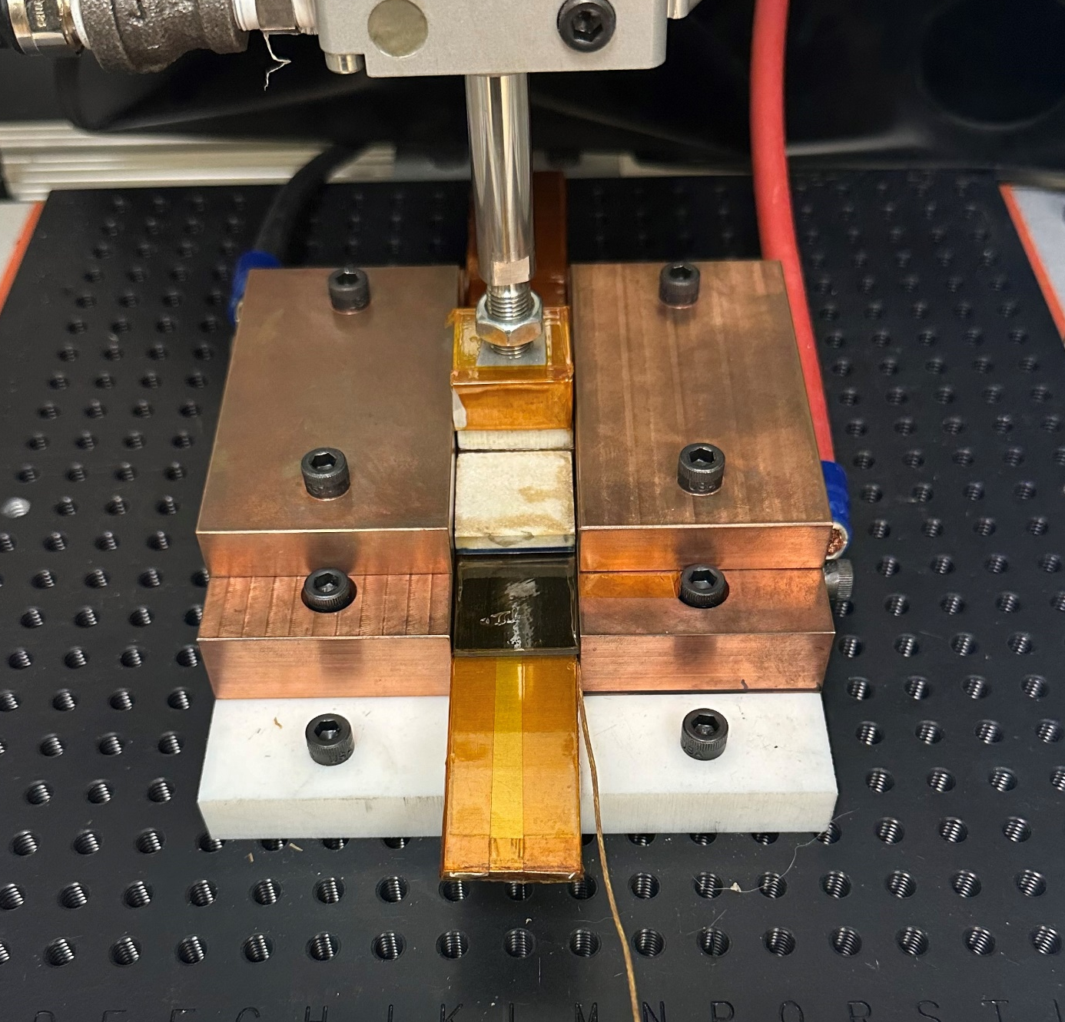
TDEA Thermoplastic Resistance Welding
Allison Clark – Marshall Space Flight Center
The Thermoplastic Development for Exploration Applications (TDEA) project seeks to enhance in-house expertise of thermoplastic composite and manufacturing joining techniques. Currently, limited data is available to trade materials and welding methods. Data on material weldability, welding process requirements, and joint performance are needed to support informed material and process decisions. These baseline capabilities are also required to support material, process, and design down selection decisions. By engaging with industry, MSFC is able to set up its own resistance welding station.
MSFC Coupon Welding Objectives:
Demonstrate equivalence to NIAR welds for process development and weld quality. Perform baseline resistance welding manufacturing and testing
Further development of in-house welding capability through process parameter study to establish processing windows
Help the development and validate thermal process modeling
Weld Line/ Bond Line
Roman space telescope (RST)
Composite materials enable NASA’s science and exploration missions more flexibility where lightweight, high-performance structural solutions are required. Currently composites are commonly manufactured with thermoset composite (TSC) materials. Conventional thermosets cannot be remolded or remelted after the first cure. Interfaces must often contain mechanical fasteners which can adversely affect mass and alter structural performance. The performance of bonded TSC joints is also highly sensitive to surface preparation techniques and bonding processes. Programs are often not able to take advantage of the structural efficiencies offered by composite structures due to characterization and certification challenges, particularly with respect to joints.
Multiple data points are needed to assess the resistive welding process such as time, temp, voltage, current, resistance, and power. By associating a power curve to a temperature curve the correct final power cure cycle can be chosen. Temperature can only be monitored by inserting a temperature probe (K type) into the bond line. This leave a foreign object into your final part. Once an acceptable temperature range has been achieved the same power curve can be used for successive welds. ​
TSC tube
TPC support beam
Materials:
PEEK thermoplastic 4x1 inch specimens
Carbon Fiber Weave Heating Element
PEEK thermoplastic resin 1x1 inch sheets
TPC fitting
~1 m
Step 1:
Thermoplastic Adherend A
Step 2:
Thermoplastic Resin Sheet A
Step 3:
Heating Element
Step 4:
Thermoplastic Resin Sheet B
Step 4:
Thermoplastic Adherend B
Step 5:
Tooling Set up

