Slide 1

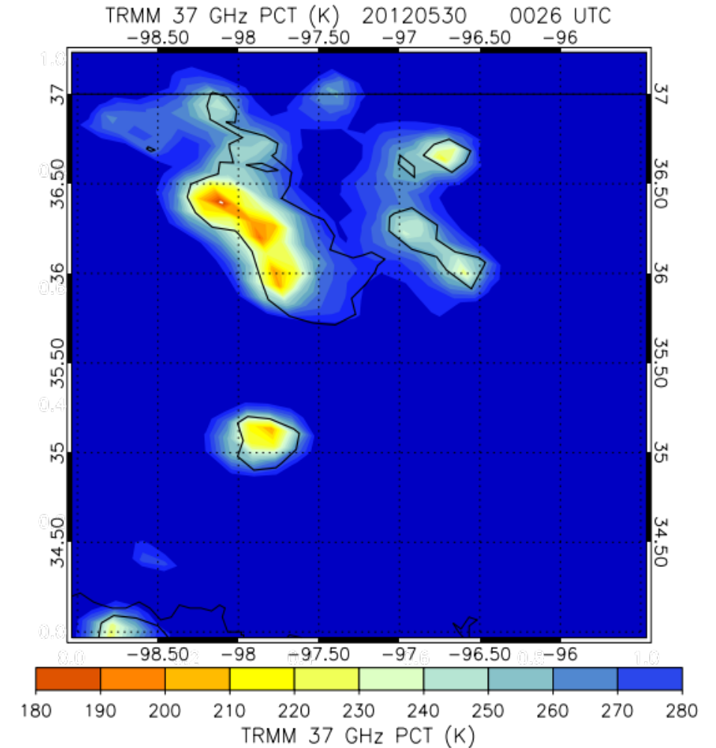
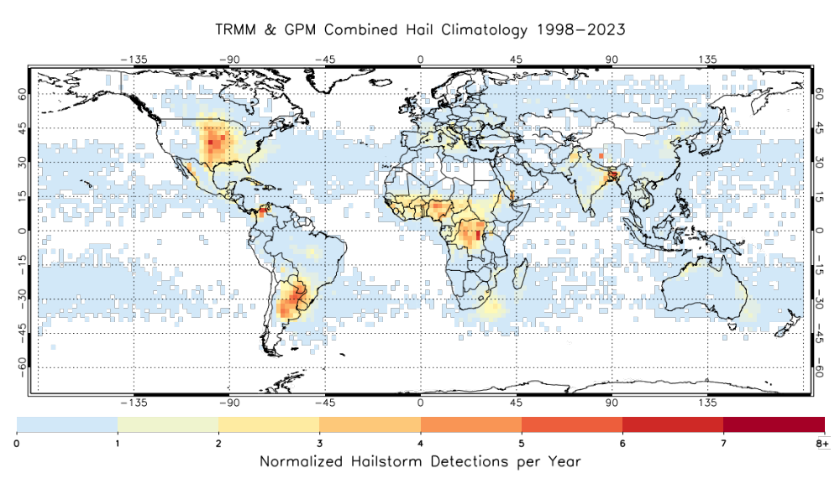
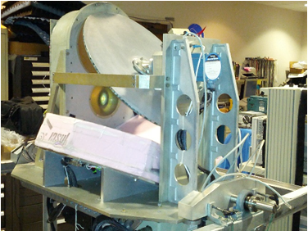
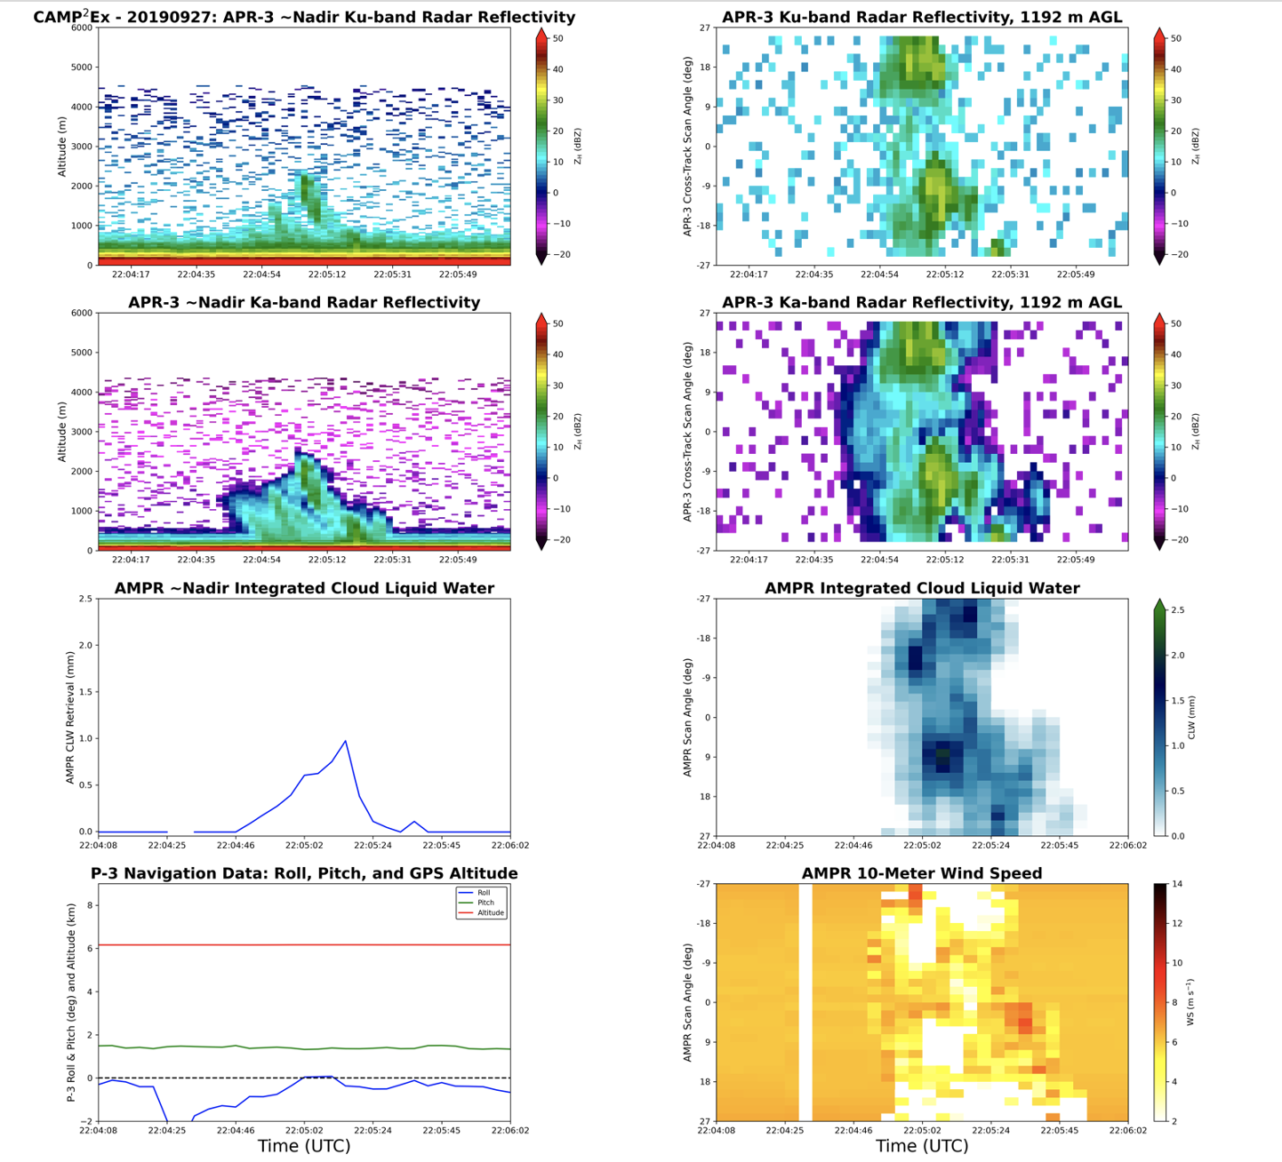
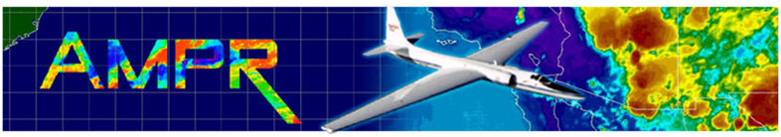
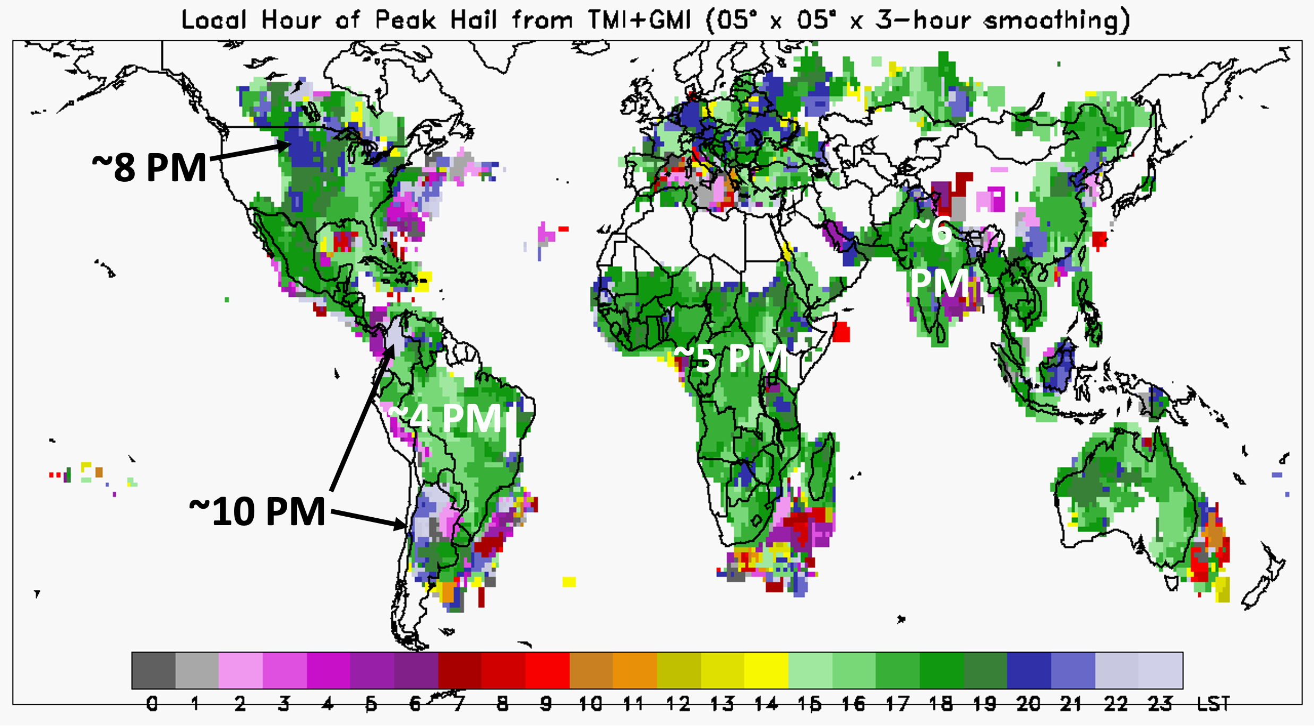
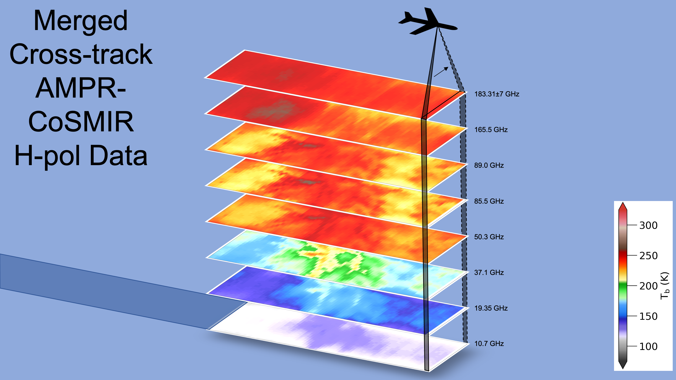
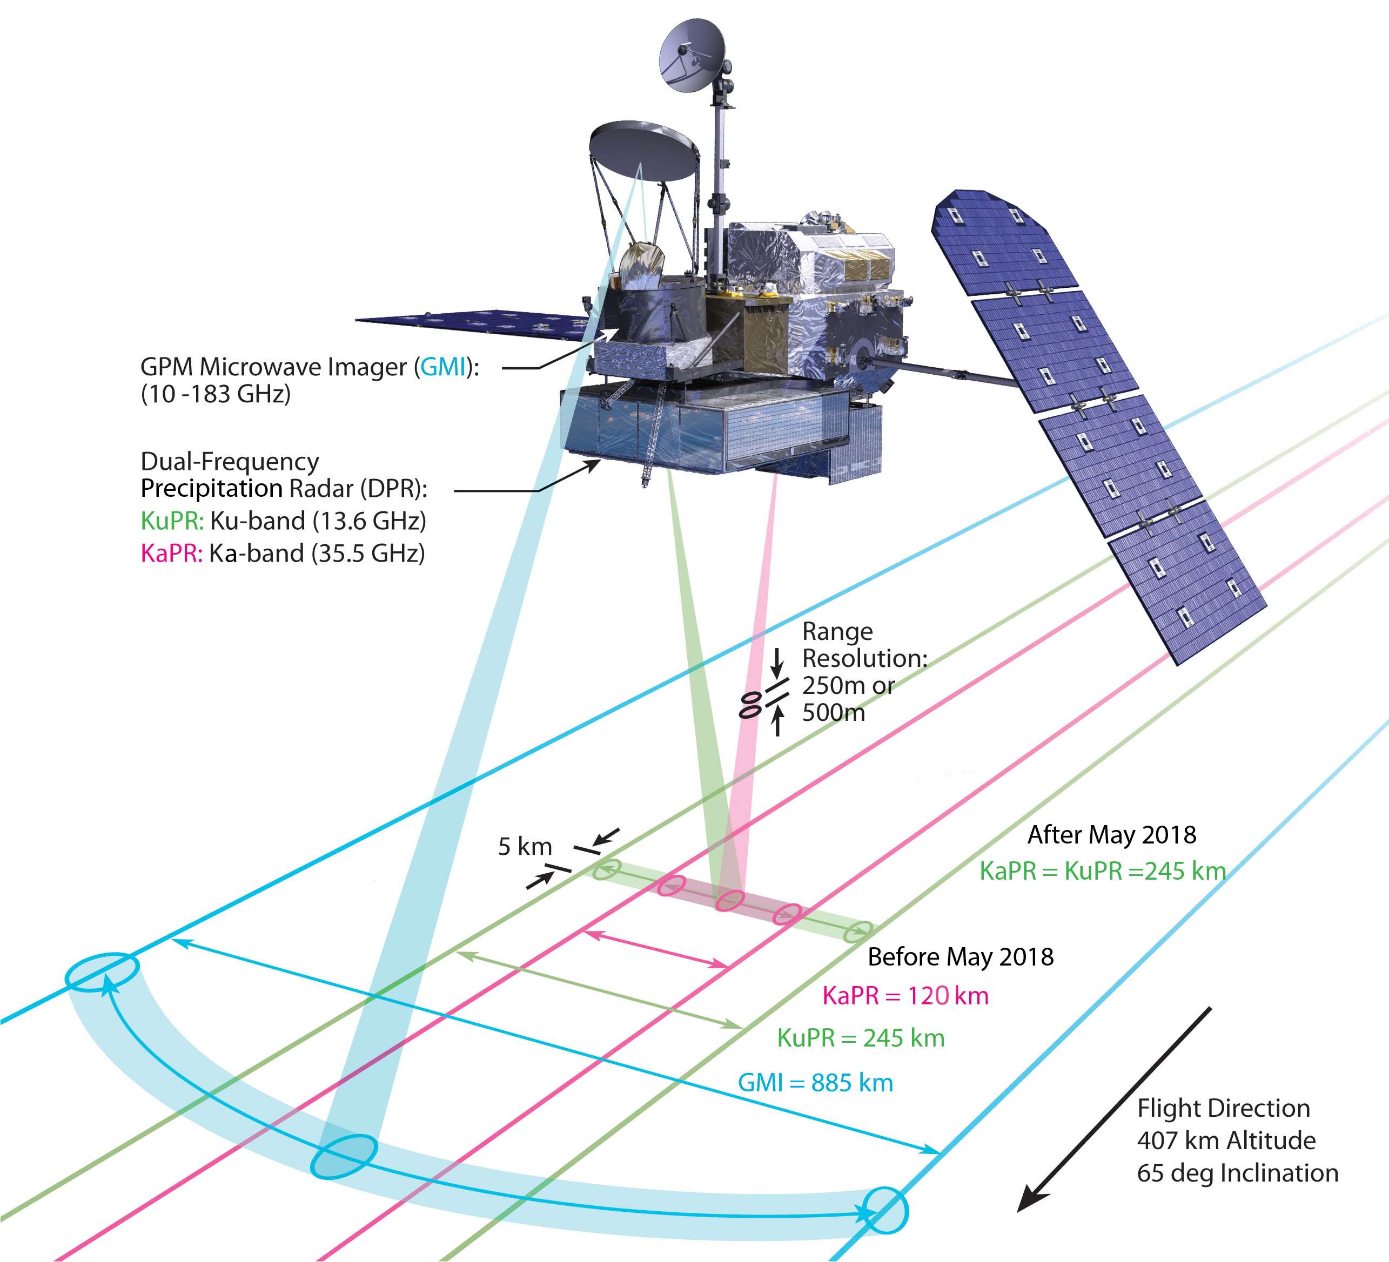
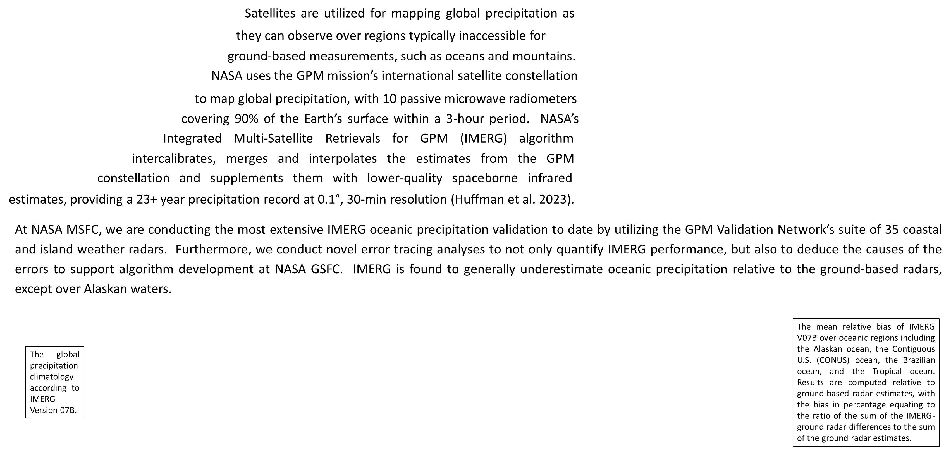
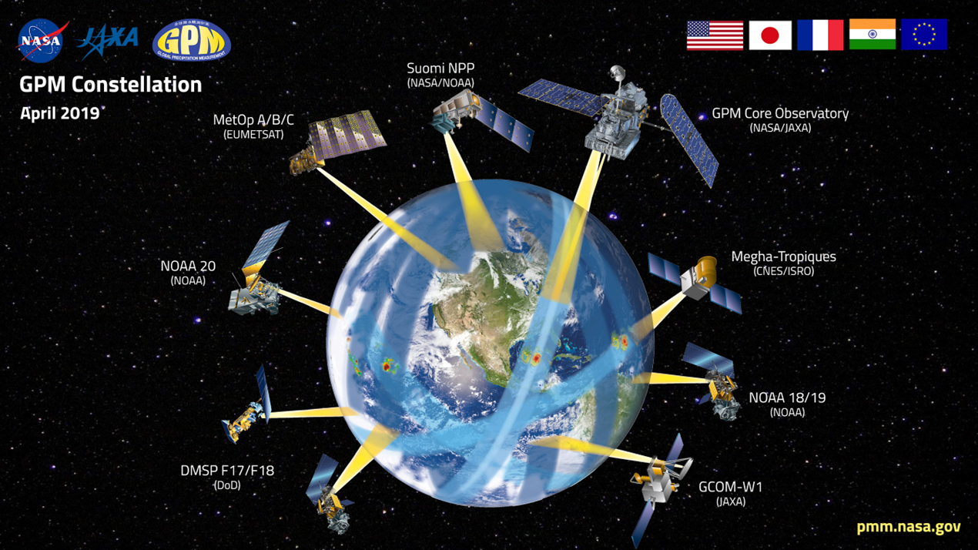


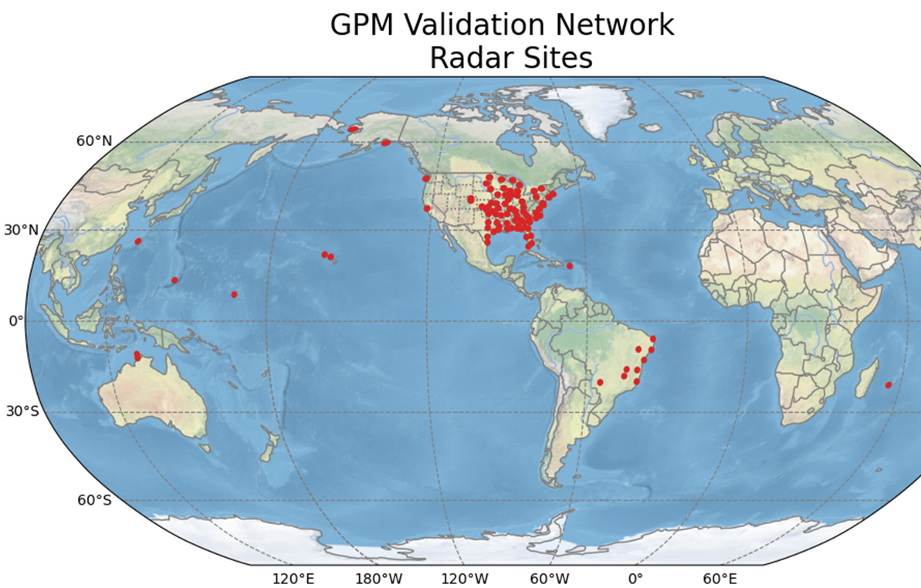
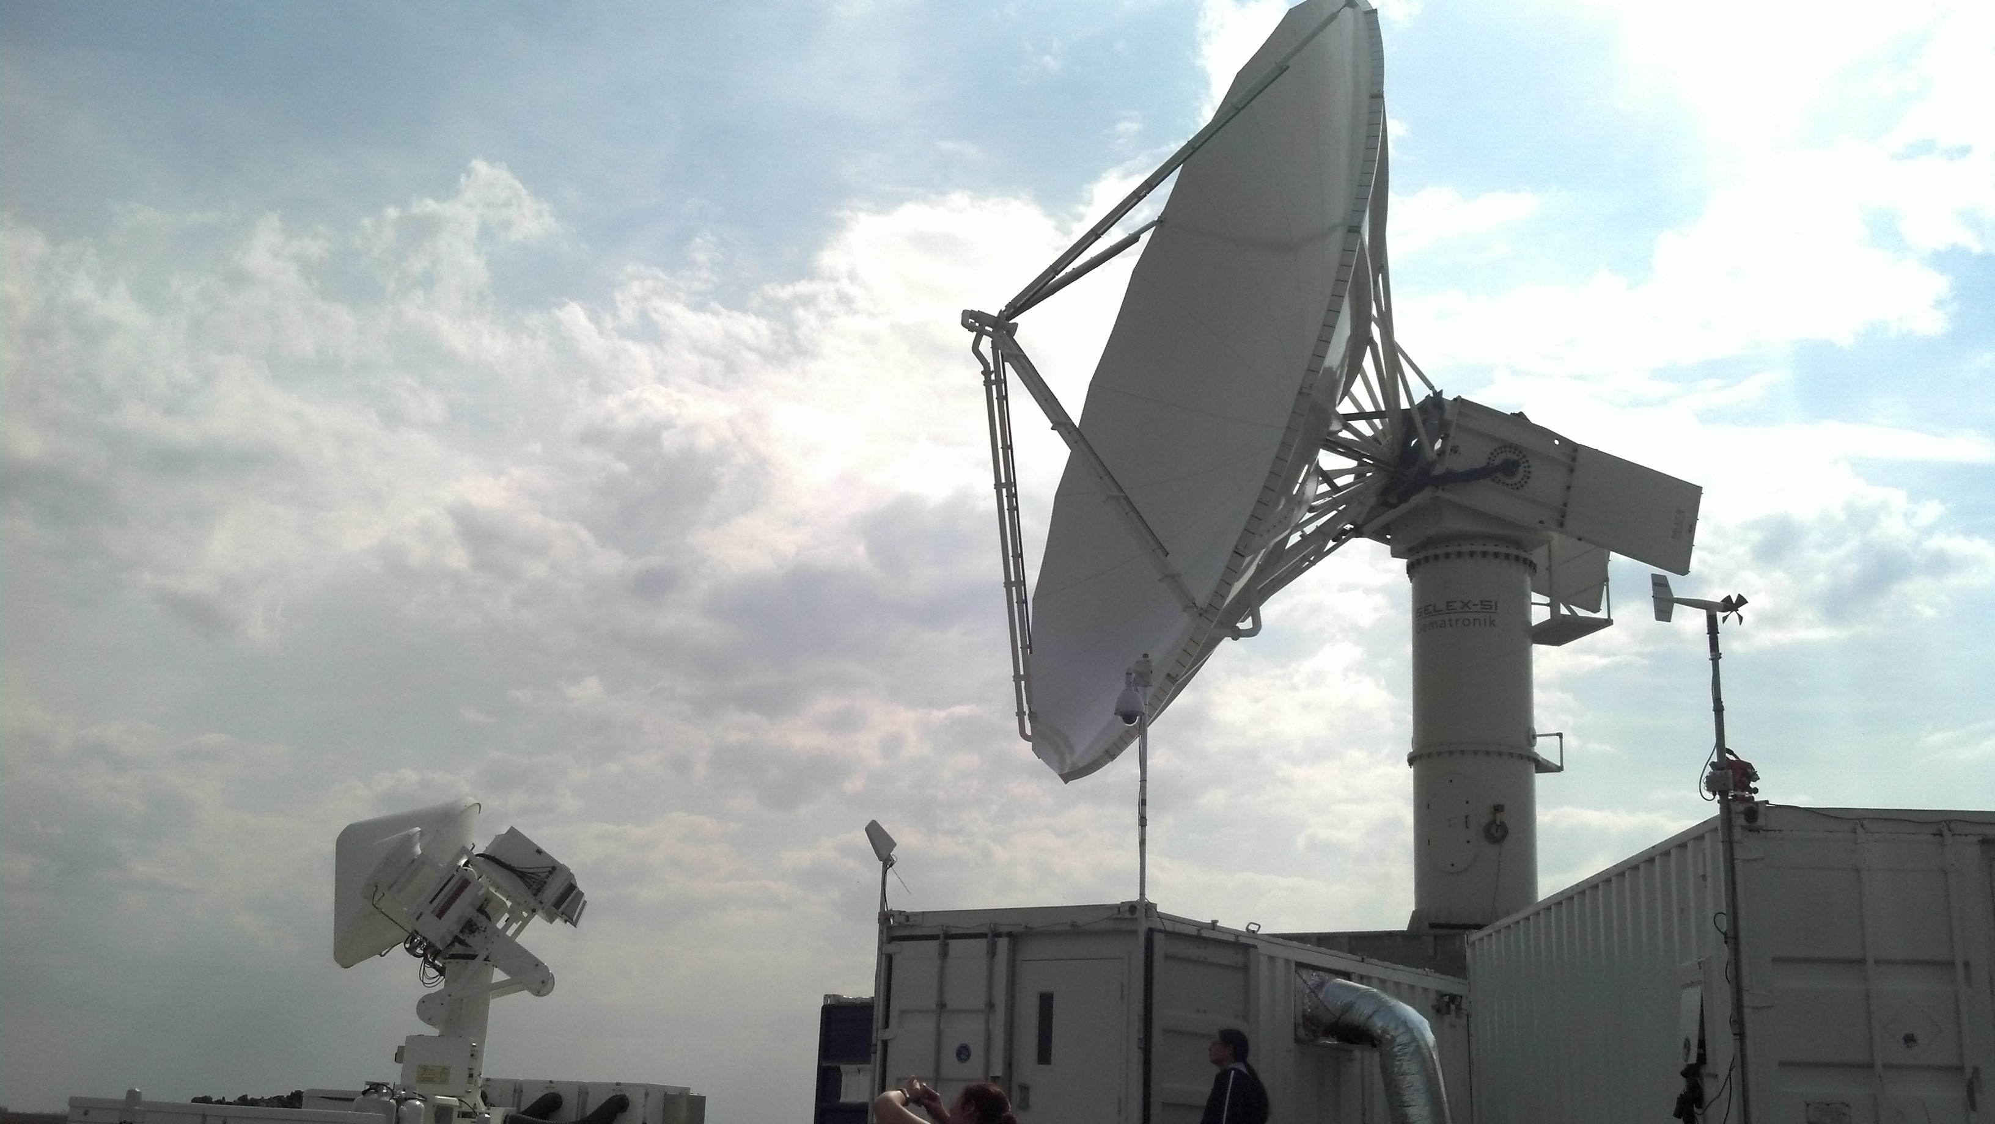
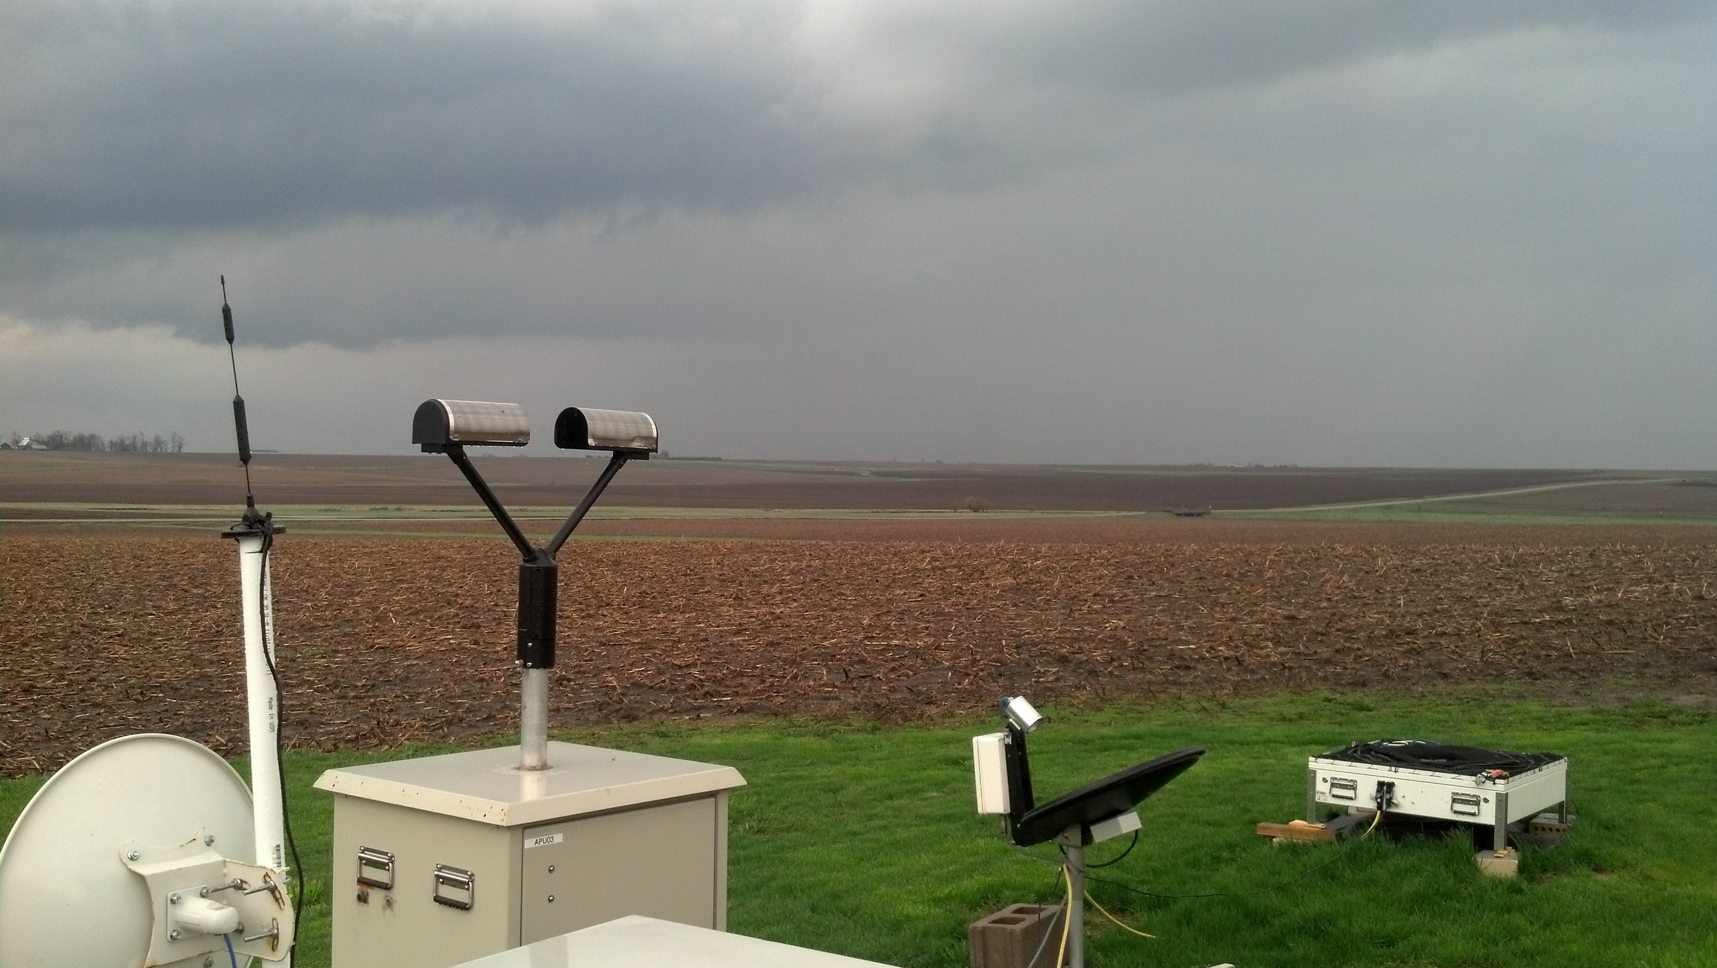
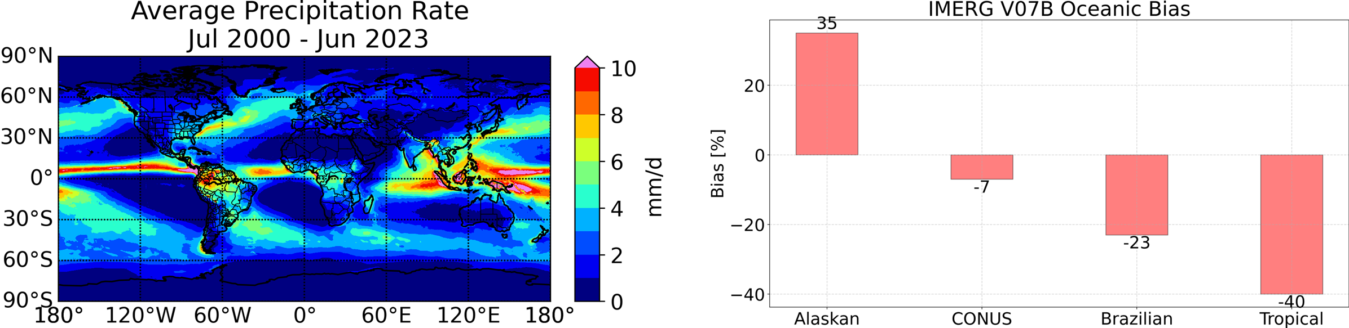
115
Precipitation Science at NASA MSFC
Sarah D. Bang¹, Daniel J. Cecil¹, Patrick N. Gatlin¹, Daniel C. Watters²,
Timothy J. Lang¹, Corey G. Amiot², Matthew T. Wingo³, David Corredor³, Michael B. Solomon³
1: NASA Marshall Space Flight Center, 2: NASA Postdoctoral Program, 3: University of Alabama at Huntsville
Passive-Microwave Hail Detection & Climatology
Advanced Microwave Precipitation Radiometer (AMPR)
T_{b} depression
16%
Hail climatologies can be made from radar or surface reports, but those are not available everywhere. Human-based reports are susceptible to geographic, societal, or non-meteorological bias. Satellite datasets are the best option for consistency, uniformity, and avoiding bias. Passive-microwave radiometers leverage the scattering properties of frozen hydrometeors (like hail) causing a lower brightness temperature (depression). The BC2019 algorithm is used to estimate the near-global climatology of severe hail since 1998, and can be applied to multiple sensors, once different footprint sizes and sampling are adjusted for.
AMPR is a cross-track-scanning passive microwave radiometer that measures total power at 10.7, 19.35, 37.1 and 85.5 GHz. It has two orthogonally polarized channels per frequency, allowing recovery of horizontally (H) and vertically (V) polarized scene brightness temperatures (TBs) after deconvolution. The AMPR instrument has flown on
many NASA aircraft,
including the P-3 & ER-2.
81%
10%
Bang & Cecil (2019)
Prob. of Hail
35%
TRMM 37 GHz PCT
30 May 2012
Passive-microwave hail algorithms leverage the relationship between decreasing T_{b} and increasing probability of hail. The Bang and Cecil (2019) algorithm uses the T_{b} in both 37 and 19 GHz channels and estimates a p_{hail} from 0-100%.
Normalized hail climatology for 1998-2023 using the TRMM and GPM passive microwave radiometers. Probability of hail is calculated using BC2019. Current work focuses on the
potentially artificial hail maxima in the tropics, hypothesized to be due to nonuniform
beam filling and/or melting of small hailstones on their trajectory to the surface.
Satellite datasets not only enable us to construct global climatologies, but satellites in inclined orbits like TRMM and GPM sample locations
at all times of day (unlike a sun-synchronous satellite). This allows
us to analyze the diurnal cycle of hail: during what hours of the
day do hailstorms occur preferentially? Storms peak in late
afternoon in most locations, although some have evening /
overnight peaks. Offshore, the diurnal cycle is more flat, with
an early-morning peak.
The Precipitation
Research Group in NASA MSFC’s
Earth Science Branch (ST-11) focuses
on observations of precipitation (rain,
snow, and hail) from a variety of
perspectives: ground-based radars, surface gauge networks, airborne instruments, and spaceborne measurements from satellites.
While the Precipitation Group largely supports NASA’s Global Precipitation Measurement (GPM) Mission and the Precipitation Science Team,
the team also looks to the future
Precipitation Measurement Mission (PMM)
and Investigation of Convective
Updrafts (INCUS) missions.
AMPR can be used to measure clouds, precipitation, water vapor, ocean winds, and other geophysical properties. Combining AMPR with lidars, radars, and other radiometers is leading to new discoveries about precipitation systems and Earth's weather.
Left: Local time of day with the most hail storms, as derived from GPM.
GPM Validation Network (VN)
IMERG Precipitation Algorithm
The Team:
The low-Earth orbiting GPM core satellite consists of a radar built by JAXA and radiometer built by NASA.
It is capable of measuring precipitation particle size and intensity.
The VN is a software tool that geometrically
matches satellite- and ground-based microwave
observations of precipitation. It is primarily used
to validate science requirements of the GPM mission,
which has been using a constellation of satellites to map
precipitation across the globe for the past decade. The VN
leverages existing operational weather radar networks as well
as research weather radars to compare with the satellite-based
retrievals. By combining these results with in-situ and higher-resolution
measurements of precipitation, the VN provides a unique capability for NASA to study this component of the water cycle.
NASA’s Disdrometer and Radar Observations of Precipitation Facility measures size and velocity of raindrops and snowflakes.
NASA’s Ku-/Ka-/S-band weather radars measure the 3-D structure of precipitation.
118 polarimetric, Doppler weather radars
March 2014–present: >30,000 overpasses
NASA Marshall Space Flight Center
STO Jamboree & Poster Expo
Sarah Bang sarah.d.bang@nasa.gov, Daniel J. Cecil daniel.j.cecil@nasa.gov, Patrick N. Gatlin patrick.n.gatlin@nasa.gov,
Daniel C. Watters daniel.c.watters@nasa.gov, Timothy J. Lang timothy.j.lang@nasa.gov, Corey G. Amiot corey.g.amiot@nasa.gov,
Matthew T. Wingo matthew.t.wingo@nasa.gov, David Corredor david.corredor@nasa.gov, Michael B. Solomon mbs0025@uah.edu
May 16, 2024 • Huntsville, Alabama, USA

