Slide 1
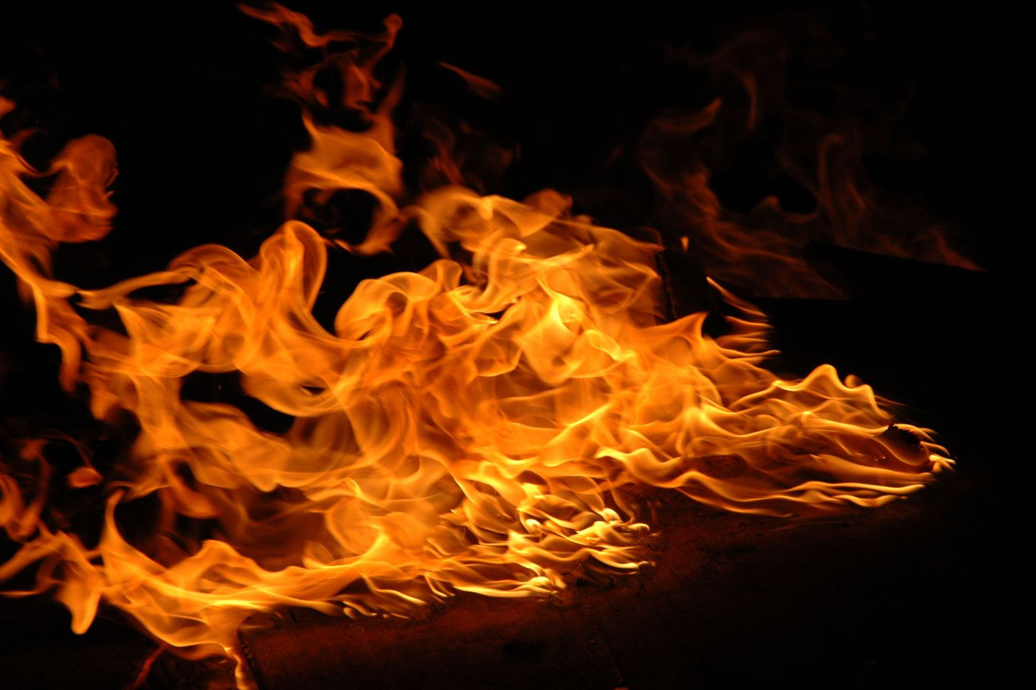
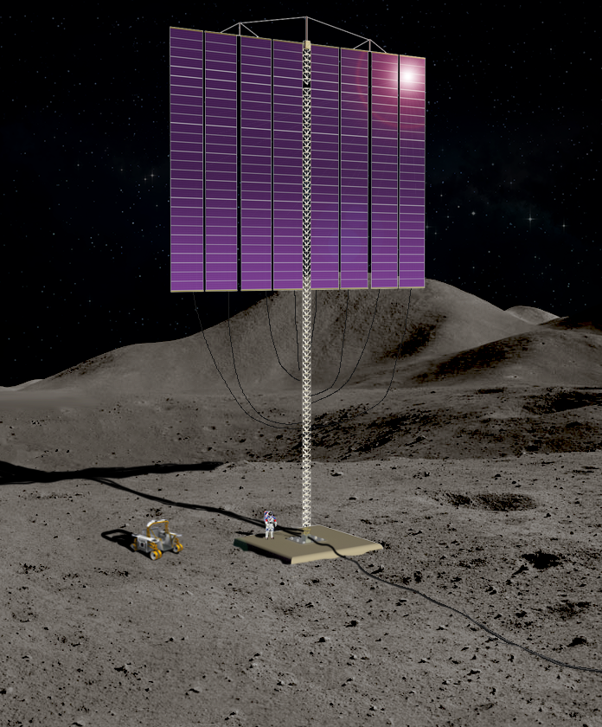

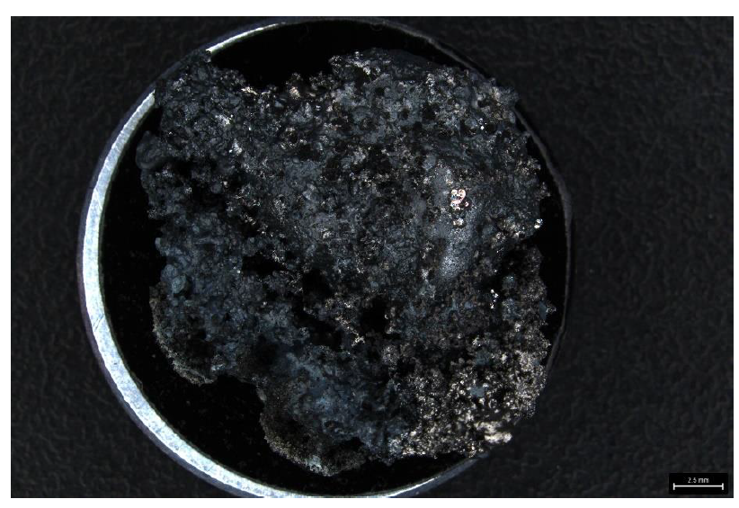
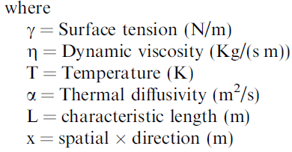
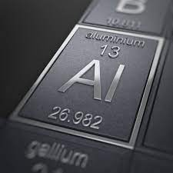
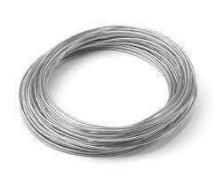
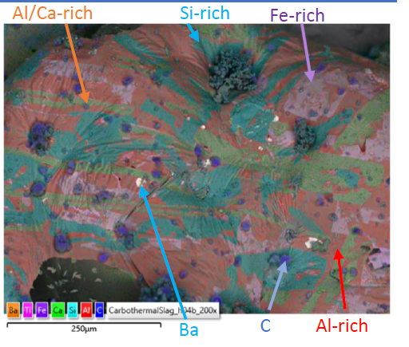
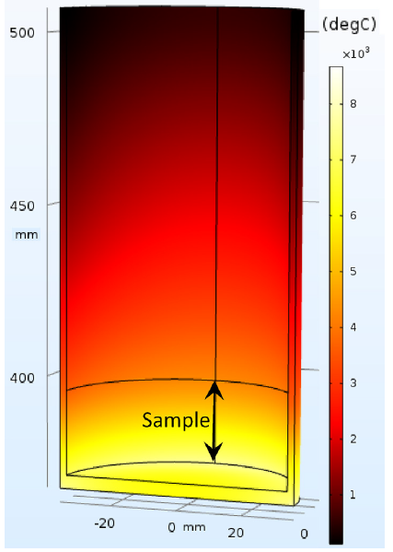
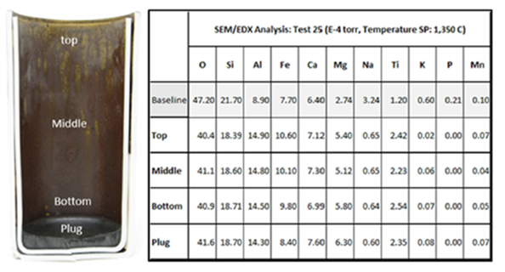
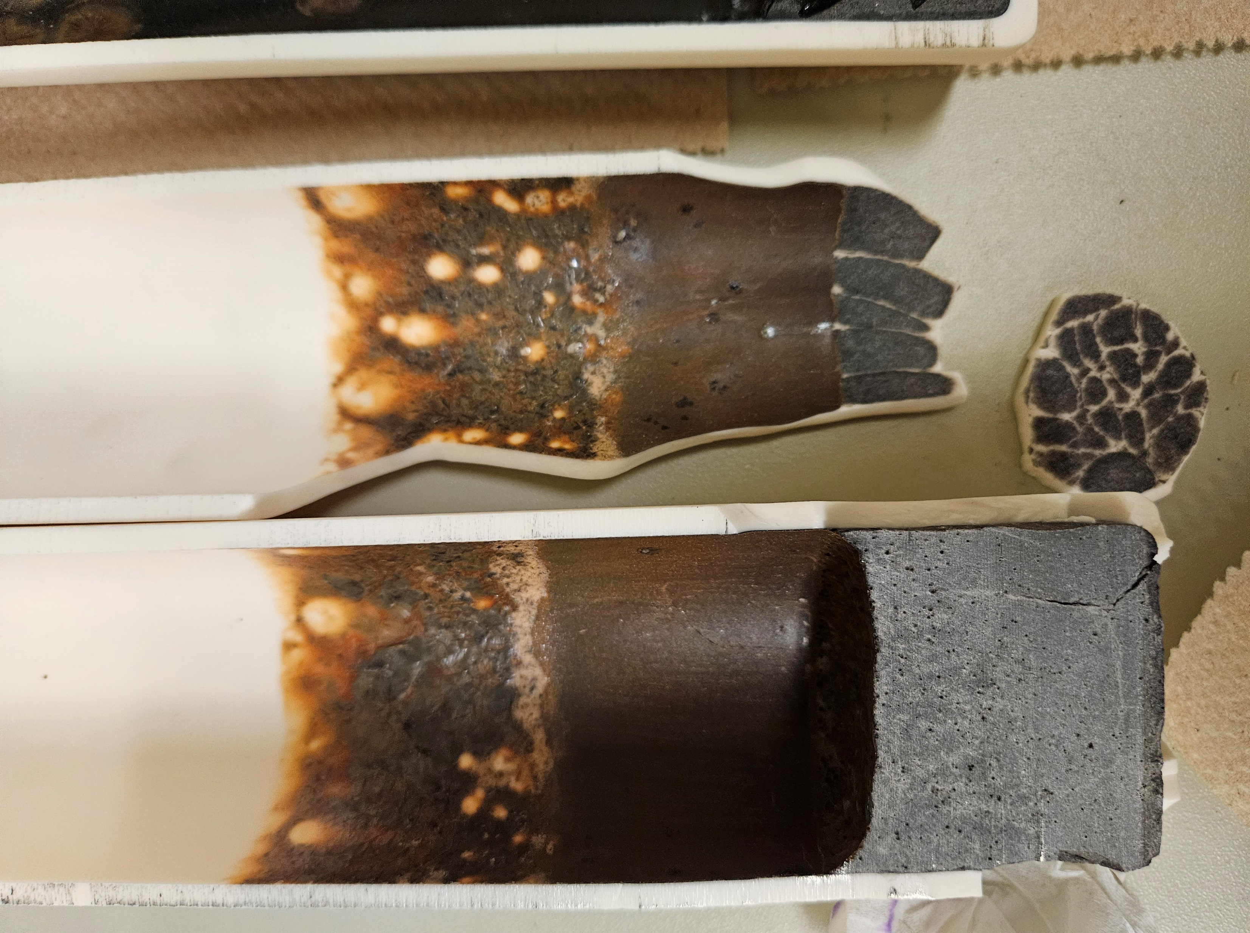
Metal Extraction Lunar Technology from Carbothermal Reduction (MELT-CR)
Christopher Henry, Lorlyn Reidy, Kagen Crawford, Will Evans
Abstract: Large metallic infrastructure components on the Moon are currently cost prohibitive due to the expense of transporting mass to the lunar surface. Astrobotic has quoted upwards of $1.2 million dollars per kilogram of payload to the surface. Advantageously, however, aluminum is present in great quantities as aluminum silicates on the lunar surface. And because aluminum is ductile, highly conductive, and amendable for advanced manufacturing processes such as wire fed directed energy deposition (DED), if it can be refined from regolith, its utilization can enable cost-effective, on-surface manufacturing of metallic infrastructure. The goal of project is to develop the core processes and technologies to extract aluminum from Lunar regolith and refine it into wire feedstock from a carbothermic reduction process.
Extraction processes of oxygen from regolith under development include carbothermal, molten regolith electrolysis (MRE), ionic liquids, and others, all of which result in a metal slag byproduct. The separation of some of these metals from the slag byproduct have been accomplished at small scales. However, no system exists at present that can extract aluminum from an oxygen extraction process at scale into suitable feedstock for manufacturing.
Surface Tension Driven Metal Separation.
End Products
The Marangoni Effect:
The Marangoni effect is a phenomenon manifested for well-established technologies such as welding metals and manufacturing integrated circuits. The Marangoni Effect is a fluid transport phenomenon driven by surface tension gradients created by concentration and temperature variation along the interface between two phases: preferably a solid and liquid phase. This phenomenon can be observed as the “Tears of Wine” which is frequently observed as a ring of wine, volatile ethanol, that forms near the top of wine glasses which, upon condensing at the end of the temperature gradient, forms droplets that fall back into the wine. Similarly, this effect applies to metals if they are in a similar thermodynamic state where the metal exists as liquids.
Delivering 1 200kg truss tower to the lunar surface costs 240 million dollars alone in payload mass. ISRU based manufacturing is the only pathway for sustainable lunar infrastructures
Notional 200 kWe solar power module. (Matt Mehlin, Polaris TLT Project)
Representation of aluminum wire for process such as wire fed DED.
Metal Separation Potential:
it was determined Marangoni Effect could serve as a potential aluminum refining technology capable of separating aluminum from iron, silicon, and other elemental metals upon evaluating the test results from lunar regolith transport phenomena. The dimensionless Marangoni Number (Ma) implies that this process can be tuned to separate metals by varying thermodynamic properties
Optical image of slag material provided by Sierra Space produced from a carbothermal reduction process (top) and . SEM and chemical map highlighting various compositions. (bottom)
Model of the thermal gradient in the crucible to induce the Marangoni flow (left), the resulting film using JSC-1a simulant resulting in increased iron concentration at the top of the crucible (middle) and LHS-1 simulant processed at 1550°C.

