Slide 1

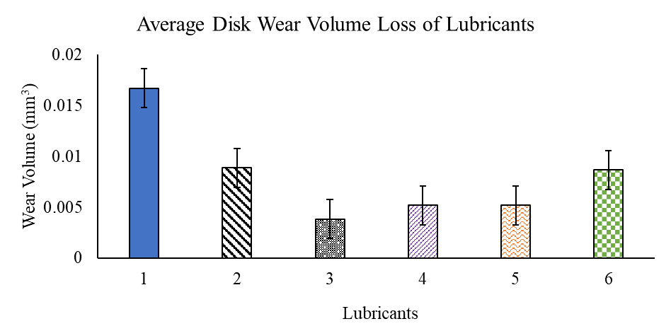
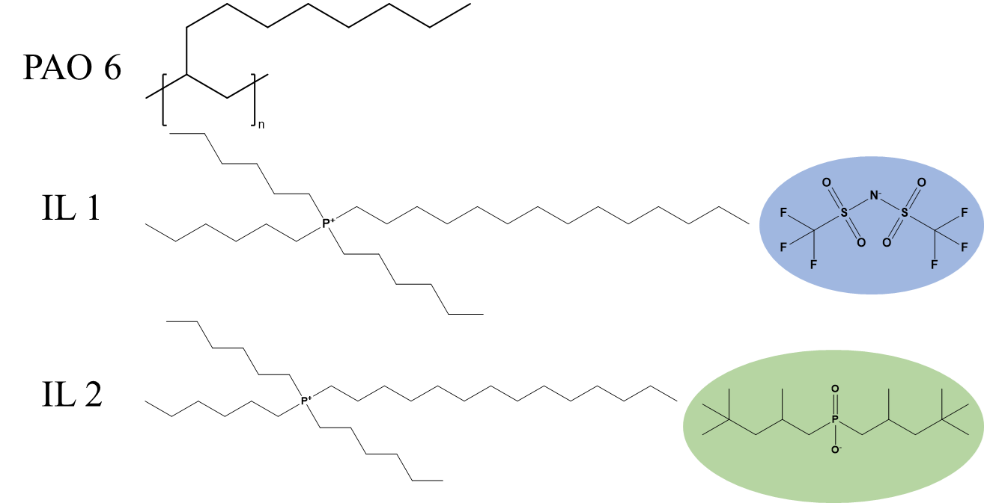
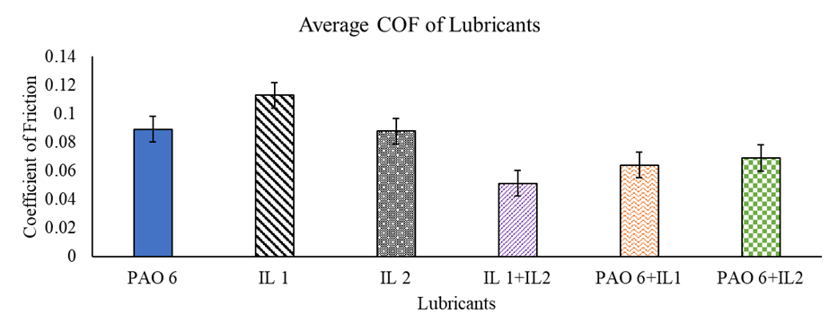
Non-Fluorinated Ionic Liquid Wear and Friction Performance
Kyle I. Williamson, Annette Gray, Kevin Yong, Jared Averitt, Yirong Mo, Daniel Herr, Micheal Dube, Christopher Henry
Lubricants are critical in achieving sustained operational milestones for the Moon and Mars mission.
Material obsolesce of fluorinated lubricants may soon pose risk for certain space systems
Ionic liquid lubricants can outperform the SOA lubricants for many applications
Chemical structures of PAO 6 and the ionic liquids studied in this work. Both ionic liquids have the same cation, but IL 1 has a fluorinated anion (blue highlight) while IL 2 has a non-fluorinated phosphinate anion (green highlight).
Our work suggests that a non-fluorinated ionic liquid IL-2 is also viable and outperformed the fluorinated ionic liquid IL-1 in the conditions of this study.
Our results and along with literature values suggest an ionic liquid lubricant can be successfully developed and qualified for flight. However, more rigorous testing and development is required.
Average tribological performance using ball-on-disc sliding 5 mm 440C steel balls, aluminum conventionally manufactured (CM) discs polished to an average surface roughness value of 0.24 µm to conform to ASTM G99, RPM of 63.66 at test radius of 3 mm (equal to sliding speed of 20 mm/s), and a run time of 1440 s (equivalent to 1,527.84 rotations).

