Slide 1

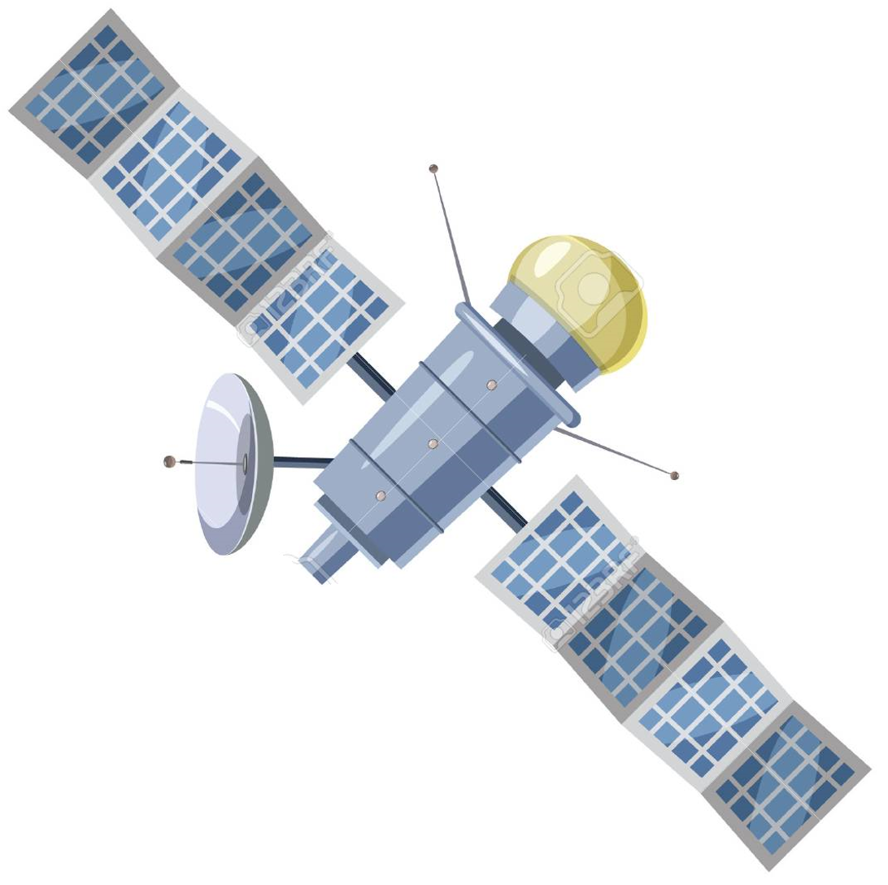
Automated Space Link Connectivity (AutoCon)
HP20 Payload & Mission Operations Division
Gayleen Ijames (HP26), Ramon Pedoto (HP25), Jeff Lippincott (HP25), Andrew Cecil (HP27)
A ground system solution that automatically connects to ground stations and executes pre-defined commands and file operations based on a contact timeline.
Huntsville Operations Support Center
Satellite/Spacecraft
AutoCon
Lunar Utilization Control Area (LUCA)
Telescience Resource Kit (TReK) Server
Ground Station Schedule
TReK Planning
TReK Automation
User (Windows)
TReK
Web Server
* Status & Control
* Messages
EPC
1
2
Ground Station (SCaN)
TReK SLE Proxy
TReK Telemetry & Commanding
6
Browser
TReK Desktop
Telemetry Status/Uplink Commands
3
4
AEON Front End Server
5
AEON Portal
Files
Recorded
Files
DAX
Automation Flow
Other Features
3
TReK provides framing and SLE support and makes the SLE bind/connection to SLE Network using CCSDS.
1
TReK Planning interface will ingest contact schedule and create a timeline template for contact events including start and stop times.
Remotely view significant messages from vehicle.
Remotely perform system administration tasks (for privileged users).
Manually command and create rich Telemetry displays using EPC/TReK Desktop.
Create timelines that align commanding and file operations with contact passes.
4
TReK Telemetry & Commanding will process downlink data for data storage and retrieval.
2
TReK Automation software will be launched prior to the pass to begin automated pass. The following functions will be performed during the pass (at a minimum): receive, monitor and process telemetry, send e-mail/text for out of limit condition, send commands and log all activities performed during the pass.
5
Stored data will be accessed through the AEON Portal.
6
Downlinked telemetry data will be made available in LUCA for Users to access.

