Slide 1

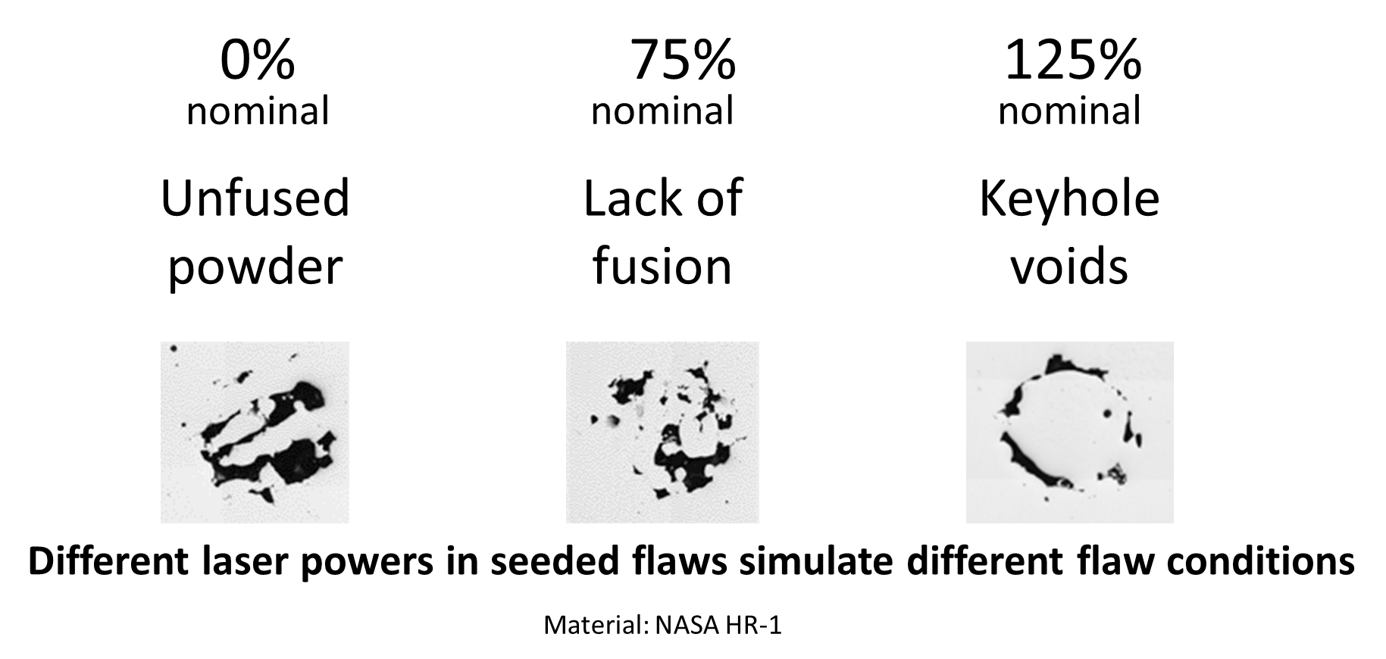
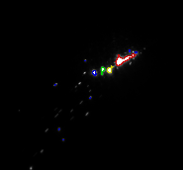
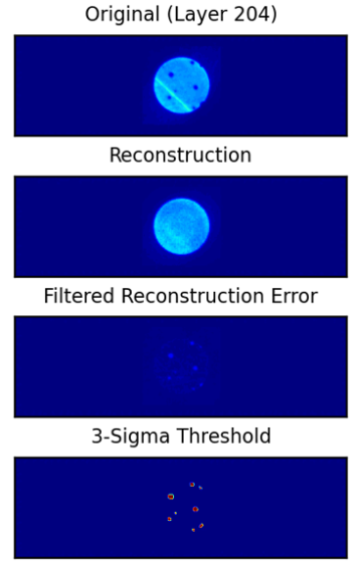
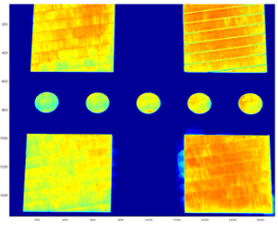
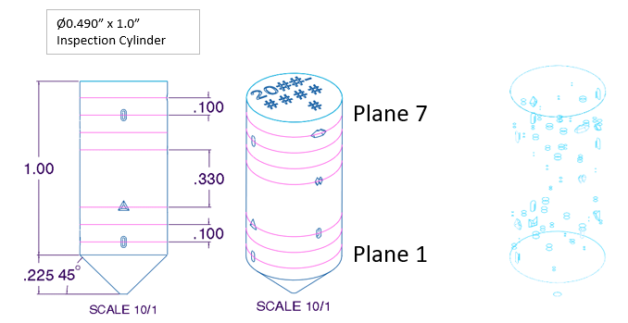
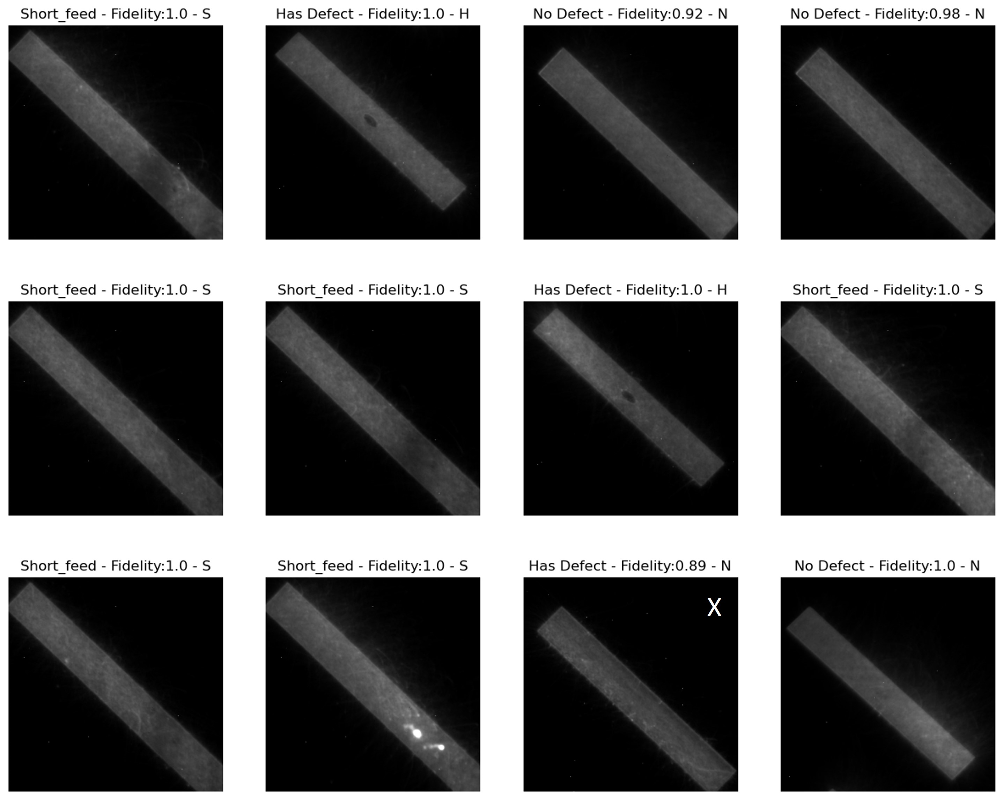
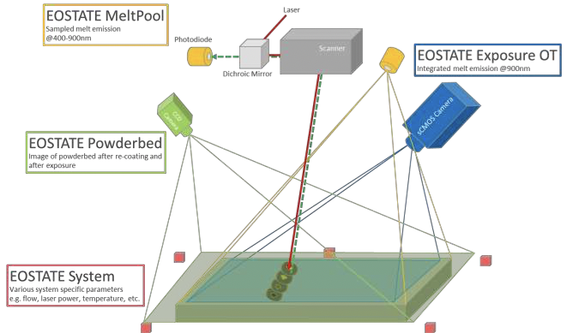
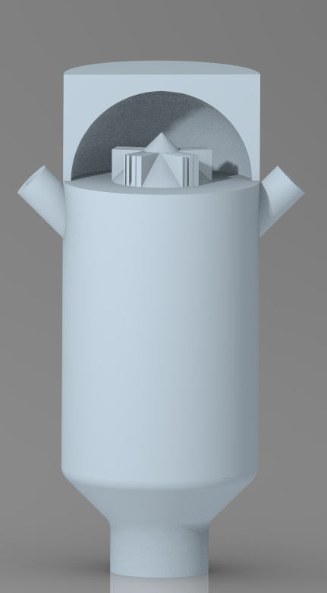
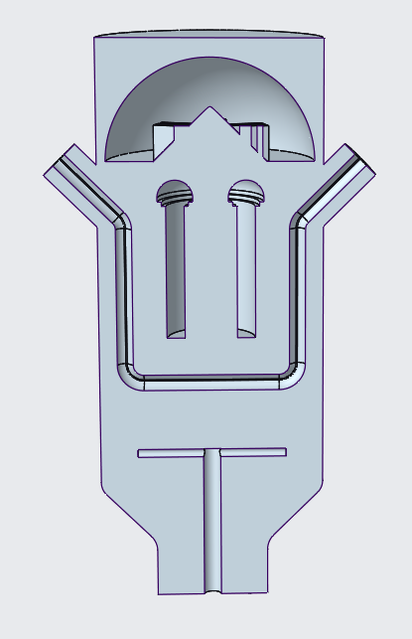
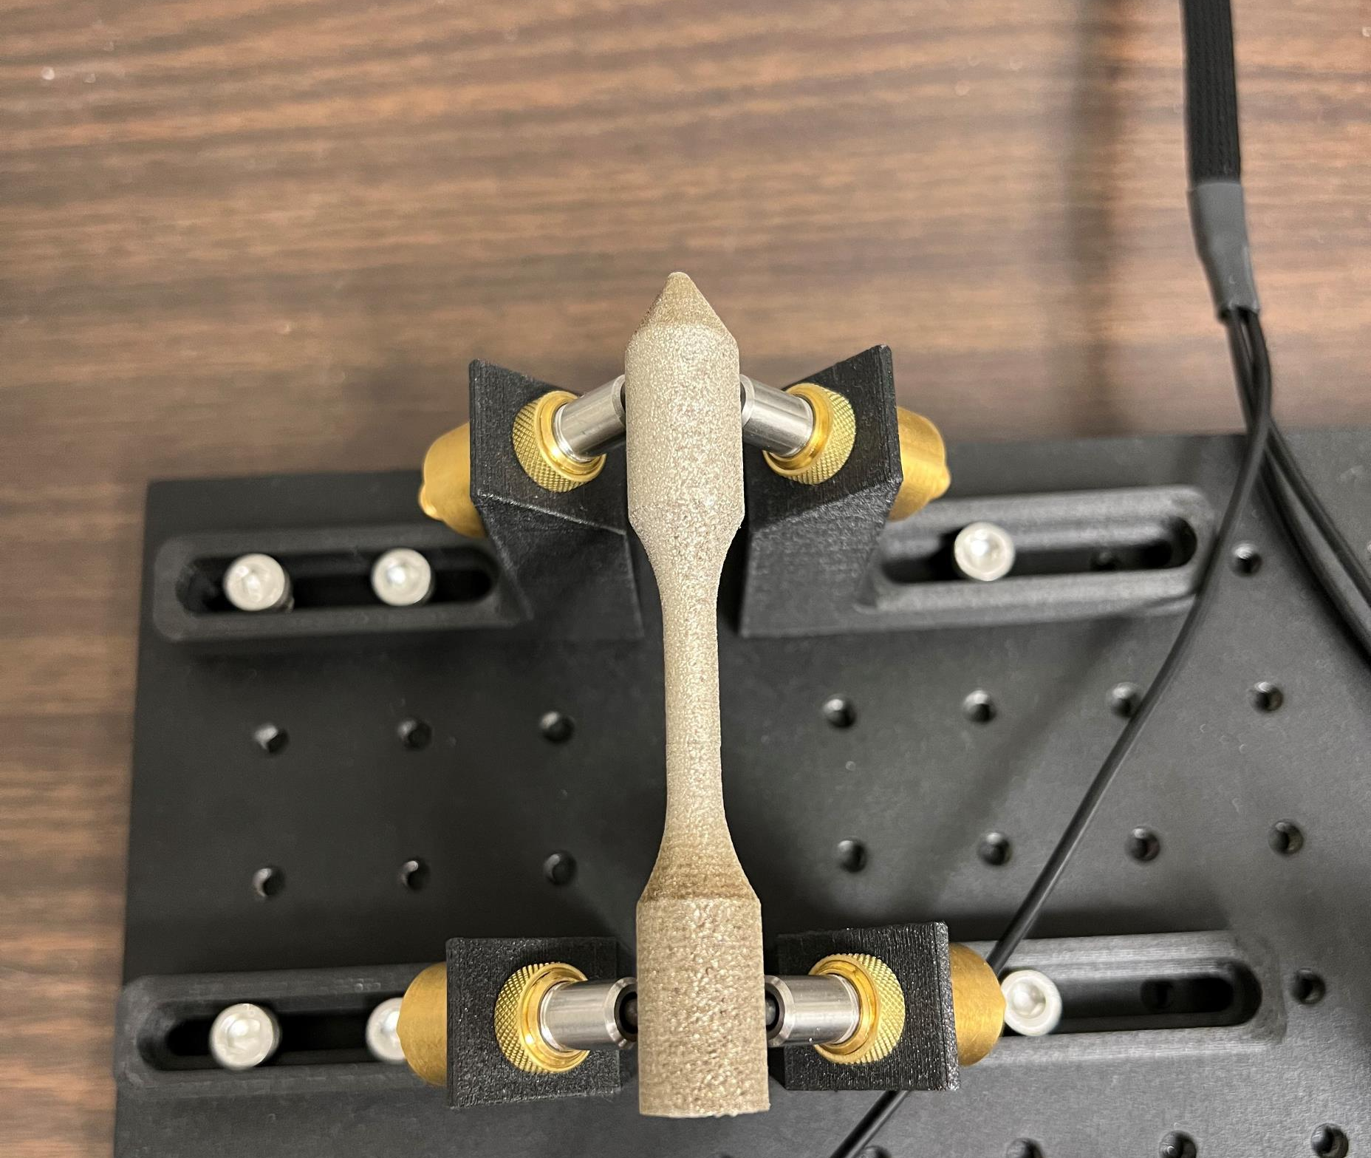
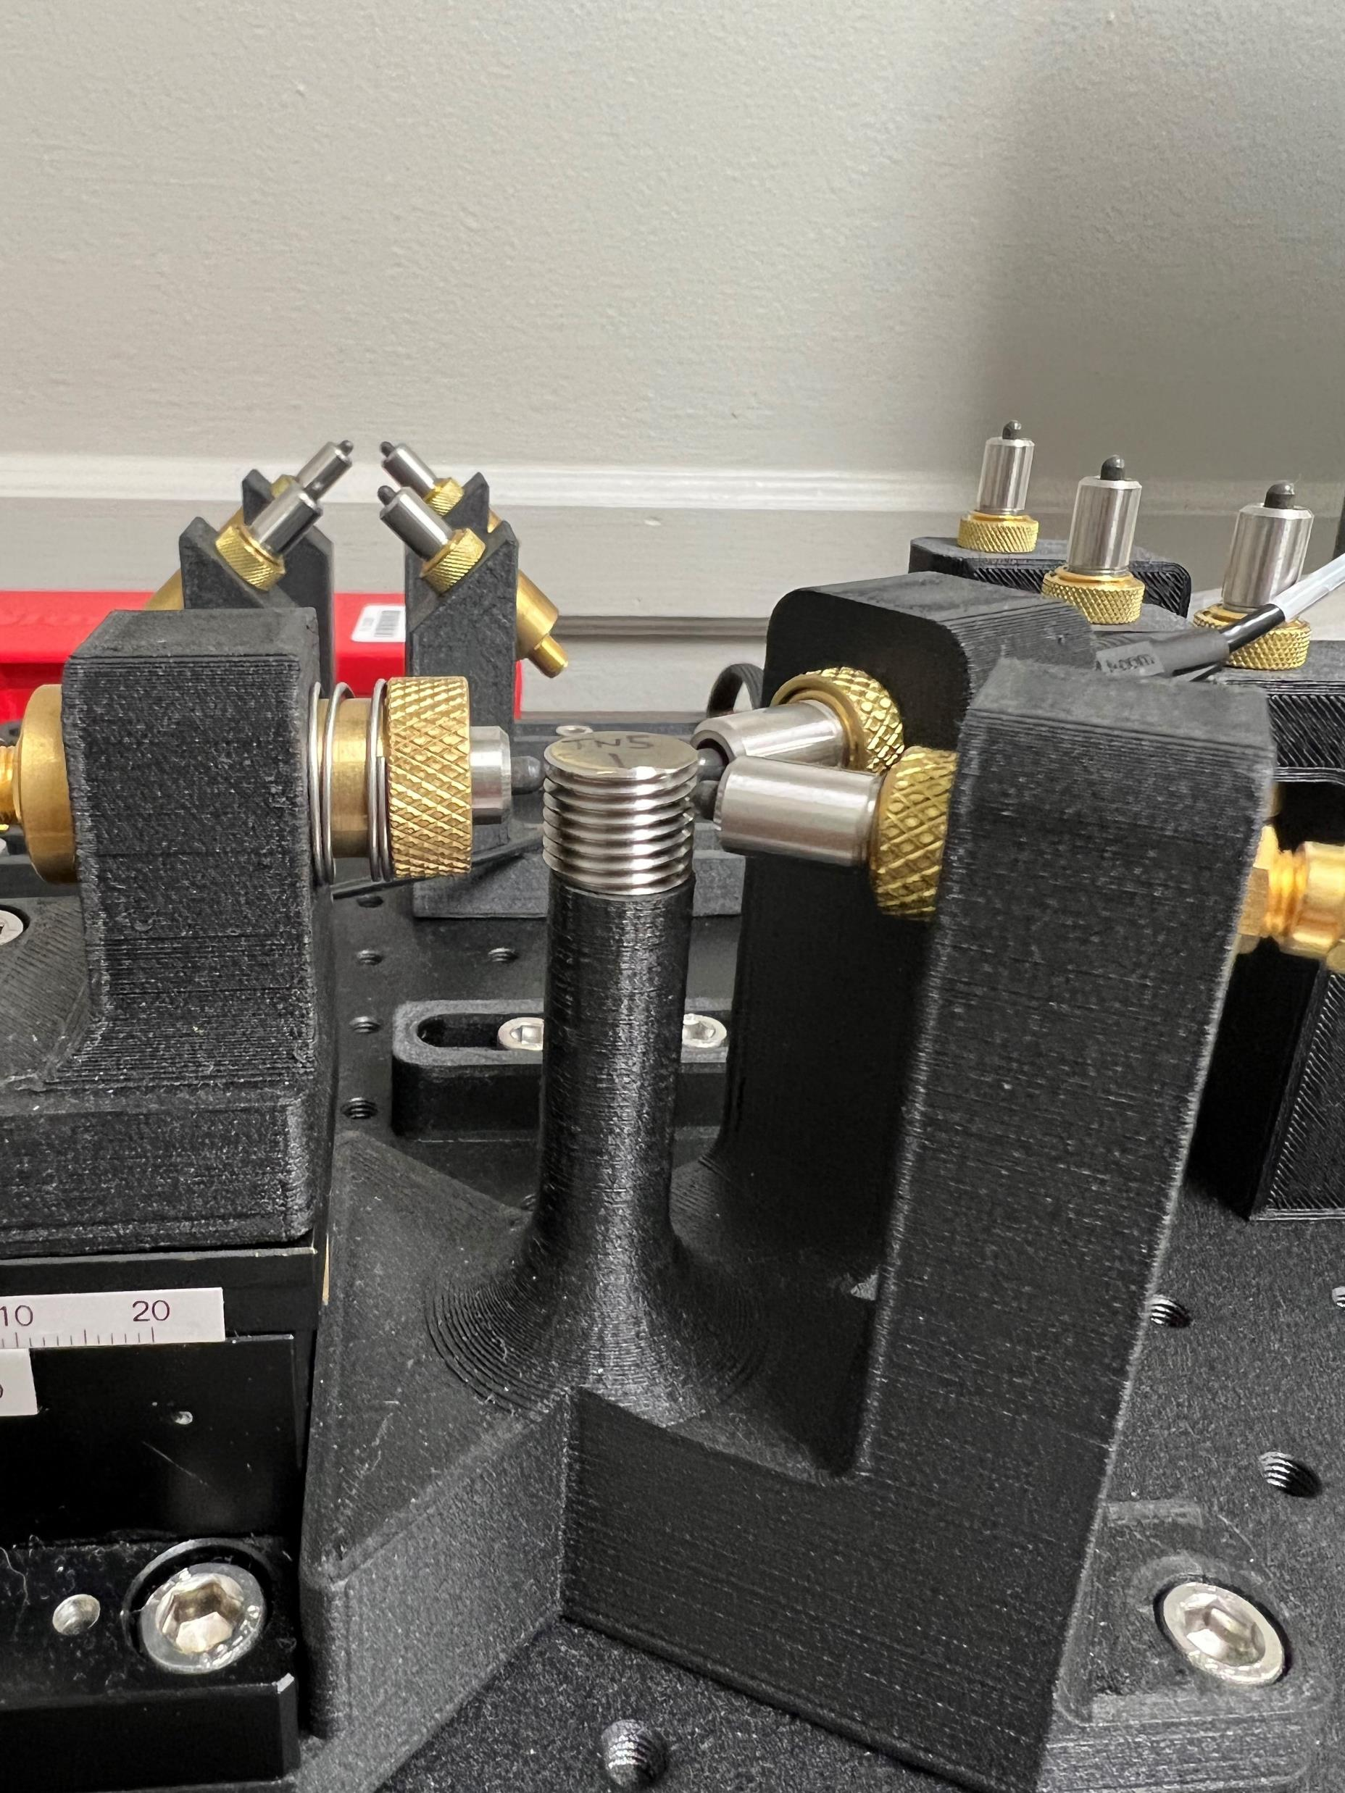
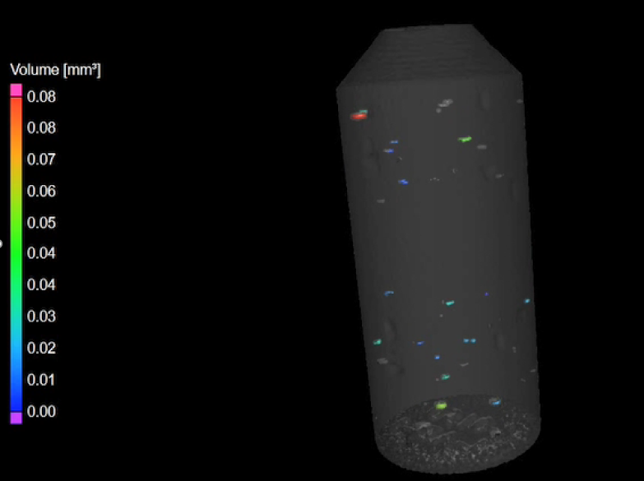
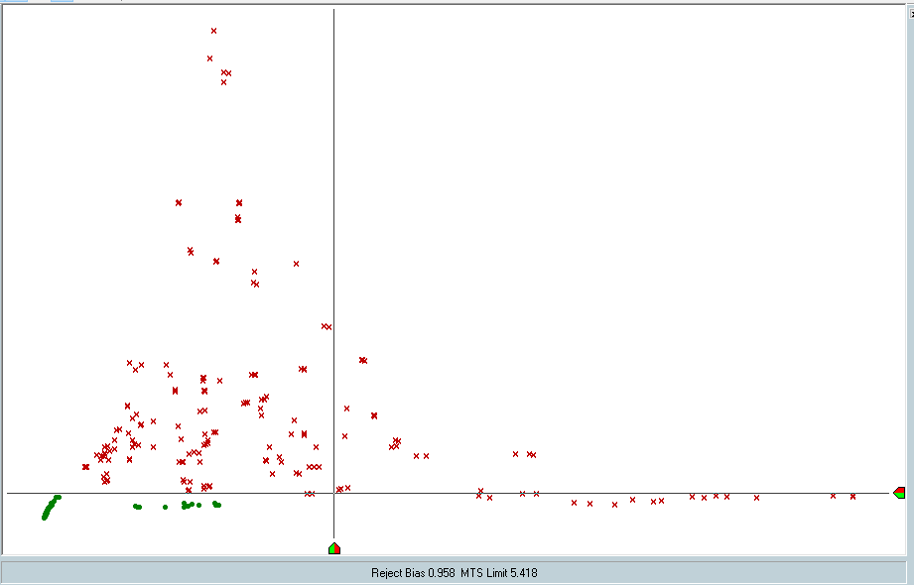
NONDESTRUCTIVE EVALUATION AND IN-SITU MONITORING EFFORTS FOR ADDITIVE MANUFACTURING
NASA Marshall Space Flight Center, Nondestructive Evaluation Team
James Mavo, Erin Lanigan, Delphine Duquette, Daniel Vaughan, Jibrail Muhammad Jr.
INTRODUCTION
SEEDED FLAWS
IMAGE ANALYSIS
Nondestructive evaluation (NDE) is required to determine the quality of additive manufactured (AM) parts due to the inherent variability of AM processes. In-situ monitoring technologies endeavor to characterize the process and part quality during production. Qualifying an in-situ monitoring technology requires a proven, causal correlation between indications in the monitoring data and flaws in the finished part.
Early efforts to qualify monitoring systems for laser powder bed fusion (LPBF) AM have used seeded flaws, that is, changing the laser power in select regions to induce flaws in the part. These changes in laser power show up very well in the monitoring data but are not representative of a true flaw.
Algorithms including machine learning are used for automated analysis of in-situ monitoring and CT images for flaw detection.
Algorithms in use at MSFC include:
Convolutional neural network (CNN)
Convolutional autoencoder (CAE)
VG Studio Porosity/Inclusion Analysis
AMSENSE Spat-Trak
Ejecta
Anomaly
Melt pool
IN-SITU MONITORING
Technologies in use at MSFC:
Laser fringe projection height mapping
Optical tomography
Melt pool monitoring
Thermal tomography
Spatter imaging
Layer imaging
Potential Anomaly
Thermal Tomography
Seeded flaws located randomly throughout a build volume
GEOMETRICAL CHALLENGE BUILD
Automated data analysis workflow
The next phase of testing includes developing a geometrical challenge build to induce more realistic flaws for characterization with in-situ monitoring and post-build NDE.
PROCESS COMPENSATED RESONANCE TESTING
EOS In-Situ Monitoring System including Optical Tomography and Melt Pool Monitoring
Process compensated resonance testing (PCRT) is an NDE method that can detect anything that changes the stiffness of a part by comparing the resonant response of parts with the same geometry and material.
NONDESTRUCTIVE EVALUATION
Technologies used at MSFC for AM:
Radiography (x-ray)
X-ray computed tomography (CT)
Eddy current
Dye penetrant
Ultrasonics
Process Compensated Resonance Testing (PCRT)
Types of flaws detected:
Trapped powder
Voids, porosity
Cracks
Test setups showing the transducers in contact with the part
Geometrical challenge build design
VIPR analysis can separate good parts from bad parts. It requires a robust data set of known good and bad parts to train the algorithm to detect resonant responses that are similar to the good parts and dissimilar to the bad parts, or vice versa.
Features of interest include:
Overhangs
Thin walls
Transitions in thickness
Internal channels
Cone
Concentric circles
Vertical and horizontal holes
Stepped brick
The goal is to induce flaws in the part without changing the build parameters by pushing the boundaries of the nominal processing window. The result will be a standardized artifact that can be built on any LPBF AM machine to qualify the in-situ monitoring system.
Computed tomography (CT) image of skipped layer flaws
VIPR analysis showing separation of good and bad parts

