Slide 1
Challenges in Safe Remote Operations: Lessons from Aerospace
Alwyn E. Goodloe
a.goodloe@nasa.gov
Natasha Neogi
natasha.a.neogi@nasa.gov
Lara Humphrey
laura.r.humphrey@nasa.gov
NASA Langley Research Center

Slide 2
Introduction
I will be discussing several issues that arise in remote operations
Remote operation has a long history at NASA
  Not always in a safety critical setting
The presentation is intended to elicit discussion so feel free to interrupt

Slide 3
Flavors of Remote Operation
Can conceive of a range of operational paradigms for remote operations. For example:
  Remote assistance, e.g., by a service provider to provide support and assistance
  Remote management, e.g., to allow a remote controller to assist when a systems requires authority to progress in its mission
  Remote control e.g., could extend from limited system guidance (of high-level functions) to full remote control of system (with associated delays)

Slide 4
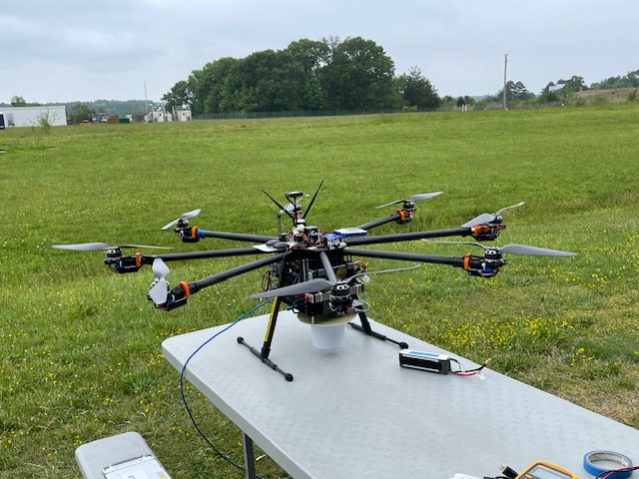
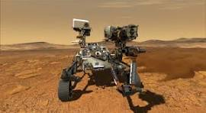
NASA’s History with Remote Operations
Aeronautics directorate has been flying uninhabited aerial systems (UAS) for many years
  Significant restrictions (e.g., pilot line of sight, restricted test ranges, etc.)
Space exploration has decades of experience at real remote operation
  Safety is a minimal concern

Slide 5
Characteristics
A system is monitored and controlled by operators located at such a distance that they cannot physically intervene to correct issues that may arise
Reliable communication between operator and system is critical
The operator needs to maintain situational awareness
  Systems sensors
  External sensors (ground-based RADAR)
  Line of sight

Slide 6
Hazards and Threats
Both hazard and threat analysis must be conducted
  Often ignored by those new to safety-critical domains
Critical components will break and do so in malicious ways
  Byzantine faults vs crash faults
Communication will fail
  How are you going to handle loss of communication and control
There will be malicious actors who will attack your system
  NASA doesn’t do research in security
  The expertise resides in DoD, Homeland Security, etc.

Slide 7
Space Exploration I
NASA remotely operates deep space probes, orbiters, and rovers across the solar system
Not safety critical
Missions last years or even decades
Little or no redundancy
Limited computational resources and no cryptography

Slide 8
Space Exploration II
Communication is irregular, as NASA loses contact with space probes on a regular basis, so it is built into the operations
  Automation compensates for temporary loss of comms
  Permanent loss of communication -> loss of mission
Pace of operations is typically very deliberate (slow)
  Rovers may move a few meters a day
There is a quiescent mode that the system can default to
Rebooting is a common solution
These solutions may not translate to earthbound setting easily

Slide 9
Humans in Space
Space is a very unforgiving environment in which to operate
Mixed crew and remote operations
  Astronauts are often part of the “remote operations” by doing prescribed tasks
Remote operations are planned and analyzed on ground
  JSC has extensive simulation facilities
Astronauts can compensate for lost communication
NASA’s planned Lunar Gateway will have long periods when it is unoccupied, so it will be remotely operated during those times
  A lot of automation is planned, and details are being worked out
Robonaut program is an example of addressing challenges of robotic systems operating in close proximity to humans in space
  The robotic limbs are engineered not to damage space suits

Slide 10
Remote UAS Operation
Pose a danger to people on the ground and other vehicles in the air
Often restricted to operating within line of sight
Typically fly predefined routes
  Less complex environment than cars
Even mid-size UAS typically lack hardened/redundant systems
Communications with the ground and GPS are both unreliable

Slide 11
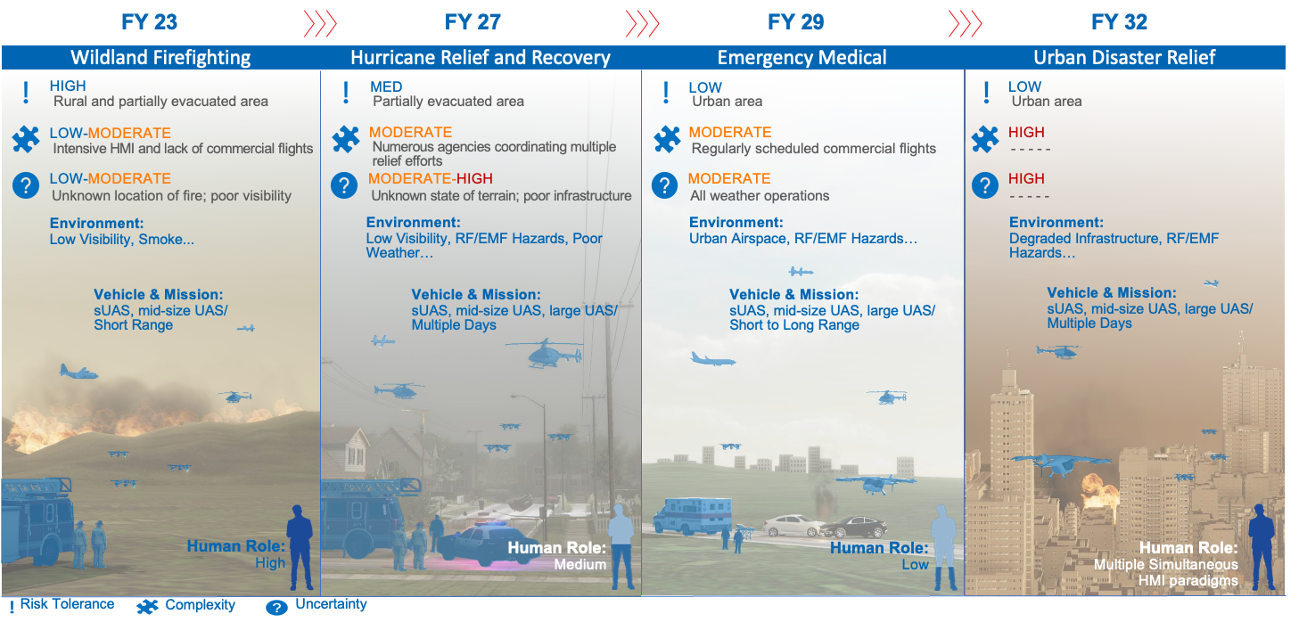
Example: Disaster-Oriented UAS Remote Operations

Slide 12
Criticality Creep
Criticality creep occurs when high-criticality functions are misidentified and treated like low criticality functions
  Sometimes a function starts as a low-criticality function but becomes high-criticality when the scope or operation of the system changes through the life cycle
  Often there is a cost incentive
What decisions/computation must be done on vehicle and what can be done on a ground station or in the cloud?
We are increasingly seeing potential critical functions being proposed to be done in the cloud
Systems and safety engineers need to be on guard against this

Slide 13
Robust Systems Needed
Remote operations is often predicated on a mental model “operator sends command, command received, command executed”
Operators expect to trust the data coming from the uninhabited aerial vehicle (UAV)
Operators not in line of sight of UAV and lacking external means of observing the system such as RADAR much trust the messages
Remotely operating systems are going to have to be constructed to be fault-tolerant

Slide 14
Secure Operations
Intercepting and hijacking unsecured UAS are well within the means of even relatively unsophisticated attackers
DARPA HACMS illustrated how to secure UAS against many common attacks
That sort of security remains rare for a number of reasons
  Workforce lacks skills and knowledge
  Embedded system hardware constraints
  The cost is viewed as prohibitive
    Often the instinct is to invest in ‘hot topics’ (e.g., AI, Large Language Models, etc.) which may not be useful to the operation

Slide 15
Unreliable Comms for UAS
Procedures -- call the FAA tell them you have a rogue UAS
Make full autonomous operation the fallback
Geofence – guarantee that vehicle will stay in a defined area
  NASA’s highly assured, rugged SAFEGUARD system
Automated collision avoidance
  Avoid touching paint
Automated self-separation NASA DAIDALUS
Task and path planning
ICAROUS – NASA’s framework for enabling autonomous operations
  Automation to land vehicle in predefined location(s) if comms are lost

Slide 16
Things to consider when opting for remote operations
The function allocation should focus on safety: A structured methodology should be used to allocate functions between onboard and offboard (i.e., ground/cloud-based) to improve safety and increase resilience.
Provide highly reliable and secure communications: Both safety and security must be considered in the communication link requirements.
Provide rich information: The information sent must be rich and in real time, and available to all agents to encourage a practice for double-checking.
Establish fault tolerance and redundancy in technical systems and/or human resources, as well as warnings: If redundancy is missing in safety critical elements, safety will be compromised. Establish a culture that encourages use of human redundancy when applicable for safety (e.g., 2 pilots in cockpit).
Consider the existence of a ‘quiescent/safe state’ and the pace of the operations when designing safety into the system: The ability to control, mitigate, and eliminate hazards will depend on whether operations can be interrupted with no safety- or mission-critical effects.
Notes:
For redundancy, Focus on both organisational redundancy and adaptability for things such as common safety goals, cooperation in change processes, clear responsibilities, technical and cultural aspects of communication, decisions in critical situations, routines and procedures for common work, common procedures and processes for readiness

Slide 17
Questions?
Contact Information:
Alwyn E. Goodloe
+1-757-864-5064
a.goodloe@nasa.gov

