Slide 1
HSI&E Design Influence
Human Systems Integration & Engineering (HSI&E) Team
NASA Marshall Space Flight Center (MSFC)
DoD HFE TAG
April 22-25, 2024

Slide 2
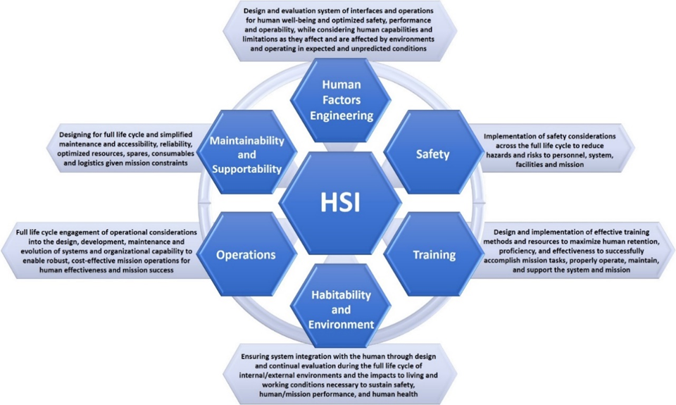
Human Systems Integration at MSFC
MSFC HSI&E
Functions
Safety, Training, and Operations knowledge exists at MSFC in other branches. EV74 also has extensive experience in Training and Operations.
*Humans/Human Behaviors: users/operators; ground controllers; monitoring personnel; trainers; integration and test personnel; manufacturers; maintainers; assembly personnel; logistics personnel; automation/autonomous systems that mimic human decision making and action (where humans provide the requirements).
NASA HSI Handbook

Slide 3
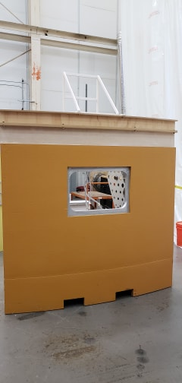
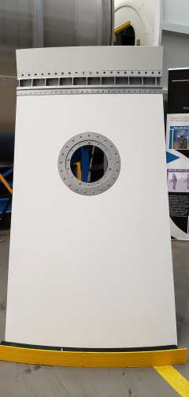
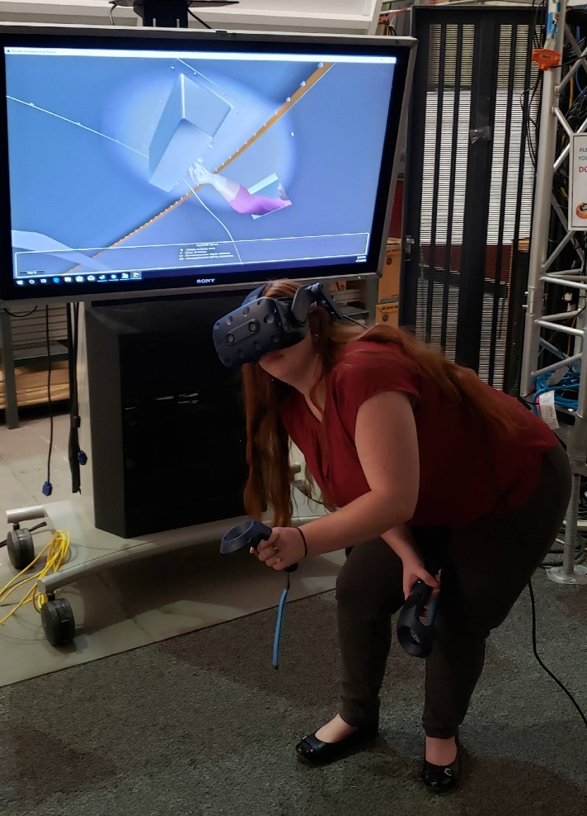
Human Factors Engineering at MSFC
EV74 is partnered with multiple projects to produce physical mockups and virtual environments of concepts and designs introduced for design evaluation.
Designers provide CAD models and requirements for the concepts that need to be produced.
HFE provides both physical mockups and virtual models to aid customers in their design.
By working with designs early in the life cycle, iterative assessments can be done to guide the design from an HSI perspective. This design influence saves cost and schedule, as well as reduces risk.
Physical Mockups
VR model

Slide 4
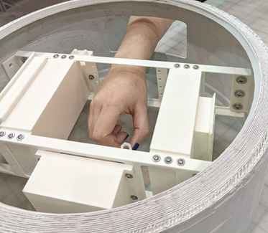
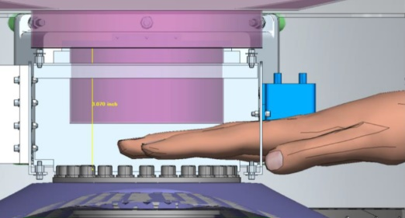
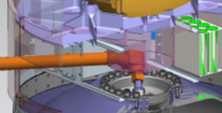
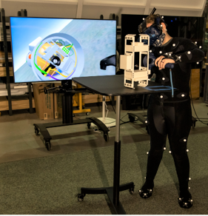
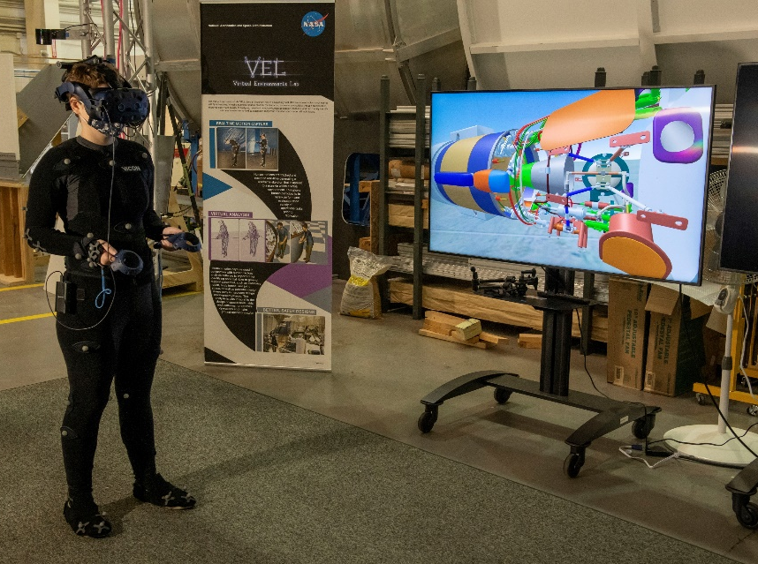
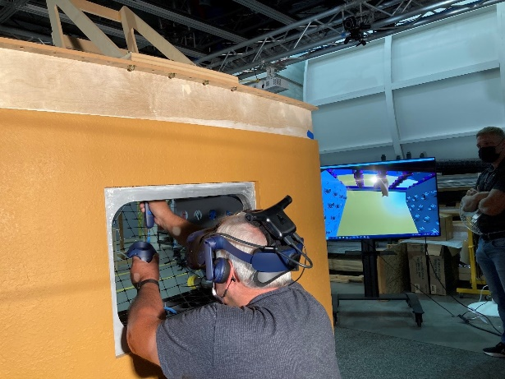
HFE Analysis Types
Physical Analyses use mockups to allow physical assessment of a design
Virtual Analyses using Process Simulate Human (PSH) to assess access, work envelope, reach, line of sight etc., for the required female and male percentiles, as well as, assessing tool fit and function.
25th Percentile Female
Mixed Reality Analyses merge real and virtual objects utilizing 3-D printed mockups within the VEL provides passive haptics and real dynamics to test subject performing assessment
75th Percentile Male
Virtual Reality Analyses allow users to interact with the model in a completely virtual world. This can be combined with Motion Capture to improve the assessment

Slide 5
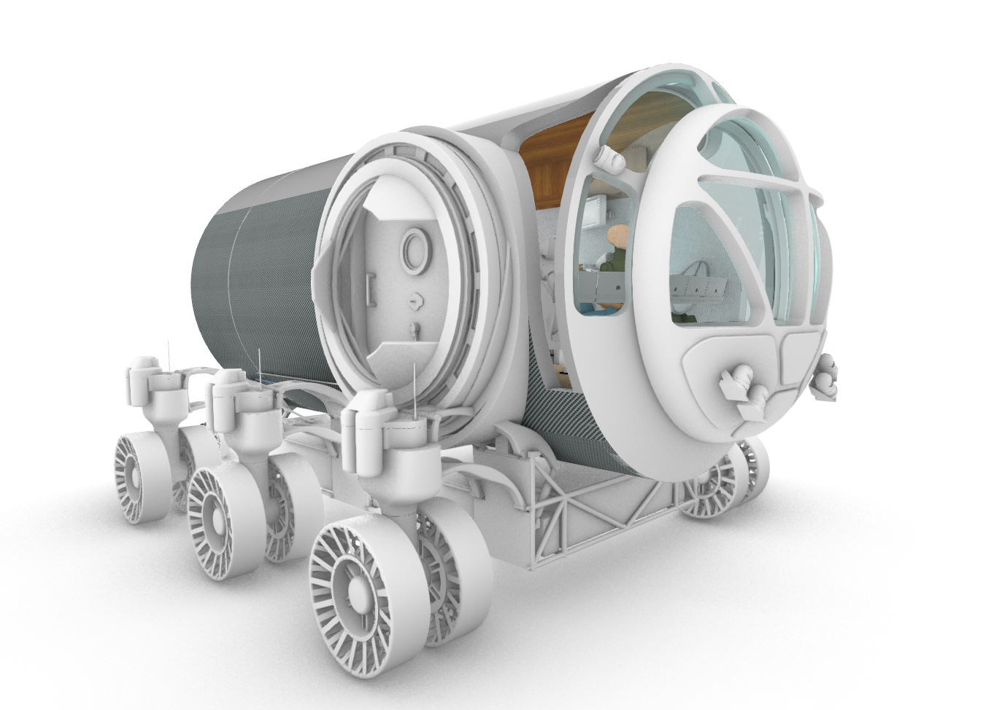
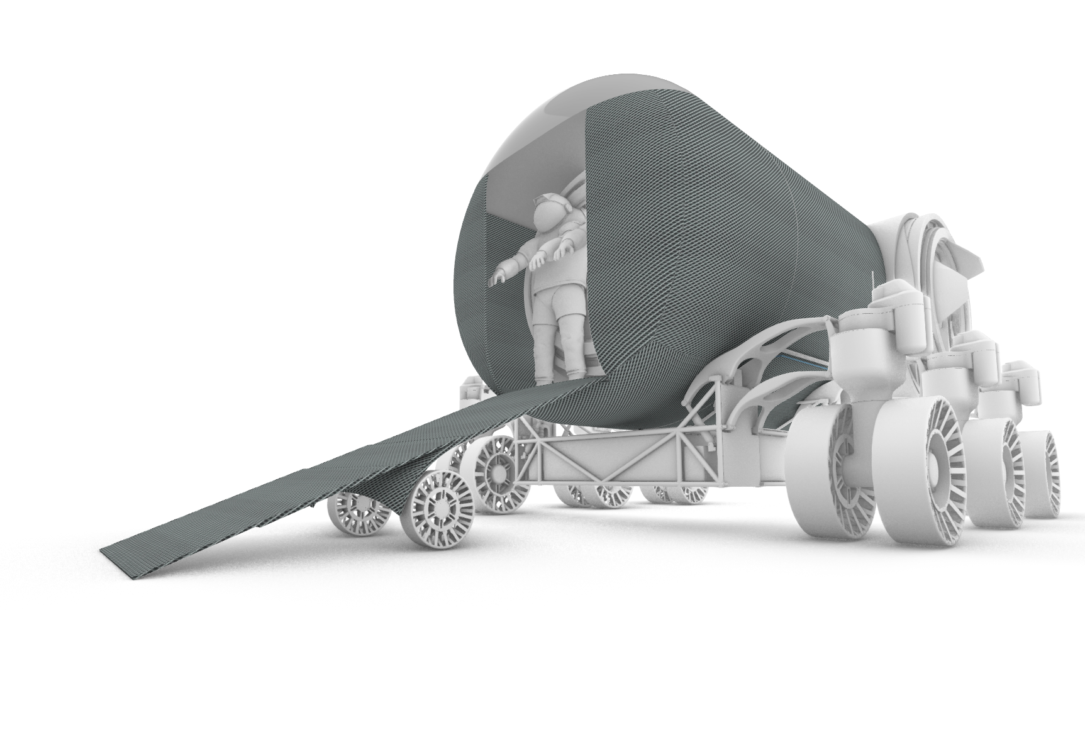
Advanced Concepts Development
Projects for ACO include the conversion of the existing Cygnus module to represent a Mars Exploration Mobile Laboratory.

Slide 6
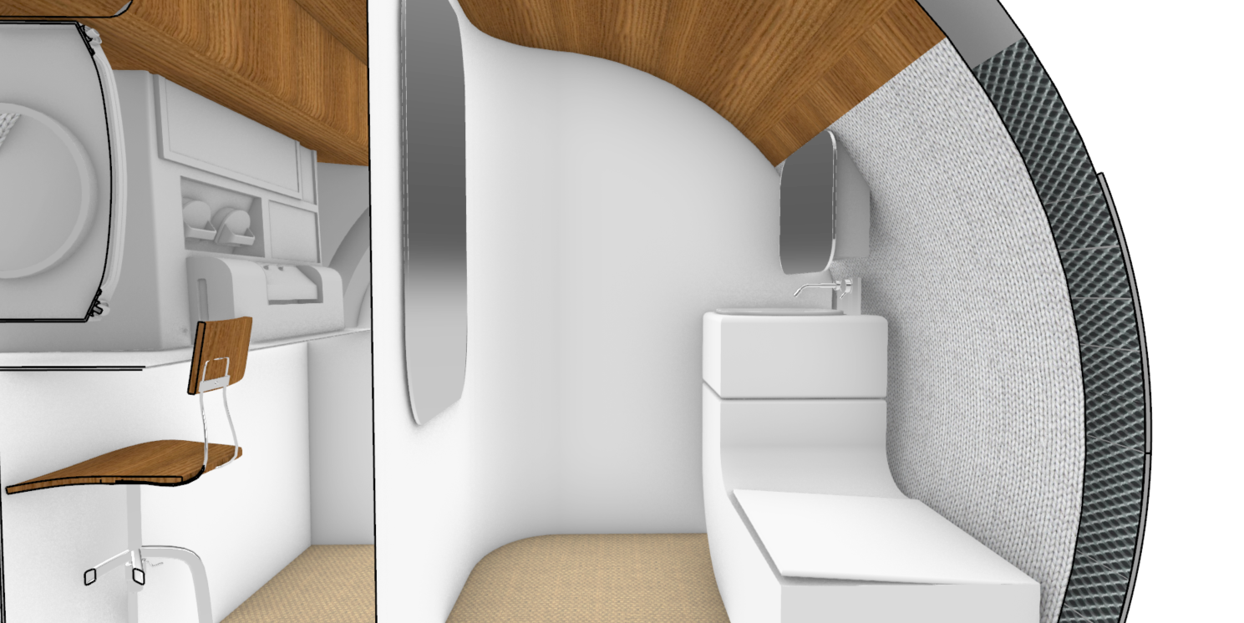
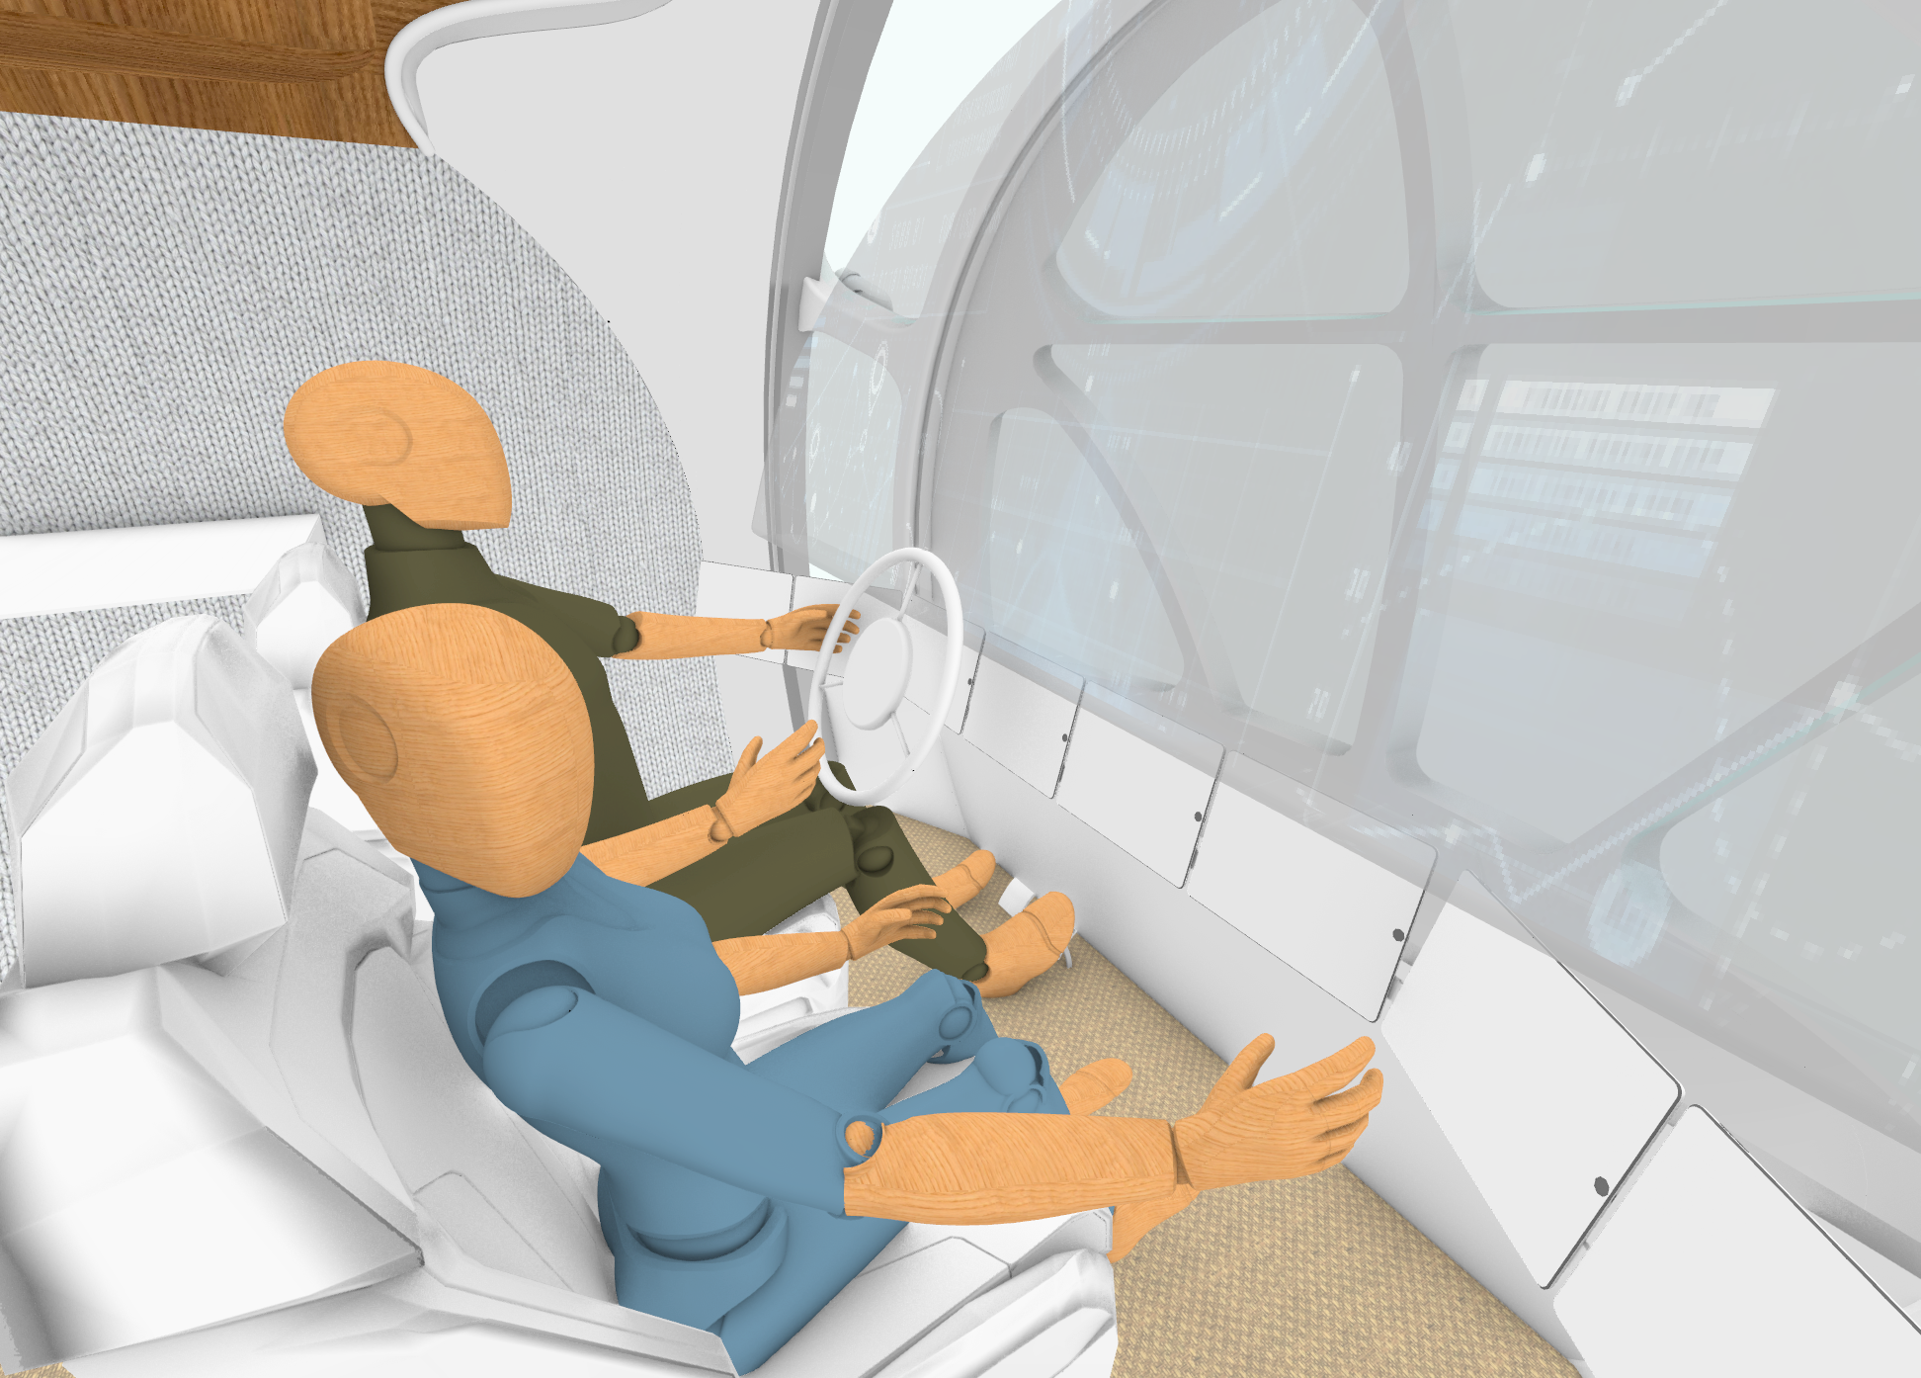
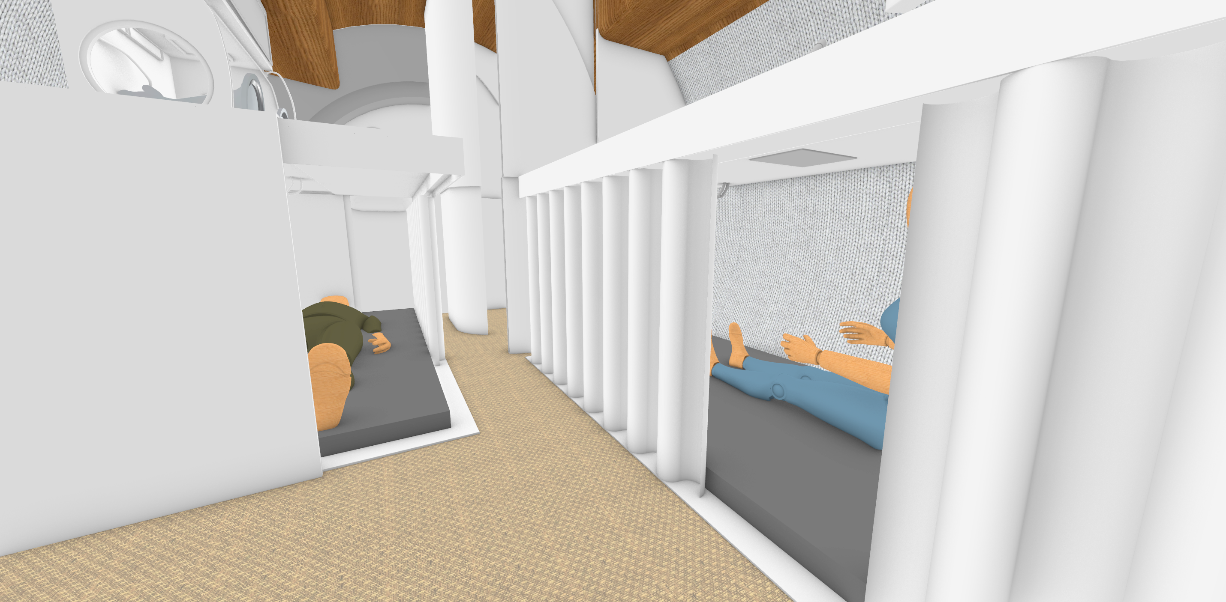
Advanced Concepts Development
Mars Exploration Mobile Laboratory Concept Mockup interior views
Work Area and Hygiene Station
Vehicle Control
Retractable Sleep Stations

Slide 7
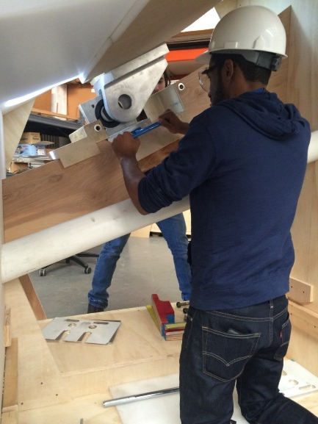
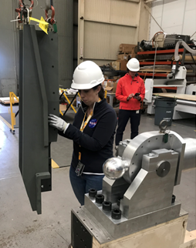
HFE Assessments using Part Task Mockups
The HFE team studies and analyzes many flight and ground system hardware designs. When initial analyses show areas of serious concern, a part task mockup can be constructed by the shop for a more thorough worksite analysis.
A full-scale mockup is developed representing the specific area of concern in very high fidelity. Other, non-problematic, elements of the mockup are built to be functional, but at a lower fidelity, for cost savings.
A human factors analysis is performed, working through all operations of the hardware. The hardware designers participate or are briefed on the findings. The physical mockup makes illustrating problems much simpler.
This process allows designers to make improvements to the design before fabrication starts.
Assessment of the Orion Stage Adapter Secondary
Payload Assembly Installation by 5th percentile Female

Slide 8
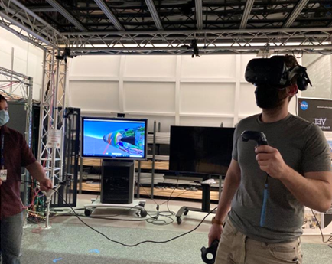
HF Analysis Using Virtual Reality
The EV74 Human Factors Engineering (HFE) Team has implemented virtual reality (VR) and motion capture (MoCap) into HFE analyses of various projects through its Virtual Environments Lab (VEL).
These techniques are being used for:
  Concept development for Deep Space Habitats (DSH)
  Design and analyses for NASA’s SLS
VR utilization in the VEL can be used to accomplish HF analyses of hardware designs in place of physical mockups. It can also be used to push the design to be better formulated before concept mockups are constructed, saving budget and time.

Slide 9
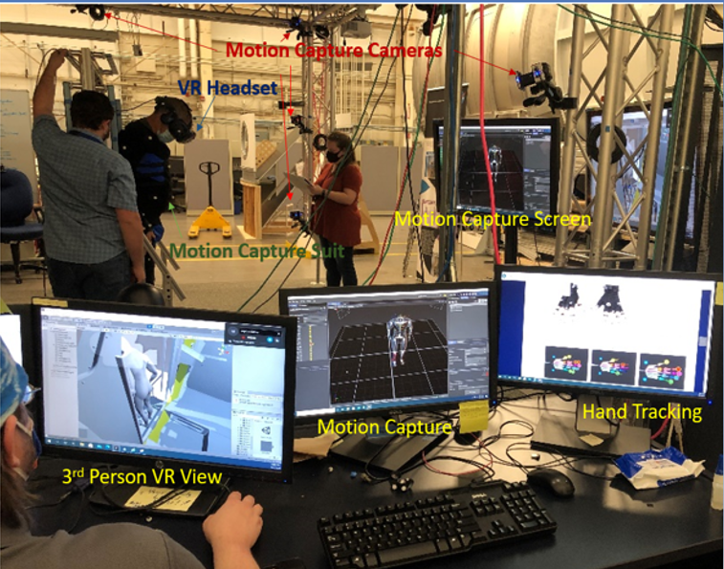
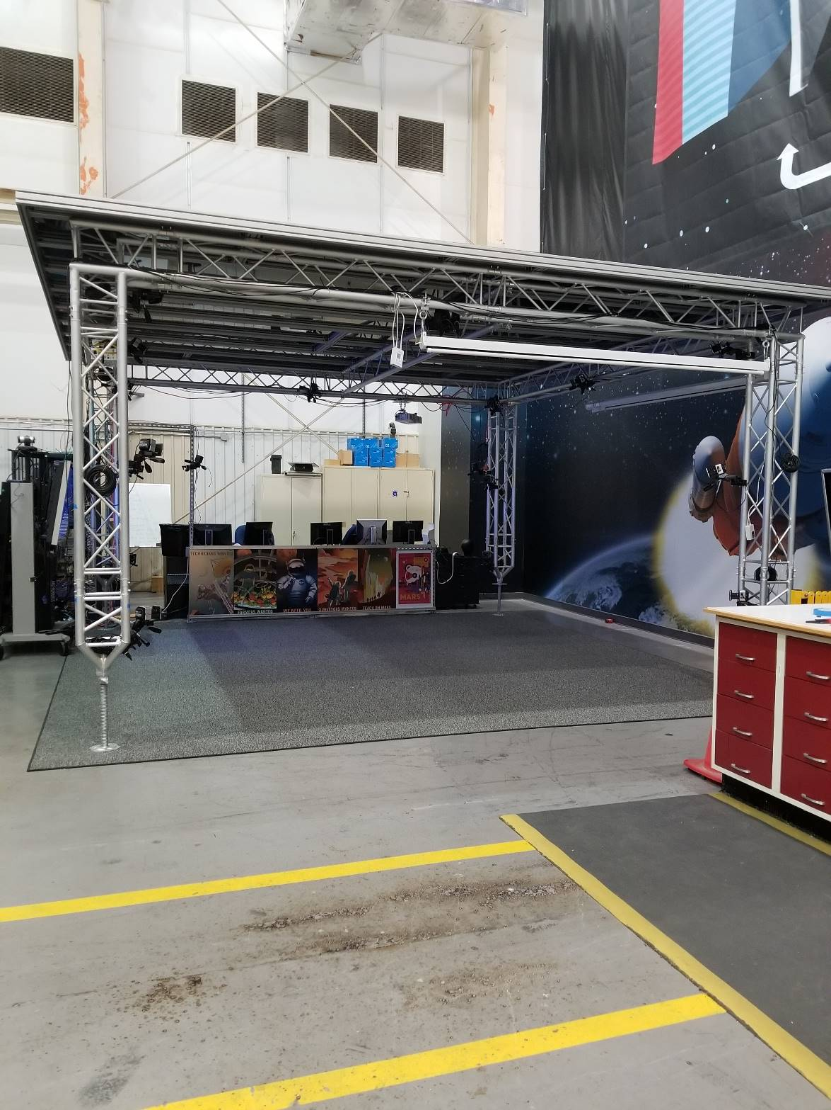
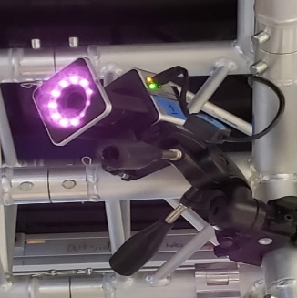
MSFC’s Virtual Environments Lab
16 Vicon MoCap Cameras

Slide 10
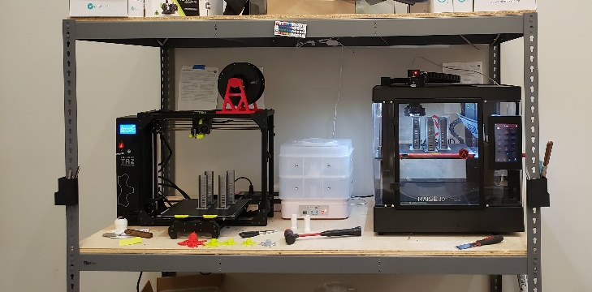
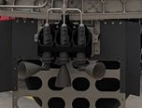
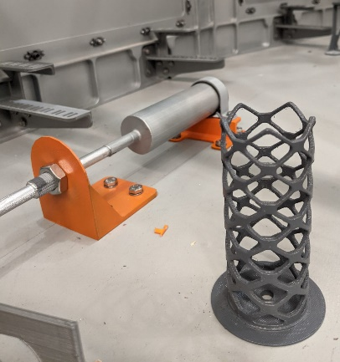
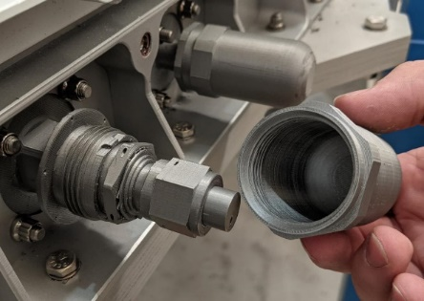
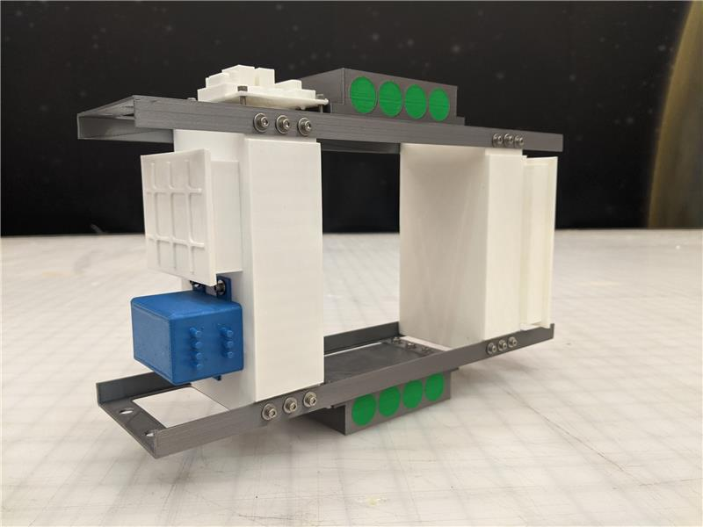
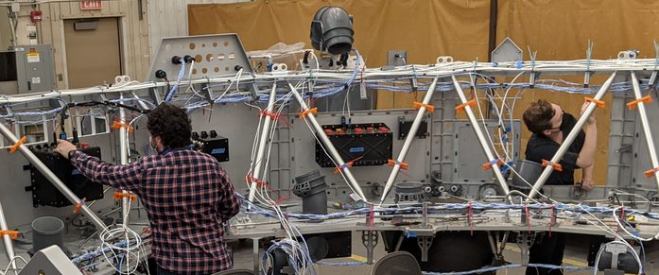
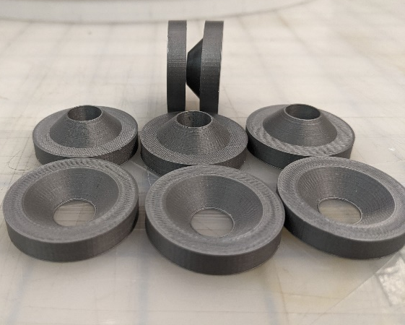
3-D Printing Capabilities
3D Printing Station
Printer | Print Volume
LulzBot TAZ Workhorse | 280 mm x 280 mm x 285 mm (11.02 in x 11.02 in x 11.22 in)
Raise3D Pro2 | 305mm × 305mm × 300 mm (12 in × 12 in × 11.8 in)
Detailed Prints for SLS
SLS Thrusters
MAV Forward Structure
Truss Assembly
Examples of Integration of Detailed Printed Parts
MAV Separation Pucks

Slide 11
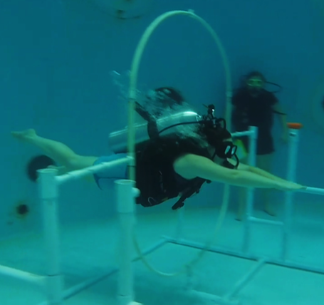
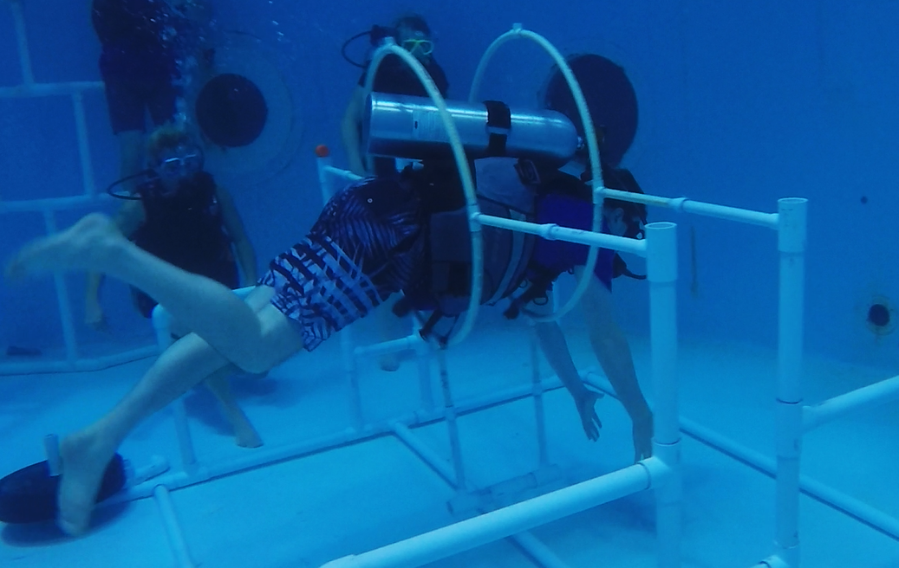
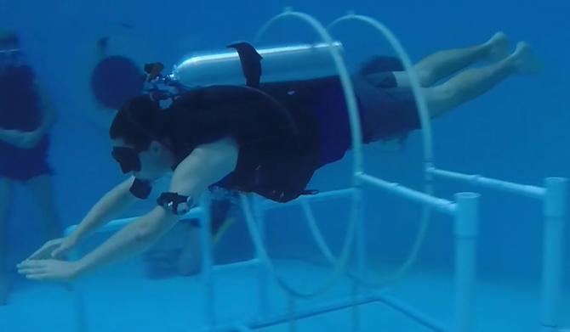
Microgravity HFE Analyses
EV74 microgravity assessments of Hatch Configurations

Slide 12
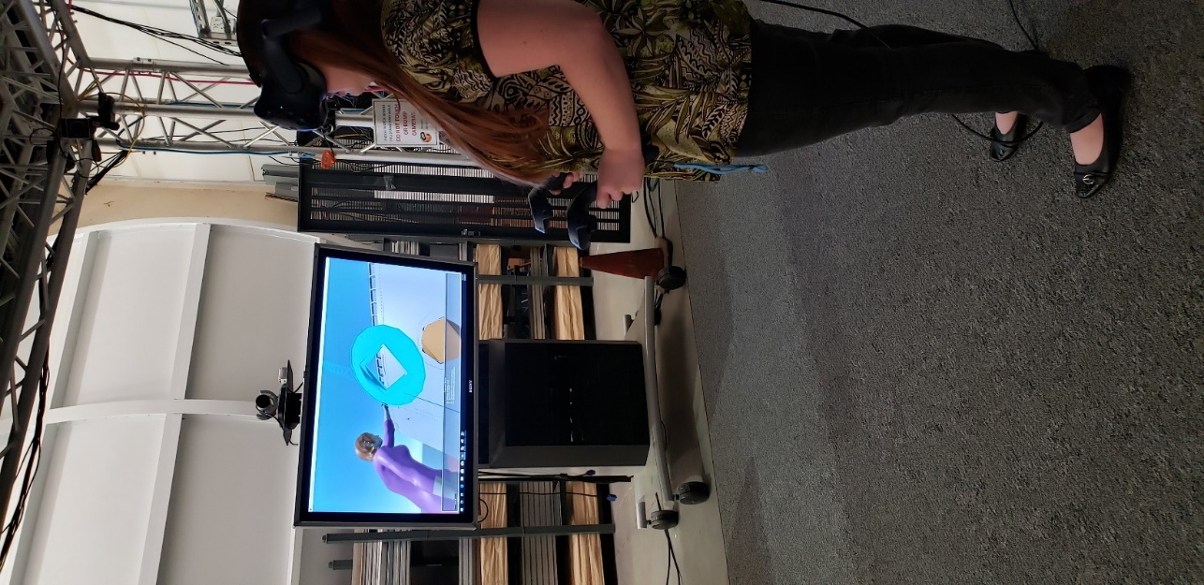

VR as an Engineering Design Tool
Visual Immersive experience into CAD models
  1:1 model size
  Adds depth to design reviews
A variety of tools within VR programs
  Routing paths for wiring or other utilities
  Video comparisons
Process Simulate Human (PSH)
  For VR Visualization of Engineering Models
    Tools like measurement and note taking
    Models can be pulled apart for examination
Notes:
Visual immersion into CAD models
Real size comparisons, 1:1
Can be utilized during design reviews to display and discuss design options
Routing paths for wiring or other utilities
Video comparisons
Process Simulate Human (PSH)
For VR Visualization of Engineering Models
Tools like measurement and note taking
Models can be pulled apart for examination

Slide 13
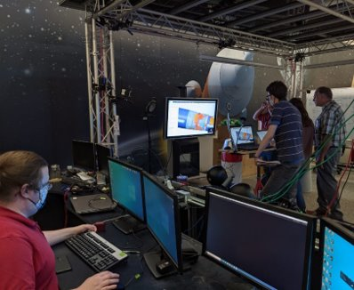
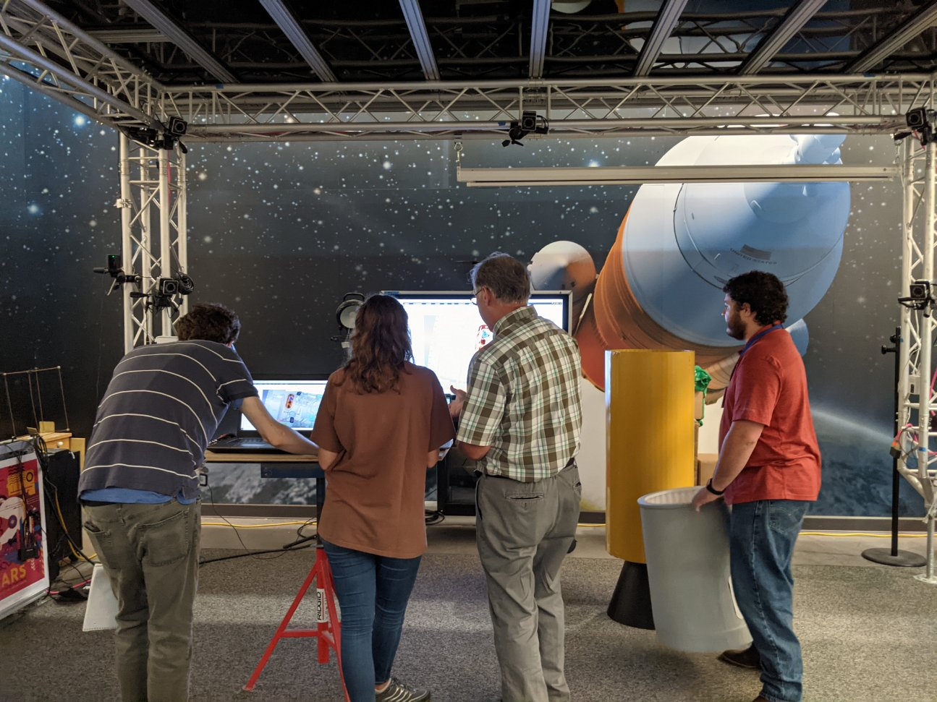
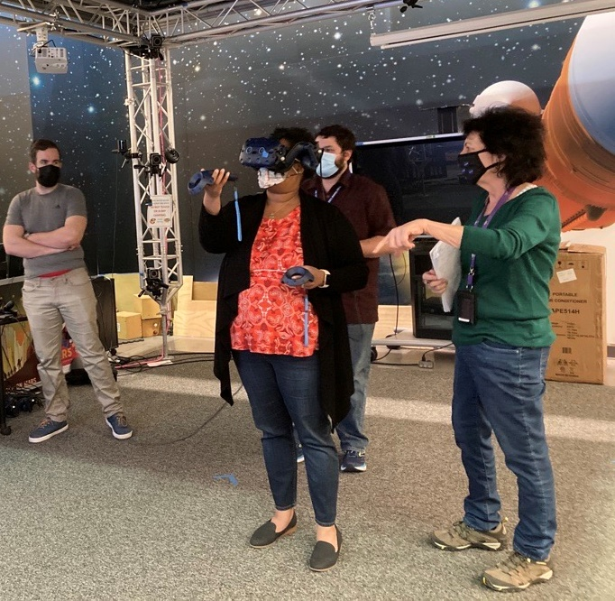
Advantages of Working within VR
Allows fast changing design layouts to be analyzed by various departments with minimal impact to cost or schedule.
Allows for more conceptual work to be tested within a limited budget.
Allows for VR use in early design cycles, saving time and budget.
Resulting HFE analysis improves usability and safety for the technicians assembling the vehicle and the astronaut crew at launch

Slide 14
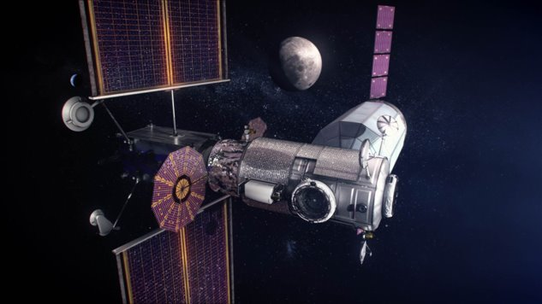
ILS Technical Disciplines – Integral Part of Systems Engineering​
​
Supportability Engineering
14
ILS applied for Sustainment in Mission Operations Phase
  System/Design Interface ​
  Maintenance Planning ​
  Manpower and Personnel ​
  Supply Support ​
  Support Equipment ​
  Technical Data ​
  Training and Training Support ​
  Computer Resources Support ​
  Facilities ​
  Packaging, Handling, Storage and Transportation (PHS&T) ​

Slide 15
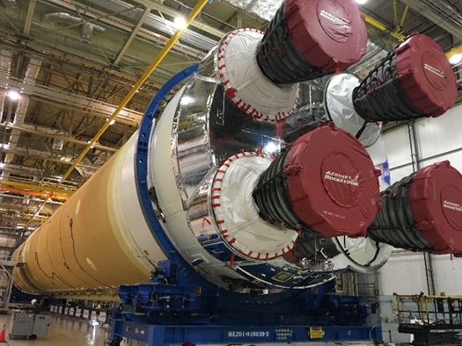
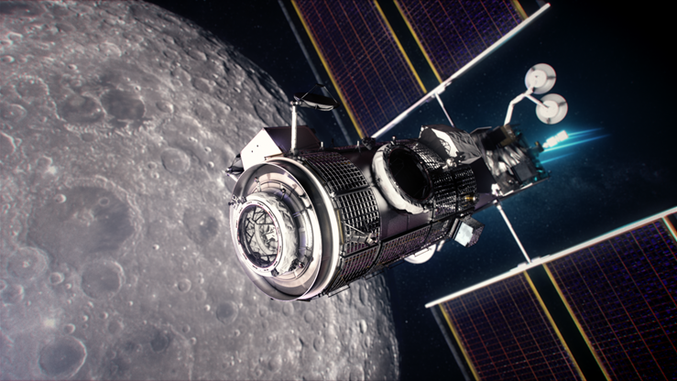
Supportability Engineering Design Influence
Supportability Engineering
15
15
Design influence is accomplished through inclusion of supportability and maintainability as part of the system’s design. Examples:
  Robust fault diagnostic capability
  Optimal location of maintenance items
  Modules/habitats component commonality
  Extra-Vehicular Activity for contingencies
  Safing – simple and isolatable
  Compatible interfaces for robotic maintenance
  Maintenance of critical ground equipment
  Modularity for easy remove and replace
  Sparing interchangeability
  Improved inherent reliability
  Life extension solutions

Slide 16
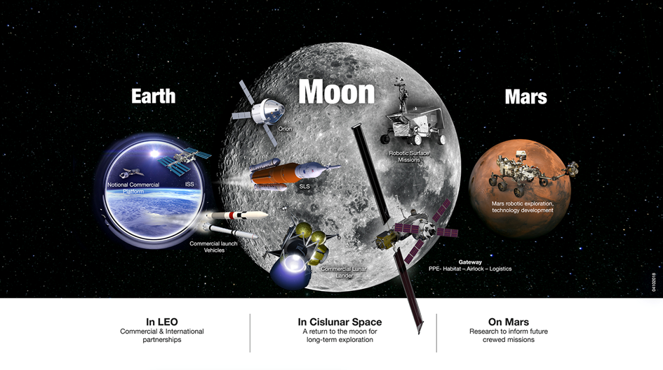
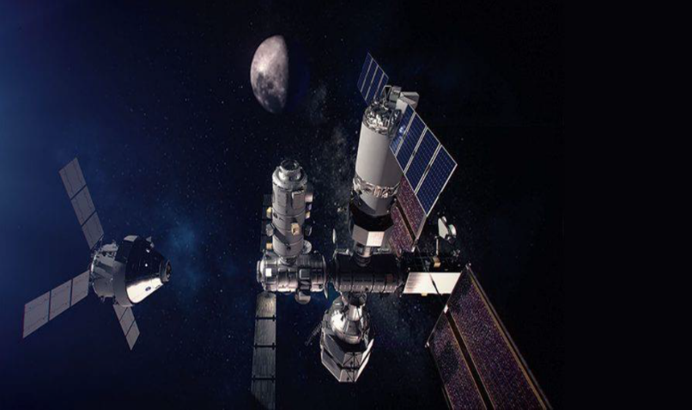
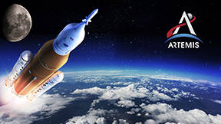
Sustainment and Moon to Mars
Supportability Engineering
16
Sustainment activities include:
  Maintenance Trend Analysis
  Supportability assessments
  Integrated architecture of systems’ product support data
  Analysis of failures
  Sparing philosophies
  Supply chain risk management
  Surface habitat maintainability
  Surface transportation planning
  Long-duration space flight maintenance
  Persistent diagnostics and inventory status
  Robotic maintenance capabilities
  Operational Availability (Ao) metrics
  Obsolescence and life extension solutions
  Disposal planning, planetary and space

Slide 17
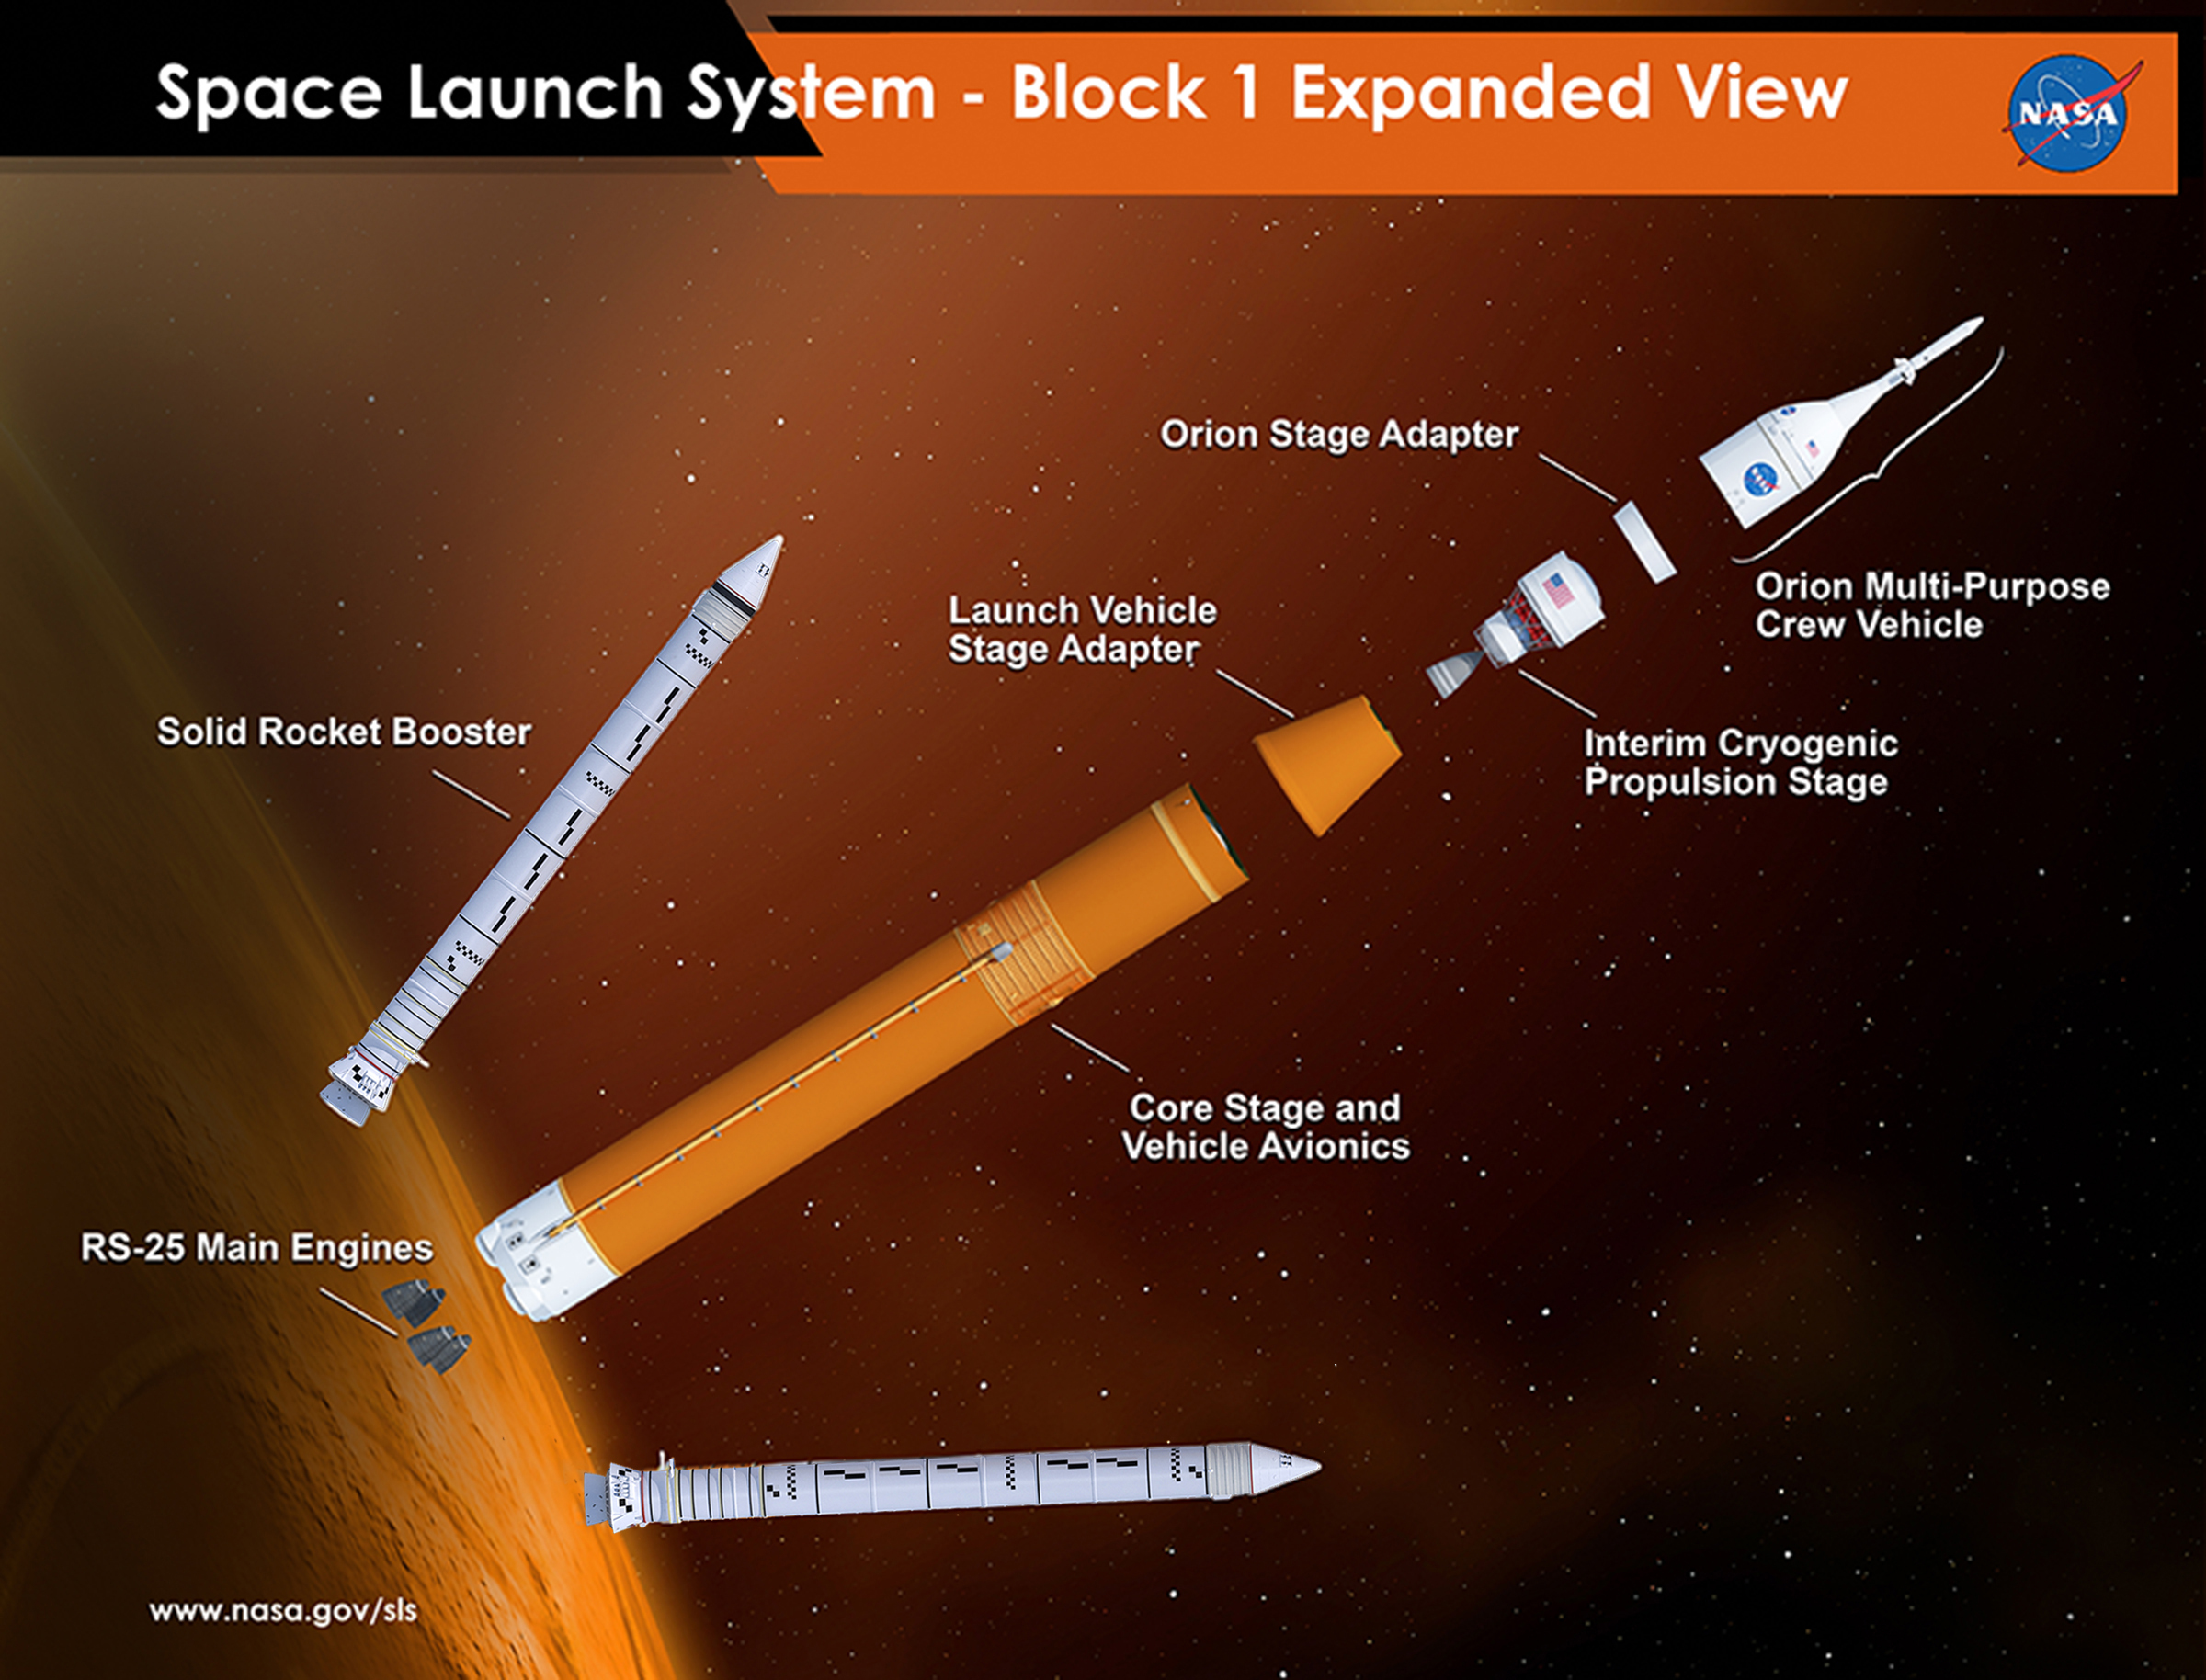
Acronyms
SLS – NASA’s Space Launch System
ACO – Advanced Concepts Office
DSH – Deep Space Habitat
VEL – Virtual Environments Lab
XR – term that encompasses virtual, augmented, and mixed reality
ANSUR – Anthropometric Survey of US Army Personnel

