Slide 1


Medical Ceramic Oxygen Generator (M-COG)
Technology description presented to:
CSA Group Technical Subcommittee Z251.20 – Medical Gas Systems
May 6, 2024
John Graf
Technology Development Lead for Life Support
NASA Johnson Space Center, Houston TX USA
john.c.graf@nasa.gov
Trade names and trademarks are used in this report for identification only. Their usage does not constitute an official endorsement, either expressed or implied, by the National Aeronautics and Space Administration

Slide 2
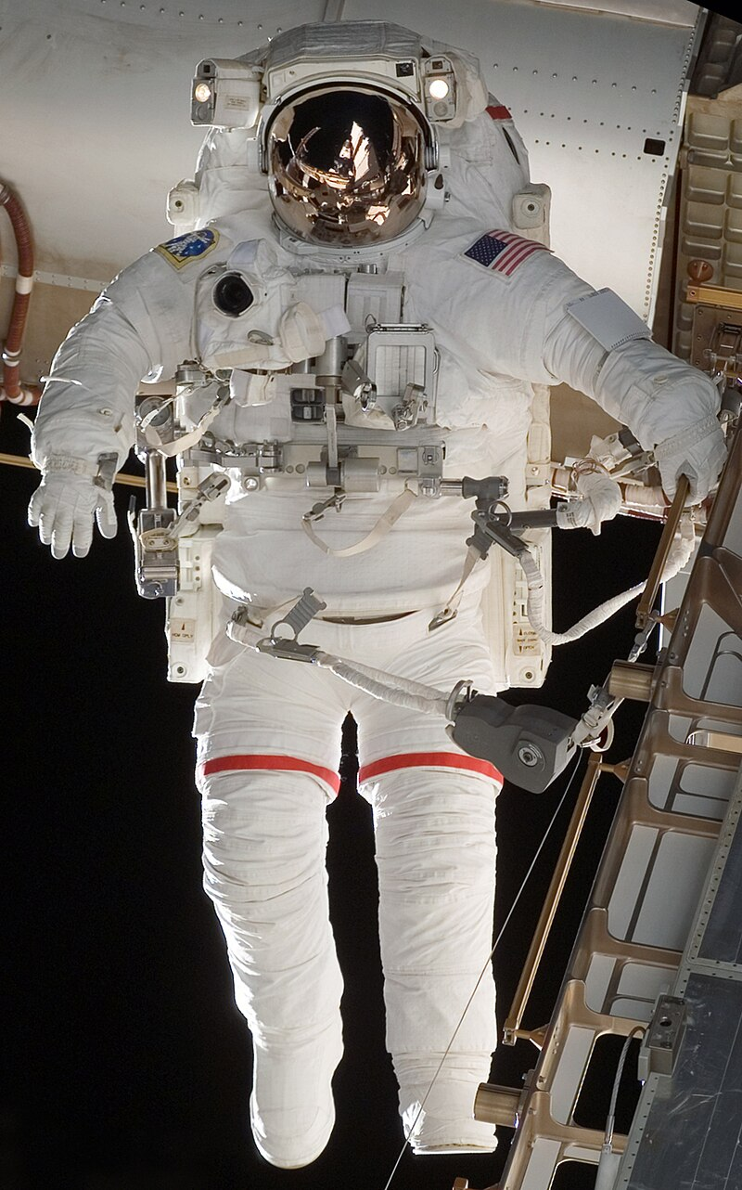
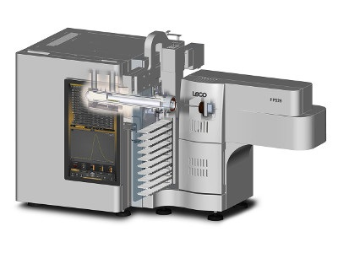
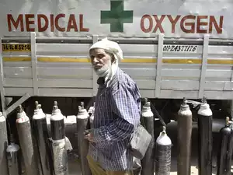
Applications for a Ceramic Oxygen Generator (COG)
Space Suit
O₂ Tank Recharge
Ultra High Purity (UHP) O₂
for analytical chemistry
Medical O₂
In Challenging Environments
Key Requirements:
Purity: >99.99%
Pressure: >3000 psig
Safety: (no H₂ hazards)
Key Requirements:
Purity: >99.999%
Price: < $500 / cylinder
Key Requirements:
Purity: >93% (prefer >99.0%)
Service Life: > 10 years
Operates in hot, humid environments
<1 hr Maintenance per year

Slide 3

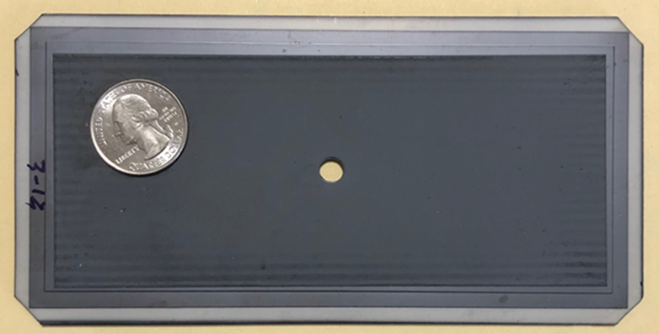

Attributes of Ideal Medical Oxygen Generator / M-COG Attributes
Attribute
Ideal System
M-COG
Reliability
Service Life
Training
Maintenance
O₂ Purity
O₂ Pressure
Temp. range
Humidity range
Elevation range
Power
Cost
MTBF >5yrs
>10 years
< 1 hr
<1 hr per year
>99.0%
>5 Bar
-10 to 50C
0 to 99.5%
0 to 4000 meters
<50 Watts/lpm
Less than SOA
one moving part, that part has 7 year MTBF)
>99.9%, > 5 bar after 10 years (35% reduction in flow)
Training needs: 1 hr instructional video
1 hr to replace blower & thermocouple every 2 years
>99.99% (under all operating conditions)
>13 Bar
-10 to 50C (limited by electronics)
0 to 99.5% (humidity no affect on purity, pressure, power)
0 to 4000 meters (demonstrated at 3300 meters)
In Work <100 Watts/lpm now, <50 Watts/lpm with Gen2 wafer
In Work with mature manufacturing, equipment cost < $1000/lpm

Slide 4
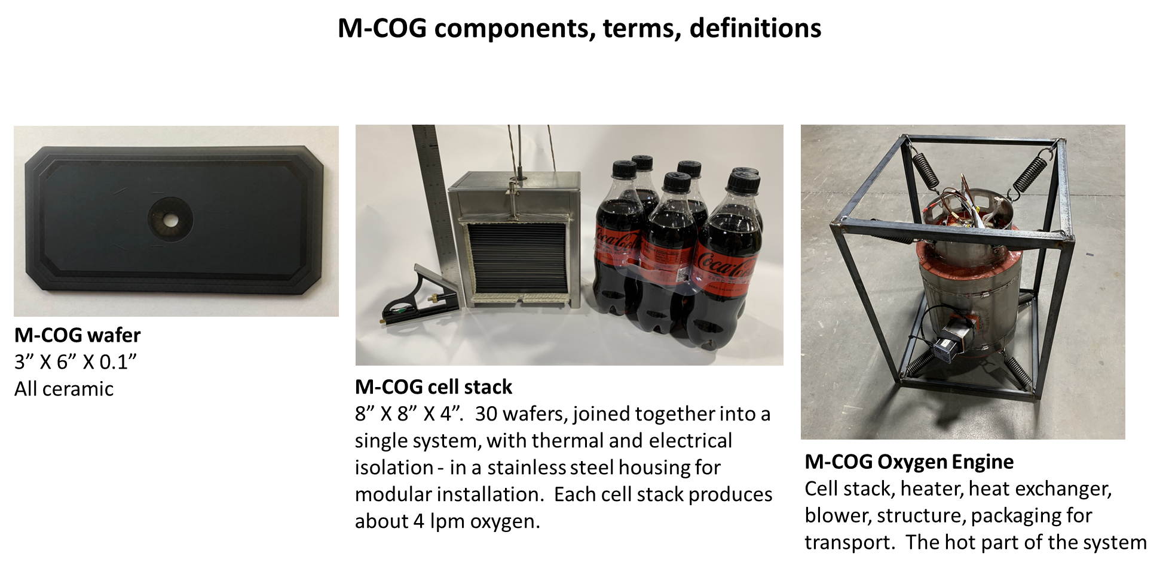

Slide 5
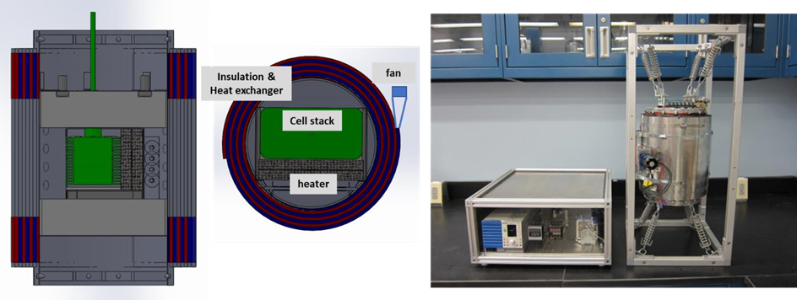
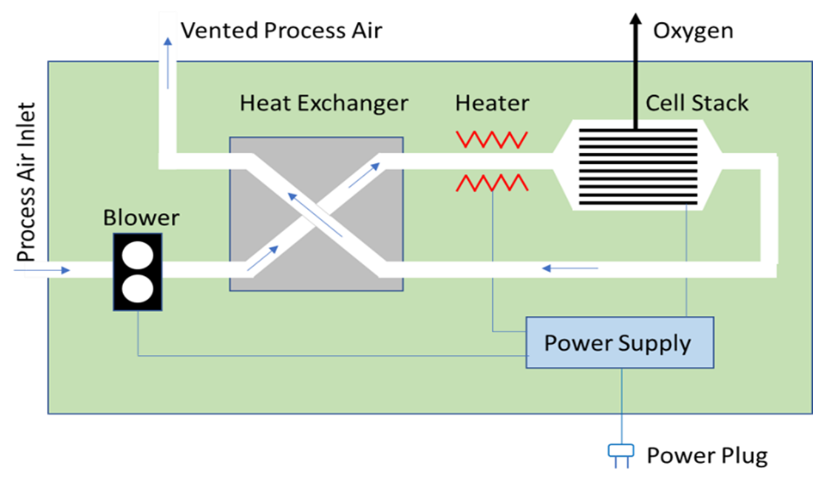
The Two Main Components of an M-COG System: Oxygen Engine & Power Supply-Control
Power Supply & Control Assembly
(Ambient Temperature)
Oxygen Engine
(High Temperature)
Cell Stack Power Supply
Instrumentation
Heater Power Supply
System
Controller
Blower Power Supply
Power Supply & Control Assy
(Ambient Temperature)
Oxygen Engine
(High Temperature)

Slide 6
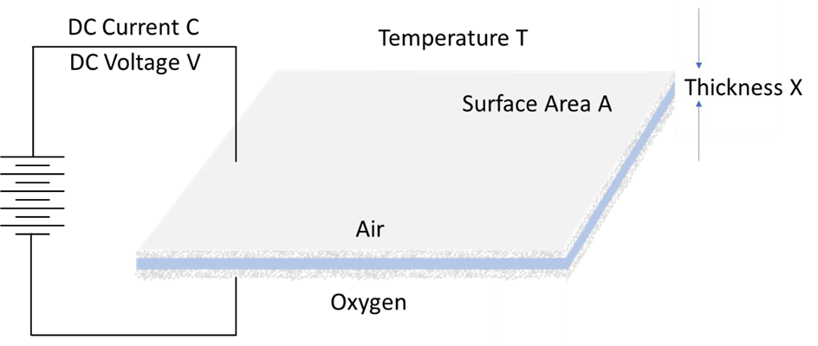
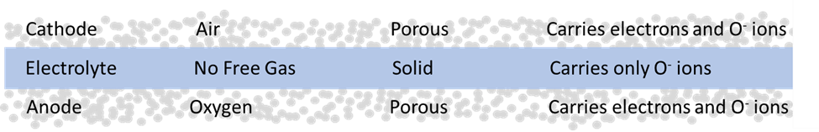
Ion Transport Membranes

Slide 7
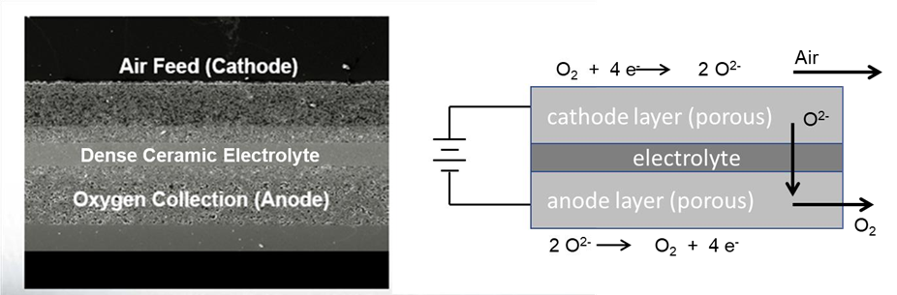
Ion Transport Membranes

Slide 8
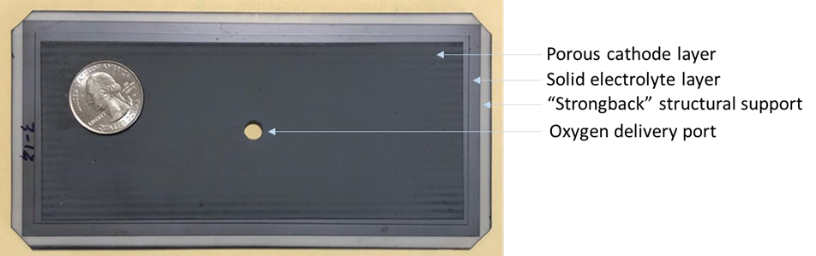
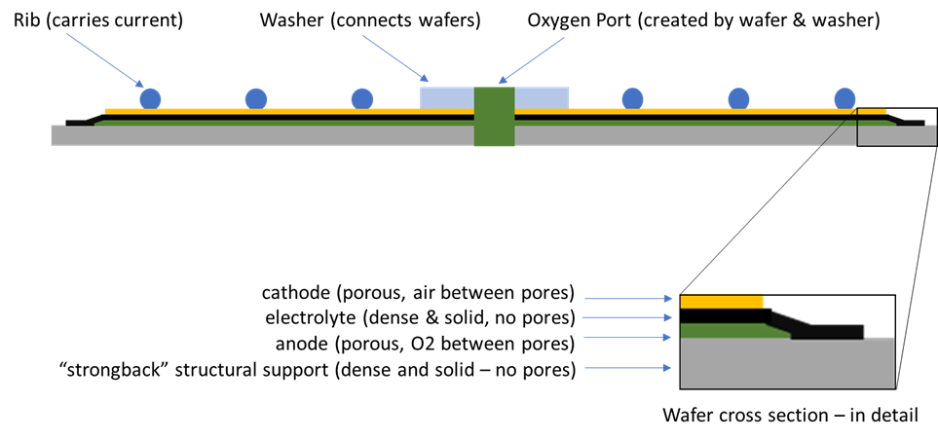
M-COG Wafers

Slide 9
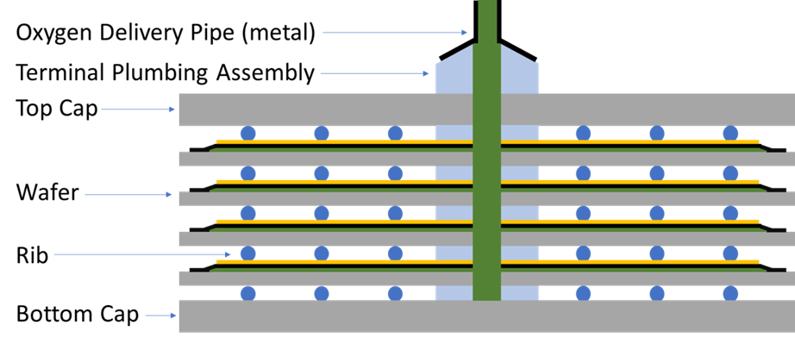
M-COG Cell Stacks (components)

Slide 10
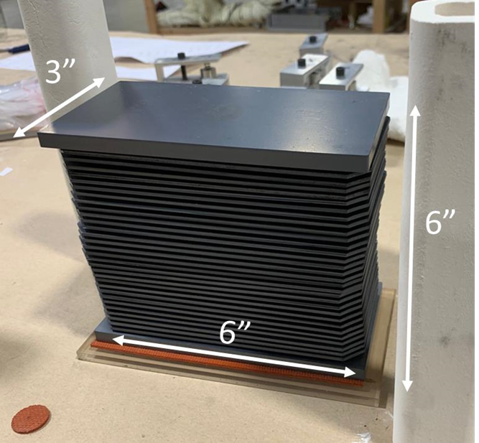
Photograph of M-COG Cell Stack
Dimensions:
7.5 X 15 X 15 cm

Slide 11
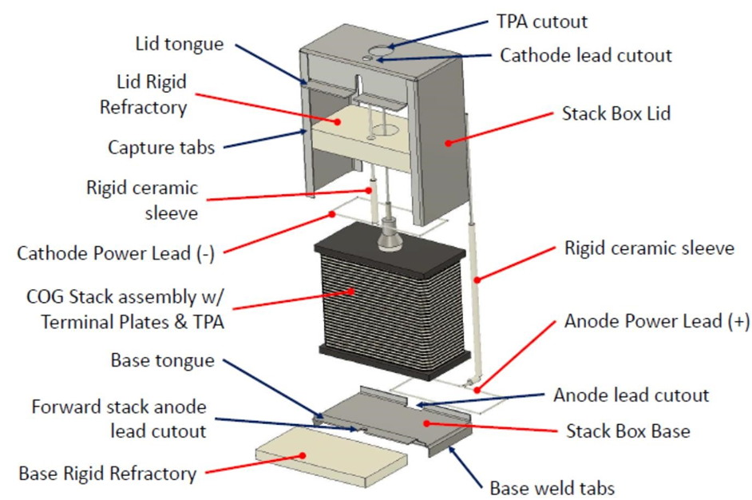
M-COG Boxed Cell Stack (exploded view)

Slide 12
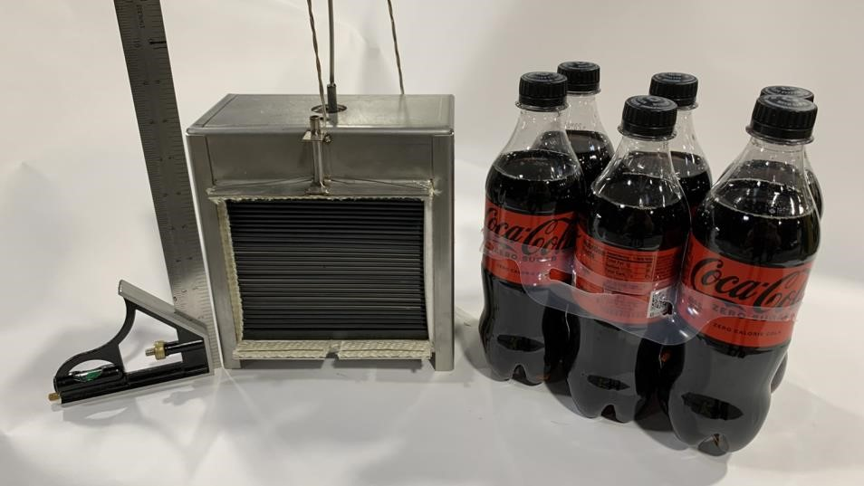
Photograph of M-COG Boxed Cell Stacks

Slide 13

M-COG Process Schematic

Slide 14
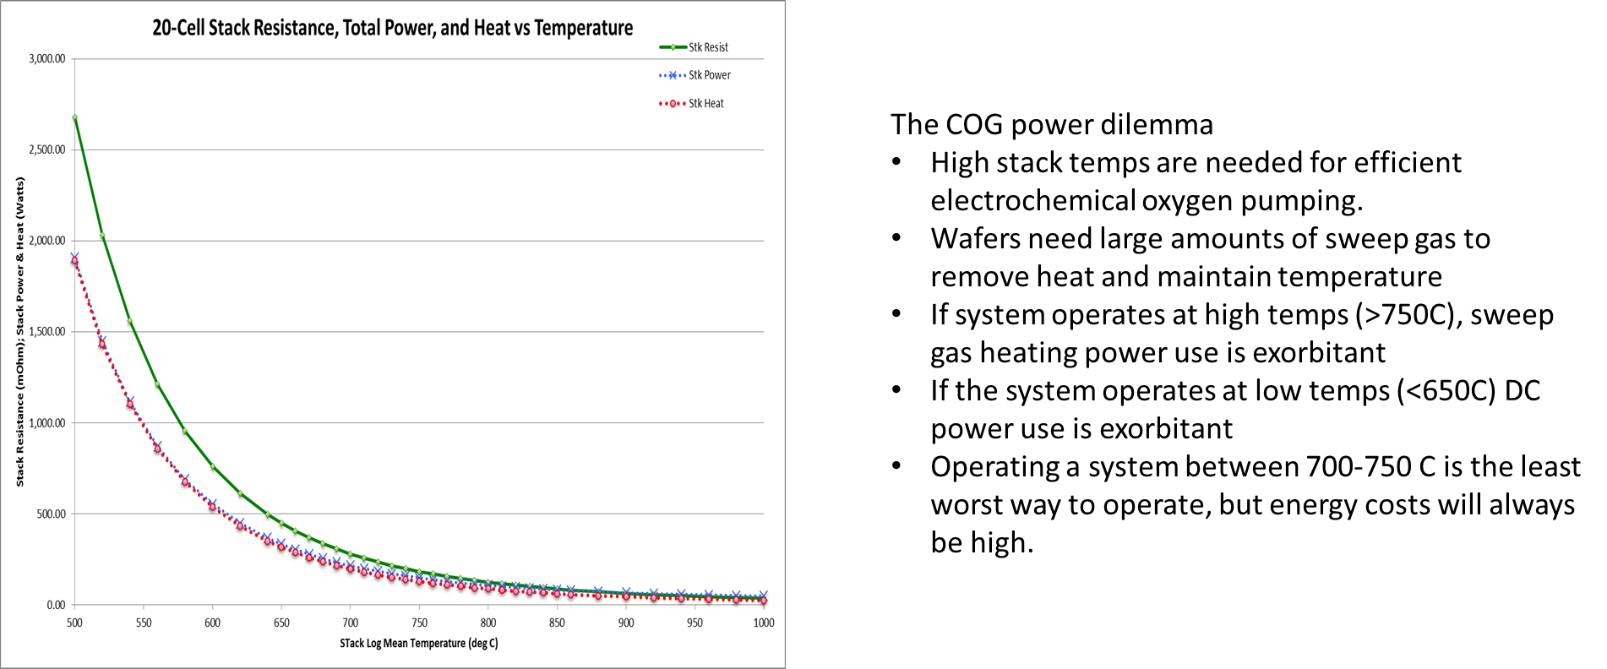
The COG power Dilemma (2012). Either too much cell stack power, or too much heater power.

Slide 15
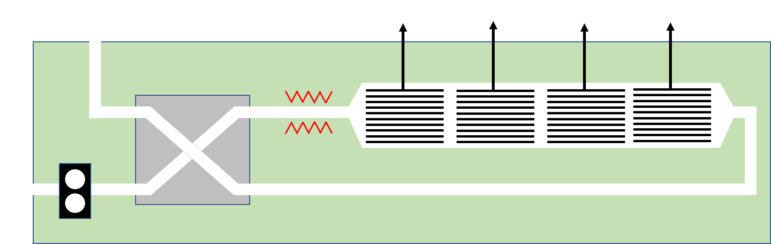
M-COG Process Schematic (4 cell stacks in series)

Slide 16
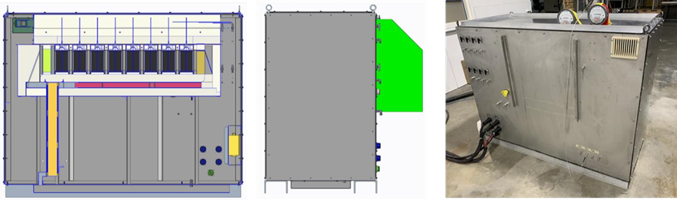
M-COG System Prototype (referred to as Chassis 2)
Purity:
Production Rate:
Power Use:
Pressure:
99.995%
4.5 lpm for one stack (total O₂ production 12.5 lpm)
400 Watts for 4.5 lpm (heaters were turned off, cell stack power only)
80 psig delivery pressure at WSTF (200 psig test pressure at AmOx)

Slide 17
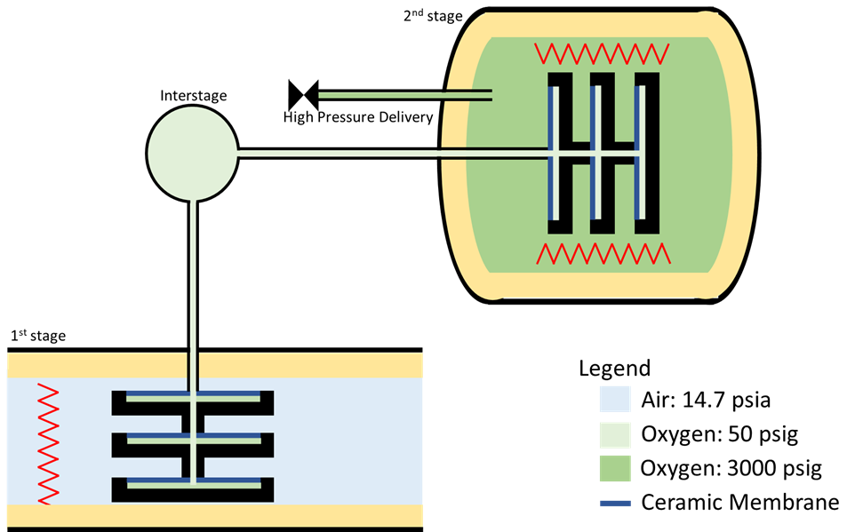
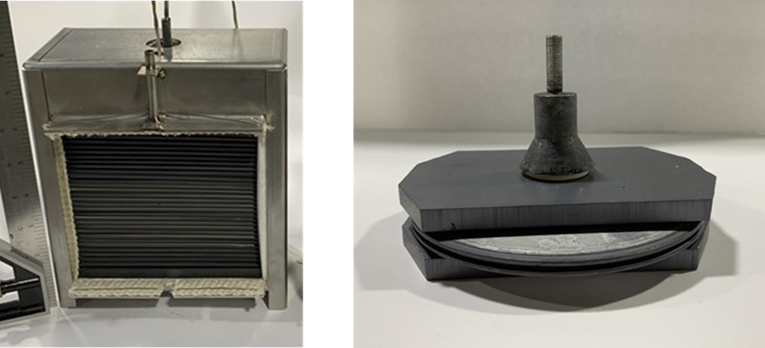
M-COG System Two-Stage Prototype (3000 psig delivery)
1st Stage
Cell Stack
2nd Stage
Cell Stack
Simplified Schematic

Slide 18
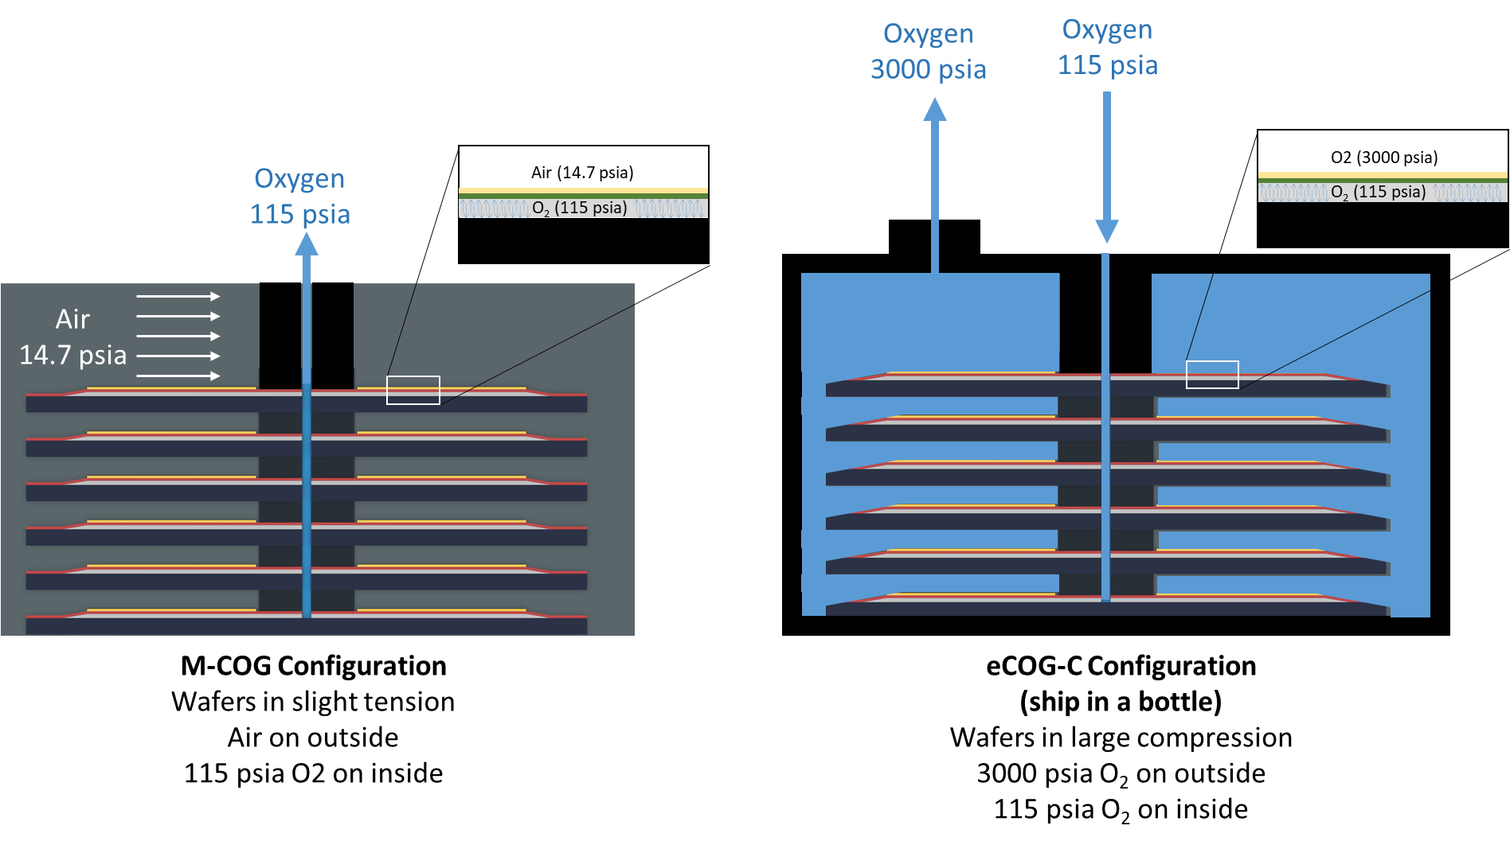
A Comparison of M-COG Wafers to Bottle Filler Wafers

Slide 19
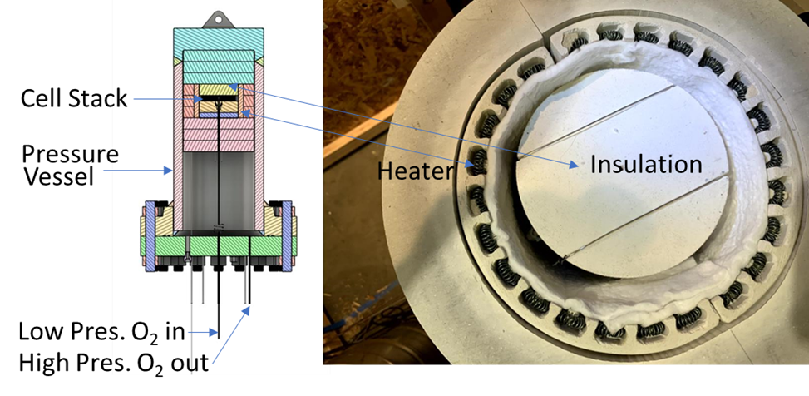
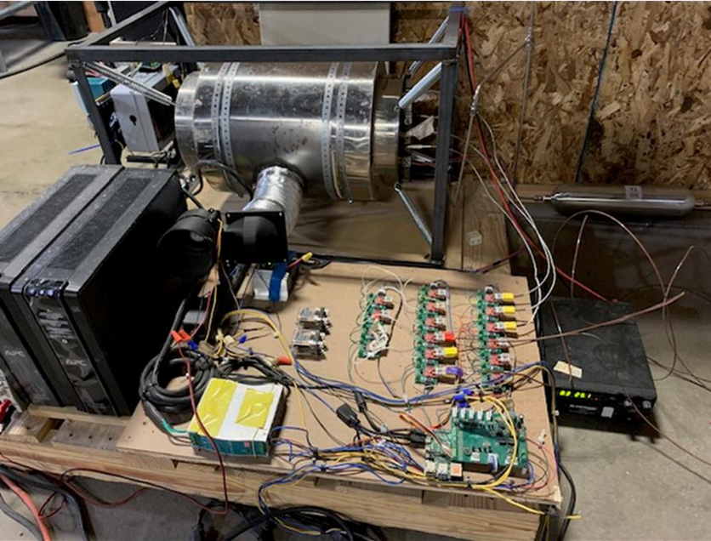
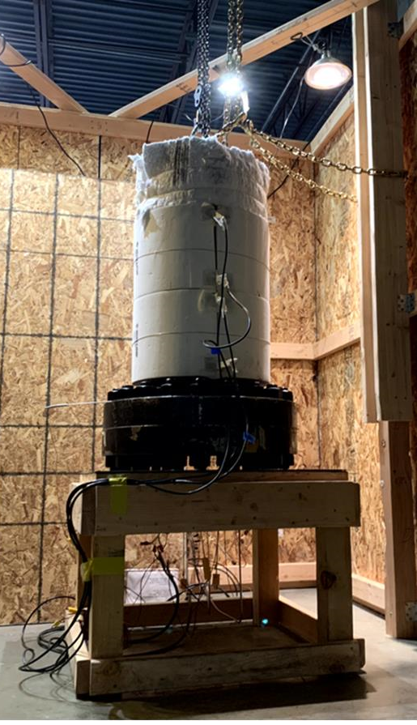
Two-Stage Prototype Testing: October 2023
Key Measurement
Oxygen Pumping into pressure vessel with 3000 psig pressure
2nd Stage
Cross section
2nd Stage
Interior, Top View
1st Stage
2nd Stage

Slide 20
M-COG System Prototype (referred to as Cross Flow Cylinder)

Slide 21
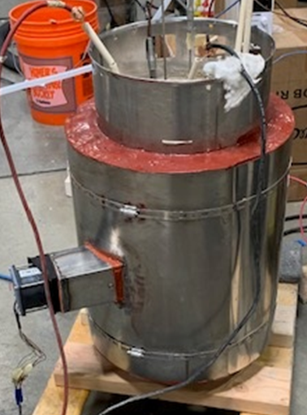
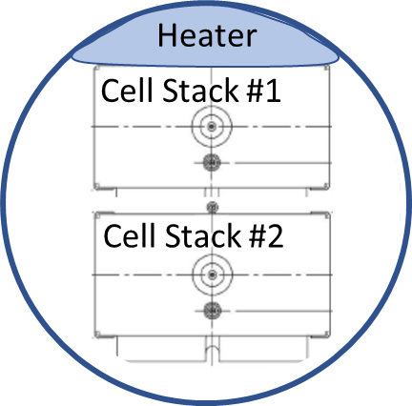
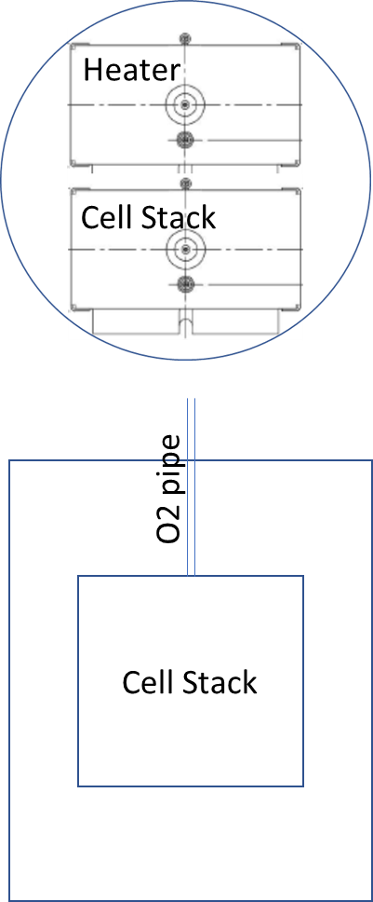
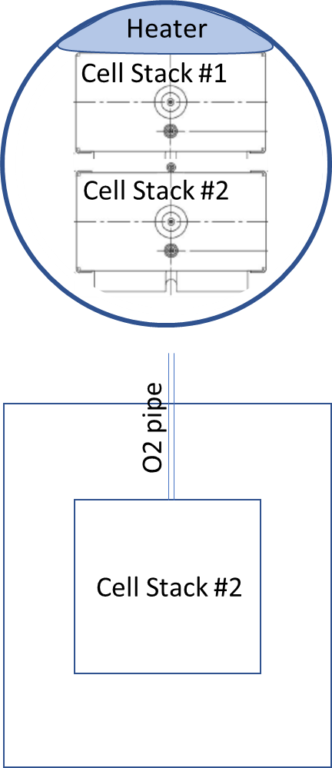
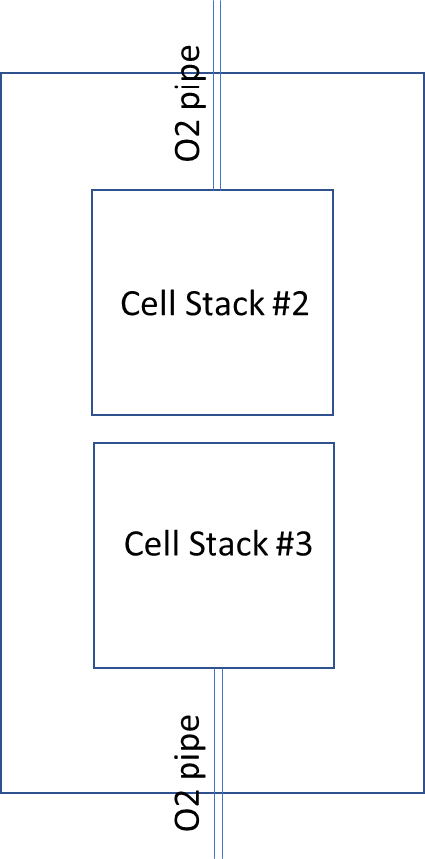
O₂ Engine Configurations
1 cell stack
generator
(0-4 lpm)
Designed
Built
Tested
4 cell stack
generator (0-16 lpm)
Most Energy Efficient
Concept Only
2 cell stack
generator
(0-8 lpm)
Designed
Not-Yet-Built
1 prototype
Due June 2024
Top view
section
Side view
section

Slide 22
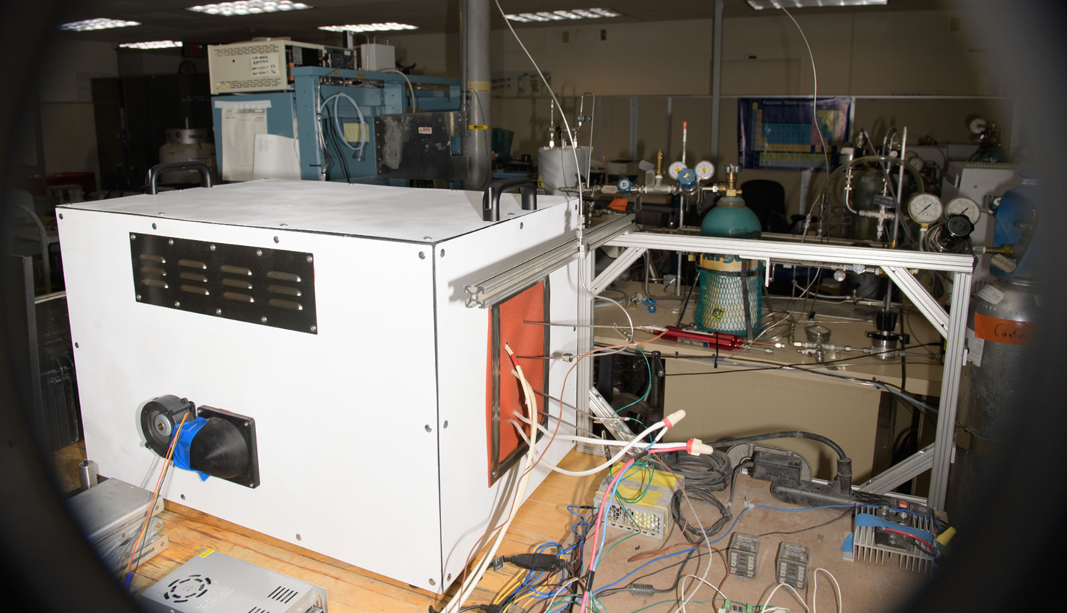
2024 Oxygen Engine (1 cell stack with 30 wafers)

Slide 23
Crossflow Cylinder Testing: Summer 2023 & Winter 2024
AmOx Key Measurements
Run time:
>2500 hours in 2023
5800 hours in 2024
Performance is nominal throughout the test.
System survived loss of facility power, unplanned system shut-down

Slide 24
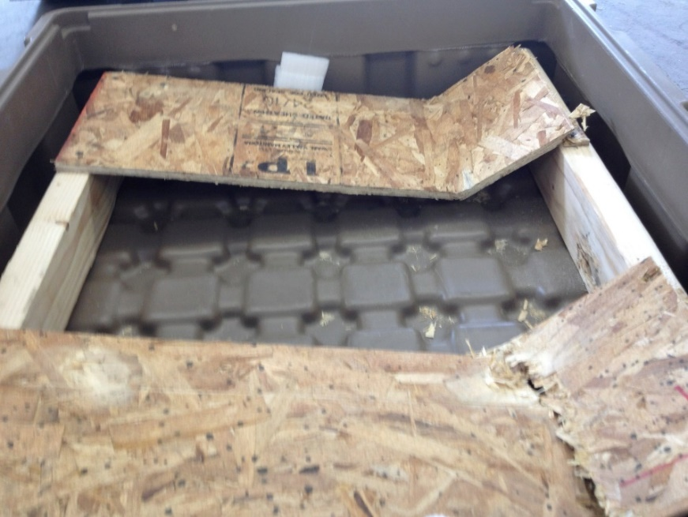
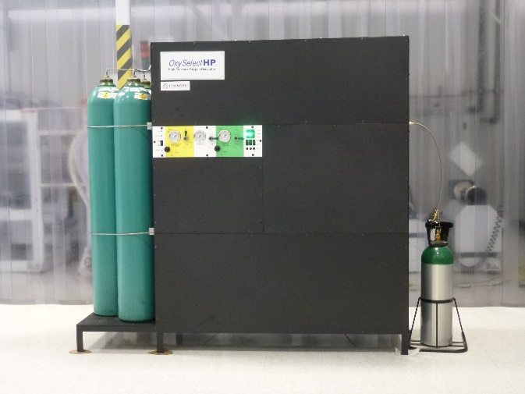
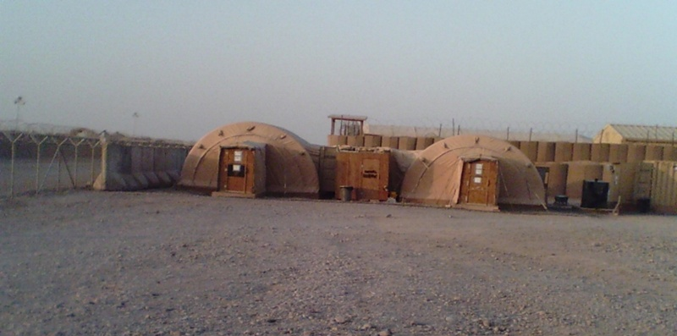
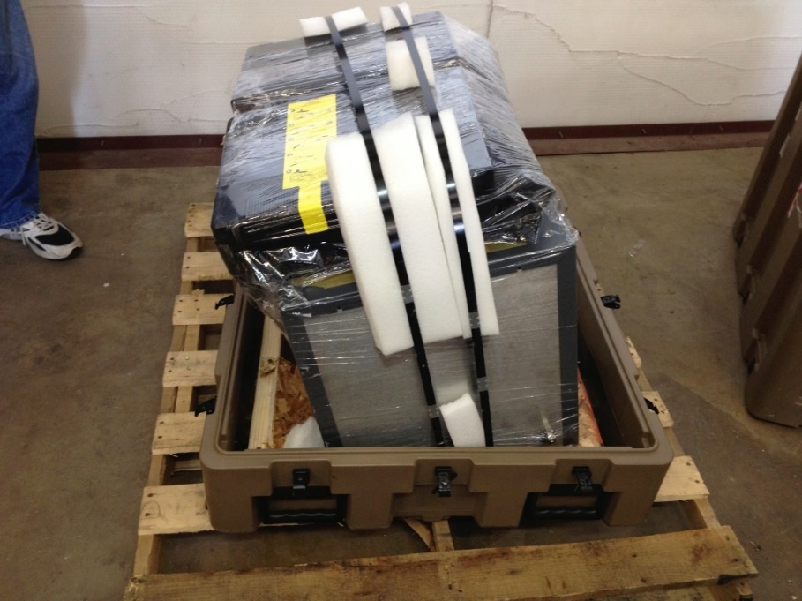
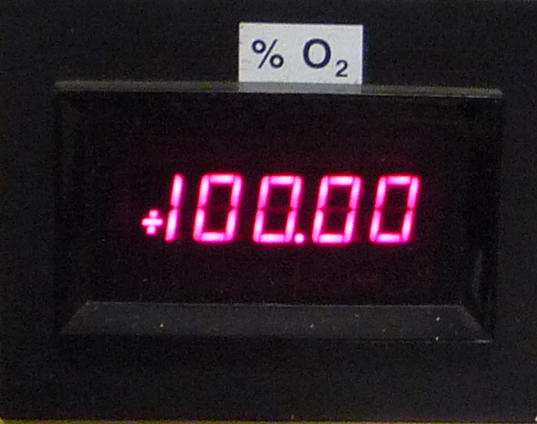
Ceramic Oxygen Generator in Afghanistan: 2011 - 2013
Supply Aviator’s Breathing Oxygen (ABO) for US Military
In operation 24/365 for over 24-months
US Marine base in Afghanistan
Shipping crate after return from Afghanistan
Housing for oxygen generator system
System used by US Marines, operating a forward operating base in Afghanistan
O₂ Product purity was always >99.9%
Chemical Oxygen Generator operated nominally after return from Afghanistan

Slide 25
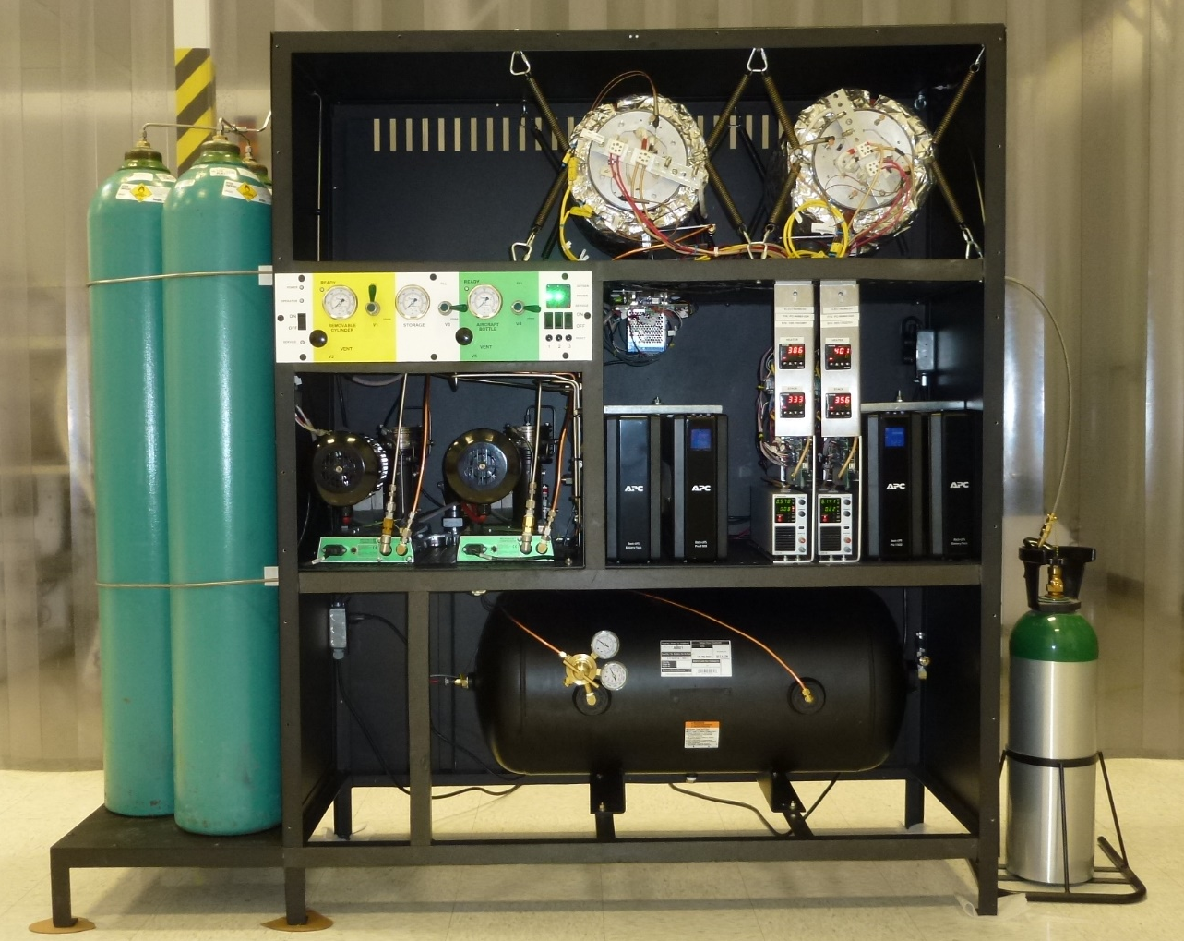
Ceramic Oxygen Generator had a high pressure tank fill station
  Mechanical Compressors needed seal repair after 1 year
  Ceramic Oxygen Generator operated 24/7 for >2 years with perfect reliability
Aviator Breathing Oxygen (ABO)
Fill 10 full-size cylinders per week.
Fill 3 aircraft bottles per day
Deployed to Afghanistan to support US Troops
High-pressure oxygen storage
High Pressure Booster
(2 units)
Oxygen
Receiver
SEOS Oxygen Engine
(2 of possible 3)

Slide 26
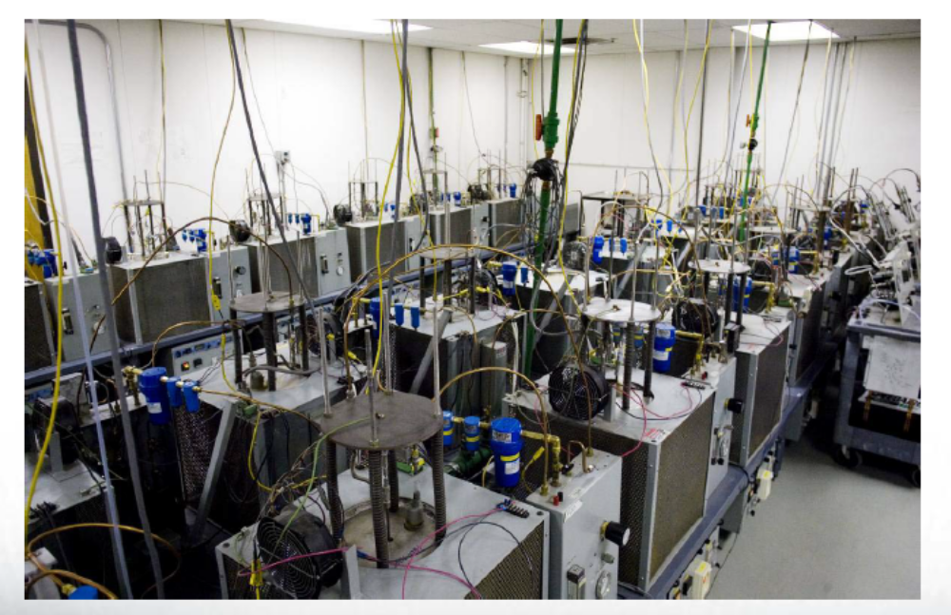
Long Duration Wafer Testing
40 wafers tested >10,000 hrs (1.1 year)
7 wafers tested >40,000 hrs (4.5 yreas)
1 wafer tested >55,000 hrs (6.4 years)
Projected aging trends:
Slow, steady, gradual decrease in production rate (if system power is maintained). Decrease in production rate after 10 years continuous use: <30%

Slide 27
M-COG Oxygen Contains Trace Amounts of Water Vapor
All available evidence suggests that water vapor is permeating through the seals of washers that separate wafers in the cell stack
  Delivery pressure trends
  Production rate trends
  Process air humidity trends
  Operating temperature trends
Water Vapor levels are affected by production rates
  At higher production rates, ppm H₂O is lower
  At lower production rates, ppmv H₂O is higher
The highest ppmv H₂O measured at 3 lpm production rate: 58 ppmv
The highest ppmv H₂O measured at 1.4 lpm production rate: 81 ppmv

Slide 28
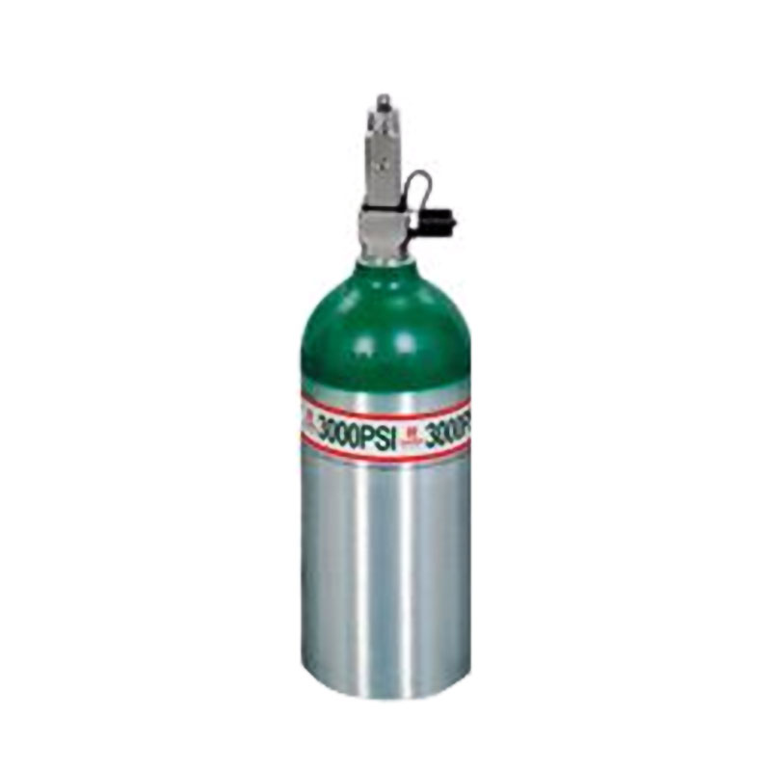

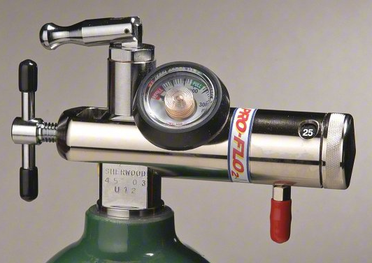
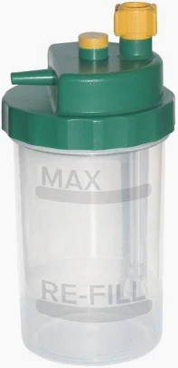
Trace Water Vapor in Compressed Gas: Medical O2
Medical O₂
Regulator must remain
>11.9 C under fast flow
conditions (25 slpm)
To prevent icing
Max Pressure:
Max ppmv:
Dew point at
67 ppmv/3000 psig:
3000 psig
67 ppmv
11.9 C
Humidifier
O₂

Slide 29
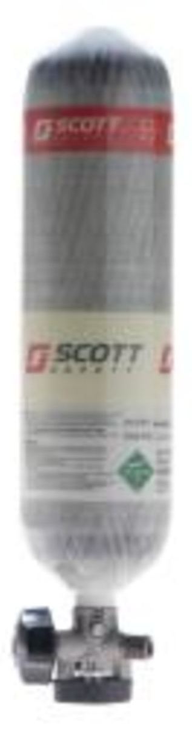
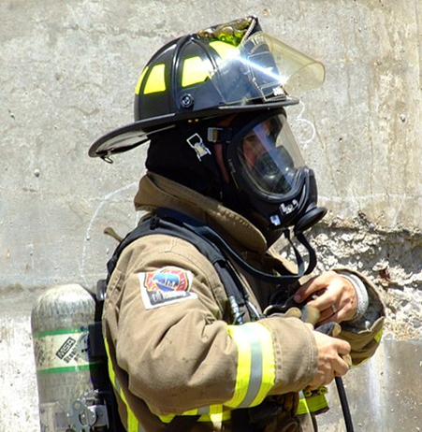
Trace Water Vapor in Compressed Gas: SCBA
SCBA Emergency Respirator
Regulator must remain
> 5.7 C under fast flow
conditions (300 slpm)
to prevent icing. Two
stage regulators are
generally used
Air
Max Pressure:
H₂O max ppmv:
Dew point at
24 ppmv/5500 psig:
5500 psig
24 ppmv
5.7 C

Slide 30
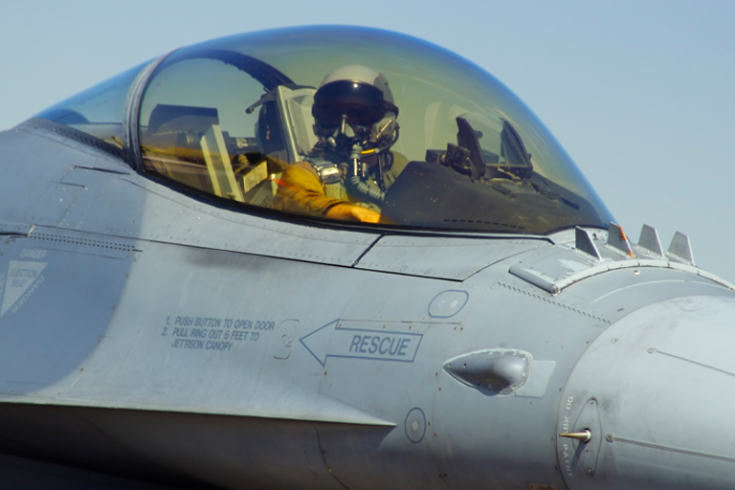
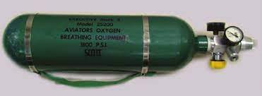
Trace Water Vapor in Compressed Gas: Aviator’s Breathing Oxygen
Aviator’s Breathing Oxygen
Regulator must remain
> -18 C under fast flow
conditions (300 slpm)
to prevent icing. Two stage regulators generally used
O₂
Max Pressure:
H₂O max ppmv:
Dew point at
6 ppmv/3000 psig:
3000 psig
6 ppmv
-18 C

Slide 31
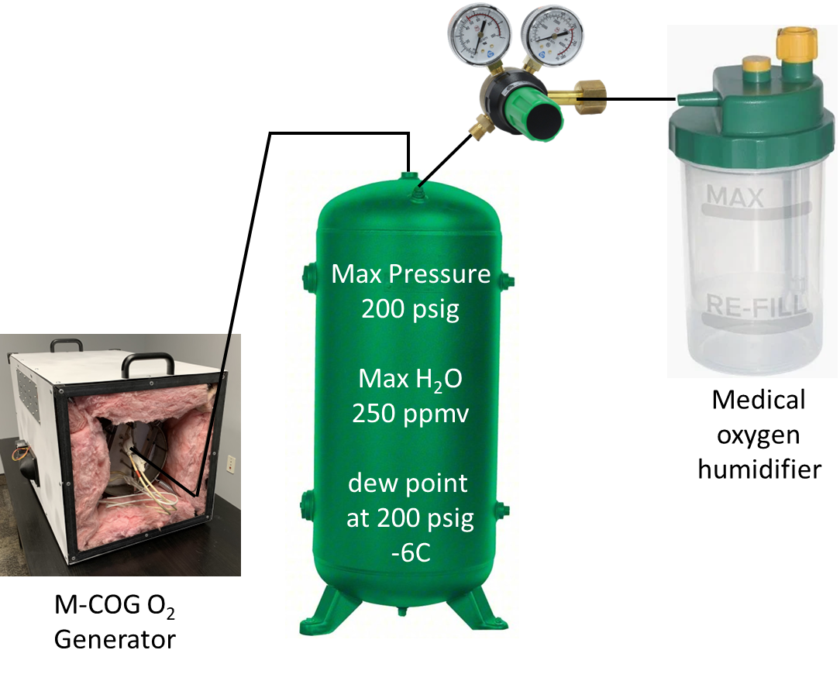
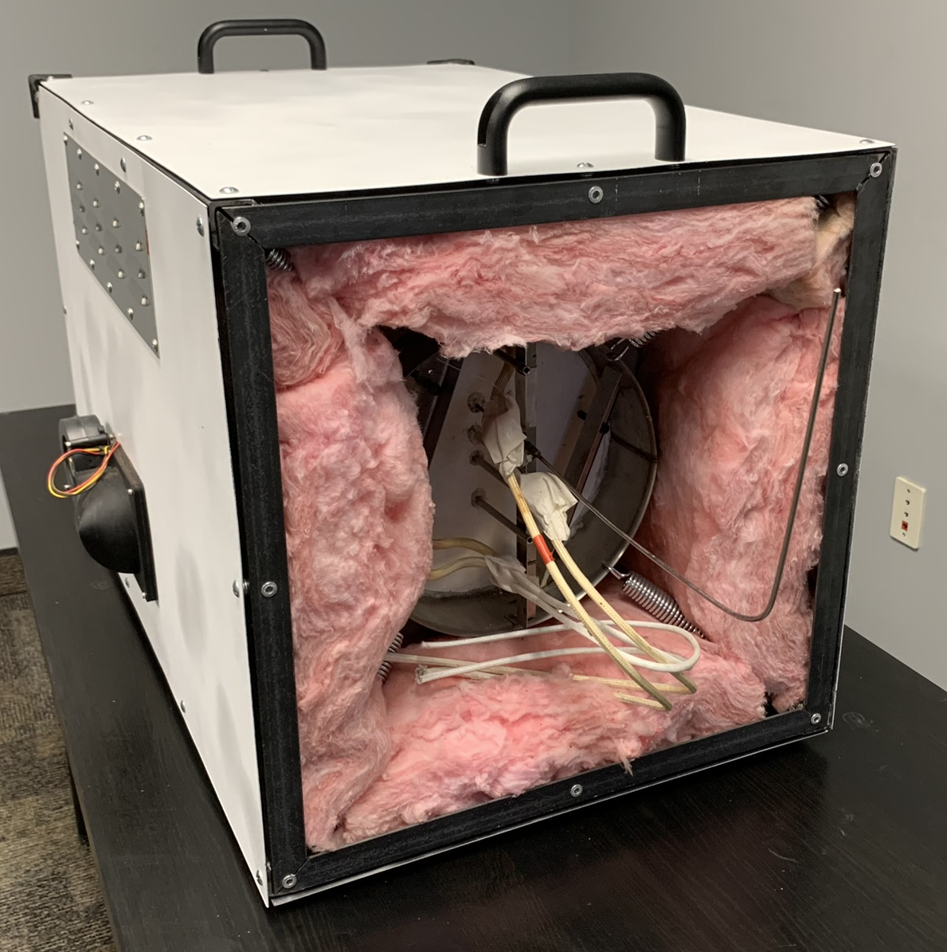
Trace Water Vapor in Compressed Gas: M-COG (proposed)
Low Pressure M-COG (proposed)
Max Pressure:
H₂O max ppmv:
Dew point at
250 ppmv/200 psig:
200 psig
250 ppmv
-6 C

Slide 32
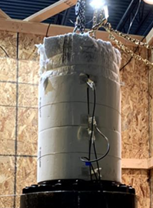
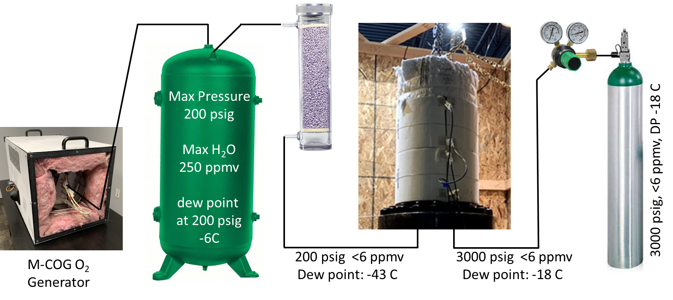
Trace Water Vapor in Compressed Gas: High Pressure M-COG (proposed)
High Pressure M-COG (proposed)
Max Pressure:
H₂O max ppmv:
Dew point at
6 ppmv/3000 psig:
3000 psig
6 ppmv
-18 C

Slide 33
Trace Water Vapor in Compressed Gas: Summary Table
Pressure
(psig)
Max water
(ppmv)
Line Pressure
Dewpoint (C)
Application
Gas
Notes / Comments
Med O₂
Med O₂
SCBA
SCBA
Aviator
M-COG (Low-P)
M-COG (Hi-P)
3000
2000
5500
3000
3000
200
3000
O₂
O₂
Air
Air
O₂
O₂
O₂
67
67
24
24
6
250
6
+ 11.9
- 5.9
+ 5.7
- 2.4
- 18.0
- 6.0
- 18.0
Ambient temps are common
2000 psi is a common use case
5500 psi for 45 min rating
3000 psi is a common use case
Cold temps likely in aviation
Receiver tanks rated to 200 psig
Actual water vapor <1 ppm

Slide 34
Oxygen Purity Can Be Verified by Inspection of Delivery Pressure
Ceramic Ion Transport membranes are fundamentally selective to oxygen. Only oxygen ions can pass through the electrolyte layer
  Electrolyte layer is gas impermeable. At 200 psig, the leak rate for each wafer is <0.013 sccm
M-COG process air is moved using a blower. The maximum pressure the blower can achieve is <1 psig.
If the gaseous product delivered by M-COG has a pressure >1psig, the pressurized gas was produced by the ion transport membrane.
Municipal Drinking Water Supply uses pressurized “outleakage” methods to verify purity using delivery pressure.
Delivery pressure of >1 psi guarantees the oxygen purity is >99.5%
  >1 psig pressure verifies the source of the oxygen is M-COG ion transport membrane
  M-COG produced oxygen purity is always >99.5%
  Purity has been verified by NASA test
    M-COG system had a fracture at the ceramic/metal joint
    M-COG delivery pressure <0.5 psi
    M-COG purity 99.97% (nitrogen 240 ppmv)

Slide 35
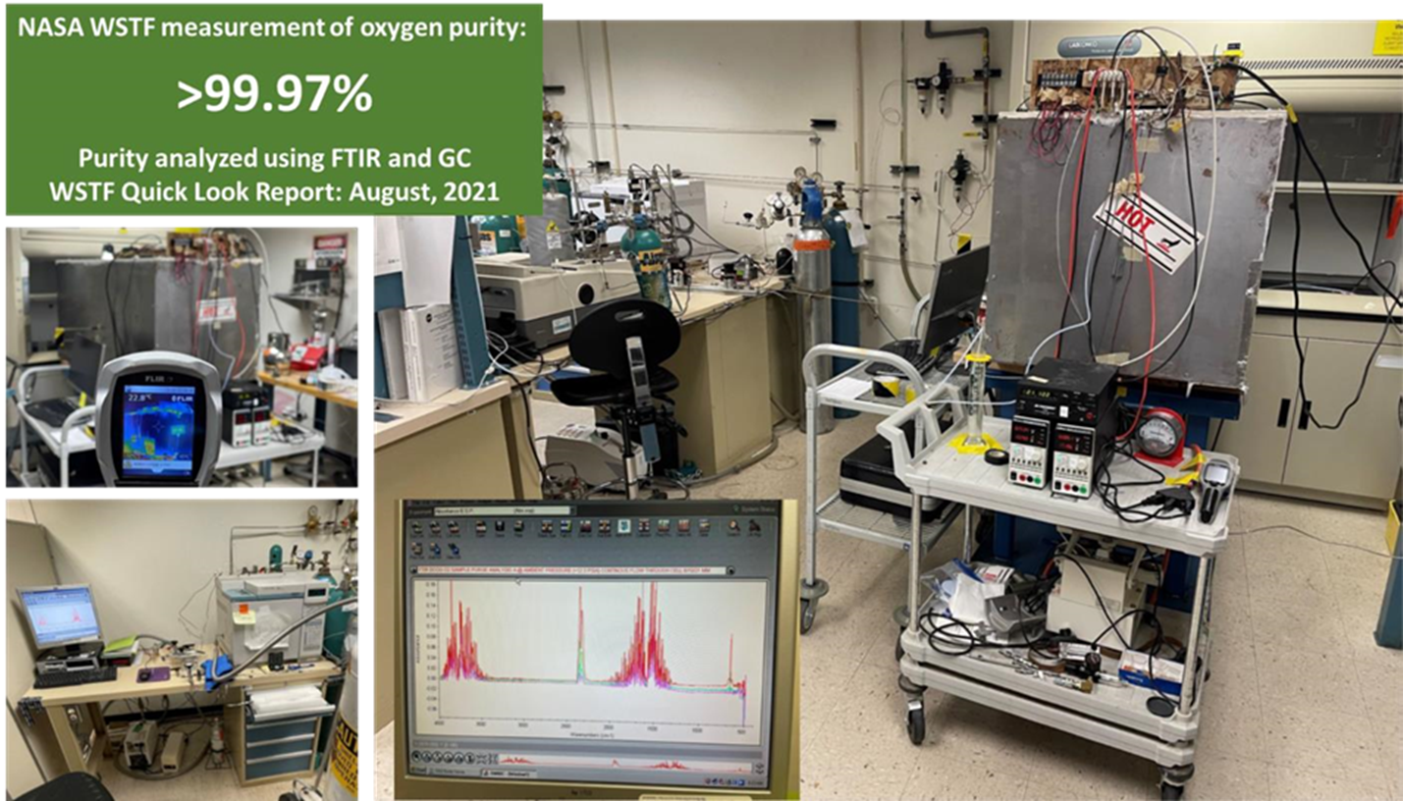
M-COG System Prototype Testing: August 2021
Purity was 99.97% under worst case in-leakage conditions: The M-COG gas delivery system was fractured and had no pressure integrity. Maximum delivery pressure was < 0.5 psi.

Slide 36
Medical Oxygen Specifications
WHO International Pharmacopoeia Definition of Medical Oxygen
Oxygen:
Carbon Dioxide:
Carbon Monoxide:
Water Vapor:
Not less than 99.5% v/v
Not more than 300 ppm v/v
Not more than 5 ppm v/v
Not more than 67 ppm v/v
USP 29 Standards for Medical Oxygen
Oxygen:
Carbon Dioxide:
Carbon Monoxide:
Water Vapor:
Not less than 99.0% v/v
Not more than 300 ppm v/v
Not more than 10 ppm v/v
n/a (no specification for water vapor)
Note:
Oxygen that is produced by the air liquefaction process is exempt from the requirements of the tests for carbon dioxide and carbon monoxide
Recommended Specifications for M-COG Produced Medical Oxygen
Oxygen:
Carbon Dioxide:
Carbon Monoxide:
Water Vapor:
Not less than 99.5% v/v
Not more than 300 ppm v/v
Not more than 5 ppm v/v
Not more than 250 ppm for gases stored at pressures less than 15 Bar
Not more than 6 ppm for gases stored at pressures between 15 and 200 Bar

Slide 37


O₂
Storage
Crate Packaging Plan
Electronics
Steam &
Hot water
Demonstration System Concept:
  15 m³/hr O₂ (250 lpm)
  200 kg/day steam
  2500 l/day hot water
  25kW continuous power
Heat Exchanger
O₂
Engines

Slide 38
Summary
M-COG performance is insensitive to temperature.
M-COG performance is insensitive to elevation/atmospheric pressure.
M-COG performance is not compromised by humidity.
M-COG can use any air (provided it is safe to breathe) without filtration or preconditioning.
M-COG can operate at small scale
M-COG is easy to ship
M-COG does not need a mechanical compressor.
M-COG is energy efficient.
Compared to PSA, M-COG requires less maintenance.
M-COG oxygen is 99.9% pure
A two-stage version of M-COG can deliver high-pressure oxygen (capable of cylinder recharge)
In some operating environments, M-COG can be the most reliable and method of oxygen supply.

