Slide 1
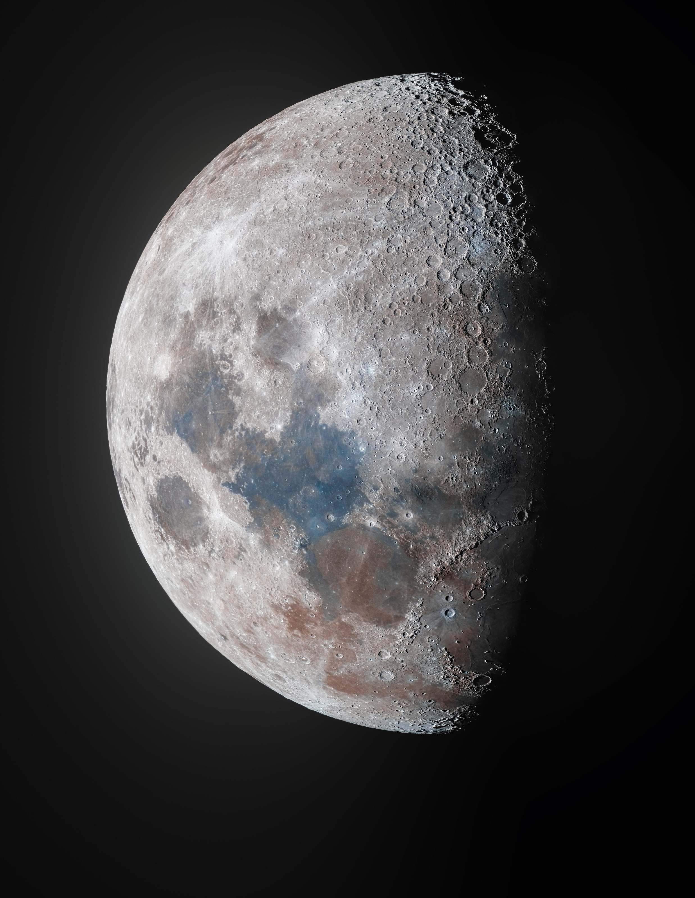

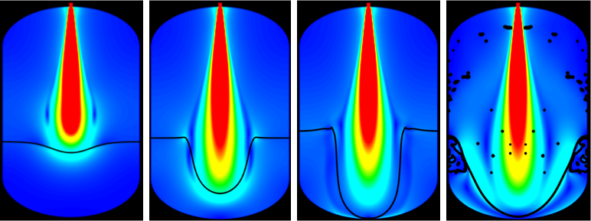




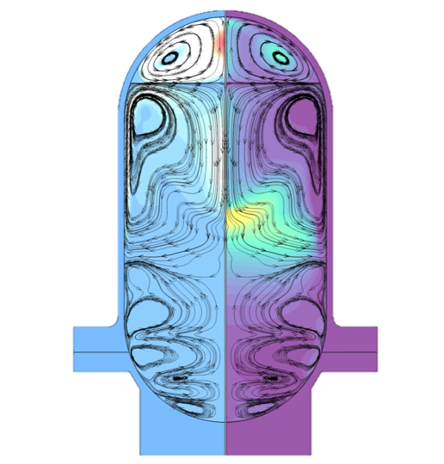
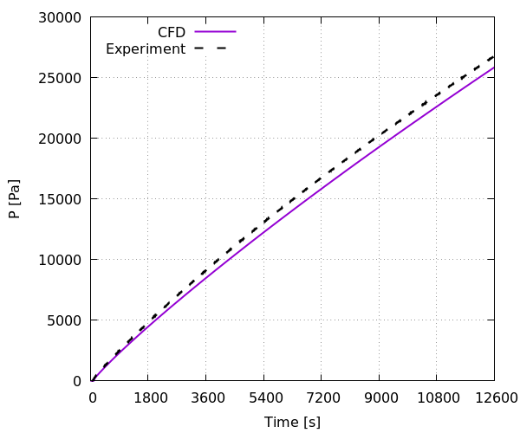
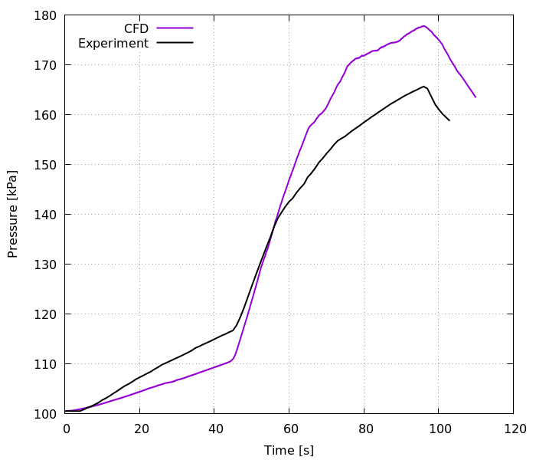
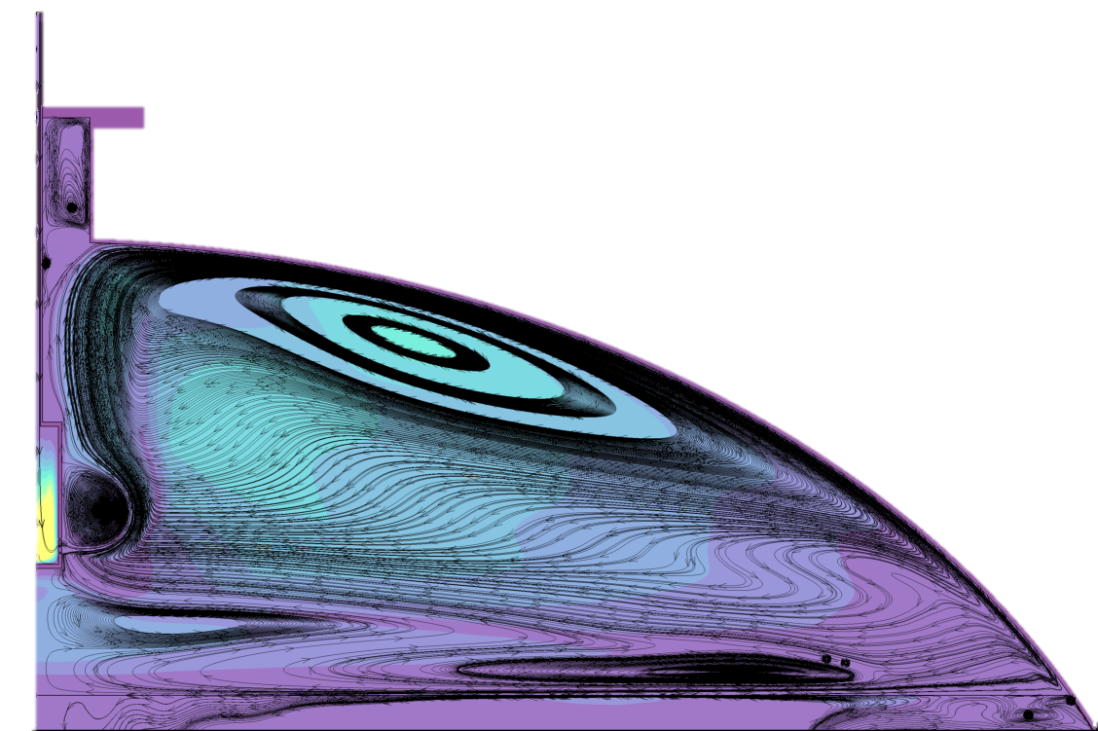
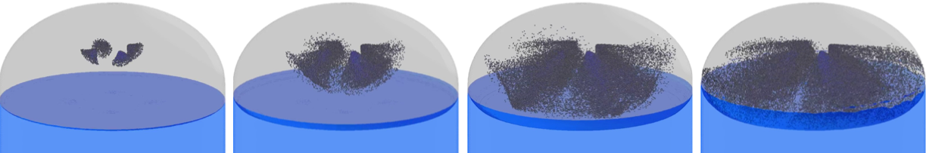
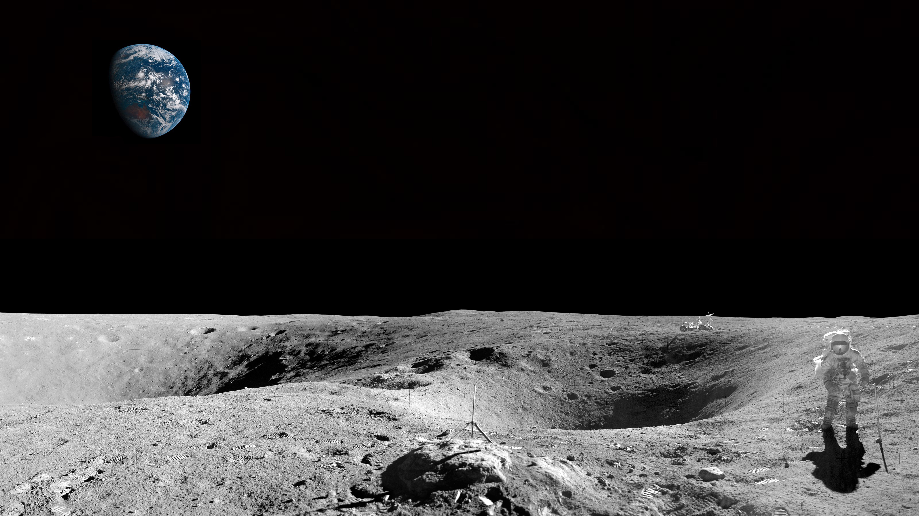
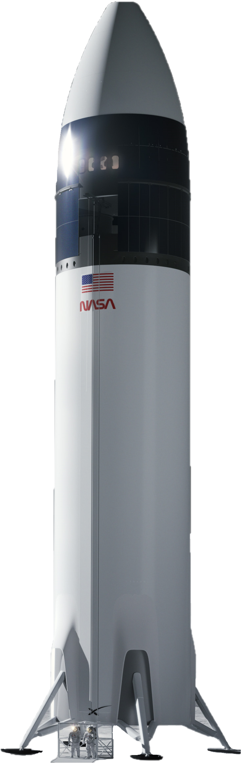
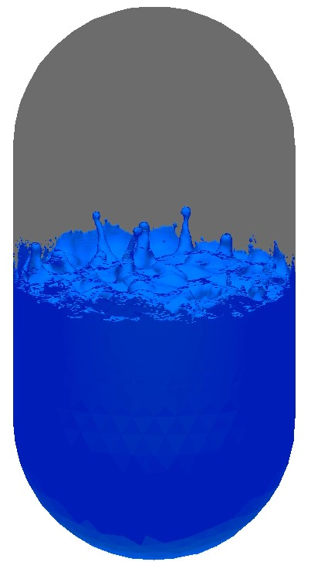
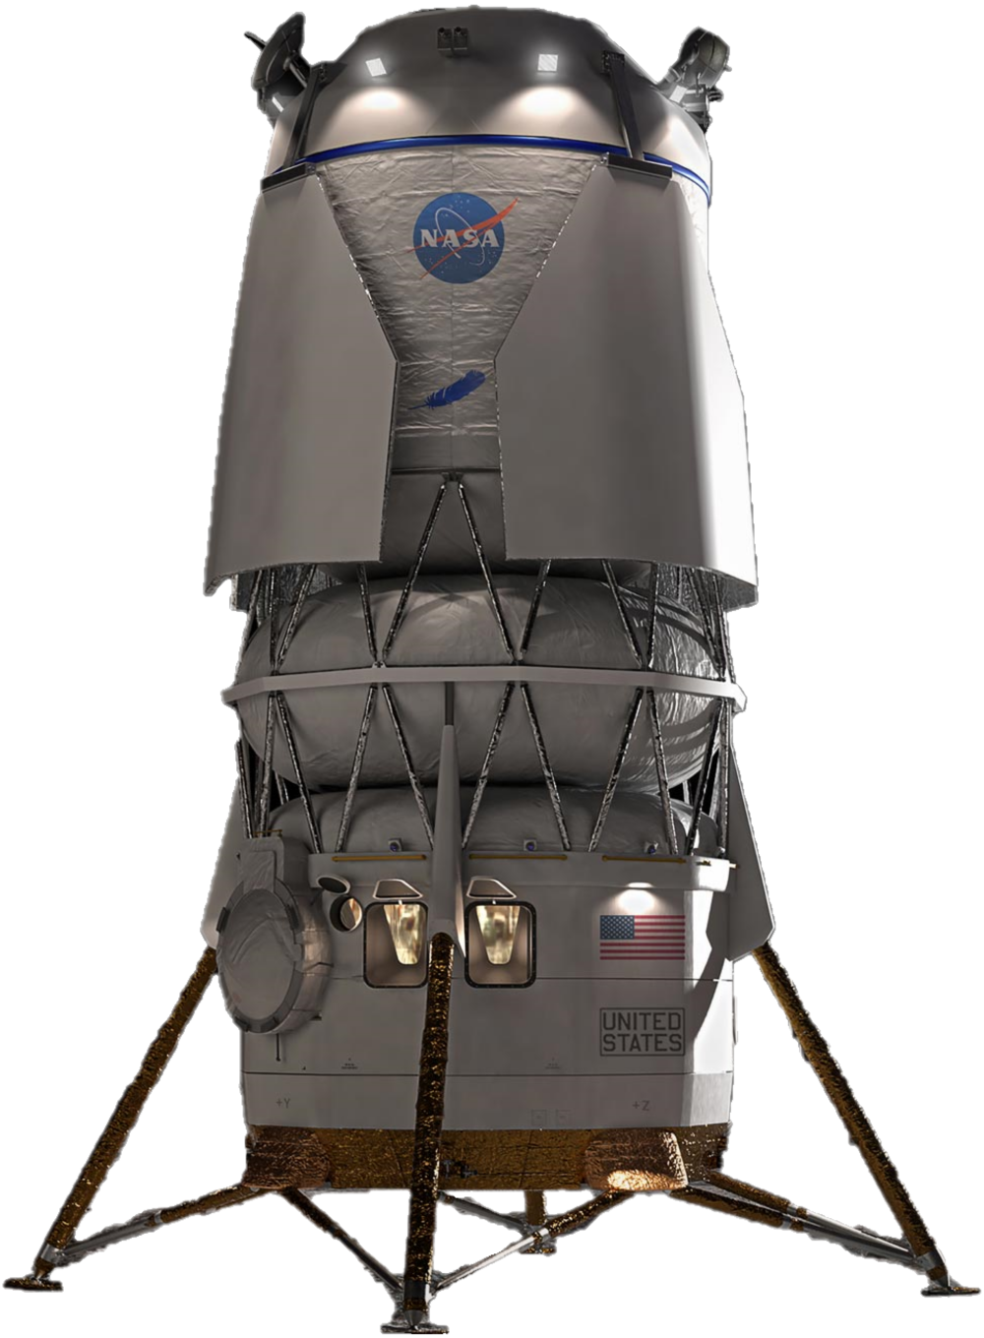
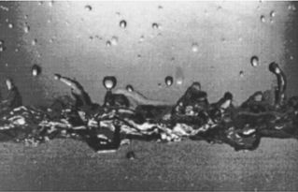
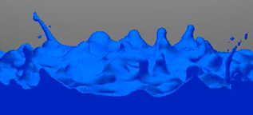

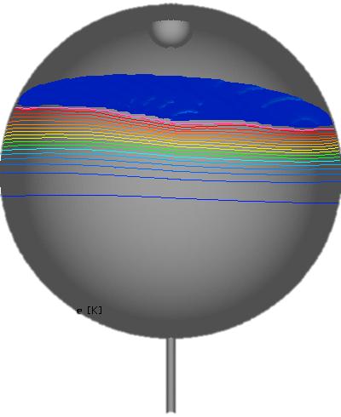
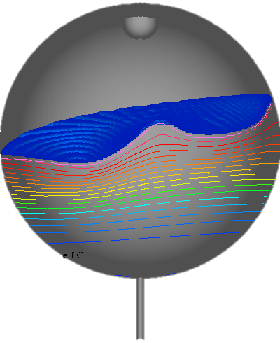
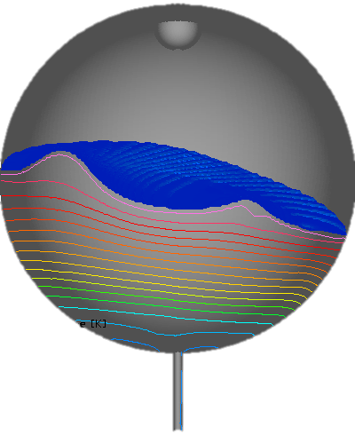
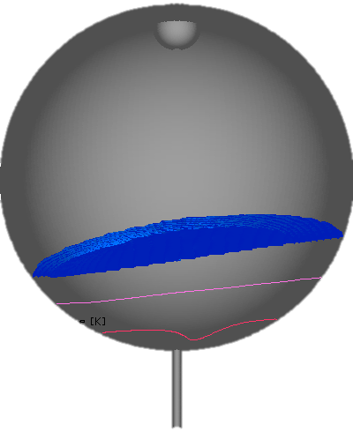
CRYOGENIC FLUID MANAGEMENT USING CFD – DEVELOPMENT AND APPLICATIONS
Fluid Dynamics Branch – ER42
POC: Jacob Brodnick
CFD Model Development and Validation Enabling In-line Support of CFM Applications
(CFM Modeling Portfolio)
Propellant Tank No-Vent Fill Operations Support
(HLS Collaboration)
Validation Activities Included:
Propellant Tank Self-Pressurization
Autogenous Pressurization
Tank Pressure-control using an Axial Jet
Slosh Induced Ullage Collapse
No-vent Tank Filling
Development Activities Included:
Improved Turbulence Modeling of the Two-phase Interface
Implicit Interfacial Phase Change Modeling
Improved Integration between Lagrangian and Eulerian Liquid Representation
Fill Operation Types Included:
Submerged Axial Jet Injection
Unsubmerged Spray Injection
Analysis Products Included:
Slosh Loads for Attitude Hold Design Requirements
Mixing Rates for Propellant Transfer Stall Quantification
Surface Dynamics for Mass Gauging Technique Selection
No-vent Fill via Axial Jet
(Eulerian Volume of Fluid (VoF))
Self-pressurization of Zero Boil-off Tank (ZBOT)
Autogenous Pressurization of EDU Tank
Industry Outreach through Conference Publication and Analysis Demonstration
No-vent Fill via Spray Injection
(Lagrangian Particle Spray Conversion to Eulerian VoF)
Droplet Ejection of Cryogenic Propellant in Microgravity Due to Pulsing Reaction Control Systems (RCS) Thrusters
Propellant Transfer Operations Support
(HLS Collaboration and Tipping Point Contract)
Outreach Activities Included:
Publishing 6 research papers in JANNAF and AIAA forums
Conducting analyses of generic tank designs to demonstrate fundamental findings from in-line program support
Analysis Products Included:
Pressurization and Pulsed Settling Scheme Evaluation for Ensuring Propellant Acquisition
Supply Tank Draining for Vapor Ingestion Identification
Experiment
Computational Fluid Dynamics
Propellant Transfer Operations
(Pressurization, Pulsed Settling, Draining)

