Slide 1

Influence of Stoichiometry on Zirconium Oxycarbides (ZrC_{x}O_{y}) Exposed to Hot Flowing Hydrogen
Martin Volz¹, J. K. P. Williams¹,A. Croell², J. Reynolds¹, B. Taylor¹, J. Rosales¹, E. Kardoulaki³ and K. J. McClellan³
¹NASA Marshall Space Flight Center
²University of Alabama in Huntsville
³Los Alamos National Laboratory

Slide 2
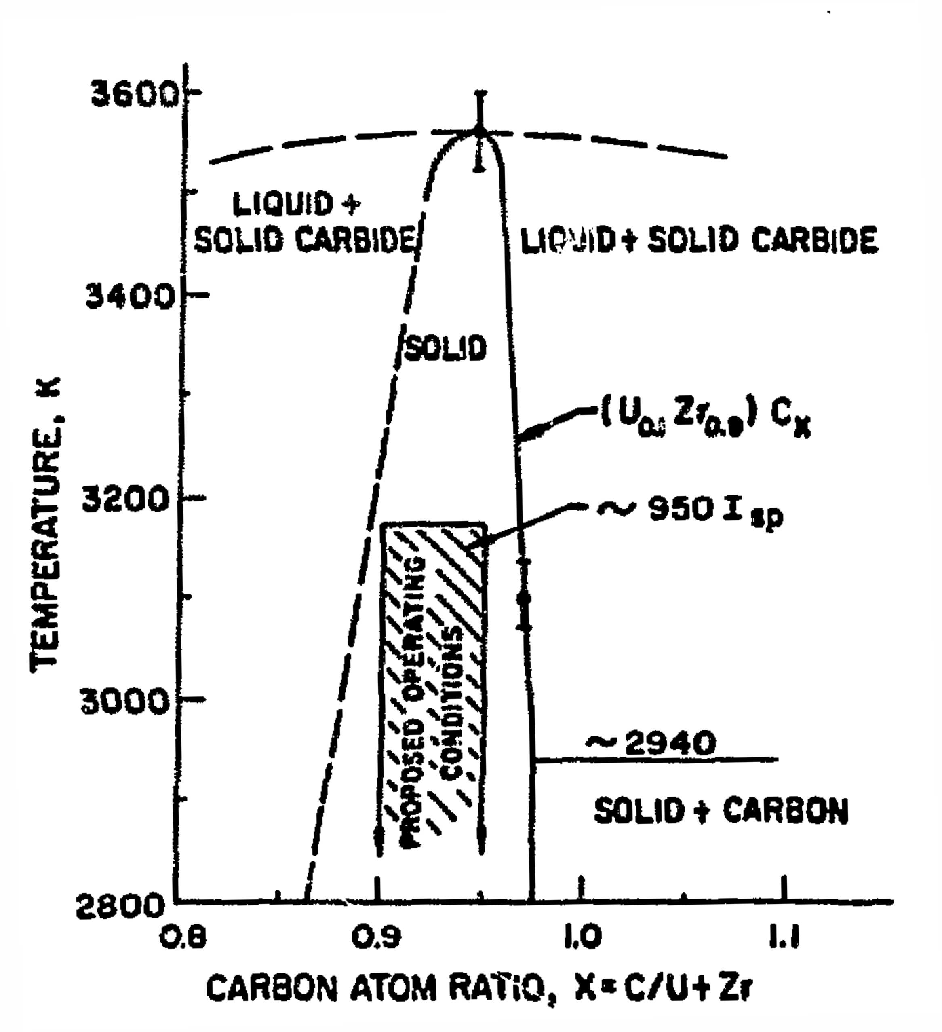

Motivation
How critical is the oxygen and carbon concentration in carbide NTP reactor fuel?
ZrC is anipated to be a primary NTP nuclear reactor material, eticither as a constituent in a solid solution binary carbide (UZrC) or tricarbide (ex. (UZrNb)C), or as a coating.
Hyper- or hypo- stoichiometries of carbon in (UZr)C carbides can decrease the melting point and operational temperature range.
Oxygen can be unintentionally incorporated into a mixed carbide either as a component in the starting powder, or through oxidization during powder processing or sintering of the solid.
Quantitative data is lacking on the effects that oxygen incorporation and carbon concentration have on mass loss rates and material structure when ZrC_{x}O_{y} is exposed to hot flowing hydrogen.
Lyon, Los Alamos Scientific Laboratory
Report LA-5398-MS (1973)

Slide 3

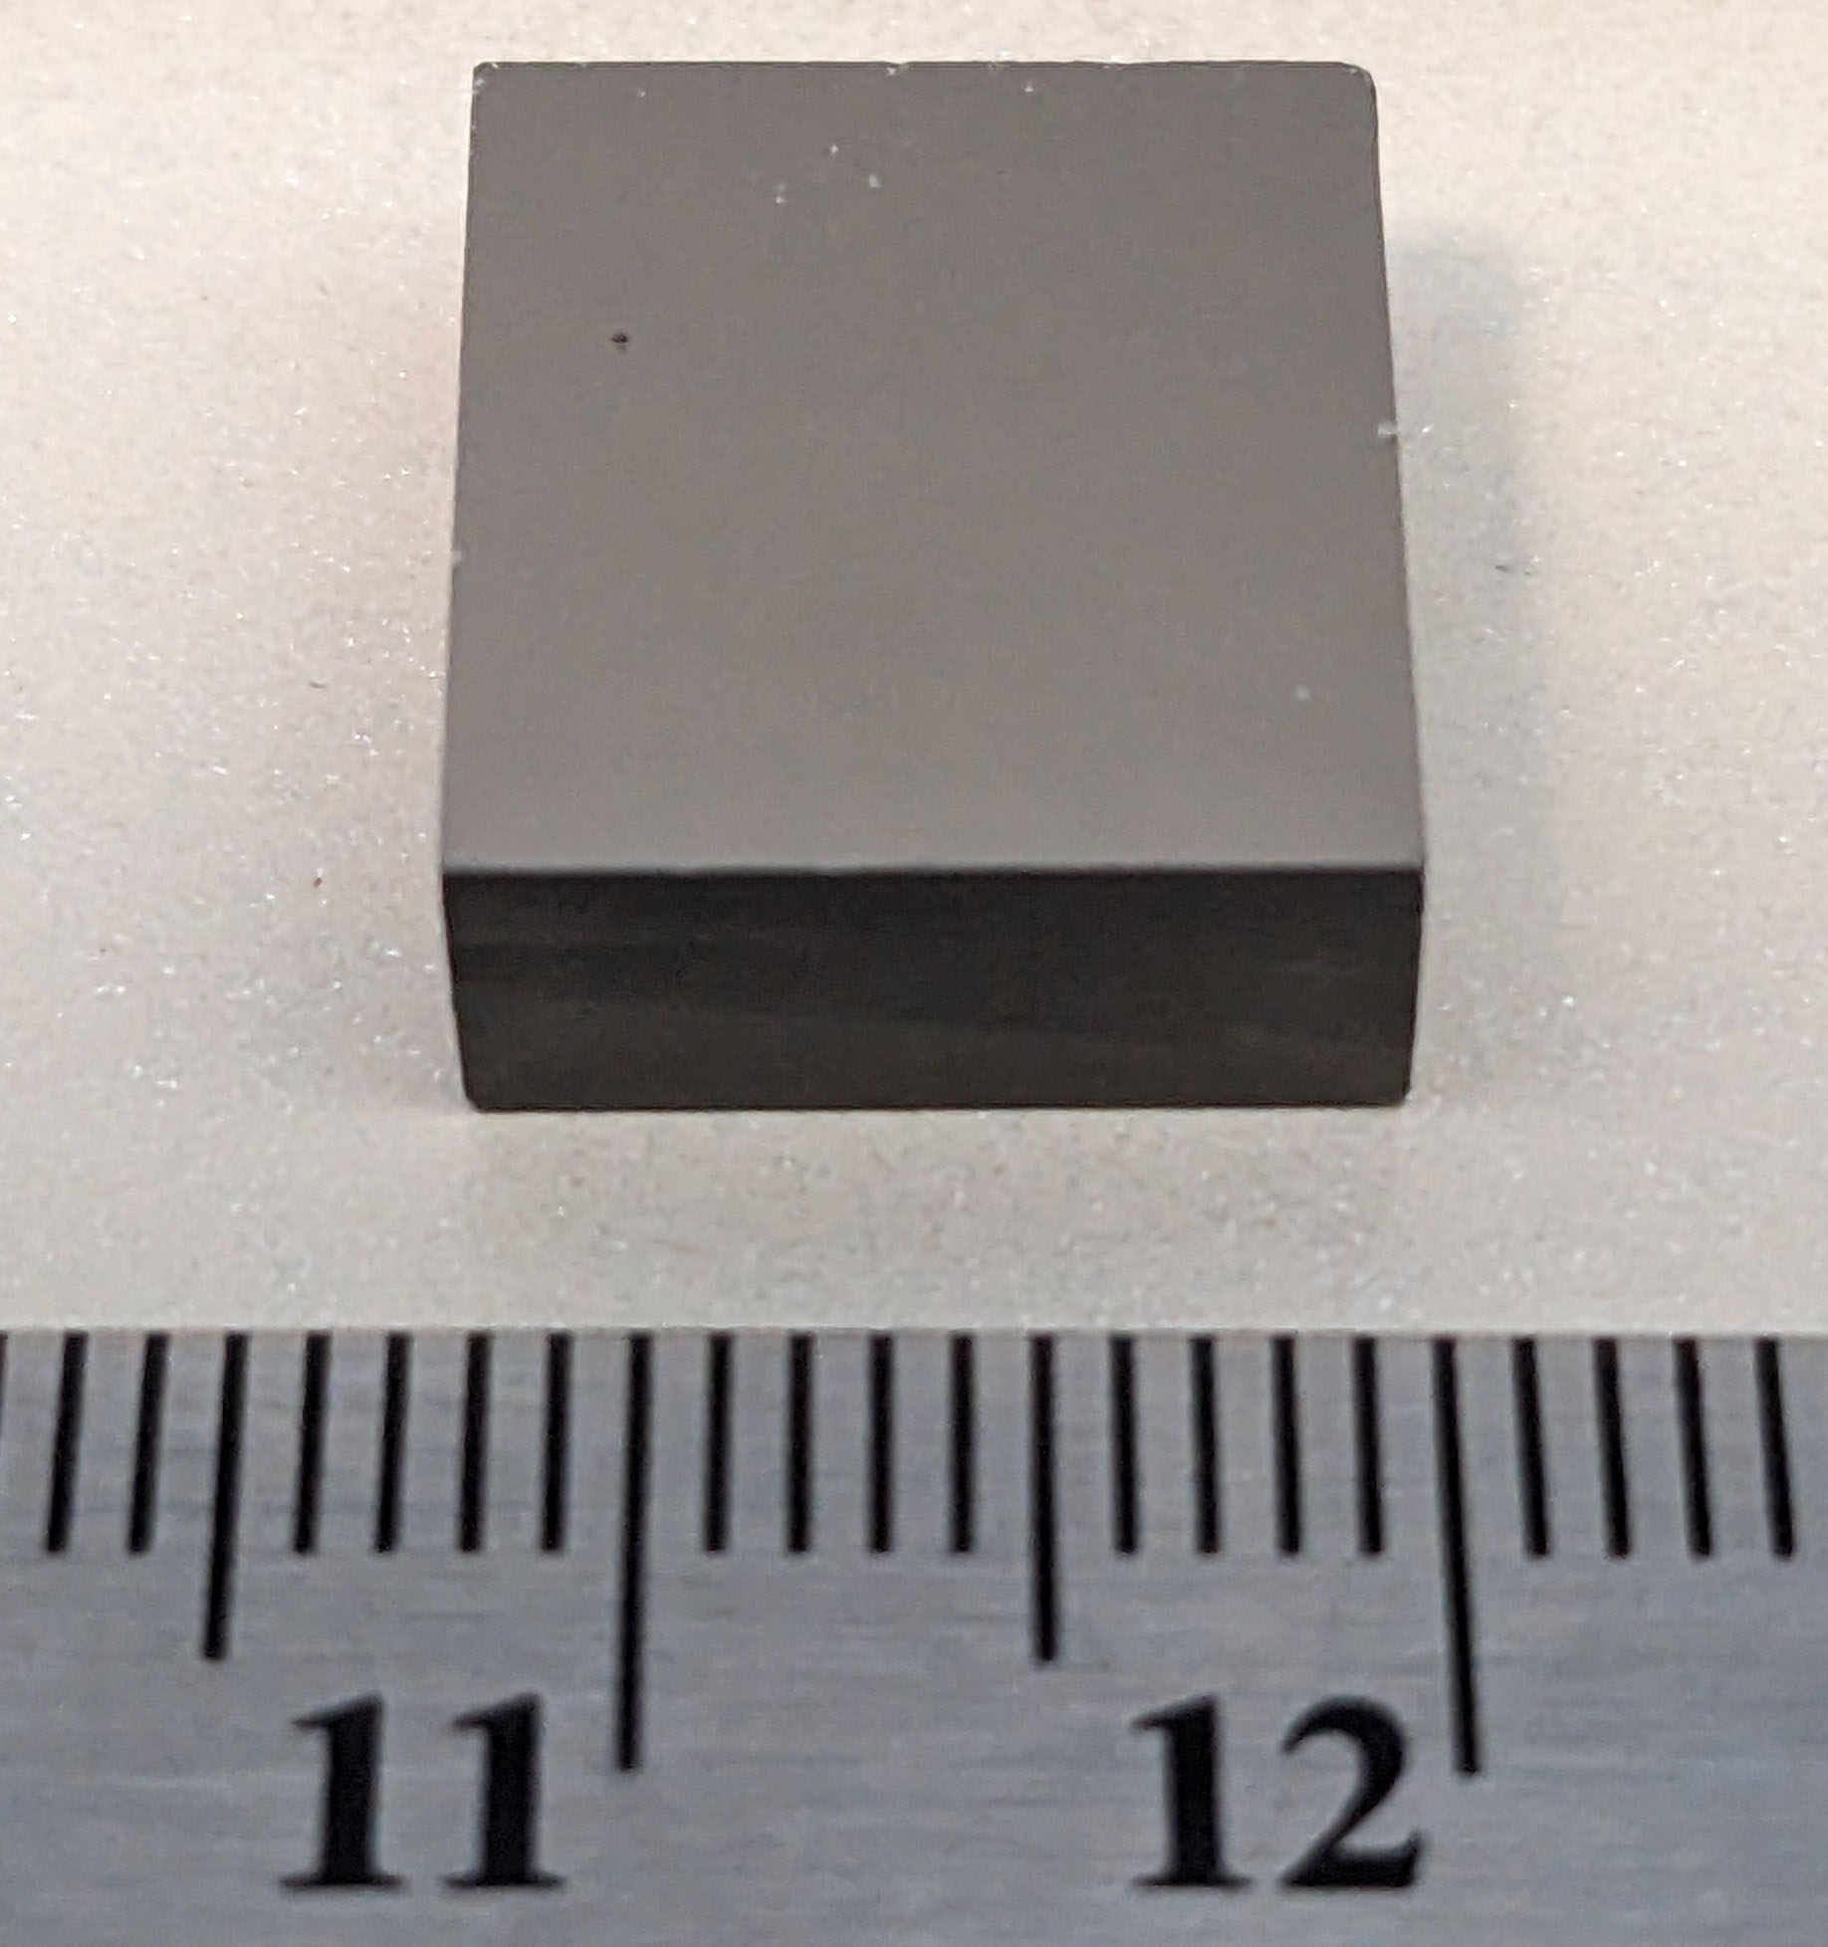
Sample Preparation
Sample ZrC23-1 was prepared with stoichiometry from powders as-received from vendors.
  ZrC_{0.95}O_{0.03}
Sample ZrC23-2 was prepared by first heating ZrC powder in air to increase oxygen concentration.
  ZrC_{0.83}O_{0.14}
Sample powders consolidated by Spark Plasma Sintering resulting in 40 mm diameter by 6 mm tall billets.
4 rectangular test specimens were cut from each billet after polishing for testing in hot hydrogen at different temperatures.
Samples characterized by oxygen and carbon elemental analysis, XRD, density measurements, and SEM/EDS at each stage of processing.
Cut-out pattern
Sample ZrC23-1B

Slide 4
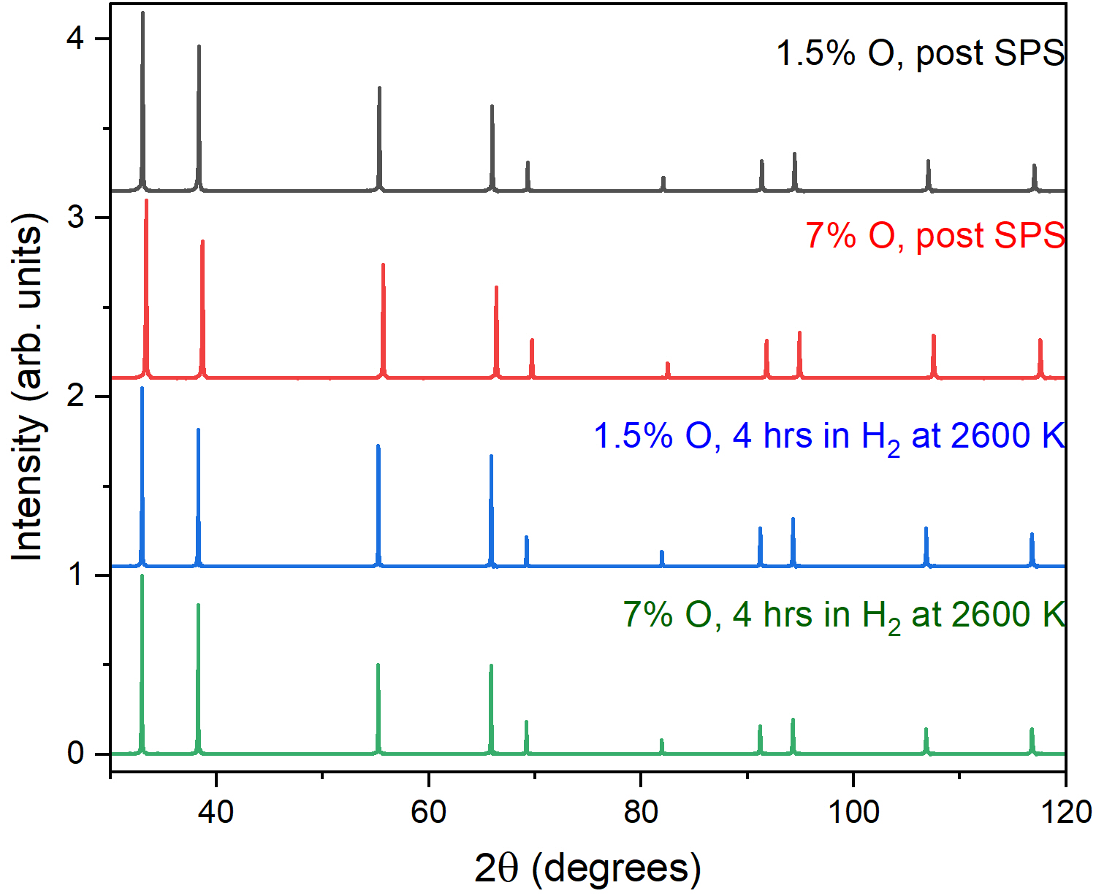
X-Ray Diffraction Results
None of the samples show evidence of any secondary phases (e.g., ZrO₂)
Oxygen can sit at a carbon site in the ZrC_{x} lattice forming the zirconium oxycarbide (ZrC_{x}O_{y})
Oxygen and Carbon concentration cannot be determined directly from XRD but were determined by inert gas fusion (oxygen by LECO ON836, carbon by Horiba EMIA-PRO)
Oxygen concentration can affect the sample density and lattice spacing (not discernable on graph)

Slide 5
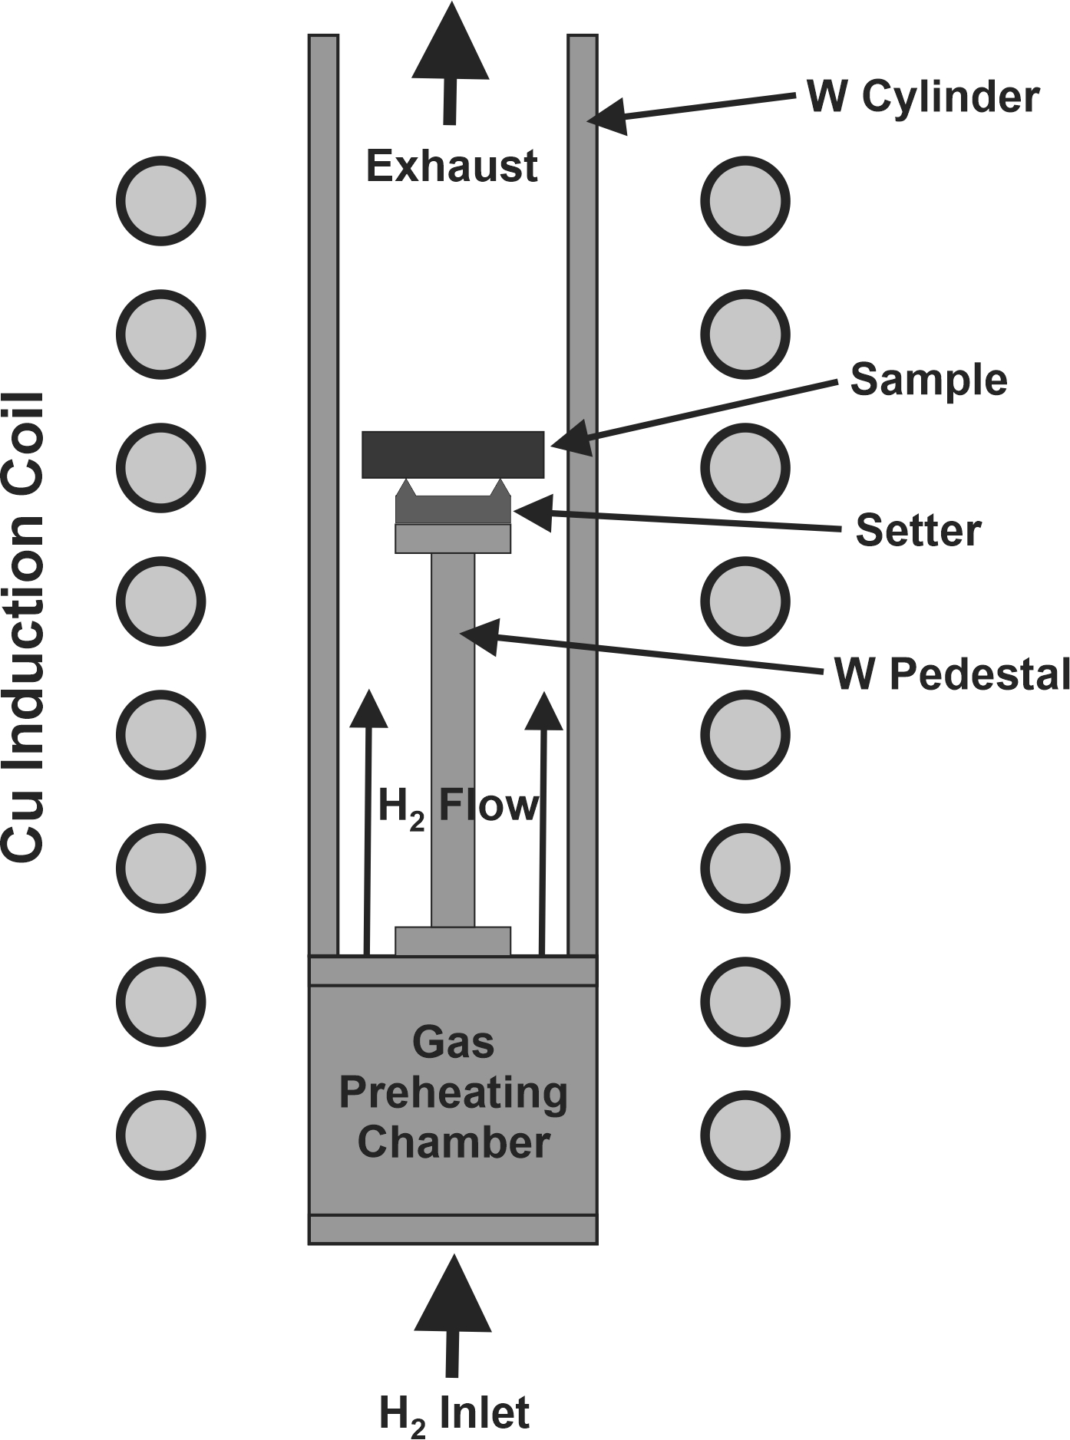
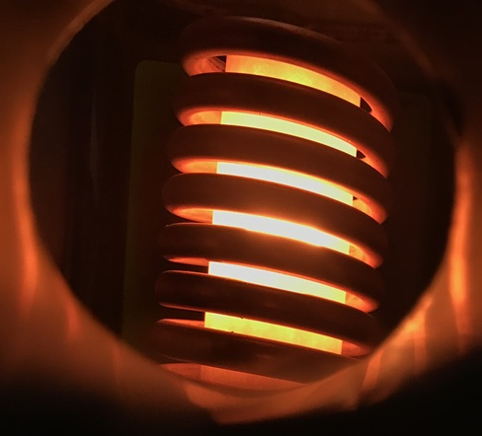
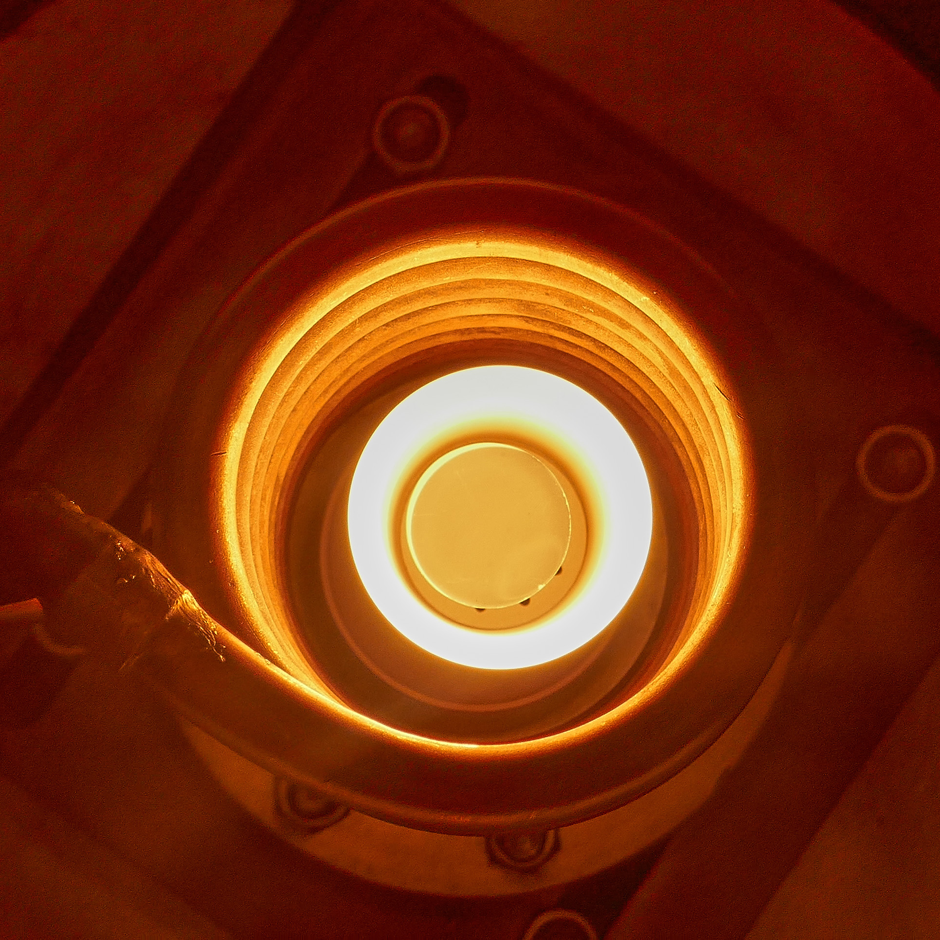
Hot Hydrogen Compatibility Test System
Compact Fuel Element Environmental Test (CFEET)
  Testing in flowing Hydrogen at 6 SLPM
  Testing to date at 2300 K and 2600 K
  Multi-spectral pyrometry (FAR Associates) for temperature measurements
  Pyrometers viewing from top and side
  Side View
  Top View

Slide 6
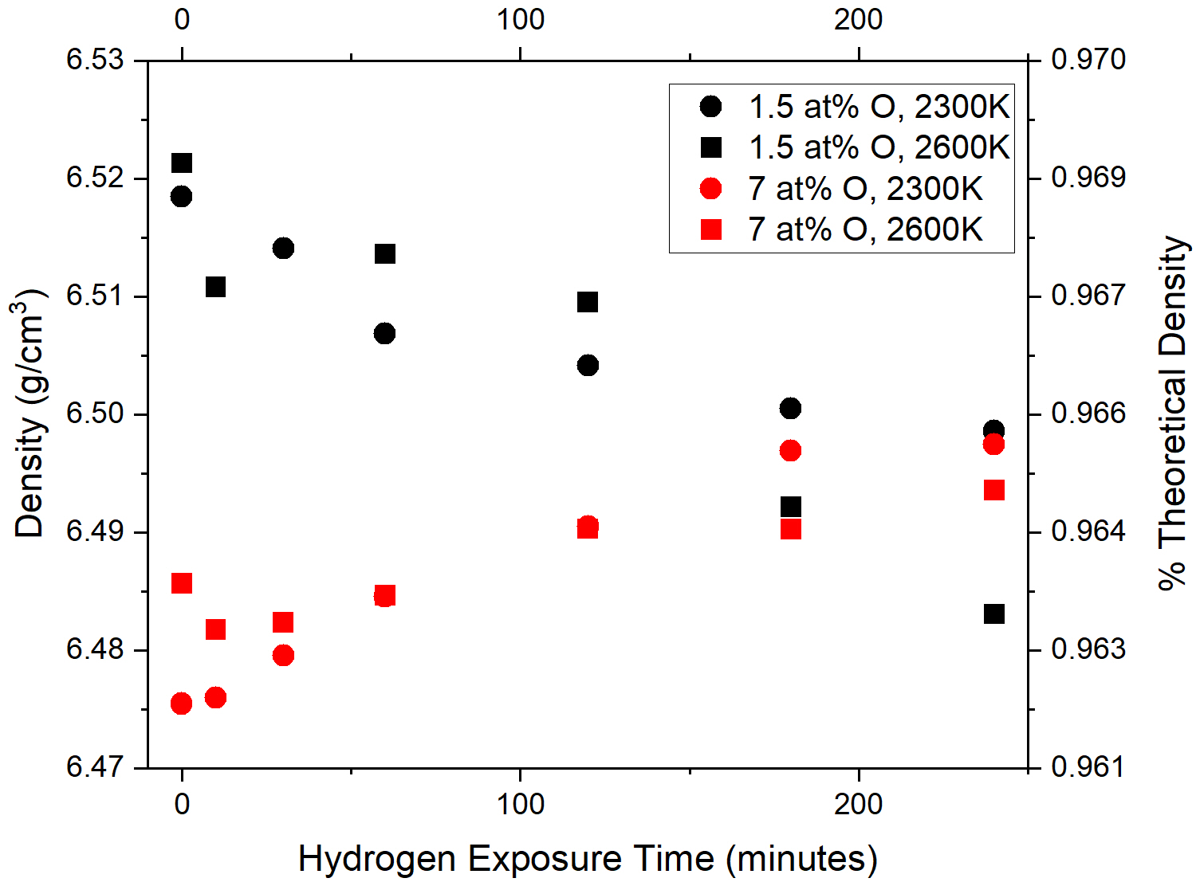
Density Changes from Hot Hydrogen Exposure
Oxygen rich samples had a lower density after SPS but increased in density upon hot hydrogen exposure.
Lower oxygen concentration samples decreased in density upon hot hydrogen exposure.
Samples exposed to higher temperatures had a lower density.

Slide 7
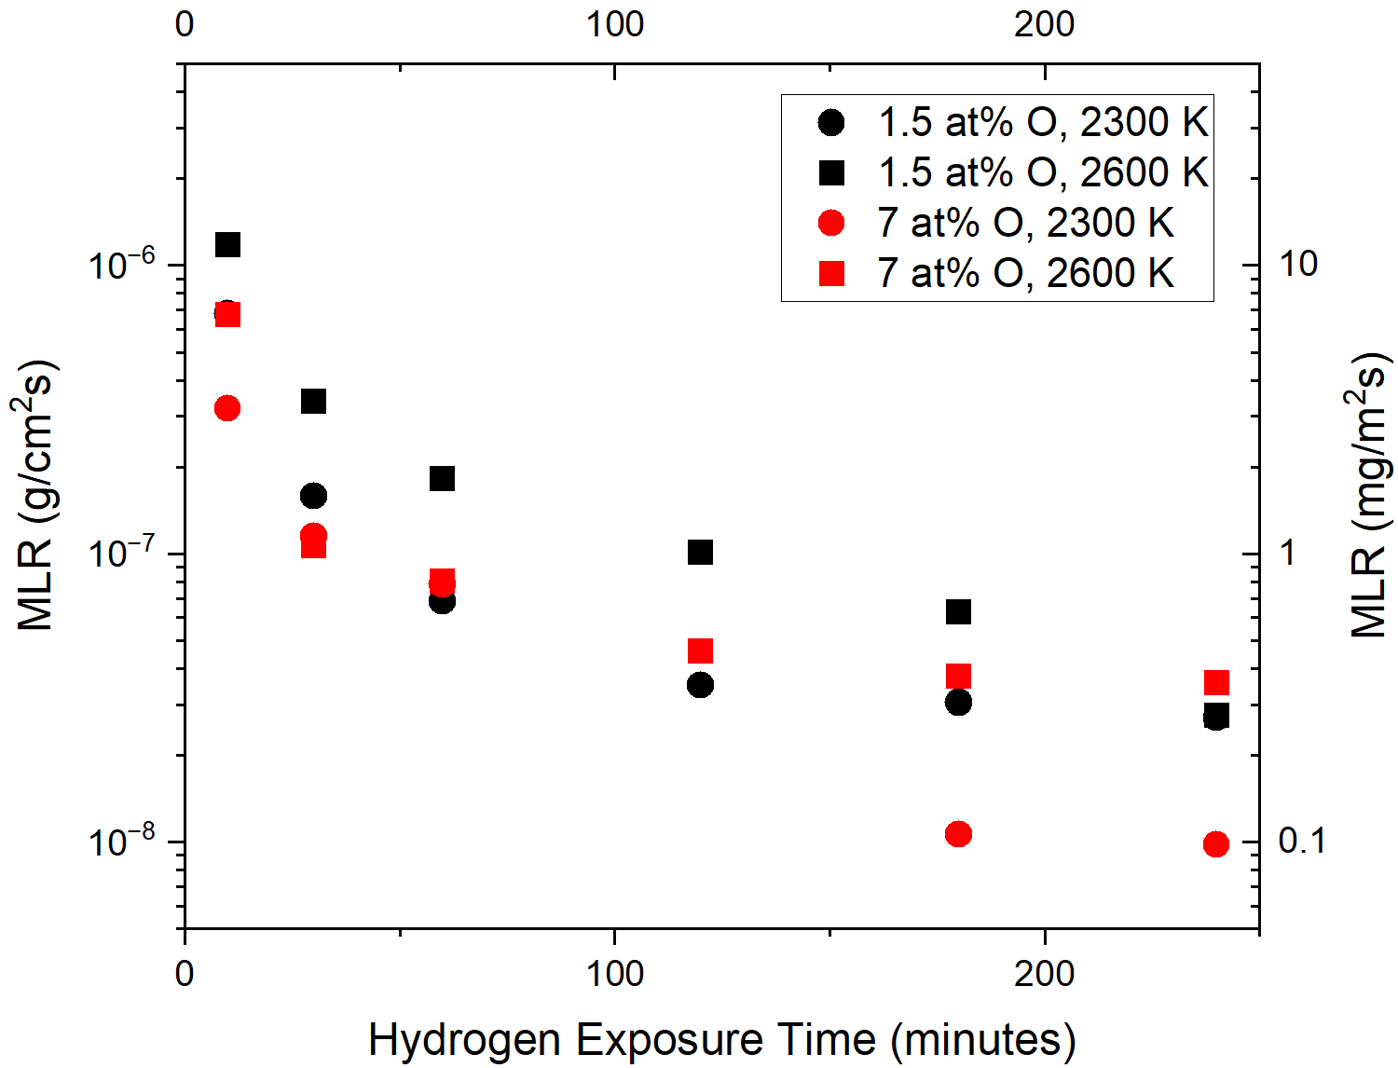
ZrC_{x}O_{y} Mass Loss Rates (MLR’s)
Factors Affecting MLR
Sample density
Diffusion rates of Zr, C, and O
Activity (vaporization) of ZrC_{x}O_{y} in hydrogen
Gas pressure
Chemical reactions
2H₂ + C → CH₄
H₂ + 2C → C₂H
2H₂ + 2C → C₂H₄
2H₂ + O₂ → 2H₂O

Slide 8
Acknowledgements
The current work was completed at NASA - Marshall Space Flight Center and supported by NASA’s Space Technology Mission Directorate (STMD) through the Space Nuclear Propulsion (SNP) project
The University of Alabama in Huntsville was involved in the research and was supported by NASA under cooperative agreement NNM11AA01A

