Slide 1


LUNAR RESOURCE INVESTIGATION WITH NASA’S VIPER MISSION
Janine Captain, VIPER MSolo PI
June 16, 2024
Notes:
STILL

Slide 2
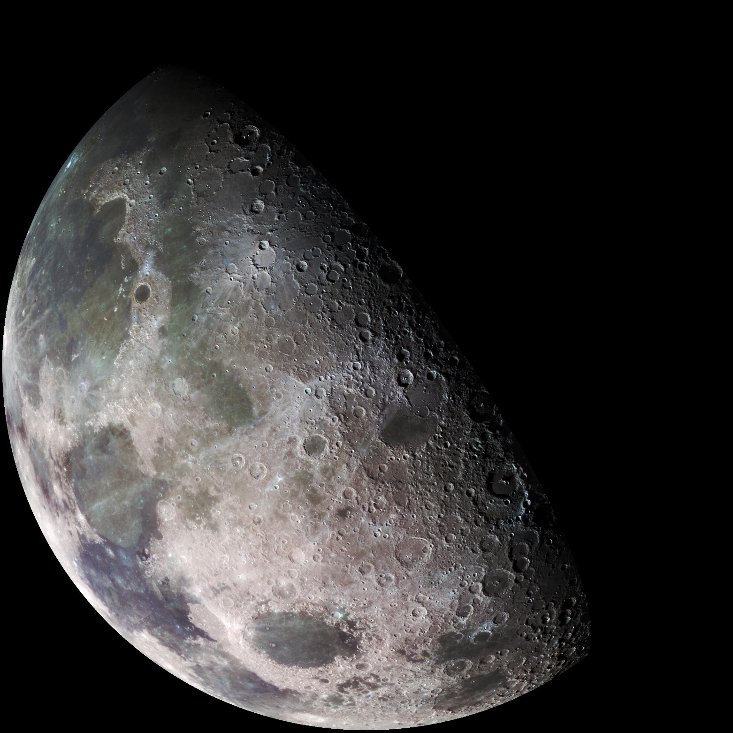
Just Two Decades Ago…
When I started at NASA…
The Moon was a very different place to how we understand it today…
Studied from the Earth, in-situ and with samples returned to Earth.
The ”general” thinking was:
Surface was relative constant
Thin exosphere of Argon, Sodium and Potassium
Bone dry (~100 ppm of water in soils)

Slide 3

The Hunt for Lunar Volatiles
Clementine (1994):
Bi-static radar tests revealed curious findings at the poles... Water-ice?
Lunar Prospector (1998): Neutron measurements reveal shadowed craters contain elevated Hydrogen levels… Water-ice?
LCROSS/LRO (2009):
Shadowed Crater Impactor confirms subsurface water-ice. How is the water-ice distributed?
Chandrayaan-1 (2018):
M³ instrument confirms surface ice at the poles. How is the water-ice distributed?
VIPER (2024–2025):
Will prospect for water-ice on human scales, creating water resource maps of the polar regions
Notes:
Chandrayaan-1 M³ = NASA Moon Mineralogy Mapper, an imaging spectrometer

Slide 4
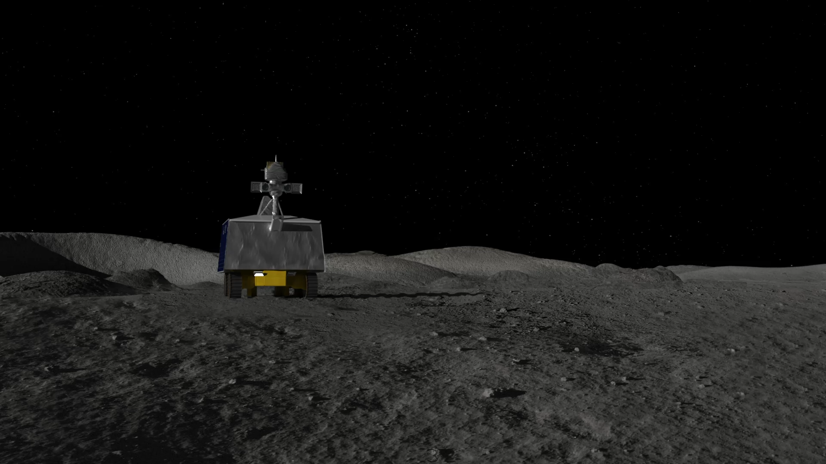

The next great leap in understanding lunar water is mapping these volatiles at the human scale.
Characterize the distribution and physical state of lunar polar water and other volatiles in lunar cold traps and regolith.
Provide the data necessary for NASA to evaluate the potential return of In-Situ Resource Utilization (ISRU) from the lunar polar regions.
Notes:
Need that surface and subsurface data measurements to ground truth orbital data and to ground truth the thermal and environmental models.
Doing resource mapping on another world….…breaking new ground
Rover mission – mobility is a key part – heterogeneity drives the need for an in-situ and mobile asset

Slide 5
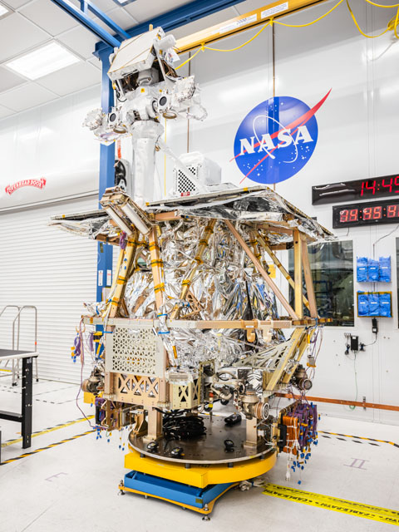
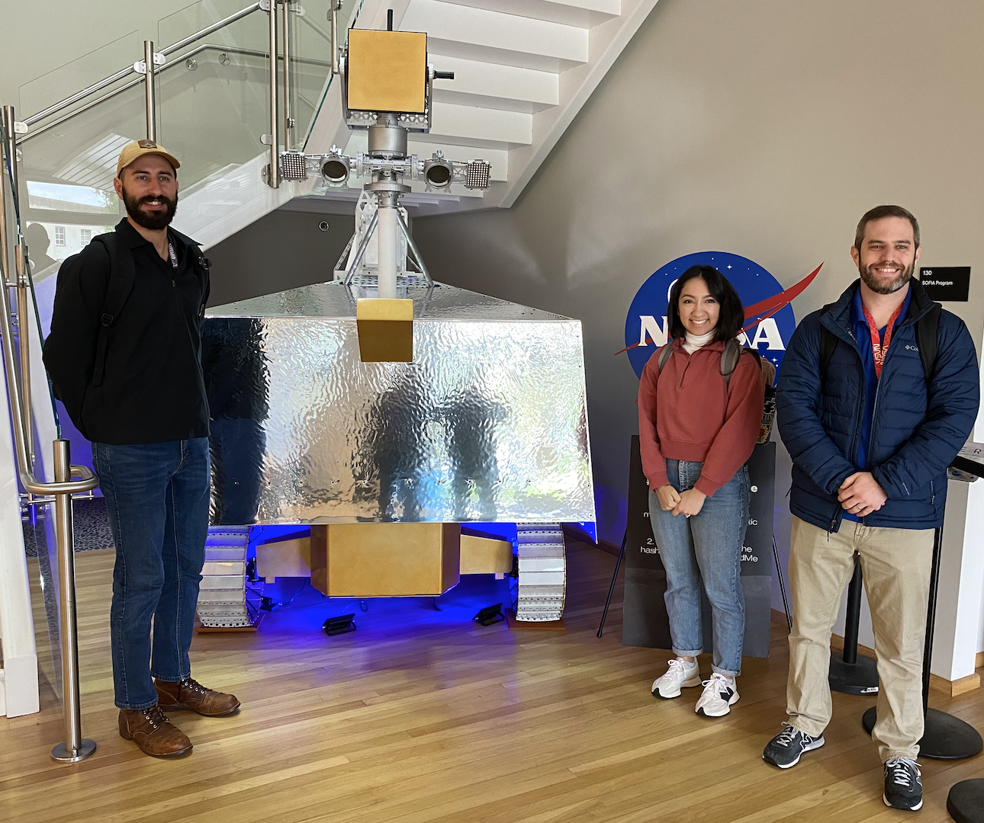
VIPER Rover Science at Human Scale
MSolo team members with VIPER Rover model
VIPER hardware integration nearing completion in readiness for environmental testing.
NASA/Josh Valcarcel

Slide 6
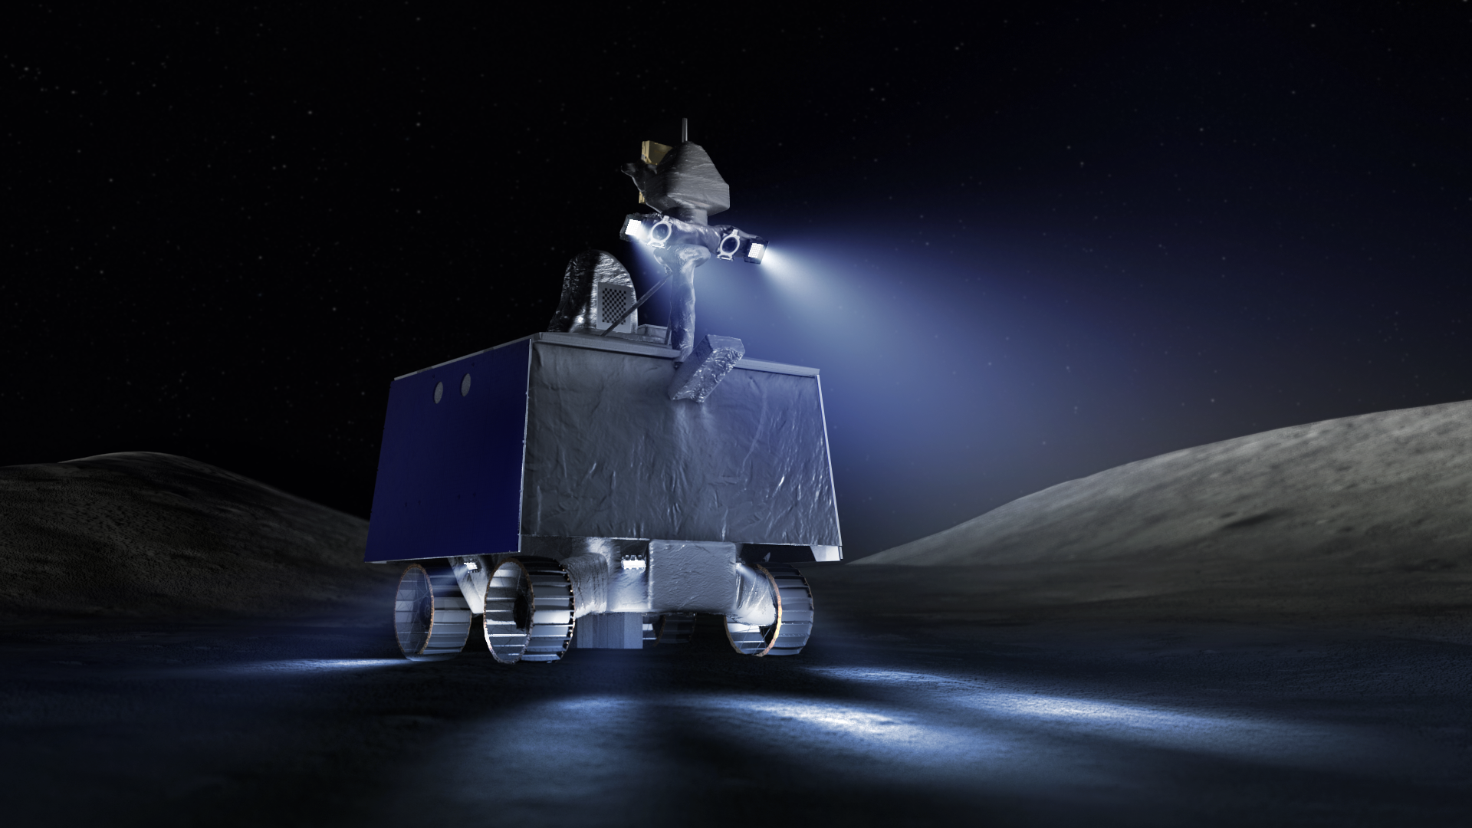
VIPER Rover
Rolling Mass: ~430kg
Power: ~450W (corner-facing) or 320W per array
Communications: X-band
  Downlink: 256kbps ; Uplink: 2kbps
  6-15 s round-trip latency
Dimensions: 1.7m x 1.7m x 2.5m
Wheel Diameter: 0.5m
Steering: Explicit steer; adjustable suspension
Top Speed: 20cm/s (0.5MPH)
Prospecting Speed: 10cm/s (0.25MPH)
Waypoint Driving: 4.5m command distance
Camera Look-ahead: stereo to 8m
Obstacles / Slopes: 20cm / 15deg
Expected Cold Environment: ~40K
Notes:
20 cm/s (0.5 mph) ; 5x faster than Mars rovers
Mars rovers have no-real time interaction, high latency, activities are all preprogrammed
Wheels to navigate around 20 cm obstacles and up to 15 deg slopes.
Ground: DSN 34m dishes: Canberra, Goldstone, Madrid
Stereo <10 cm resolution out to 8m

Slide 7
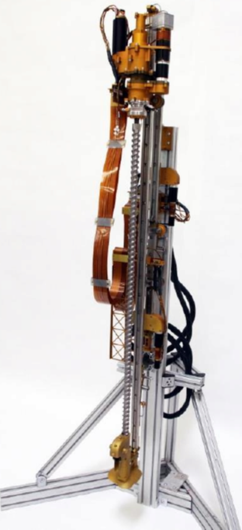
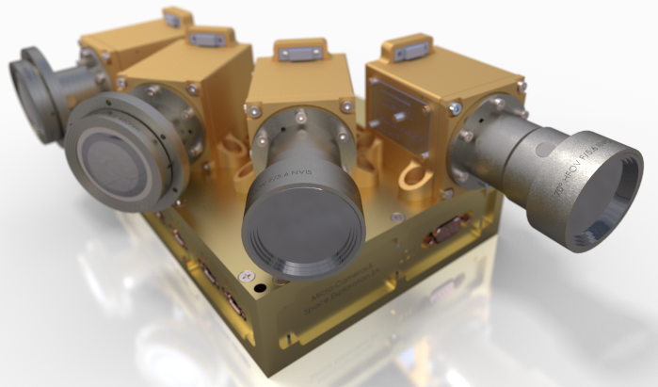
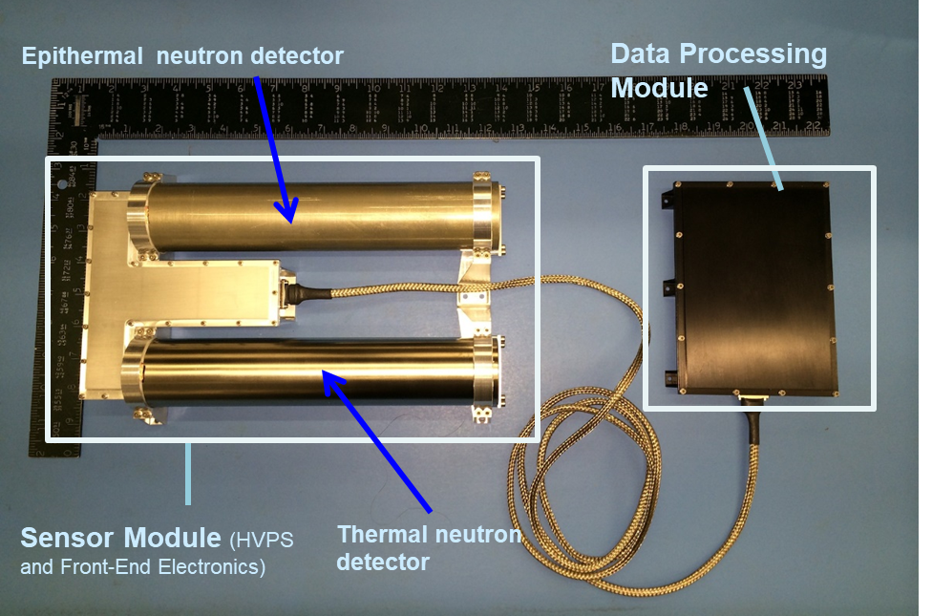
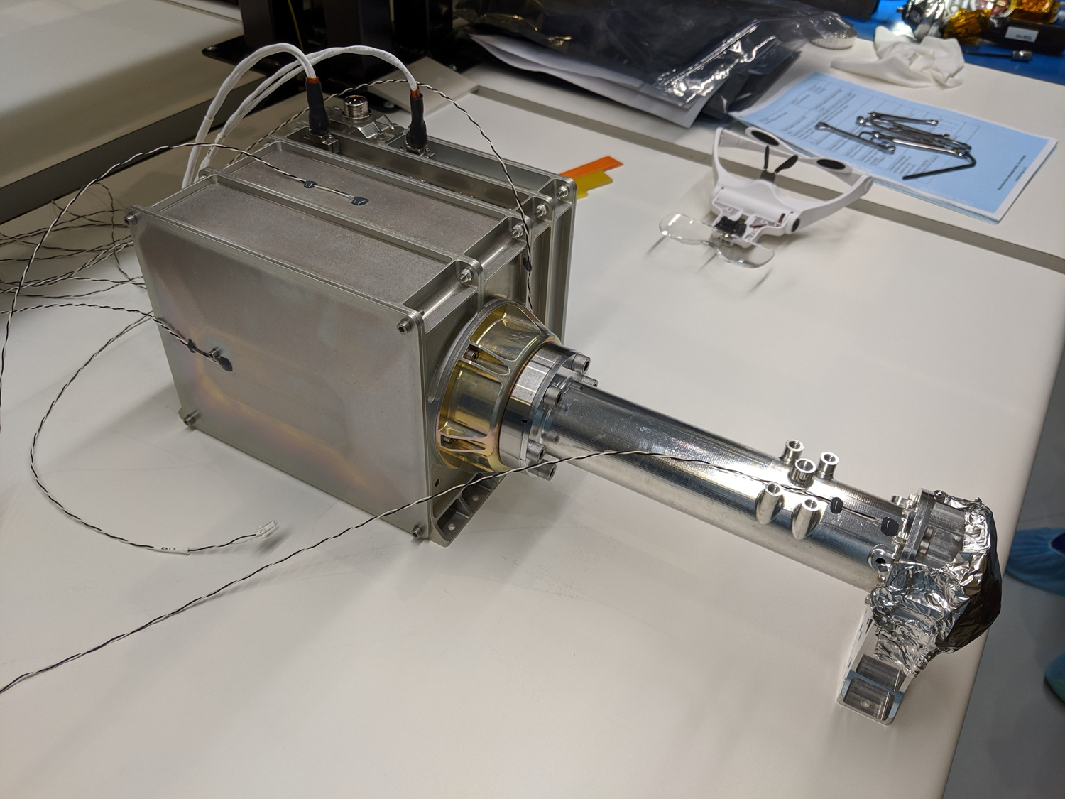
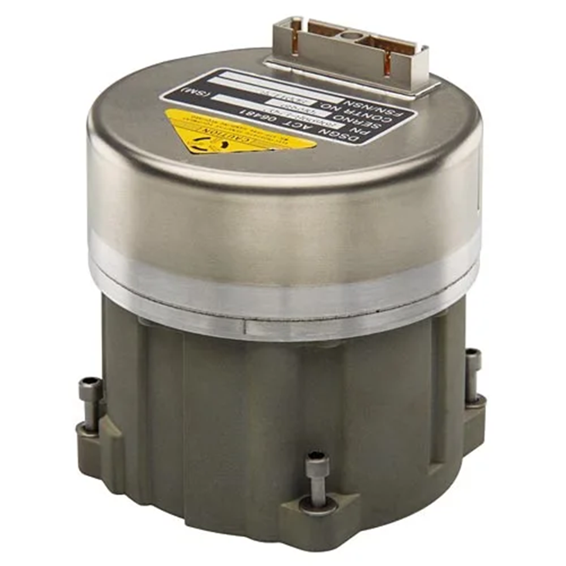
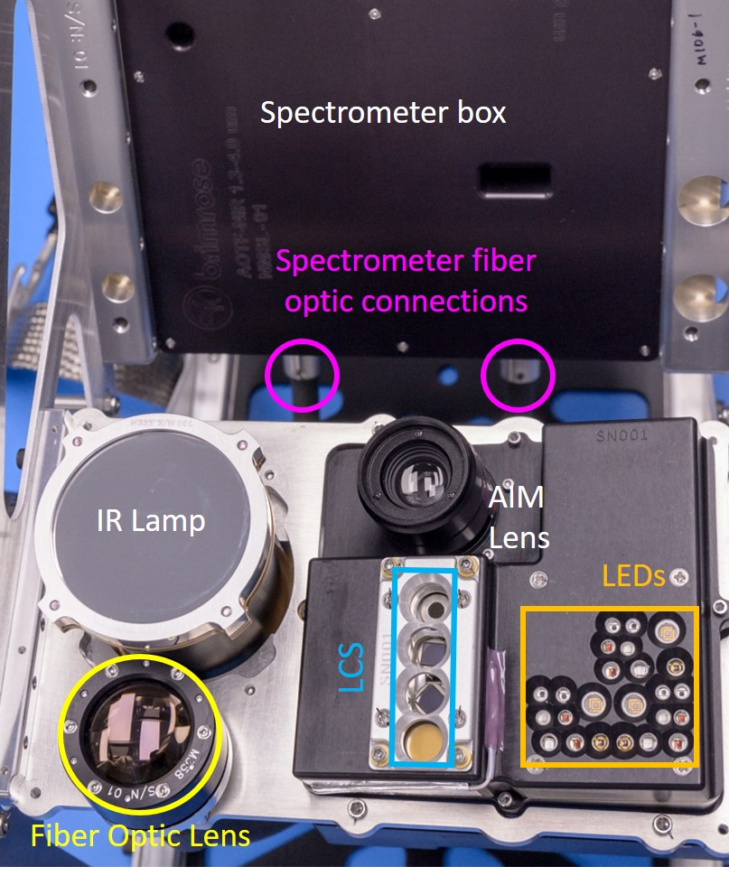
Science Instruments
Imaging Science
VIS
Subsurface
excavation
TRIDENT Drill
Prospecting Neutron Spectrometer System (NSS) Instrument
Subsurface
Sounding
Rover IMU
Prospecting & Evaluation
Near Infrared Volatiles Spectrometer System (NIRVSS) Instrument
Prospecting & Evaluation
Mass Spectrometer Observing Lunar Operations (MSolo) Instrument
Notes:
VIPER payload is integrated and analytically powerful.

Slide 8
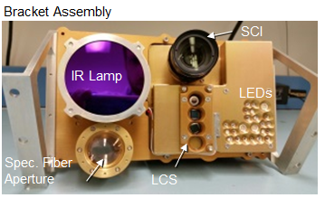
VIPER Instruments
NSS
NSS (NASA ARC/Lockheed Martin ATC)
PI: Rick Elphic (NASA ARC)
Instrument Type: Two channel neutron spectrometer
Key Measurements: NSS assesses hydrogen and bulk composition in the top meter of regolith, measuring down to 0.5% (wt) WEH to 3σ while roving
NIRVSS (ARC, Brimrose Corporation)
PI: Anthony Colaprete (NASA ARC)
Instrument Type: NIR Spectrometer, 4Mpxl Imager with 7 banks of color LEDs, four channel thermal radiometer
Key Measurements: Volatiles including H₂O, OH, and CO₂ and, minerology, surface morphology and temperatures
NIRVSS
MSolo (KSC, INFICON, NSF– SHREC Space Processor, & Blue Sun – Virtual Machine Language)
PI: Janine Captain (NASA KSC)
Instrument Type: Quadrupole mass spectrometer
Key Measurements: Identify low-molecular weight volatiles between 1-70 amu, unit mass resolution to measure isotopes including D/H and 0^{18/}0¹⁶
TRIDENT (Honeybee Robotics)
PI: Kris Zacny (Honeybee Robotics
Instrument Type: 1-meter hammer drill
Key Measurements: Excavation of subsurface material to 100 cm; Subsurface temperature vs depth; Strength of regolith vs depth (info on ice-cemented ground vs. ice-soil mixture).
MSolo
TRIDENT

Slide 9
Sampling: TRIDENT, NIRVSS and MSolo
Sampling via the TRIDENT, MSolo and NIRVSS profile water (and other volatiles with depth, tying down NSS derived concentrations)
TRIDENT samples in 10 cm “bites” down to 1 meter, using a simple auger bit
Each 10cm sample can be brushed to the surface for inspection by NIRVSS and MSolo
NIRVSS images the cuttings at multiple wavelengths (providing context for NIRVSS and MSolo observations) and measures the scene temperature
This process identifies the stratification of hydrogen bearing volatiles, “tying down” NSS measurements

Slide 10
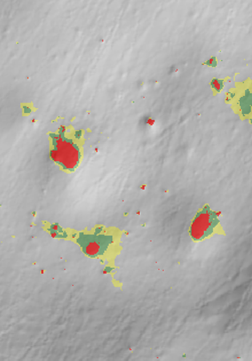
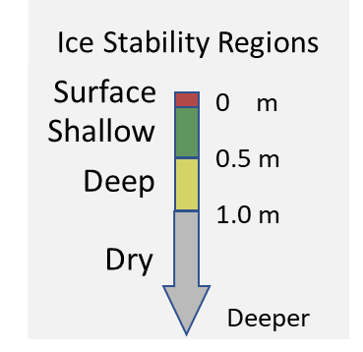
VIPER Mapping Approach: Thermal Proxy Model Concept
Rather than “find” the water VIPER methodically characterizes the range of thermal environments and geologic settings to build correlations between volatiles and environments
VIPER will explore four polar “Ice Stability Regions” (ISRs)*:
“Surface” - Ice expected stable on the surface (PSRs – Permanently Shadowed Regions)
“Shallow” - Ice expected stable between 0-50cm of the surface
“Deep” - Ice expected stable between 50-100 cm of the surface
“Dry” - Ice not expected stable (0-100cm too warm to be stable)
* ISR’s are based on the predicted thermal stability of ice with depth

Slide 11
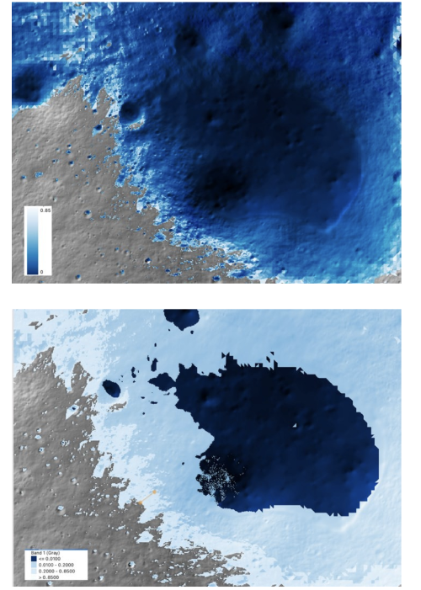
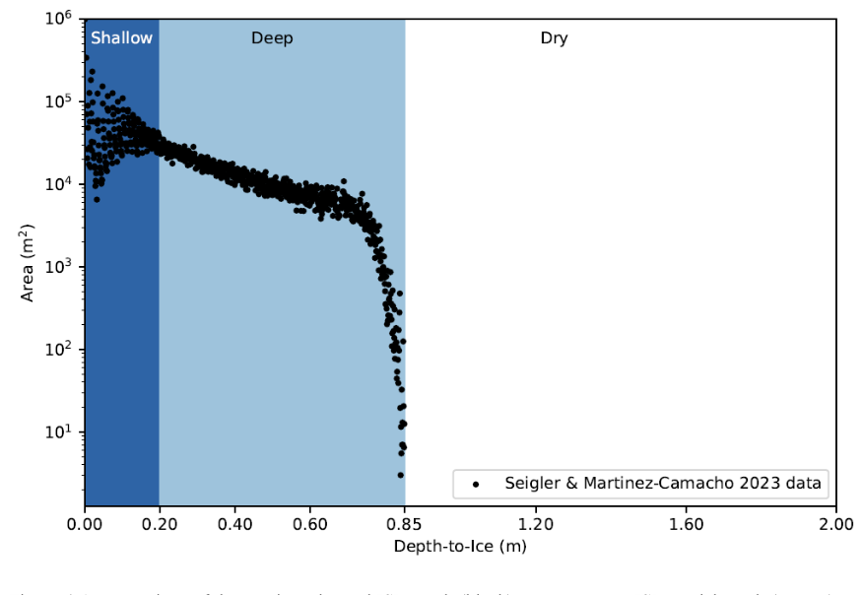

Predicted Ice Stability Depth and Ice Stability Regions

Slide 12
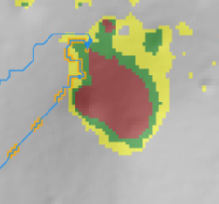
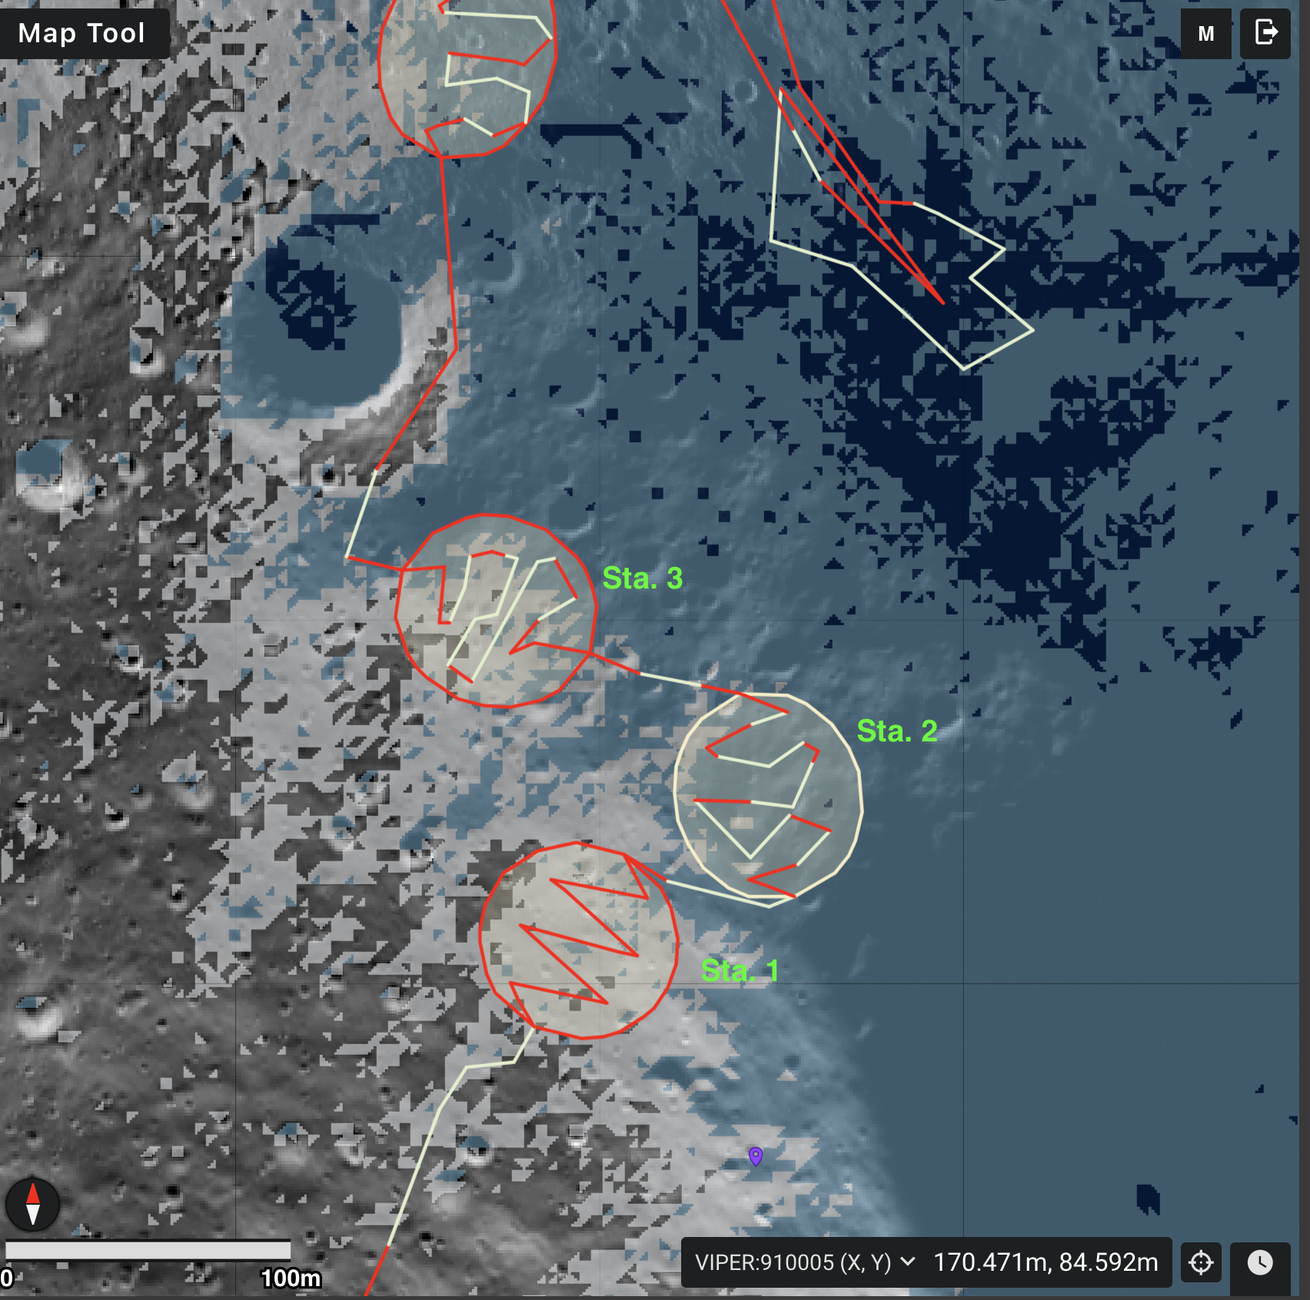
Example of a Mission Area Traverse
Strategic Traverse Planning
Tactical Traverse Planning

Slide 13
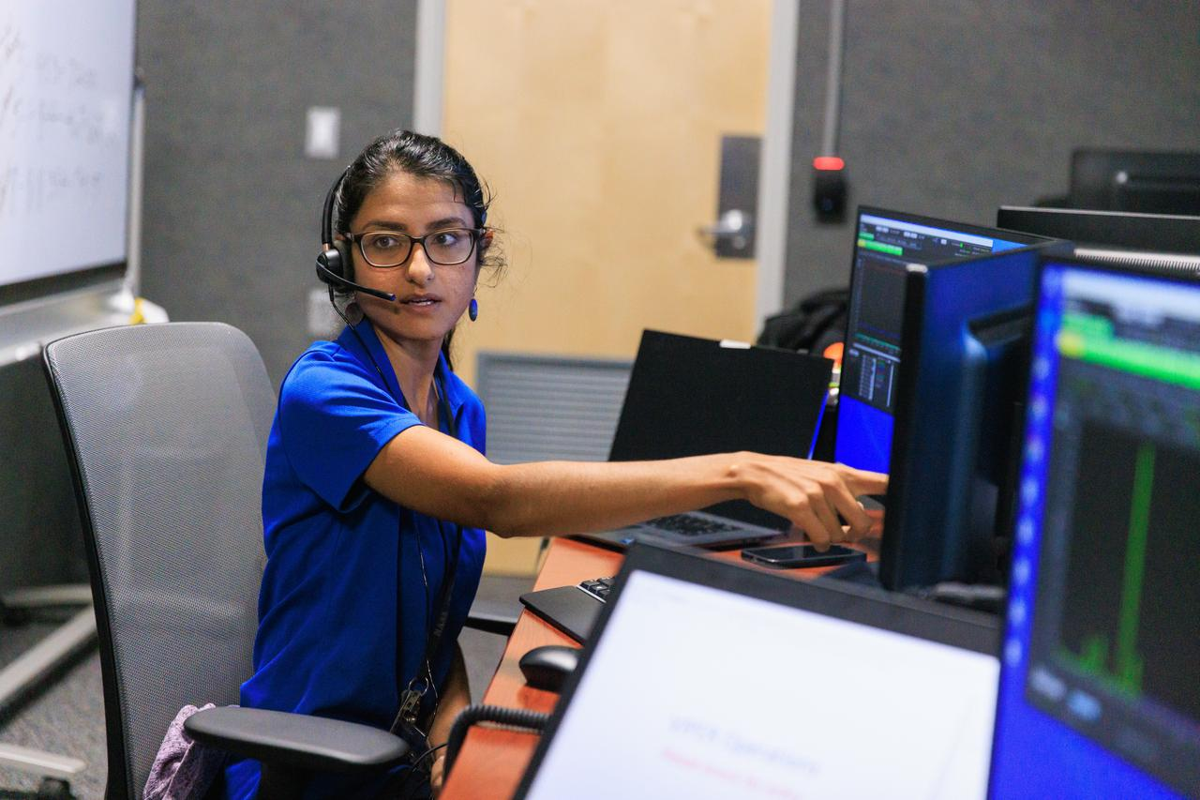
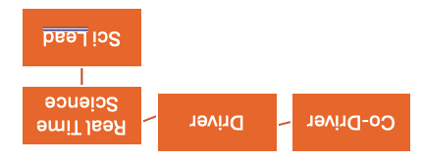
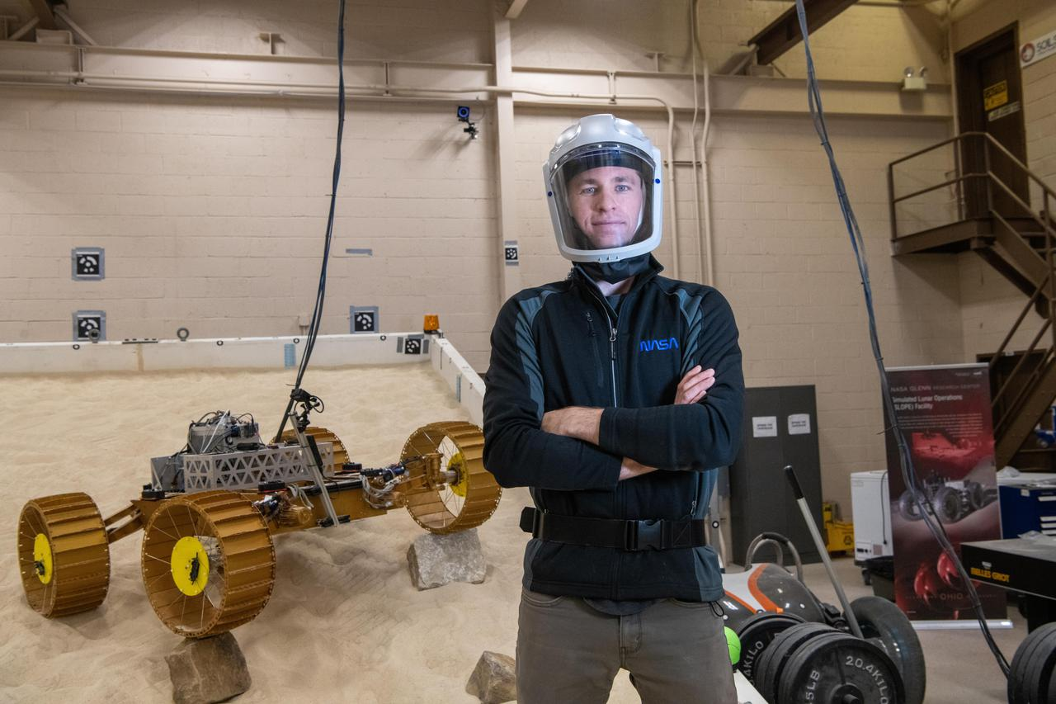
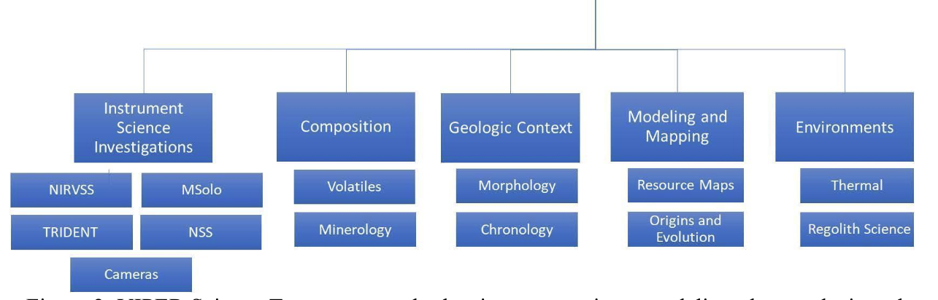
Science led exploration
NASA/Frank Michaux
Mission Science Lead
NASA/GRC/ Bridget Caswell

Slide 14
Mapping via Science Station Activities
planned traverse
planned
landing
site
Science Station 3
Science Station 1
safe havens
actual traverse
drill site
actual
landing
site
recharge
Science Station 2
PSR
Requires sufficient areal coverage (10-15% of a 3800 m² area of dominant ISR type)
Drill three times, with at least one subsurface temperature measurement
Separate measurements on scales from 5-1000 m. Minimum: Visit all 4 ISR types, repeat 2.
Notes:
For each ISR zone type
Cover 10% (min) 15% (goal) of a 3800 m^2 area
Equivalent to 224 m (min) 335 m (goal) of driving
Plus 3 drill sites (10-80 cm w sampling interval of 8 cm)
Separate measurements on scales from 5-1000 m.
Visit all 4 types, repeat 2

Slide 15
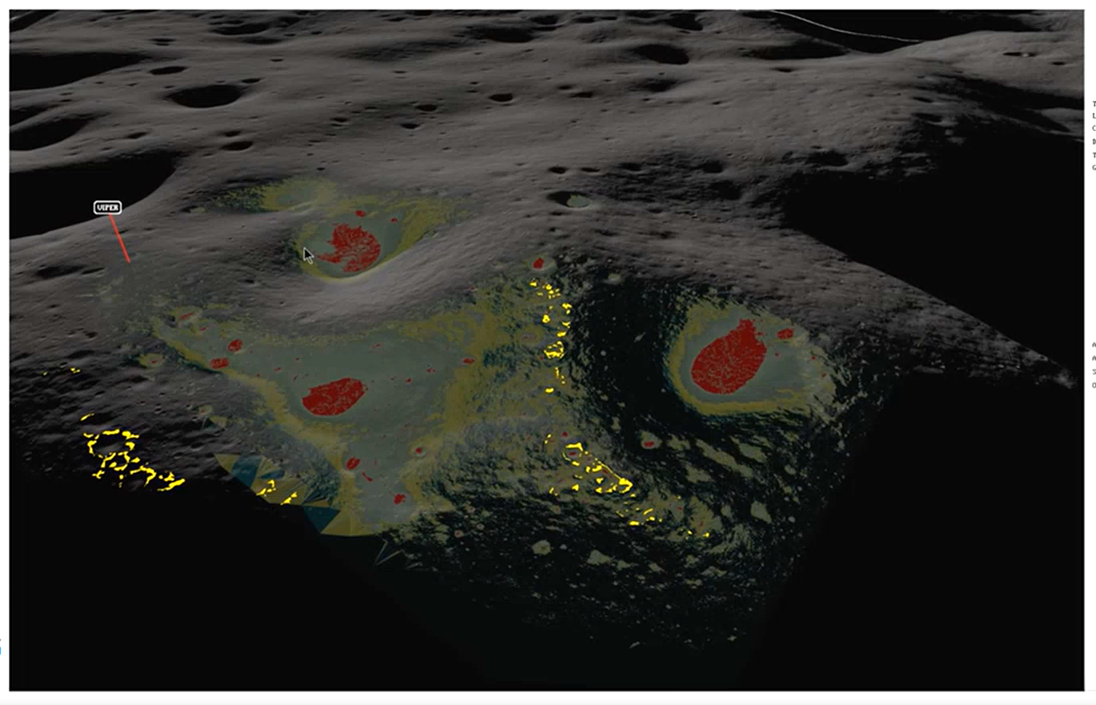
Mons Mouton region with Safe Havens
Screenshot from the VIPER Traverse Planning tool /M. Shirley
Yellow Safe Havens experience less than 50hrs of contiguous shadow during the 2 weeks VIPER is out of view of Earth

Slide 16
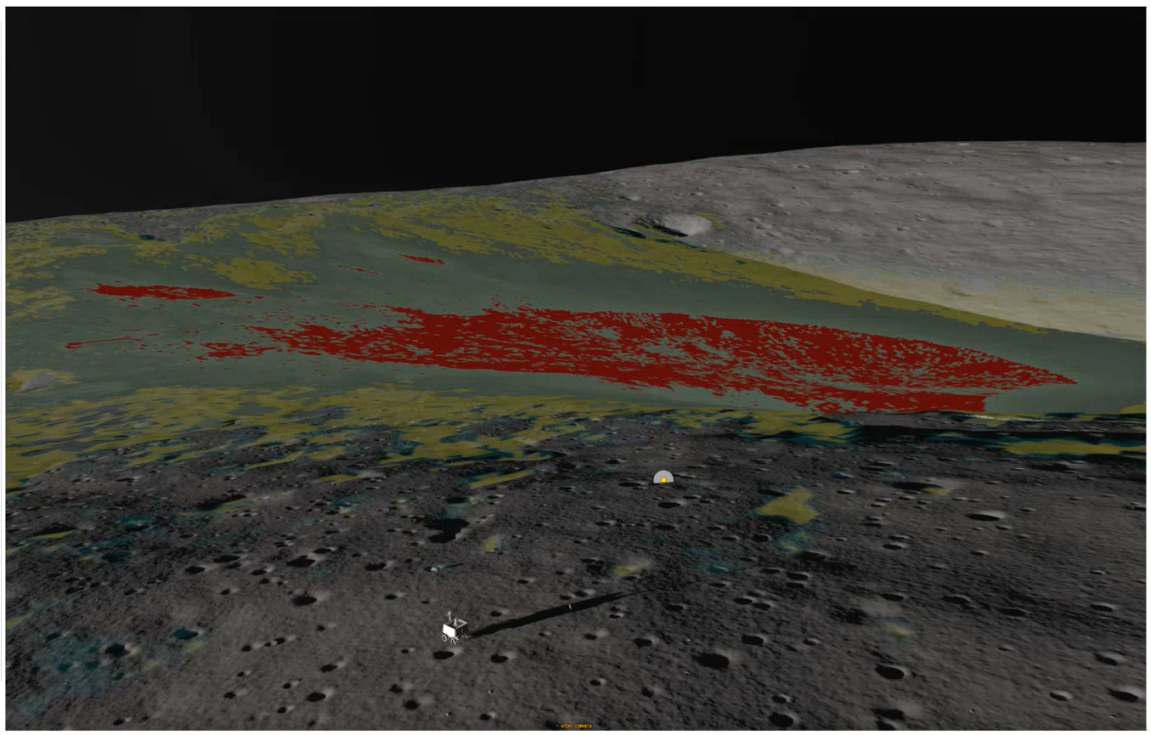
VIPER and the four Ice Stability Regions (ISRs)
Will spend 2-3 days exploring these ISRs before heading into the PSR
We then depart along the back ridge to our first safe haven
Screenshot from the VIPER Traverse Planning tool /M. Shirley
VIPER

Slide 17
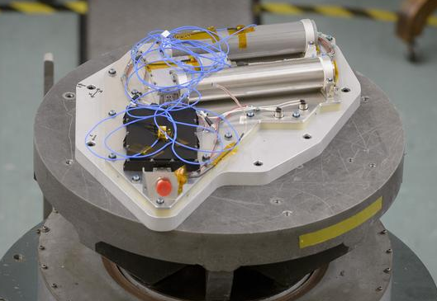
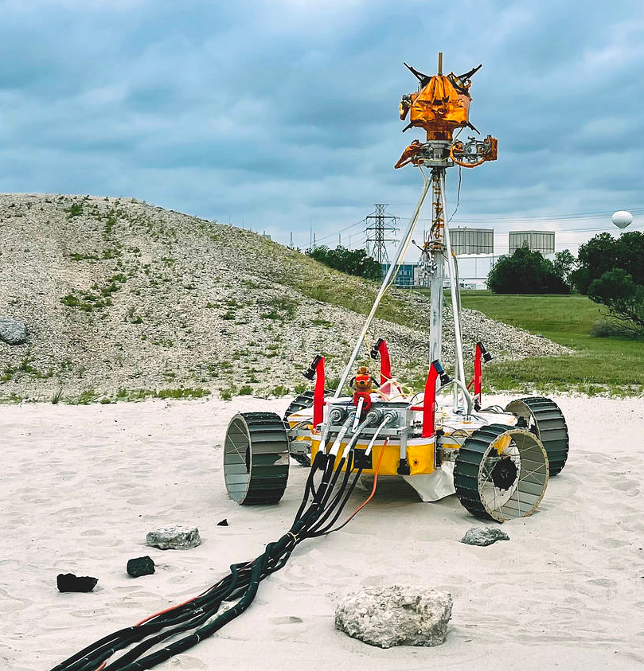
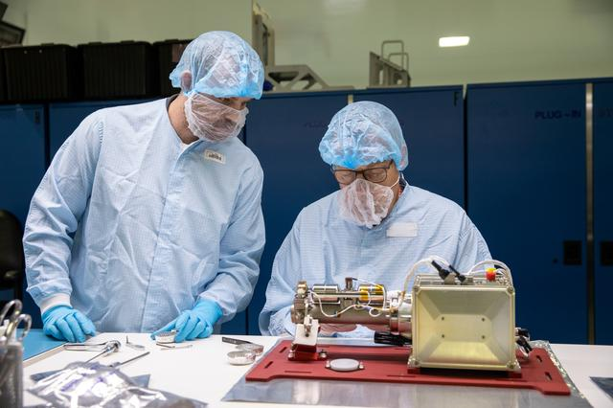
VIPER – Mission Update
NSS Vibe Test at the EEL Lab
Photo Dominic Hart
VIPER is working towards our launch date in late 2024
Instrument integration completed over the last year, rover is nearly complete and ready for environmental testing.
Mission operation simulations are continuing to coordinate ops scenarios between control rooms at ARC and KSC
Mission Ops will integrate completed rover into operational testing/training with end-to-end testing (ARC, JSC, and KSC)
Science team is developing tools to track progress towards gathering instrument data to address hypothesis for real-time science
Antenna Pointing Tests at JSC
https://www.nasa.gov/viper
MSolo getting ready for shipment to JSC for integration Photo: NASA/Kim Shiflett

Slide 18
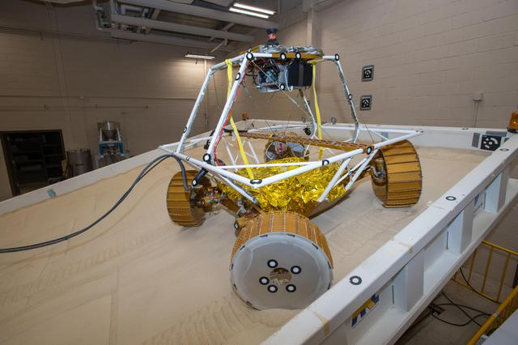
Rover driving and flight hardware build
Image will be added after released by PAO
Testing driving capabilities at GRC
Photo: NASA/GRC/Bridget Caswell
Rover assembly at JSC
Photo: NASA/

Slide 19
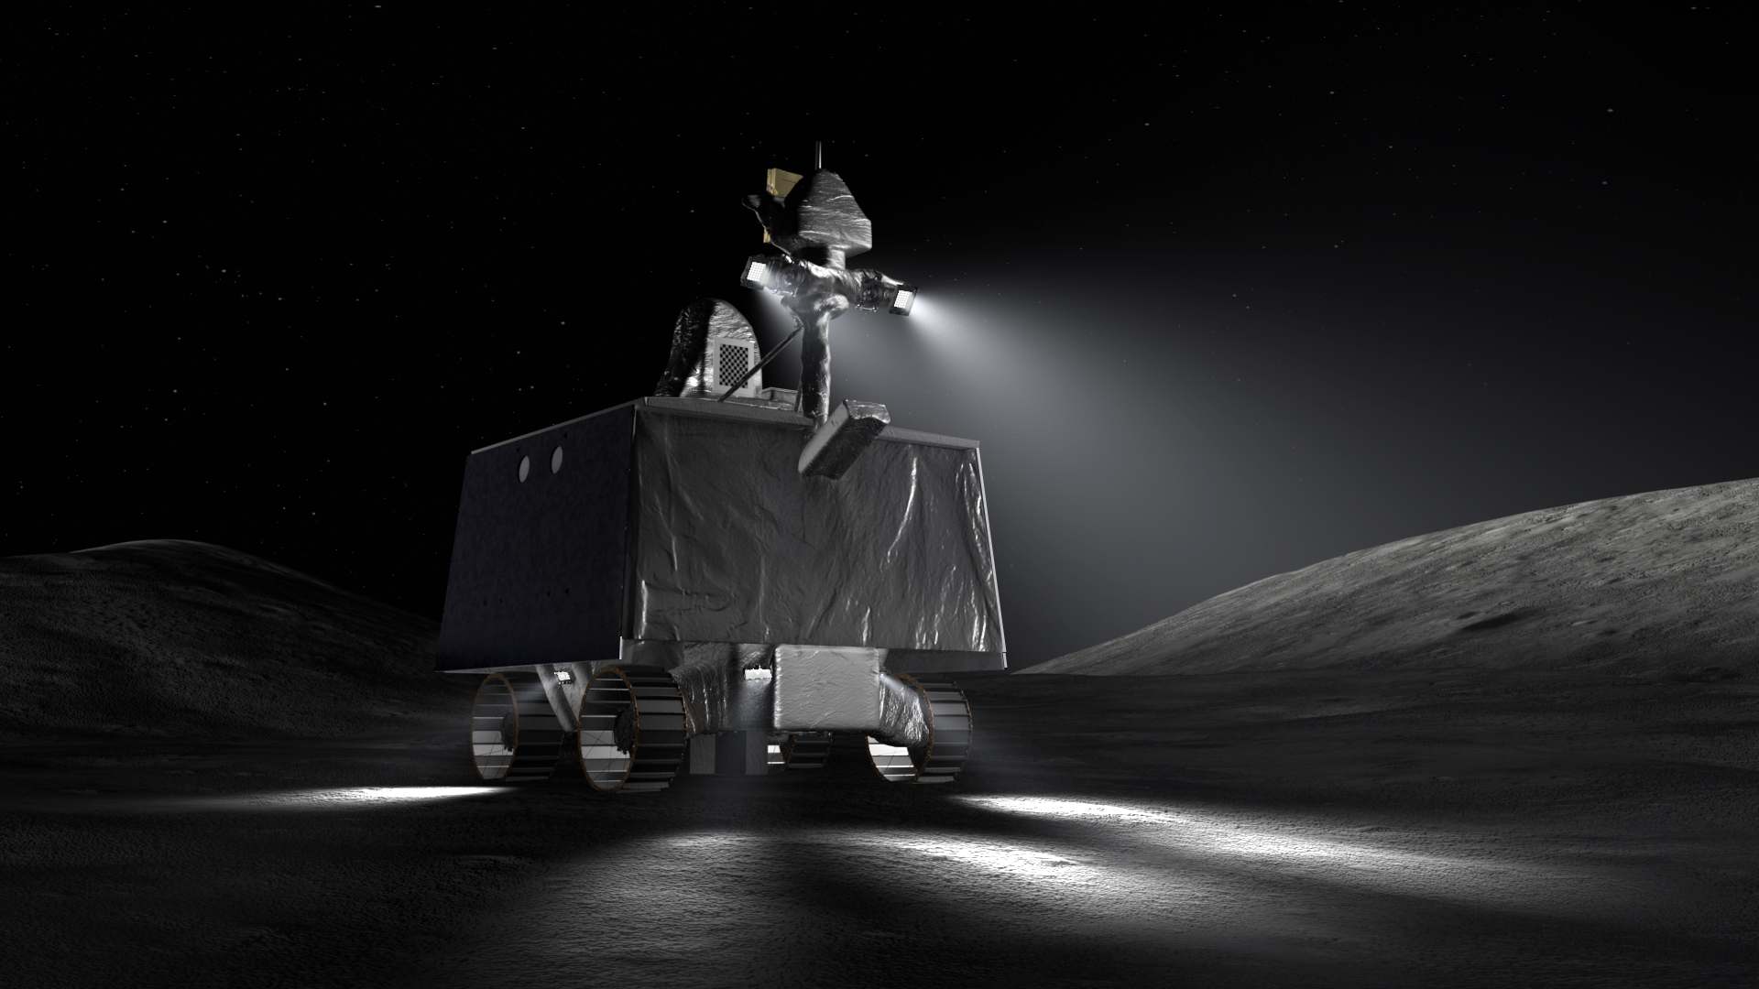
Thank you!

Slide 20
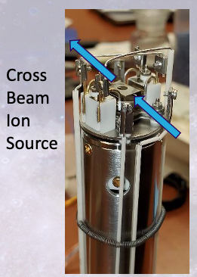
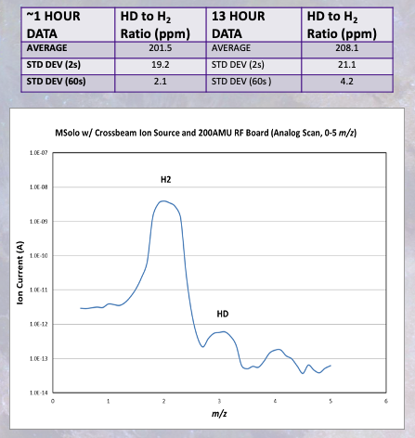
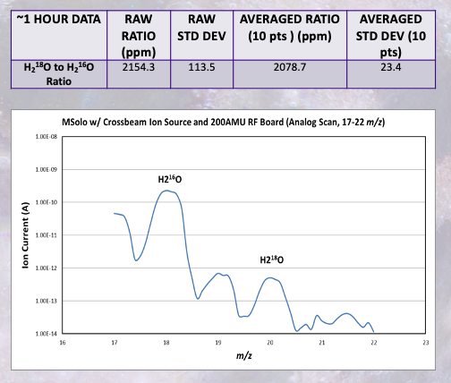
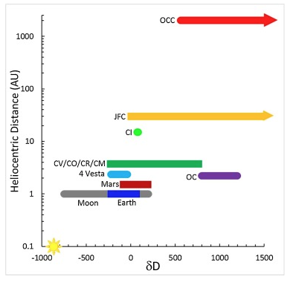
MSolo – Mass Spectrometer observing lunar operations
Modified Commercial off the Shelf – INFICON Transpector RGA
Avionics boards modified for increased radiation tolerance where possible
Mechanical modifications for vibration ruggedization
Instrument tested to factory standards after modifications with flight boards
Cross-Beam Ion Source Selected for VIPER mission
- slightly lower sensitivity compared to Open Ion Source but enhanced directional sensitivity (original application focused on molecular beams)
- Quads not ideal for isotopes, but bulk isotope differences can identify sources with large differences (i.e. cometary vs solar wind implanted)
the range of D/H for solar system materials: Earth (mantle), Moon (interior), Mars (interior), chondrites, howardite-eucrite-diogenite (HED) meteorites from Vesta, Jupiter-family comets, and outer Oort cloud comets. The D/H ratio of cometary water varies but approaches 300 × 10⁻⁶ (Altwegg et al., 2015; Hartogh et al., 2011; Robert, 2006), the D/H ratio of H₂ gas in the protosolar nebula was 21 × 10⁻⁶ (Geiss and Gloecker, 1998), but that of carbonaceous chondrites is 140 ± 10 × 10⁻⁶ (Robert, 2006). It has been inferred that H₂O in the chondrite-forming region had D/H = 88 × 10⁻⁶, or δD = -440‰ (Deloule et al., 1998).

Slide 21
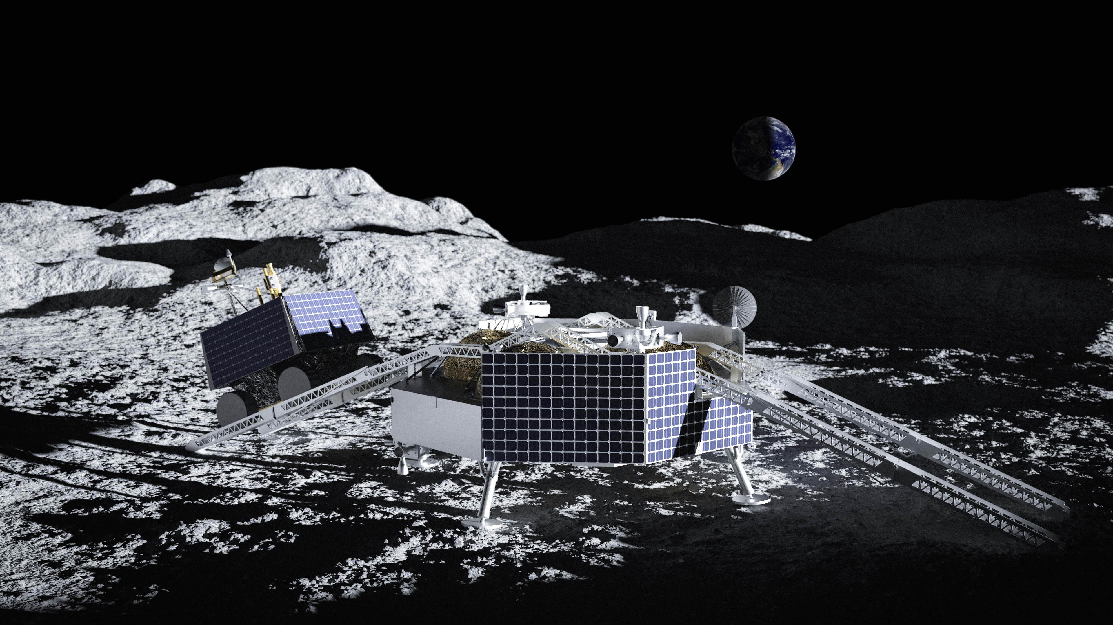
NASA CLPS program has selected Astrobotic Technology to deliver VIPER to the lunar South Pole in late-2024 aboard their Griffin Lander
Image courtesy of Astrobotic Technology Press Kit

Slide 22
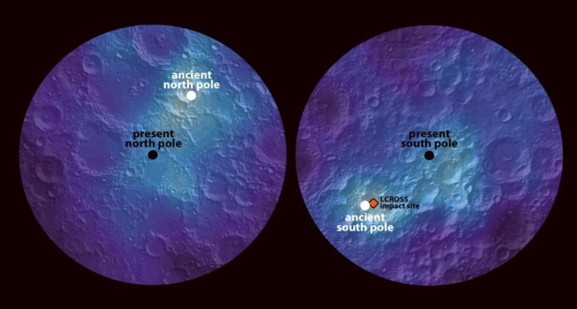
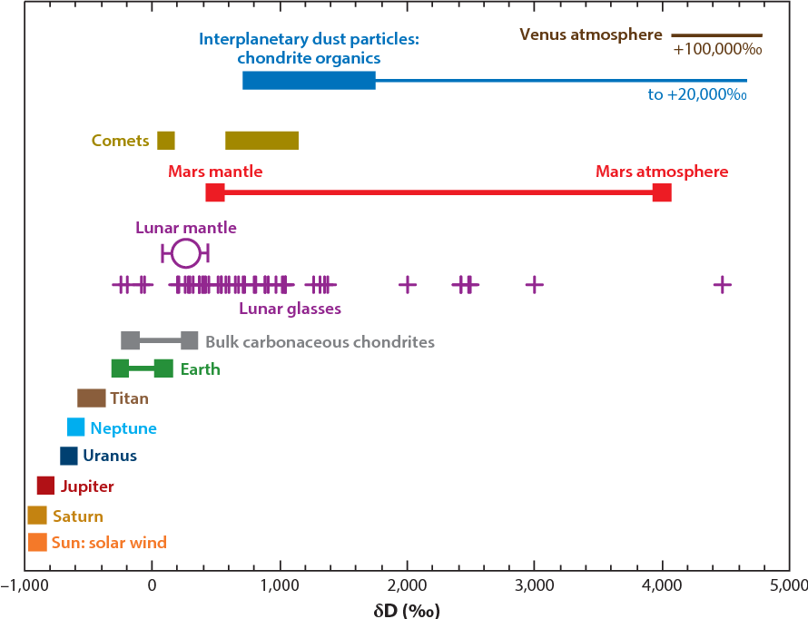
Predictive Resource Models – An Example
Model
Emplacement of water may have been through early volcanic outgassing, comet or asteroid delivery, or production through solar wind interaction with lunar soils
  Current estimates of solar wind water production show very small amounts of water produced (Benna et al., 2019; Hendrix et al., 2019); no uniformity in surface “frosts” suggest production/loss are nearly equivalent or favor loss (Farrell et al., 2019)
  Hydrogen enhancements appear aligned to a potential paleo-pole (Siegler et al, 2016) with the ancient south pole very near where the LCROSS mission impacted
A potential source of near surface, bulk water (i.e., of significant ore quality) is the excavation (via cratering) of deeper ancient ice which was emplaced prior to the polar wander
Observations
Observations of hydrogen/water distribution (e.g., association with craters of a certain age and size) and key isotopes can help constrain the initial origin of the water and hence it’s emplacement
Trace minerals associate with aqueous alteration
These observations (e.g., hydration and isotopes) at locations where both paleo-temperatures and contemporary temperatures are sufficiently cold enough to retain water
The current “buried” distribution of water may be an ancient relic
Siegler et al., 2016
Isotopes from each reservoir may give clues to their origin and history
Hauri et al., 2017

Slide 23
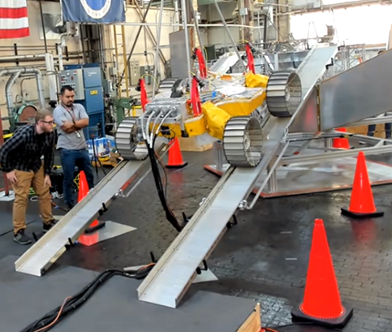
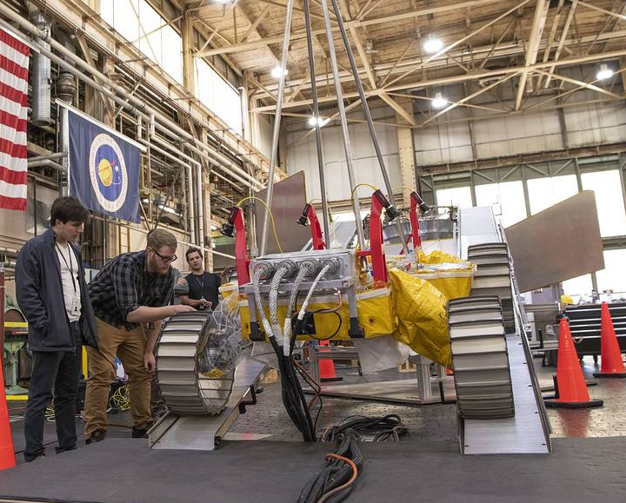
Lander Egress Testing at NASA GRC

Slide 24
VIPER Key Science Measurements
Sensitivity
Coverage Density
Length Scales
Variability
Area Coverage
Vertical Coverage
Vertical Sampling

Slide 25
VIPER Key Science Measurements
concentrations as low as 0.5% wt
sample >10-15% per target area
across scales from 10s to 100s of meters
measure at scales of <5 meters and as large as 1000m, ISRs separated by 100 m
>3800 m² per ISR type
0.8 m neutrons
1 m drill depth
~5 m seismic
8-10 cm bite size, >5 samples along 0-80 cm depth
Notes:
Determine water distribution and form across defined Ice Stability Regions with an uncertainty of <50%
Cover 10% (min) to 15% (goal) of a 3800 m² area
Equivalent to 224 m (min) to 335 m (goal) driving (assuming a 1.7 m sampling area)
Subsurface measurements must sample across depths from 10cm to 80cm with a sampling interval of 8 cm
Separate measurements on scales from 5-1000 m (scales of variability)
Minimum of two additional ISR repeat measurements separated by at least 100 meters
Minimum of three subsurface characterizations in each ISR separated by 10s of meters

Slide 26
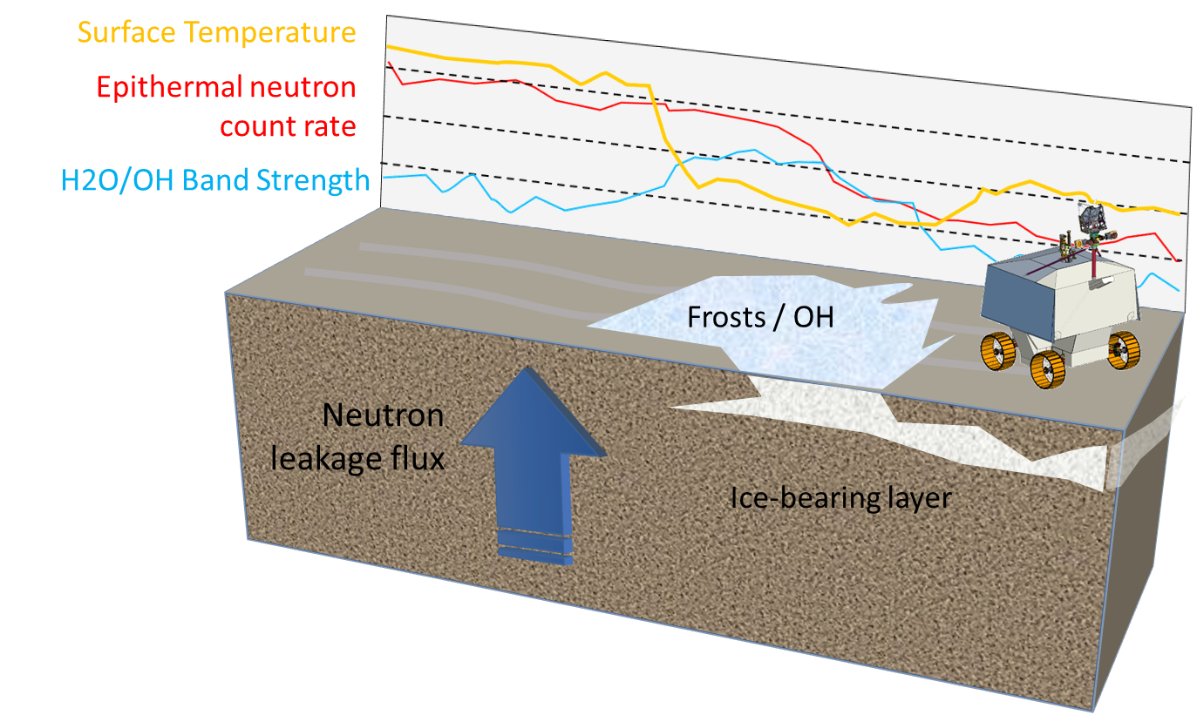
Prospecting: NSS, NIRVSS, MSolo & Seismic (Rover IMU)
Prospecting characterizes regions & identifies points to drill
NSS, NIRVSS & MSolo take data continuously while roving or parked
NSS Neutron flux variations identify abundance and burial depth of hydrogenous materials
NIRVSS NIR surface reflectance identifies surface and excavated hydration
MSolo detects subliming gasses (H₂ or H₂O vapor) identify surface and excavated hydration
Mass 18 Strength
Neutrons
Drill
Seismic

Slide 27
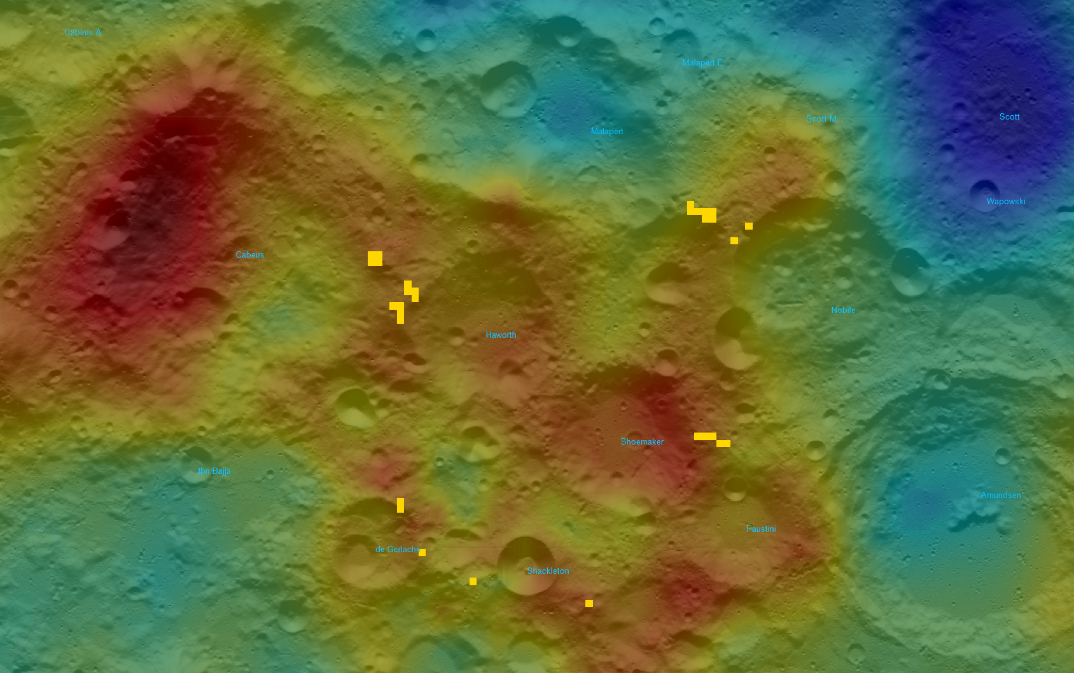
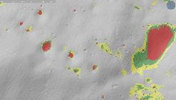
VIPER Mission Area
Needed: location with …
High water-equivalent hydrogen
(background map)
A variety of thermal environments using ice stability depth as an indicator
(insets)
Periods of shadow short enough for the rover to survive
(yellow blocks)
Unobscured line-of-site to Earth for communications
Earth
Mons Mouton
VIPER Mission Area
Water Equivalent
Hydrogen:
High
Low
Ice Stability Depth
Surface:
Shallow:
Deep:
Dry:
Area containing
safe havens:

Slide 28
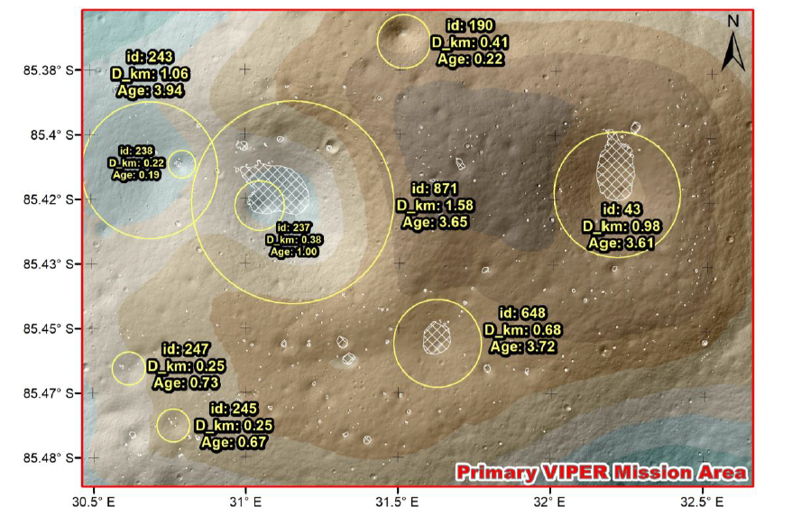
VIPER Mission Area
5 km x 5 km centered at 31.6218 E, 85.42088 S
Hosts craters ranging
from 100 Mya to >3 Gya
Role that the age of PSRs plays in controlling the presence or absence of polar volatiles is of substantial interest for discerning volatile history
Fassett et al. 2022
Notes:
Wanted to have an area with crater ages that varied widely with some at 1 Ga.
Role that the age of PSRs plays in controlling the presence or absence of polar volatiles is of substantial interest for discerning volatile history.
If ancient they can tell us about conditions that existed during early history of the solar system that have been largely erased on Earth – perhaps information about how Earth’s oceans and atmosphere formed.
If they are more “recently acquired” they would reflect current conditions in the modern solar system.
Measuring isotopes could indicate if ice is ancient or a more modern emplacement – that could tell you whether is the ice replenished vs. a static fixed reserve.

Slide 29
Example of a Mission Area Traverse

Slide 30
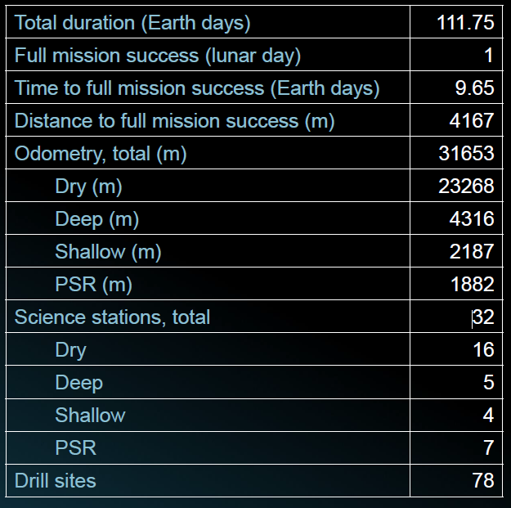
Example of a Mission Area Traverse

Slide 31
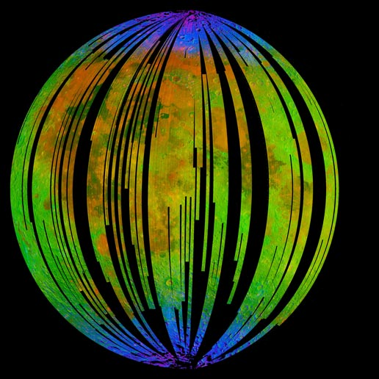
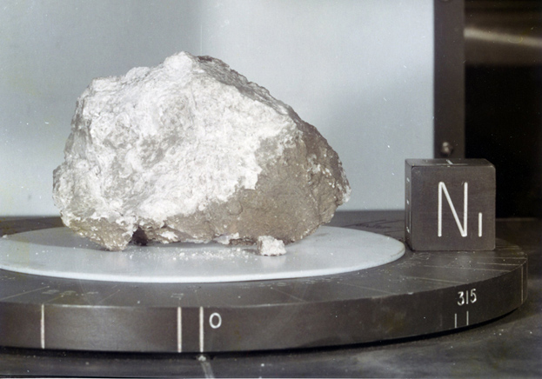
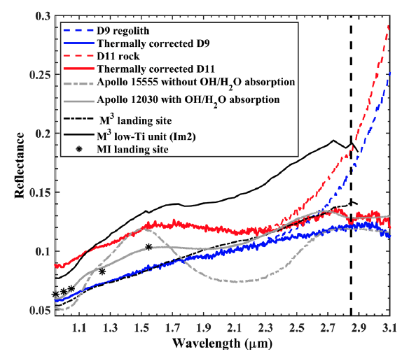
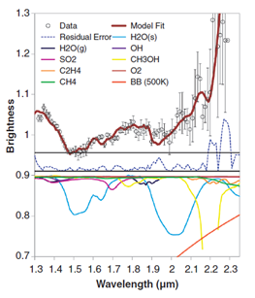
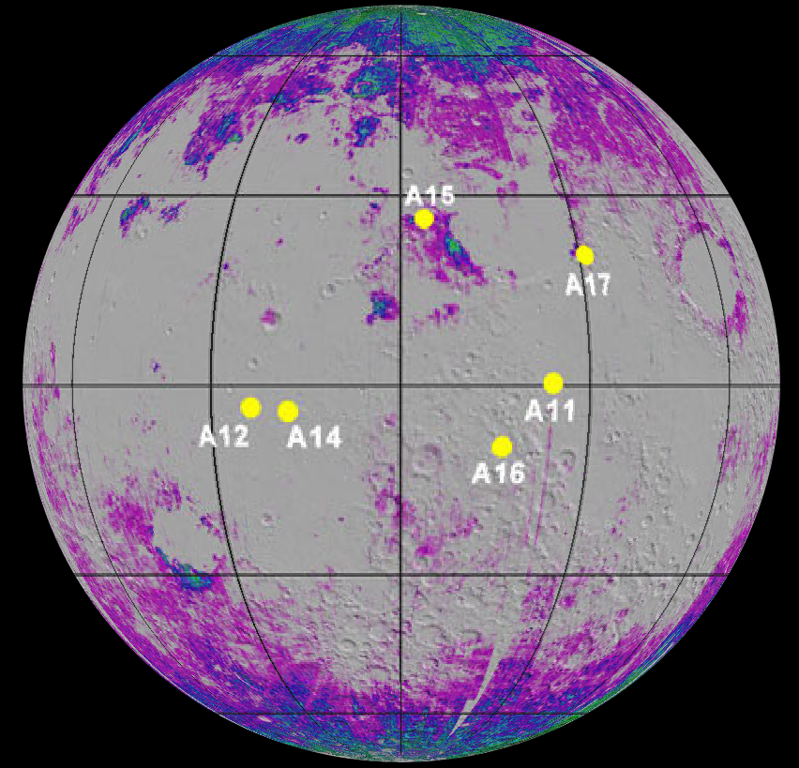
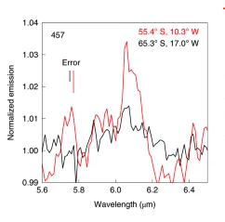
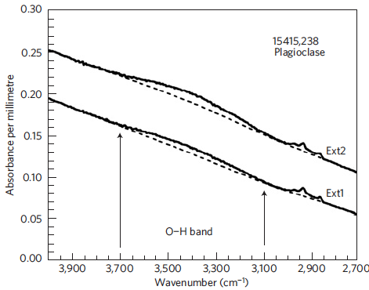

Towards Understanding Lunar Water
Moon now known to host all three forms of Solar System water: endogenic, sequestered external and in-situ.
Do not yet understand the concentration, evolution and interrelated dynamics of these varied sources of water.
Surface measurements across critical scales are necessary to characterize the spatial distribution and state of the water.
Pieters et al. 2009
Apollo 15
Genesis Rock
Hui et al. 2013
D11 Rock
Honniball et al. 2020
Li and Milliken 2017
Colaprete et al. 2010
Lin et al. 2022
Notes:
Endogenic – originates on the moon – soil (45% O) + solar wind (H) -> H2O and OH ions.
Sequestered external – captured/buried in cold traps
In-situ– magma/interior
M3, LCROSS, M3, Apollo15, SOFIA, Change’5

Slide 32

ISRU Need Cases
There may be several different needs as defined by the total amount of oxygen or hydrogen needed, or even just the total amount of water needed.
While some observations may be of science interest, they may not be relevant to most ISRU architectures (e.g., mono-layers of H₂O on dust grains or water ice at 10 meters deep).
Ore grade (water concentration) currently begin considered as viable is at a minimum 1% wt.
Refs: Duke 2006 1.5%, Charania et al. 2007 1%, Spudis & Lavoie 2010 10%, NASA Lunar Water ISRU Measurement Study 2020 1-5%
100 ppm = 0.01% (wt); 10,000 ppm = 1% (wt)
Notes:
Total water needed to produce fuel for “N” lunar ascent rockets can be very different than total water needed for habitat radiation shielding.

Slide 33
Resource Exploration: “This rock?”
Several ISRU studies have considered the economics or viability of lunar water ISRU.
The assumed concentration of water ice typically varied between 1 to 10%(wt)
Duke (2006) 1.5%
Charania et al. (2007) 1%
Spudis & Lavoie (2010) 10% water ice
LWIMS currently assuming 1-5%
Water ice concentrations of greater than 1% to 1.5% expected to be competitive with some other oxygen extraction techniques that use just regolith
Architecture and Commercialization Market studies have shown significant benefit or viability when ice concentrations are >1%
Water use has added benefit over oxygen extraction methods of providing hydrogen
In all cases a great number of poorly constrained assumption exist
More 0.5% history
Traces back to RLEP (Robotic Lunar Exploration Program)
1% critical threshold: RLEP-2, a large rover mission concept design assumed “1% accuracy”
Led to a sensitivity threshold of 0.5% with an accuracy of +/-50% for LCROSS (initially a RLEP mission)
The water concentrations needing to be characterized are in the 1%(wt) range. Thus a measurement to 0.5%(wt) would provide enough sensitivity and limit false negatives.

