Slide 1
Tropical Cyclone Tornadoes
Daniel J. Cecil, NASA MSFC
Daniel.J.Cecil@nasa.gov
NSSTC 4007

Slide 2
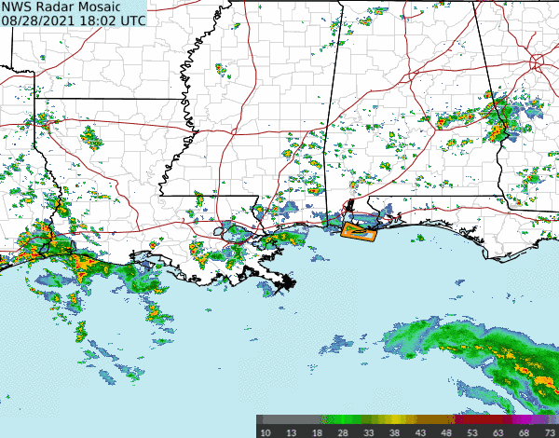
Hurricane Ida 2021 Radar Loop
Aug 29 – Sep 2
36 Tornadoes
MS: 14
LA: 2
AL: 7
VA: 2
MD: 3
PA: 5
NJ: 2
MA: 1
Hurricane landfall in Louisiana, but spawned an EF-3 in New Jersey and a killer tornado in Pennsylvania
From Brian McNoldy’s webpage of Tropical Cyclone Radar Loops
https://bmcnoldy.earth.miami.edu/tropics/radar/
“Please feel free to link to or use these loops, but I would appreciate if credit is given:
(Brian McNoldy, Univ. of Miami, Rosenstiel School).”

Slide 3
Resources
https://bmcnoldy.earth.miami.edu/tropics/radar/
  Radar reflectivity loops of dozens of tropical cyclones
https://www.spc.noaa.gov/publications/edwards/tctor.xls
  Spreadsheet of US Tropical Cyclone Tornadoes since 1995 (TCTOR)
https://www.spc.noaa.gov/exper/tctor/
  Web interface for plotting from TCTOR
https://www.ncei.noaa.gov/products/international-best-track-archive
  Tropical Cyclone best tracks archive

Slide 4
What Do We Know About TC Tornadoes Already?
That’s the royal “we”
Audience participation, name some things that are known
Bonus points on the pop quiz at the end

Slide 5
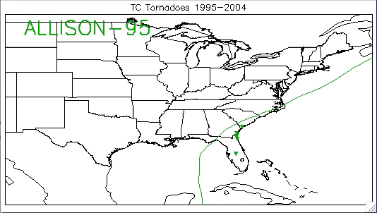

Slide 6
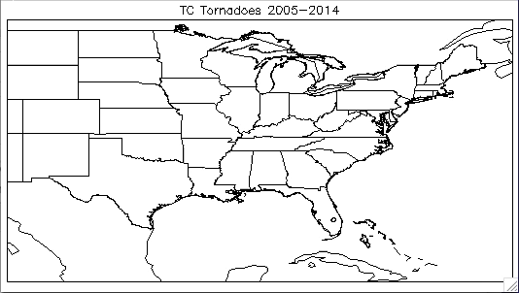

Slide 7
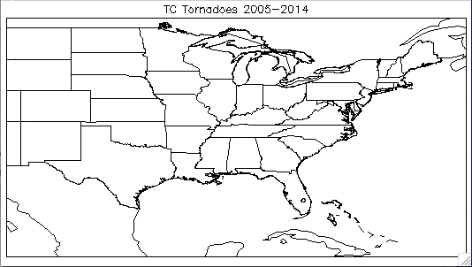

Slide 8
TC Tornado Locations
Usually right-of-center (w.r.t. TC motion)
Clustering near the coast (45% within 50 km)
Inland outbreaks with recurving TCs (heading 000° - 050°)
Most landfalling TCs produce <10 tornadoes, but some produce dozens
  Ivan (2004): 118 Tornadoes
  Beulah (1967): 115 Tornadoes
  Frances (2004): 103 Tornadoes
  Rita (2005): 97 Tornadoes
  Katrina (2005): 59 Tornadoes

Slide 9
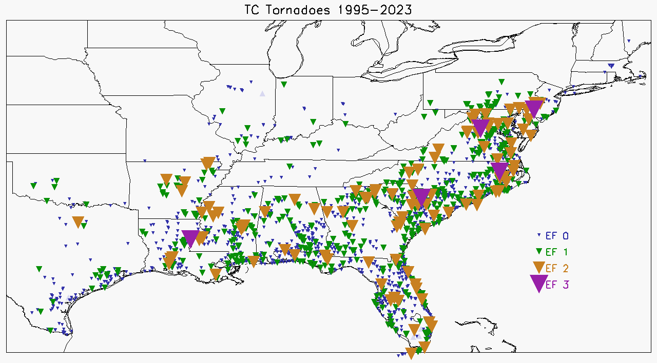
Most TC Tornadoes relatively weak
64% of TC Tornadoes are EF-0
29% EF-1
6% EF-2

Slide 10
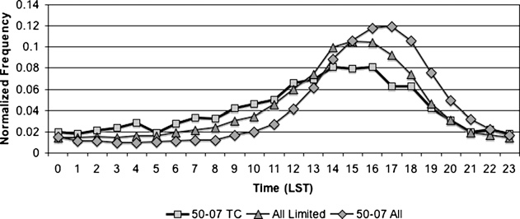
Diurnal Cycle of Tornado Counts
Hurricane season tornadoes within 400 km of coast
All USA tornadoes
TC tornadoes
From Schultz and Cecil (2009)
Schultz, L. A., and D. J. Cecil, 2009: Tropical cyclone tornadoes, 1950–2007. Mon. Wea. Rev., 137, 3471–3484.
DOI: 10.1175/2009MWR2896.1
© American Meteorological Society. Used with permission.
Afternoon peak, but diurnal cycle is less sharp than for general tornado database.
Notes:
Dear Dr. Cecil,
Thank you for your email. This signed message constitutes permission to use the material requested below.
You may include:
Fig. 3 Schultz, L. A., and D. J. Cecil, 2009: Tropical cyclone tornadoes, 1950–2007. Mon. Wea. Rev., 137, 3471–3484.
Figs. 7, 15, 16 Trier, S.B., D.A. Ahijevych, D. Carroll-Smith, G.H. Bryan, and R. Edwards, 2023: Composite mesoscale environmental conditions influencing tornado frequencies in landfalling tropical cyclones. Wea. Forecasting, 38, 2481-2508.
Figs. 12, 14 Schenkel, B. A., R. Edwards, and M. Coniglio, 2020: A climatological analysis of ambient deep-tropospheric vertical wind shear impacts upon tornadoes in tropical cyclones. Wea. Forecasting, 35, 2033–2059.
Fig. 1, Table 2 Nowotarski, C.J., J. Spotts, R. Edwards, S. Overpeck, and G.R. Roodall 2021: Tornadoes in Hurricane Harvey. Wea. Forecasting, 36, 1589-1609.
...In your 2024 NASA Scientific and Technical Information presentation, “Tropical Cyclone Tornadoes," with the following conditions:
1. Include the complete bibliographic citation of the original source for each.
2. Include the following statement with that citation for each: © American Meteorological Society. Used with permission.
If you have any questions or need additional information, please feel free to contact me.
*Please note: If the material in an AMS journal is credited to another source, the requester must obtain permission or license from that source directly. That material may not be used without permission or license from the copyright holder.*
Best,
Ms. Erin Gumbel, she/her/hersSenior Peer Review Support Associate
Senior Permissions Specialist
egumbel@ametsoc.org
617-226-3926

Slide 11
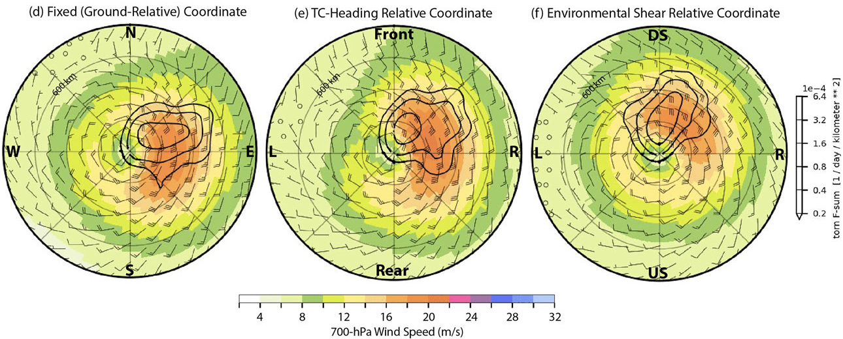
East of center; Right-Front quadrant; Downshear-Right
From Trier et al. 2023
Trier, S.B., D.A. Ahijevych, D. Carroll-Smith, G.H. Bryan, and R. Edwards, 2023: Composite mesoscale environmental conditions influencing tornado frequencies in landfalling tropical cyclones. Wea. Forecasting, 38, 2481-2508.
DOI: 10.1175/WAF-D-22-0227.1
© American Meteorological Society. Used with permission.
Shear direction seems to exert greatest control on tornado location, favoring downshear / downshear-right regions.
Heading is usually NNE, with WSWly shear.

Slide 12
Basic Tornado Ingredients
Vertical vorticity
  Tilting from horizontal; baroclinic generation; ambient vorticity
Stretching
  Convective updrafts, convergence features
Magic
Not too much magic, tornadoes don’t happen everywhere
How does Tropical Cyclone structure contribute to those ingredients?

Slide 13
Basic Tornado Ingredients + TC Structure
Vertical vorticity
  Tilting from horizontal; baroclinic generation; ambient vorticity
  Lots of ambient vertical vorticity – it’s a cyclone, after all
  Strong vertical wind shear --> horizontal vorticity available for tilting
Stretching
  Convective updrafts in rainbands, but limited buoyancy
  Convergence lines in the TC flow (often forcing rainbands)
    Dry slots + insolation can add thermal boundaries + buoyancy
  Convergence associated with changes in friction (especially near coast)
High-shear, low-buoyancy environment

Slide 14
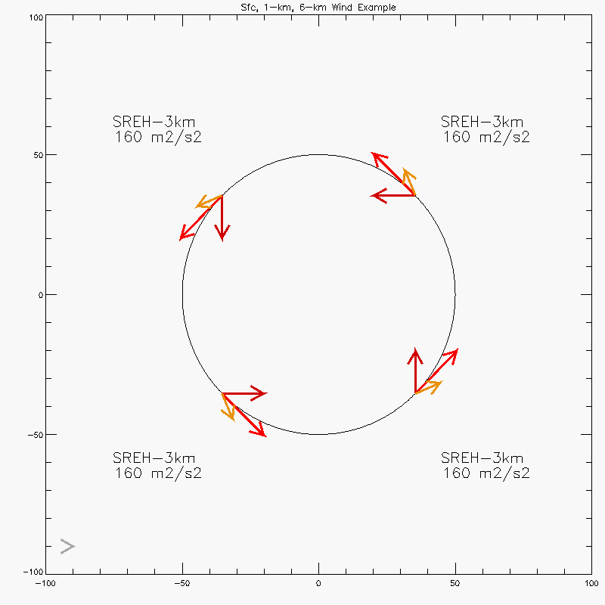
Why East-of-center; Right-Front quadrant; Downshear-Right?
Audience participation needed –
what is the structure like for a TC after landfall?
Strong shear in boundary layer.
Cyclonic flow peaks in lower troposphere.
Anticyclonic shear + increasing radial outflow with height through free troposphere.
21 m/s 1-km
10 m/s 6-km
15 m/s sfc
Cyclonic flow with radially inward component at low levels
Vortex distorts background thermal gradient, advecting warmer, moister air on east (southerly flow) side
Idealized TC vortex vertical structure has curved hodograph, ~150 m2/s2 SREH without accounting for ambient vertical wind shear
I’m no artist – obviously!

Slide 15
Warm-Core Vortex Vertical Wind Structure
6-km
For this schematic, thick, dark arrows represent surface wind, thinner, lighter arrows represent higher altitudes.
3-km
1-km
Surface
Start with a simple, idealized cyclonic warm-core vortex.
Azimuthal flow increases immediately above surface, then weakens with height.
Straight-line shear everywhere in this idealized example.

Slide 16
Add Ambient Shear to a Warm-Core Vortex
In left-of-shear quadrant, the shear magnitude is enhanced because the shear directions align.
Start with a simple, idealized cyclonic warm-core vortex.
Azimuthal flow increases immediately above surface, then weakens with height.
Straight-line shear everywhere in this idealized example.
Add a simple, straight-line westerly vertical wind shear profile to represent the ambient environment.
In right-of-shear quadrant, the shear magnitude decreases because the shear directions are opposed.

Slide 17
Add Ambient Shear to a Warm-Core Vortex
In upshear quadrant, the winds back with height.
In downshear quadrant, the winds veer with height.
Start with a simple, idealized cyclonic warm-core vortex.
Azimuthal flow increases immediately above surface, then weakens with height.
Straight-line shear everywhere in this idealized example.
Add a simple westerly vertical wind shear profile to represent the ambient environment.
Warm-core vortex + ambient shear = curved hodographs upshear and downshear.
Backing upshear, veering downshear.

Slide 18
Add Ambient Shear to a Warm-Core Vortex
Start with a simple, idealized cyclonic warm-core vortex.
Azimuthal flow increases immediately above surface, then weakens with height.
Straight-line shear everywhere in this idealized example.
Add a simple westerly vertical wind shear profile to represent the ambient environment.
Warm-core vortex + ambient shear = curved hodographs upshear and downshear.
Backing upshear, veering downshear.

Slide 19
Add Ambient Shear to a Warm-Core Vortex
Start with a simple, idealized cyclonic warm-core vortex.
Azimuthal flow increases immediately above surface, then weakens with height.
Straight-line shear everywhere in this idealized example.
Add a simple westerly vertical wind shear profile to represent the ambient environment.
Warm-core vortex + ambient shear = curved hodographs upshear and downshear.

Slide 20
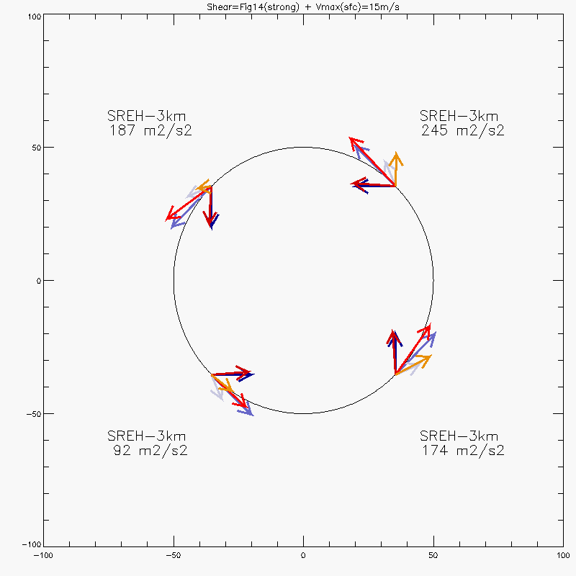
Add Ambient Shear to TC Vortex
21 m/s 1-km
10 m/s 6-km
15 m/s sfc, just below TS strength
Upshear
Downshear
Idealized, axisymmetric TC vortex with low-level inflow, upper-level outflow, and anticyclonic vertical wind shear. Vertical structure has curved hodograph, ~150 m2/s2 SREH without accounting for ambient vertical wind shear.
Realistic ambient vertical wind profile (from Schenkel et al. 2020 Fig. 14, Strong Shear Composite) added to the idealized vortex at left. Helicity maximized downshear-left, minimized upshear-right. More realistic asymmetric TC vortex maximizes helicity upshear-right.

Slide 21
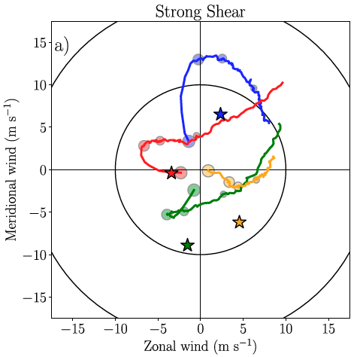
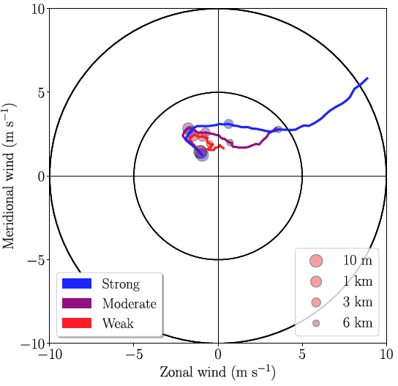
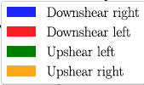
Observed Vertical Wind Profiles
Radiosonde hodographs in shear-relative quadrants
Ambient vertical wind profiles of TC environment for strong, moderate, and weak shear cases
From Schenkel et al. 2020, Figs. 14 and 12, using TC cases that produced tornadoes.
Downshear quadrants have curved, veering hodographs, especially downshear-right.
Schenkel, B. A., R. Edwards, and M. Coniglio, 2020: A climatological analysis of ambient deep-tropospheric vertical wind shear impacts upon tornadoes in tropical cyclones. Wea. Forecasting, 35, 2033–2059.
DOI: 10.1175/WAF-D-19-0220.1
© American Meteorological Society. Used with permission.

Slide 22
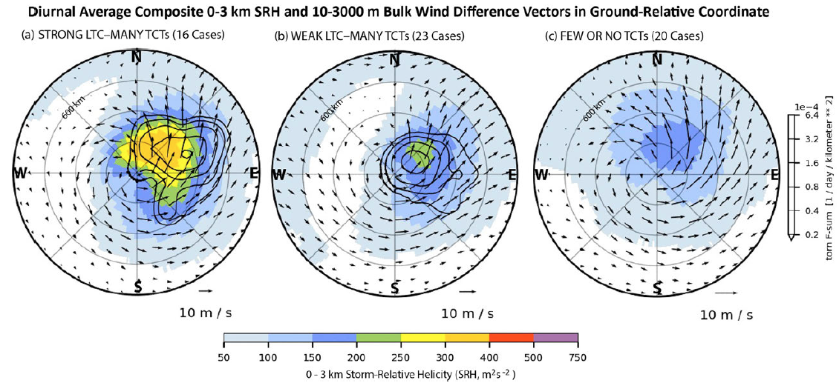
SR Helicity in Ground-Relative Coords
Average ambient shear vector is from WSW, about 250°
From Trier et al. 2023
Trier, S.B., D.A. Ahijevych, D. Carroll-Smith, G.H. Bryan, and R. Edwards, 2023: Composite mesoscale environmental conditions influencing tornado frequencies in landfalling tropical cyclones. Wea. Forecasting, 38, 2481-2508.
DOI: 10.1175/WAF-D-22-0227.1
© American Meteorological Society. Used with permission.
Tornado locations (line contours of density) align very well with 0-3 km Storm Relative Helicity (shaded).
TCs with few tornadoes have much lower helicity (right).

Slide 23
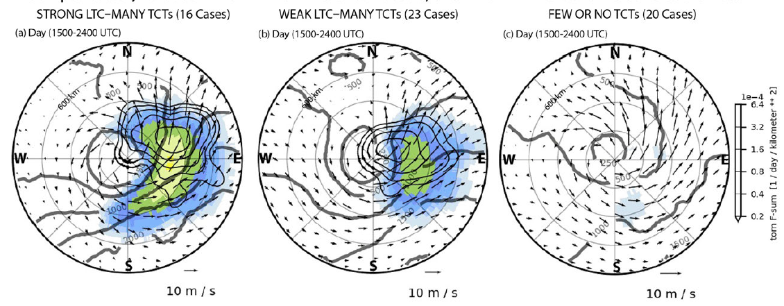

CAPE, SCP in Ground-Relative Coords
Average ambient shear vector is from WSW, about 250°
From Trier et al. 2023
Trier, S.B., D.A. Ahijevych, D. Carroll-Smith, G.H. Bryan, and R. Edwards, 2023: Composite mesoscale environmental conditions influencing tornado frequencies in landfalling tropical cyclones. Wea. Forecasting, 38, 2481-2508.
DOI: 10.1175/WAF-D-22-0227.1
© American Meteorological Society. Used with permission.
Higher CAPE (thick contours) right-of-shear, on south and southeast sides.
Supercell Composite Parameter (shaded) suggests tornado threat should extend more to south (right-of-shear) side than observed.
To be fair, the south side is more often offshore, where no tornadoes would be observed. There is a southward extension of tornado locations in TCs that are further inland.

Slide 24
Radar Attributes / Warning Challenges
Mini-supercells embedded in rainbands
Smaller, shallower, shorter-lived than classic supercells
  Short-lived does NOT mean short path length
Rotational velocity weaker than non-TC tornado couplets
Multiple threats to monitor simultaneously (flash flood, tornadoes, high wind…), can’t focus exclusively on tornadoes
If high POD for warnings is desired, a high FAR is likely
  Indications of TC Tornado can be subtle; how easily do you issue a warning?

Slide 25
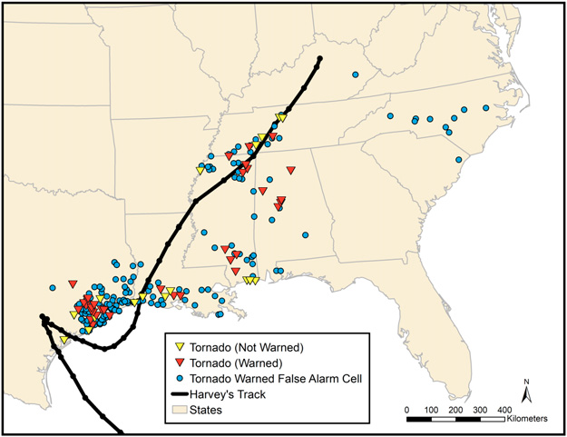
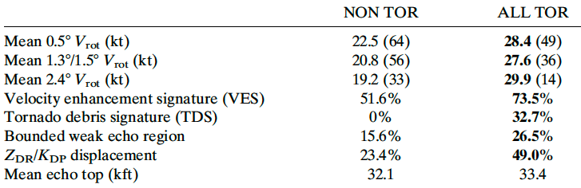
Hurricane Harvey 2017 Tornadoes and False Alarms
Tornadic cells had stronger velocity couplets than False Alarm (tornado-warned) cells, but not dramatically stronger.
Differences were greatest at higher elevation angles, but most cells did not have velocity couplets present at high elevation angles.
Horizontal displacement between ZDR and KDP maxima looked like a promising signature for differentiating tornadic versus non-tornadic.
From Nowotarski et al. 2021
Nowotarski, C.J., J. Spotts, R. Edwards, S. Overpeck, and G.R. Roodall 2021: Tornadoes in Hurricane Harvey. Wea. Forecasting, 36, 1589-1609.
DOI: 10.1175/WAF-D-20-0196.1
© American Meteorological Society. Used with permission.

Slide 26
Questions
Why do TC Tornadoes cluster near the coast?
Why are TC Tornadoes usually EF0 / EF1 and rarely violent?
93% of TC tornadoes EF0/EF1, vs 90% of US Tornadoes
0.3% EF2+, vs 2.3% of US Tornadoes EF2+
Why don’t all (most) landfalling TCs produce tornado outbreaks?
How can tornadic cells be distinguished from others in rainbands?

Slide 27
Summary
Most TC Tornadoes fall into one of two categories:
  Clusters near the coast
  Inland outbreaks after landfall, while recurving TC interacts with westerlies
Locations:
  Right-of-center (eastern side)
  Downshear, downshear-right
  Can be far from landfall location
Cyclone has background vorticity and curved hodographs
Addition of ambient shear enhances helicity on downshear side
Upward motion (large scale) is favored downshear
More buoyancy (warmer, moister air) on right-of-shear side
TC Tornadoes usually in high shear, modest instability environment
Mini-supercells, embedded in rainbands
Tornadic cells difficult to distinguish from other rotating cells in rainbands – high False Alarm Rate

Slide 28
Selected Literature
Malkin, W. and J.G. Galway, 1953: Tornadoes associated with hurricanes: As illustrated by the Franconia, Va., tornado, September 1, 1952. Mon. Wea. Rev., 81, 299-303.
Smith, J.S., 1965: The hurricane-tornado. Mon. Wea. Rev., 93, 453-459.
Pearson, A. D., and A. F. Sadowski, 1965: Hurricane-induced tornadoes and their distribution. Mon. Wea. Rev., 93, 461–464.
Hill, E. L., W. Malkin and W. A. Schulz Jr., 1966: Tornadoes associated with cyclones of tropical origin—practical features. J. Appl. Meteor., 5, 745–763.
Fujita, T.T, K. Watanabe, K. Tsuchitya, and M. Shimada, 1972: Typhoon-associated tornadoes in Japan and new evidence of suction vortices in a tornado near Tokyo. J. Met. Soc. Japan, 50, 431–453.
Novlan, D. J., and W. M. Gray, 1974: Hurricane- spawned tornadoes. Mon Wea Rev., 102, 476–488.
Gentry, R.C., 1983: Genesis of tornadoes associated with hurricanes. Mon Wea. Rev., 111, 1793–1805.
McCaul, E.W. Jr., 1987: Observations of the Hurricane “Danny” tornado outbreak of 16 August 1985. Mon. Wea. Rev., 115, 1206-1223.
McCaul, E.W. Jr., 1991: Buoyancy and shear characteristics of hurricane-tornado environments. Mon. Wea. Rev., 119, 1954-1978.
Spratt, S. M., D. W. Sharp, P. Welsh, A.C. Sandrik, F. Alsheimer and C. Paxton, 1997: A WSR-88D assessment of tropical cyclone outer rainband tornadoes. Wea. Forecasting, 12, 479–501.
McCaul, E.W. Jr., D.E. Buechler, S.J. Goodman, and M. Cammarta, 2004: Doppler radar and lightning network observations of a severe outbreak of tropical cyclone tornadoes. Mon. Wea. Rev., 132, 1747-1763.
Verbout, S., D. M. Schultz, L. M. Leslie, H. E. Brooks, D. J. Karoly and K. L. Elmore, 2007: Tornado outbreaks associated with landfalling hurricanes in the North Atlantic Basin: 1954–2004. Meteor. Atmos. Phys., 97, 255–271.
Schultz, L. A., and D. J. Cecil, 2009: Tropical cyclone tornadoes, 1950–2007. Mon. Wea. Rev., 137, 3471–3484.
Molinari, J. and D. Vollaro, 2010: Distribution of helicity, CAPE, and shear in tropical cyclones. J. Atmos. Sci., 67, 274-284.
Green, B. W., F. Zhang, and P. M. Markowski, 2011: Multiscale processes leading to supercells in the landfalling outer rainbands of Hurricane Katrina (2005). Wea. Forecasting, 26, 828–847.
Edwards, R., 2012: Tropical cyclone tornadoes: A review of knowledge in research and prediction. Electronic J. Severe Storms Meteor., 7, 1-61.
Edwards, R. , A. R. Dean, R. L. Thompson and B. T. Smith, 2012: Convective modes for significant severe thunderstorms in the contiguous United States. Part III: Tropical cyclone tornadoes. Wea. Forecasting, 27, 1507-1519.
Martinaitis, S. M., 2017: Radar observations of tornado-warned convection associated with tropical cyclones over Florida. Wea. Forecasting, 32, 165–18.
Schenkel, B. A., R. Edwards, and M. Coniglio, 2020: A climatological analysis of ambient deep-tropospheric vertical wind shear impacts upon tornadoes in tropical cyclones. Wea. Forecasting, 35, 2033–2059.
Schenkel, B.A., M. Coniglio, and R. Edwards, 2021: How does the relationship between ambient deep-tropospheric vertical wind shear and tropical cyclone tornadoes change between coastal and inland environments? Wea. Forecasting, 36, 539-566.
Nowotarski, C.J., J. Spotts, R. Edwards, S. Overpeck, and G.R. Roodall 2021: Tornadoes in Hurricane Harvey. Wea. Forecasting, 36, 1589-1609.
Trier, S.B., D.A. Ahijevych, D. Carroll-Smith, G.H. Bryan, and R. Edwards, 2023: Composite mesoscale environmental conditions influencing tornado frequencies in landfalling tropical cyclones. Wea. Forecasting, 38, 2481-2508.

