Slide 1
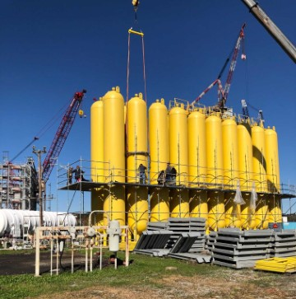
National Aeronautics and Space Administration
NASA’s Use Of Ground-Based Multi-Layered Pressure Vessels (MLPV)
Clifton T. Arnold, Jr.
NASA HQ
Office of Safety and Mission Assurance
Program Executive: PS, LDE, and P&P
April 10, 2024
www.nasa.gov

Slide 2
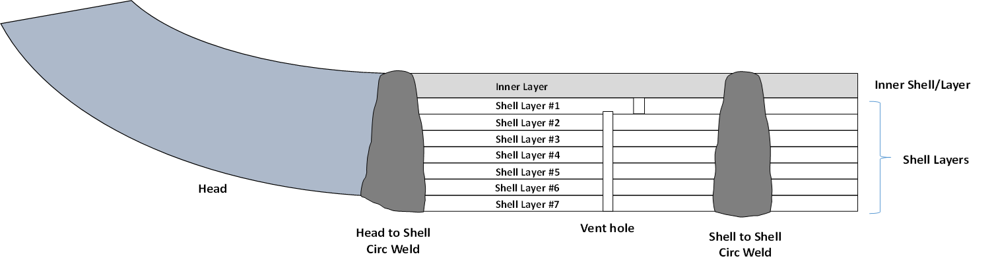
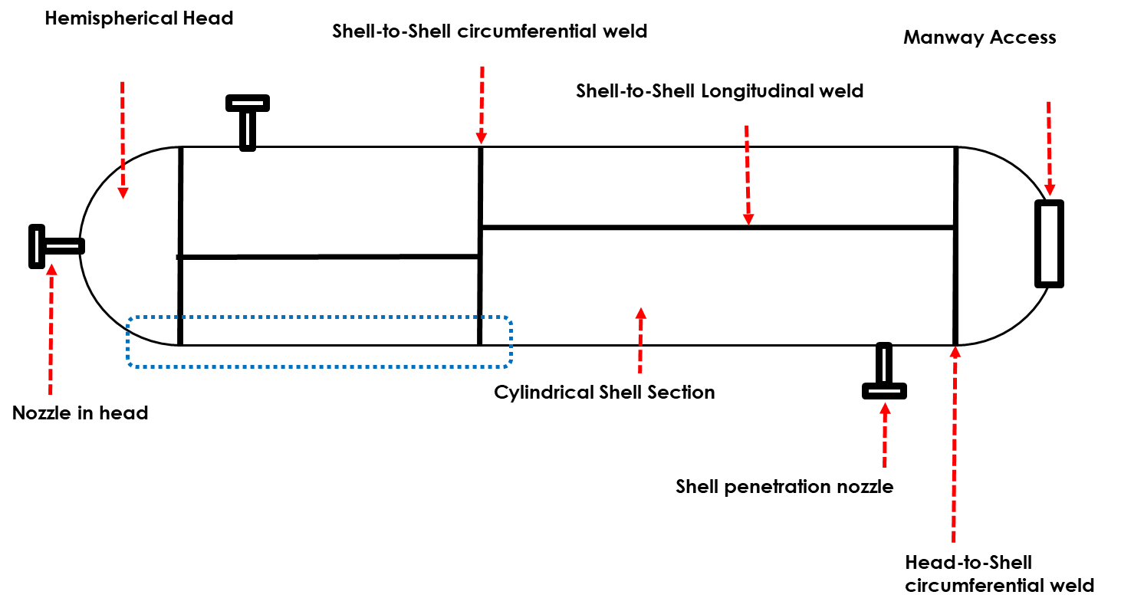
Overview
Executive Summary
MLPV History
NASA MLPVs
  Risk Mitigation Project (RMP)
  NDE Pilot Project (PP)
Conclusion
Expanded view of cross section
Notes:
Advantages
Easier to form thin material
Less full thickness welding
Possible favorable pre-stress if tightly wrapped
Leak detection via vent holes
Disadvantages
Non-code material with very limited fracture properties characterization (toughness, crack growth rate, and transition temperature)
Less favorable toughness properties in thin high strength material
Layer gaps, possible inconsistent tension, and welding residual stresses make analysis a non-trivial task (particularly for older vessels)
Difficult to inspect inner layers, intermediate layers, and shell to shell welds
Very high MDMT(minimum design metal temperature)for solid heads and full thicknesses welds, typically ∼120F per current Code

Slide 3
Executive Summary
NASA has taken the US technical lead in assessing and reducing risks associated with operations of non-code MLPVs, with the goal of developing technical standards and processes for continued use, maintenance, inspection, and repair of MLPVs
NASA/OSHA Alternate and Supplemental Standard, NASA Requirements for Ground Based Non-Code Metallic Pressure Vessels, NS 8719.26
Technical Memorandums (TMs) publicly released: Materials testing, Structural analysis, NDE, Probabilistic and Fracture assessments
Collaboration with DoE, USSF 30th and 45th Wing, AEDC, AFRL, and NRPTG
L I K E L I H O O D | 5
 | 4 |  |  |  |  | NC-MLPV
 | 3
 | 2
 | 1
 |  | 1 | 2 | 3 | 4 | 5
C O N S E Q U E N C E
Notes:
OSHA General Industry regulations require ASME Code construction for many pressure vessel applications
OSHA regulations fail to address some NASA LPV applications
Most NASA LPV are not ASME Code stamped
OSHA Basic Program Elements for Federal Employees 29 CFR 1960 requires an Alternate Standard for cases in which an Agency does not comply with regulations.
29 CFR 1960 requires a Supplementary Standard for those cases in which an Agency has operations not specifically addressed by the OSHA regulations.
NASA has operations in both of these categories and intends to develop an Alternate/Supplementary Standard for use of LPV

Slide 4
MLPV History
A pressure vessel using layered construction of relatively thin material to provide pressure retaining capability equivalent to a thicker monolithic vessel.
    OSHA 29 CFR § 1910 requires pressure vessels to be ASME code compliance
    1930’s design various constructions, including concentric layers, coil wound, shrink fit, and spiral wrapped.
    The ASME Boiler and Pressure Vessel Code has allowed for layered heads as well as shells since 1978.
NASA vessels:
    Manufactured late 1950’s and early 1960’s (prior to inclusion in ASME Code)
    Concentric wrapped layered shells and monolithic heads.
      GRC and SSC unique, autofrettage construction
    Material non-code and not well characterized
    Not inspected in full compliance with code
    Originally rated by the manufacturers based on lower safety factor (not compliant with Code), generally 2.5:1 on UTS vs. 4:1 then, or 3.5:1 today.
    Mostly 3/8 - 1/2 inch liner and ¼ inch layers
    357 out of 360 not code-stamped
Notes:
Advantages
Easier to form thin material
Less full thickness welding
Possible favorable pre-stress if tightly wrapped
Leak detection via vent holes
Disadvantages
Non-code material with very limited fracture properties characterization (toughness, crack growth rate, and transition temperature)
Less favorable toughness properties in thin high strength material
Layer gaps, possible inconsistent tension, and welding residual stresses make analysis a non-trivial task (particularly for older vessels)
Difficult to inspect inner layers, intermediate layers, and shell to shell welds
Very high MDMT(minimum design metal temperature)for solid heads and full thicknesses welds, typically ∼120F per current Code

Slide 5
NASA MLPV Use vs Industry
Industry
  Urea reactors
  Low cycles
  Stress Corrosion Cracking (SCC) potential
  Often elevated (300-400°F) temperature operation, some low temperature
  ~ 10 catastrophic failures per 23K vessels fabricated
NASA
Most in air or inert gas service (few in gaseous hydrogen service)
Cyclic operation (pressure swings)
No SCC
No catastrophic failures
Ambient temperature operation which is below Code Minimum Design Metal Temperature limits at every NASA Center
Some blowdown service resulting in lower temperature at nozzle and surrounding area
Often located in uncontrolled areas with significant personnel exposure
Notes:
Advantages
Easier to form thin material
Less full thickness welding
Possible favorable pre-stress if tightly wrapped
Leak detection via vent holes
Disadvantages
Non-code material with very limited fracture properties characterization (toughness, crack growth rate, and transition temperature)
Less favorable toughness properties in thin high strength material
Layer gaps, possible inconsistent tension, and welding residual stresses make analysis a non-trivial task (particularly for older vessels)
Difficult to inspect inner layers, intermediate layers, and shell to shell welds
Very high MDMT(minimum design metal temperature)for solid heads and full thicknesses welds, typically ∼120F per current Code

Slide 6
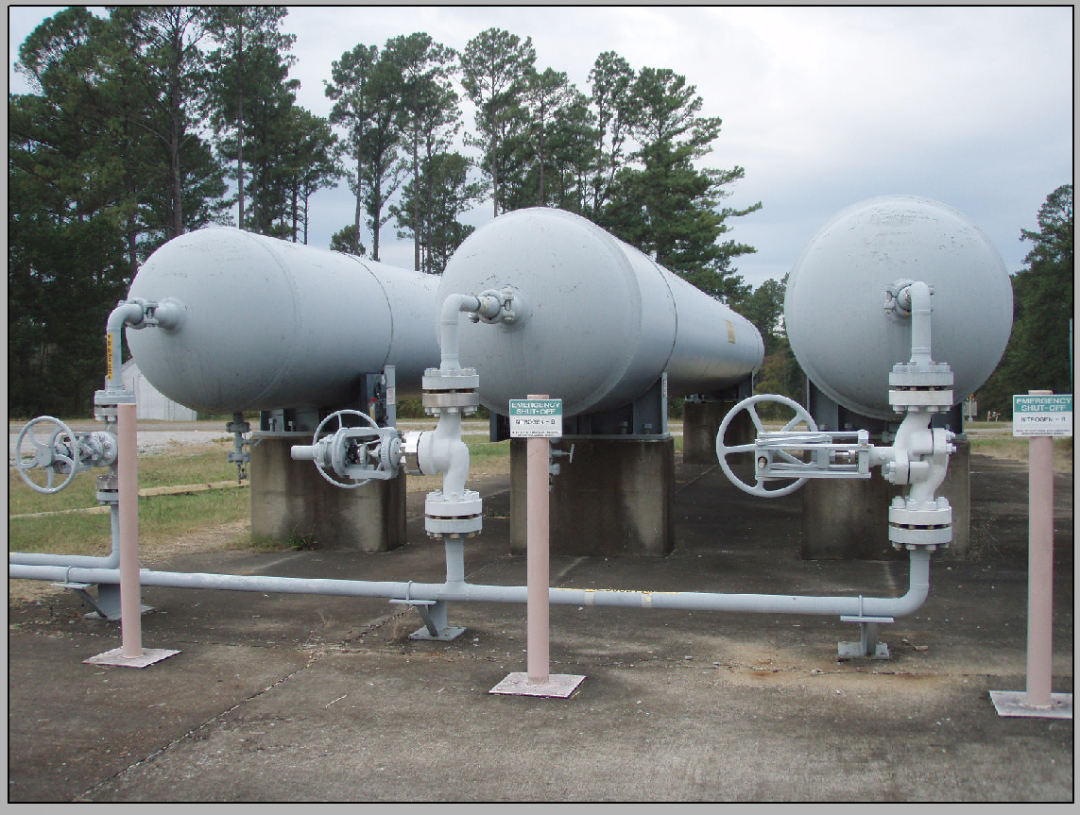
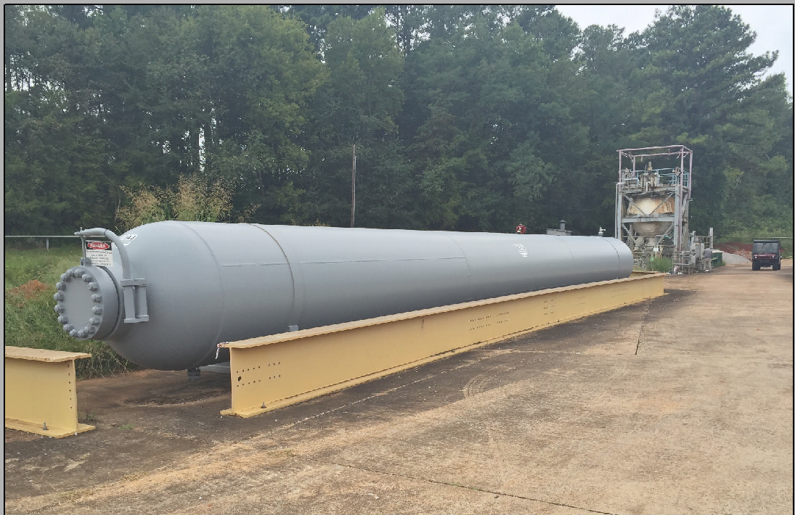
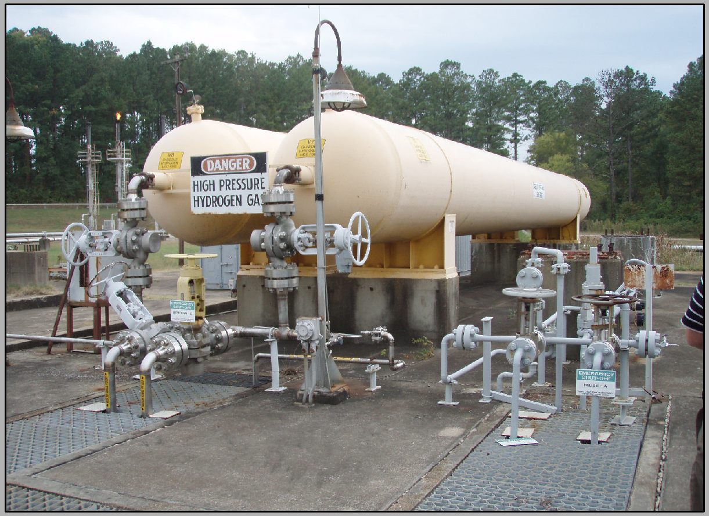
MLPV Catastrophic Failure Risk
Head / Projectile
Head / Projectile
Vessel
Horizontal Vessel
Vessel
Vertical Vessel
Notes:
Jettison of Heads most probable catastrophic failure

Slide 7
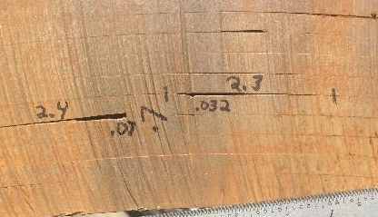
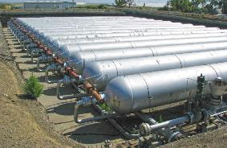
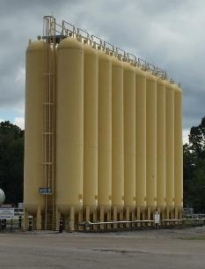
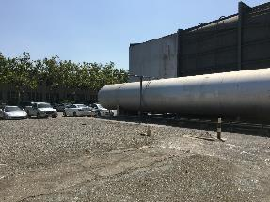
NASA MLPVs
Notes:
Frequently proprietary specifications and non-code
Not well characterized from a fracture perspective
Frequently high ductile-brittle transition temperature
19 primary materials and dozens of material combinations (welds and heat affected zones) in NASA vessels, reduced for testing purposes:
Availability and prevalence of data
Similarities of materials and material conditions (welds)

Slide 8
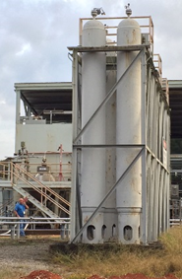
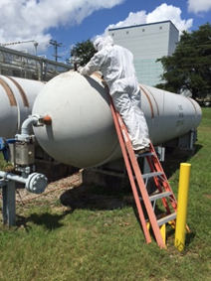
NASA Owns ~360 MLPVs, 3 Code
~204 in service, desire to return 156 to service
Not OSHA compliant
Challenges
Complex design and fabrication, non-code propriety material, and inability to inspect inner layer welds
Located in heavily populated areas
High stored energy risk, includes Hydrogen
Ensure safety
Not equivalent to ASME BPVC Section VIII compliant vessels required by Occupational Safety and Health Administration (OSHA)
Ensure reliability
Mitigate Risk
Replacement cost $1.2B

Slide 9
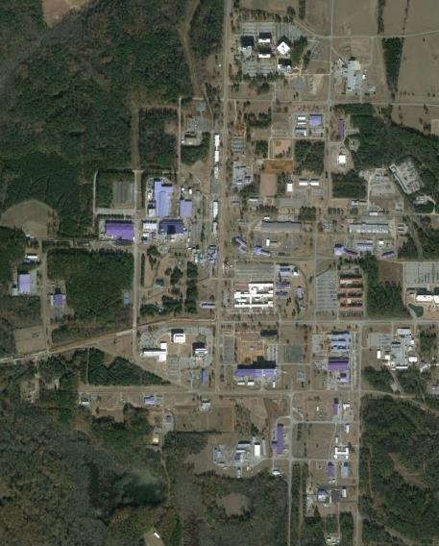
NASA MLPV Catastrophic Risk
Overpressure Effects Combined with Frag Distance (Vertical and horizontal head throw distance)
Legend
Red – Minor Building Damage
Orange – Personnel Exposure
Yellow – Dome Impact
Rideout Road
Radius
Red – 495’
Orange – 575’
Yellow – 2721’
Directional
Yellow – 4718’
Over Pressure Minor Risk
Fragmentation Major Risk
4751
Site
Martin Road
NASA MLPVs
Notes:
6K Psi vessel.

Slide 10
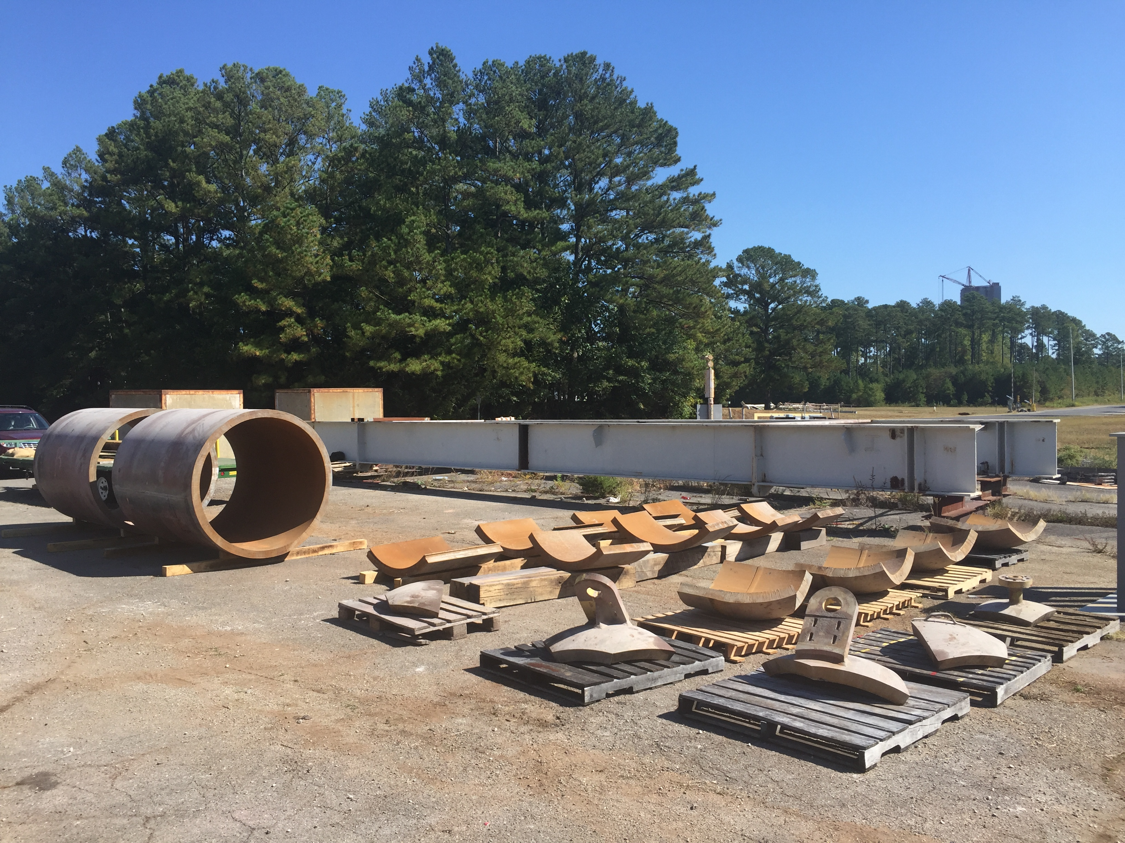
NASA MLPV Risk Mitigation
Investigated Risk Associated with the Operations of Non-code vs Code MLPVs
MLPV Risk Mitigation Project (RMP) (2014 - present)
  Formulate non-code MLPV continued use and Risk Mitigation Strategies
  Research and Development in MLPV Materials, Structures, Probabilistic Analysis, and Non-Destructive Evaluation (NDE)
  NDE RFI Solicitation and down-select
  Develop MLPV weld repair procedures and vessel certification processes
MLPV NDE Weld Inspection Pilot Program (FY22-FY30)
  100% inspection of active in-service MLPVs
Notes:
Understand materials
•Understand physics
•Identify potential defects
•Identify risk associated with each defect
•Determine critical crack sizes for each flaw based on bounding properties and stresses
•All flaws addressed logically in some way –probabilistic, analytic, inspection (e.g., deterministic analytical approach, can reliably find, always LBB, no crack growth, etc.)
•Field capability to inspect for defects of concern

Slide 11
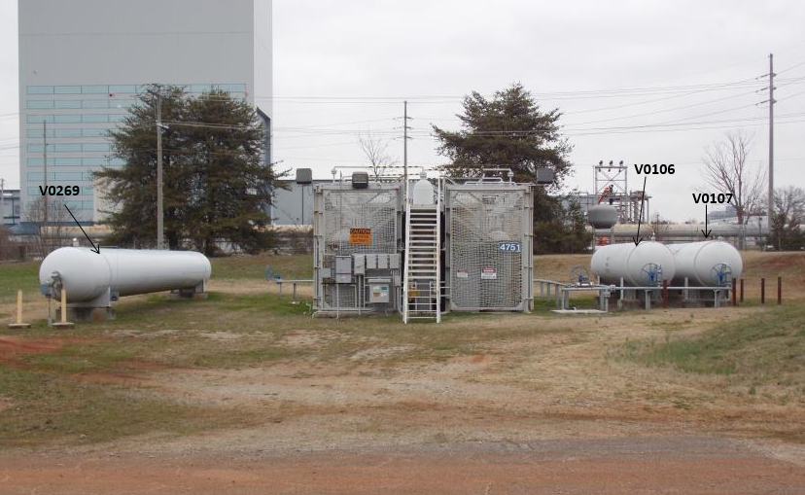
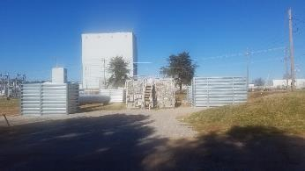
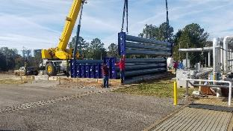
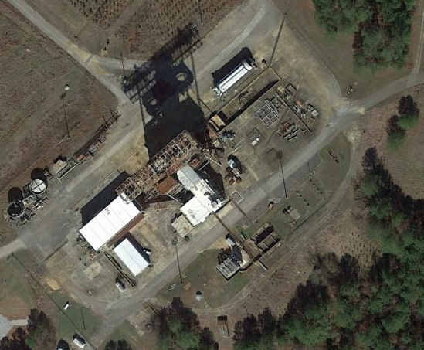
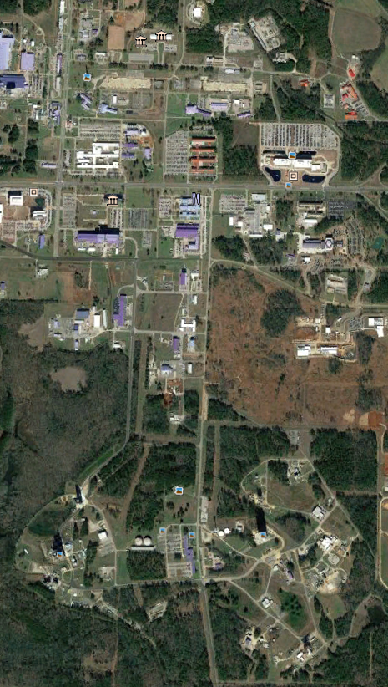
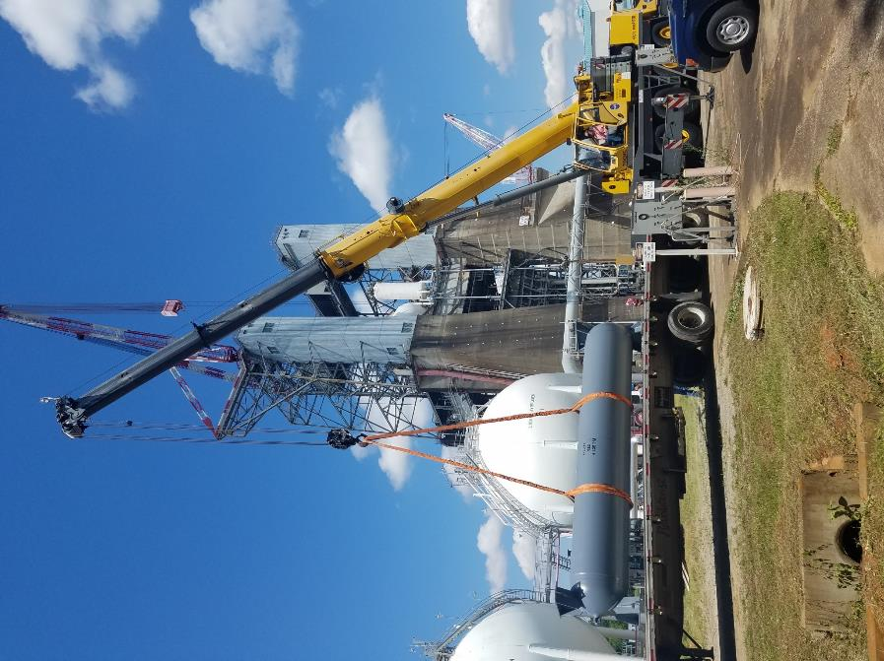
RMP MLPV Risk Mitigation
Before
After
Installation of Physical Barriers
New ASME Forged Vessels
Relocation Area
Ambient Temperature Restrictions
NASA MLPVs
Notes:
Reduced operational pressures based on environmental conditions. Cold weather ambient temp restrictions

Slide 12
NASA MLPV Certification
Notes:
Material knowledge can appropriately inform basic structural analysis to generate bounding critical crack sizes and critical initial flaw sizes (CIFs) for NDE baseline screening and calibration.
19 primary materials and dozens of material combinations (welds and heat affected zones) in NASA vessels, reduced for testing purposes:
Availability and prevalence of data
Similarities of materials and material conditions (welds)
Frequently proprietary specifications and non-code
Not well characterized from a fracture perspective
Frequently high ductile-brittle transition temperature

Slide 13
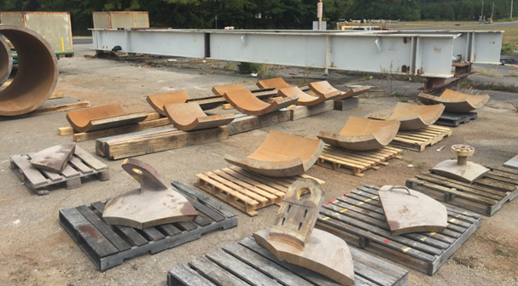
NASA RMP MLPV Material
Frequently proprietary specifications and non-code
Not well characterized from a fracture perspective
Frequently high ductile-brittle transition temperature
19 primary materials and dozens of material combinations (welds and heat affected zones) in NASA vessels, reduced for testing purposes:
                Availability and prevalence of data
Similarities of materials and material conditions (welds)

Slide 14
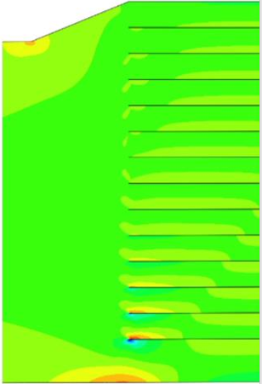
NASA RMP MLPV Structural Assessment Toolset
Custom built parametric models for LPVs
                Axis-Symmetric FEA
Plane-Strain FEA
LAPVAT (3D FEA)
Nozzles, both head and shell
LPVGCT, accounting for intra-layer gapping
ILLTC, custom closed form crack solutions for inner-layer cracks
Utilization of existing software packages
MLPV-specific case studies allow tailored use of existing software packages to be applied for layered geometries

Slide 15

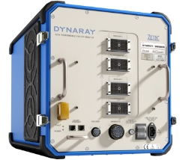
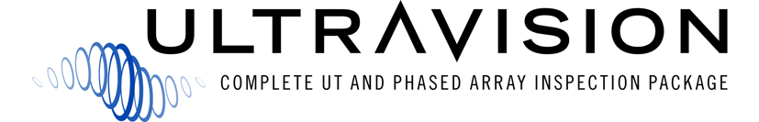
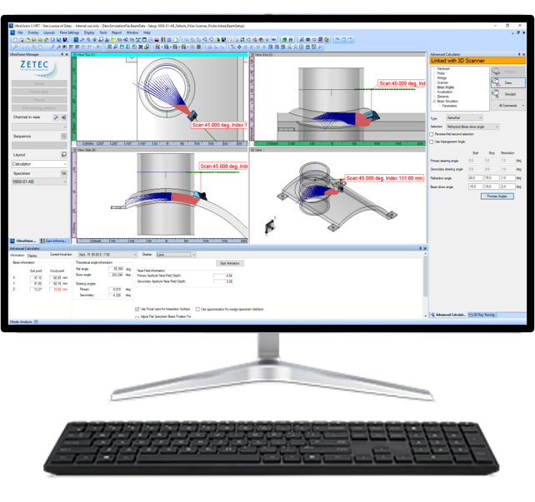
NDE Down- Select: 2D PAUT
256 beam forming channels, to fully support 2D matrix array technology
High data throughput
Inspection technique development in full 3D environment
Support of 2D matrix arrays
3D visualization of inspection data
Large data files (> 20 Gbytes)
Notes:
56/178 active
2 repaired
2 non repairable, T-1 Steel
Duration 50”
A high-performance phased array UT system and software are required to efficiently deploy the proposed inspection techniques.
The DYNARAY system with 256 beamforming channels is necessary to drive the large 2D-matrix array probe with a high data throughput.
The system is controlled by the UltraVision Classic software. This complete inspection package manages all phases of the inspection process in a full 3D environment, starting from the development and validation of probes and inspection techniques, to setup, calibration and data acquisition, and finally offline data analysis, evaluation and reporting.
The software can handle data files larger than 20 Gbytes.

Slide 16
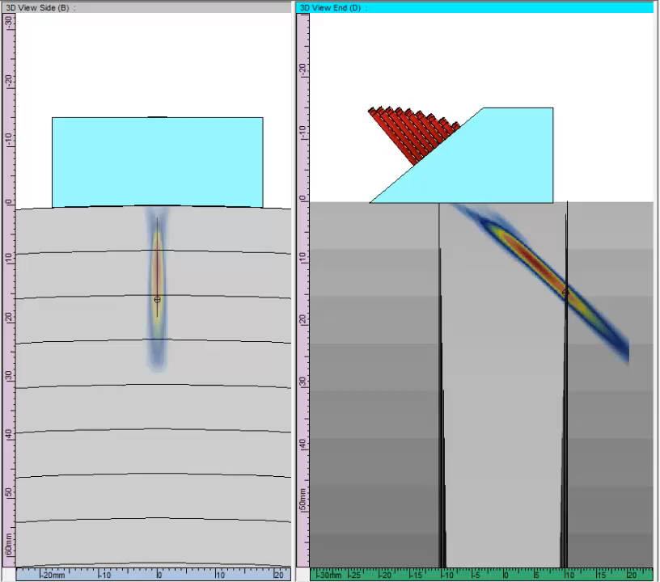
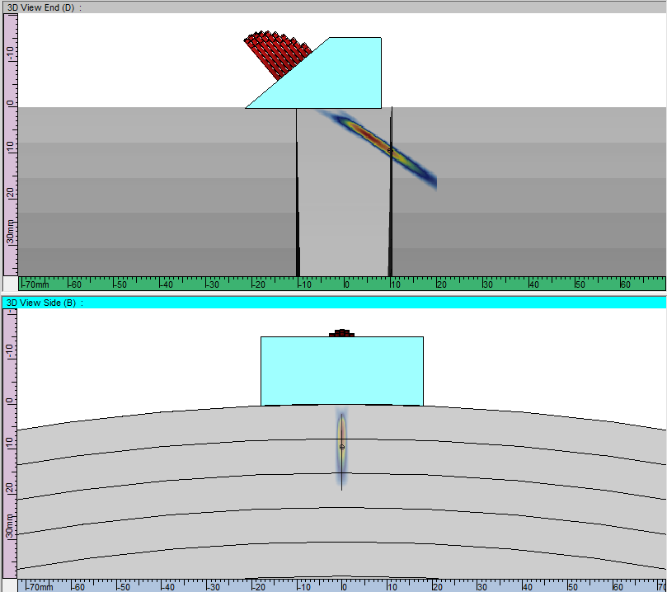
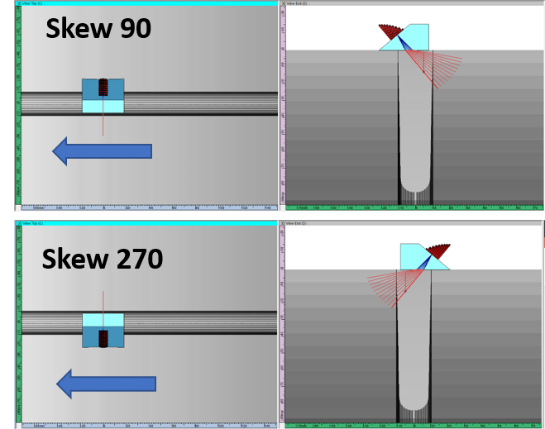
Inspection Technique – Circ. Flaws - OD
2D-matrix array, 5 MHz, 9 x 7 elements
Depth range 0 to 0.6”
Sector scan, from 40 to 80 SW
Skew 90 and 270, beams Ʇ to WCL
Two probe orientations, skew 90 and 270, beams Ʇ to WCL
Mechanical single line scan, ‖ to WCL, resolution 0.04” (1 mm)
Notes:
Duration 1’30”
So let’s now see what inspection techniques and phased array UT search units we need to overcome these challenges. We will start with the detection of circumferential flaws.
First of all, we decided to divide the thickness of the vessel in several depth ranges.
For the zone near the OD surface, from 0 to 0.6 inch deep, we selected a small 2D-matrix array probe at 5 MHz, with 9 x 7 elements, mounted on a shear wave wedge.
As shown on the image and the animation from the acoustic beam simulation, the probe assembly is located on the weld, and a sector scan, from 40 to 80 SW, is used to cover the bevel and part of the weld volume. For this inspection technique, the benefit of the 2D-matrix array lies in its capability to focus in the perpendicular plane as well as in the incidence plane, thus providing better sensitivity and lateral resolution of the acoustic beam.
Two probe orientations perpendicular to the WCL are required to cover the complete examination volume, in combination with a mechanical single line scan parallel to the WCL, with a resolution 0.04” (1 mm).

Slide 17
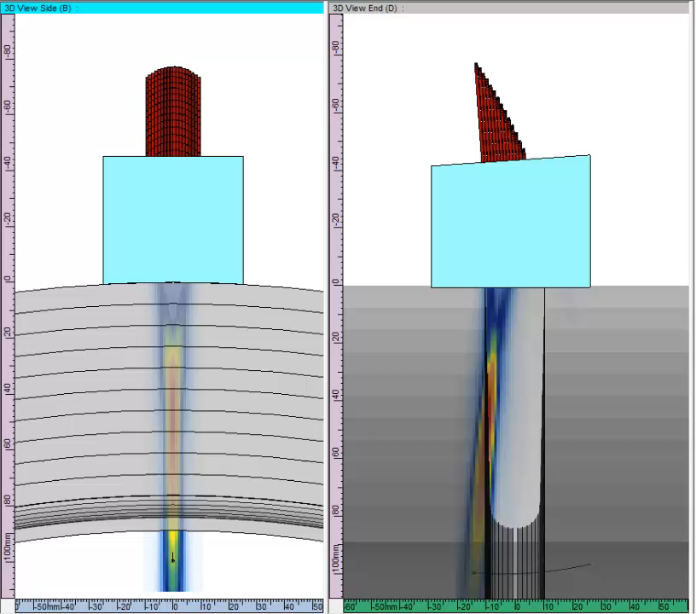
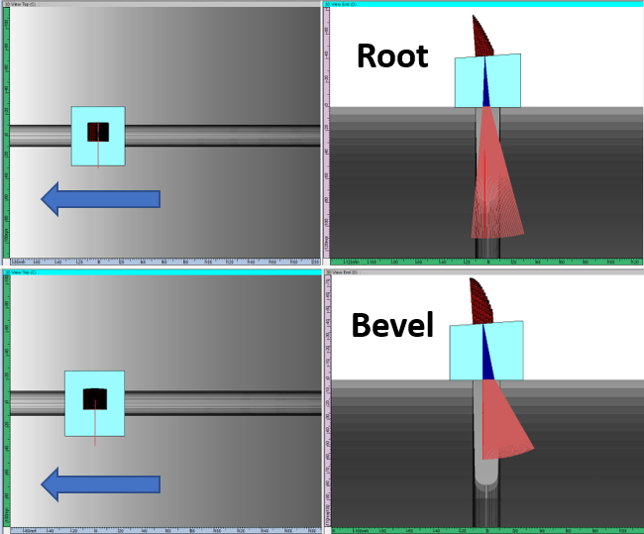
Inspection Technique – Circ. Flaws – Intermediate & ID
2D-matrix array, 5MHz, 18 x 14 elements, on 10LW wedge
Depth range from 0.6” to T
2 focal law groups :
  Root, sector from -5 to 15 LW, focused at ID
  Bevel, sector from 0 to 30 LW, focused at HP 1”
Two probe orientations, skew 90 and 270, beams Ʇ to WCL
Mechanical single line scan, ‖ to WCL, resolution 0.04” (1 mm)
Notes:
Duration 1’30”
For the intermediate and ID surface zones, from 0.6 inch to full thickness, we designed a custom large 2D-matrix array probe at 5 MHz, with 18 x 14 elements. Since we can only penetrate the weld volume from the weld surface, we need to use very low refracted angles, and therefore L-waves need to be used.
The probe assembly is again located on the weld, and 2 different focal law groups are generated to cover the ID Root zone and the Intermediate Bevel zone. Again 2D-matrix array technology is used to optimize focusing for better sensitivity and lateral resolution of the inspection.
As already mentioned, we are forced to use very low inspection angles for the ID Root zone. Therefore, no corner trap responses can be expected for ID connected planar flaws, so the inspection technique will have to rely entirely on tip signals.
Two probe orientations perpendicular to the WCL are required to cover the complete examination volume, in combination with a mechanical single line scan parallel to the weld

Slide 18
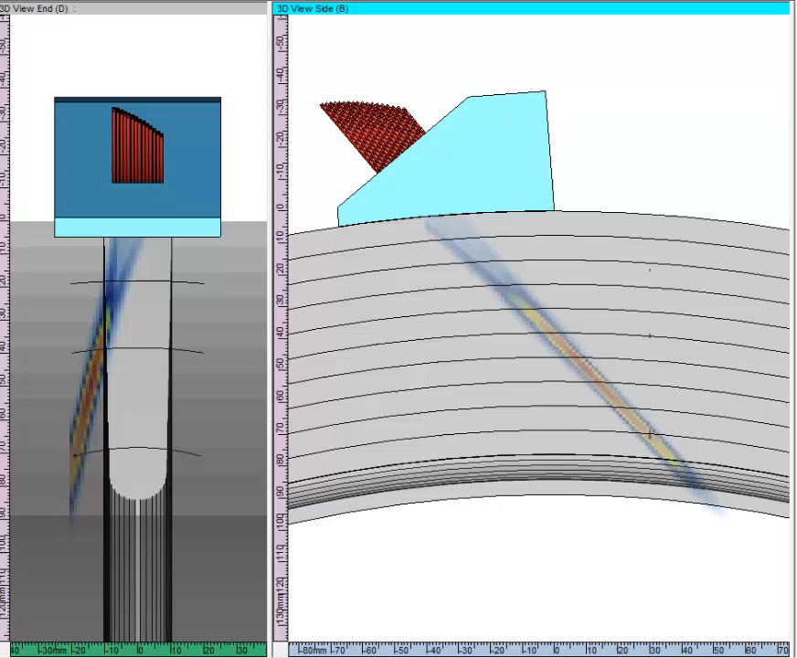
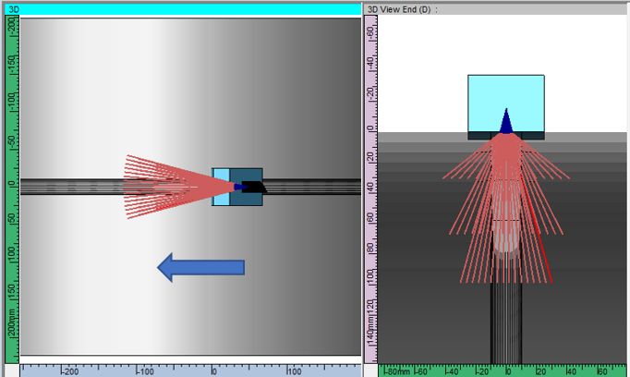
Inspection Technique – Axial Flaws
2D-matrix array, 5MHz, 18 x 14 elements, on 55SW wedge
3 focal law groups :
  70 SW, skew -15 to +15 deg, OD range
  60 SW, skew -15 to +15 deg, intermediate range
  40 SW, skew -15 to +15 deg, mid-wall and ID
Two probe orientations, skew 0 and 180, beams ‖ to WCL
Mechanical single line scan, ‖ to WCL, resolution 0.04” (1 mm)
Notes:
Duration 1’20”
So now, let’s look at axial flaws.
Again we divided the thickness of the vessel in three depth ranges, and a dedicated focal law group will be generated to cover each range.
We will use the same large 2D-matrix array probe at 5 MHz, with 18 x 14 elements, but for axial flaws the weld geometry allows us to use shear waves.
For this inspection technique, we are using the capability of 2D-matrix arrays to simultaneously steer and skew the acoustic beam, as you can see on the animation.
For the zone near the OD surface, 70 SW beams will be generated, with skew angles from -15 to +15 degrees to cover the complete weld volume and the bevel. Similar focal law groups at 60 SW and 40 SW will be generated to cover the intermediate and the ID surface range.
Two probe orientations parallel to the WCL will be used, clockwise and counter clockwise, in combination with a mechanical single line scan parallel to the WCL, with a resolution 0.04” (1 mm).

Slide 19
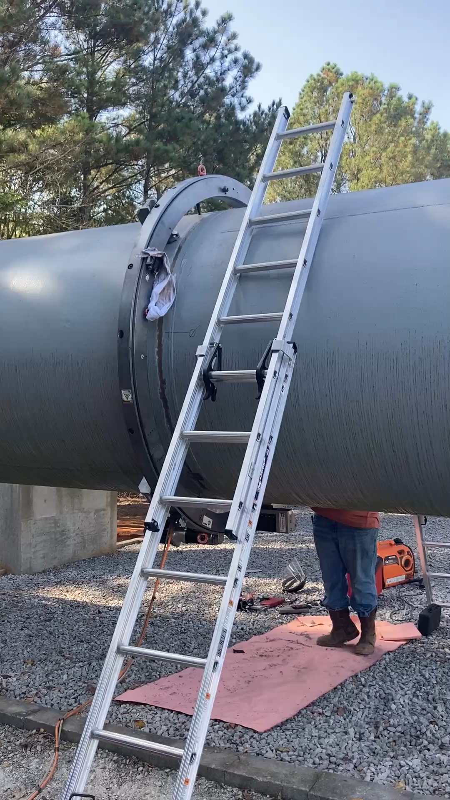
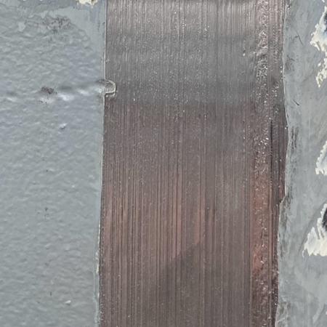
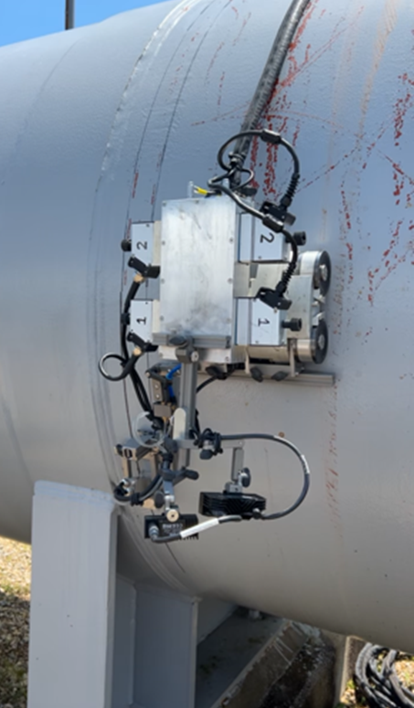
MLPV NDE PP Weld Examination
Shell-to-shell weld after flat topping operation
Machining of shell-to-shell weld video
Inspection of shell-to-shell weld

Slide 20
Flaw Naming Convention
Region:
NH = Nozzle to Head
NS = Nozzle to Shell
HS = Head to Shell
SS = Shell to Shell
HM = Head to Manway
LW = Longitudinal Weld
NP = Nozzle Parent
HP = Head Parent
WP = Wrapper Parent
IP = Inner Parent
Orientation (opening stress):
H = Hoop
A = Axial
M = Meridional (Spherical)
C = Circumferential(Spherical)
Flaw Location:
H = HAZ
W = Weld
F = Fusion Line
P = Parent
A = All/Any
Flaw Type:
T = Through
Si = Surface, inner surface
So = Surface, outer surface
C = Corner
E = Embedded
Flaw Size (in):
D = 1 x a Depth
L = 1 x c Length
Naming Convention:
Region-Orientation-Type-Location-D-L
Examples:
SS-A-Si-F-1-2 = Shell to shell weld, axially opened, semi-elliptical inner surface, located in fusion line, 1” deep by 4” total surface length
NS-H-C-P-0.5-1 = Nozzle, hoop oriented, corner crack, located in parent material, 0.5” depth 1” surface length
WP-H-S-H-0.25-2 = wrapper parent, hoop orientated, surface crack, located in HAZ, 0.25” in depth with 4” total length. Since this is wrapper parent it must be in the LW backer layer.

Slide 21
Axially Loaded Flaws
Primary Inspection Method:
Red = Limited or None
Magenta = Leakage
Orange = Guided Wave
Blue = Surface inspection: TECA, Mag
Green = Ultrasonic: PAUT, TFM/FMC
Critical size sufficiently large that out of plane growth should allow circumferential guided wave to detect it.
HS-A-Si-W
HS-A-Si-F
SS-A-Si-F
SS-A-Si-W
HS-A-E-F
SS-A-E-F
HS-A-So-A
SS-A-So-A
Inspection Risk:
Red = Not easily found
Orange = Not easily found, but limited consequence
Green = Easily found with existing/known methods

Slide 22
Hoop Loaded Flaws
Primary Inspection Method:
Red = Limited or None
Magenta = Leakage
Orange = Guided Wave
Blue = Surface inspection: TECA, Mag
Green = Ultrasonic: PAUT, TFM/FMC
Guided wave developed for SS welds may also work for HS transverse flaws, replacing skewed PAUT.
PAUT scanning parallel to weld may be able to find this flaw for smooth crowned welds.
HS-H-Si-A
IP-H-Si-A
IP-H-T-A
SS-H-Si-A
LW-H-T-W_{mid}
WP-H-T-A
Inspection Risk:
Red = Not easily found
Orange = Not easily found, but limited consequence
Green = Easily found with existing/known methods
HS-H-So-A
LW-H-T-W_{outer}
SS-H-So-W

Slide 23
Nozzle Shell Flaws
NS-H-Si-F
NS-H-Si-H
NS-H-C-P
NS-H-E-F
NS-H-So-F
NP-A-So-H
Some form of borescopic probe is required for nozzles in shell sections.
Primary Inspection Method:
Red = Limited or None
Magenta = Leakage
Orange = Guided Wave
Blue = Surface inspection: TECA, Eddy Current
Green = Ultrasonic: PAUT, TFM/FMC, Conventional, EMATS
Inspection Risk:
Red = Not easily found
Orange = Not easily found, but limited consequence
Green = Easily found with existing/known methods

Slide 24
Nozzle Head Flaws
Primary Inspection Method:
Red = Limited or None
Magenta = Leakage
Orange = Guided Wave
Blue = Surface inspection: TECA, Eddy Current
Green = Ultrasonic: PAUT, TFM/FMC, EMATS
Inspection Risk:
Red = Not easily found
Orange = Not easily found, but limited consequence
Green = Easily found with existing/known methods
NP-A-So-H
NH-M-So-F
NH-M-E-F
PAUT from the head outside any reinforcement plate should find all of these flaws. A borescopic probe is also feasible.
NH-C-C-P
NH-M-Si-F

Slide 25
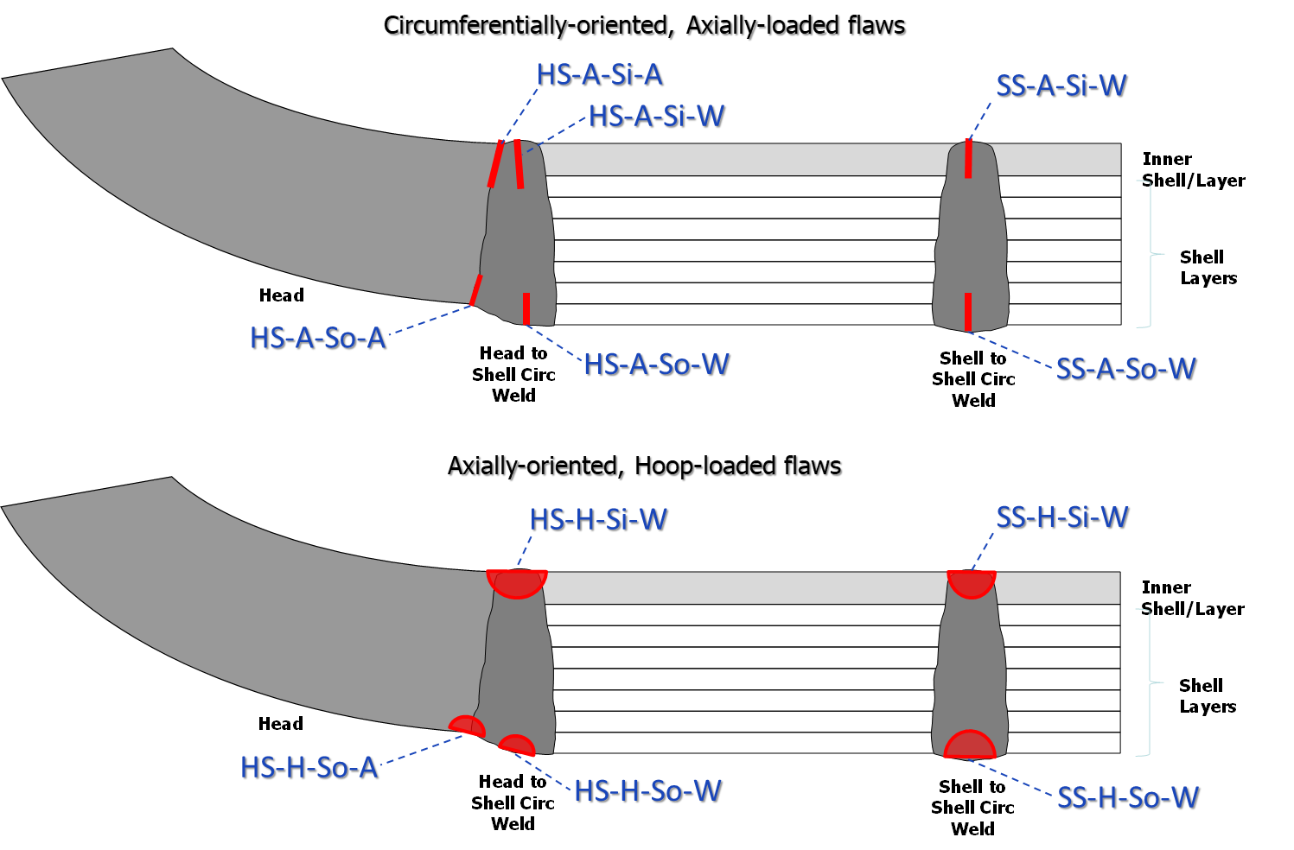
PAUT Finding: SS-H-Si-W
Notes:
Vessel Descriptions
Owning Organization: RPT
No. of Vessels: 3 (V-141-HE, V-143-HE, V-144-HE)
Media: Helium
Pressure/Capacity: Helium (6,000 psig/1,500 cu.ft.)
No. S-S Welds per Vessel: Helium (8 welds)
S/H/N Materials: T-1 Steel
Shell Nozzles: 2
Unique construction features: Typical

Slide 26
Flaw Indication
SS-H-Si-W flaw, 0.72” depth, 1.8” length.

Slide 27
CIF & CCS Table, SSC 5.5” block
SS-H-Si-W flaw, 0.72” depth, 1.8” length.

Slide 28
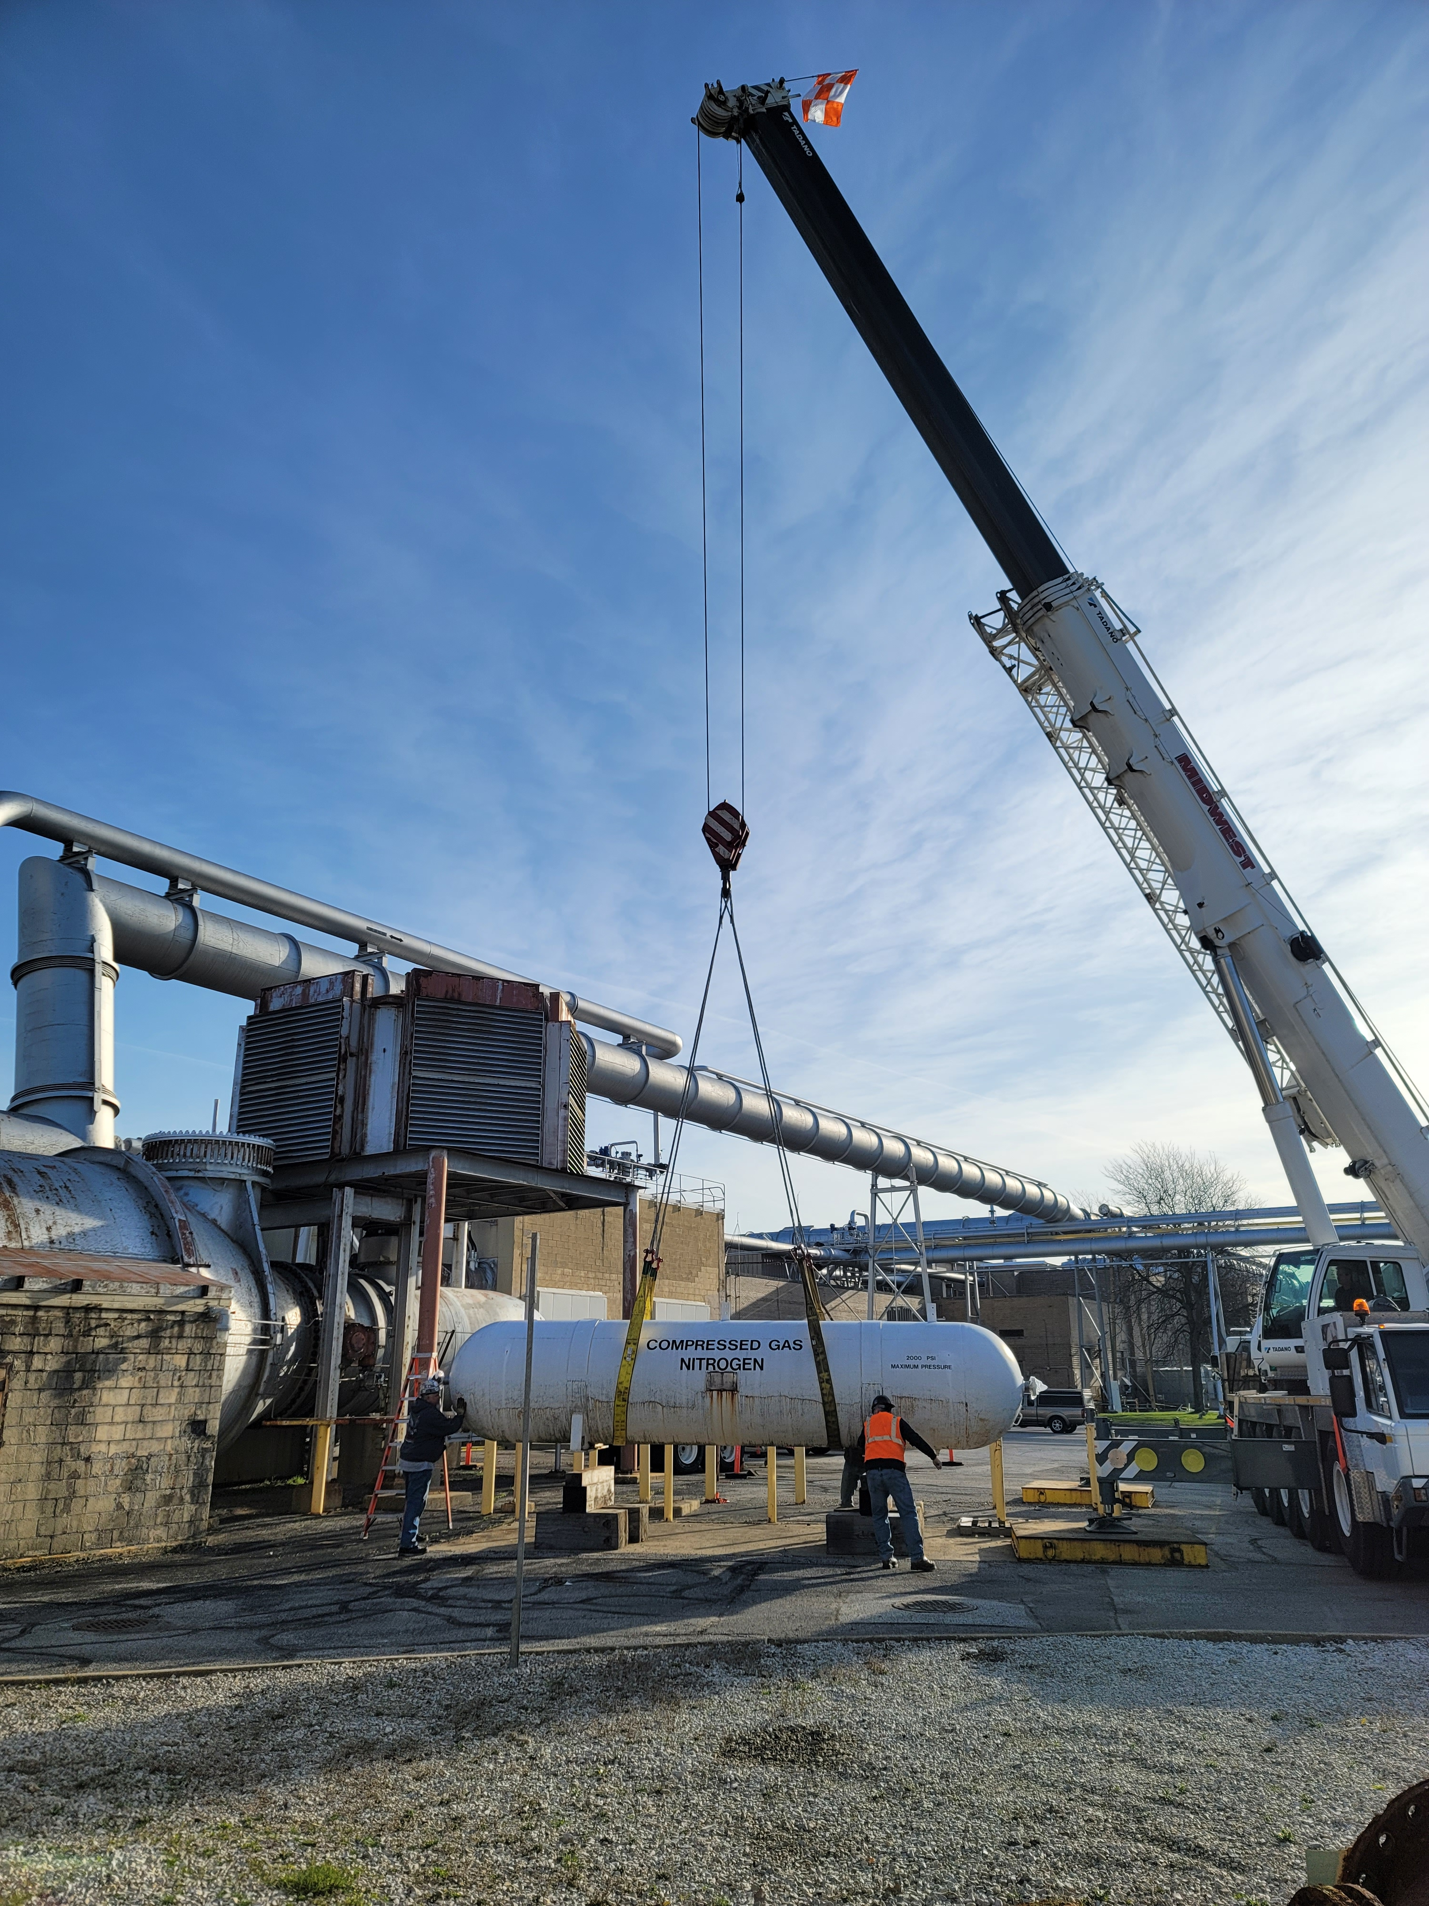
Conclusion
Operation of non-code MLPVs is a willful OSHA non-compliance and present a significant safety risk
NASA MLPV continued use guidance available
  NASA Requirements For Ground Based Non-Code Metallic Pressure Vessels, NASA-Std- 8719.26,
  Evaluation of Agency Non-code Layered Pressure Vessels (LPVs), NASA TM-2014-218505/Volume 1
  NASA Ground-Based Layered Pressure Vessels Materials Report, NASA/TM-20210019043
  NASA Ground-Based Layered Pressure Vessels Nondestructive Evaluation Report, NASA/TM- 20210020973
  TM’s pending
    MLPV Structures Report
    MLPV Operations and Certification Handbook
Notes:
SSC T-1 Steel discovery presents a potential threat to Agency’s large scale propulsion test
Systems removed from service (cold month service reduction impacts)
Space Operations Mission Directorate Capability Asset Program (CAP) has been contacted

Slide 29
SignOffPage

Slide 30
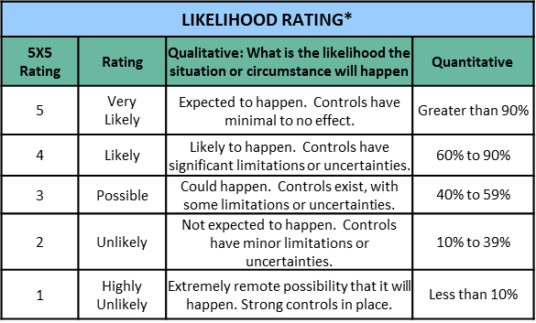
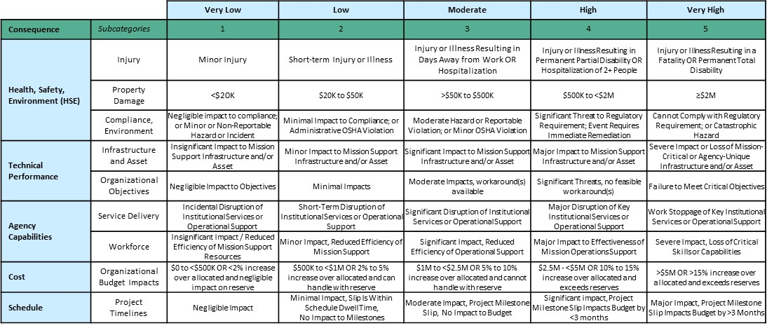
NASA Risk Assessment Code (RAC) (LxC)
Likelihood
  Rate the probability of occurrence of the condition being
  realized using MSD score card.
Consequences
  Rate the consequences of the risk using MSD score card.
For risk scoring, think most-probable, not worst-case.
MSD RISK MATRIX
L
I
K
E
L
I
H
O
O
D
5
4
3
2
1
1
2
3
4
5
CONSEQUENCES

Slide 31
OSHA Alternate/Supplemental
Standard: NS 8719.26
  Applies a risk based approach
  Supplemental to NASA-STD-8719.17 NASA Requirements for Ground-Based Pressure Vessels and Pressurized Systems (PVS)
  Addresses MLPV material properties, construction variability, welding residual stress, fabrication defects, analysis, and inspection.
  Defines analyses approaches
  Defect categories are identified, then in order to validate operation of a vessel, all categories will be addressed and safety validated.

Slide 32
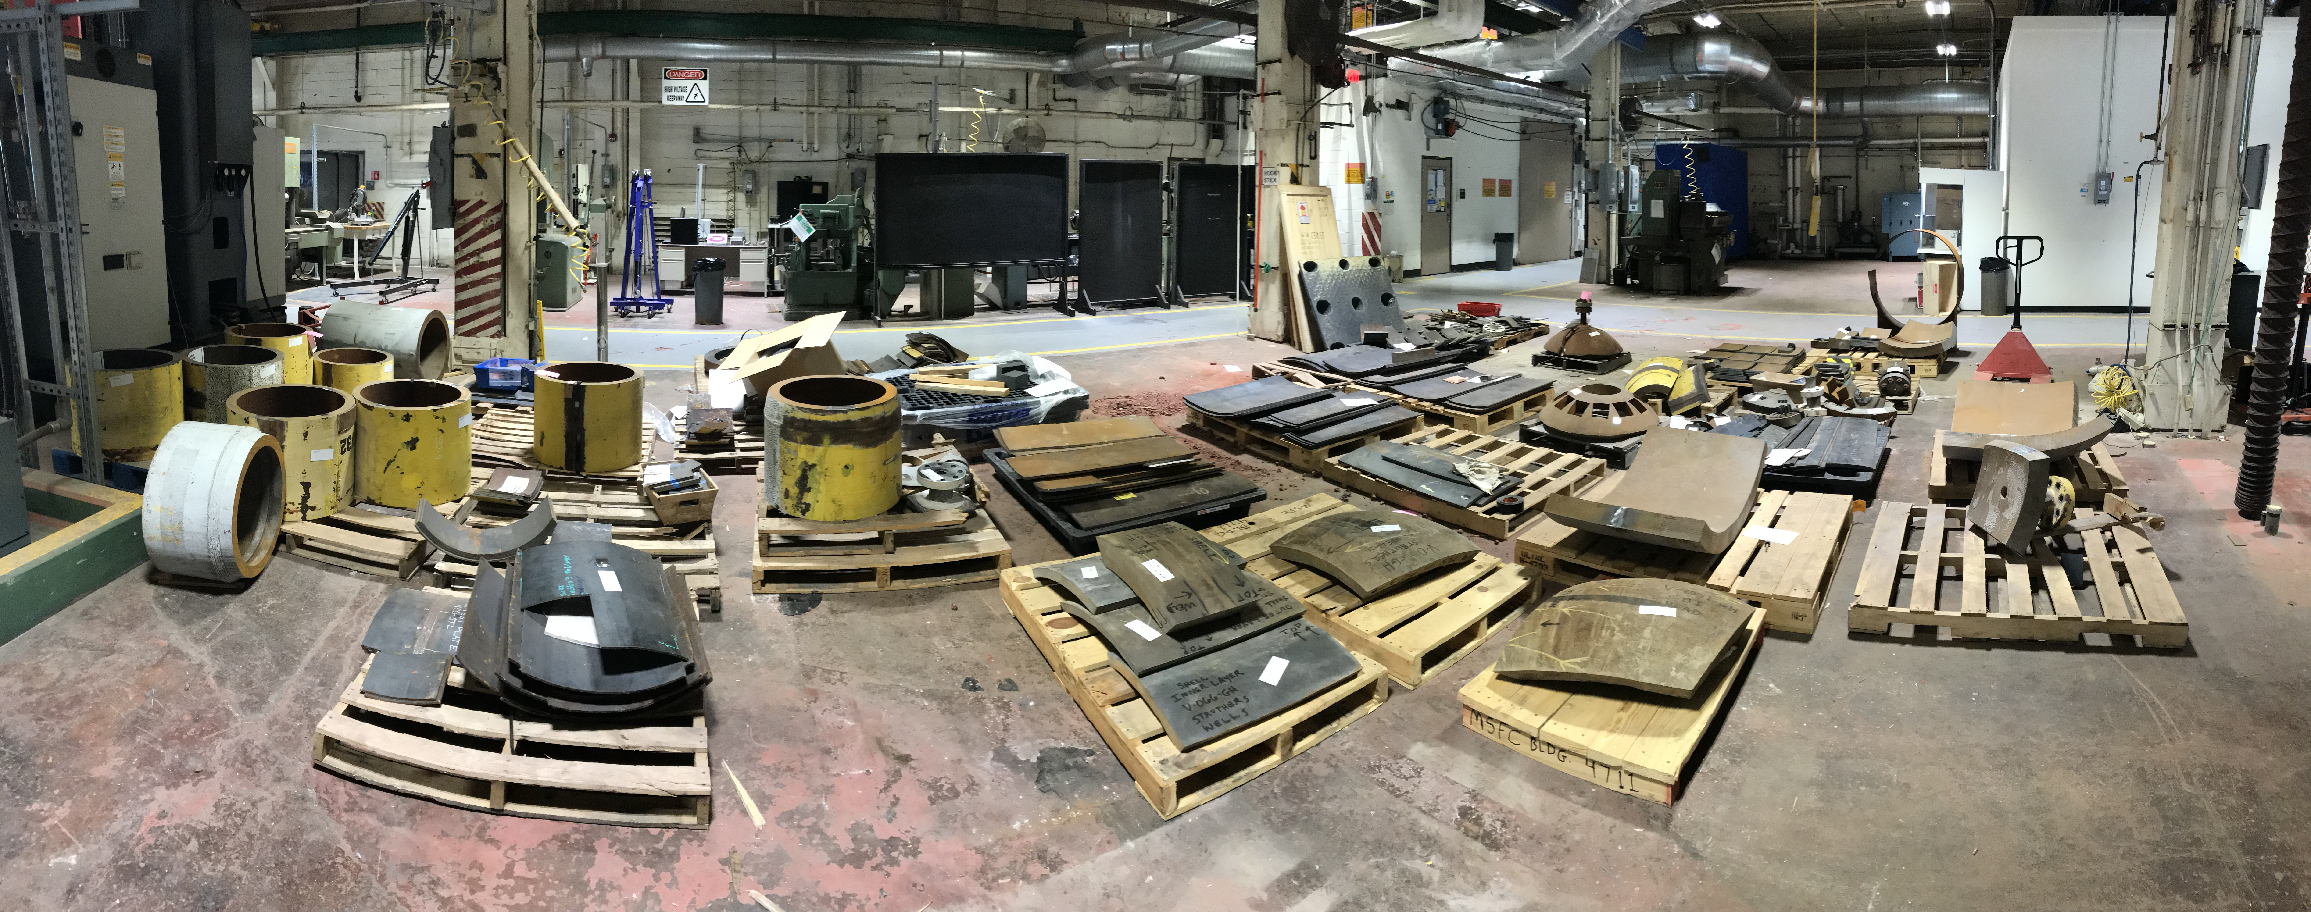
OSHA PVS Requirements Referenced in NASA-STD-8719.26
1.2.5.2 This standard applies the criteria established in the OSHA LOI referenced in 1.2.5.1 for the specific subparagraphs of the OSHA General Industry regulations of 29 CFR cited below only with respect to non-compliance of PVs with ASME BPVC Section VIII Division 1 or Division 2-1968:
a. 29 CFR § 1910.103(b)(1)(i) - Hydrogen, Gaseous Hydrogen Systems, Design, Containers; subparagraph 29 CFR § 1910.103(b)(1)(i)(a)(1).
b. 29 CFR § 1910.103(c)(1)(i) - Hydrogen, Liquefied Hydrogen Systems, Design, Containers; subparagraph 29 CFR § 1910.103(c)(1)(i)(a).
c. 29 CFR § 1910.104(b)(4)(ii) - Oxygen, Bulk Oxygen Systems, Storage Containers, Construction – Liquid; subparagraph 29 CFR § 1910.104(b)(4)(ii).
d. 29 CFR § 1910.104(b)(4)(iii) - Oxygen, Bulk Oxygen Systems, Storage Containers, Construction – Gaseous; subparagraph 29 CFR § 1910.104(b)(4)(iii)(a).
e. 29 CFR § 1910.106(b)(1)(iv) - Flammable Liquids, Tank Storage, Design and Construction of Tanks, Low Pressure Tanks; subparagraph 29 CFR § 1910.106(b)(1)(iv)(b)(2).
f. 29 CFR § 1910.106(b)(1)(v) - Flammable Liquids, Tank Storage, Design and Construction of Tanks, Pressure Vessels; subparagraph 29 CFR § 1910.106(b)(1)(v)(b).
g. 29 CFR § 1910.169(a)(2) - Air Receivers, General Requirements, New and Existing Equipment; subparagraph 29 CFR § 1910.169(a)(2)(i).

Slide 33
Manufacturers of NASA MLPV
 |  |  | In-Service Only
Center/Manufacturer | Vessels In Service | Out of Service | A. O. Smith | Struthers Wells | CB&I | Hahn & Clay | Consolidated Western Steel | Taylor Forge
Ames Research Center | 17 | 1 | 17
Glenn Research Center | 59 | 10 | 59
Johnson Space Center | 0 | 3
Kennedy Space Center | 3 | 22 | 3
Langley Research Center | 2 |  | 2
Marshall Space Flight Center | 79 | 112 | 48 | 2 | 26 | 3 | 0
Michoud Assembly Facility | 8 |  | 6 | 2
Stennis Space Center | 15 | 7 |  | 15
Wallops Flight Facility | 17 |  | 12 |  |  |  |  | 5
White Sands Test Facility | 4 | 1 | 3 | 1
Total | 204 | 156 | 150 | 20 | 26 | 3 | 0

Slide 34
NDE RFI Respondent | Technology Proposed | Services Proposed | Applicability | Notes
M2M NDT, Inc. | PAUT with real-time TFM | Equipment Sales | Circumferential welds | M2M GEKKO system used on a 4 layer demonstration block to verify locating of defects.
AVNIK Defense Solutions, Inc. | Vibro-acoustic SHMS | Install/operate/ manage SHMS of LPVs | Vessel defect screening | SHMS developed originally for aircraft structures. Briefing by AVNIK scheduled for Nov 13 during NDE telecon - NASA only
Zetec | PAUT with 2D Probes | Technique development and equipment sales | Circumferential welds | 2D PAUT probes with Dynaray system and UltraVision Classic software.
Digital Wave Corp. | Modal AE | Testing services | Vessel defect screening | Submittal mentions “recent advances..” Is this the same technology employed for V0023 AE test by DWC?
Eddyfi Technologies | Tangential ECA | Equipment Sales | Surface connected cracks for all directly accessible welds | TECA using I-Flex probe. Replacement for MT and no paint removal required.
The Phased Array Company | PAUT/FMC with WSM | Technique development and equipment sales | Circumferential welds | Use water-filled flexible wedge to couple to weld cap. Adaptive software algorithms to compensate for weld surface irregularity.
EWI | PAUT/FMC with TFM and WSM ECA and MFL Computational Modeling | Research and development | Circumferential welds and Surface/near surface cracks of accessible welds | Largest applied research and development org in North America specializing in welding and manufacturing technologies. Experience with NDE technologies for heavy wall vessels and piping.
LUNA | HMS (monitoring weep-holes for leakage) | Technique development and equipment sales | Vessel inner liner | Monitor weep holes for leakage using active/passive sensors
BWXT-NOG Technologies, Inc. | PAUT/FMC with water column coupling and WSM | Technique development and testing services | Circumferential welds | Babcock and Wilcox Nuclear Operations Group. Techniques developed for nuclear reactor components with rough weld surfaces. Also proposes use of 2D probes and CIVA for UT simulation. Patent numbers referenced in submittal.
Southwest Research Institute (SwRI) | PAUT MFL Ultrasonic Guided Wave PAUT with WSM | Technique development/prototype assembly and validation | Inner liner Long. Welds Vessel defect screening S-S Welds | Inner surface : PAUT Robotic scanner for inspection of inner liner Long. Welds/Plate acreage: Magnetic Flux Leakage Vessel defect screening: Ultrasonic Guided Wave S-S Welds: PAUT with weld surface mapping
Southern Research | Ultrasonic Spectroscopy Digital Image Correlation Large Structure Strain Capture | Technique development and testing services | Vessel defect screening | Techniques proposed as supplementary to other NDE techniques employed by NASA. Other NDE techniques would still be required for follow-up inspections.
Note: Respondents listed in the order received
PAUT – phased array ultrasonic test AE – Acoustic Emission
SHMS – Structural Health Monitoring System ECA – Eddy Current Array
TFM – Total Focusing Method MFL – Magnetic Flux Leakage
WSM – Weld Surface Mapping

Slide 35
NDE RFI Respondent | Technology Proposed | Primary Services Proposed |  |  |  |  | Applicability
 |  | Equipment Sales | Technique Refinement | Basic R&D | Examination/Testing | Vessel Health Monitoring
M2M NDT, Inc. | PAUT with real-time TFM | X | X |  |  |  | Circumferential welds
AVNIK Defense Solutions, Inc. | Vibro-acoustic SHMS |  | X |  | X | X | Vessel defect screening
Zetec | PAUT with 2D Probes | X | X |  |  |  | Circumferential welds
Digital Wave Corp. | Modal AE | X | X |  | X |  | Vessel defect screening
Eddyfi Technologies | Tangential ECA | X |  |  |  |  | Surface connected cracks for all directly accessible welds
The Phased Array Company | PAUT/FMC with WSM | X | X |  | X |  | Circumferential welds
EWI | PAUT/FMC with TFM and WSM ECA and MFL Computational Modeling |  |  | X |  |  | Circumferential welds and Surface/near surface cracks of accessible welds
LUNA | HMS (monitoring weep-holes for leakage) | X | X |  |  | X | Vessel inner liner
BWXT-NOG Technologies, Inc. | PAUT/FMC with water column coupling and WSM |  | X |  | X |  | All directly accessible welds including nozzles
Southwest Research Institute (SwRI) | PAUT MFL Ultrasonic Guided Wave PAUT with WSM |  | X | X |  |  | Inner liner UT inspection Long. Welds Vessel defect screening S-S Welds
Southern Research | Ultrasonic Spectroscopy Digital Image Correlation Large Structure Strain Capture |  | X | X | X |  | Vessel defect screening
Note: Respondents listed in the order received
PAUT – phased array ultrasonic test AE – Acoustic Emission
SHMS – Structural Health Monitoring System ECA – Eddy Current Array
TFM – Total Focusing Method MFL – Magnetic Flux Leakage
WSM – Weld Surface Mapping

Slide 36
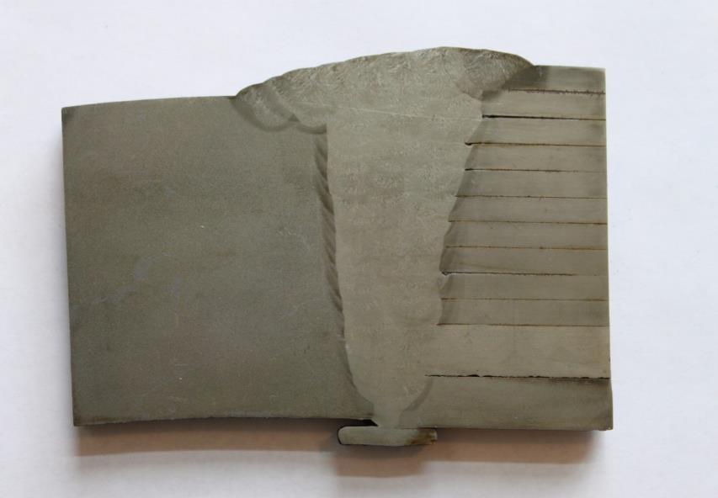
MLPV Head to Shell Construction
Solid head to layered shell sections are relatively easy to inspect
Inspection performed from head side only using Shear- Wave Ultrasonic (angle-beam inspection) techniques
Specific angles can be used to interrogate explicit areas of interest in welds where critical flaws originate
Layer section provides landmarks in the PAUT data showing fusion of weld to plates
Weld geometry data can also be derived and compared to vessel drawings if available

Slide 37
MLPV Shell to Shell Construction
Shell to shell welds require inspection to justify continued use.
Most vessels only have small nozzles (3 to 8 inch inside diameter) on each end restricting personnel access for entry
Vessels in service at NASA require maintenance of cleanliness; opening the vessel to atmosphere is not preferred and costly when performed

