Slide 1

Johnson Space Center
Thermal Technology Roadmap 2024
National Aeronautics and
Space Administration
Tom Leimkuehler, Ph. D.
Active Thermal Technical Discipline Lead

Slide 2
JSC Overview
The Hub of Human Spaceflight
Established in 1961 as the Manned Spacecraft Center
Renamed in 1973 in honor of the late President, and Texas native, Lyndon B. Johnson
Science, technology, engineering and medicine
Home of mission control and astronaut training

Slide 3
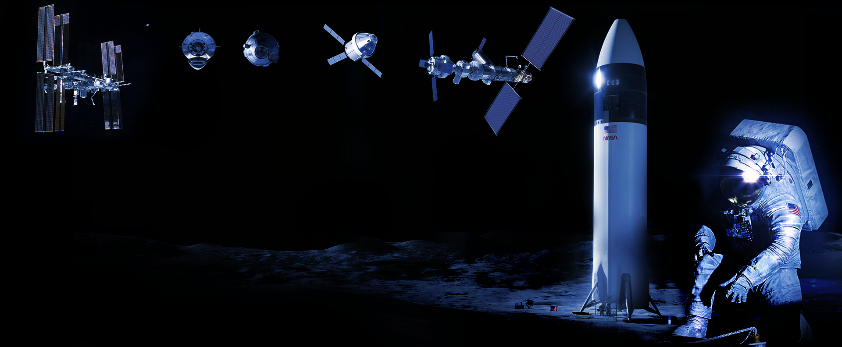



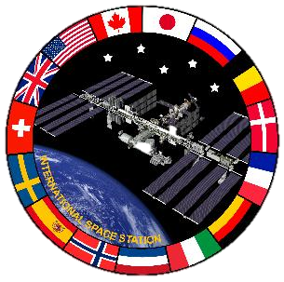

Human Spaceflight Programs
Currently Supported at JSC
International Space Station
Commercial Crew
Orion
Gateway
Human Landing System
Extravehicular Activity & Human Surface Mobility

Slide 4
Human Spacecraft
Thermal Systems Development at JSC
International Space Station
Commercial Crew
Orion
Gateway
Human Landing System
Extravehicular Activity & Human Surface Mobility
75 kW
Dual pumped loops
  Internal: Water
  External: Ammonia
Deployable Radiators
  73 ft x 11 ft x 6
Heat pipes
Shell heaters
MLI
Localized dynamic radiative environment
Optical property degradation leading to structural loads issues
Large heat pipe & 2-phase ATCS dev prior to ISS
ATCS
PTCS
TPS
5 kW
Dual pumped loops
  Internal: PGW
  External: HFE-7200
Body-Mounted Radiators
  24m²
Software controlled heaters
MLI / SiOx tape on CM
6.3 kw
Dual pumped loops
  Internal: PGW
  External: HFE-7200
Body-Mounted (HALO = 36m²) & Deployable Radiators
Unique challenge due to cislunar environment and 7-day lunar orbit
Potential lunar dust deposition
Optical property degradation
ATCS
PTCS
TPS
Spacesuits
Rovers

Slide 5

JSC Engineering Directorate
EA12 Chief Engineers Office
EA13 Directorate Integration Office
EC Crew & Thermal Systems Division
EC2 Design and Analysis Branch
Thermal Analysis, Advanced Materials, Softgoods
EC3 Life Support Systems Branch
ECLSS
EG Aeroscience & Flight Mechanics Division
EC4 Systems Test Branch
Thermal Vacuum Chambers
EP Propulsion & Power Division
EC5 Space Suit and Crew Survival Systems Branch
Suits, PLSS
EC6 Thermal Systems Branch
ATCS
ER Software, Robotics & Simulation Division
EC7 Tools, Equipment, and Habitability Systems Branch
EVA Tools, Cold Stowage
ES Structural Engineering Division
ES3 Thermal Design Branch
PTCS, TPS
EV Avionic Systems Division
EX Project Management & Systems Engineering Division

Slide 6
Needs & Current Tech/Flight Development
NASA’s Space Technology Mission Directorate (STMD) has published a set of Envisioned Futures to describe how Capability Areas are working to achieve Strategic Outcomes which comprise the Strategic Framework of technology investments
  https://techport.nasa.gov/framework
JSC informs and is guided by these Envisioned Futures

Slide 7
Needs & Current Tech/Flight Development
Thermal systems are categorized as follows:
  Temperature Regime
  Cryogenic (< -150°C) (TX 14.1)
  Moderate Temperature (-150°C to 500°C) (TX 14.2)
  High Temperature (> 500°C) (TPS) (TX 14.3)
Human/Robotic
  Human Spacecraft
  Satellite/Robotic Spacecraft
  Active/Passive
  Active (ATCS)
  Passive (PTCS)

Slide 8
Needs & Current Tech/Flight Development
Organization
  TX14 Thermal Management Systems
    TX14.1 Cryogenic Systems
    TX14.2 Thermal Control Components and Systems
      Heat Acquisition (TX 14.2.1)
        Cold plates, heat exchangers, condensing heat exchangers
      Heat Transport (TX 14.2.2)
        Fluid loops, pumps, heat pumps/two phase systems [here or under system?]
      Heat Rejection and Storage (TX 14.2.3)
        Heat Rejection: Radiators, radiator turn-down devices, coatings
        Heat Storage: Phase change materials
      Insulation and Interfaces (TX 14.2.4)
        MLI
      Thermal Control Analysis (TX 14.2.5)
      Heating Systems (TX 14.2.6)
      Thermal Control System
        Verification and Validation (TX 14.2.7)
        Measurement and Control (TX 14.2.8)
        System architecture, integrated performance, hybrid systems
    TX14.3 Thermal Protection Components and Systems
      Thermal Protection Materials (TX 14.3.1)
      Thermal Protection Systems (TX 14.3.2)
      Thermal Protection Analysis (TX 14.3.3)
      Thermal Protection System Testing (TX 14.3.4)
      Thermal Protection System Instrumentation (TX 14.3.5)
  TX09 Entry, Descent, and Landing
    TX09.1 Aeroassist and Atmospheric Entry
      Thermal Protection Systems (TX09.1.1)
  TX06 Human Health, Life Support, and Habitation Systems
    TX06.1 Environmental Control & Life Support Systems (ECLSS) and Habitation Systems
      Atmosphere Revitalization (TX06.1.1)
        Condensing Heat Exchangers
    TX06.2 Extravehicular Activity Systems
      Portable Life Support System (PLSS) (TX06.2.2)
        Thermal Control
    TX06.3 Human Health and Performance
      Food Production, Processing, and Preservation (TX06.3.5)
        Refrigeration, Cold Stowage

Slide 9
Heat Acquisition Gaps
Advanced Heat Exchangers

Slide 10
Condensing Heat Exchangers &
Water Separators
CHX are a critical function of closed-loop life support
  Provide sensible and latent cooling to the vehicle
  ~50% of reclaimed water on ISS is from CHX condensate
Current technology utilizes a hydrophilic coating to gather condensate and control microbial growth in conjunction with a monthly dry-out. Slurper bars and water separator is used to draw condensate off the CHX, delivering it to the WPA
Three problems with current technology
  Coating longevity
    Hydrophobic contamination turns hydrophilic surfaces hydrophobic leading to water carry-over
    CHX’s must be uninstalled and refurbished on a regular basis (significant crew time & resources)
  Microbial and fungal growth concerns
    Current coating utilizes silver oxide to mitigate microbe growth and must be dried out on a monthly basis to prevent bio-film formation
    Potential for flaking, potential for hydrophobic contamination, and additional logistics tracking with MCC
  Current coatings may react with airborne contaminants which may cause downstream impacts to WPA
    Chemical reaction between contaminants and coatings which produce DMSD’s that degrade filters in the WPA
    Currently on ISS, WPA filters can remove compounds, but are degraded at an accelerated rate (replaced every year)
To enable long duration spaceflight and reduce upmass/downmass
a more robust CHX is needed

Slide 11
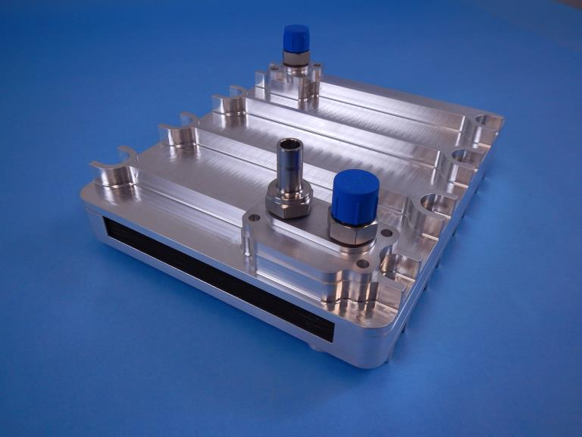
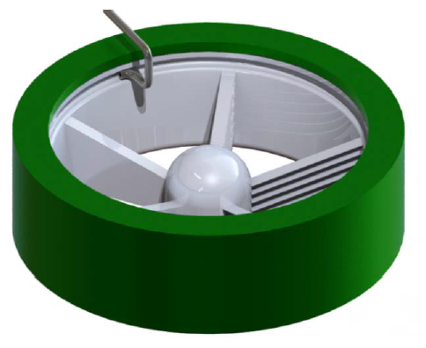
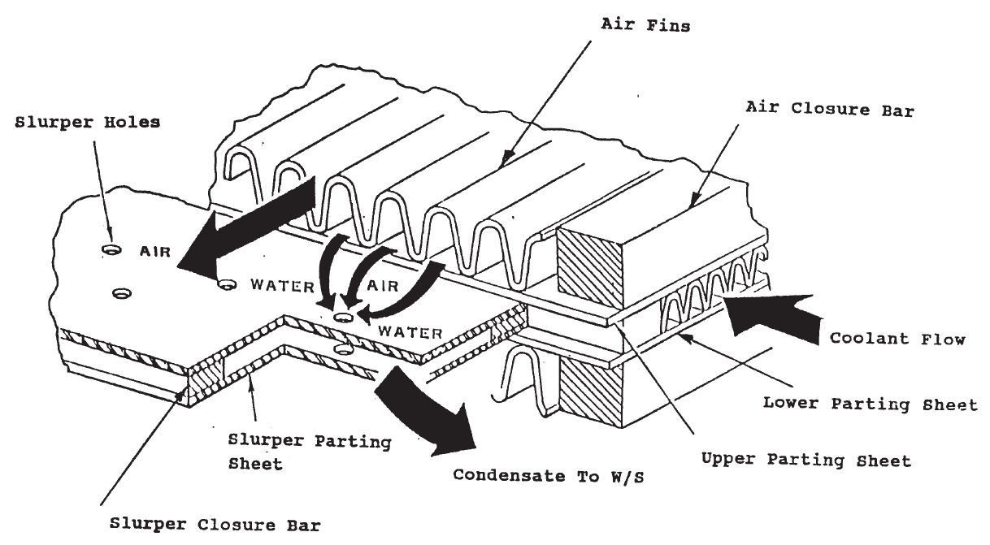
CHX & Water Separator
Technologies Being Pursued
Collins Advanced Coating
Reformulation of current coating to address issues with wettability, dissolution, microbial growth, and DMSD production
Reformulation primarily replaces problematic portions of their coating with more favorable coatings to decrease potential for coating contaminations and increase anti-microbial capabilities
Concept utilizes same water separator as currently on ISS
Titanium 3D printed CHX also being pursued with use of the new coating to decrease mass and move away from brazed CHX’s
Laser Processed Condensing HX (LP-CHX)
Dimpled plate heat exchanger replaces typical plate/fin heat exchanger
Condensing surfaces are 99.95% pure laser processed silver which exhibit antimicrobial properties
Designed to eject condensate from the outlet of the LP-CHX (i.e. hydrophilic/hydrophobic insensitive)
COndensate Separator for Microgravity Conditions (COSMIC)
Water separator (COSMIC) is placed directly downstream of the LP-CHX and sized for full airflow, condensing rates, and various water droplet dimensions
Once water enters, it functions similar to the current water separator in terms of water removal
Concept allows for hydrophilic/hydrophobic insensitive condensing surfaces to be utilized, like the LP-CHX

Slide 12
Heat Transport Gaps
Novel Heat Transfer Fluids
HFE 7200 Replacement
TCS Fluids for Long Duration, Deep Space Missions
Gas Trap for Non-Water Fluids
In Situ Coolant Health Assessment
In Situ Coolant Tube Repair
Coolant Flexlines that Are Impermeable
Automated Coolant Leak Locating
Coolant Tubing with Reduced Mass
Pumps with Increased Efficiency and Reduced Mass

Slide 13
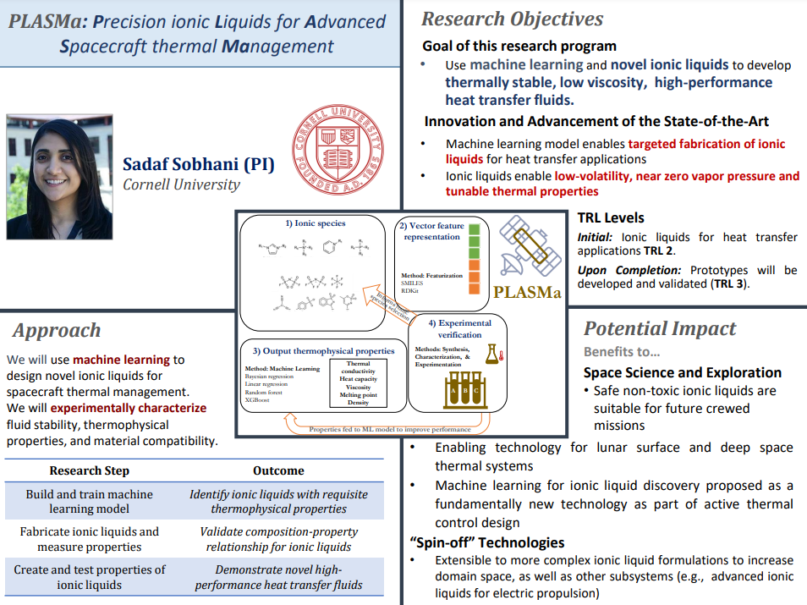
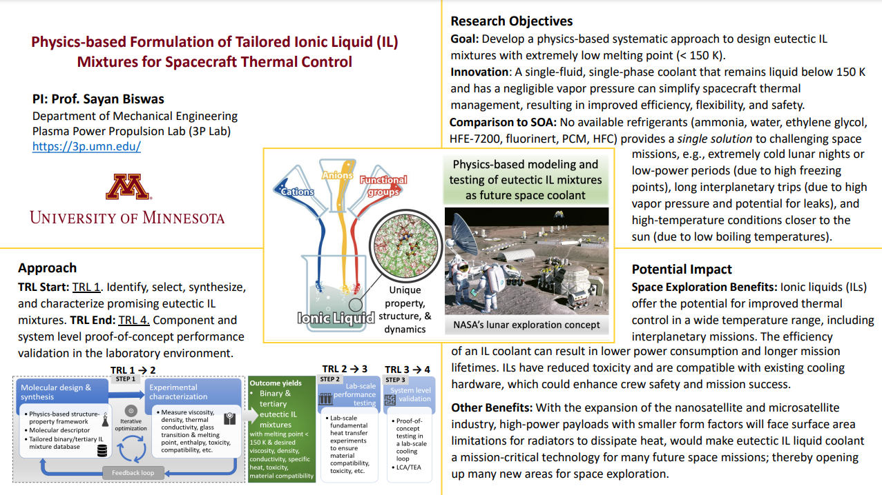
Novel Heat Transfer Fluids
Early Career Faculty 2023 Awards
Sadaf Sobhani
Cornell University
PLASMa: Precision Ionic Liquids for Advanced Spacecraft Thermal Management
Sayan Biswas
University of Minnesota, Minneapolis
Physics-based Formulation of Tailored Ionic Liquids for Spacecraft Thermal Control

Slide 14
HFE 7200 Replacement
HFE 7200 is the heat transfer fluid in the external coolant loops for Orion and Gateway
3M has announced their intent to phase out production of HFE 7200 by the end of 2025 to exit manufacturing of perfluoroalkyl substances (PFAS)
Orion and Gateway are stockpiling HFE 7200
JSC is working with the NASA Engineering and Safety Center (NESC) to identify and evaluate alternate coolants for use in future missions

Slide 15
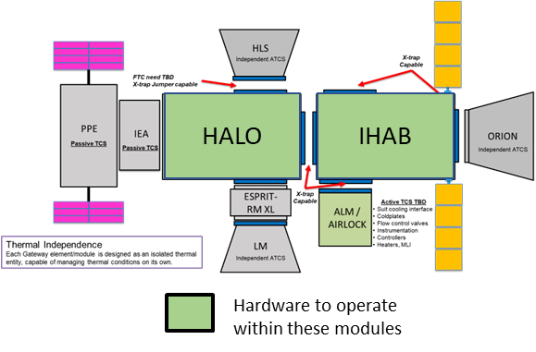
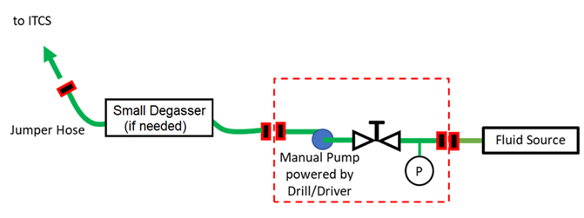
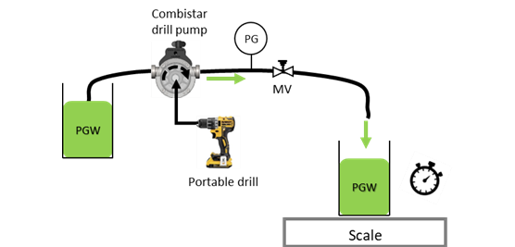
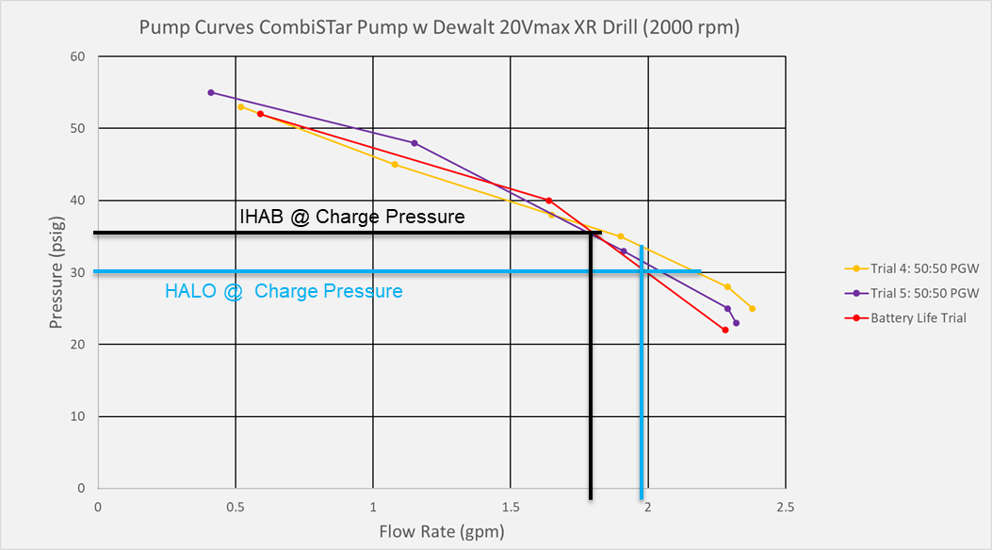
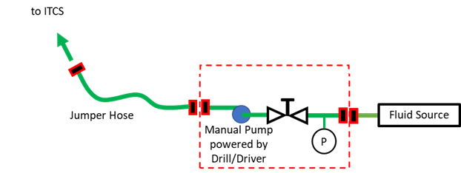
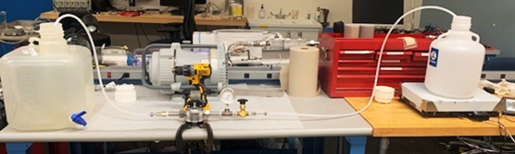

Gateway Fluid Refill
  Purpose: Provide a universal Fluid Refill System that can transfer replacement thermal fluid to various Internal Active Thermal Control System (IATCS) systems of Gateway including iHAB, HALO, and Airlocks.
  Technical Challenge: Minimize complexity and power consumption while providing ability to transfer PGW at required rates into a pressure head with different/varying back pressures from fluid sources. Added complexity of gas removal during operation.
  Proposed Solution: Positive displacement pump driven by available (manifested) portable drill.
Fluid Refill w Gas Trap
Fluid Refill Only
Combistar 2001-A

Slide 16



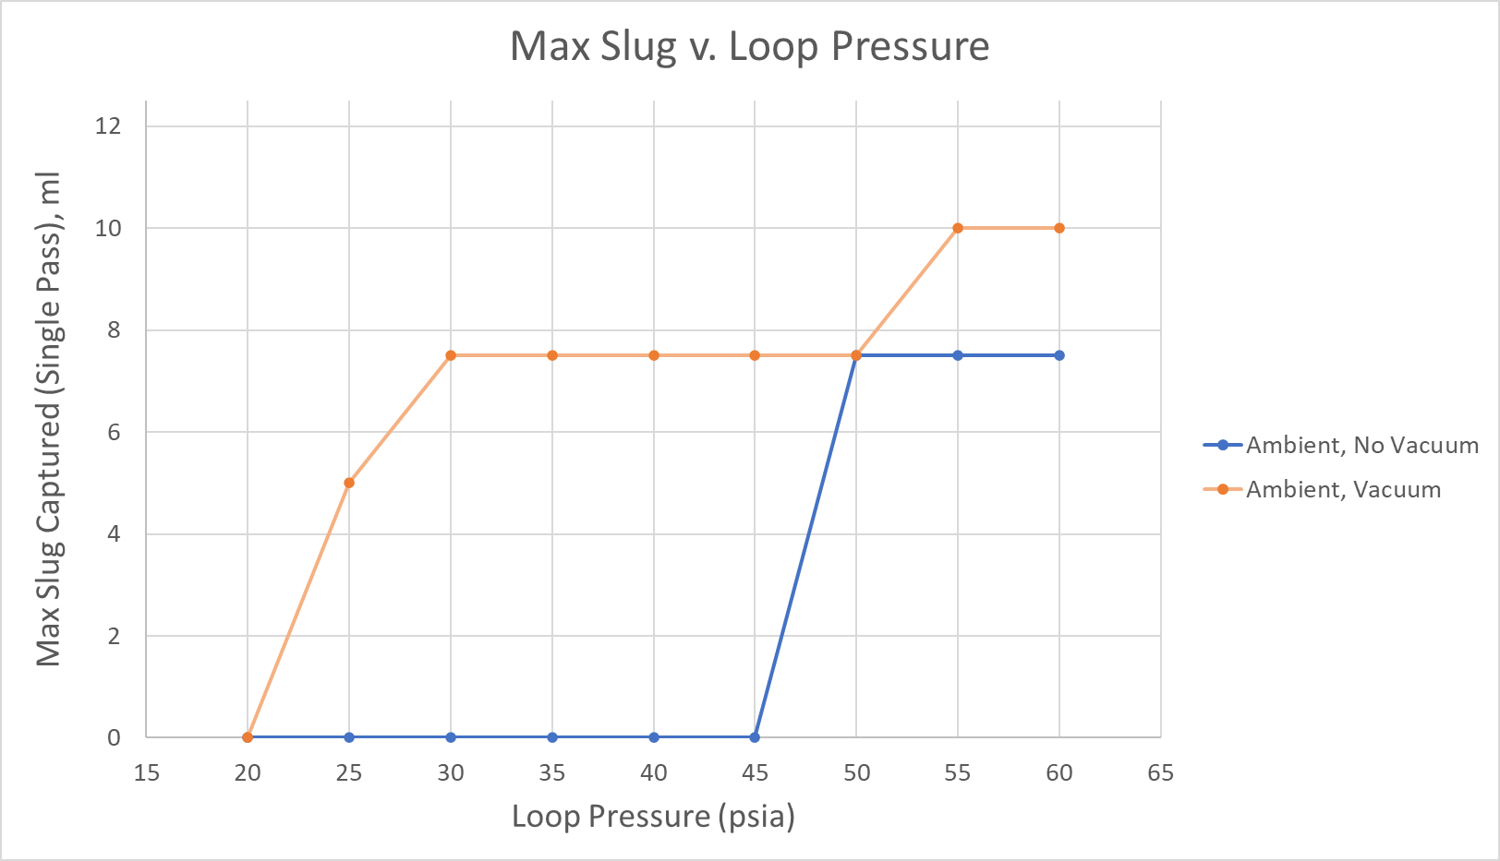

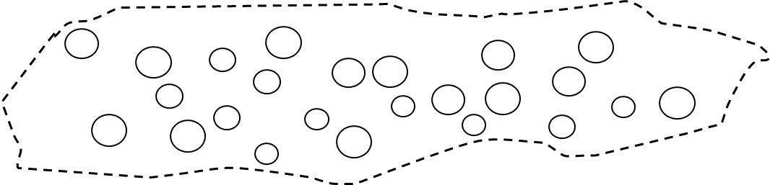
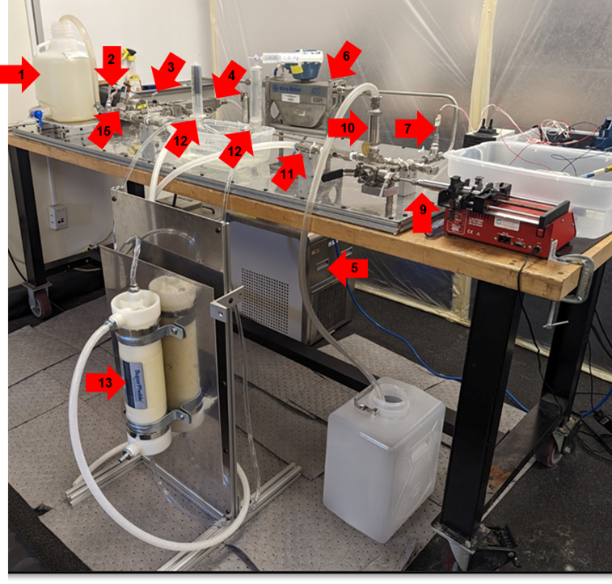


Gateway Gas Trap
  Purpose: Provide a universal Gas Trap that can remove undissolved gas bubbles from thermal fluid within IATCS of iHAB, HALO, and Airlocks.
  Technical Challenge: Remove bubbles from fluid with low surface tension at relatively high pressures while preventing liquid breakthrough. Added challenge of small residence time within gas trap.
  Proposed Solution: Membrane degasser with high effective porosity to allow sufficient gas diffusion but with high enough hydrophobicity to prevent liquid breakthrough.
PGW
Superphobic
membrane
(w cutaway)
Gas
Removed
Gas Removed
Drill Pump Max Pumping Pressure
HALO Charge Pressure
IHAB
Charge Pressure
Gas Removal Testing
Gas diffused
across membrane
Discharge to atmosphere
Vacuum assist at discharge

Slide 17
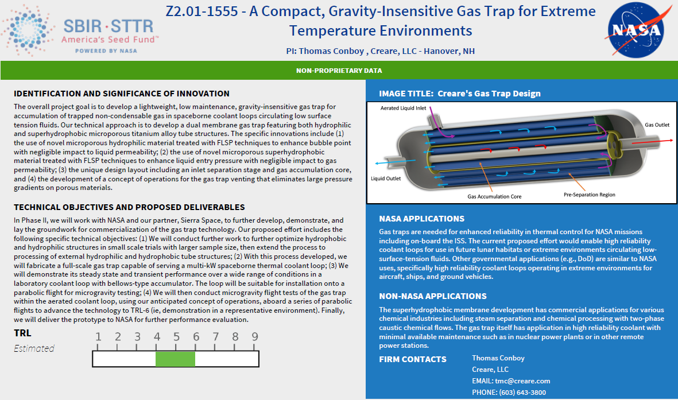
A Compact, Gravity-Insensitive Gas Trap for Extreme Temperature Environments (SBIR)

Slide 18
Heat Rejection Gaps
Variable Heat Rejection
Advanced Radiators – Deployable
Advanced Radiators – Body Mounted
Thermal Control Coatings
Dust Tolerant Thermal Systems

Slide 19
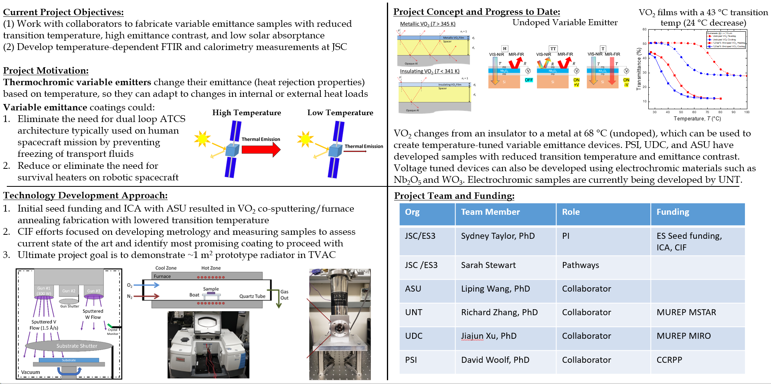
Insulation and Interfaces – Variable Emittance Coatings Tech Dev

Slide 20
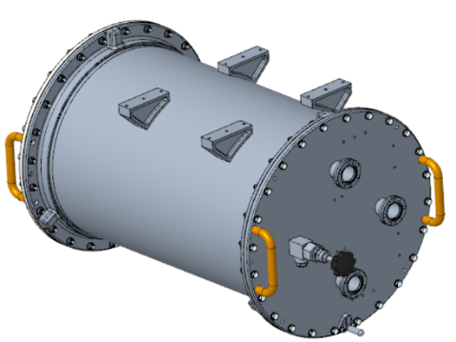
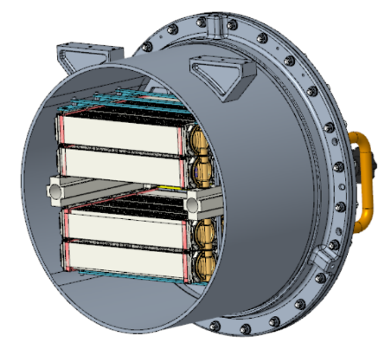
Supplemental Heat Rejection Evaporative Cooler (SHREC)
Supplemental Heat Rejection Evaporative Cooler (SHREC) is being developed as a back-up heat rejection system for ISS in the event of a dual external thermal control system (ETCS) loop failure
If needed, ISS will transition to minimal power and SHREC will provide evaporative cooling to the internal thermal control system (ITCS) while the crew repairs one of the failed ETCS loops
Heat rejection is provided by 44 hollow fiber cartridges that are stacked in an evaporator exposed to vacuum
The SHREC cartridge design is based on the spacesuit water membrane evaporator (SWME)
Evaporator Drum Assembly
Cartridge Assemblies

Slide 21
Heat Storage Gaps
Phase Change Materials with Increased Energy Storage

Slide 22
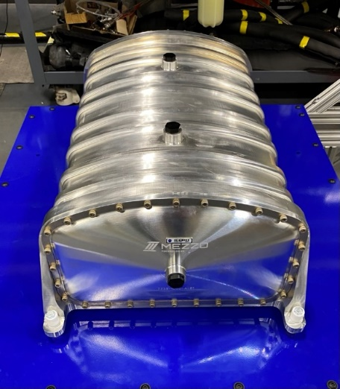
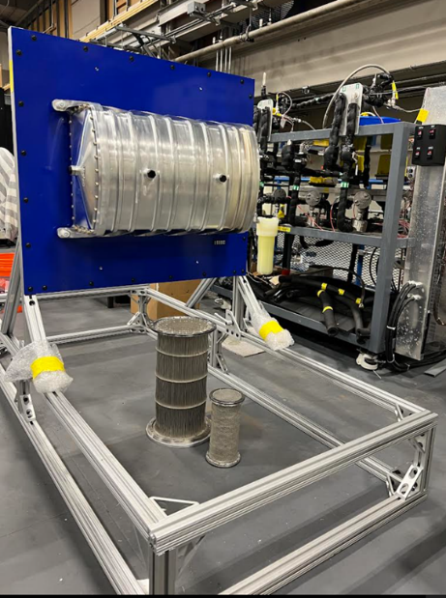
Alternate Phase Change Material (PCM)
Heat Exchanger Development for Orion
Mezzo Technologies designed and delivered a Phase Change Material Heat Exchanger Engineering development unit
The Thermal Systems Branch is partnering with Lockheed Martin to subject the EDU to a full test series
  Thermal Systems Branch will perform proof, leak and functional testing
  Lockheed Martin’s Denver environmental test labs will perform vibration and shock testing to Orion qualification levels
With successful completion of the test campaign, the expectation is that Lockheed Martin will work with Mezzo Technologies to continue design and development of the heat exchangers to be incorporated into future flight units
Implementation of this alternate heat exchanger would result in a mass savings of 58 pounds per flight vehicle.

Slide 23
Thermal Control Analysis Gaps
Advanced modeling techniques
Lunar and Martian thermal data and modeling tools
Window thermal modeling and analysis
Cross-domain sharing of thermal results
Thermal sizing due to lunar dust adhesion

Slide 24
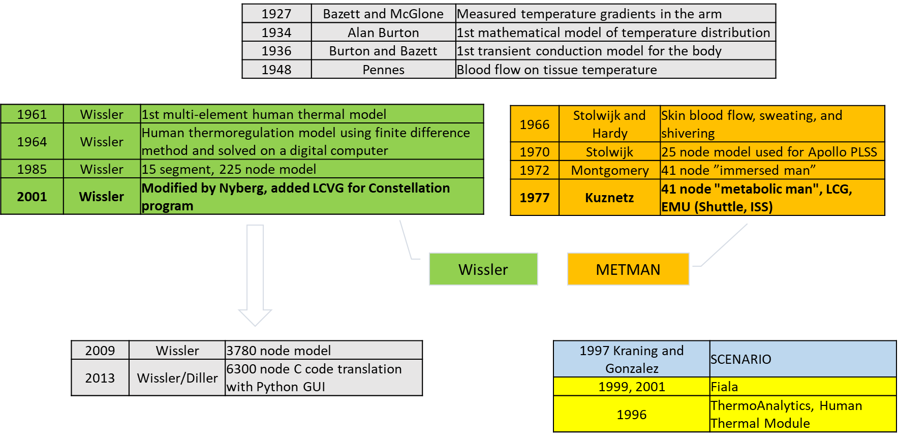
Human Thermal Modeling (Overview)

Slide 25
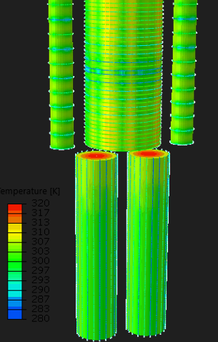
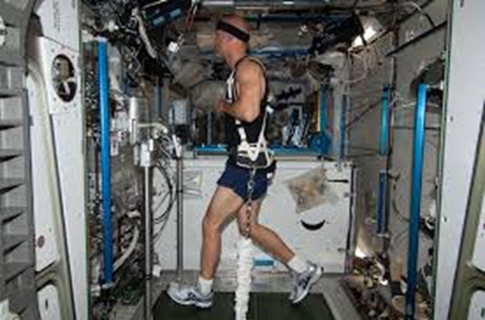
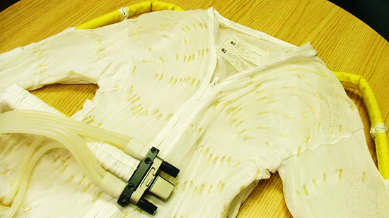
Human Thermal Modeling Development
SBIR Phase 2
“A SINDA compatible Human Thermal Model Assessing Crew-Induced Loads”
  Coupler between TAITherm Human Thermal Model and Thermal Desktop
NSTGRO
”Modeling of Human Thermoregulation Response to Spaceflight Changes Applied to the Technological Design of EVA Liquid Cooling and Ventilation Garments”
Internal Development
Crew population specific anthropometry
Cardio-vascular deconditioning
Fluid shift

Slide 26
Refrigeration Gaps
Refrigerated long term stowage chamber for food preservation in deep space (passive and active approaches)

Slide 27
Refrigeration
Refrigeration via heat pumps or other means may be required for storage of food or science samples, or even for cooling of whole habitats in hot environments
  Temperature requirements range from room temperature down to cryogenic
  Many different technologies are possible
JSC manages the cold stowage freezer fleet for ISS
  Many active freezers as well as phase change materials and dewars for passive cold stowage
JSC has conducted a few refrigeration research projects and SBIR contracts
  Mostly focused on vapor compression cycle
  Oil management in micro-gravity
  Scroll & screw compressors
  Vacuum insulation

Slide 28
TPS Gaps
Thermal Protection System Performance Modeling & Optimization for Human Mars Exploration
Thermal Protection System Performance Modeling & Optimization for Robotic Missions
Efficient Backshell TPS
Efficient Heatshield TPS
High-Mass, High-Velocity Earth Entry Thermal Protection Systems
EDL Flight Vehicle (Aeroshell) Flight Performance Data for Human Mars Entry and Earth Return
EDL Flight Vehicle (Aeroshell) Flight Performance Data for Robotic Missions
Multi-Use Ablative TPS
High enthalpy TPS Test Facility for Crewed Mars Entry
Efficient Reusable TPS
Cost Efficient TPS Certification
High-Enthalpy TPS Testing with CO2 Working Gas
Validated Thermostructural Modeling for Thermal Protection Systems Integrated onto Aeroshell Structure

Slide 29
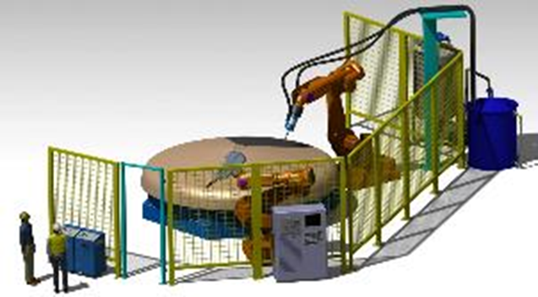
Technology Gap: Additive Manufacturing for Thermal Protection Systems (TPS)
Description:
The goal is to significantly improve and automate the manufacturing processes of Thermal Protection Systems (TPS) used on human-rated spacecraft and robotic missions with the intention of reducing cost and improving quality and system performance.
Strategic Alignment:
Technology Taxonomy: TX 9.1.1, Thermal Protection Systems; TX 12.1.4, Materials for Extreme Environments; TX 12.4.1, Manufacturing Processes;
TX 14.3.2, Thermal Protection Systems
Technology Maturation Plan / Roadmap:
Plan is to demonstrate technical feasibility for small capsules and then scale-up the technology for 1-meter class vehicles. Then, continue to advance to TRL 6.
2024 AMTPS Workshop is being planned to obtain inputs from industry and DoD to guide future planning and solicit collaboration.
Infusion / Commercialization Potential:
Industry (large) and DoD are pursuing this technology but it is in its infancy.
Commercial space is expanding and will need technologies to reduce manufacturing costs.
NASA Human Mars missions will need to reduce cost and mass of TPS on large entry vehicles.
Related Projects (Past & Present):
A STMD CIF project, 3D Printing Heat Shields, was funded FY18-20 and technical feasibility at a small scale was demonstrated. An ~11-inch diameter sphere/cone heat shield was 3D printed and delivered to University of Kentucky for use on their capsule and was flown on Cygnus NG-16.
A STMD ECI project, Additively Manufactured TPS, started in FY21 and continued through FY23. Manufacturing demonstration units were fabricated and new material formulations were developed.
Partnership Opportunities:
Currently we collaborate with Oak Ridge National Lab, NASA Ames and University of Kentucky
Plan to pursue partnerships with DoD and industry.

Slide 30
Technology Gap: TPS Performance & Reliability Prediction for EDL
Description:
The goal is to improve and validate our analytical modeling capability of thermal protection materials and systems to more accurately predict flight performance.
Strategic Alignment:
NASA STMD Taxonomy: TX 9.1.1 Thermal Protection Systems; TX09.4.5 Modeling and Simulation for EDL, TX 14.3.3 Thermal Protection Analysis
Technology Maturation Plan / Roadmap:
The plan is to investigate the physics of interaction and response of materials exposed to hypersonic entry environments and then develop analytical models to predict their performance.
Multiple tests are conducted to better understand the physics and validate the analytical models.
Once the models are developed and validated, they are disseminated to the user community for application.
Infusion / Commercialization Potential:
NASA has been developing the analytical models, validating them with test data and then making them available to US industries and other organizations.
Examples are FIAT from NASA Ames and CHAR from NASA-JSC
Related Projects (Past & Present):
Currently, a STMD Entry System Modeling project has funded efforts at NASA Ames and JSC. Grants have been issued to several universities including University of Kentucky, University of Colorado and University of Illinois-Urbana-Champagne.
A small JSC grant has been setup with The University of Texas at Austin for an inductively coupled plasma torch facility.
Partnership Opportunities:
We currently partner with NASA Ames and several universities.
NASA STRI (Space Technology Research Institute) for Entry Physics at University of Minnesota, University of Colorado, University of Illinois-Urbana-Champagne and University of Kentucky.

Slide 31
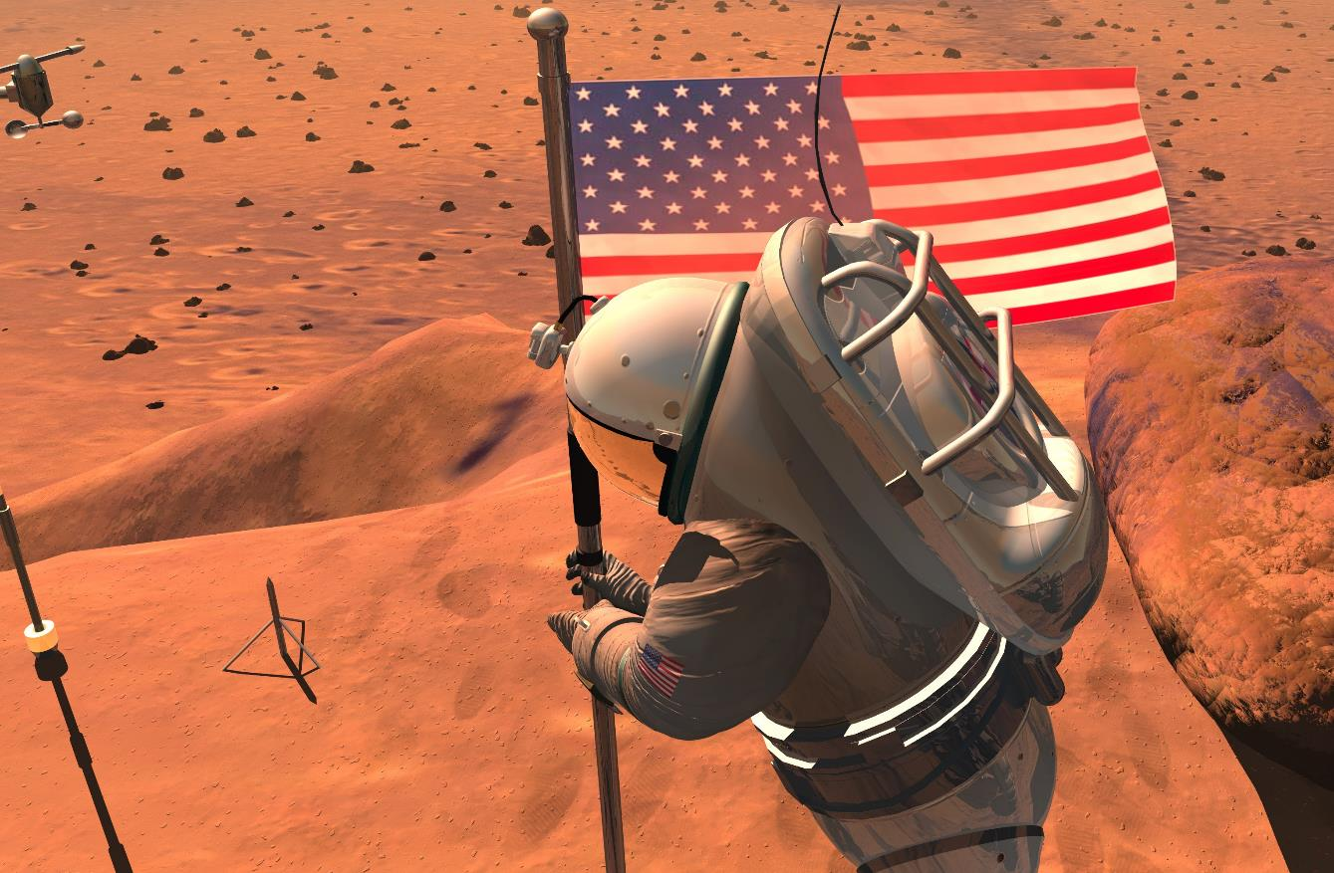
Portable Life Support System (PLSS)
Thermal Gaps
Mars Surface EVA Suit
Heat Rejection for Mars EVA Suit in Non-vacuum Applications
Mars EVA Suit Environment Thermal Insulation

Slide 32
EVA Thermal Control
Technology Candidates (1/3)
Technology | Description/Examples | Considerations Pros Cons
LCVG + SWME with boost compressor or sweep gas [1,2] | Used in xEMU – Warm water from LCVG is passed through a membrane that separates liquid from vapor and is then exposed to cold vacuum, cooling achieved by evaporation of H2O rather than by sublimation. | Tolerant to contaminated water Directly integrated with existing water loops in suit | Requires water consumption and recharge Boost compressor is high power assembly that we’d have to mitigate Semi-open loop
Heat exchangers [2,3,4] | PCM-TES – System that can adsorb heat for later rejection between EVAs. Thermal energy storage (TES) also provides the option of having heat available for later use, if necessary. Ex) Sub-cooled PCM – Fixed-mass ice packs absorb internal heat load, first as sensible heat and then as latent heat of fusion as the ice melts. No water is allowed to escape SPCM packs, so heat is effectively stored throughout the EVA. When no ice remains or EVA is complete, CM detaches SPCM unit and places it in exterior radiator to refreeze ice packs. | No mass consumables Operation independent of local environmental conditions | Added mass and volume of required water/ice may outweigh gain in consumables
 | Thermoelectric cooler – Solid state heat pump made of thermocouples that creates a temperature difference across the device when a current runs through it (the Peltier Effect). When a current flows through a junction between two different conductors (from a battery), heating and cooling occur because charge carriers diffuse to opposite sides of the device. Thermoelectric generator – Seebeck Effect, opposite of Peltier electrocooler process, useful in applications where surface temperature of the skin remains relatively constant at a much higher temperature than the surrounding environment and exterior surface of the suit. When the external temperature exceeds the internal temperature inside the suit, the process reverses and the generator runs as a cooler. | No moving parts Low system mass Can continuously operate in an extreme thermal gradient | Power requirements to drive a network of TECs is potentially unsustainable for a 6-8 hr EVA (depends on environmental factors)

Slide 33
EVA Thermal Control
Technology Candidates (2/3)
Technology | Description/Examples | Considerations Pros Cons
Spacesuit radiator [5, 6, 7, 8, 9, 10, 11, 12] | Gas gap radiators – Heat flow to radiator is controlled by a switch. If no gas is present in between the ends of the switch, the switch is open, and heat cannot flow through. The on-state conductance has many contributions such as the surface area of the ends that contact the gas, the amount of gas carrying the heat, and the conductivity of the metal switch internals. | Gap barrier can significantly reduce the amount of heat rejected or absorbed by the radiator | Resistance at the switch boundary hinders conductance Probably loses gas to environment Mars atmosphere might not be suitable for evacuation
CO2 decomposition (rather than adsorption and desorption) | Freeze tolerant and variable conductance radiator – Water in hot portion of the circulation loop is cooled in a membrane evaporator. The resulting water vapor condenses in a radiation-cooled freeze-tolerant condenser, which selectively freezes to “turn down” the radiator. Each radiator passively self-regulates its thermal conductance to control the heat rejection rate to the ambient environment. | Lightweight and compact Requires very little pumping power Eliminates need for secondary circulation loop | Freezing and thawing takes time Requires fluid for freezing
 | Variable emissivity electrochromic radiators – Small voltage is applied to electrodes consisting of conducting polymer films electro-deposited onto microporous membranes. Ions move through electrolyte contained within the micropores, and addition/removal of these ions causes a change in emissivity of the EC layer. Heat rejection occurs when radiator is in the absorptive state and can be turned off when heat loads change. Multiple electrochromic pixels could allow for a wide range of variation in the level heat rejection at any given time. | Operational in variable radiation environments Thin and lightweight No mass consumables | Heat distribution to radiator surfaces could be a challenge Limited ability to remove heat when sink temps are greater than the desired skin temperature Doesn’t provide low enough heat rejection settings

Slide 34
EVA Thermal Control
Technology Candidates (3/3)
Technology | Description/Examples | Considerations Pros Cons
Adsorber/radiator with mechanical heat pump [12] | Evaporative cooling garment (ECG), bed of vapor-adsorption material, & backpack-mounted radiator panel – Cool water is pumped through the ECG and across CM's skin, where the metabolic heat load causes water to evaporate through the porous ECG material and collect in the PLSS. A heat exchanger and vapor pump supply the hot water vapor to a bed of anhydrous LiCl that is capable of absorbing and storing it. During the EVA, an adjacent radiator panel mounted on the PLSS backpack continuously rejects a portion of the stored heat, causing some (though not all) of the absorbed vapor to cool and return to the ECG liquid water loop. | Allows for relatively high radiator surface temperature, resulting in better cooling performance for smaller radiator surface | Radiator performance less than nominal heat load, so adsorption bed saturates with water vapor over course of EVA
Insulation technologies [13,14] | Variable insulation suits – Removable suit layers to tailor insulation level to climate and time of day, similar to earth outdoors clothing today. | Allow for prevention of both excessive heat loss from crew member or excessive heating from environmental fluxes and other sources | Adding layers will change the mobility of the suit, which could be difficult to manage
 | Gas injection into insulation layers – Thermal control in flexible soft space suit by transient increase of heat flow through the insulation. A small amount of gas is injected into evacuated layers of insulation which increases thermal conductivity of suit. Gas is retained in the suit until low heat flow through insulation is desired. |  | Means of controlling injection and evacuation of gas in response to thermal needs to astronaut could be complicated
 | Flexible space garments – Varying the conductance and heat flow of the space suit insulation by compressing the insulation. |  | Could only have a narrow range of heat flow control Compromises space suit mobility May require additional crew time to adjust to changing conditions

Slide 35
EVA Thermal Control
Technology Candidates (References)
Spacesuit Water Membrane Evaporator Integration with the ISS Extravehicular Mobility Unit. https://ntrs.nasa.gov/api/citations/20140003403/downloads/20140003403.pdf
Equivalent System Mass Analysis for Space Suit Thermal Control. https://arc.aiaa.org/doi/pdf/10.2514/6.2011-5180
Modelling and Experimental Evaluation of an Active Thermal Energy Storage System with Phase-Change Materials for Model-Based Control. https://spectrum.library.concordia.ca/id/eprint/980456/
Critical Review of Thermal Management Technologies for Portable Life Support Systems. https://ttu-ir.tdl.org/server/api/core/bitstreams/1a31b9db-a5db-4117-b9d2-71e2701d18d8/content
A Multi-Environment Thermal Control System With Freeze-Tolerant Radiator. https://ntrs.nasa.gov/api/citations/20130011331/downloads/20130011331.pdf
Freeze Tolerant Radiator for Advanced EMU. https://doi.org/10.4271/2004-01-2263
Lightweight, Flexible, and Freezable Heat Pump/Radiator for EVA Suits. https://doi.org/10.4271/2008-01-2112
Passive Gas-Gap Heat Switches for use in Low-Temperature Cryogenic Systems. https://ntrs.nasa.gov/api/citations/20180004494/downloads/20180004494.pdf
Radiator Heat Pump Subsystem for the Space Suit Portable Life Support. https://doi.org/10.4271/2009-01-2407
Space Suit Radiator Performance in Lunar and Mars Environments. https://ntrs.nasa.gov/api/citations/20070013698/downloads/20070013698.pdf
Electrochromic Radiator Coupon Level Testing and Full-Scale Thermal Math Modeling for Use on Altair Lunar Lander. https://ntrs.nasa.gov/api/citations/20100017007/downloads/20100017007.pdf
Technology Study of Passive Control of Humidity in Space Suits. https://ntrs.nasa.gov/api/citations/19660005267/downloads/19660005267.pdf
Theoretical performance analysis of electrochromic radiators for space suit thermal control. https://doi.org/10.1016/j.asr.2010.11.018
Approaches and Solutions for Martian Spacesuit Design. https://www.researchgate.net/publication/320298445
Emma Goodman, Olivia Lawson, Madeleine Oliver, “Mars PLSS Technology Options to be Considered,” JETS2-JE33-24-TLSS-DOC-0008, February 15, 2024.

Slide 36
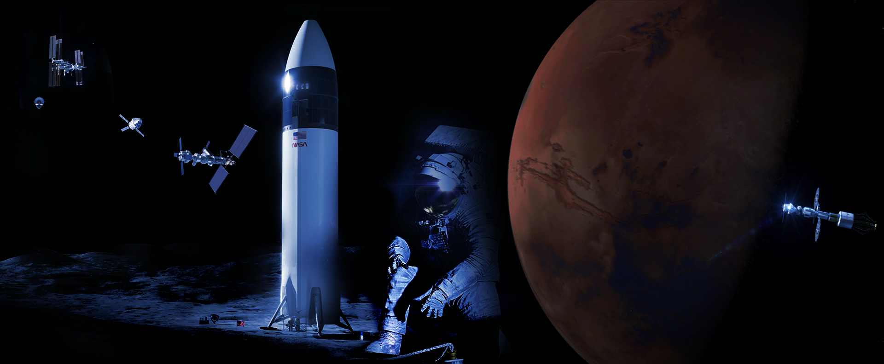
JSC Thermal Systems Future
Human spaceflight missions
Sustained presence in Cis-Lunar space
Mars exploration
Innovative partnerships and collaborations
Commercialization

Slide 37
Acknowledgements
Scott Coughlin
Mrugen Patel
Sydney Taylor
Hee Jong Song
Mike Ewert
Bruce Conger
Cinda Chullen
Scott Hansen
Hung Le
Richard Barido
Jeannie Corte

