Slide 1
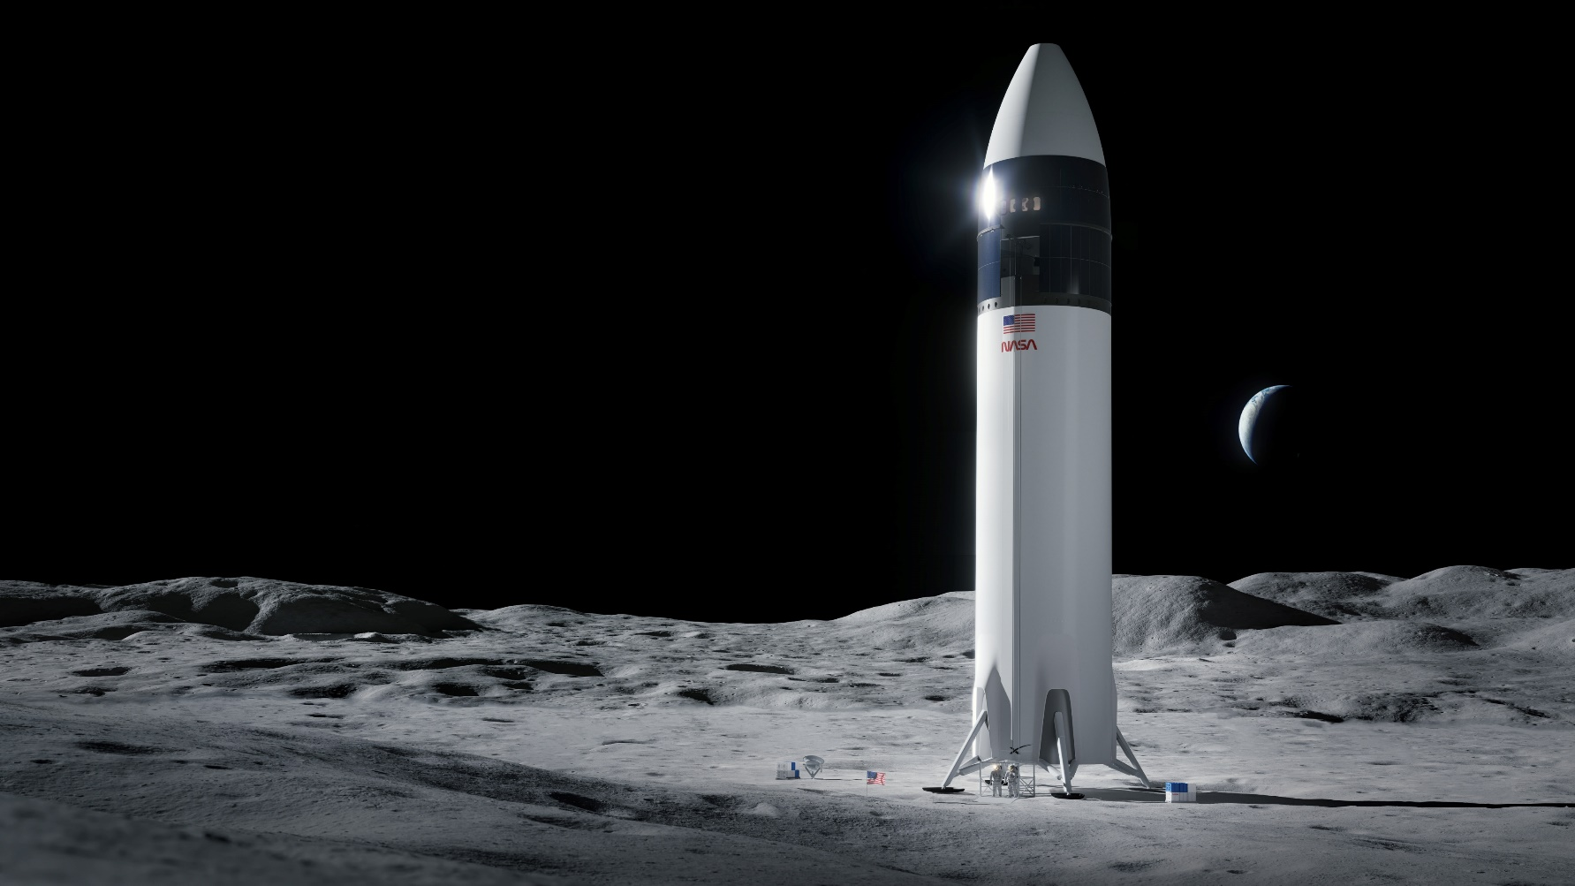


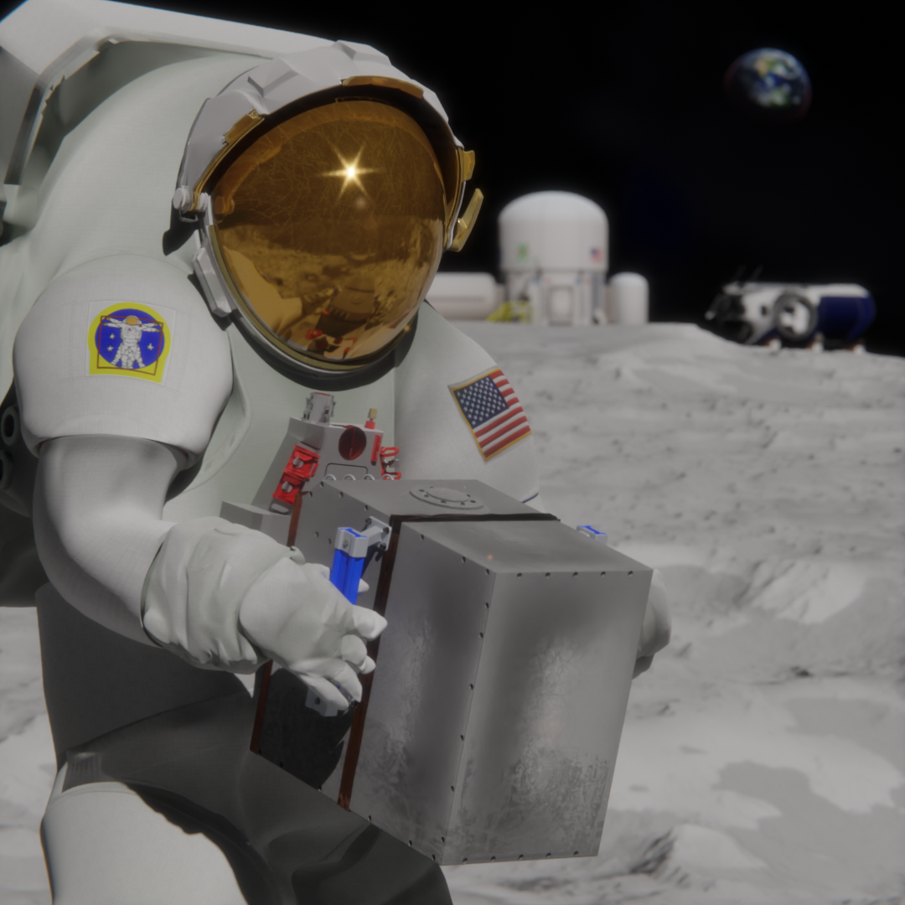
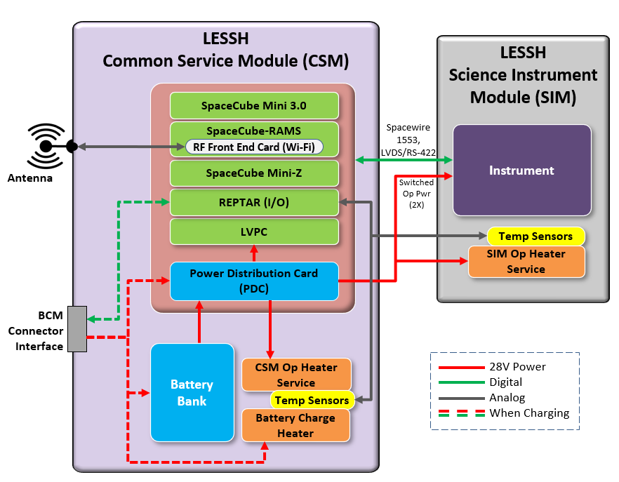
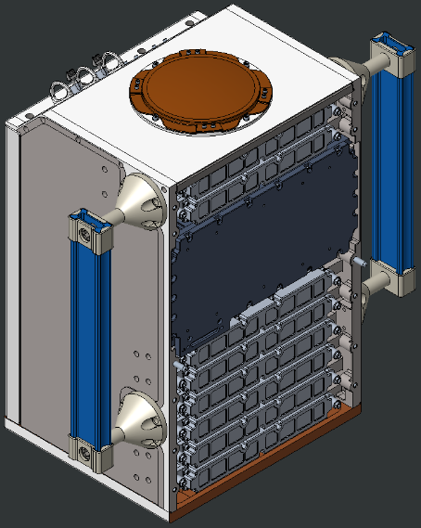
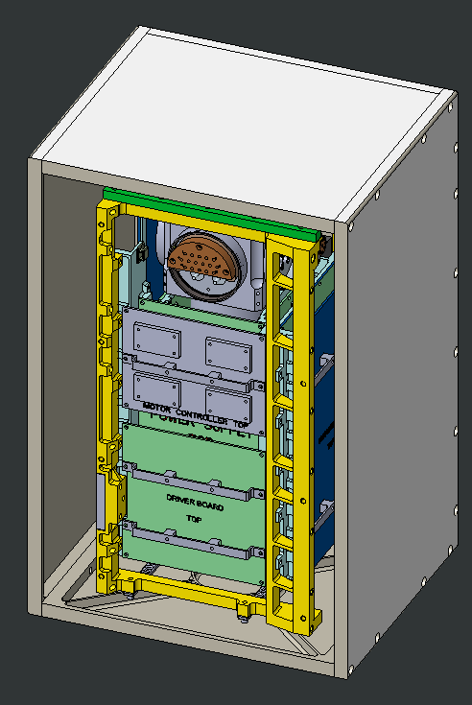
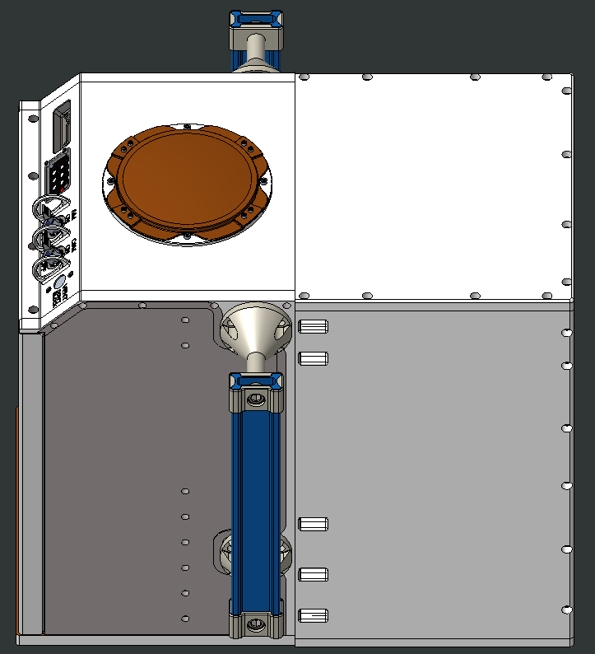
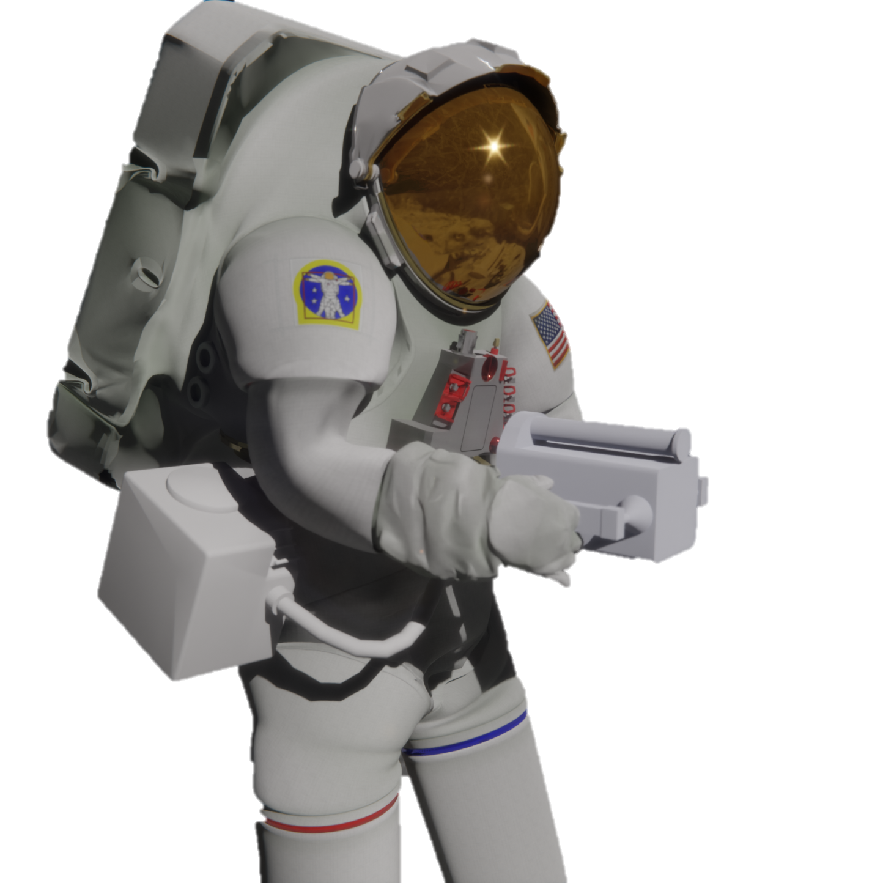
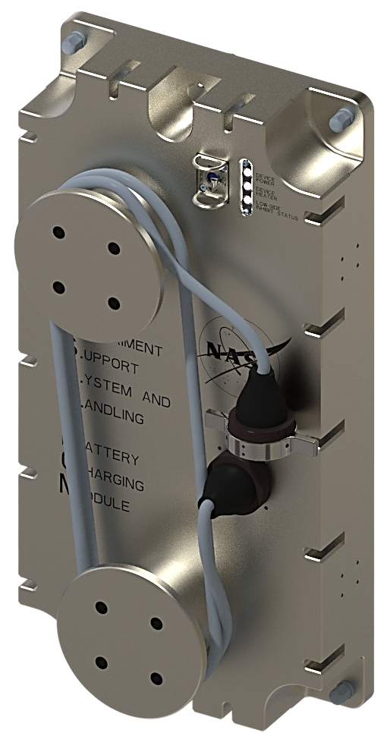
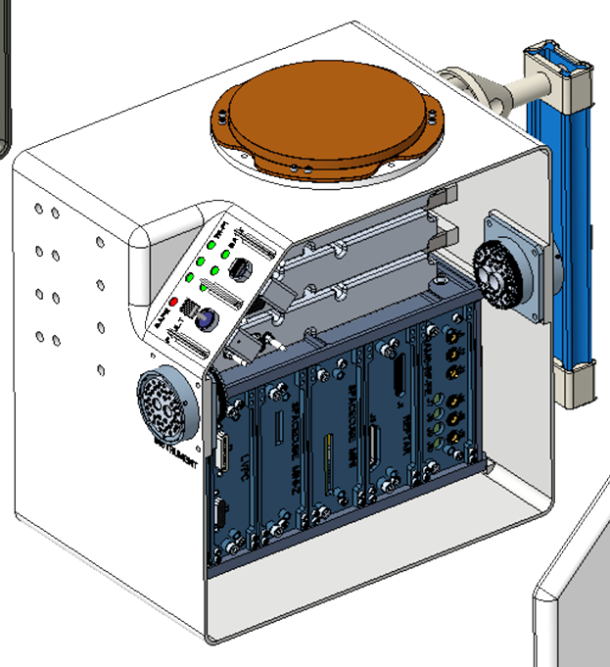
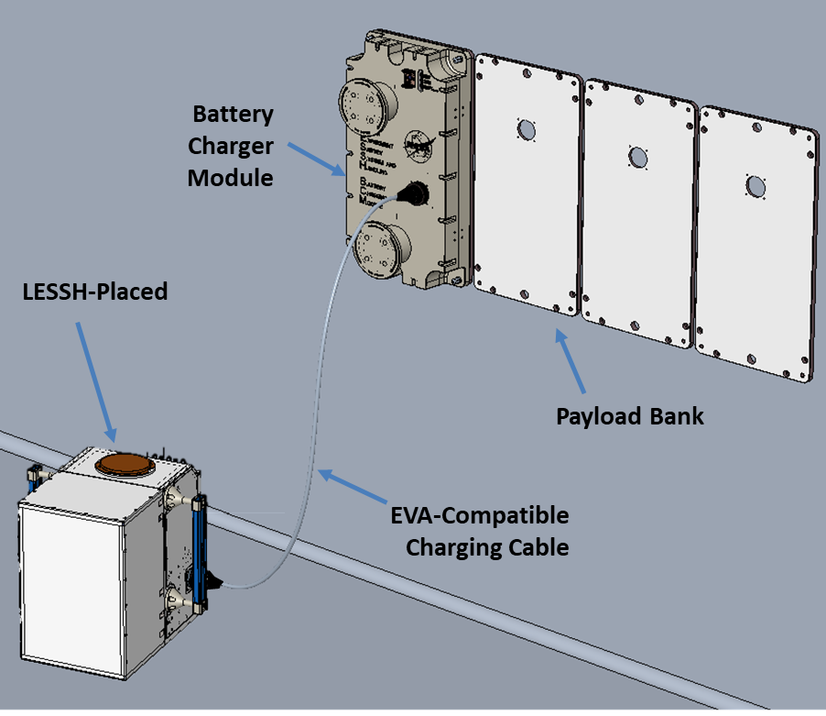
LESSH
LESSH
Lunar
Experiment
Support
System &
Handling
Astronaut Deployed Services Bus and Payload Solution
LESSH Placed:
Battery powered avionics / thermal / communications box with an attached science instrument
Modular design enables rapid integration of science instruments for Artemis (landers & rovers)
  Mass: 31 kg; Volume: 38 x 36 x 39.5 cm with handles
WIFI Communications (surface to surface)
Common Service Module (CSM)
Scientific Instrument Module (SIM)
Power Services
Battery Capacity | 720 Wh, 28V across eight battery packs (CSM uses 10-30W)
External Charging | Rechargeable via LESSH Battery Charger Module (BCM) on multiple vehicles (estimated 4-hour recharge time)
Data / Processing
Processing | Xilinx Kintex based FPGA
Data Storage | 28 GB NAND Flash storage for science & telem packets, 4 GB reserved for CSM flight software use
Communications
Wireless Interface | Max range: ~200m @ 5.3 GHz, 6.5 Mbps Max rate: ~10m @ 5.3 GHz, up to 70 Mbps Assumes performance characteristics of the 802.11n wireless access point on International Space Station or equivalent
WiFI Antenna | Surface-to-Surface, Dipole-like, line of sight
CSM
Mass: 18.3 kg
Volume: 37.8 x 36.0 x 19.7 cm
Operations: Lunar South Pole
SIM
Mass: 13 kg* max
Volume: 37.8 x 36.0 x 19.8 cm
* Additional mass possible, with reduced battery power
Total mass: 31 kg
LESSH Handheld:
Compact Common Service Module for handheld instrument
LESSH Placed Avionics and Communication
Battery quantity reduced to minimize size
Compatible with LESSH Battery Charger Module
LESSH Battery Charger Module (BCM):
Enables recharging and hard-line data transfer on Human Landing System (HLS) or other Artemis vehicles.
  Standardized GFP Payload Bank interface
Part of “astronaut safe” LESSH power system
Flexible, EVA-compatible harness
Antenna
Batteries
Control Panel
LESSH Mini
Service Module
Handheld Instrument
Avionics
Interconnect Harness

