Slide 1

Specific Heat Capacity Measurement of Bi-Carbide Fuels for Nuclear Thermal Propulsion
Jason Reynolds¹, Jhonathan Rosales¹, Martin Volz¹, Brian Taylor¹, Jamelle Williams¹, Arne Cröll², Travis Knight³, Ted Besmann³, Juliano Schorne-Pinto³, Ronnie Booth³, Matt Phipps³, Robert Demuth³
¹NASA George C. Marshall Space Flight Center
²University of Alabama in Huntsville
³University of South Carolina

Slide 2

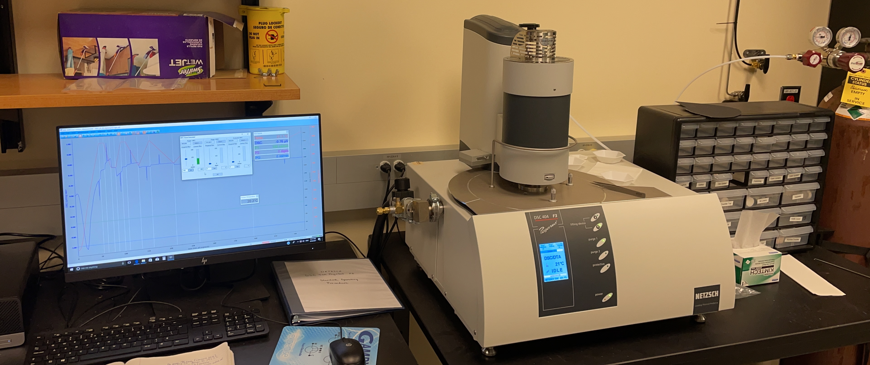
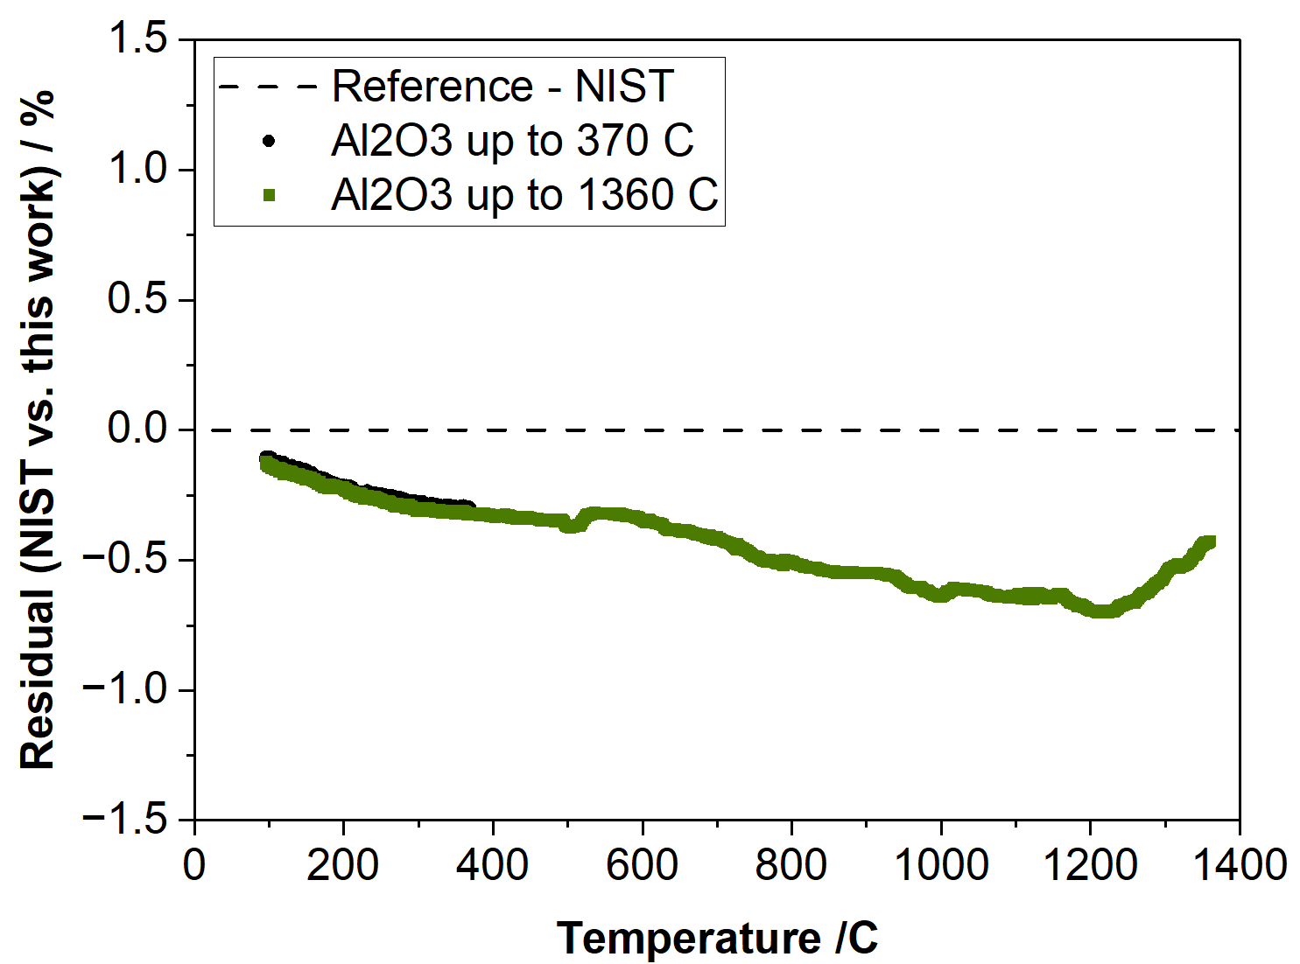
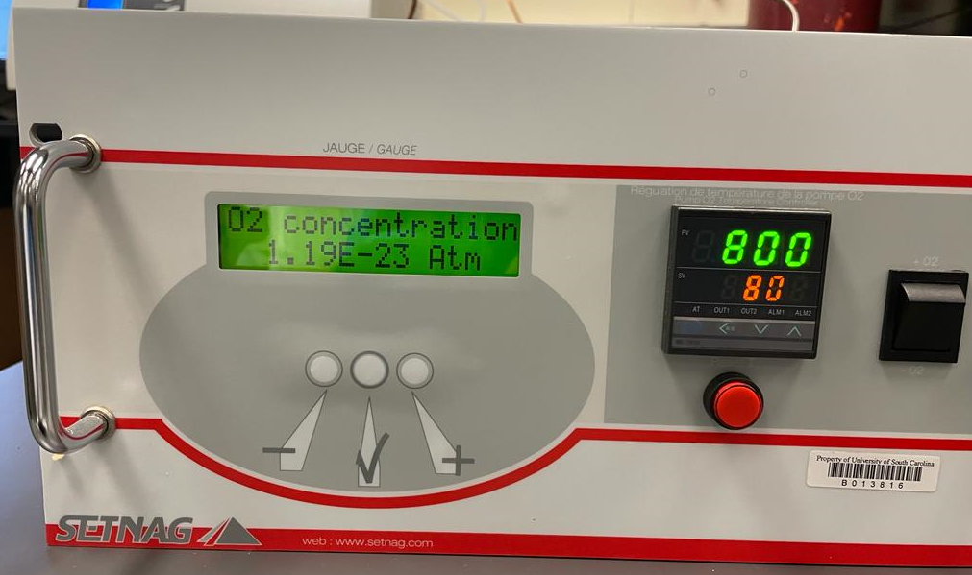
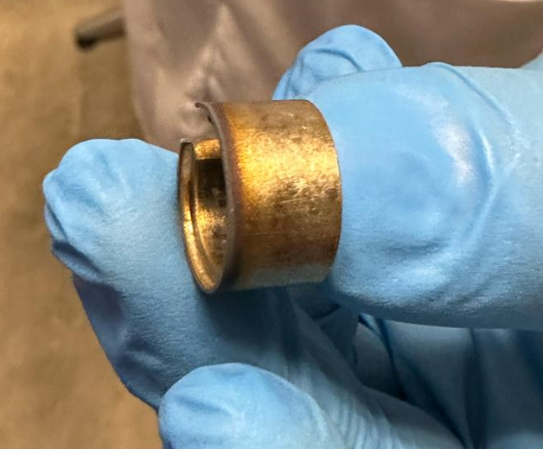
Instrumentation
Methodology
Heat capacity measurements: DSC 404 F3 Pegasus® - Netzsch
ASTM - 2018 - E1269-11 Standard Test Method for Determining Specific Heat Capacity by DSC
“Classical” three-step method: 1) empty crucible, 2) sapphire standard, and 3) sample. Conditions:
Temperature range: 100-1200/1360 °C
Heating rate: 10 K/min
Atmosphere: He (Oxygen levels down to ~10⁻²³ atm)
Crucibles: Pt-Rh
Verification of measurement precision using sapphire:
Type B error: ~1-2%
Reducing O₂ contamination: SETNAG (purifier) + sacrificial Zr ring (inside DSC)
Maximum inaccuracy: 0.7%

Slide 3
Estimation of heat capacity for the mixtures
Neumann Kopp (NK) is an additive semiempirical approach to obtain the Cp(T), also known as linear rule of mixtures (ROMs)
Example: 32UC-68ZrC = 0.32Cp(T)_{UC} + 0.68Cp(T)_{ZrC}

Slide 4
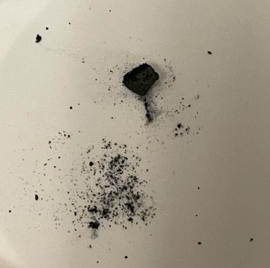

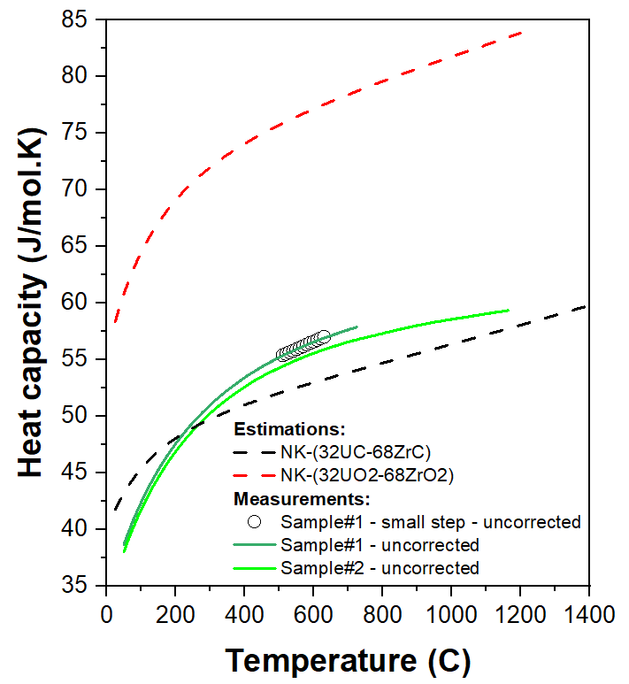
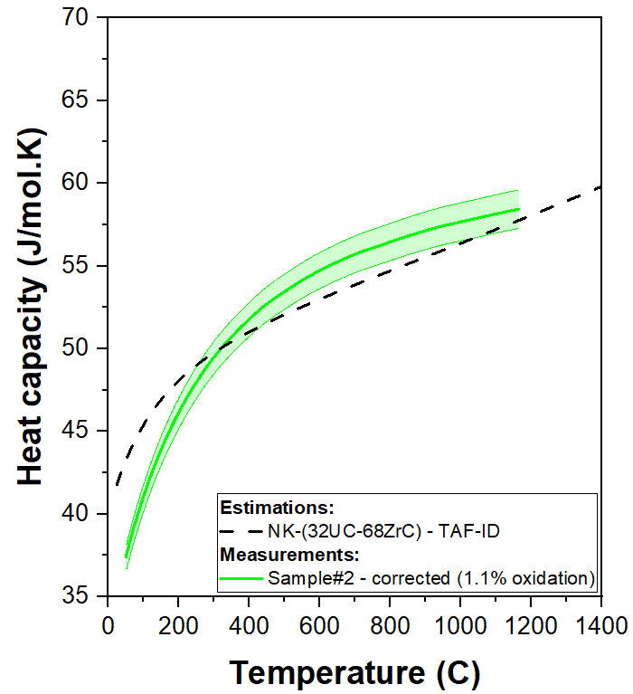
Preliminary results (32UC-68ZrC)
Samples after DSC:
If the sample was fully oxidized:
(32UC-68ZrC)_{solid-solution} = ZrO₂ + UO₂
The mass would change +13.3%
Sample#1 32UC-68ZrC:
Initial mass = 83.95mg (N=5)
Final mass = 84.63mg (N=5)
Variation = 0.68mg (+0.8%), equivalent to oxidation of ~ 6.1% of the monocarbides
Sample#2 32UC-68ZrC:
Initial mass = 85.40mg (N=5)
Final mass = 85.53mg (N=5)
Variation = 0.13mg (+0.15%), equivalent to oxidation of ~ 1.1% of the monocarbides
Outcomes:
Results from sample#1 were discarded because of the oxidation issues due to the long DSC runs.
It seems that (32UC-68ZrC)_{solid-solution} converges to NK/ROM values at high-temperature.
#1
#2
Uncorrected values + NK estimations
Corrected sample#2 + NK

Slide 5
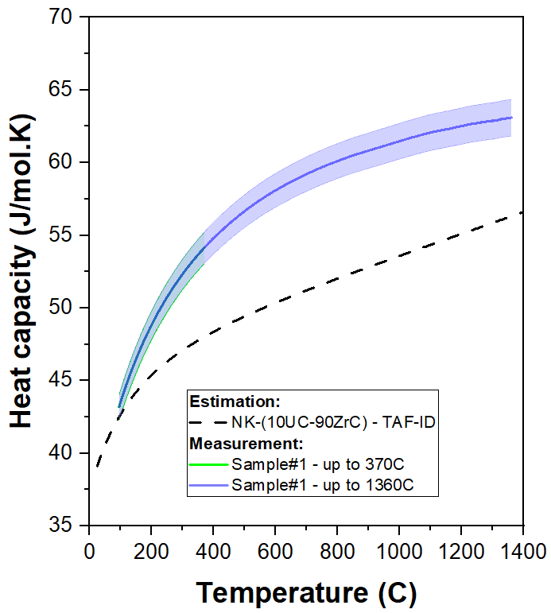
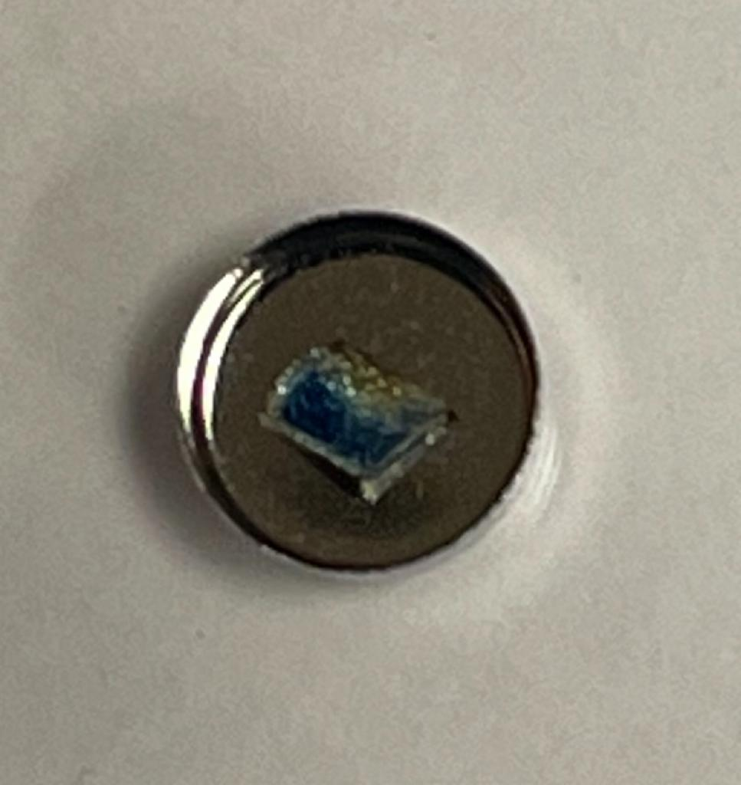
Preliminary results (10UC-90ZrC)
Sample after DSC:
Sample 10UC-90ZrC:
Square shape with a reduced contact area with the detector compared to the preceding sample (32UC-68ZrC)
Initial mass = 63.94mg (N=5)
Final mass = 63.93mg (N=5)
Variation = -0.01mg (-0.02%), no oxidization could be quantified
Outcomes:
Unexpectedly high Cp* in comparison to NK/ROM
New tests will be required to statistically validate this preliminary result (two runs, single sample), varying sample size and shape**. Powder samples would be preferable, but there is a high risk of oxidation during the DSC run.
Other DSCs might be used (STA at USC or Setsys at NASA)
*Carbide mixtures, according to Kardoulaki et al. (2022)¹ and Schwind et al. (2022)², diverge from NK/ROM at low temperature, but eventually converge at high temperatures to the ideal mixture behavior.
**Heat flux DSC results can be very dependent of the sample format and thermal contact with the 2D detector
¹ Synthesis, thermal conductivity, and hydrogen compatibility of a high melt point solid solution uranium carbide, (U_{0.2}Zr_{0.8})C, Nucl. Mater. Energy, v 33, 101290
² Thermal and electrical properties of a high entropy carbide (Ta, Hf, Nb, Zr) at elevated temperatures, J. Am. Ceram. Soc., v 105(6), p. 4426-4434
5

Slide 6
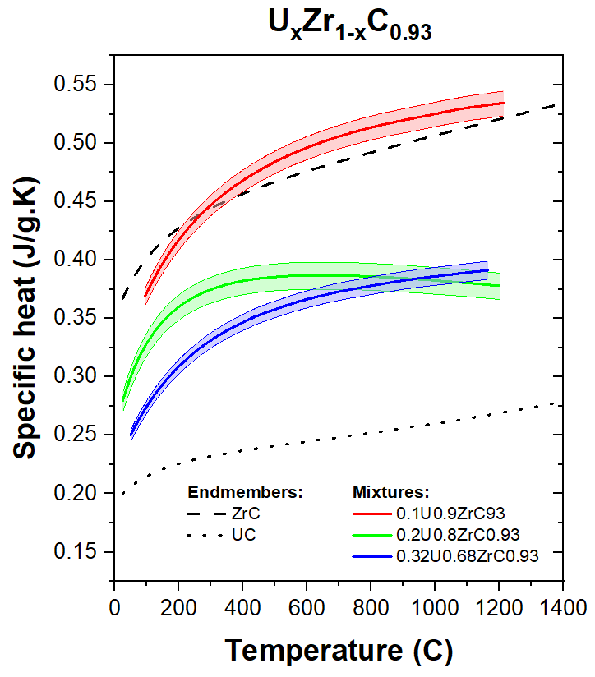
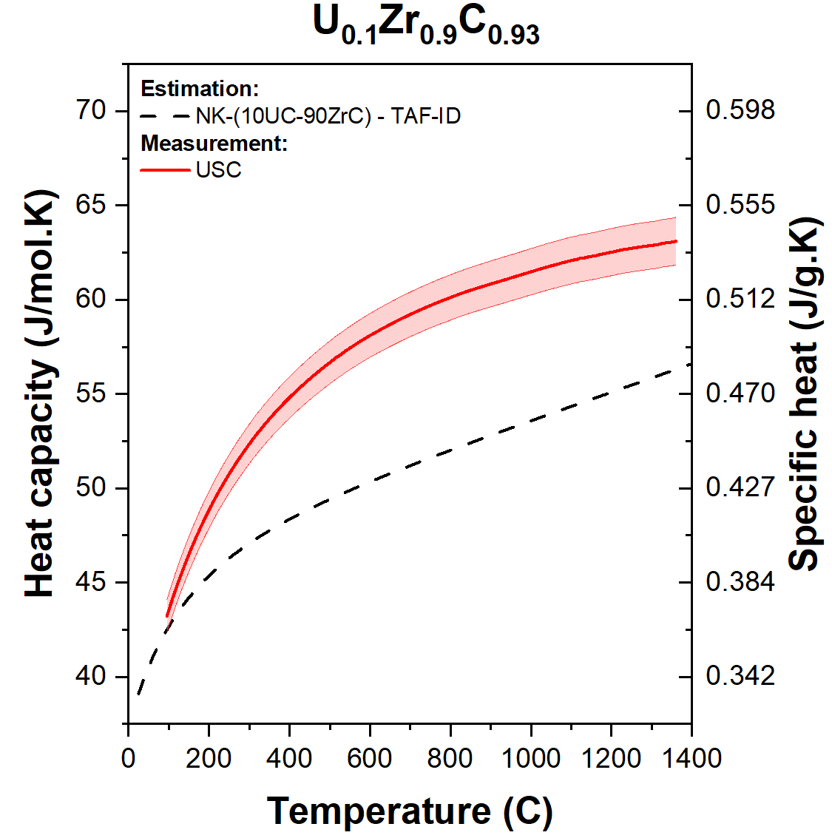
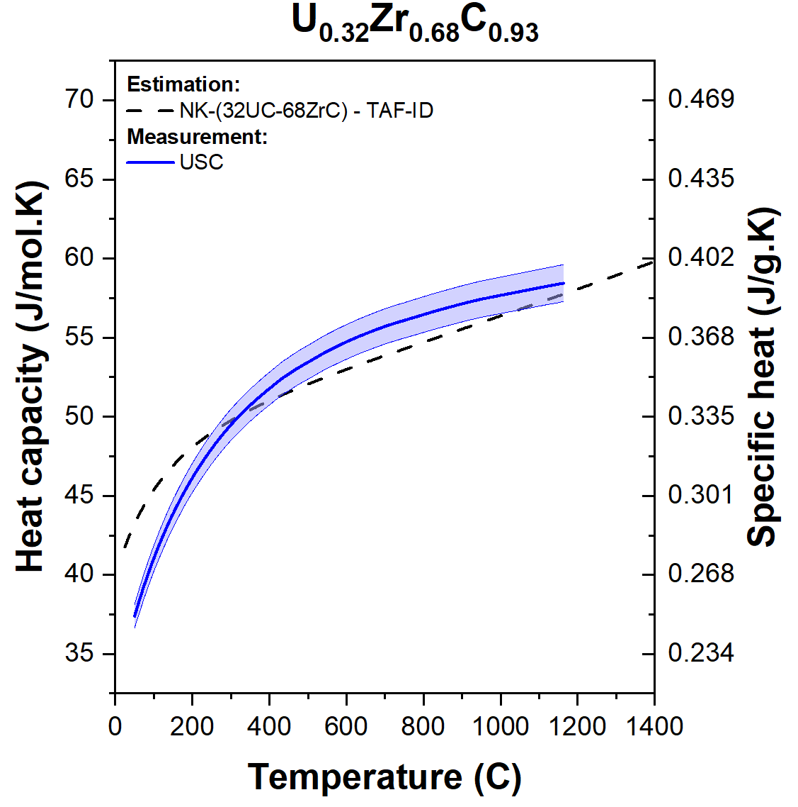
UC-ZrC solid solution
1) Comparing with UC and ZrC:
2) Experimental vs Neumann Kopp:

Slide 7
Acknowledgements
The current work was completed at NASA - Marshall Space Flight Center and supported by NASA’s Space Technology Mission Directorate (STMD) through the Space Nuclear Propulsion (SNP) project
This work was achievable with the successful powder synthesis by Eri Kardoulaki and Ken McClellan at Los Alamos National Laboratory and expertise from Travis Knight and Ted Besmann’s team at the University of South Carolina.

