Slide 1



Slide 3
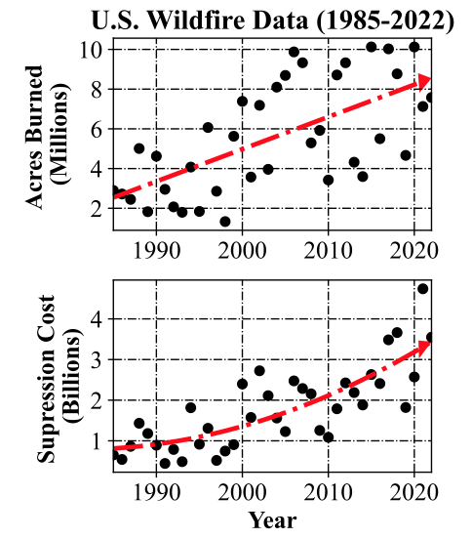
Suppression Cost
($ Billions)
Notes:
VTOL Analysis for Emergency Response Applications (VAERA) - Identifying Technology Gaps for Wildfire Relief Rotorcraft Missions
3 to 7.5 million acres (1985-2022, 5yr. avg.)
1 to 4 billion dollars (1985-2022, 5yr. avg.)
Wildfire figure is from Ref. 1
Data for the figure is originally from Ref. 2
CDC data is from Ref. 3

Slide 4
Leading Causes ​of Fatal Aviation Events in Wildland Firefighting Activities – United States 2000-2013 | Percent of Total (%) ​
Engine, structure or component failure​ | 24​
Pilot loss of control ​ | 24​
Failure to maintain clearance from terrain, water, or objects​ | 20​
Hazardous weather ​ | 15​
Notes:
VTOL Analysis for Emergency Response Applications (VAERA) - Identifying Technology Gaps for Wildfire Relief Rotorcraft Missions
3 to 7.5 million acres (1985-2022, 5yr. avg.)
1 to 4 billion dollars (1985-2022, 5yr. avg.)
Wildfire figure is from Ref. 1
Data for the figure is originally from Ref. 2
CDC data is from Ref. 3

Slide 5
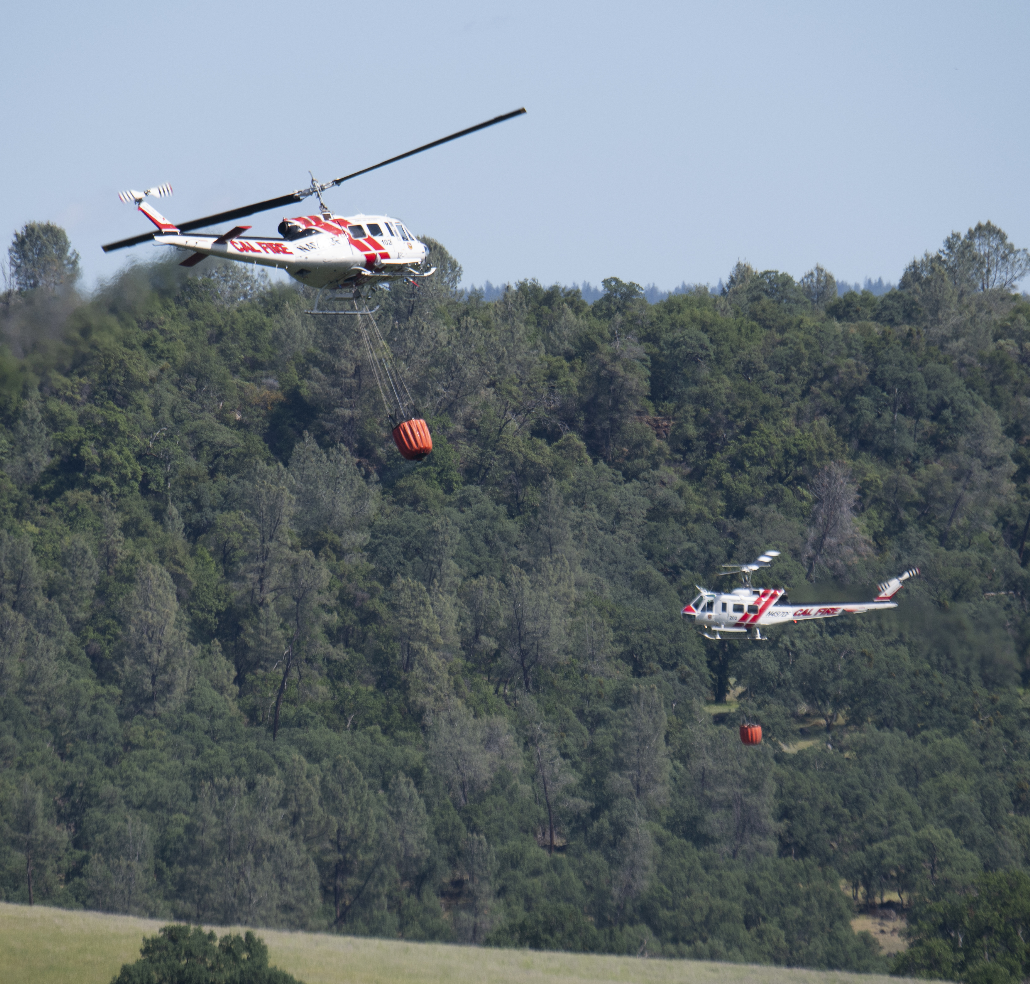
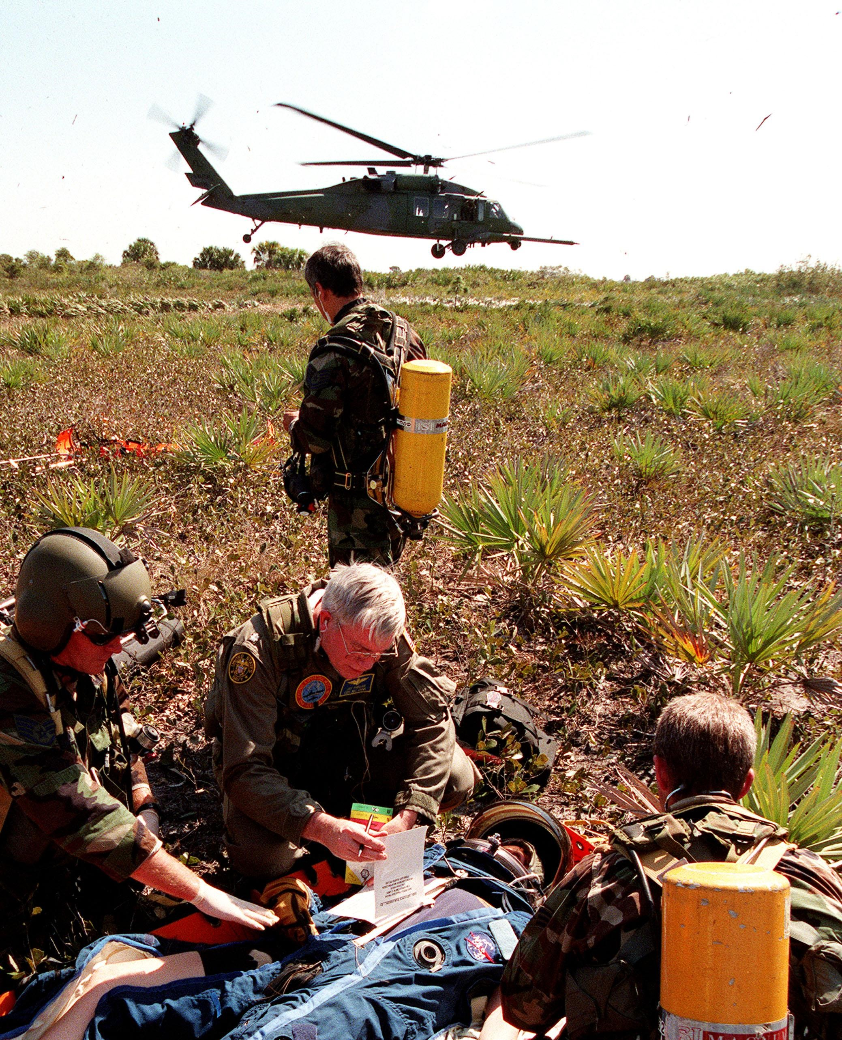
Notes:
Image 1 (Left): A pair of Cal Fire UH-1H Super Huey helicopters are seen during an aerial attack on a simulated wildfire. Photo Credit: NASA/Joel Kowsky.
Image 2 (Right): Kennedy Space Center response team practices stabilizing an injured crew member before transport to a local hospital by an Air Force HH-60 helicopter. Photo Credit: NASA.

Slide 8
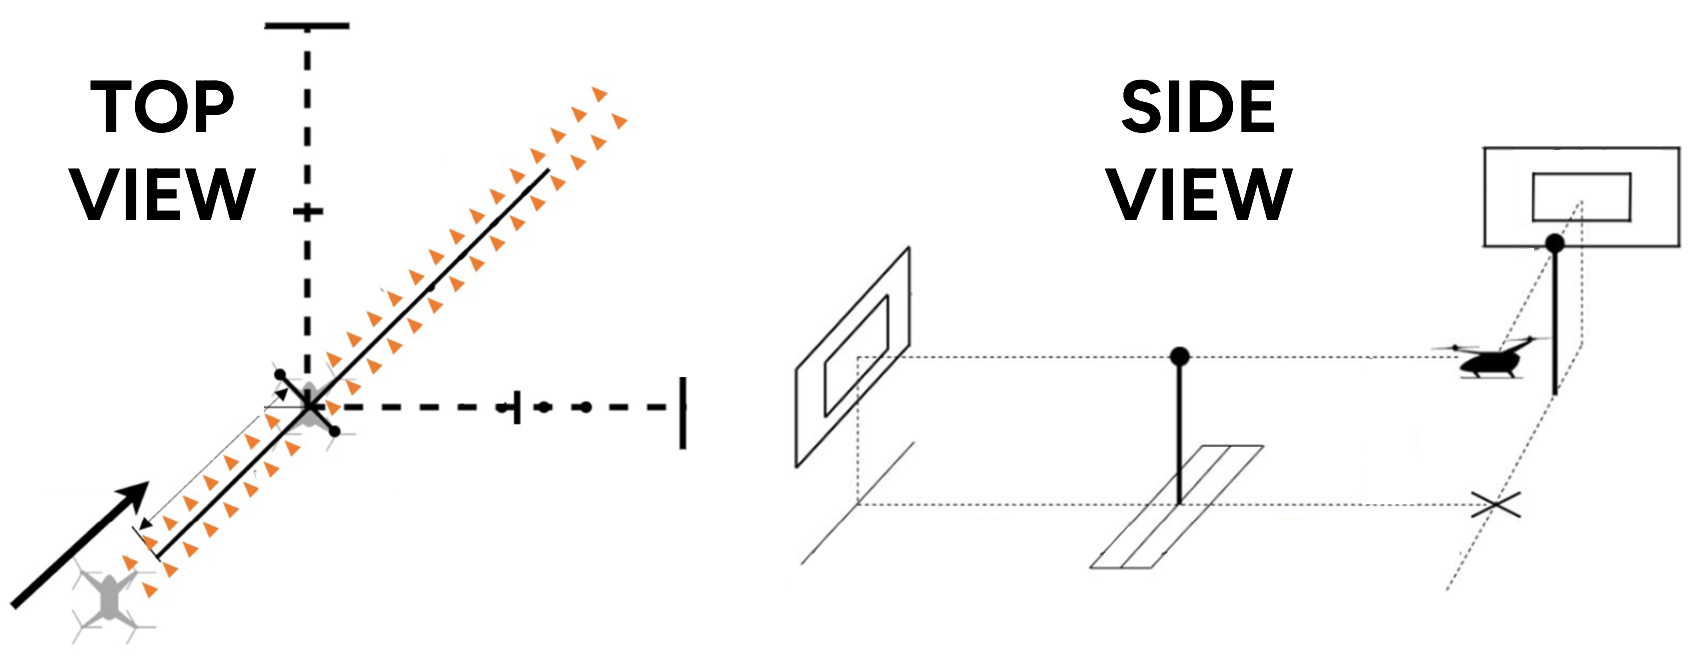
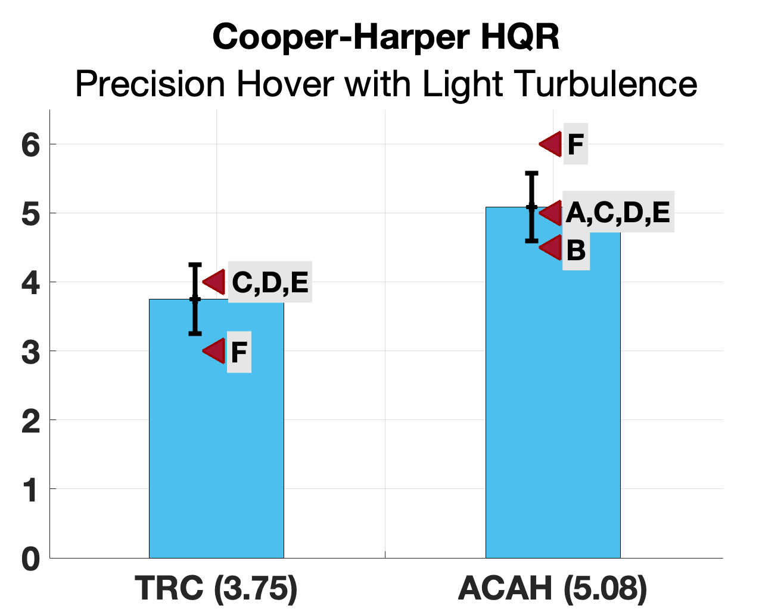
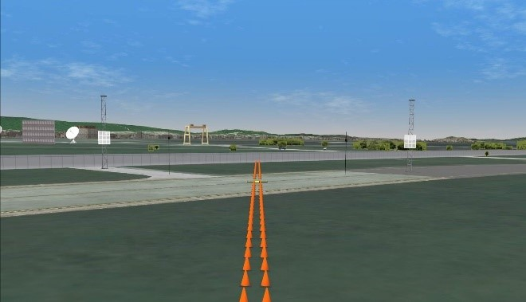
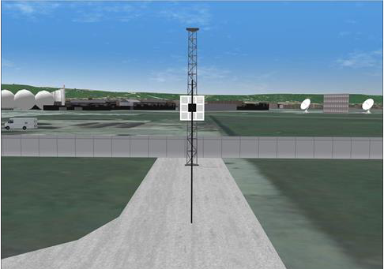
Notes:
Results shown used the FAA HQTE / UAM standards for Precision Hover MTE. Pilots fly in at 45° angle while maintaining a forward heading. They target a ground speed of 6-10 knots before calling their deceleration mark, Desired/Adequate deceleration time: 8/12 seconds. Pilots also call out once they have achieved a hover and must then station keep for 30 sec.
Bar chart uses data from 2021 VMS study, legend shows average cooper-harper rating in parentheses. Pilot names have been replaced with alphabetical letters.
This presentation is for the handling qualities session at the VFS forum and it is assumed that folks are familiar with the attitude command attitude hold (ACAH) response type. Be sure to elaborate on this when presenting to other audiences who may not know.
More data on Dryden model is in Ref. 4.
VMS visuals are from Ref. 5.

Slide 10
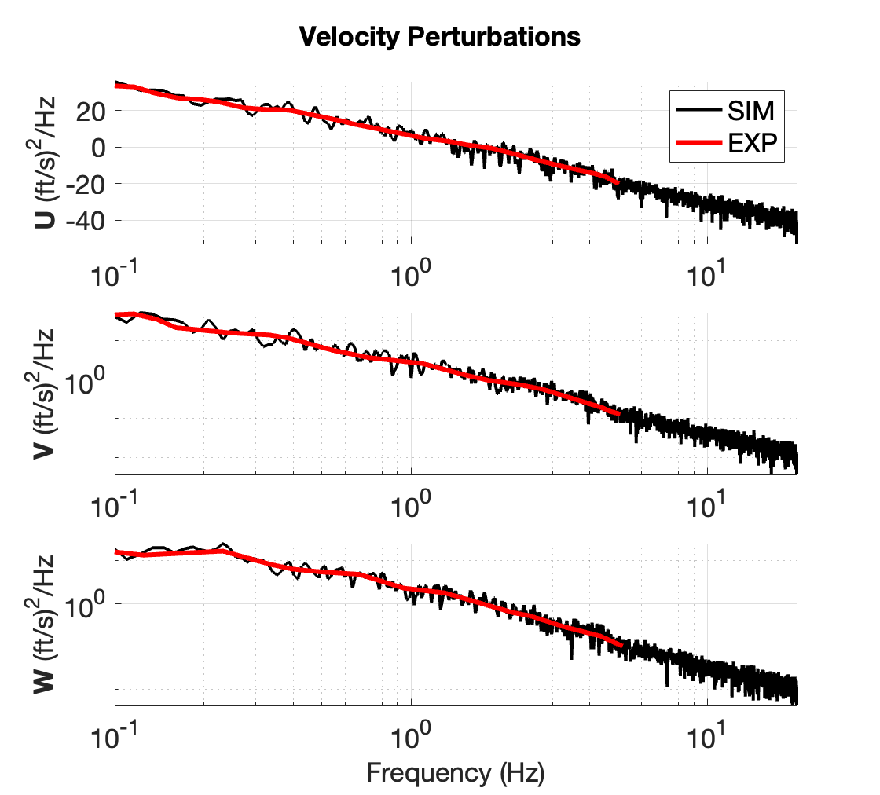
Notes:
May want to use the phrase ”from work by folks at San José State University and the U.S. Forest Service”

Slide 11
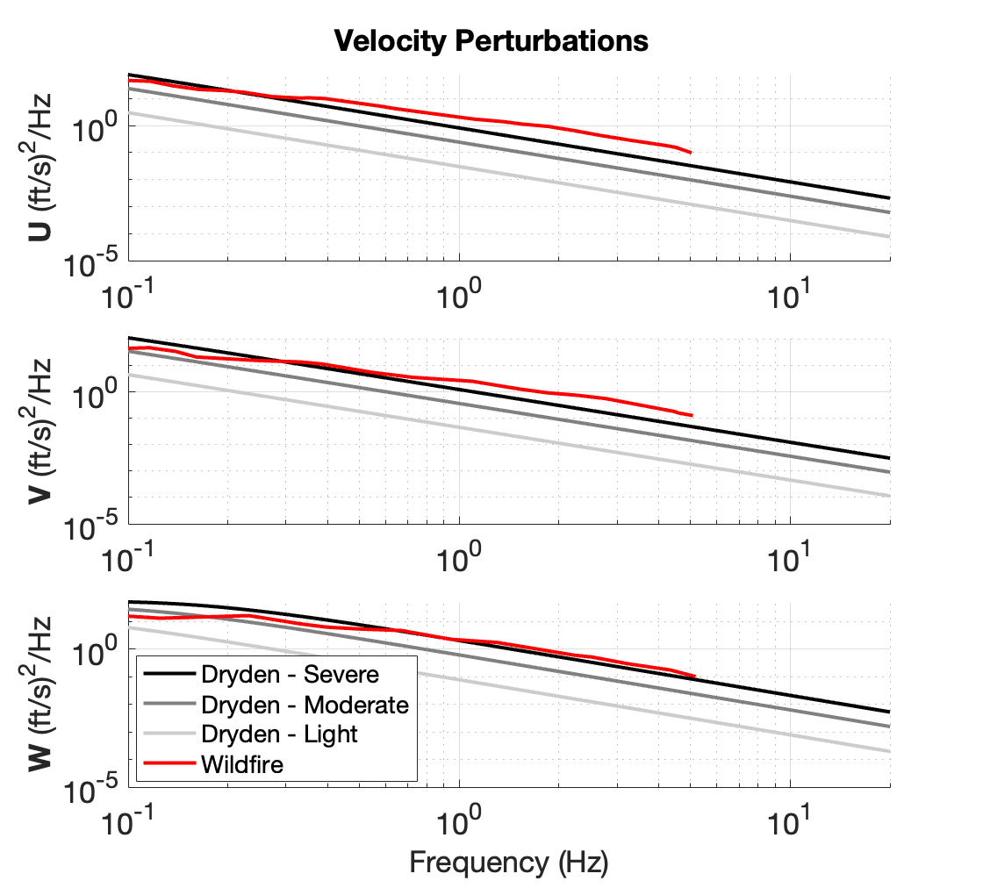


Slide 13
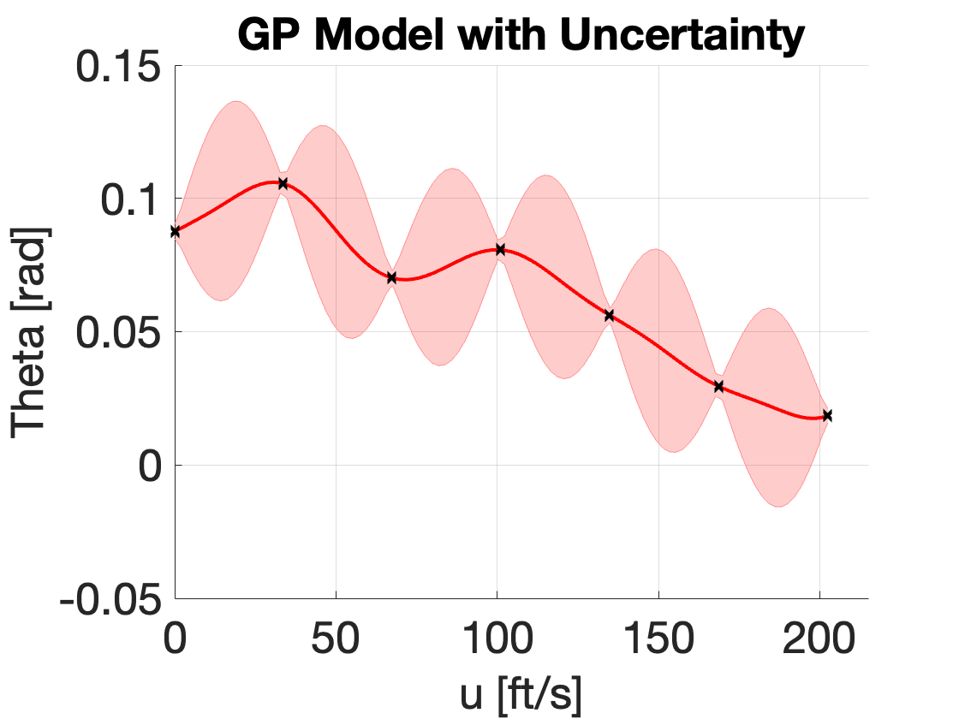
Notes:
More information on the GPLPV model can be found in Ref. 6.

Slide 14
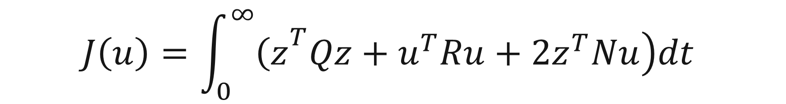
$$\begin{aligned}&J\left(u\right)=\int_{0}^{∞}{\left.{\left(z\right.}^{T}Qz+u^{T}Ru+2z^{T}Nu\right)dt}\end{aligned}$$
For this study, R=1 & N=0

Slide 19
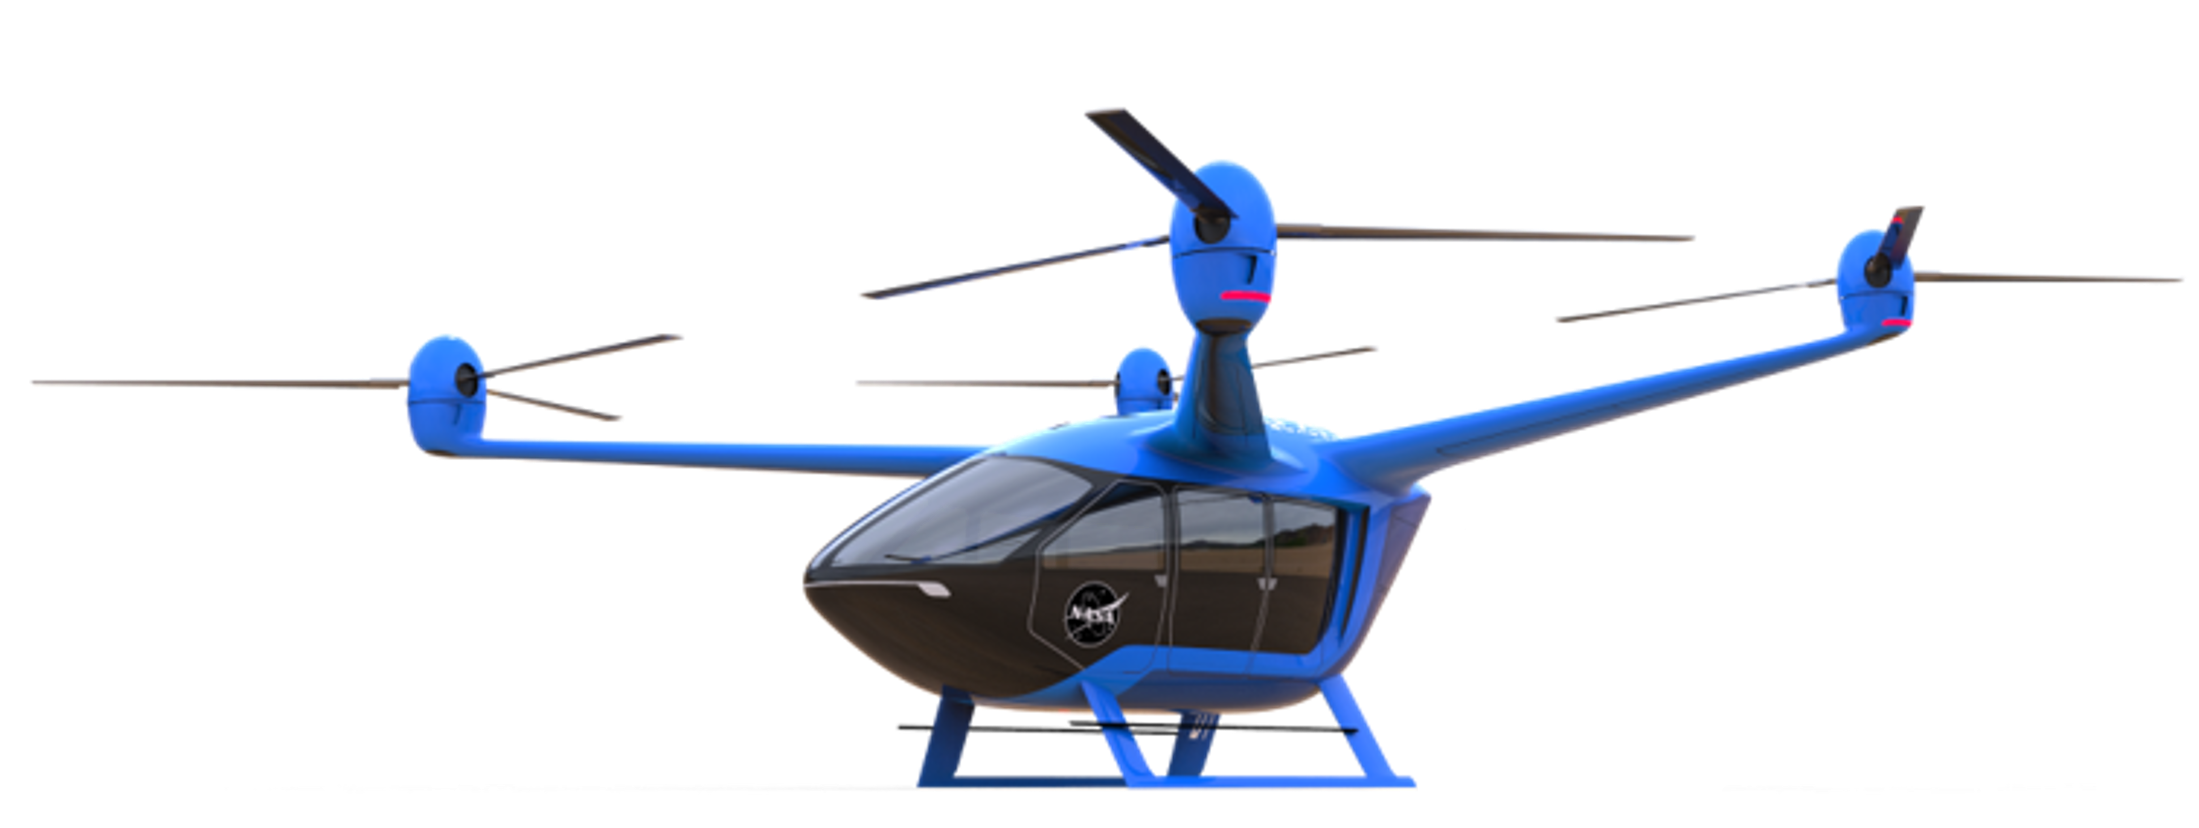
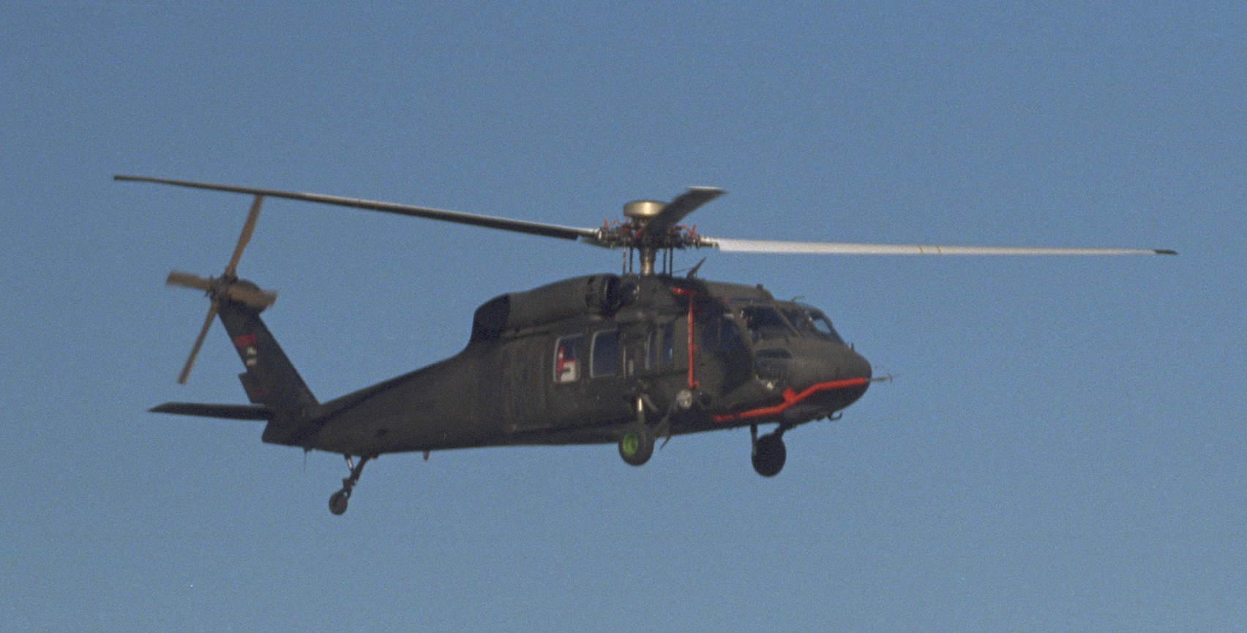
Notes:
UH-60 Blackhawk (NASA 748) and YO-3A (NASA-718) inflight over Altamont Pass, CA - Blade Vortex Interaction Noise experiment.

Slide 21
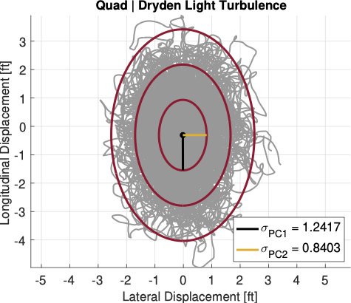
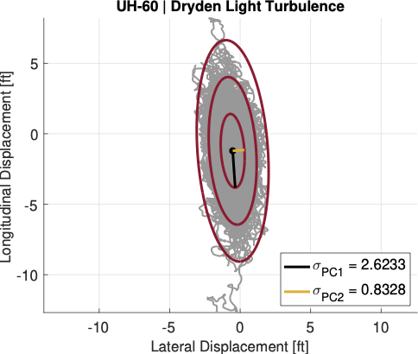

Slide 24
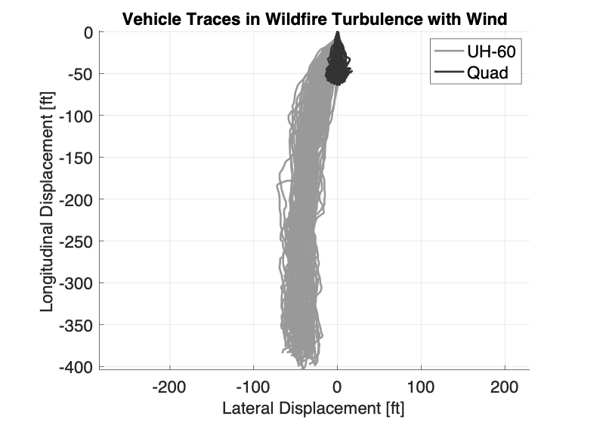
Notes:
“If we zoom in you can see the aft longitudinal drift for the quad is about 50 feet”

Slide 25
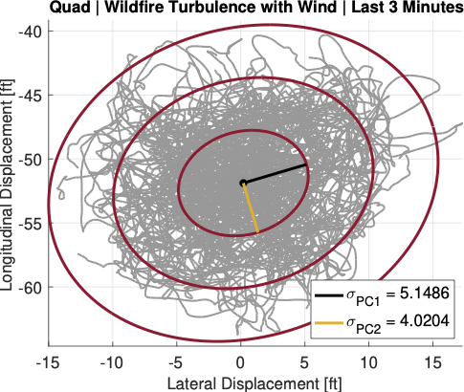
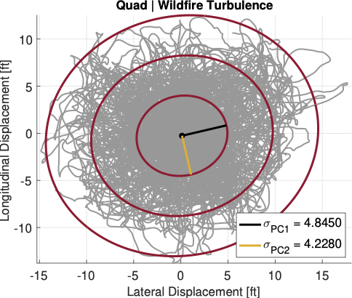
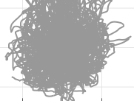
Notes:
“Again, the UH-60 had a deficiency for its TRC, but it is expected that, once corrected, similar results should be attainable”

Slide 26
Notes:
Estimated ${3σ}_{PCA}$ ranges for expected performance are shown in the figure
, thus, for this study, characterization of the displacement ranges for both models will be based on turbulence-only results
Despite possible improvements to the control system, true displacement is likely to be larger because not all features of the turbulence environment are being modeled (plumes, vortices, etc.)

Slide 27
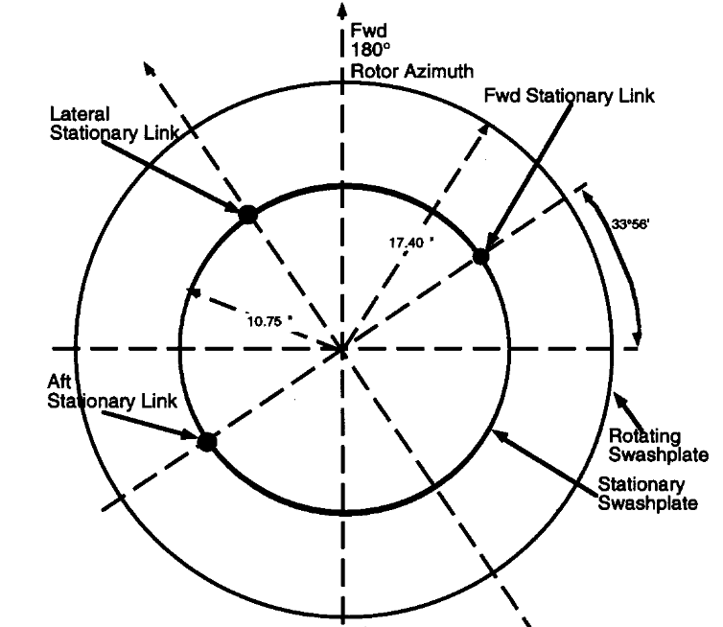
Notes:
Swashplate figure adopted from Ref. 7.

Slide 28
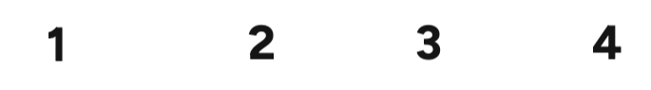

Slide 29
Notes:
Quadcopter uses over 250% for all test cases.

