Slide 1
Arc Jet Test Article Instrumentation
AM-TPS Workshop 3.0
Jose Santos, Josh Monk
NASA Ames Research Center
1-May-2024

Slide 2
Outline
TPS Instrumentation Overview
Sensor types
  Technical considerations
  Availability
  Facility considerations
Examples
  Stagnation, shear, and panel test articles
Application
  Thermal Response Models
Summary

Slide 3
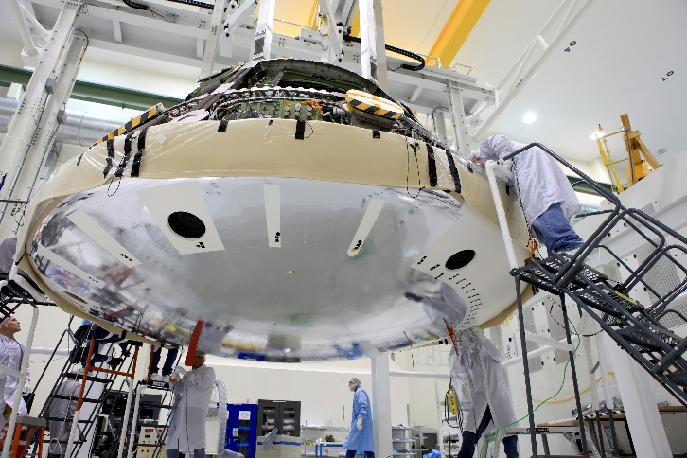
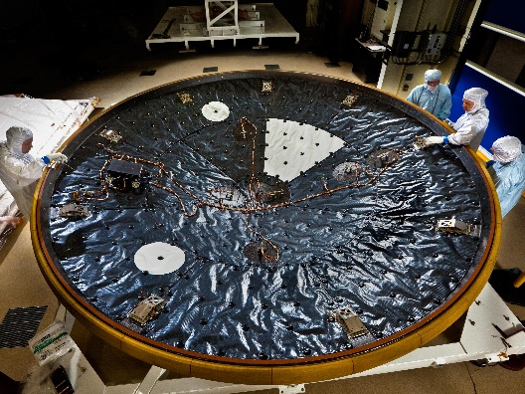
TPS Instrumentation
For spaceflight missions involving atmospheric entry, the environment experienced by a spacecraft cannot be fully replicated on the ground
Taking measurements in the flight environment is the “gold standard” for:
  Validating predictive modeling tools
  Reducing risk on future EDL missions
Instrumenting arc jet models with TPS sensors provides critical data needed for:
  Development and validation of material response models
    Ground-to-flight traceability analysis
  Evaluation of sensor performance
  Demonstrating “Do No Harm” to the TPS
Orion EFT-1 heat shield
MEDLI instrument suite

Slide 4
Sensor types

Slide 5
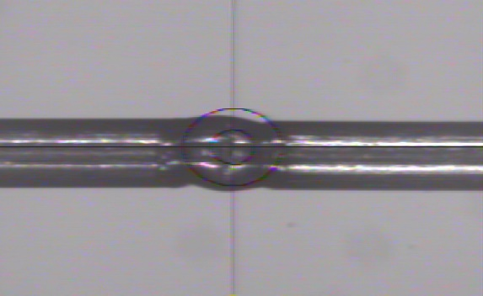
Thermocouples (TCs)
Measurement quantity:
  Temperature difference between hot and reference junctions by measuring voltage arising from the Seebeck effect
Sensor considerations:
  Measurement range is dependent on TC type (see ASTM E230 standard)
  Type K, R, S, and C are most commonly used
Availability:
  Good to Fair for COTS item from various vendors
  Produced in-house at NASA ARC with laser weld at the hot junction (upon request)
Facility considerations:
  Passive sensor ⇒ no power excitation
  Susceptible to noise or extraneous currents if embedded in conductive TPS material
  Typical installation into TPS material via TC plug
Metal 1 (+)
T_{hot}
Measure voltage here
T_{ref}
Metal 2 (-)
TC bead weld (“hot junction”)
Type K: -200 to 1,260 °C
Type R or S: 0 to 1,480 °C
Type C: 0 to 2,315 °C

Slide 6
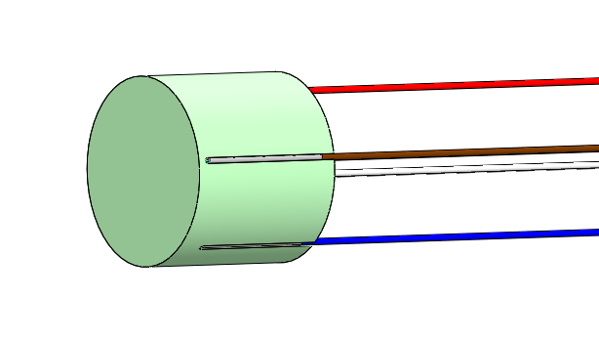
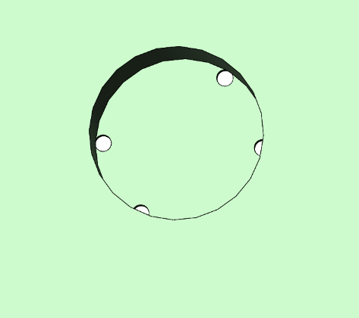
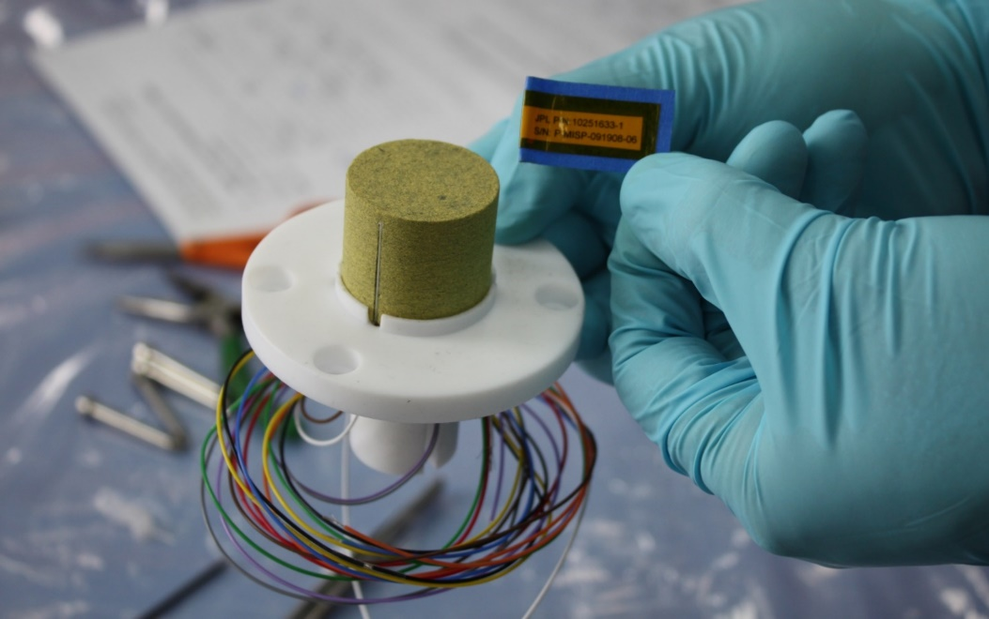
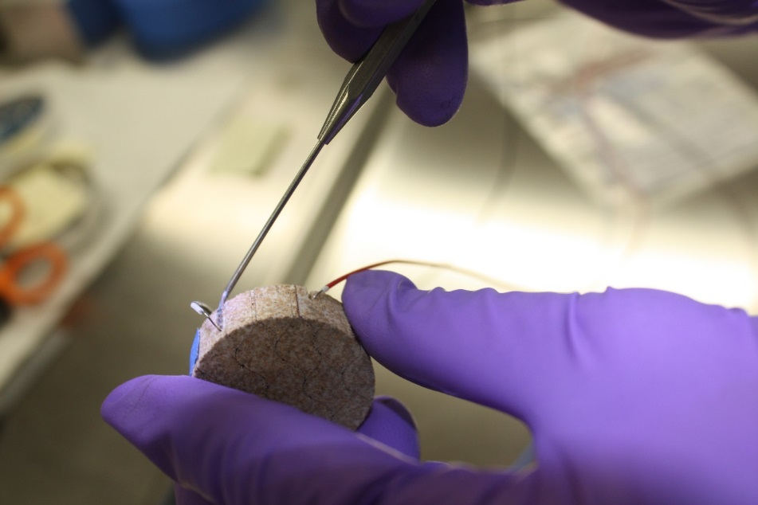
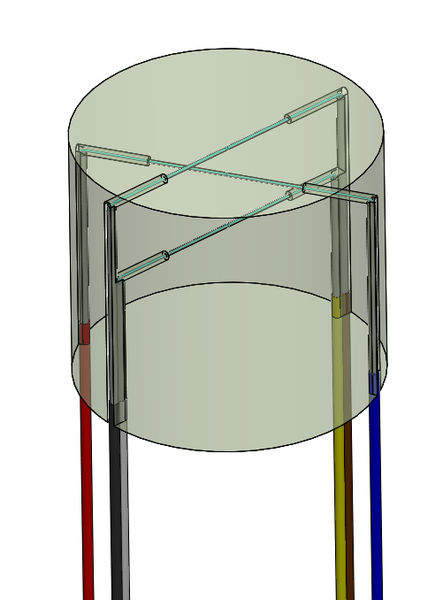
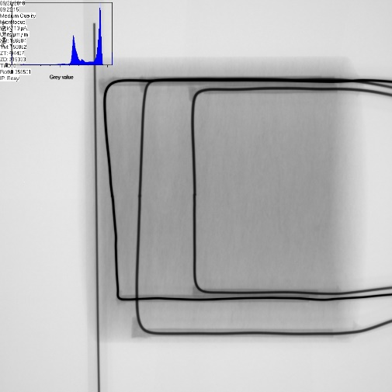
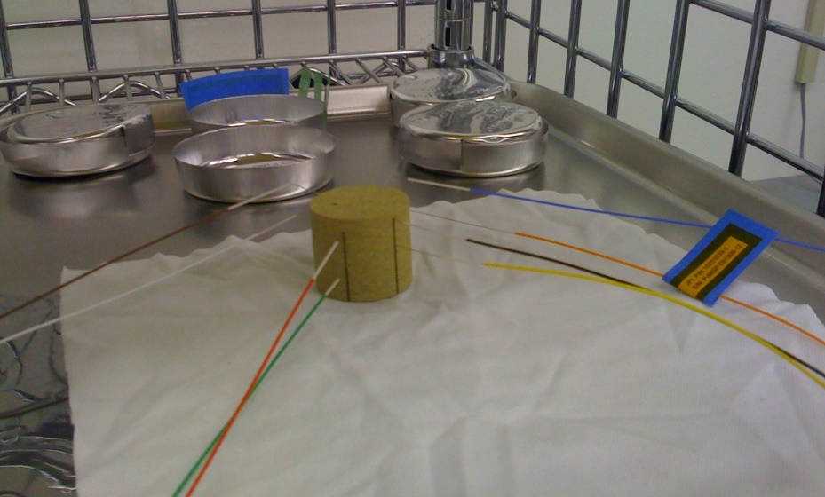
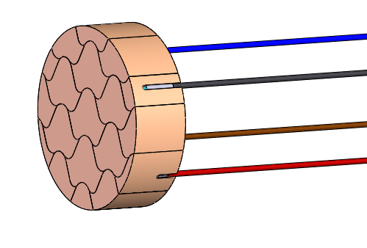
Thermocouple (TC) Plugs
Counterbore hole
See ASTM E377 for low-conductivity TPS materials
TC plug can be installed into a counterbore with adhesive or press-fit
Lead wires fed through the thickness to route to data acquisition system
Can also be installed via threaded design (higher density materials) or through-hole (instead of counterbore) and substrate
Adhesive or press-fit
Thermocouple plug fabrication at NASA Ames
X-ray image

Slide 7
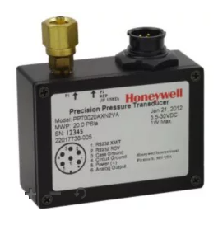
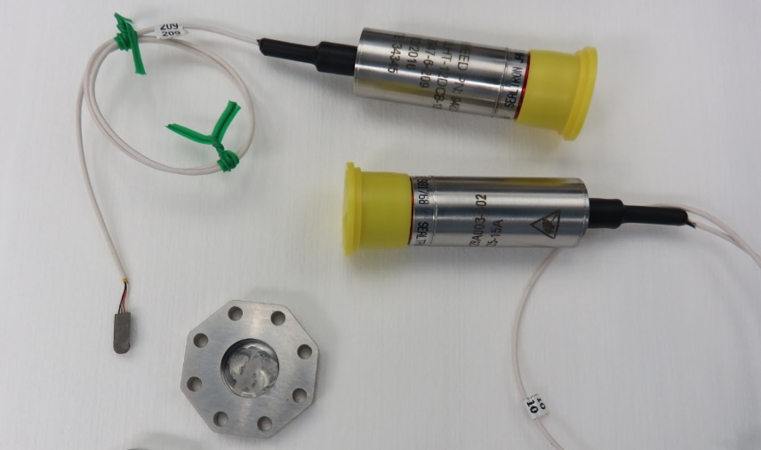
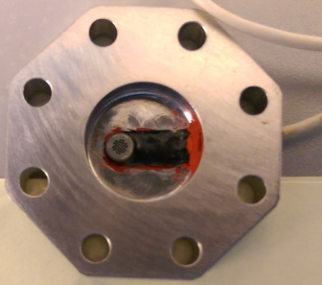
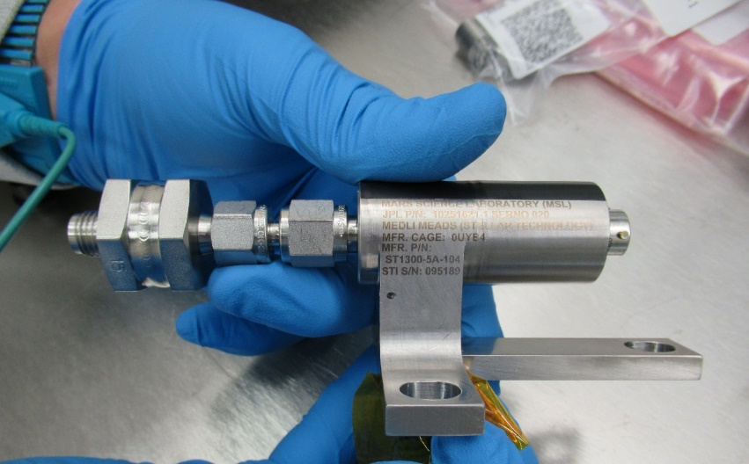
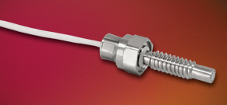
Pressure Transducers
Artemis 1 shoulder pressure transducer
Measurement quantity:
  Absolute or differential pressure
Sensor considerations:
  Piezoresistive strain gage-based measurement is common
  Specialized units (e.g., variable reluctance) for very low pressure applications (hundreds of Pascal)
  Often requires temperature compensation
Availability:
  Good to Fair for COTS items from various vendors
  Very few choices for spaceflight ready transducers
    Difficulty with cold temperatures (<≈ -120 °C)
Facility considerations:
  Form factor and size
  Calibration
  Integration within arc jet test article
Orion EFT-1 pressure transducer
Kulite brand pressure transducer
MEDLI / MEDLI2 Hypersonic transducer

Slide 8
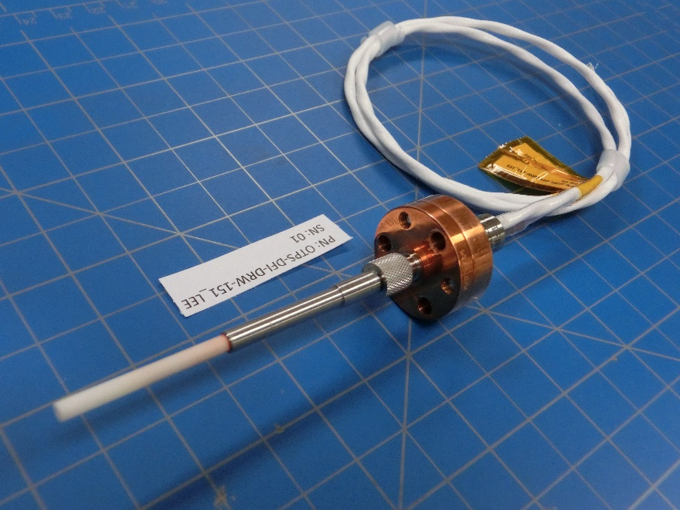
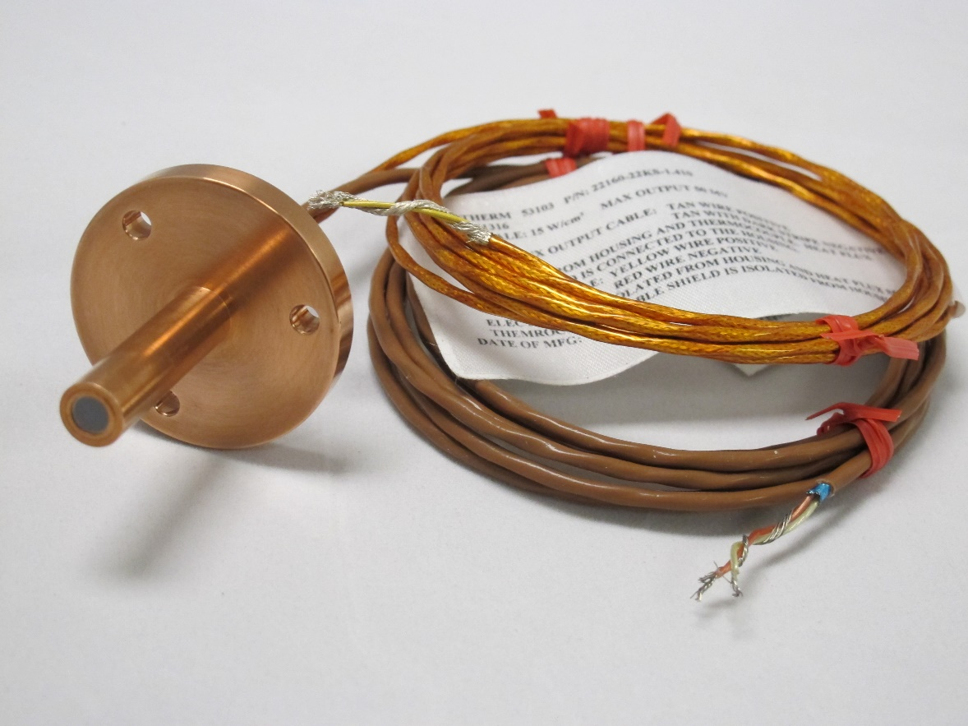
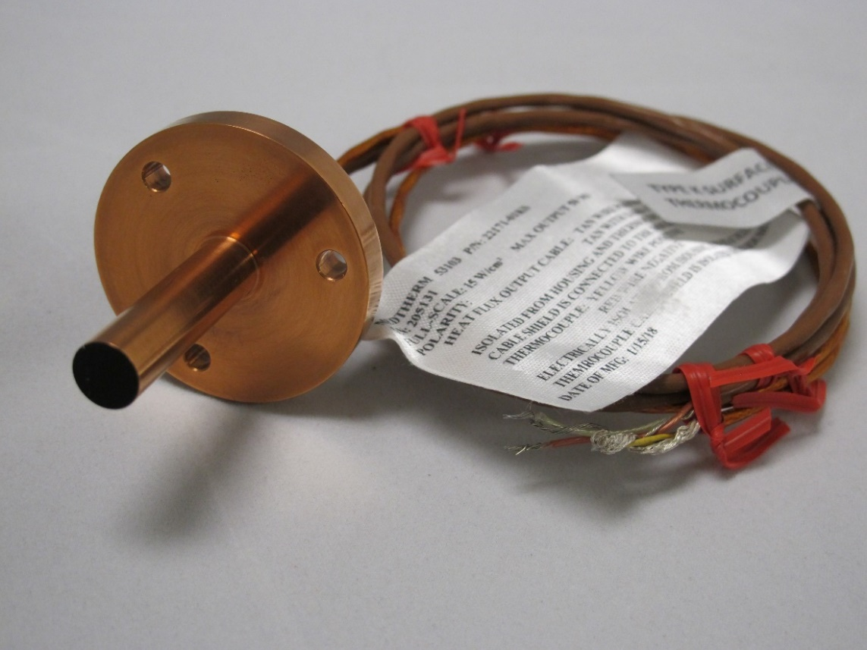
Heat Flux Sensors and Radiometers
Measurement quantity:
  Total heat flux sensor: combined convective and radiative heating
  Radiometer: radiative component of heating
  Direct measurement of heat flux
    Voltage output calibrated with radiant heat source
EFT-1 Heat shield Radiometer
Sensor Considerations:
  Radiometers typically incorporate a window to block out convective heating
  If installed at the surface, deposition of TPS ablation/pyrolysis products on the window will alter the heat flux measurement
Availability
  Fair, only a few select reputable vendors
Facility Considerations:
  Pre-run checkouts and DAS setup
  Calibration
MEDLI2 Backshell Radiometer
MEDLI2 Backshell Total Heat Flux Sensor

Slide 9
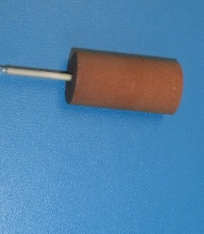
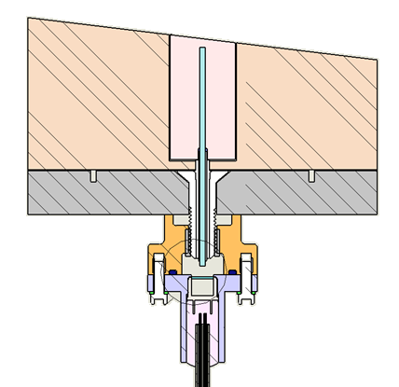
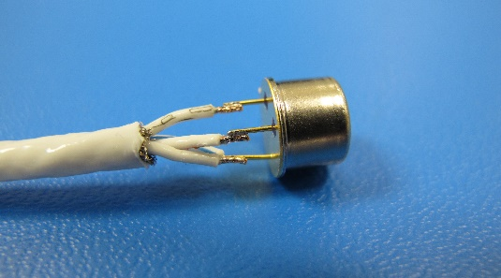
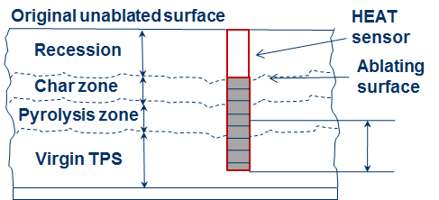
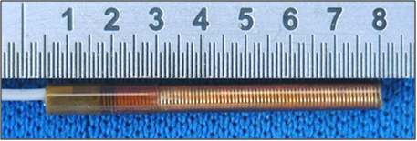
Recession Sensors
Measurement quantity:
  Direct or inferred recession of TPS material
Sensor considerations:
  Discrete vs continuous recession measurement
  Calibration process is not well established
  Accuracy better than ≈ +/- 0.1 cm not attainable with current higher TRL options
Availability:
  No ready-made COTS solutions
  NASA custom designs flown/will fly on specific flight missions (MEDLI, Artemis II)
  Low TRL concepts from SBIRs or other R&D efforts
Facility considerations:
  Power excitation and DAS setup
  Pre-run checkouts
  May need to rely on arc jet run video or other diagnostics to compare with sensor response
UV from shock layer
Ablation direction
TPS
Photo diodes
Optical Recession Sensor (ORS)
Hollow aErothermal Ablation and Temperature (HEAT) sensor

Slide 10
Examples

Slide 11
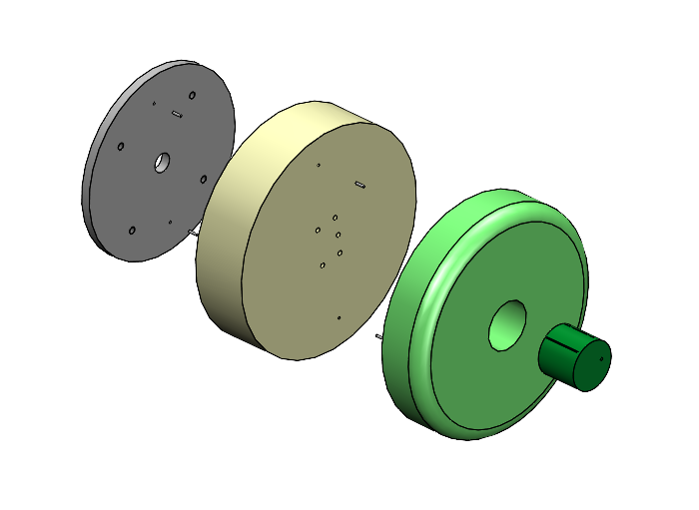
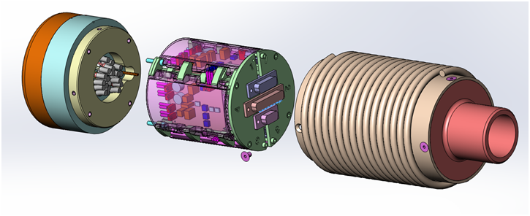
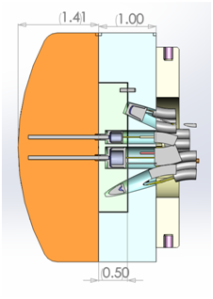
Stagnation Test Articles
Wide range of test article designs have been tested in the arc jet facilities
  Successful measurements made with TC plugs, active pressure ports, heat flux sensors, and recession sensors
Simple Design
Complex Design
Insulator
TPS model
Electronics subassembly
Water cooled housing
TPS model
TC Plug
Mounting plate
Flat face geometry
Single TC plug installed in the center
No power excitation
“Iso-Q” curved OML geometry
Electronics packaging
Power excitation

Slide 12
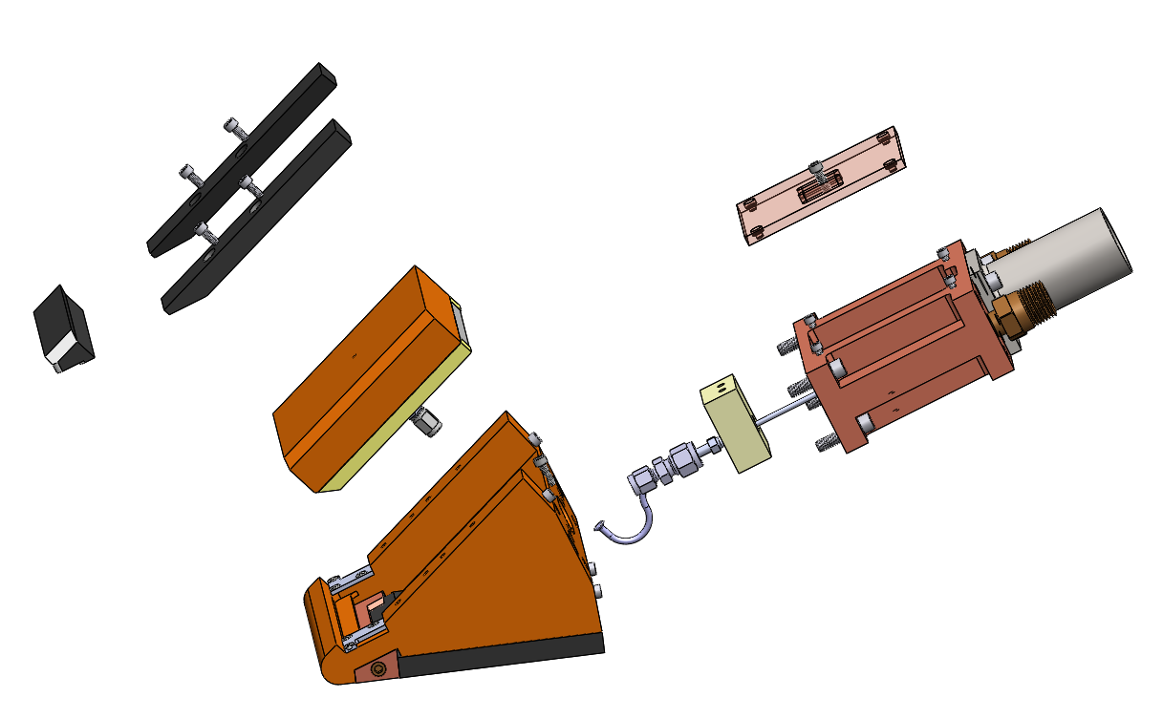
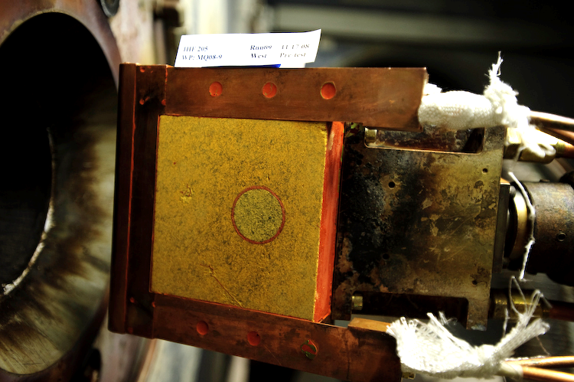
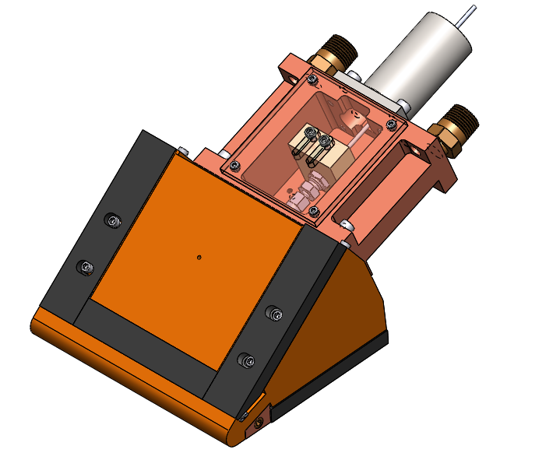
Wedge Test Articles
Wedge test articles need a water-cooled holder assembly
  Leading edge and side frame pieces
  “Plug-and-play” adapter available for additional interior volume to house sensors
Exploded view of CAD design of wedge pressure port test article
Test article OML surface exposed to flow ≈ 4.2” x 4.5”
Total TPS test coupon thickness limited to ≈ 1.3”
TC Plug
CAD image of assembled wedge pressure port test article
“Plug-and-play” adapter
“Wedge” shear test configuration in IHF. Test article with TC plug shown.

Slide 13
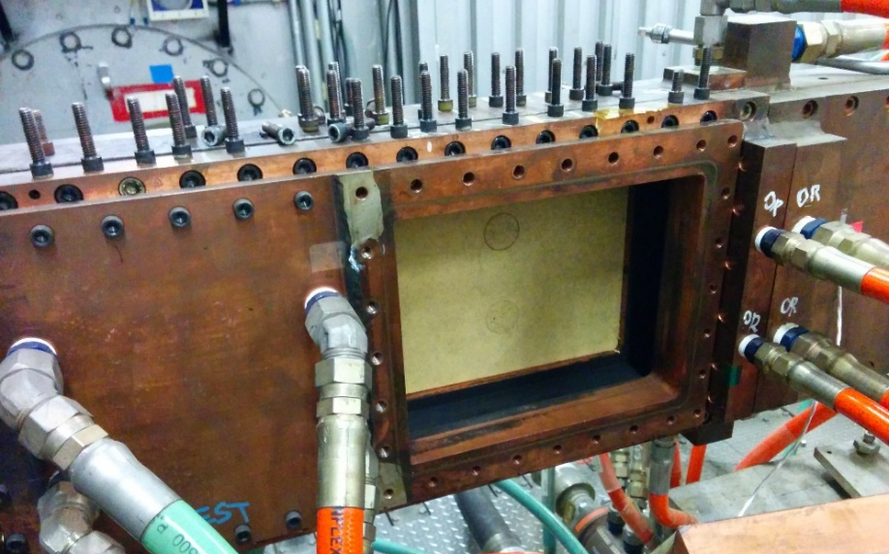
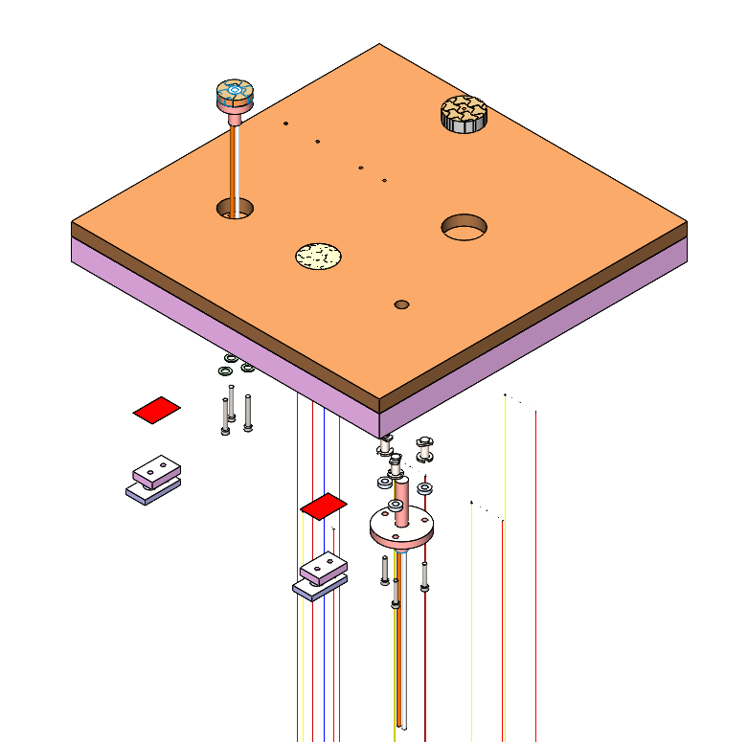
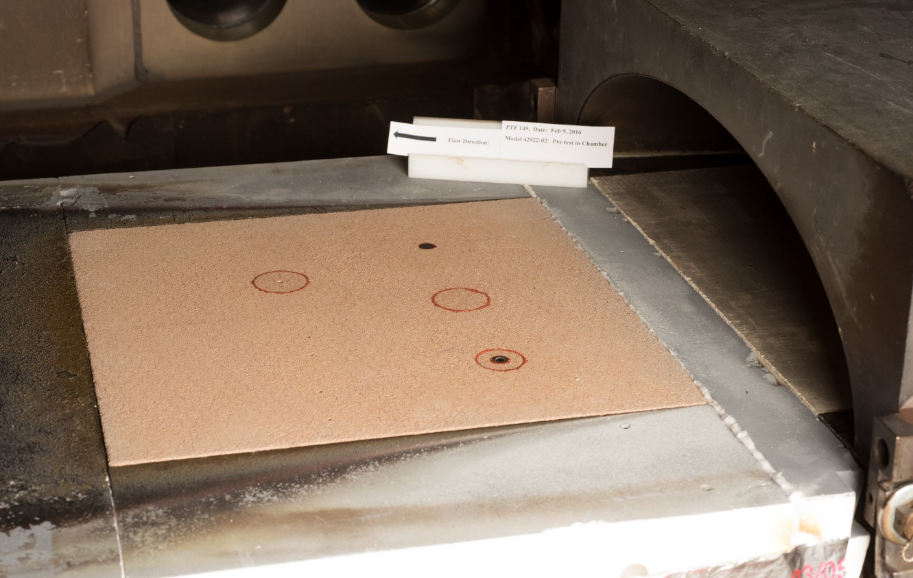
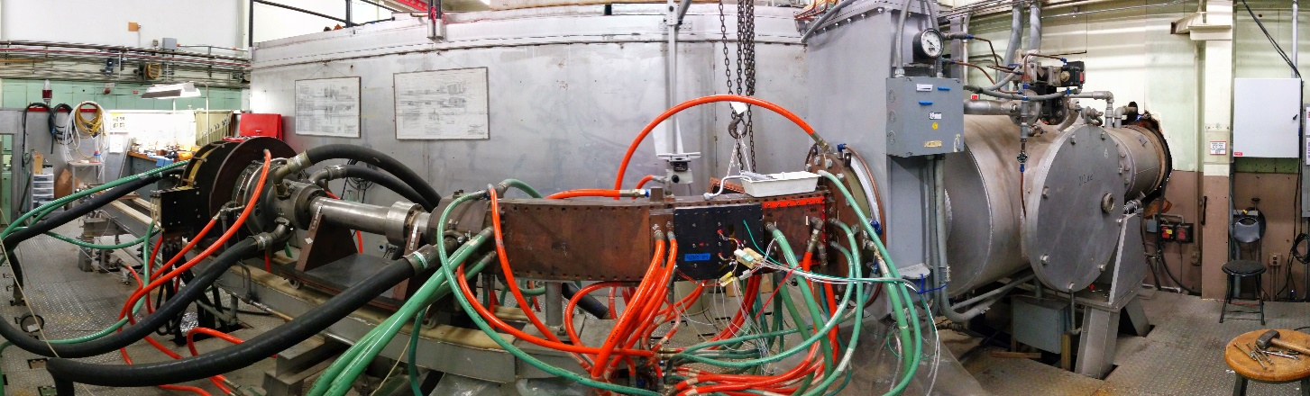
Panel Test Articles
Larger test articles can accommodate multiple sensors, but max. test conditions are lower than IHF or AHF
12”x12” PTF test article
8”x10” TFD test article
Various pressure port holes
Pressure
Port Plug
Heat flux Sensor in TPS plug
TPS material
TC Plug
Substructure material
TC Plug
Heat flux Sensor

Slide 14
Application

Slide 15
Validation of Material Models with Ground Test Data
Material response analysis is leveraged for thermal protection material sizing for flight projects
It is critical to evaluate the predictive capabilities for the TPS models using ground testing as flight conditions cannot be fully replicated and modeling must be used for TPS design
Confidence of the material response models are derived from comparisons with thermocouple data at relevant flight conditions
  In-depth temperature predictions
  Recession predictions
Uncertainties and margin policies are also informed by these comparisons and sometimes updates to material models are recommended to reduce risk

Slide 16
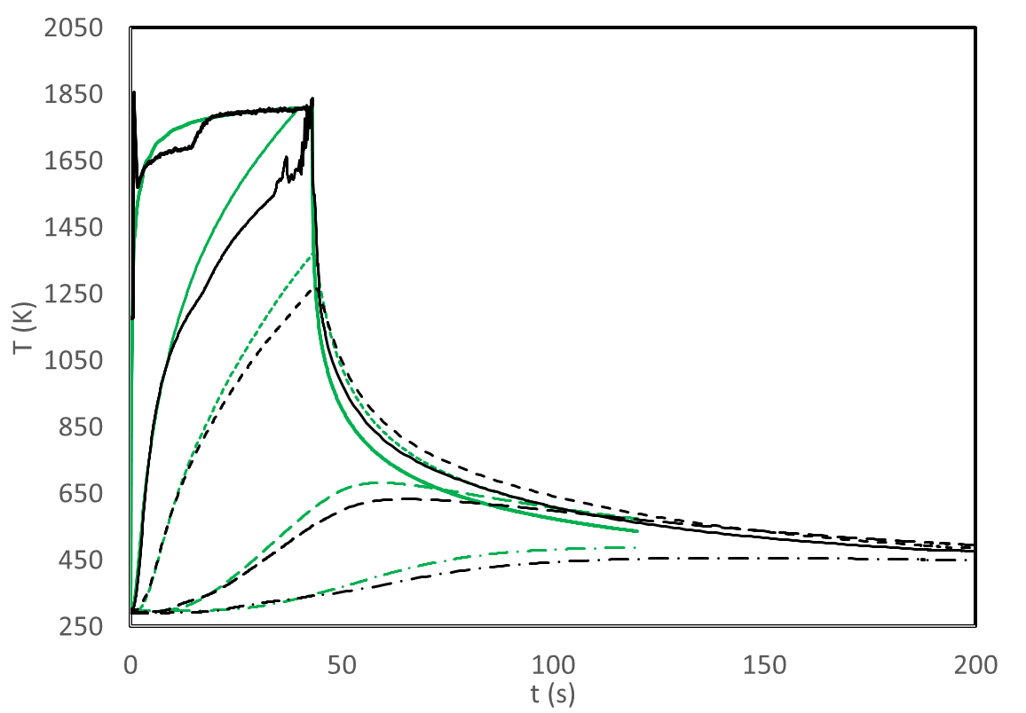
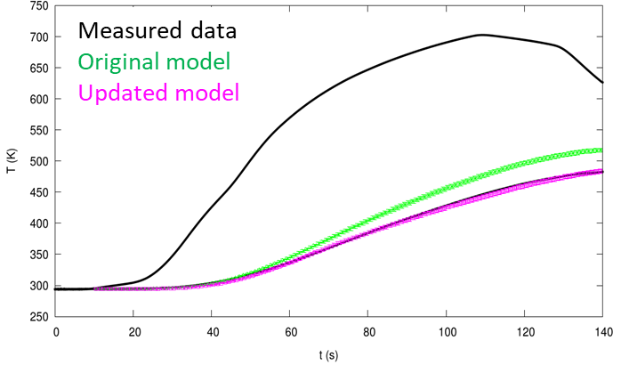
Examples of Material Response Analysis Approaches
CFD informed in-depth comparison
TC Data used as direct boundary condition
Pyrometer
TC1
Measured data
Material Response Predictions
0.10”
0.20”
TC2
0.45”
0.70”
IHF High Condition Instrumented Test
Low Condition PTF Instrumented Test
Multiple TCs for in-depth comparisons
CFD informed conditions allow for comparison of cool down predictions
Shallow TCs are another opportunity to validate model recession predictions when TC burn out occurs
Limitations:
TPS coating effects may add uncertainties in comparisons
Complex facility conditions may lead to aerothermal environment uncertainties
Decouples impact of coatings in model comparison
TC driver approach allows for easy side-side comparison for material response models
More TCs allow for TC1, TC2 etc. driver simulations
Limitations:
Simulations only run as long as TC data is available
TC burn out leads to short simulations and in-depth comparisons may not be relevant (plan conditions and run times accordingly)

Slide 17
Summary
There are many important considerations for the design of an instrumented arc jet test article
  Traceability to TPS material or flight instrumentation test objectives
  Test configuration (stagnation, wedge, panel)
  Number and type of sensors
  Facility interfaces
Arc jet facility has experience with several different sensor types
  Examples: thermocouples, pressure transducers, heat flux sensors, recession sensors
Instrumented TPS ground test provides critical data used to validate TPS material response models for future flight missions

Slide 18
Back Up

Slide 19
Additional Resources
Contact information:
  Jose Santos: jose.a.b.santos@nasa.gov
  Josh Monk: joshua.d.monk@nasa.gov
ASTM standards:
  ASTM E230: https://www.astm.org/e0230_e0230m-17.html
  ASTM E377: https://www.astm.org/e0377-08r20.html
  ASTM E21.08 subcommittee: E21.08 Jurisdiction Page (astm.org)
    Many standards on heat flux measurement relevant to ground tests

