Slide 1

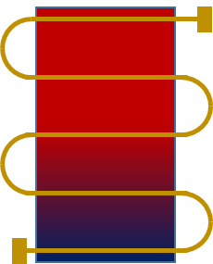
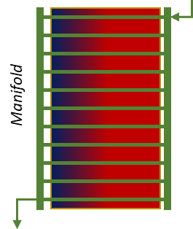
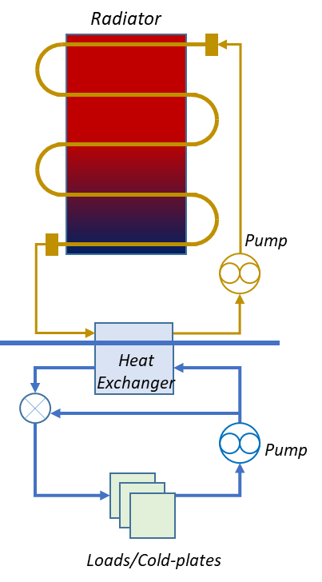
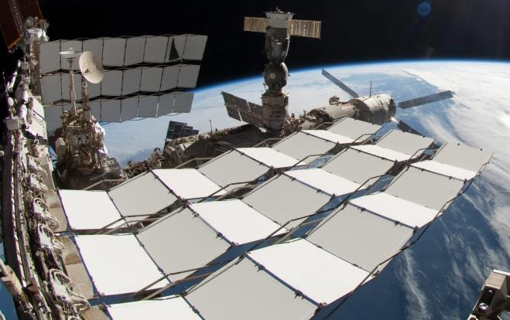
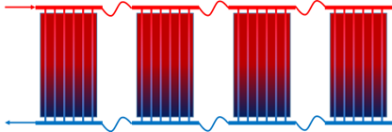
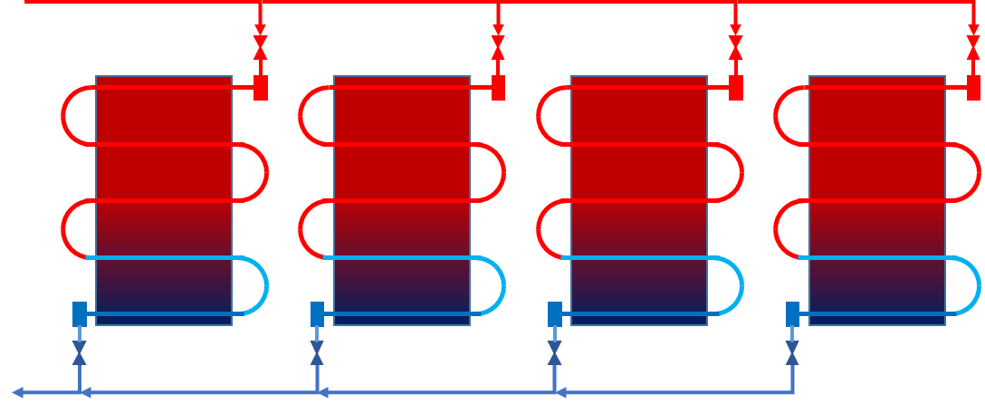
Advanced Single Phase Thermal Radiator for Moon-to-Mars Exploration
Stephen Wess/EV34, Greg Schunk/EV34
Project Goal
Project Deliverables
Development of an advanced single phase, pumped loop thermal radiator utilizing a serpentine flow path with high thermally conductive face-sheets.
Potential applications include use for Moon-to-Mars surface, transit, habitation and lander missions.
This effort will result in both hardware and thermal math model deliverables.
A breadboard radiator panel to be constructed and evaluated for thermal performance and pressure drop in a bench top test (utilizing various coolant options) and delivered as a part of this investment.
A highly conductive pyrolytic graphite layer to be added to the face-sheet in the breadboard radiator for improved efficiency.
Tests conducted with water, Galden fluid, and other coolants (time permitting). Parametric evaluation of the radiator performance at different temperatures and heat loads will be performed.
Separate test to assess hydraulic pressure drop.
Thermal math-models to predict radiator performance to be developed. The math models will parameterize performance and mass versus geometry (height and cross-sectional area) and working fluids.
Thermal math model will be correlated to test data
The math models may support many projects including Moon-to-Mars Surface and Transit Habitation.
Serpentine Radiator Design (Left) vs. Manifold Radiator Design (Right)
Background
Pumped loop radiators are commonly used to reject large amounts of heat associated with crewed systems. The State-of-the-Art (SOA) for crewed systems is represented by the International Space Station (ISS) External Heat Rejection System (HRS) Thermal Radiators.
The ISS HRS utilizes a manifold design with many parallel flow paths coupled to thin face-sheets and low viscosity ammonia as the working fluid, which may not be preferred due to toxicity concerns.
Although contemporary coolant choices provide lower freezing points, the current SOA design may not be well positioned to provide both sufficient heat transfer and manageable pressure drop due to very different fluid thermo-physical properties, including higher viscosities.
Representative of Habitat External Loop
Fluid: Galden HT-170
Fluid: DowFrost HD Glycol
Premixed
Manifold Radiator Wing Diagram (Left) SOA Deployable Thermal Radiators on the ISS (Right)
Representative of Habitat Internal Loop
Benefits of Advanced Single Phase Thermal Radiator Development
For a manifold radiator panel, the film coefficient for heat rejection between the tubes and face-sheet is strongly correlated to the viscosity and velocity of the fluid (i.e., the Reynolds number) as well as the fluid thermo-physical properties and tube geometry.
Dividing the manifold flow may make it difficult to maintain a sufficient Reynolds number while also managing pressure drop (both due to decrease in tube diameter) for high viscous fluids.
A serpentine flow pattern, commonly used in two-phase systems may better balance the two competing demands.
An advanced radiator could be optimized to offer lower mass, improved performance, improved failure tolerance and greater compatibility with current coolant choices.
Diagram of Test Bed Setup
Conceptual Diagram for Serpentine Radiator Wing with Panel Isolation

