Slide 1
Developing a Consistent Methodology for Estimating Consumptive Use from Evapotranspiration in the Upper Colorado River Basin for the United States Bureau of Reclamation
Project Team:
Dr. Christopher Hain, NASA Marshall Space Flight Center (MSFC)
Dr. Joshua Fisher, Jet Propulsion Laboratory (JPL)
Dr. Thomas Holmes, NASA Goddard Space Flight Center (GSFC)
Mr. Alberto Guzman, NASA Ames Research Center (ARC)

Slide 2

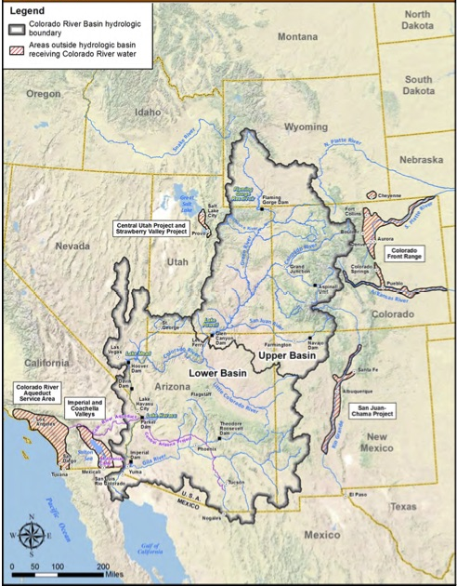
Needs Introduction
WWAO conducted a Colorado River Basin Needs Assessment and has identified Consumptive Use for Calculating Water Budgets as a Use Case, which seeks to determine consumptive use for reporting and long-term planning purposes.
Partner: The United States Bureau of Reclamation (USBR) is mandated to perform the accounting of consumptive use and loss for the Colorado River Basin.
Currently, each state in the basin relies on what is reported by water-rights users, in order to verify these reports, unbiased estimates of consumptive use are needed. Water-rights planning in the Colorado River Basin is done at the state and federal levels. This includes planning, emergency drought requirements, and Indian Water Rights Settlements.
Therefore, the USBR would like to adopt a consistent methodology to be used at the USBR and potentially within four states in the Upper Colorado River basin.
Map of the Upper Colorado and Lower Colorado River Basins.

Slide 3
Needs Introduction
Focus Area: The need identified by WWAO’s Colorado River Basin Needs Assessment focused on the entire Colorado River Basin. However, after consultation with USBR, the proposed project will focus on the estimation of consumptive use within the Upper Colorado River Basin.
Beneficiaries and partners involved in addressing this need include decision makers such as state agencies (for example, the Arizona Department of Water Resources, Colorado Division of Water Resources, New Mexico Office of the State Engineer’s Office, and Wyoming Interstate Stream Division) as well as data providers (for example, the USBR).
Changes: Currently, USBR requires estimates be available by July 1 for the previous growing season, but to enable better planning/coordination with the states in the basin, the USBR would like estimates from the previous growing season by March 1.
Requirements:
Spatial resolution: 30-meters
Temporal resolution: Monthly over the growing season (1 April to 31 October)
Model Accuracy: 15 to 20% over agricultural areas
Product Availability: ET estimates by 1 March for the previous growing season
Study Period: 2017-current

Slide 4
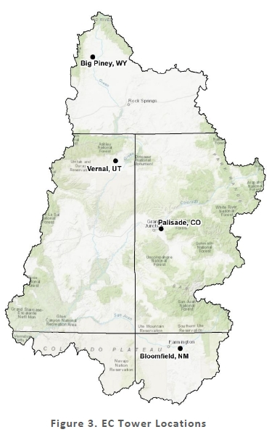
Available Flux Tower sites within UCRB, and analysis of situation with respect to dominant wind and elevation.
FIGURE: Map of UCRB and surrounding region with locations of Flux Towers, stream networks and elevation. (update Phase 3 final report fig 3.)
FIGURE: Results of footprint analysis for each Flux Tower resource.
State | Station | Latitude | Elevation (m) | Start of Operation | Crop Type / Irrigation
Wyoming | Big Piney | 42.54°N, 110.195°W | 2130 | March 2018 | Foxtail Grass - Flood
Colorado | Palisade | 39.094°N, 108.37°W | 1417 | March 2018 | Peach Orchard - Ground Sprinkler
Colorado | Kremmling | 40.149116°N, 106.450809°W |  | June 2020
Utah | Vernal | 40.458°N, 109.562°W | 1665 | 2017 | Alfalfa -Side Roll Sprinkler
New Mexico | Bloomfield | 36.691°N, 107.914°W | 1694 | March 2018 | Alfalfa – Center Pivot (2020-)

Slide 5
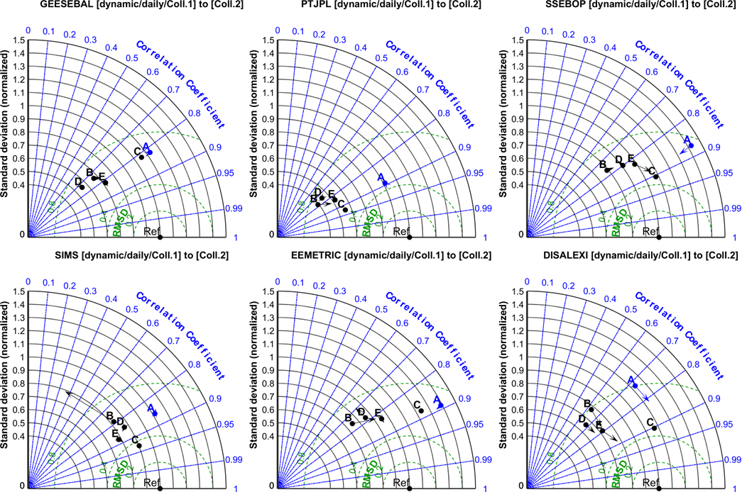
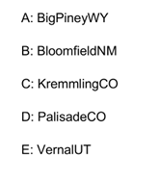
OpenET results for USBR EC sites (irrigated crops), daily averages.
Collection 1 to Collection 2 (by Model)

Slide 6
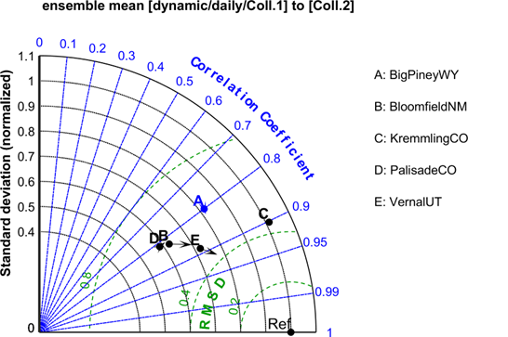
OpenET model results for USBR EC sites (irrigated crops), daily averages.
Collection 1 to Collection 2
Improved precision (R, RMSD), especially for DisALEXI, and SSEBOP.
Ensemble performance relatively stable.
Remaining site to model differences in dynamic range (normalized standard deviation).
ENSEMBLE

Slide 7
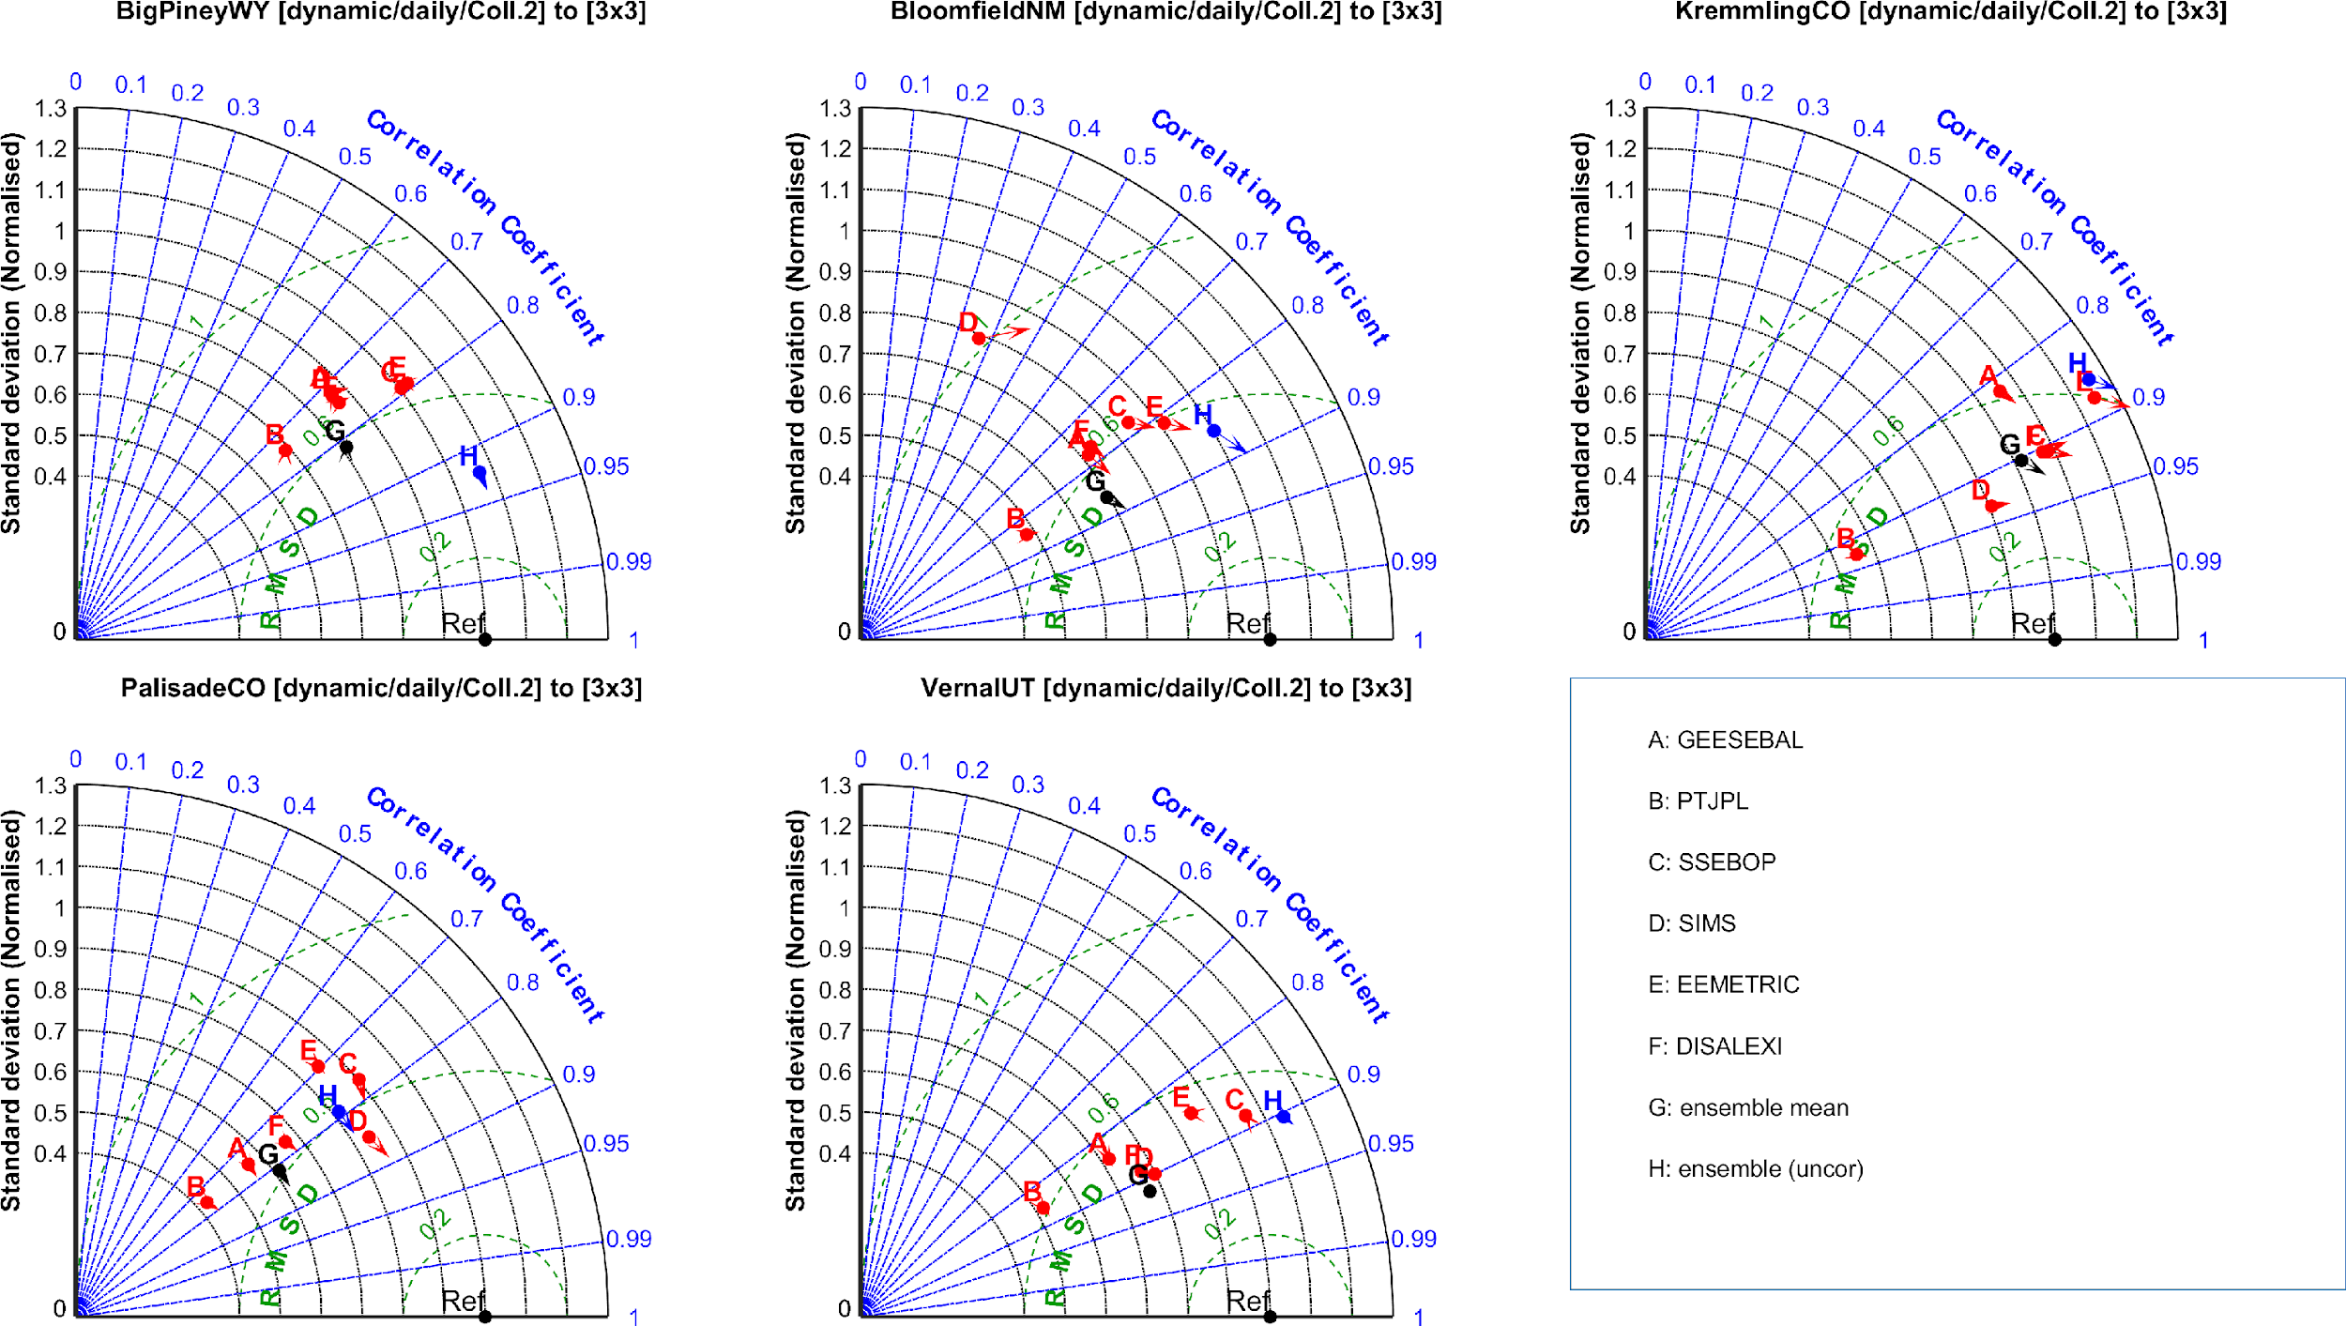
OpenET results for USBR EC sites (irrigated crops), monthly averages.
Dynamic to 3x3 footprint (by Site)
Not much impact from dynamic footprint calculation; the fixed 3x3 compares a bit better for these 5 sites.
RMSD of 20% of the Mean flux station ET as target precision.
Enforcing EB closure impacts dynamic range only
Big Piney is known exception

Slide 8
