Slide 1
NASA
Space Nuclear Propulsion (SNP)
MBSE Initiatives
2024 MBSE Cyber Systems Symposium
May 14, 2024
David Greeson
Aerospace Engineer
SNP MBSE/DE Lead
NASA-MSFC ER12
David.S.Greeson@nasa.gov
256-541-7683
Diana Gorokhovskaya
Systems & Integration Engineer
Jacobs Space Exploration Group
NASA-MSFC ER12
Diana.Gorokhovskaya@nasa.gov
256-544-6749

Slide 2
Project Overview
David Greeson

Slide 3
NASA Space Nuclear Propulsion Vision and Goals
Vision – Robust and enduring access to destinations throughout the solar system
  Nuclear Propulsion and Power are enabling capabilities
    Nuclear propulsion is more efficient than chemical rockets, requires less propellant
    Nuclear power can operate in the outer solar system where solar panels are not practical
Goal - Develop and demonstrate Nuclear Thermal Propulsion (NTP) and Nuclear Electric Propulsion (NEP) Systems whose capability can be directly leveraged or readily evolved for NASA’s future missions including Crewed and Large Cargo Mars Transit
Strategy
  Balance technology maturation with relevant integrated system development and demonstrations
  Leverage applicable near earth, cis-lunar, and deep space science mission spaces on the path to Mars transit development
  Seek out synergistic opportunities for cost sharing and partnerships

Slide 4
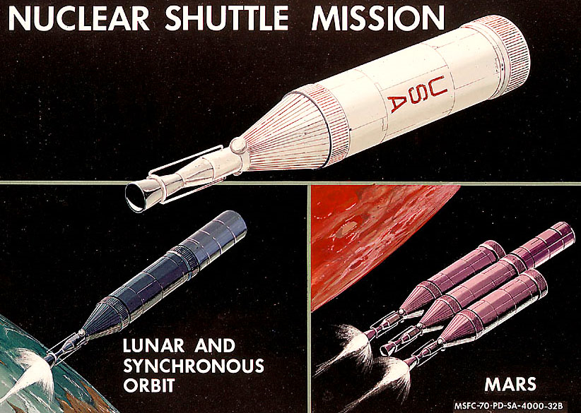
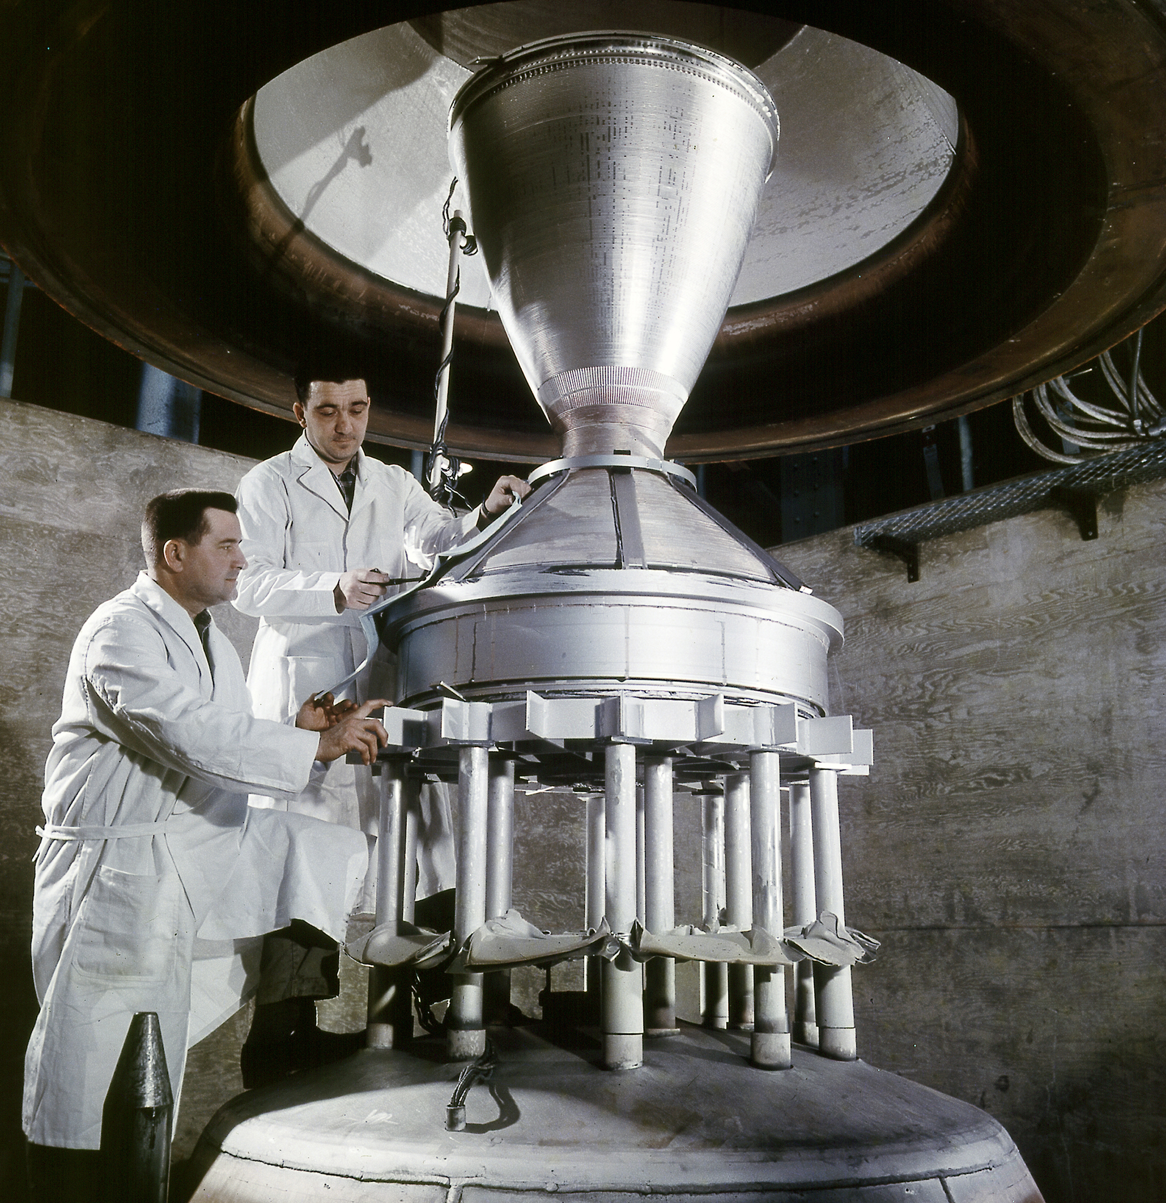
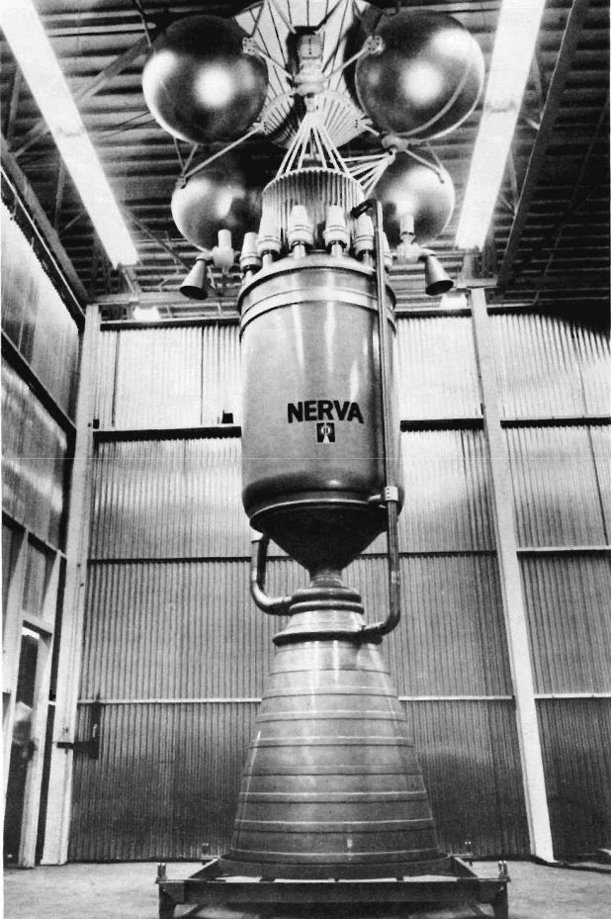
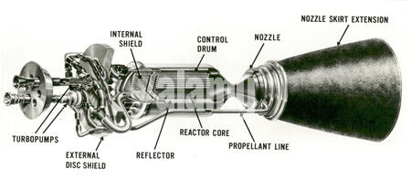
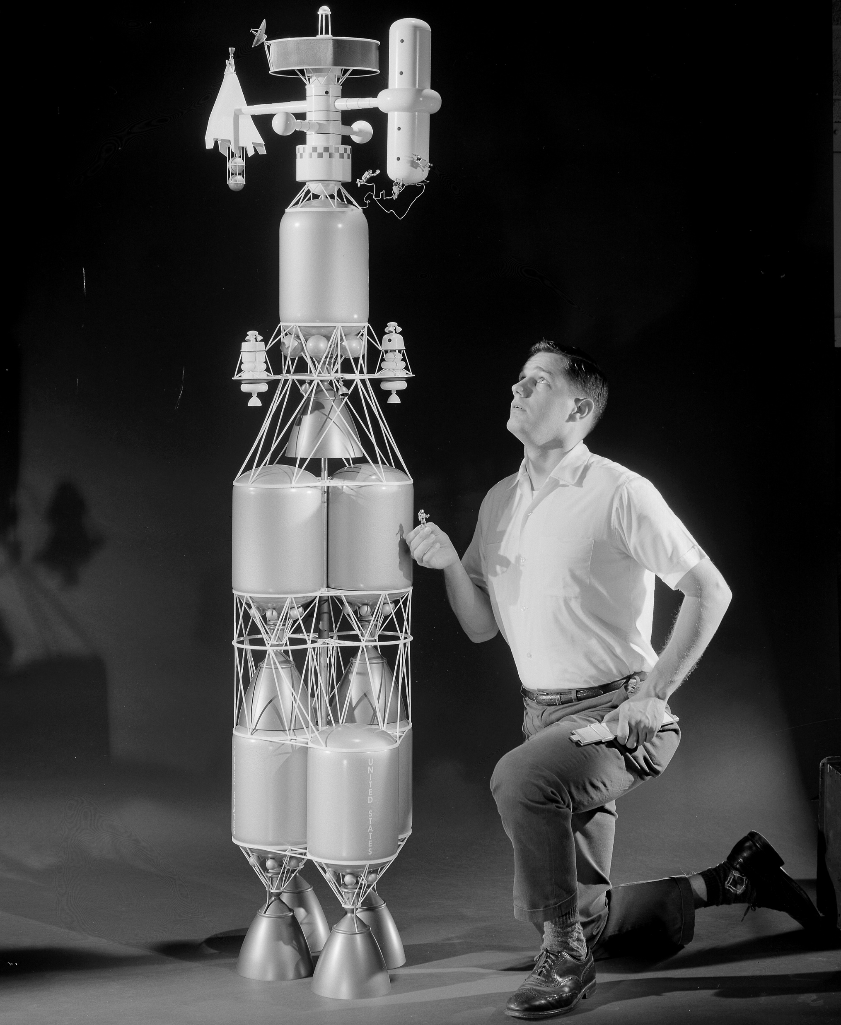
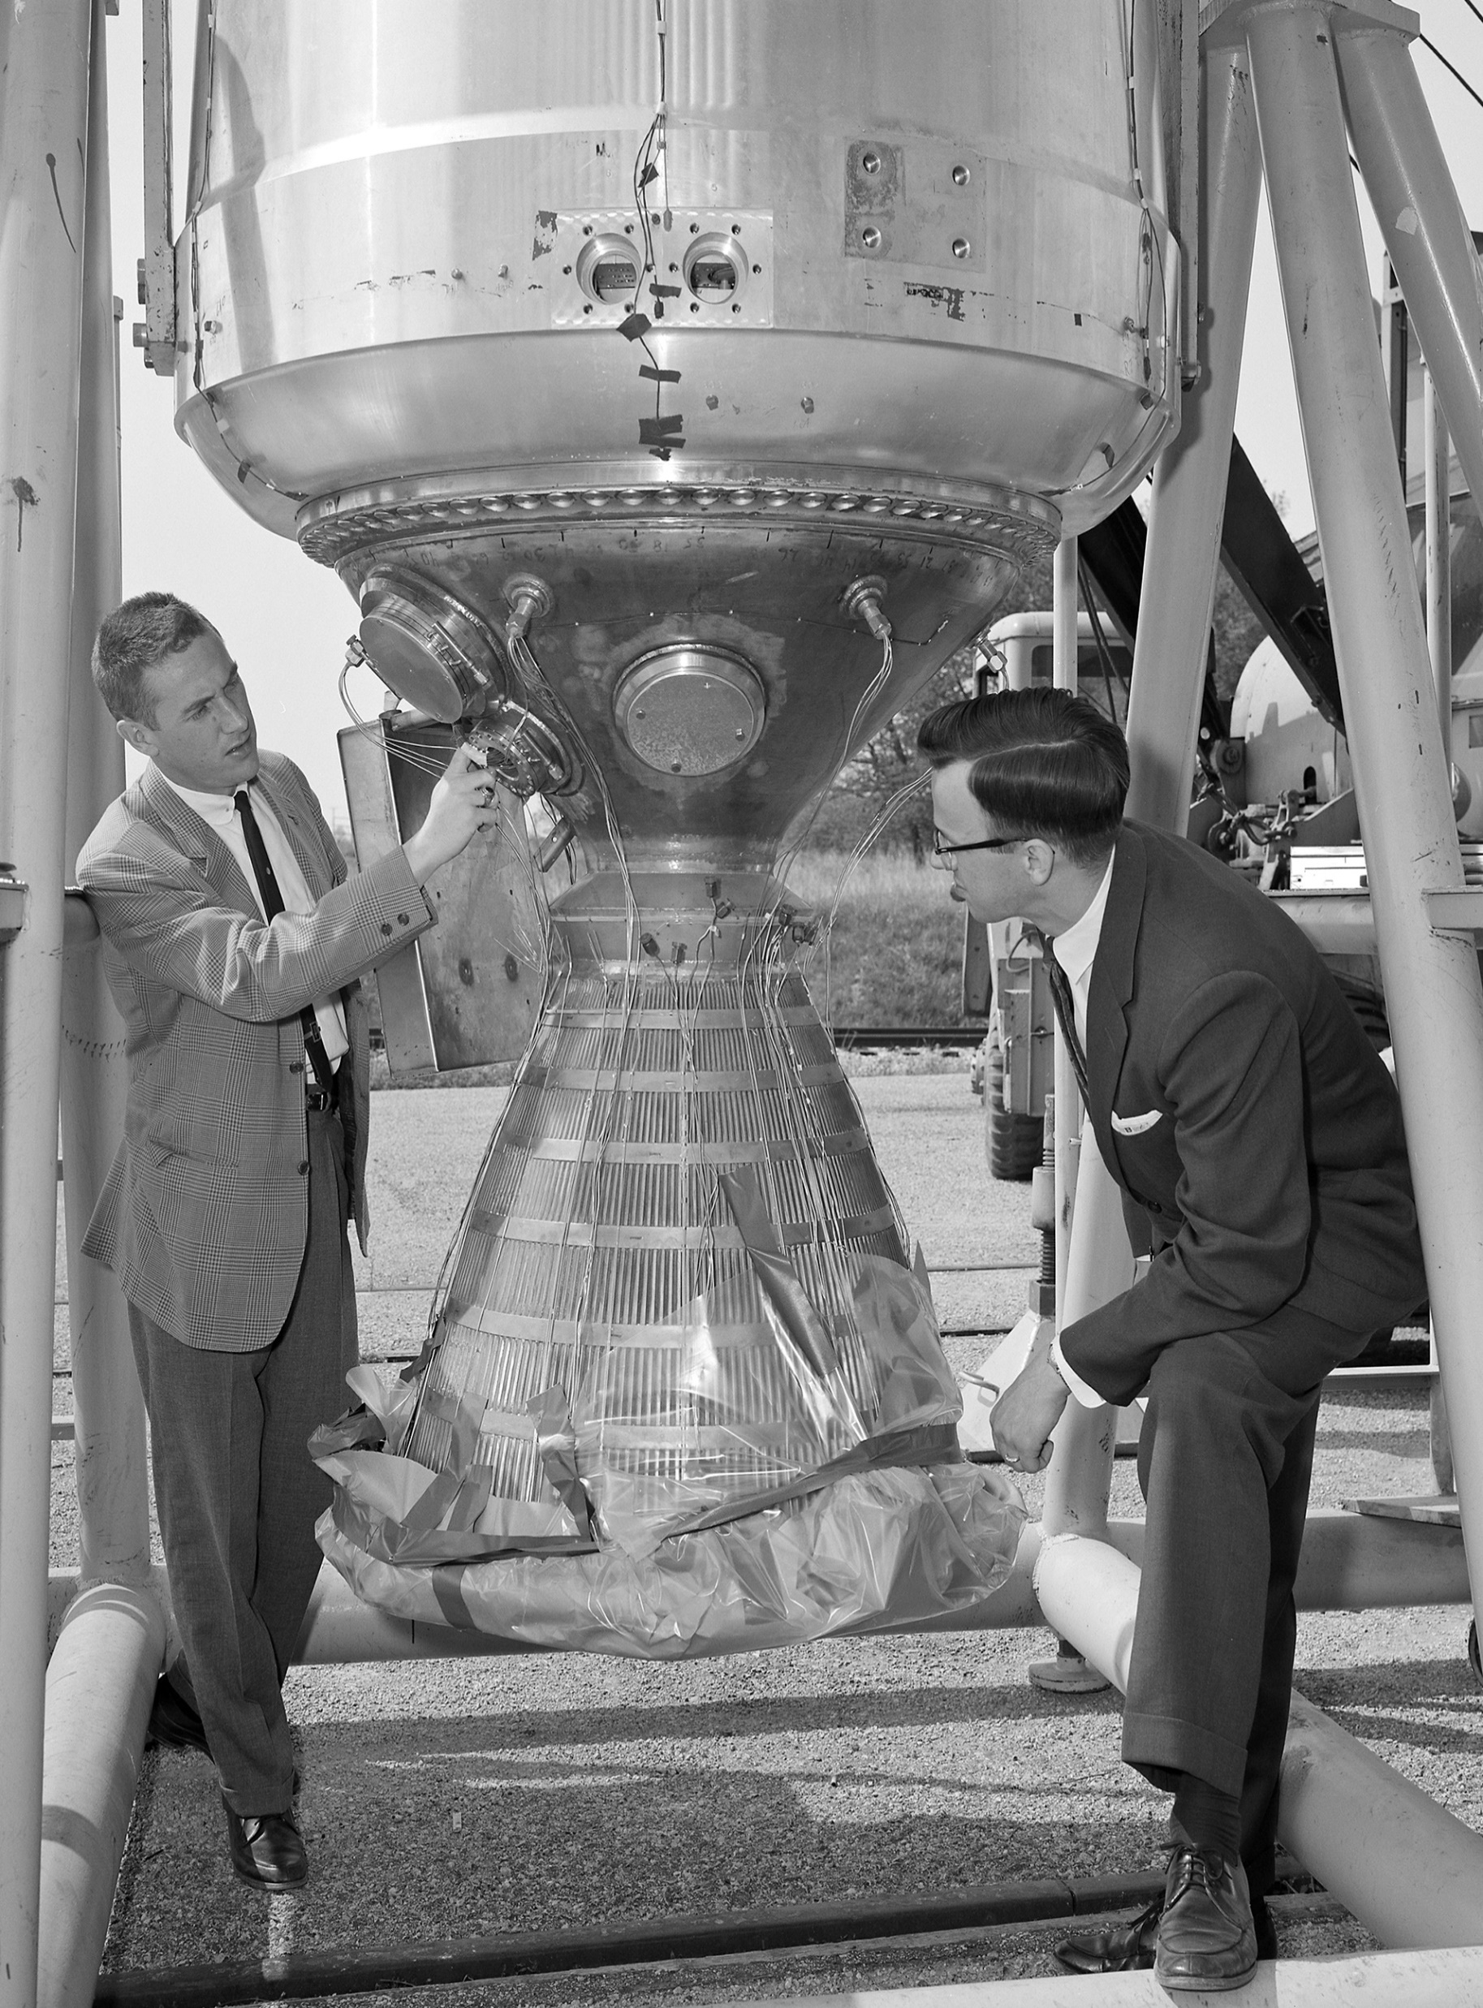
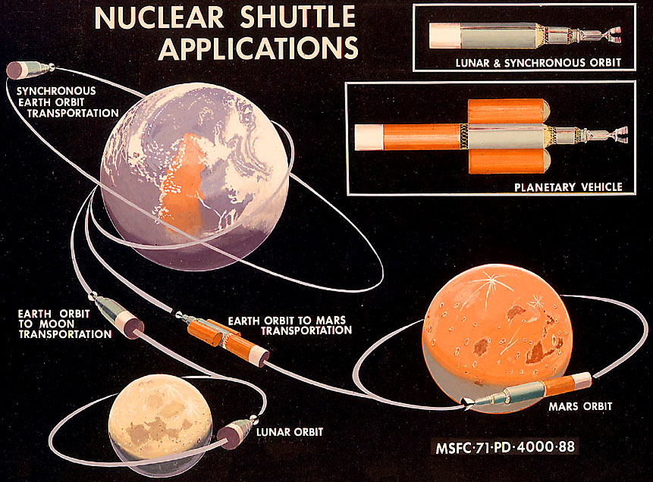
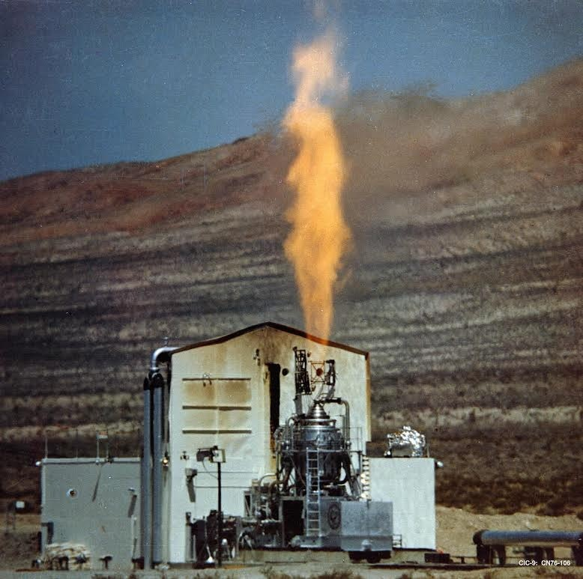
Past Nuclear Thermal Rocket Engine Programs
(Rover, Phoebus,RIFT, Kiwi, NERVA) 1957-1973
Modular
Nuclear Stages
For Moon and Mars
The Original
Model-Based
Systems Engineering!
In 1:48 scale!
NERVA
Open-Air
Testing at
Jackass Flats,
Nevada

Slide 5
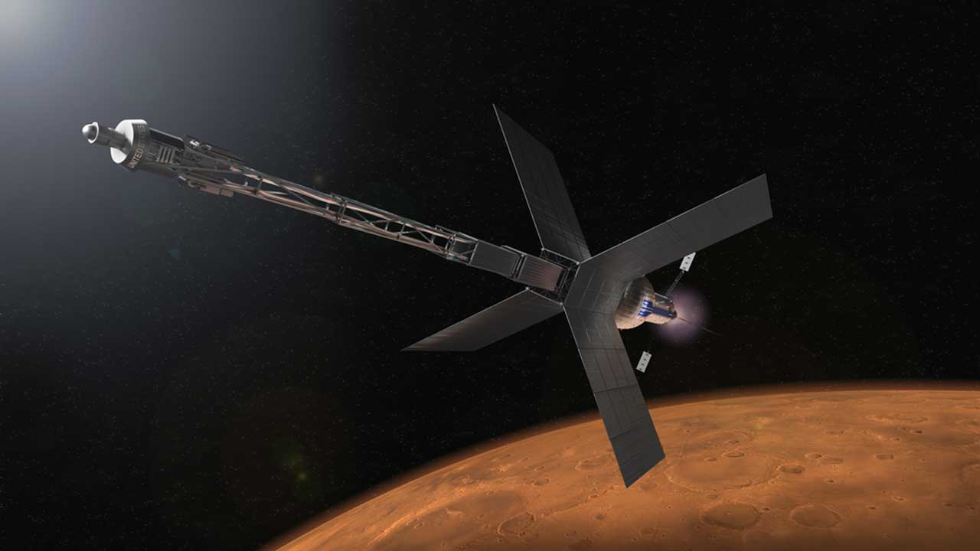
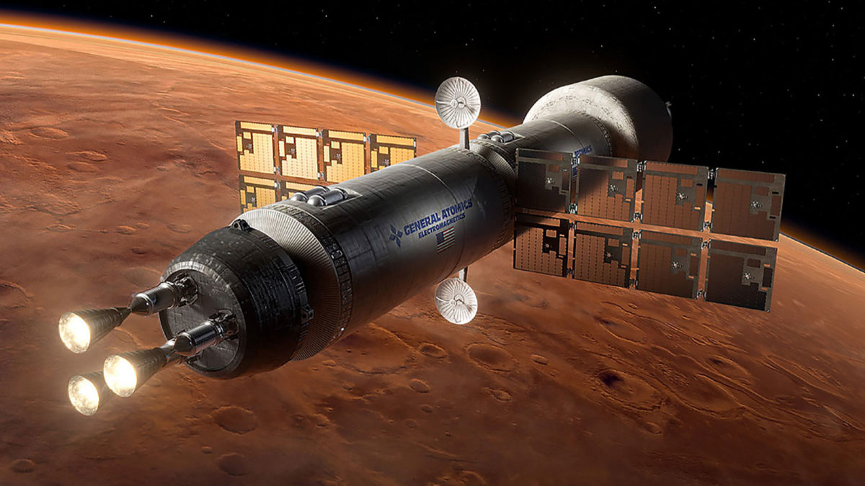
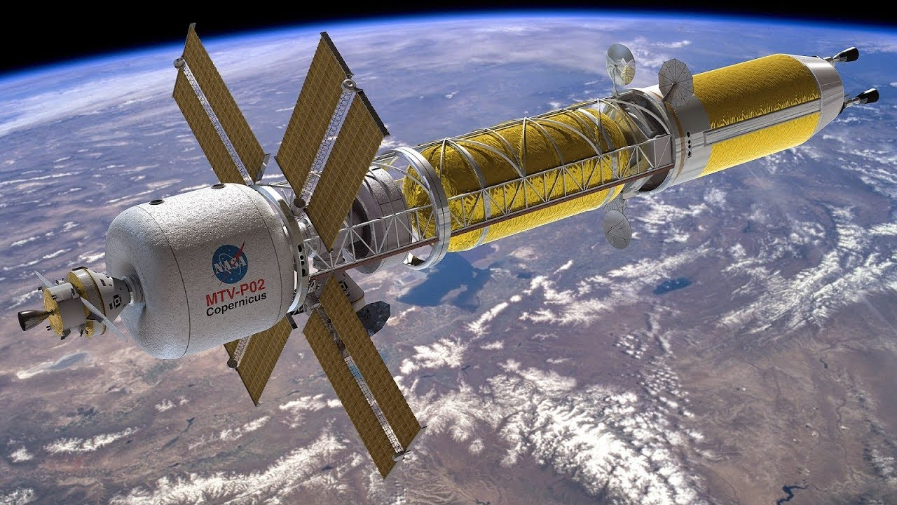
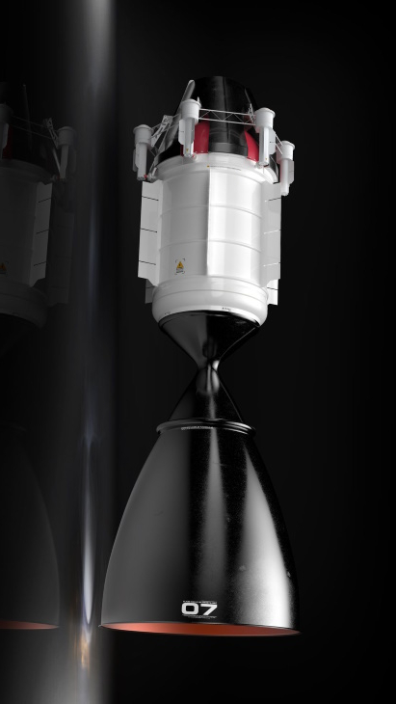
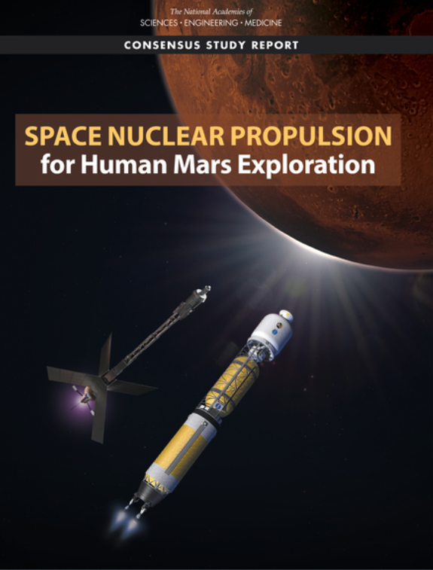
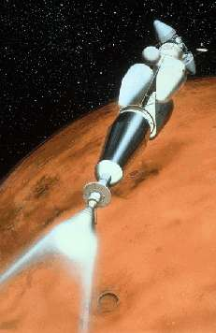
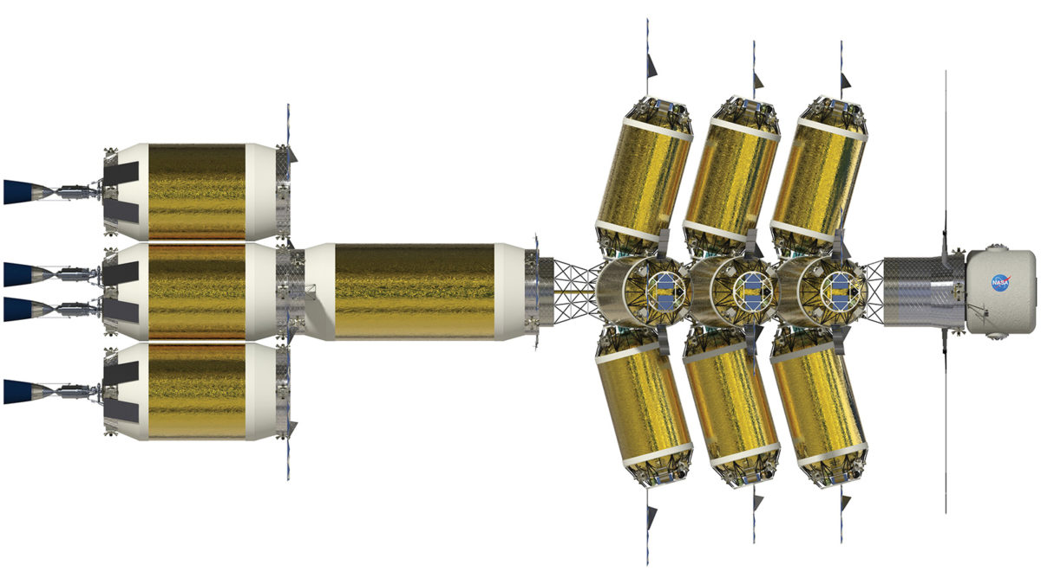
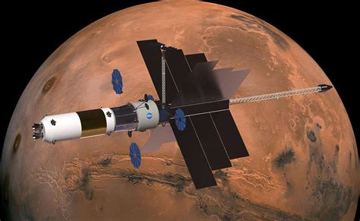
Future SNP Concepts
Mars Transportation
Architecture Study
2023

Slide 6
What are SNP and DRACO?
SNP – Space Nuclear Propulsion, a MSFC Project
  Nuclear Thermal Propulsion (NTP) – near term
    NTP relies on a nuclear fission reactor to heat a propellant and expel it out of a rocket nozzle, no chemical reaction required
  Nuclear Electric Propulsion (NEP) – mid term
    NEP uses a nuclear fission reactor and a power conversion system to generate a large amount of electricity, which is used to power an ion rocket engine
  Bimodal (combines NTP and NEP) – far term
    Bimodal uses a nuclear fission reactor that can operate in both NTP and NEP modes to provide high thrust, low thrust, and no thrust electrical power
DRACO – Demonstration Rocket for Agile Cislunar Operations, a joint NASA/DARPA protoflight project to build and flight test a Nuclear Thermal Rocket Engine (NTRE)
  Lockheed Martin is prime contractor, BWXT is the reactor contractor, several subcontractors
  Planned for launch in 2027

Slide 7
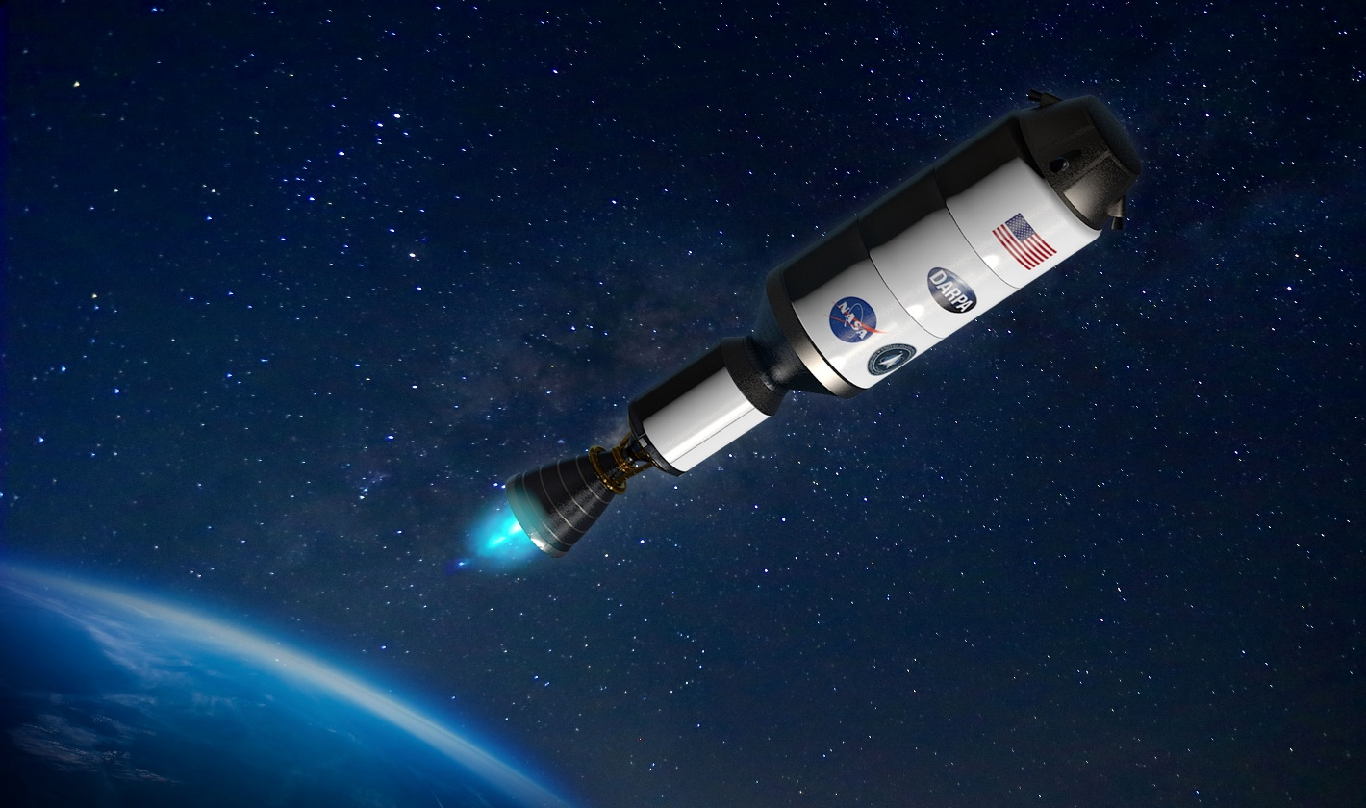



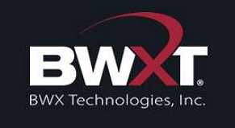
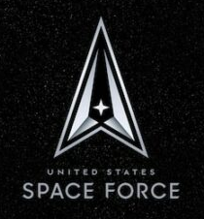

DRACO (Demonstration Rocket for Agile Cislunar Operations)
DARPA-NASA In-space Flight Demonstration of NTP
DRACO in-orbit flight demonstration of a nuclear thermal rocket engine (NTRE)
  Use a demo flight in lieu of an integrated system nuclear ground test
  Demonstrate controllable reactor power up and shutdown
  Collect data to validate models and advance design process
  Demonstrate safe operation and disposal
  Inform development of future operational system
  Provide significant cost and resource sharing between gov’t agencies and increase stakeholder support
  Provide an NTRE design and data that can be leveraged and further developed by NASA after the DRACO effort is concluded
  Be a pathfinder for developing the interagency regulatory bases for launching and operating a fission-based system – beneficial for NTP, NEP, and Fission Surface Power (FSP)
  Use High Assay Low Enriched Uranium (HALEU) – has multiple benefits for gov’t and industry including streamlined launch approval by Secretary of Defense
    DARPA is acquiring HALEU nuclear fuel from DOE/NNSA (National Nuclear Security Administration)
DARPA and NASA executed an Interagency Agreement which defines roles and responsibilities in a jointly managed effort
NASA has responsibility to fund and manage the design, development, and test of the NTRE
DARPA has responsibility to fund and manage design and development of the flight vehicle; all assembly, integration and testing of the integrated vehicle-engine system; launch of the demonstrator; in-space flight operations; and all nuclear launch safety and approval processes
U.S. Space Force (USSF) is responsible for launch vehicle and launch support
  Subsequently selected a United Launch Alliance (ULA) Vulcan Centaur launch vehicle for the mission
Prime contract awarded in spring 2023 with flight currently planned for 2027
  Lockheed Martin is Prime Contractor, BWXT is reactor subcontractor

Slide 8
Digital Engineering Overview
David Greeson

Slide 9
Tools Disclaimer
NASA does not endorse any company providing the Model Based Systems Engineering (MBSE) or Digital Engineering (DE) tools described in the following slides.

Slide 10
Digital Engineering Tasks and Tools
Currently planned tools architecture
Many analysis tasks are
reliant on MagicDraw

Slide 11
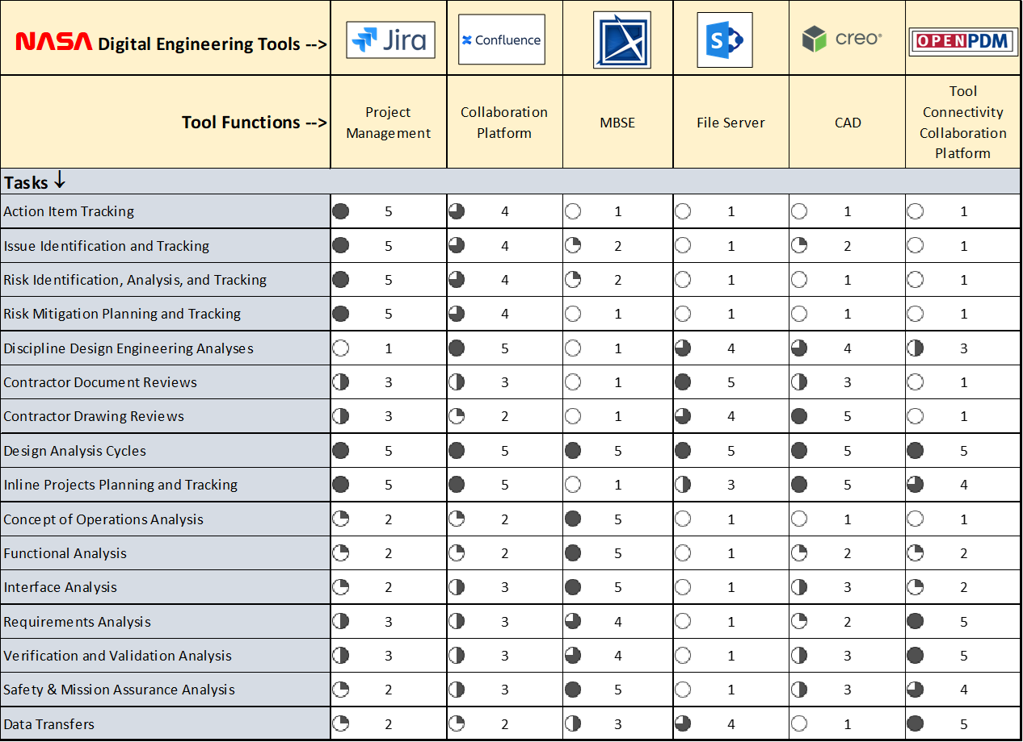
Key Digital Engineering Tools by Tasks

Slide 12




OpenPDM and VSI
CAN Partners
SNP is working with the NASA Office of the Chief Engineer (OCE),
Victory Solutions, Inc. (VSI), and PROSTEP on
a Cooperative Agreement Notice (CAN) to implement
the OpenPDM connectors necessary to realize an integrated
Tools architecture as shown on a previous slide. This is part of
NASA’s Digital Transformation initiative.
OpenPDM has been evaluated by the OCE and is made by
PROSTEP, a German company.
OpenPDM is an example of a “collaboration platform” that can be used to create data sharing links between different tools
and databases, to create a Digital Thread.
Development of the OpenPDM connectors is a custom process for each connector, dependent on the IT security environment,
exact tools to be connected, tool versions, data to be transferred, frequency of transfers, unidirectional vs. bidirectional, and
integrated workflow process, shown on the following slide.

Slide 13
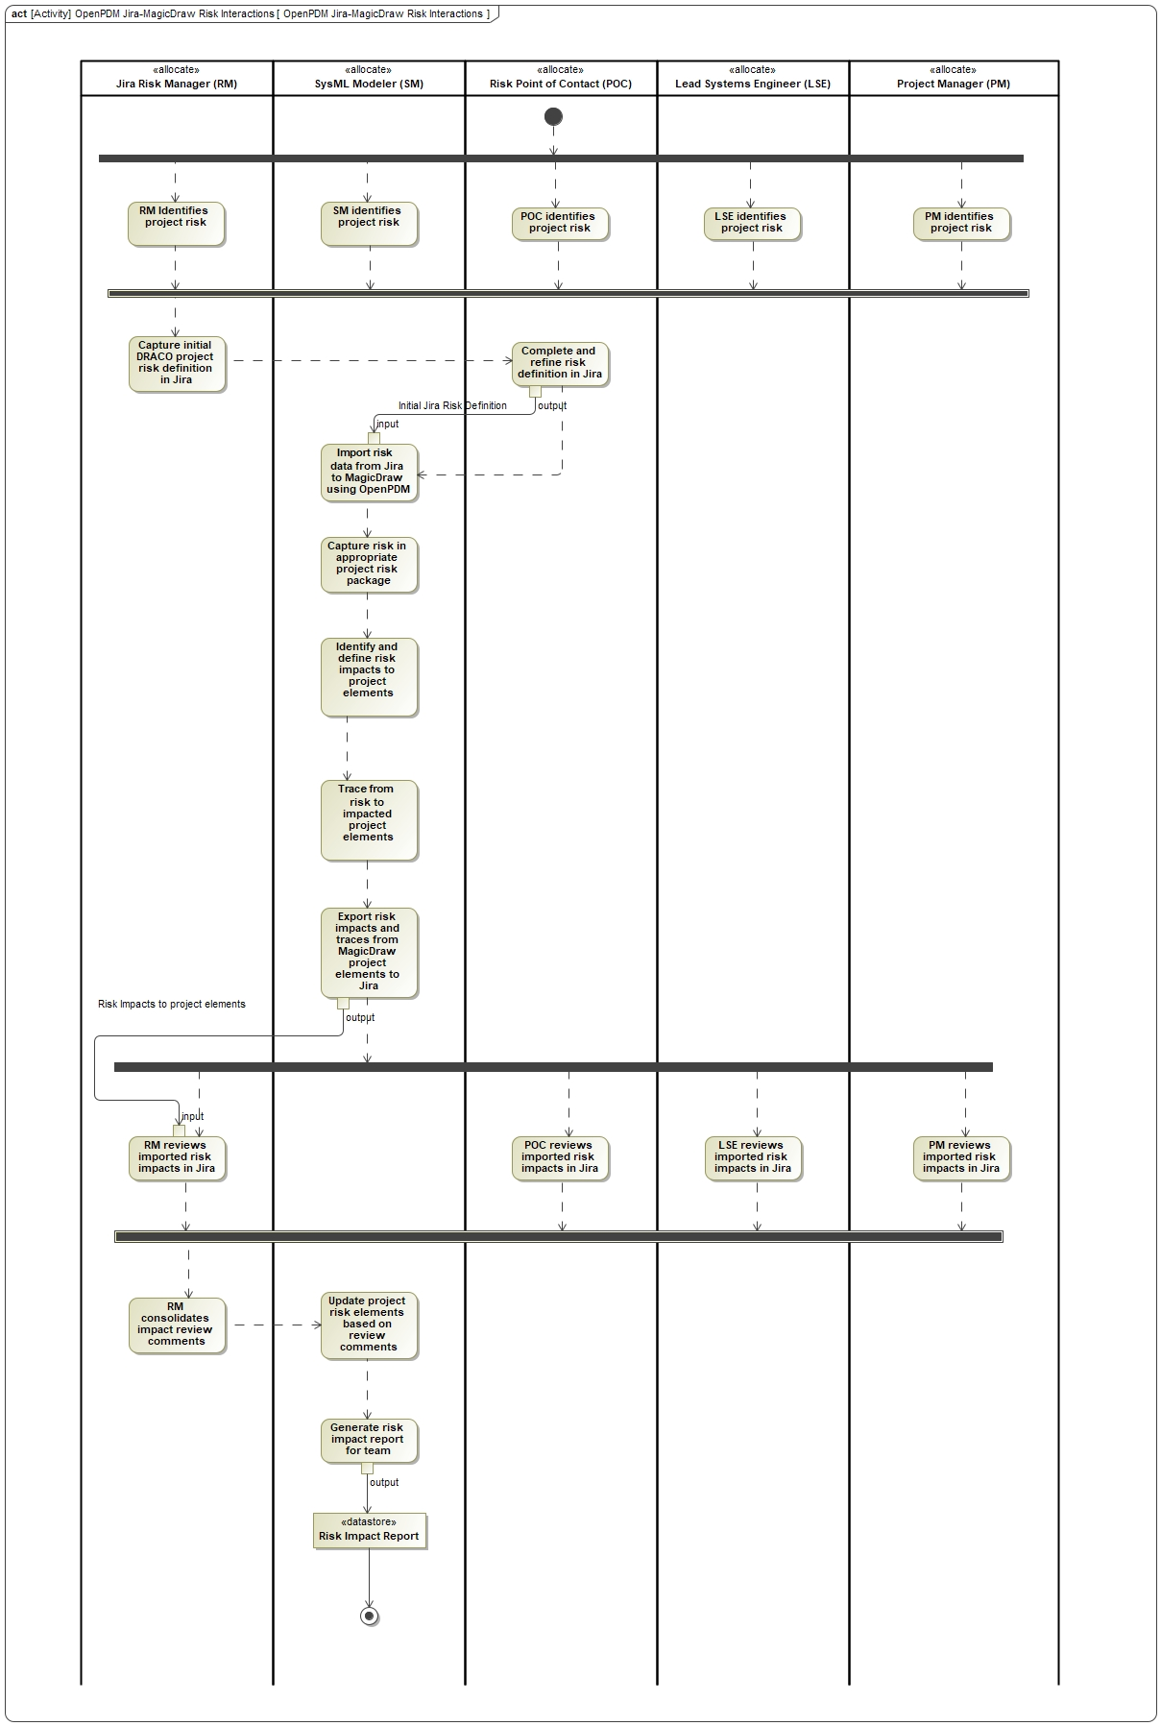
Risk Impact Analysis Workflow between
Jira and MagicDraw via OpenPDM
An integrated workflow process has been defined between Jira and MagicDraw for Risk Impact Analysis
Swimlanes for each actor in the process
  Jira Risk Manager
  System Modeler
  Risk Point of Contact (Subject Matter Expert)
  Lead Systems Engineer
  Project Manager
Concept is as follows:
Identify and capture initial risks in Jira
Transfer risks to MagicDraw with OpenPDM
Perform risk impact analysis in MagicDraw
System architecture, behaviors, requirements, verifications, lessons learned
Transfer risk impacts back to Jira with OpenPDM
Publish risk impact analysis report in MagicDraw
Store Word or PDF report on Confluence

Slide 14
Hub and Spoke MBSE ASoT Analogy
The MBSE ASoT Dilemma
The MBSE ASoT Solution

Slide 15
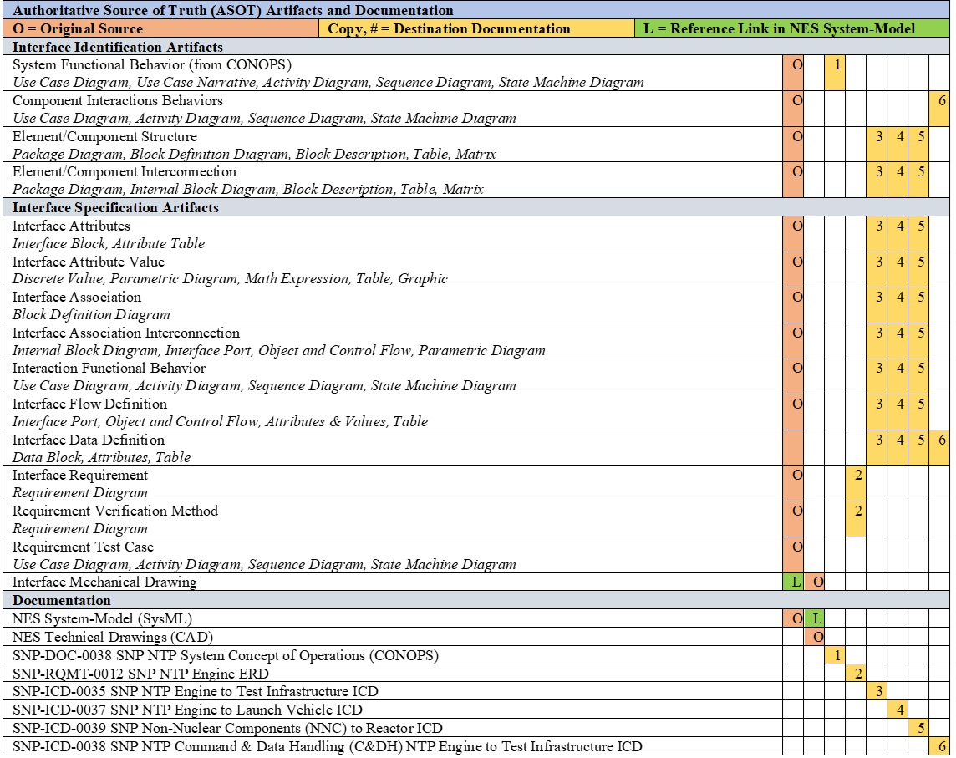
SNP Interface Control Management Plan (ICMP)
Authoritative Source of Truth (ASoT) Table
The intent of SNP Systems Engineering &
Integration is to use MagicDraw MBSE
Models as the Authoritative Source of Truth
(ASoT) for the technical baseline:
Concept of Operations
Functional Behavior
System Architecture
Interfaces
  Physical
  Logical
Requirements
Verification
Other tools, such as CAD models, Jira,
Confluence, and physics-based simulation
Models complete the Digital Twin and Digital
Thread.

Slide 16
Jira and Confluence
Digital Engineering
Diana Gorokhovskaya

Slide 17
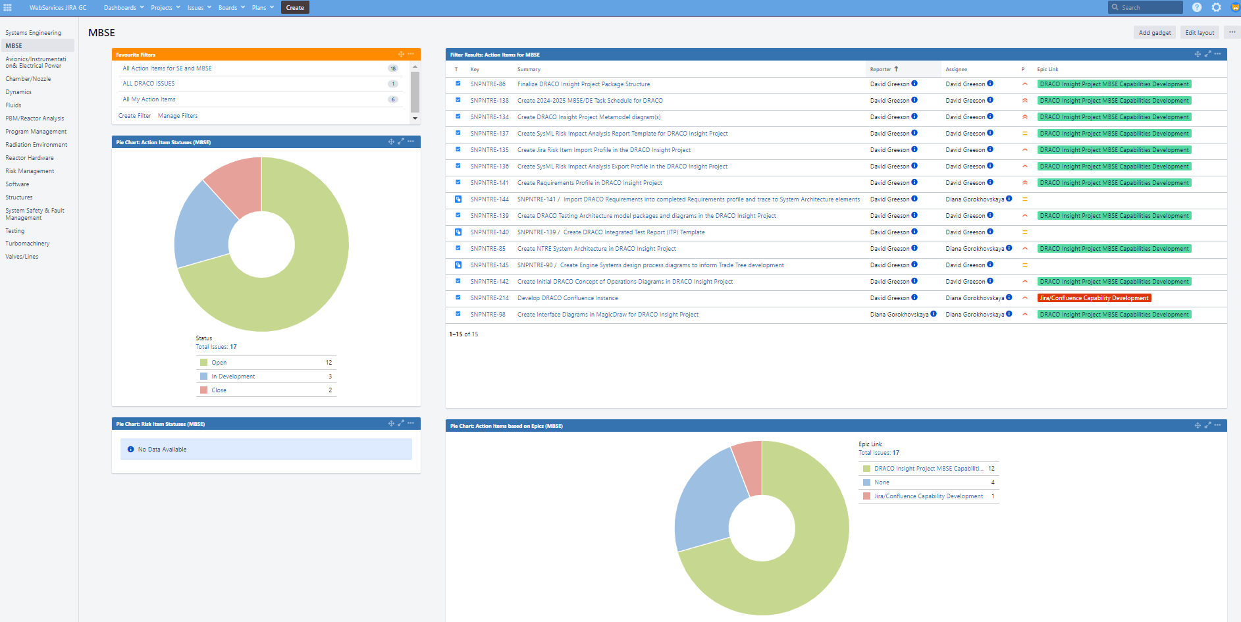
Jira Dashboard Screenshot

Slide 18
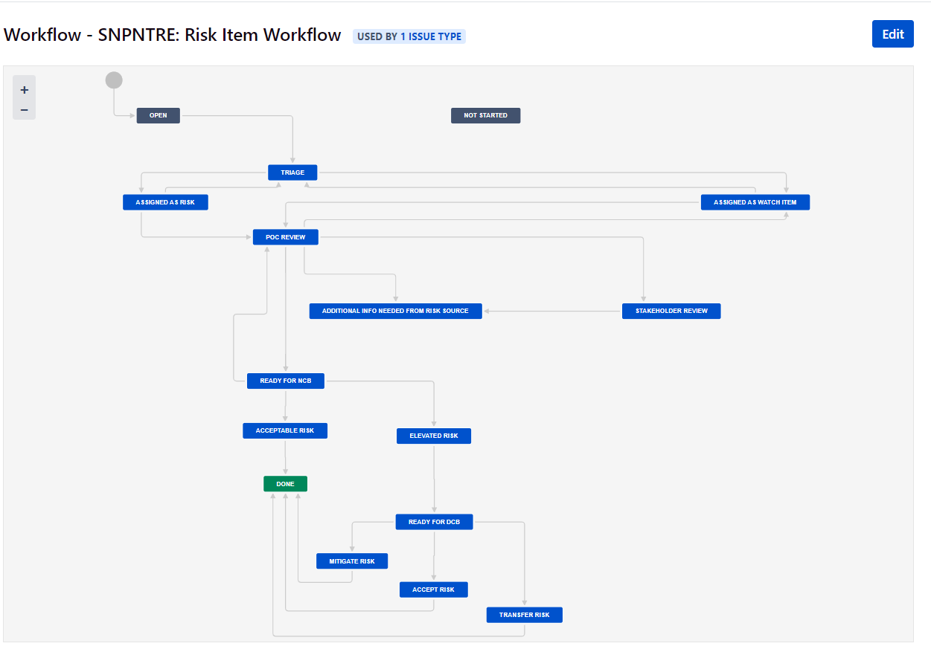
Jira Risk Management Workflow

Slide 19
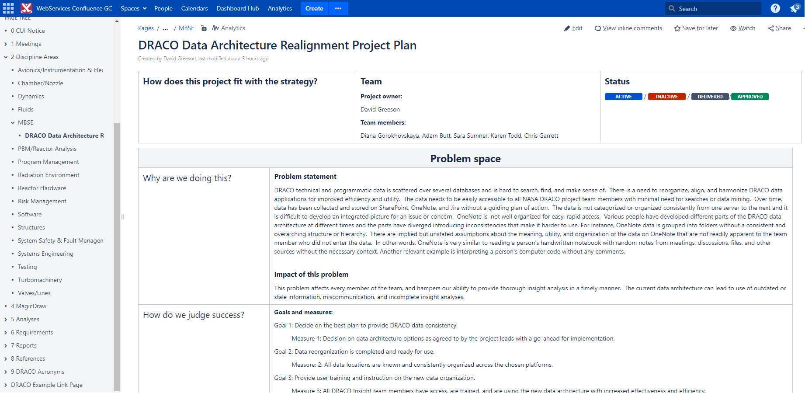
Confluence Screenshot

Slide 20
MBSE Models Overview
Diana Gorokhovskaya

Slide 21
SNP MBSE Models
Stakeholder Engagement Model
  Captures and defines complex relationships and interdependencies
    Mission and developer stakeholders, missions, technologies
    Intent is to facilitate mission capture and cross program efficiencies
NTP Instrumentation & Control (I&C) Goal Function Tree (GFT) Model
  Uses FRIGATE plugin
    Performs fault detection sensor coverage analysis
    Based on Aerojet Rocketdyne (AR) Testing Reference Design (TRD) NTRE
    Future iterations may include fault recovery planning
Technology Maturation Plan (TMP) Models (planned, at end of presentation)
  Planned to create the roadmap for successive generations of NTP technologies
    Gen 0 (DRACO), Gen 1, 2, 3, 4

Slide 22
DRACO MBSE Models
DRACO Insight Project Model
  Captures and defines DRACO system architecture, interfaces, behaviors, requirements, risks, lessons learned, system safety, and fault management
    Primary tool for DRACO insight, designed for reuse on other projects
    MagicDraw Plugins: SysML, Data Marking and Classification, System Safety & Reliability, FRIGATE
DRACO Trade Tree Model
  Used to analyze system architecture trade options, generalized for any NTRE
  Extensible to chemical rocket engines, useful for training and trade studies
Government Reference Design (GRD) Model
  Used to understand the likely Concept of Operations of DRACO and other NTREs
  Designed to be reusable for future NTRE efforts

Slide 23
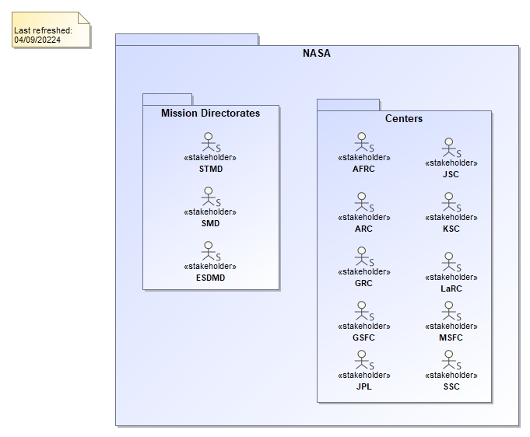
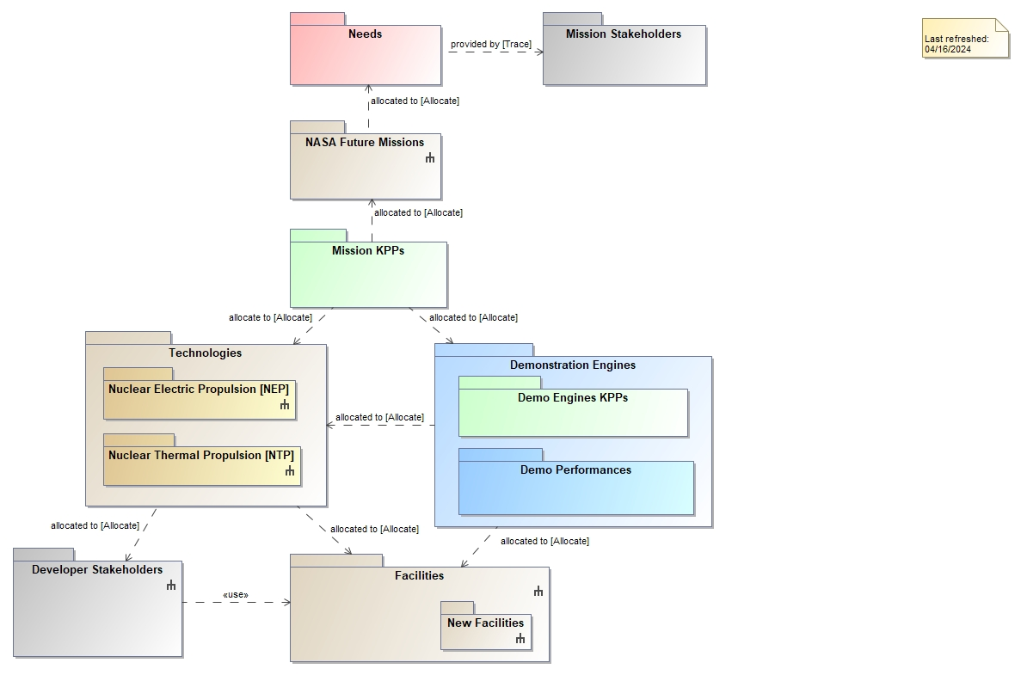
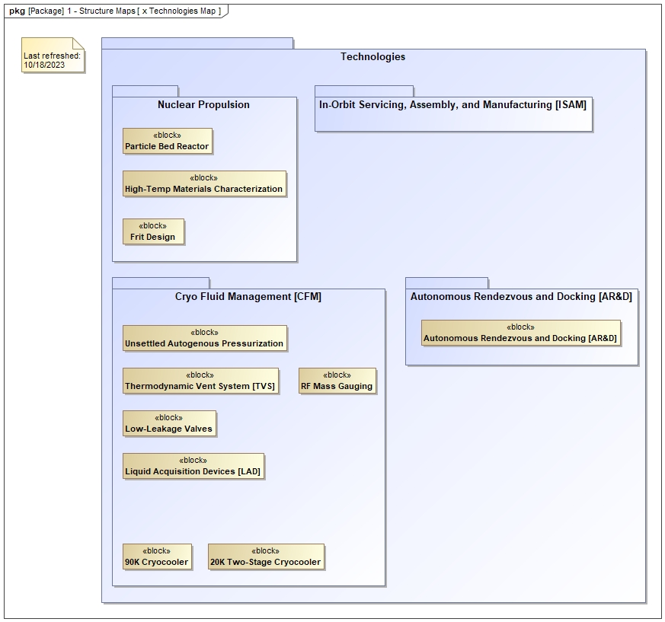
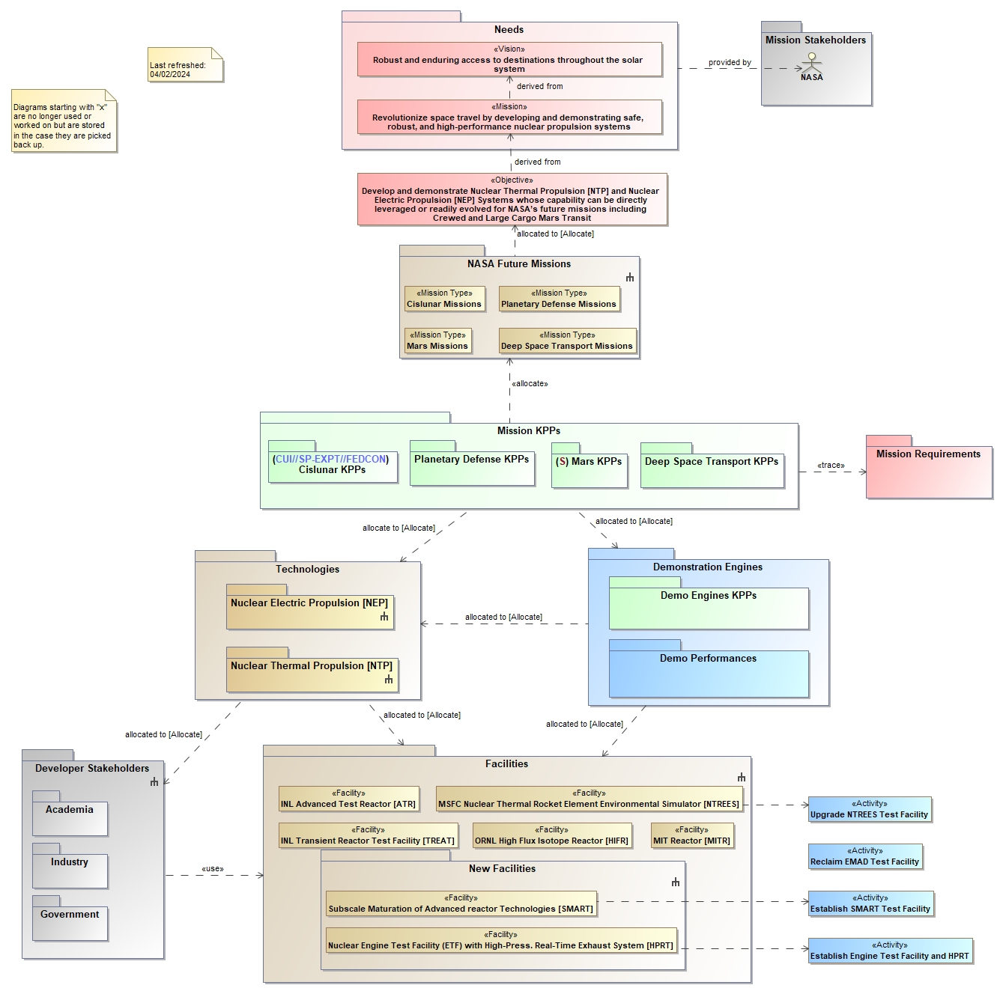
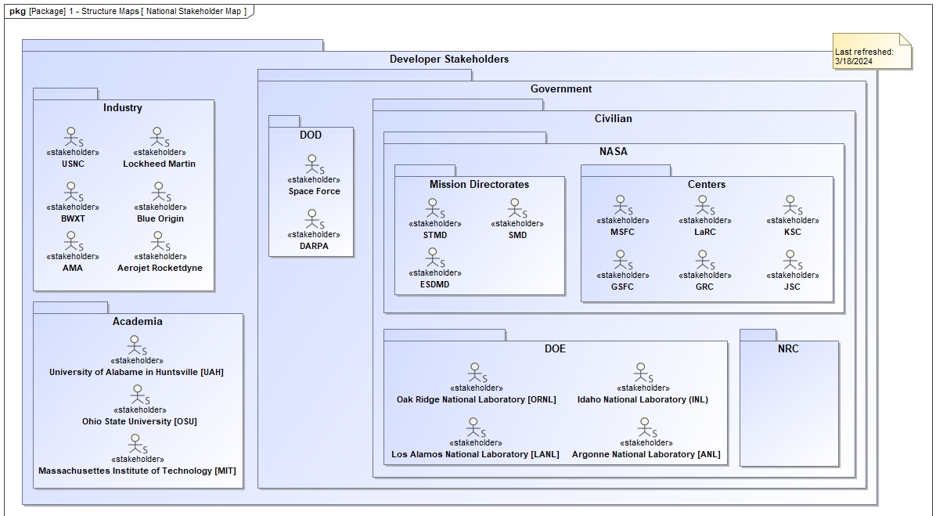
SNP Stakeholder Engagement Model
Purpose(s)
Define the relationships between internal NASA and external SNP stakeholders
Identify target projects and programs that can use SNP technology as an enabler or as an enhancement
  Exploration Systems Mission Directorate (ESMD)
  Science Mission Directorate (SMD)
Identify necessary technologies to support each project customer
Define program strategy to support multiple customers on different development timelines
SNP High Level Overview
NASA Stakeholder Map
Technologies Map
SNP Strategy Overview
National Stakeholder Map

Slide 24
DRACO Insight Project Model
Diana Gorokhovskaya

Slide 25
DRACO Insight Project Model Goals (1)
Develop a holistic model that accounts for all the major elements and activities (ground and flight)
  Identify necessary missing information that the contractor has not provided
Focus on the Nuclear Thermal Rocket Engine (NTRE)
  Only model other elements as needed to analyze interfaces to the NTRE
    Black box rather than white box
  Emphasize NTRE ground development and verification activities up to the handover for launch and flight operations
    Model NTRE flight operations as needed to:
      Define necessary ground verification activities
      Understand the planned NTRE flight testing and identify any discrepancies
  Avoid modeling too much detail, subsystems should be sufficient in most cases
Produce documentation from the model for general review and distribution
  Mark with appropriate CUI markings

Slide 26
DRACO Insight Project Model Goals (2)
Analyze available contractor functions, requirements, interfaces, designs, and verifications
  Define an Integrated Test Plan to use in assessment of contractor plans (Assembly, Test, and Launch Operations [ATLO])
  Model and assess the NTRE Instrumentation & Control
  Capture, identify, and define Architecture, Functional Behavior, Requirements, Risks, and Lessons Learned
    Map, trace, allocate, and link to model elements as needed
Defer value-added modeling efforts as needed
  Defer System Safety & Fault Management analysis models until after Preliminary Design Review (PDR)
    Use the MagicDraw Safety & Reliability Analyzer plugin to perform PHA, FMEA, FTA, as needed
  Defer Goal Function Tree (GFT) modeling until above elements are sufficiently defined
    Instrumentation sensor coverage analysis
    Test campaign analysis

Slide 27
DRACO Forward Plans
We have a good forward plan for the DRACO MBSE effort
  The plan covers the major concerns of the DRACO systems engineering and integration team
The planned DRACO Insight Project model will contain information directly relevant to future SNP developments
  SysML structural, behavioral, and requirements elements of the model will be extensible and reusable for future SNP NTRE and NEP projects
  Risks and Lessons Learned will be identified and linked to SysML elements for traceability
  Documentation artifacts will be generated from the model for review, insight, and future reference

Slide 28
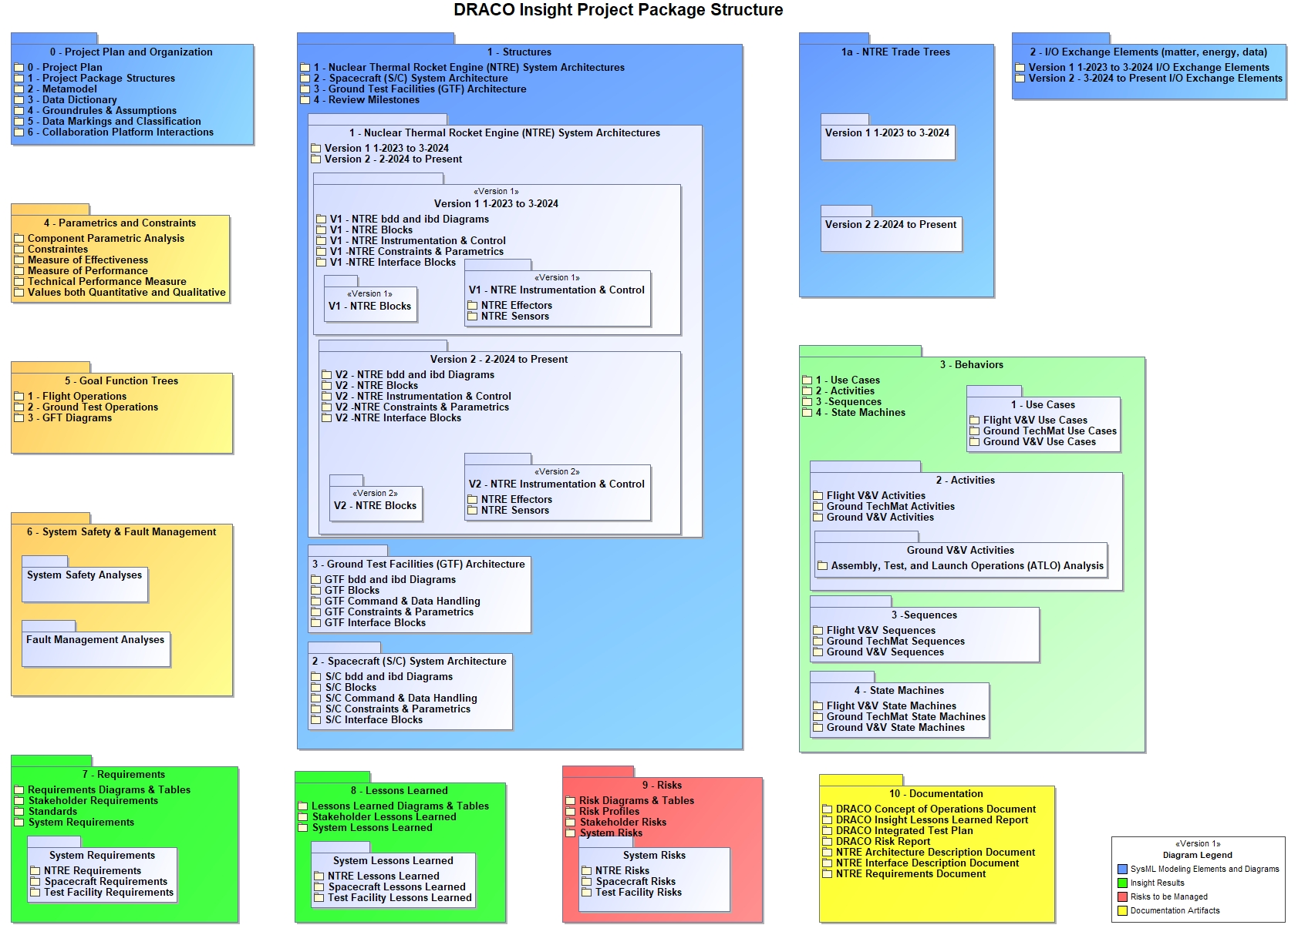
DRACO Insight Project Model

Slide 29
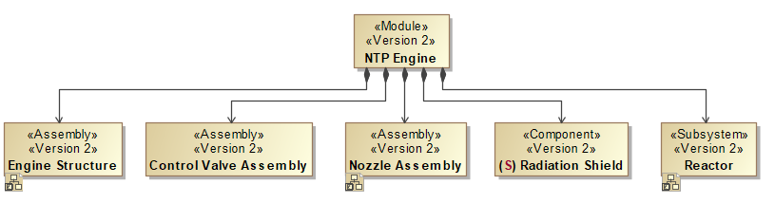
Example NTRE Structure Diagram

Slide 30
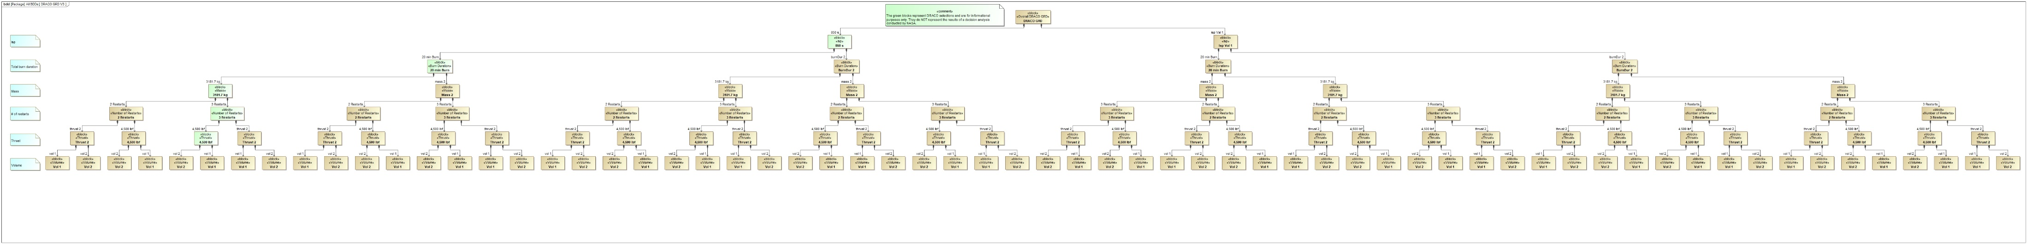
Trade Tree Model
Purpose(s)
Find the NTRE subsystem technology alternatives and major trades
Define DRACO selections and use as an insight evaluation tool
Serve as a reference for later NTRE designs
Serves as a training tool for Diana G. to NTRE, DRACO, and MBSE
The trade tree is also useful for chemical rocket engine trade options analysis

Slide 31
SNP Testing Reference Design (TRD)
Instrumentation & Control (I&C)
Goal Function Tree (GFT)
Diana Gorokhovskaya

Slide 32
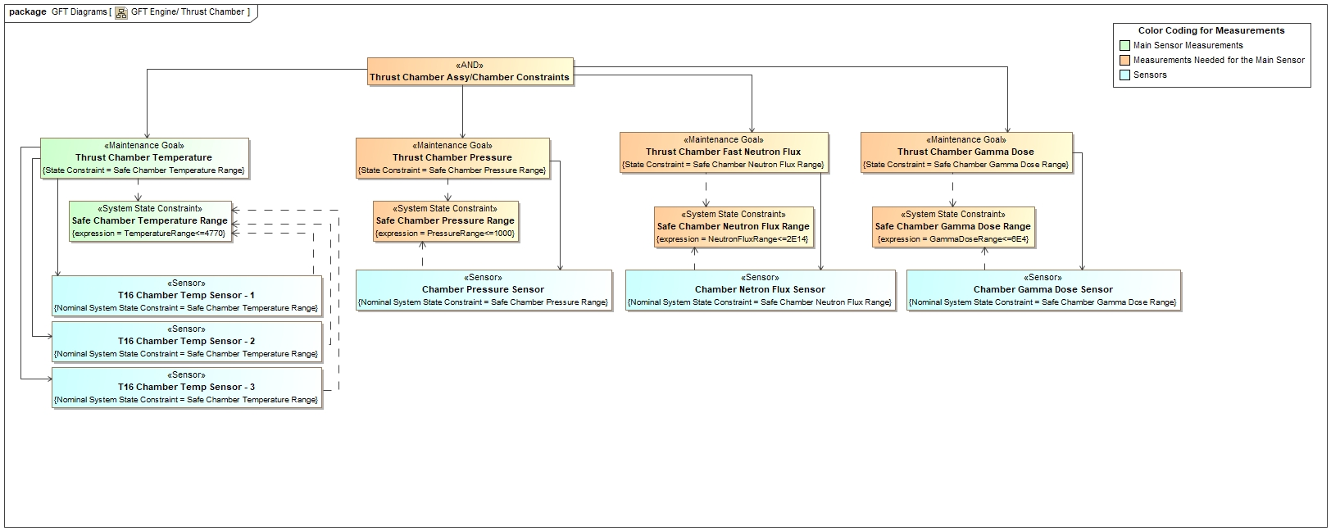
Nuclear Thermal Propulsion (NTP) Instrumentation & Control (I&C) Goal Function Tree (GFT) Model

Slide 33
Failure Recovery Instruction Generation using Automata derived from Traditional Engineering
Models (FRIGATE)
Goal Function Tree (GFT) Plugin
David Greeson

Slide 34
Goal Function Tree (GFT) Basic Concept
Purpose
To provide a method to determine the necessary conditions for success
  Goals based on mission and program objectives: Achievement, Maintenance, and Prevention Goals
  Functions define what conditions must be detected to protect accomplishment of Goals
    Qualitative system state constraints are defined for each function
  Hierarchical Tree structure to organize and prioritize the Goals and Functions
Control
Trajectory
The GFT describes the goals that a system must achieve to meet mission and safety objectives and the functions that must be performed in order to achieve those goals.
GFT is a top-down functional decomposition of system functions, arranged by major system phase and configuration, which defines what functions the system must perform successfully. The GFT supports the standard functional decomposition analysis of the system.
The GFT representation is not merely a functional decomposition, however, because it inherently integrates goals and functions together in a rigorous manner through the use of state variables.
The state variable-based approach connects Fault Management (FM) to the design, by identifying the range in which state variables must be controlled to achieve goals, and conversely, the failures that exist if system behavior goes out of that range.
This in turn allows for the systems engineers and FM engineers to determine which state variables to monitor to determine if a goal is not being achieved.
X, V
X Err
V Errv
Control Error
Between
Desired & Measured Pos/Vel
Abort:
Trajectory Error Exceeded
Des X
Des V
Meas X
Meas V
provide desired
Pos/Vel
Measure actual Pos/Vel
Abort = New Goal, with new functions leading to new GFT
Abort

Slide 35
GFT Origin and History
Origin
Invented by Stephen B. Johnson, PhD for use on the Space Launch System (SLS) program
  GFT analyzes “success space” rather than “fault space”
  Fewer cases to identify for success than failure
  Reduces analysis overhead and increases confidence that the correct solution is obtained
Any important failure must compromise a required nominal function and/or goal
  GFT does not rely on identification of every possible failure, only on success conditions
    Impossible to exhaustively identify all possible failures, GFT provides increased confidence analysis is comprehensive
History
Successfully used to analyze fault detection sensor coverage for SLS Core Stage, Interim Cryogenic Propulsion Stage (ICPS), and Exploration Upper Stage (EUS)
  Used to define necessary and sufficient set of Abort Triggers (sensors + algorithms)
  Minimum set of triggers is desirable to prevent False Positive initiation of an unnecessary abort
Prior art used Enterprise Architect and MagicDraw Systems Modeling Language (SysML v1) representations
  Tools were not well-suited to GFT analysis, kludge solution
  Custom SysML profiles, inconsistent implementation
  Manual inspection process to evaluate validity of the GFT
  Labor intensive, requires highly knowledgeable evaluator, potential for error

Slide 36
FRIGATE Summary
Development
Developed by Galois, Inc. (formerly Adventium Labs)
  Tyler Smith, Principal Investigator
  Ryan Peroutka, Research Engineer
  Adam Karvonen, Research Engineer
Small Business Innovation Research (SBIR) contract with NASA, started in 2020
  Now in Phase 2
Features
FRIGATE is a plugin (extension) for MagicDraw that implements a new GFT profile type in SysML
  Adds sophisticated Formal Logic mathematics to evaluate GFT logic
    Realizability is checked
    Validity of Goals and System State Constraints are checked and errors are flagged for correction
  New Sensor Coverage Analysis feature
    Evaluates if deviations from goals can be detected with a given set of sensors
    Space Nuclear Thermal Rocket Engine propulsion sensors can be modeled
      Pressure, temperature, position, angle, speed, flow, radiation, etc…
  FRIGATE uses automated reasoning to discover failure recovery plans
    Long term, evaluate alternative ground-based or vehicle-based support to redefine mission modes and goals
  Interface with external physics-based system models
    MATLAB/Simscape currently implemented
    Others are possible (Modelica, Simcenter, etc..)
Availability
FRIGATE is available to government and commercial users (see backup slides)

Slide 37
Government Reference Design (GRD)
Work Performed in 2023
A generic NTRE concept, for use as a reference when analyzing contractor
Designs and specifications
David Greeson

Slide 38
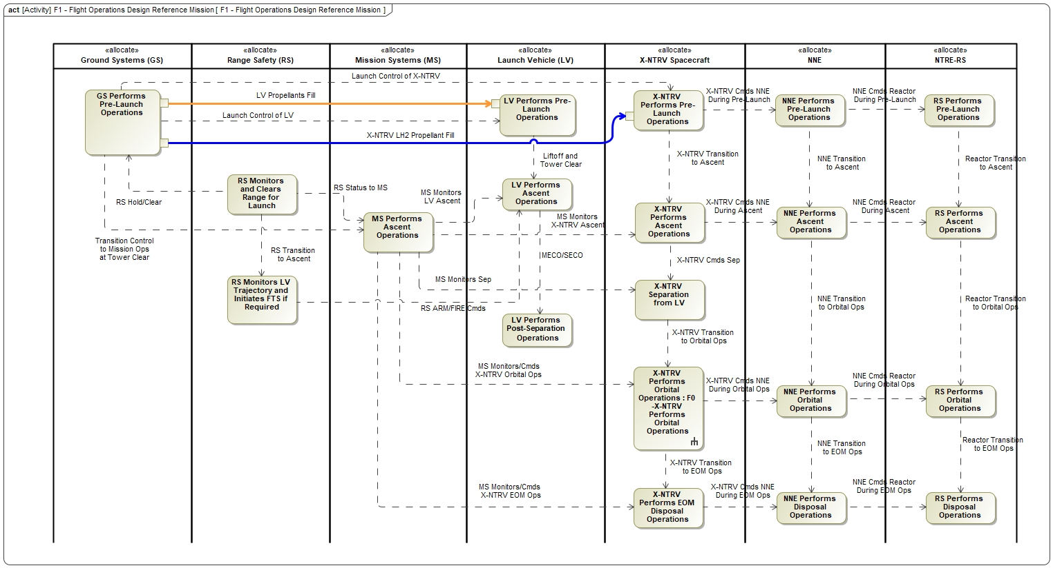
Design Reference Mission (DRM) Activity Diagram

Slide 39
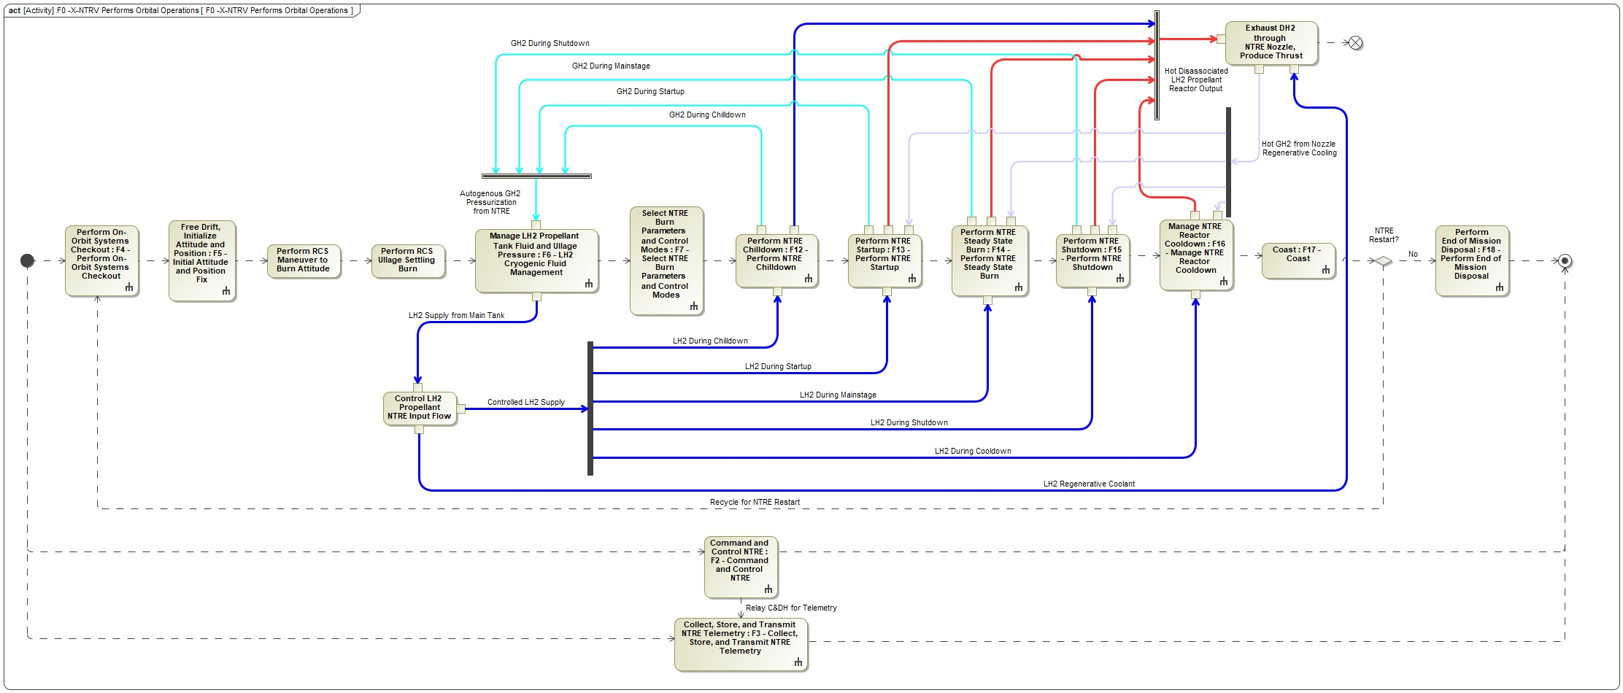
NTRE Orbital Operations Activity Diagram

Slide 40
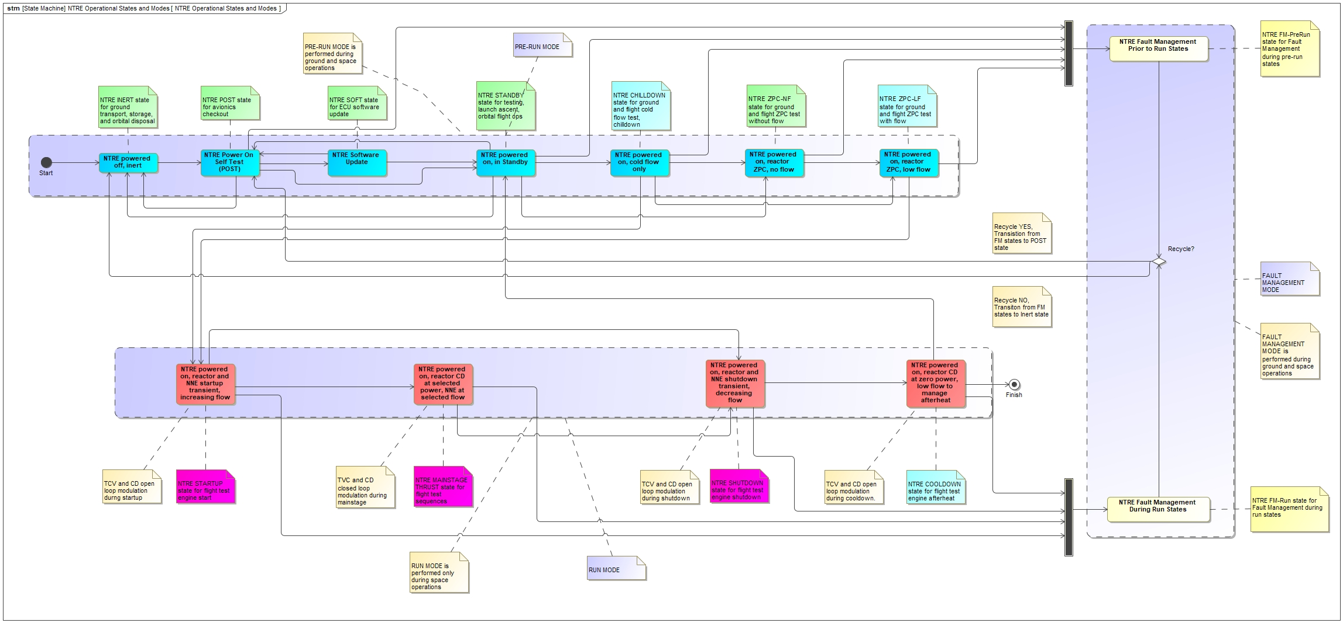
NTRE States and Modes SMD

Slide 41
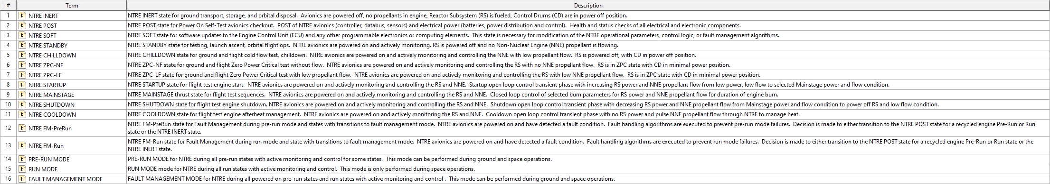
NTRE States and Modes Glossary Table Diagram

Slide 42
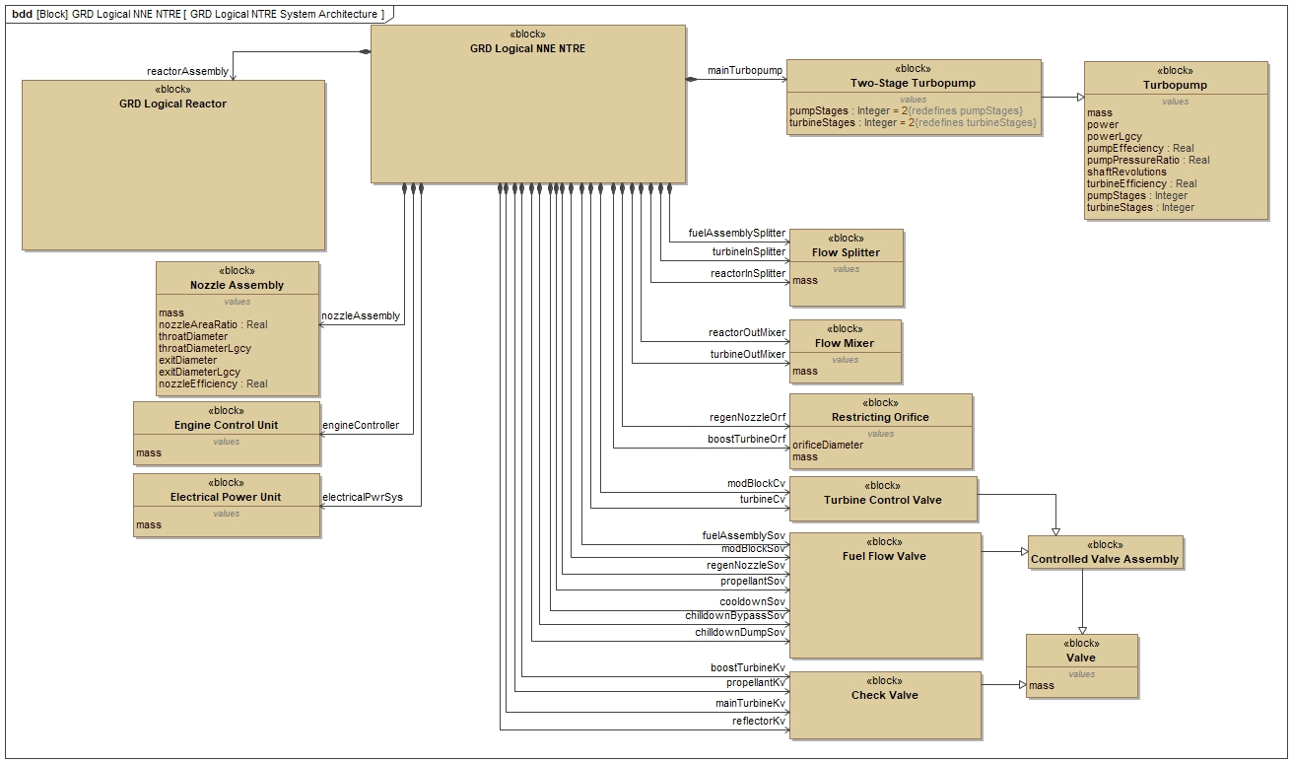
NTRE System Architecture BDD

Slide 43
SNP Technology Maturation Plans (TMP)
Nuclear Thermal Propulsion (NTP)
Nuclear Electric Propulsion (NEP)
Future Work
David Greeson

Slide 44
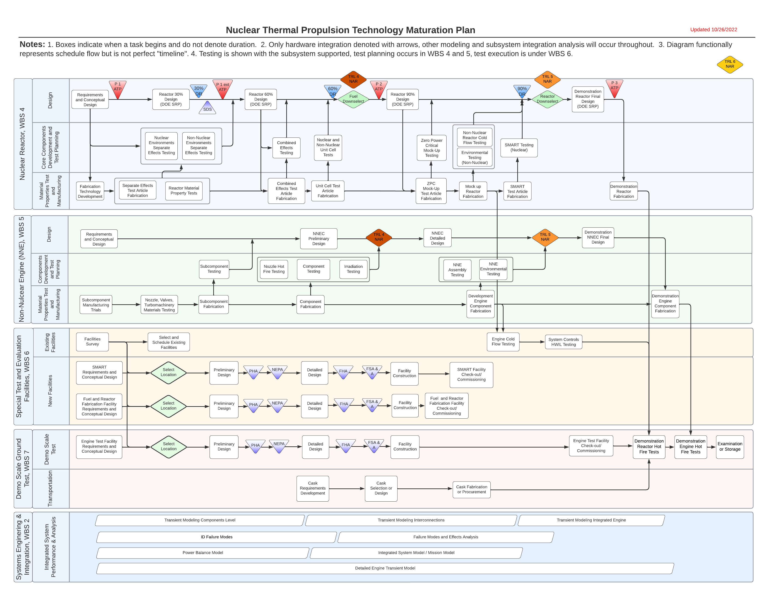
NTP and NEP Technology Maturation Plan Models
(Future Work)
Purpose(s)
Define the relationships between predictive simulation models and hardware tests (ground and space)
Identify necessary simulation models and sequence of needs
Identify feed forward predictions and feed backward anchoring data
Identify gaps in knowledge that need to be filled
  Simulation models
  Materials tests
  Component bench tests
  Subsystem integrated tests
  Flight test
Define interactions and dependencies
  System architecture interfaces
  Process interfaces
  Organization interfaces
  Multi-domain analysis

Slide 45
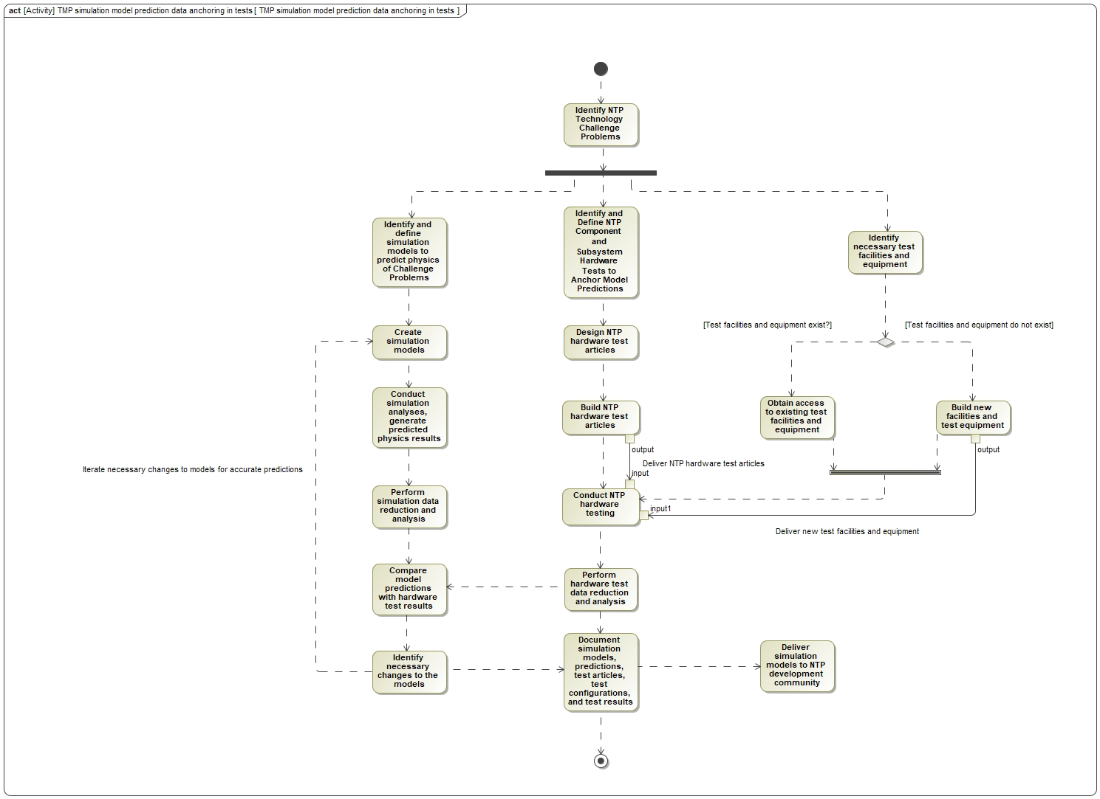
NTP TMP Activity Diagram

Slide 46
MBSE/DE Mentoring,
Training,
Process Development,
and Agency MBSE Community
David Greeson

Slide 47


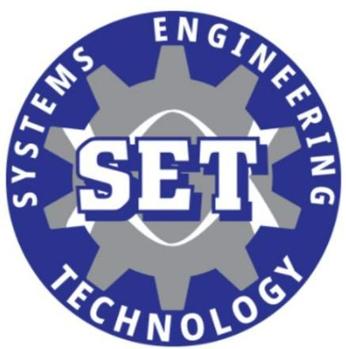
SNP MBSE Mentoring & Training
Mentoring
David Greeson, mentor (career spanning 41 years)
Diana Gorokhovskaya, mentee, (in the 1st year of her career)
  Greeson has mentored other young engineers on SNP and elsewhere within Marshall Space Flight Center
    SNP Stakeholder Engagement Model developers
  Recently signed up for the NASA FIRST agency-wide mentoring program
  Working to pass along knowledge, experience, lessons learned, tools, and techniques
Goal is to increase the NASA labor pool of skilled MBSE practitioners for future projects
  MBSE is a growing discipline within NASA, but there are still fewer people than we need
Training
NASA has had several in-house MBSE training classes in the past several years
  NASA SATERN and NESC Training Curriculum includes some MBSE classes, offered periodically
  Contracted classes with Subject Matter Experts (SMEs) (Casey Medina [Studio SE], Loyd Baker [UAH])
  In-house SMEs (Greeson, others) teaching tutorials to small groups for Just In Time, specialized topics
    Functional Analysis techniques and MBSE applications for specific projects
External training classes
  Huntsville INCOSE MBSE Working Group training
  University of Alabama at Huntsville (UAH) MBSE training
  VSI MBSE Systems Engineering Technology (SET) training at Calhoun Community College

Slide 48


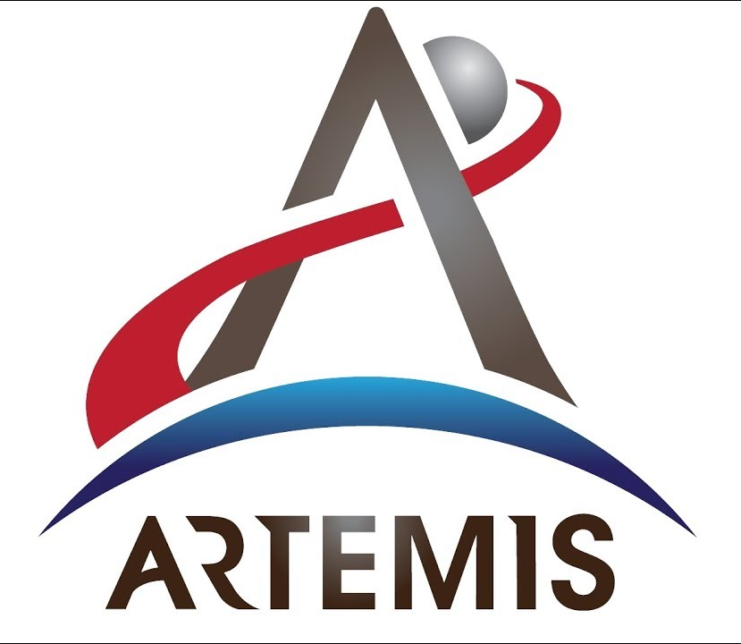
NASA MBSE Process Development and Agency Community
Process Development
NASA-HDBK-1009, NASA Systems Modeling Handbook
Greeson participating in the team to revise and update the handbook and Companion Model
  Handbook defines a standardized systems modeling process for NASA programs, model provides templates
NASA-HDBK-1004, NASA Digital Acquisition Framework Handbook
  Greeson participating in the team to revise and update the handbook
    Handbook defines how contractors can develop and deliver MBSE models to NASA as part of system acquisitions
Agency Community
NASA MBSE Community of Practice (CoP) on the NASA Engineering Network (NEN)
  Agency-wide group that meets once a week to discuss tools, techniques, processes, developments, conferences, symposiums
  All programs and centers have some representation in the CoP
Glenn Research Center (GRC) MBSE Working Group
  Bi-weekly meeting to discuss Glenn-focused MBSE efforts, and demonstrate new tools
Artemis Campaign Development (ACD) Modeling Coordination Working Group
  Monthly meeting to discuss Artemis (Return to the Moon) MBSE efforts and interactions
  Launchers, Landers, Capsules, Lunar Stations, Rovers, Spacesuits, Comms, etc…
NASA Systems Engineering Workshop, MBSE presentation “Is MBSE Right for My Project?”

Slide 49
Summary and Final Thoughts
David Greeson

Slide 50
Summary and Final Thoughts
Summary
NASA’s Space Nuclear Propulsion (SNP) project is actively using MBSE for multiple purposes and goals
  MBSE is seen as a key enabler for the project’s engineering efforts as well as strategic planning
The portfolio of SNP MBSE models under development is diverse and growing
  We are using multiple MagicDraw plugins for our work, with plans to use more in the future
Unique plugin and collaboration tools are under development as part of the SNP MBSE
  FRIGATE Goal Function Tree (GFT)
  OpenPDM Collaboration Platform
Mentoring and training the next generation of MBSE practitioners at NASA is integral to the effort
SNP is actively engaged with the wider NASA MBSE community to share lessons learned and the latest developments
Final Thoughts
MBSE is now an established and growing discipline at NASA
  Several generations of MBSE tools have come and gone at NASA in the past 20 years
    Cradle, Enterprise Architect, Innoslate, Rhapsody
  Several generations of MBSE practitioners have been trained and grown in expertise
The agency has recognized the need for MBSE as a key enabler
  Different levels of commitment, depending on the program or project
  No one-size-fits-all approach, and there probably never will be
The future of MBSE at NASA looks bright, with many exciting things planned for the next series of projects

