Slide 1
Managing Failure by Design
In Sociotechnical Systems
Jon Holbrook, PhD
National Aeronautics and Space Administration
May 8, 2024
IFS Briefing

Slide 2
Bottom line up front
Failure to acknowledge how human cognitive systems work – and how they evolved to work – leads to misconceptions and oversimplifications about human performance
  Miscalibrations of what humans contribute to system performance
  Misinterpretations about what humans are “bad at” or “good at”
Successful long-term solutions for designing socio-technical systems require knowledge of how people think and work
  This is true whether designing systems to replace humans, work with humans, or rely on humans to intervene
  Experience “being human” is an insufficient qualification for being an expert on how people think

Slide 3
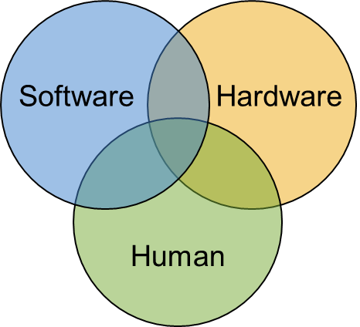
All complex sociotechnical system fail
All system components are potential sources of failure
Failure prevention through design
  Design to achieve a state in which conditions leading to an undesired outcome are controlled
Designing for failure prevention can reduce failures but doesn’t make systems failure-proof
Designs must also enable preparing for and recovering from both expected and unexpected failures
Environment
Hierarchy of Controls
Eliminate
Most
Effective
Replace
Isolate
Procedures
Training
PPE
Least
Effective
Notes:
Eliminate: Remove the hazard
Replace: Substitute a safer alternative
Isolate: Isolate critical system components from the hazard
Procedures & Training: Work practices that reduce hazard exposure
PPE: Equipment worn to minimize hazard exposure (typically when hazard source is environment)

Slide 4
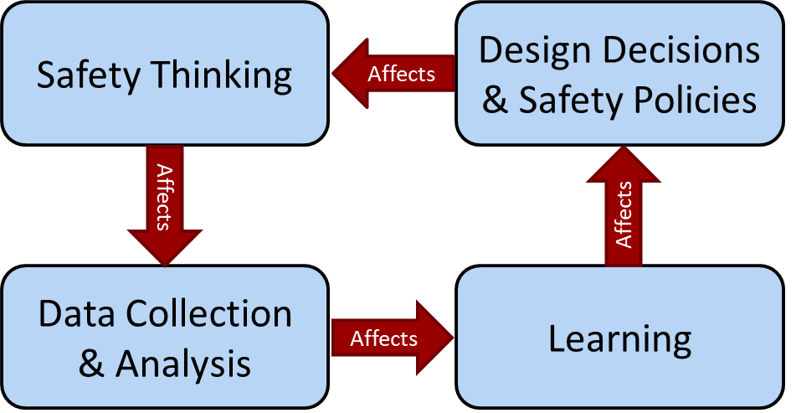
Data-driven failure management
In today’s aerospace industry
data talks…
  … and it talks a lot about errors and failures!
  … and exceedances
  … and deviations
  … and violations
Even a “safety event” refers only to a loss of safety
  An undesired outcome
  Increased risk of an undesired outcome
  Conditions that could result in an undesired outcome (i.e., close call)

Slide 5
Absence of evidence evidence of absence
When we characterize task performance only in terms of errors and failures, we ignore the vast majority of human impacts on the system
When design or policy decisions are based only on failure data, they are based on a very small sample of systematically non-representative data
  Sampling bias: Results based on non-random samples can be erroneously attributed to the phenomenon under study rather than to the method of sampling
When the only available human performance data are about failure, then data-driven designs only consider that humans fail

Slide 6
To err is human
Claybrook & Kildare (Science, 2018)
  “… humans are inherently bad at monitoring semi-autonomous systems and are readily distracted.”
  Note: The cited reference (Cunningham & Regan, 2015) doesn’t actually say that…
NASA APPEL “Cognitive Bias in Engineering Decision-Making” course description:
  “… will help participants understand how decision-making can be compromised at all levels in an organization through reliance on heuristics…”
“To fast forward to the safest possible operational state … network operators will be interested in the path that realizes full machine autonomy as quickly as possible.” (Uber, 2016)

Slide 7
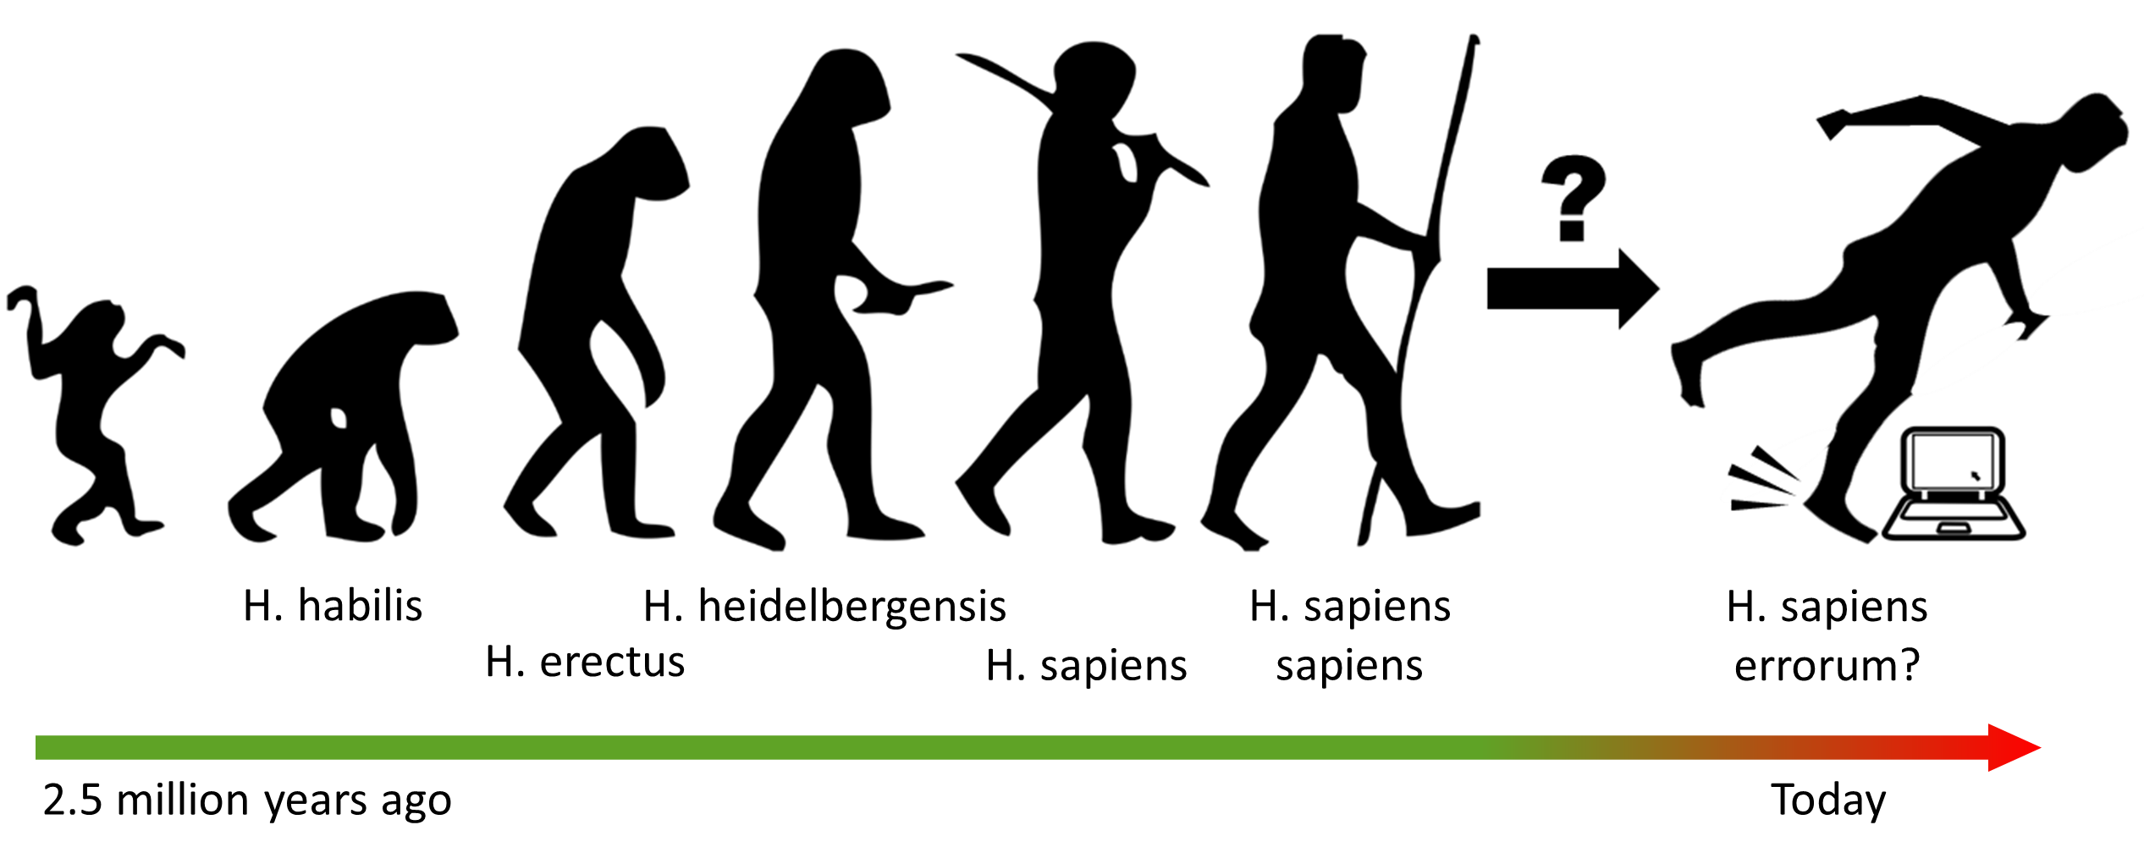
Did millions of years of natural selection go wrong?
Image credit (left image): Jose-Manuel Benito, released into the public domain. Available at: https://commons.wikimedia.org/wiki/File:Human_evolution_scheme.png.

Slide 8
The mind is a successful adaptive system
Evolutionary adaptation is the adjustment of organisms to their environment to improved their chances of survival in that environment
Natural selection produces computational systems that solve adaptive problems reliably, quickly, and efficiently, but those systems are functionally specialized (Cosmides & Tooby, 2013)
Environments and tools that are poorly aligned with what our cognitive systems evolved to do limit human capabilities for resilient performance

Slide 9
Illusions of memory
(Howe, Garner, & Patel, 2013)
“False memories” are an inevitable consequence of a powerful, reconstructive memory system
What determines whether they have a positive or negative consequence depends solely upon how they are later put to use
Associative problem solving was faster and more accurate when critical information was falsely recalled than when it wasn’t
“The person who misremembers seeing a predator while foraging for food might be more cautious upon their return to gather more food than the person who accurately remembers that only signs (e.g., feces, scent) of the predator had been present on an earlier visit.”

Slide 10
Judgments under uncertainty
(Cosmides & Tooby, 1996)
Literature on cognitive biases has been interpreted to suggest that human inductive reasoning mechanisms do not embody a calculus for computing probability (i.e., people are “bad at” intuitive statistics)
Evolutionary psychology, however, predicts that humans should be able to successfully represent probabilities as frequencies
The probability of a single event is intrinsically unobservable
There’s a 20% probability that today’s hunt in the north canyon will be successful.
We were successful 2 out of the last 10 times we hunted in the north canyon.
vs

Slide 11
Judgments under uncertainty
(Cosmides & Tooby, 1996)
Medical diagnosis problem (famous for eliciting “base-rate neglect” cognitive bias) presented either as a probability problem or as a frequency problem
Probability Condition
A test to detect a disease (disease X), whose prevalence is 1/1000, has a false positive rate of 5%. Assuming that you know nothing about the person's symptoms or signs, what is the chance that a person found to have a positive result actually has the disease? %
Frequency Condition
1 out of every 1000 Americans has disease X. Every time the test to detect disease X is given to a person who has the disease, the test comes out positive. But sometimes the test also comes out positive when it is given to a person who is completely healthy. Specifically, out of every 1000 people who are perfectly healthy, 50 of them test positive for the disease. From a random sample of 1000 Americans, on average, how many people who test positive for the disease will actually have the disease? out of .

Slide 12
Judgments under uncertainty
(Cosmides & Tooby, 1996)
Correct = ~ 2% (or ~ 1 out of 50)
Base rate conservative (considering only the base rate) = ~ 0.1% (or ~ 1 out of 1000)
Base rate neglect (ignoring the base rate) = ~ 95% (or 950 out of 1000)

Slide 13
Judgments under uncertainty
(Cosmides & Tooby, 1996)
Correct = ~ 2% (or ~ 1 out of 50)
Base rate conservative (considering only the base rate) = ~ 0.1% (or ~ 1 out of 1000)
Base rate neglect (ignoring the base rate) = ~ 95% (or 950 out of 1000)
A simple rewording of the problem can elicit correct Bayesian reasoning and eliminate base-rate neglect for a majority of subjects

Slide 14
A real-world base-rate fallacy example
Probability Condition
Human error contributes to 80% of aviation accidents¹
Humans cause most of the accidents, so:
Remove them
Replace them
Isolate the system from them
(1) Weigmann & Shappell, 2003

Slide 15
A real-world base-rate fallacy example
Probability Condition
Human error contributes to 80% of aviation accidents¹
Frequency Condition
From 2007- 2016, there were 244,000,000 commercial aviation departures, of which 388 resulted in accidents²
Human error was implicated in ~310 out of the 388 accidents (i.e., 80%)
Pilots intervened to manage aircraft malfunctions on ~48,800,000 of the 243,999,612 non-accident flights (i.e., 20%)³
Humans cause most of the accidents, so:
Remove them
Replace them
Isolate the system from them
(1) Weigmann & Shappell, 2003; (2) Boeing, 2017; (3) PARC/CAST, 2013

Slide 16
A real-world base-rate fallacy example
Probability Condition
Human error contributes to 80% of aviation accidents¹
Frequency Condition
From 2007- 2016, there were 244,000,000 commercial aviation departures, of which 388 resulted in accidents²
Human error was implicated in ~310 out of the 388 accidents (i.e., 80%)
Pilots intervened to manage aircraft malfunctions on ~48,800,000 of the 243,999,612 non-accident flights (i.e., 20%)³
Humans cause most of the accidents, so:
Remove them
Replace them
Isolate the system from them
Pilots intervene to keep flights safe from aircraft malfunctions over 157,000 times for every 1 time that a human error is implicated in an accident.
Does removing, replacing, or isolating them still sound like the safest idea?
(1) Weigmann & Shappell, 2003; (2) Boeing, 2017; (3) PARC/CAST, 2013

Slide 17
Humans cause safety
Analysis of 20 “major incidents” by PARC/CAST Flight Deck Automation Working Group (2013)
  “These major incidents represent cases where pilots successfully mitigated the risk of the malfunction.”
  Equipment malfunctions identified as a threat in 11 of 20 major incidents
  No checklist or defined procedure to address equipment malfunctions in 5 of these 11 incidents (i.e., failure not anticipated by designers)
Reasoning beyond procedures is essential for many recovery actions

Slide 18
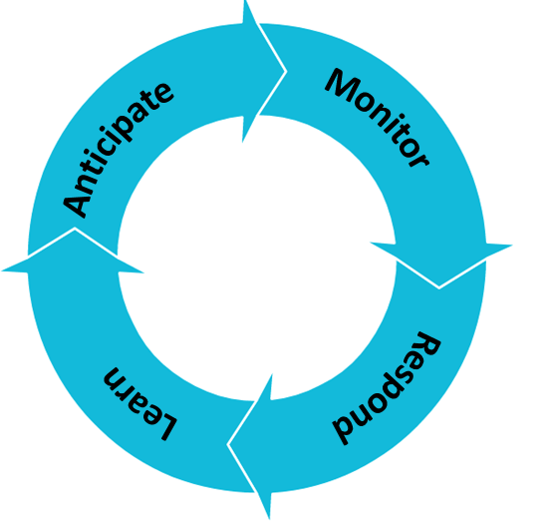
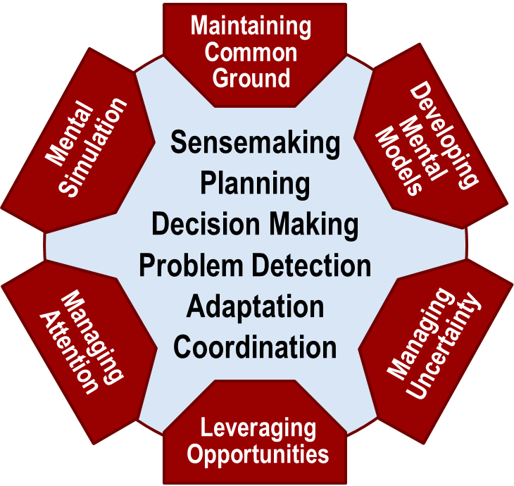
Human potential for resilient performance
Resilient performance¹ comprises the capabilities to
  Anticipate – consider what might happen in the future
  Monitor – know what is happening and where to look for change
  Respond – know what to do and have the opportunity to do it
  Learn – know what has happened and why
Resilient performance enables macrocognitive functions² (i.e., “goals”)
Outer circle adapted from Hollnagel (2015)¹ ; Inner circle adapted from Klein et al. (2003)²

Slide 19
Consequences of designing out failure factors
Designs intended to protect the system from error-prone humans can inadvertently limit the capability to intervene and adapt
For example…
  Inadequacies in training can limit the ability to anticipate
  Creating impoverished environments when automating tasks can limit the ability to monitor
  Simplified interfaces and inability to over-ride or take control from automation can limit the ability to respond
  Designs that restrict feedback can inhibit the ability to learn

Slide 20
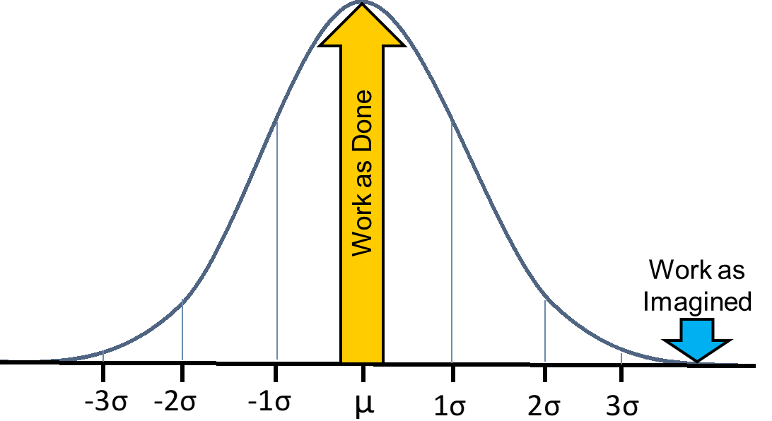
Designing for “nominal” performance
Nominal describes performance according to plan or design
Because the human’s role in preventing failures is rarely acknowledged, it is often assumed that “nominal” performance is free of failure and free of human intervention
Even in ultra-safe, well-studied systems, failures and the need to deal with them are routine
  Airline pilots intervene to deal with system malfunctions on 1 in 5 “normal” flights
  These systems are all carefully designed, rigorously tested, and fully certified
  When “nominal” is characterized as a blue-sky, “everything works” condition, we risk designing for a state that rarely if ever occurs
Notes:
Because the actions that people take to routinely sustain safe operations go unacknowledged, another prevalent misconception is that we can design complex sociotechnical systems that never or almost never fail

Slide 21
We don’t think like we think we think
Just for fun, try Googling “the most complicated thing in the universe”… ☺
Why everyone isn’t an expert on how human’s think just because they’re human
  People do not have reliable introspective access to their own cognition (Nisbett & Wilson, 1977)
  It doesn’t feel like our introspections are unreliable, so people overestimate their ability to do so (Dunning & Kruger, 1999)
  We employ scientific methods to understand how people think
  We employ human performance experts to understand the science

Slide 22
Managing failure by design: A path forward
Include expertise in human performance on your design team
Recognize system failures as both routine and unavoidable – account for that in design and in testing
Measure what happens, not just what fails
Don’t simply design out failure factors without considering the possible reduction of preparation and recovery factors
Question dogmatic assumptions about what people are “bad at” or “good at”
Support capability for resilient performance through system designs that align with what our cognitive systems evolved to do
There are engineering solutions to designing for failure management, and they are integrated solutions

Slide 23
Thank you

